Slide 1
2019 STFM Conference on
Practice & Quality Improvement

Slide 2
Setting
Michigan Medicine Primary Care clinics.

Slide 3
CPC+: Lessons Learned with Implementation at Michigan Medicine
December 7th, 2019
Kathryn Harmes, MD, MHSA, John Tranfaglia

Slide 4
Objectives
Upon completion of this session, participants should be able to:
Describe the benefit of comprehensive primary care payment to patients and practices
Identify workflow changes necessary to provide care in a comprehensive payment model
Describe components of the CPC+ model and their importance to improving the health of a population

Slide 5
Primary Care Practice Transformation
Notes:
John

Slide 6
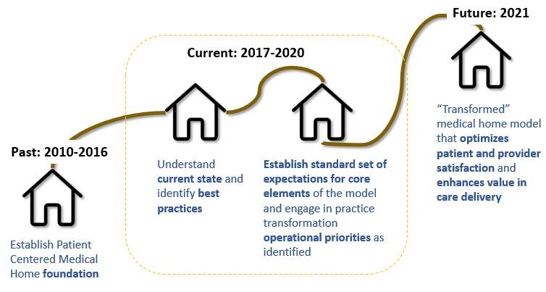
Medical Home Practice Transformation Journey

Slide 7
Payer Programs supporting Primary Care Practice Transformation
Program | Participating Payers | Michigan Medicine Practices | Payment Model
Michigan Primary Care Transformation (MiPCT) 2012-2016 | Medicaid Health Plans, Medicare, BCBSM, BCN, Priority Health | All primary care practices | Practice Transformation Payment Care Management and Care Coordination Payment—based on Medicaid program
State Innovation Model (SIM) Patient Centered Medical Home (PCMH) Initiative 2017-2019 | Medicaid Health Plans | All primary care practices | Medicaid: Practice Transformation Payment Care Management and Care Coordination Payment—based on Medicaid program (benchmarks evaluated through G and CPT code billing)
Comprehensive Primary Care Plus (CPC+) 2017-2021 | Medicare, BCBSM, Priority Health | Briarwood General Medicine, Brighton General Medicine, Canton General Medicine, Chelsea Family Medicine, Canton Adult Medicine and Pediatrics, Dexter Family Medicine, East Ann Arbor General Medicine, East Ann Arbor Geriatrics, Northville General Medicine, Taubman General Medicine, West Ann Arbor General Medicine, and Saline General Medicine *Practices that were not accepted did not meet the threshold number of Medicare patients | Medicare: Care Management Fee—based on HCC risk quartile (pbpm) Performance-Based Incentive Payment* Comprehensive Primary Care Payment *UM will not receive PBIP payment based on participation in MSSP ACO.
Commercial Payers | BCBSM and Priority Health | All Michigan Medicine practices with attributed members. | Continue to use G and CPT codes for FFS reimbursement
Premier Care/GradCare Primary Care Capitation | Blue Care Network | All primary care sites | Capitated PMPM for attributed patients with $1pmpm for care management
Notes:
John

Slide 8
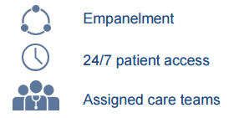
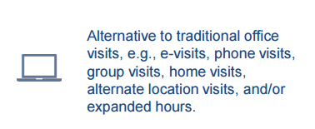
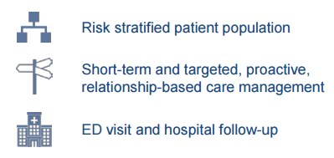
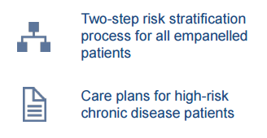
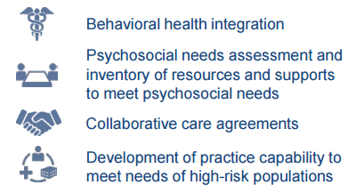
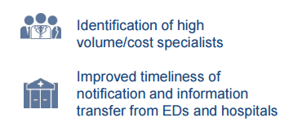
CPC+ implementation focused on practice transformation, building on existing PCMH infrastructure we had in place….
Access and Continuity
Care Management
Care Coordination

Slide 9
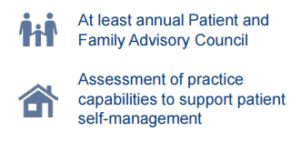
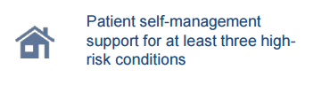
…and had implications for funding flows and payment mechanisms, coding and billing optimization, and reporting requirements going forward
Patient and Caregiver Engagement
Population Health and Planning

Slide 10
CPC+ Pillars
Notes:
“Dreaded Driver Diagram of CPC+”

Slide 11
Primary Care “Home” Model
Practice Transformation
Increase Access and Continuity
Targeted Care Management
Comprehensiveness and Coordination
Patient and Caregiver Engagement
Team Based Care Model
Medical Home Model Core Competencies
Michigan Medicine and UMMG Goals
Notes:
Katy to take over from here

Slide 12
Michigan Medicine & UMMG Goals
Practice Transformation
Increase Access and Continuity
Targeted Care Management
Comprehensiveness and Coordination
Patient and Caregiver Engagement
Team Based Care Team Model
These goals are foundational to the operational and transformational work we have been and continue to engage in
Medical Home Model Core Competencies
Michigan Medicine and UMMG Goals
Notes:
Build the HOME through the presentation – MAKE GRAY

Slide 13
Background and Foundation
Developed core competencies of a Michigan Medicine Patient Centered Medical Home based on alignment with strategic goals, evidence-based care, and payer requirements over the last several years
Registries
Quality Performance reporting and outreach
Practice Transformation
Patient Portal
Increase Access and Continuity
Targeted Care Management
Comprehensiveness and Coordination
Patient and Caregiver Engagement
Team Based Care Team Model
Admission, Discharge and Transfer (ADT) alerts
Care Team Management
Medical Home Model Core Competencies
Michigan Medicine and UMMG Goals
Electronic prescribing and management
Test result tracking and follow up
Notes:
Core competencies developed over the last several years, driven by acs strategy, ummg goals and payer requirements. Blue Cross PCMH accreditation and MiPCT program were also central to this work and emphasized strengthening the patient-care team relationship along with reducing fragmentation of care through enhanced communication and coordination activities.
These core competencies are foundational to the operational and transformational work we continue to engage as part of practice transformation.

Slide 14
Medical Home Model Operational Pillars
Practice Transformation
Reflect the CPC+ Pillars
Key Drivers have been identified to enhance our medical home core competencies
Several operational activities support each of these pillars
These pillars were used as a framework to understand current state across clinics and identify best practices
Increase Access and Continuity
Targeted Care Management
Comprehensiveness and
Coordination
Patient and Caregiver Engagement
Team Based Care Team Model
Medical Home Model Core Competencies
Michigan Medicine and UMMG Goals
Notes:
illustrates how all components of the pillars model work together to support your practice in the delivery of primary care
These operational pillars help to guide much of the current and future operational work our ACUs engage in
Pillars were developed by aligning payer requirements and ummg/department priorities with key operational drivers.
Describe pillars

Slide 15
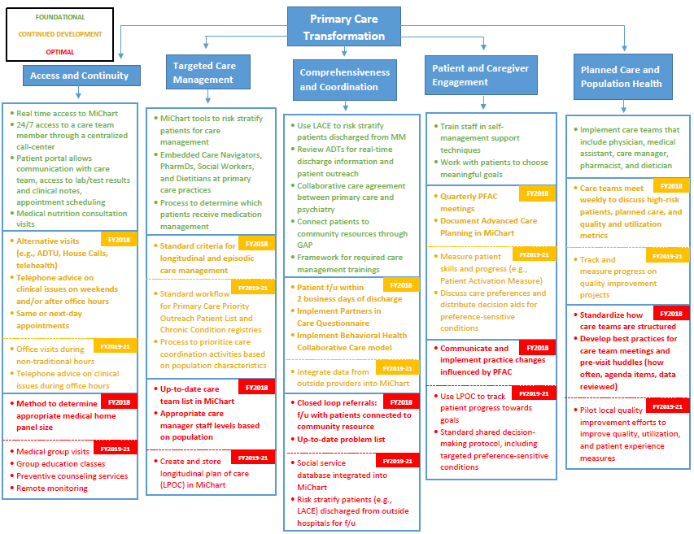
Framework: Activities supporting key operational drivers
Notes:
2017: The roadmap illustrates the suggested sequencing of high-level changes that may lead to the enhanced capabilities
Depending on your particular site or department, your practice may be more advanced in one domain than in another
Not using this as a report card, but inform our understand of where acus are and identify best practices, areas of opportunity and priorities across sites.
Explain green, yellow, red and that many of these activities in flight, and several will be supported centrally – like after hours call center.

Slide 16
Transformational Approach
Transformational approach: Development of an innovative and collaborative primary care practice model that optimizes patient satisfaction, provider satisfaction and value in care delivery; supports a process to challenge existing assumptions and processes of care delivery
Practice Transformation
Key elements:
What do consumers want in a primary care practice? Providers?
What are the anticipated changes in the market place and how should they shape practice design?
What practice changes will meaningfully transform care? Care team composition and roles, integration of alternative visits, population segmentation, etc.?
What are other health systems doing in this space? What can we learn from other industries/disciplines in terms of service design, patient satisfaction, etc.?
Increase Access and Continuity
Targeted Care Management
Comprehensiveness and Coordination
Patient and Caregiver Engagement
Team Based Care Team Model
Medical Home Model Core Elements
Michigan Medicine and UMMG Goals

Slide 17
Primary Care Transformation Roadmap FY 18-19
UMMG Goals
Drivers
Supporting Activities
Manage 400K lives locally
Increase Access and Continuity
Expanded office hours
Alternative visits
Transition management
1
Risk-adjust patient panel
Triage patients for CM interventions
Identify appropriate population for longitudinal care management
Identify appropriate dx groups for episodic CM
Optimize Panel Size
2
Care Management
Patient Satisfaction Score >93%
Identify and address social needs
Integrate behavioral health services in primary care
Referral management and coordination in medical neighborhood
3
Care Coordination
Reduce PCS ED utilization for primary care attributed population
Establish PFAC to work on QI strategies
Group visits for common chronic
Integrate self-management support
Engage patients in shared decision making
4
Engage Patients and Care Givers
Population Health and Planning
Patients attributed to a care team
Weekly care team review of panel data
5
Notes:
John Take over

Slide 18
Medical Home Model Core Competency – Care Team Management
Clinical Care Resources
Care Management Resources
Specialty providers
ADTU
eConsult
eVisit
Clinical Care Team
Care Management Team
PCP
APP
RN
MA
Care Navigator
SW
PharmD
RD
Complex Care
GAP
HouseCalls
Administrative Team
Panel Manager
Clerk
Scribe
Administrator
Medical Director
Project Manager
Administrative Supports
Quality
UMMG
ACS
Notes:
Expanding the resources in the medical home: developing a care team.
Practices have develop processes to provide coordinated, patient centered care through growing the medical home . The care management interventions are focused on patients with mild to moderate chronic disease and co-managing patients that have high complexity, high cost, and/or high utilizers of the health care system with our central care management resources like Complex Care. We also introduced systematic processes to supported by this evolved team to follow up with patients to ensure evidence based preventive services, and tests are ordered and completed
We continue to utilize the team-based medical home model as the central structure in support of the operational and transformational elements of care delivery redesign.

Slide 19
Beginning of CPC+
Complex Care Manager
House Calls Care Manager
Focused on high need, high utilizing, most vulnerable population; typically low income patients with complex medical, mental health, social and physical resource needs
Provide between-visit assessment and follow-up to assure timely and appropriate care
Nurse Care Navigator
Provide home-based primary care and services for patients
Services include home assessment, resource finding, care coordination and comprehensive geriatric assessment focused on geriatric syndromes for appropriate population
Patients do not need to be homebound, but are limited in their ability to leave their home
Social Worker
Pharmacist
Patient
Registered Dietitian
Guest Assistance Program
SNF Care Manager
Bachelor-level SW focused on connecting all UM patients with community resources
Deep knowledge of social service agencies, grant funding, and health plan supports
Focused on managing transitions from skilled nursing facility to home
Coordinates with hospital, primary care physician and SNF facility staff

Slide 20
Added Layer of Inpatient Care Management
House Calls Care Manager
Social Work
ED SW Case Managers
ACMT
Inpatient Nursing
Case Managers Bedside Nurses
Nurse Care Navigator
Complex Care Manager
SNF Care Manager
Social Worker
Pharmacist
Patient
Inpatient Nutrition Services
Registered Dietitian
Inpatient Pharmacists
Guest Assistance Program

Slide 21
Current State
How do we organize ourselves to deliver a transformed practice?
House Calls Care Manager
Care Team responsible for panel of patients
Clinic Support targeting chronic disease and rising risk patients
Pharmacist
Nurse and Care Navigator
Registered Dietitian
Central resources targeting highest risk patients
Physician
MA
Panel
Complex Care Manager
APP
SNF Care Manager
Nurse and Care Navigator
Physician
MA
Panel
Social Worker and BHCC SW
APP
Panel Manager
Guest Assistance Program

Slide 22
Behavioral Health Colloborative
PCP
Core BH Model
Patient
Social Worker as BH Care Manager
Psychiatrist
Other Behavioral Health Clinicians, Medical Home Team
KEY Requirements to Effective Implementation at UMHS:
Psychiatrist partner identified for each primary care ACU
Social Workers trained in psychotherapy and behavioral health care management
MiChart optimized to support efficient BH panel management
Workflows coordinated to embed in medical home
At least .5 Social Work FTE added or incremented where necessary to support care management activities
Notes:
Katy takes over

Slide 23
Care Management resources target populations based on patient complexity
Intervention/Tool | Team Member | Outcomes
CCMP* | Complex Care Manager | Improve care coordination, reduce readmissions, reduce avoidable ED visits
SNF Care Manager*, ** | Complex Care Manager | Improve care coordination, reduce readmissions, reduce avoidable ED visits
HouseCalls Care Management* | Complex Care Manager | Improve care coordination, reduce readmissions, reduce avoidable ED visits
SIM ED Intervention* | Complex Care Manager | Reduce avoidable ED visits
Care Management | CN/PharmD/SW/RD | Improve care coordination, improve quality, increase provider satisfaction
PiCQ | MDDO/MA/GAP/SW | Improve care coordination, improve quality
TOC | Care Navigator/PharmD | Reduce readmissions
BHCC | BHCC Social Worker | Increase access, improve quality
Priority Outreach Patient List | Panel Manager /Care Navigator | Improve care coordination, reduce readmissions, reduce avoidable ED visits
5+ Disease Registries | Panel Manager | Improve quality
4+ Disease Registries | Panel Manager | Improve quality
3+ Disease Registries | Panel Manager | Improve quality
2+ Disease Registries | Panel Manager | Improve quality
1+ Disease Registry | Panel Manager | Improve quality
e-Visits/e-Consults | MDDO/APP | Increase access, increase provider satisfaction
Wellness and Prevention | MDDO/Panel Manager | Maintain health and wellness
Most Complex
Rising Risk
Mild-moderate illness
Healthy/Managed Population
*These interventions are available for any Michigan Medicine patient and not limited to the Primary Care Panel.
**Eligible patients include Michigan Medicine patients discharged to Heartland Ann Arbor.
Notes:
John

Slide 24
Proactive management of populations through care pathway redesign is being piloted for diabetic patients
Ambulatory Care Management Intervention
The diabetic population uses more services and has higher readmission rates
A1c >8.5
Medication mgmt by pharmacist
SW consult for depression, social needs
A1c <8.5 and >7.5
Lifestyle mgmt by dietitian
Referral to diabetes education
A1c <7.5 and >7
Self management support by nurse care navigator
Supported through panel management work flows, and standard checklist across care team (e.g., foot/eye exam; DME, etc.)
*MiChart = MiChart Primary Care Panel
Notes:
Katy to talk through. Point – continuous improvement arm of CPC+ - rich culture of CI at UM

Slide 25
Alternative care venues for attributed patients provide the right care at the right time
HouseCalls
eVisits
eConsults
Video Visits
ADTU
HouseCalls | eVisits | eConsults | Video Visits | ADTU
Case mgmt., TOC and one time assessments for homebound adults | Asynchronous portal-driven questionnaire, managed by APP | Electronic exchange between PCP and specialist colleagues | 2-way face-to-face return visit between an established patient and provider | Outpatient space for diagnosis and treatment of acute conditions
Notes:
Katy to review

Slide 26
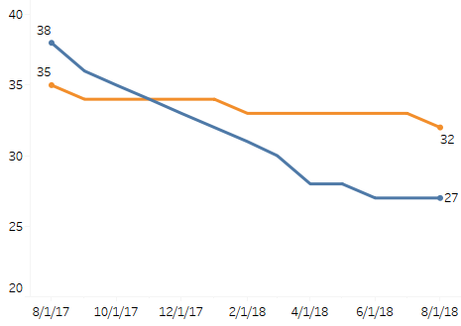
Current State Care Site Optimization
We are making significant progress…
Population Observation Utilization Rate (per 1000 patients)
Geriatric (9% reduction)
Adult (29% reduction)
Population Observation Utilization has dropped by 24% for Adult/Geriatric population within the UMHS Responsible patient cohort over the past year
Notes:
John – Inptatient utilization to UM hospital

Slide 27
Stage 1 Activities
Pillars | Stage 1 Activities: | Target to achieve goal:
Access and continuity | Alternative Site of Care (E-Visits, E-Consults, ADTU, HouseCalls, MIHP, lactation counseling, video visits) | Each PCP must engage in at least one alternative site of care
Targeted care management | Use risk stratification tools to identify patients for proactive care management (Patient Priority Outreach) | 85%+ dispositioned at end of quarter PharmD and Care Navigator use of LACE
 | Care Management charge capture through G-Code billing | Implementation of standard charge capture
Coordination and comprehen-siveness | Transitions of care coordination for discharged patients | 75% of patients receive follow-up within 2 business days of discharge
 | Behavioral Health Collaborative Care | Planning – complete readiness assessment
 | Screening and coordinating care with community services through PICQ | 80% of eligible population is screened and connecting with services as appropriate
Patient and caregiver engagement | Advance Care Planning | Advance Directive quality focus measure improvement
 | Patient and Family Advisory Councils | Quarterly meetings with standard minutes
Notes:
Katy until the end. Internal initiative to reward clinics for completing certain tasks

Slide 28
2018 Accomplishments
Access and Continuity
Targeted Care Management
Comprehensive-ness and Coordination
2000th adult eVisit
Piloting the Diabetes Care Model
Longitudinal Care Management Report (next release 2/15)
Live with Pediatric eConsults and eVisits
HouseCall TOC
Patient and Family Engagement
Planned care and Population Health
BHCC live in majority of adult clinics
Updated Partners in Care to reflect community needs
Majority ACUs hold quarterly PFACs
Significant increases across all adult clinics in advance directive collection rates
Developed a working mission / vision
Developed and endorsed a care team model

Slide 29
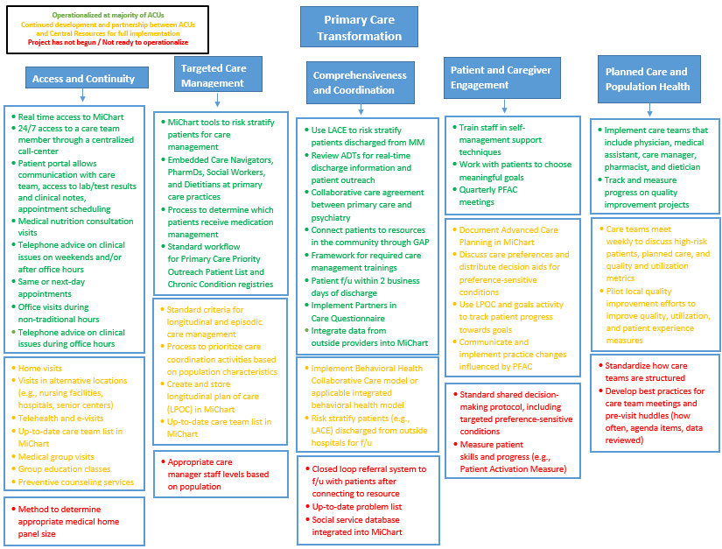
End of CY 18
Notes:
The roadmap illustrates the suggested sequencing of high-level changes that may lead to the enhanced capabilities
Depending on your particular site or department, your practice may be more advanced in one domain than in another
Not using this as a report card, but inform our understand of where acus are and identify best practices, areas of opportunity and priorities across sites.
Explain green, yellow, red and that many of these activities in flight, and several will be supported centrally – like after hours call center.

Slide 30
2019 and Beyond: Primary Care Strategy Infrastructure Priorities
Primary Care Optimization
Team-Based Care and Workflow Redesign
Primary Care Model
Visit Cycle
Visit Frequency
Standard roles and expectations
Risk Stratification
Primary Care Optimization Infrastructure
Shift to Population-Based Business Model
Michigan Medicine and UMMG Goals
Virtual Care/Alternative Sites of Care

Slide 31
5 Stages of Visit Cycle
● Appointment Request Triage
● Pre-Visit Planning
● Pre-Visit Chart Prep for Provider
● Provider’s Pre-Visit Review
● Care Team Huddle
● Core Team Daily Huddle
● Check-In
● During Visit
● Check-Out
● Diagnostic and Laboratory Test Tracking
● Test Results Review, Management and Communication
● Continuation or Referral Coordination Process
● Referral Tracking and Follow Up
● Visit Follow Up and Reminders Via Telephone or Portal
● Episodic Care Coordination
● Longitudinal Care
● Gaps in Care and Outreach
● Remote Monitoring
● Alternative Visit
● Patient Communication
● Medical Nutrition Counseling
● Medication Management Visit
● Behavioral Health Counseling Visits
● Preventive Counseling Visits
● Group Visits
● E-Visits/Telehealth
● Home Visits
Stage 1
Prior to Visit
Stage 2
Day of Visit
Stage 3
Post Visit
Stage 4
In Between Visit
Stage 5
Alternate Visit

Slide 32
Primary Care: Organizing Care Team Resources
House Calls Care Manager
Legend:
Core clinical care team members delivering care to a defined number of unique patients
Registered Dietitian
Shared resources aligning with specific ambulatory care teams working with patients who have been identified as needing specific intervention(s)
Pharm
Care Navigator
Shared resources working across all of Michigan Medicine with specific patient populations
Nurse
Complex Care Manager
Physician
Active
Patient
Base*
MA
SNF Care Manager
General approach for determining resource requirements:
Core clinical care team resources are determined based on the number of unique patients and provider schedules
All other resources are determined based on the attributes and needs of active patients
APP
Social Worker; BHCC SW
Panel Manager
*Refers to patients who have actively engaged with the core clinical care team in the last 18 months
Guest Assistance Program

Slide 33
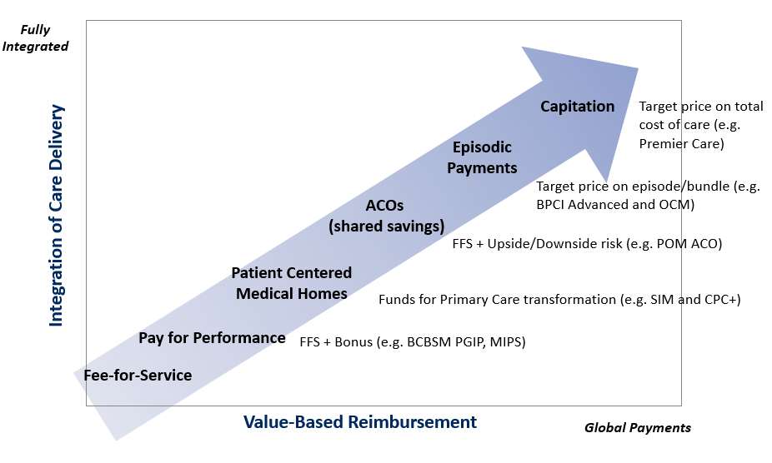
Shift to population-based business model
The business model for primary care is changing, making primary care accountable for total cost of care, clinical quality measures, and population and utilization management efforts outside of standard face-to-face E&M visits
Share internal data (practices compared to other practices, providers compared to other providers) and how we compare to peers
Measure all work related to visit cycle, not just RVU-generating activities
Move away from RVU-based department/physician compensation models towards capitated population-based models
Accurate billing/coding by all care team members to capture revenue

Slide 34
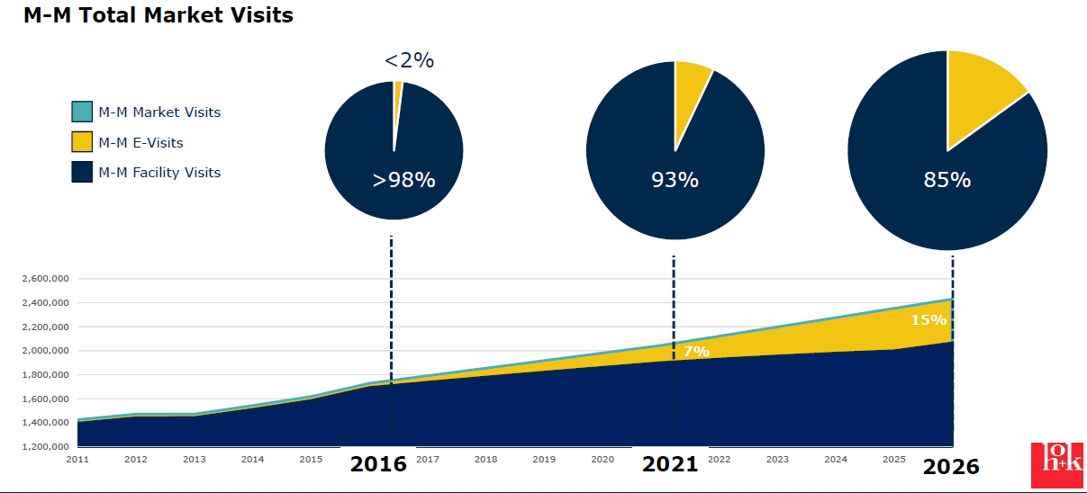
Alternative Visit Types/Sites of Care
Enhance alternative visit types and alternatives sites of care to increase access and improve patient experience and outcomes
Michigan Medicine Virtual Care Penetration by 2026
MM Total Visits
MM Virtual Care Visits
eVisits
eConsults
Video Visits
BHCC
Pharmacy management of Diabetes/HTN/Hyperlipidemia
HouseCalls
ADTU
Remote patient monitoring
MM Total Visits

Slide 35
Disclosures
None

Slide 36
Evaluate
Please evaluate this presentation using the conference mobile app! Simply click on the "clipboard" icon on the presentation page.

Slide 37
Thank you

