Slide 1
Best practices for engaging patients around behavior change: A successful case study approach
Gretchen Holmes, PhD
GME DIO & Director, Clinical Research
STFM Conference on Practice and
Quality Improvement
September 12, 2023

Slide 2
Challenges
It’s an uncomfortable topic to bring up
It’s a complex issue
Most of the general public believe it is all due to controllable lifestyle factors and not any biological or external factors
75% say ppl are overweight due to lack of exercise
59% say it’s a lack of “willpower”
Numerous studies demonstrate that genetics and heredity are major factors
Studies also show that there is widespread stigmatization of people with obesity as “lazy, weak-willed, unintelligent, and unsuccessful”

Slide 3
Challenges
Several studies show that healthcare providers have implicit and explicit “anti-fat bias” & report that pts with obesity feel stigmatized by their providers (Schwartz, M., et al. 2012; Lawrence, B. et al. 2021)
This perceived anti-fat bias decreases the likelihood that patients will seek care
Plus, obesity stigmatization has been shown to negatively impact a person’s ability to even lose weight
Creates maladaptive coping mechanisms (i.e., binge eating), creating feelings of more shame and stigma and gaining weight

Slide 4
Can we agree?
Everyone is frustrated: physicians, patients, and everyone else
Patients feel disrespected and invisible and physicians and other healthcare providers find patients defensive and noncompliant
Patients with obesity get tired of every office visit being about their weight and being shamed, which leads to avoidant behavior and more eating
Physicians are trying to do their job and getting pushback and/or no response at all

Slide 5
Here’s the thing…
The world is a cruel place for overweight and obese patients
There is a lot of fatphobia
“the irrational fear of, aversion to, or discrimination against, obesity or people with obesity”
Weight stigma is pervasive driven by increased shame and blame coming from social media and the media
Substantive evidence that weight stigma is not only unfair and unjustified but creates health disparities and hampers healthcare and health outcomes

Slide 6
Here’s the thing…
We need to do something different
To be clear: It’s not your job to walk around monitoring your pts food intake and make sure they go to the gym
The ultimate responsibility falls to the patient, but we need your help
What we don’t need is more psychological distress
When we do come see you, we need a partner, not an adversary
As a patient, social scientist, and professional in the healthcare field, I am hopeful that my story can help

Slide 7
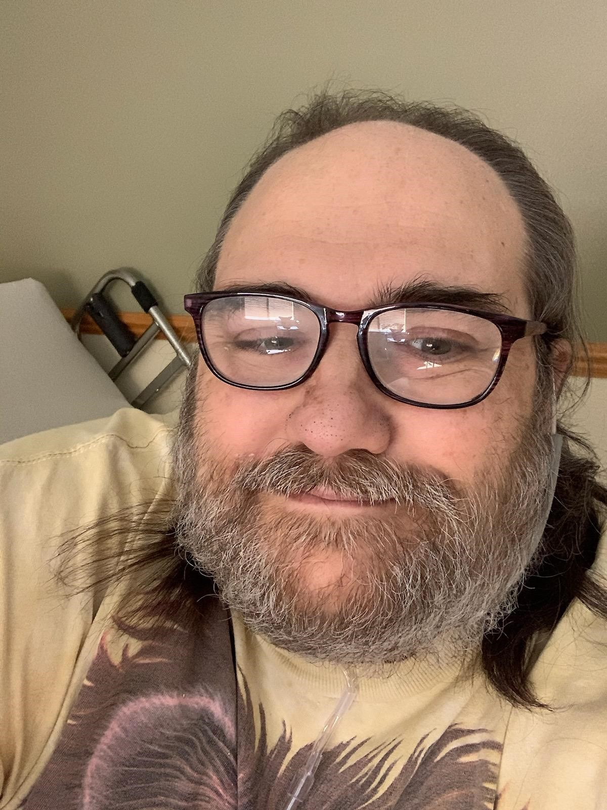
My story
From my upcoming book:
“In February 2021, I was diagnosed with diabetes. My A1c was 6.7.I had been prediabetic for years and had plenty of opportuni-ties to make healthy changes, but I didn’t. I had been watching my brother, Eric, fight complications of diabetes for the past ten years. His kidneys had already
failed, and he was on dialysis. He fought an infection in his foot for over a year but finally had to have it amputated and now, he had another infection to fight.”

Slide 8
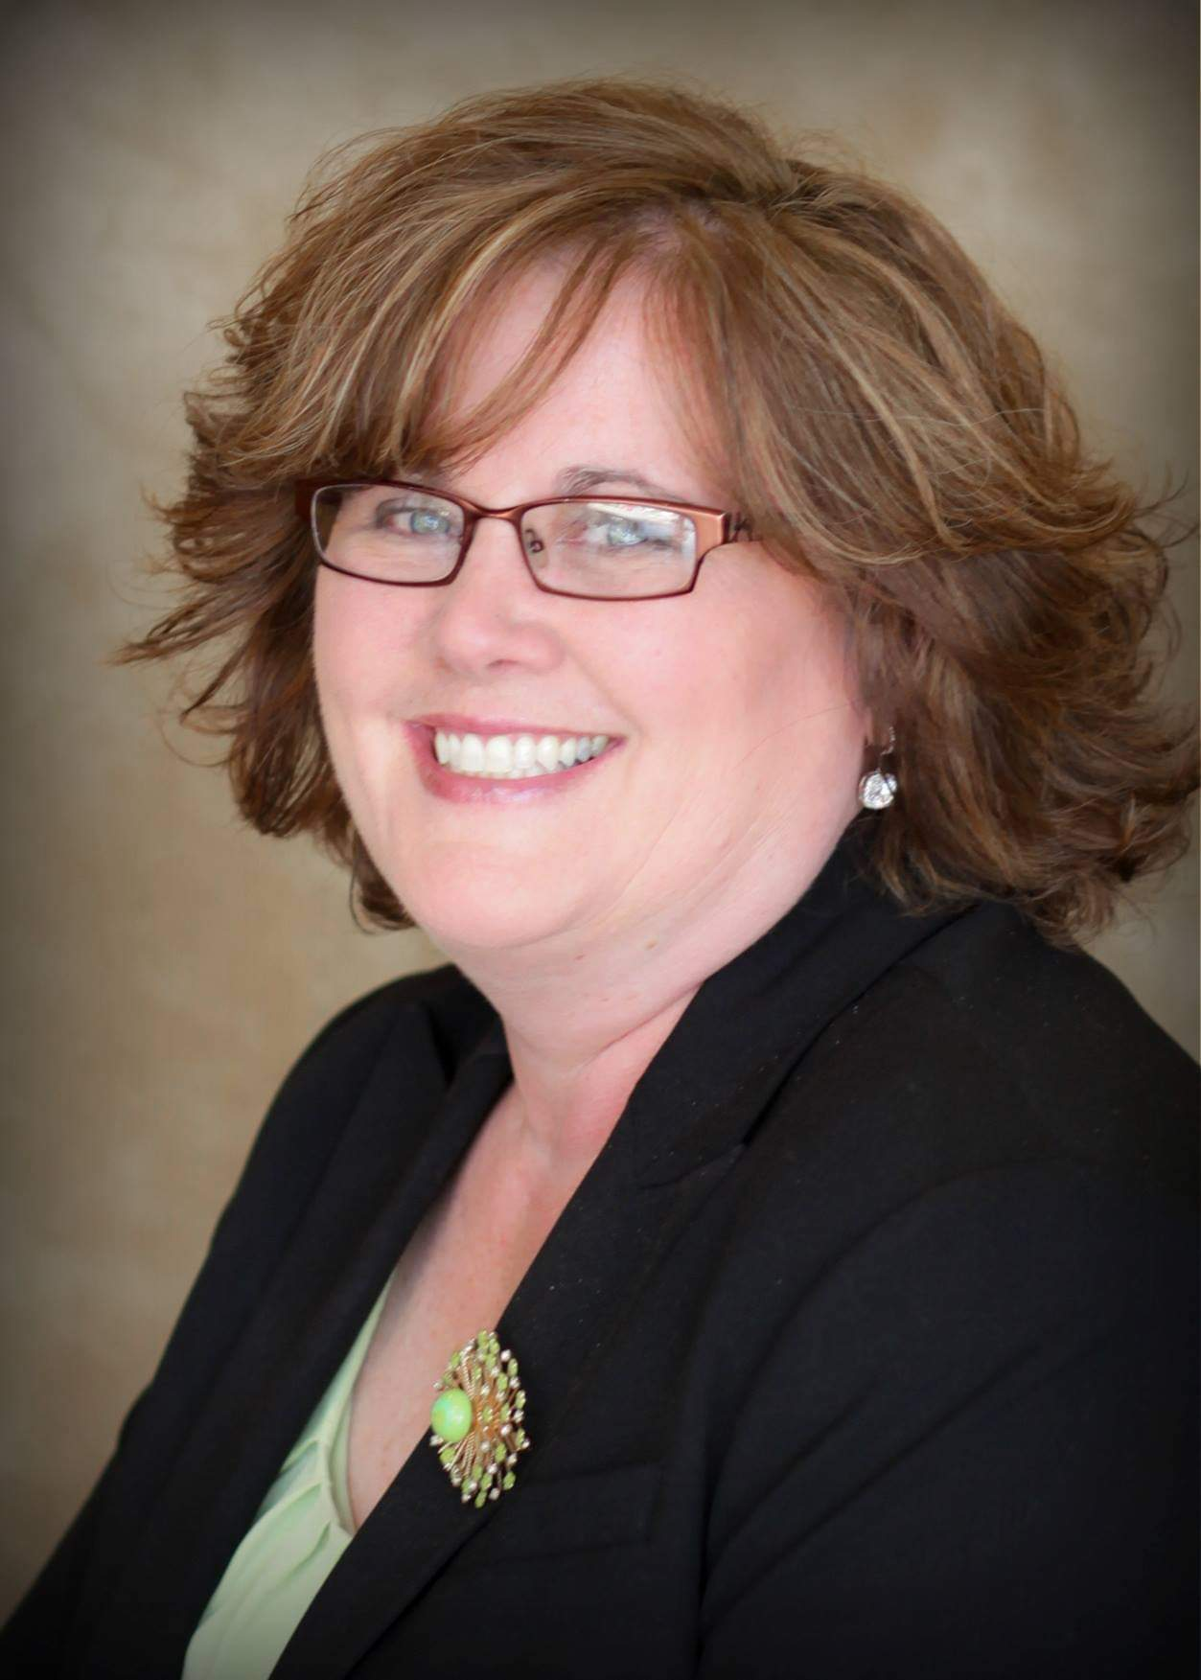
My story - Where I started
BMI – 41.6
A1c – 6.7
Blood pressure – semi-controlled by medication
Neuropathy
3x Cancer survivor
FEB 2020

Slide 9
My story - Where I started
Diagnosed diabetic Feb 2021
Joined WW that night
Fear was my motivator
I knew my future
Changed my attitude from self-pity, anger, and hopelessness to gratitude
I took control, even when it made people uncomfortable
I packed my lunch and snacks for the day – w/o fail
I found out I was addicted to sugar; the cleaner I ate, the less cravings I had
Anxiety around food was gone
I started working on why I self-soothed with food

Slide 10
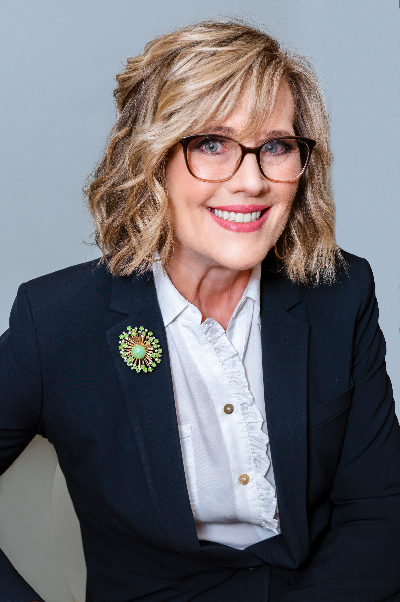
My story – Where I am now
Lost 110 lbs (total)
BMI – 25.5
A1c – normal
Blood pressure – normal
Neuropathy – still there
3x Cancer survivor
– still here
July 2022

Slide 11
Stages of Change

Slide 12
5A Model
ASK
Ask for permission to discuss weight
“Are you open to talking about your weight? Or “Are you open to making a few small changes to help you feel better?”
Explore readiness to change (see Stages of Change Model)
“Is your weight negatively impacting your life in any way?”
ASSESS
Assess for drivers, complications, and barriers
What’s going on in their lives?
Not everyone has the same access to resources
Even if they want to lose weight, a lot can get in the way

Slide 13
5A Model
ADVISE
Explain the benefits of modest weight loss
“Even losing 10 lbs would help you feel better and reduce your knee pain.”
Having to lose large amounts of weight is overwhelming and paralyzing, help them realize that losing smaller amounts over time is a healthy approach
Rethink success: Not gaining weight at the next visit is a success vs the “all or nothing” approach
Explain that you are in this together
Feeling supported is critical to success
Discuss treatment options
Are there choices on treatment? What would they like to do?

Slide 14
5A Model
AGREE
Agree on a realistic weight-loss goal and strategies to get there
Focus on reasonable, achievable behavior change strategies
Can they join WW? Optivia? Keto? Mediterranean diet?
Can they start walking for 10 minutes/day and then increase?
Telling a patient to, “Eat less and move more” is not a strategy nor is it helpful nor will it lead to results
Basically, when we are told this, we hear, “You’re on your own. Good luck.”
Trust us, we knew we were fat when we walked into the office. If we could do it on our own, we would have done it already.
It is overwhelming to make these changes, especially if no one else in their family or support system is willing to support them

Slide 15
5A Model
ASSIST
Provide education and resources
Refer to other providers, including behavioral health, if needed
Arrange follow up
Encourage them, set them up for success by helping them understand you are in their corner
Focus on the positive (anything!), comment on their effort, even if they are failing
Help them tweak it to start seeing successes
What can they add to their diet instead of always taking away – small victories add up!
We often need a lot of help to even begin to think we can do this
“Atomic Habits” by James Clear – highly recommend

Slide 16
Some Final Thoughts
How my PCP supported me: kindness, coaching, celebrated my wins
Consider moving the scale to a more private location
We can stay in denial if we don’t get on the scale but causes anxiety
Framing the data on the scale
Talk with your patient about not letting the number on the scale define who they are as a person; it’s just one piece of data
Increase medical school training in obesity around harm caused by social & cultural norms and messaging around body image
Focus on other contributing factors, not just individual control factors
Increase empathy

Slide 18
Discussion
www.gretchenholmesphd.com
This Photo by Unknown Author is licensed under CC BY-NC

