Slide 1
Developing a Behavioral Science Curriculum for Rotating Medical Students
Limor Gildenblatt, PhD, LCSW
Annmarie Walsh, DO, MBS
Shelly Capps, MD
Angelica Alonso, BS
Kim Reinhart, BA, BS

Slide 2
Introductions
Behavioral Scientist
Dr. G
Faculty Instructor
Dr. Walsh
Physician-in-the-making/
Medical Student
Kim
Physician-in-
the-making/
Medical Student
Angelica
PGY-2
Dr. Capps

Slide 3
We have no financial agreements to disclose.
L

Slide 4
Goals and Objectives
1) Discuss a behavioral health curriculum for rotating medical students aimed at enhancing physician/patient relationship
2) Involve family medicine residents in teaching medical students about behavioral health topics
3) Incorporate a Behavioral Science curriculum for rotating medical students at other residencies
L

Slide 5
Typical Rotation Curriculum
4-8 week rotations
Clinic with residents and attendings
Residency Didactics once weekly
Sessions to discuss core FM topics
Other opportunities: Inpatient medicine, Sports clinics or didactics, Sporting events
AM

Slide 6
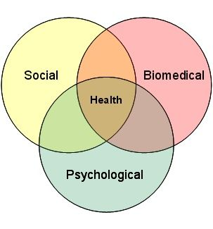
Why a behavioral science curriculum for medical students?
3rd and 4th year medical students focus on clinical work
Little focus on mental health training prior to this point
Individuals with mental health distress often enter the health system through primary care (McGuinness, 2012)
Up to 70% of primary care visits include psychosocial components (Hodgson et al., 2014)
Make behavioral science more relevant
Engage students in learning, conversations,
reflection
L

Slide 7
Behavioral Science Background
Inpatient psych clerkship at VA, biopsychosocial assignment in FM clerkship, internship at drug addiction wellness center
Undergraduate psychology major, inpatient psych rotation at Stroger, addiction medicine rotation
S/K

Slide 8
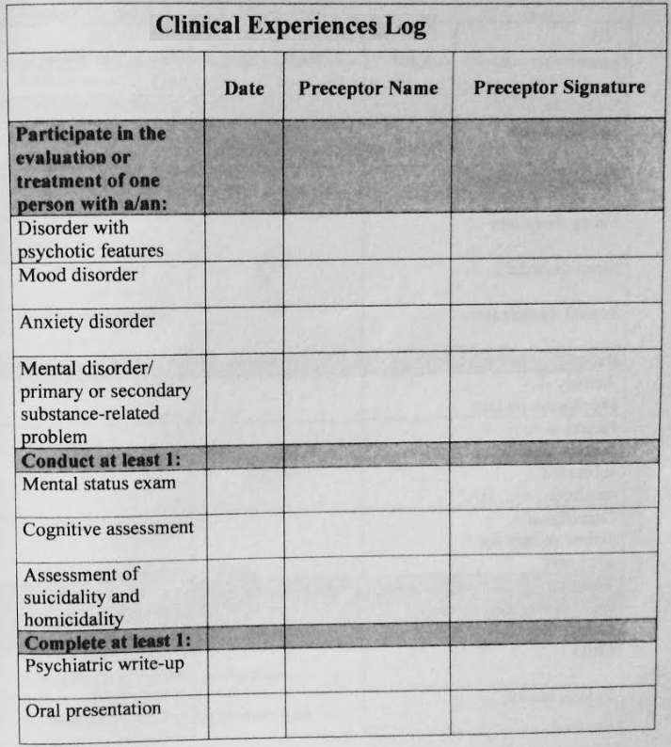
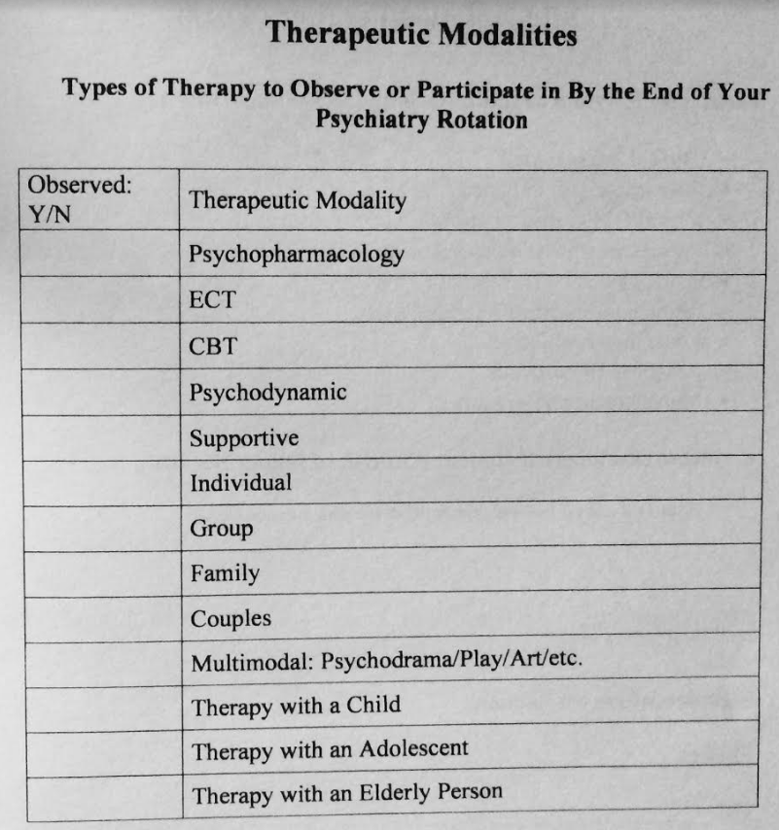
Behavioral Science Background
Curricular Courses at UI Chicago COM entail:
Essentials of Clinical Practice & Professionalism
Human Development
Intro Psychiatry
Psychiatry Rotation
A
The above images belong to the University of Illinois College of Medicine Psychiatry Clerkship Curricula
Notes:
Angelica –
My behavioral science background started in college as a psychology minor, then it continued in medical school as an Urban medicine and medicina fellow and as a public health student MD/MPH at UIC AND in our medical curriculum ECPP course during our 1st and 2nd year where we were introduced to problem-based/ team-based learning, in which we had a lecture and then a small group session where we discussed. presented or acted out hypothetical clinical cases dealing with ethics, biostatistics, epidemiology, among others. Our first year we were exposed to Human development, and psychology. Our 2nd year we were introduced to Psychiatry to obtain a foundation for our 3rd year psychiatry rotation. Most 3rd years experienced CBT and psychopharmacology Therapeutic modalities

Slide 9
Literature Review
Limited information available regarding behavioral health curriculum for medical students in FM residency programs
Wake Forest FM residency requires interns to present 1 hour behavioral health lecture during noon conference to medical students, residents, and faculty
S
Notes:
http://www.wakehealth.edu/School/Family-and-Community-Medicine/Residency/Behavioral-Science.htm (1min) SNC

Slide 10
Literature Review
Courses in the BSC differ in content, methods, and settings of instruction; however, they all share the common interest of integrating key humanistic and social science principles into the medical curriculum (Benbassat et al., 2003)
Important to understand our beliefs and culture, acknowledge our patients’ beliefs and culture, and to examine our own attitudes, biases, personal stressors and limitations and how this can interfere with patient care
A

Slide 11
Literature Review
Impact:
The medicine provided to the individual and the community
Effective, ethical and empathetic doctor patient relationship; thus, impacting your practice
Treatment plans that consist of both medicine and behavior modification techniques or therapy
Ultimately, BSC should impact your awareness of both your perspective and the patient’s perspective of their disease.
Medical concern, intention and behavior should positively affect the patient, the patient's family and the community you serve
A
(Benbassat et al., 2003; Tsutsumi, 2015; Vanselow et al., 2004)

Slide 12
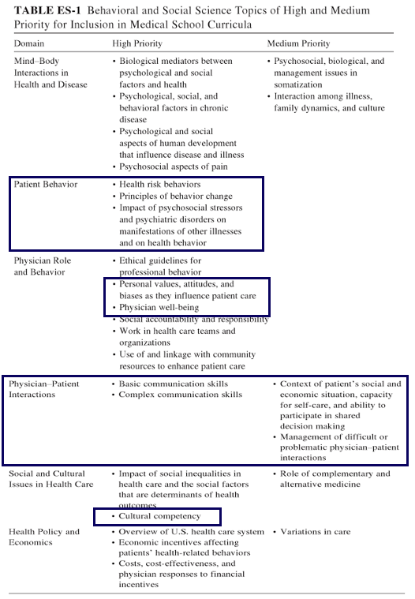
A
(Vanselow et al., 2004)

Slide 13
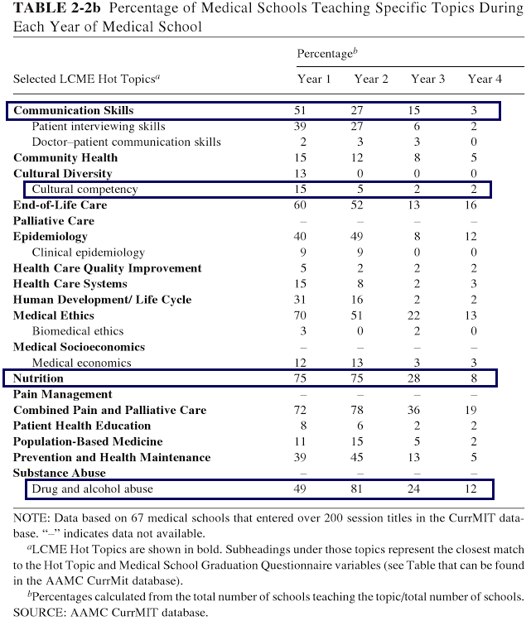
A
(Cordingley et al., 2013; Tsutsumi, 2015; Vanselow et al., 2004; )

Slide 14
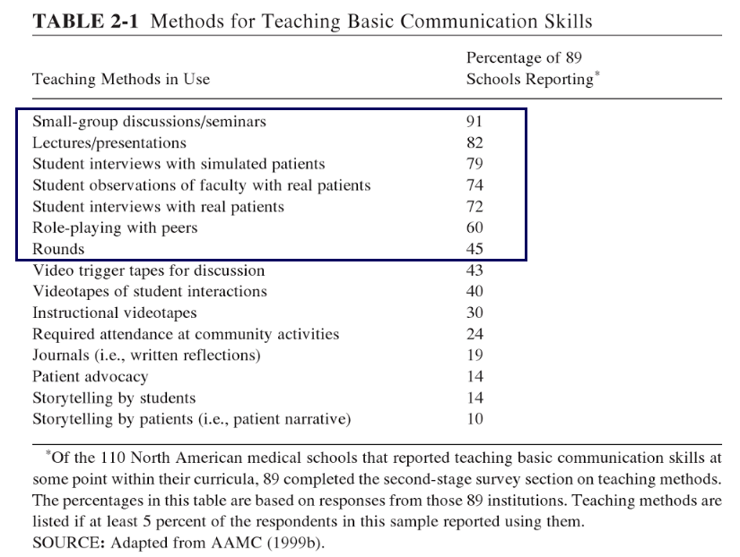
A
(Benbassat et al., 2003; Vanselow et al., 2004)

Slide 15
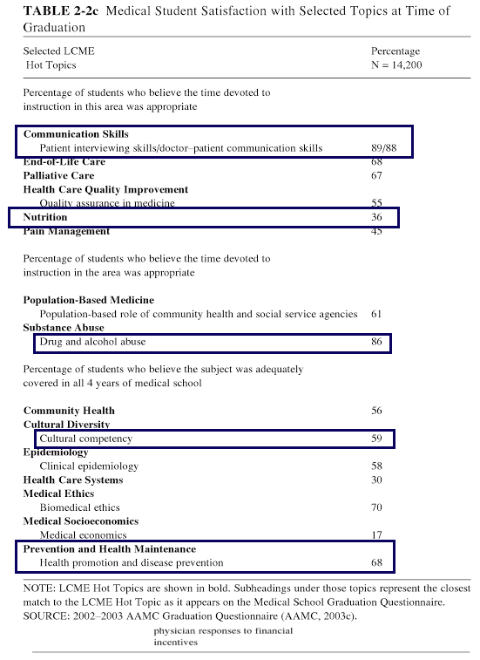
What should medical students know?
What captivates medical students?
A
(Vanselow et al., 2004)

Slide 16
Inclusion of behavioral and social sciences
Emphasis on psychosocial aspects of patient care
No set standard for specific exposure
OMS1: Behavioral Health Assessment (Clind 1503)
OMS2: Mental Illness and Treatments (Clind 1603)
OMS3: Psychiatric Clerkship (Psyd 1702)
OMS4: Electives only
K
(AACOM, 2017; AOA, 2016; COCA, 2016)

Slide 17
The Plan…
Initial idea:
6-8 week curriculum
Multiple topics
Meet weekly for one hour
Provide feedback forms after each lecture and “series”
Shadow in therapy
*Discussion-based meetings, informal, go outside when we can
AM

Slide 18
Curriculum
Counseling Skills/Interviewing Skills
Anxiety
Depression
Genograms
Death & Dying
Substance Abuse
Suicide
Student Pick lectures:
BPD
Pt/Dr. Communication
Mindfulness
Physician Wellness
L

Slide 19
Behavioral Science Topics include but are not limited to…
Motivational Interviewing
Suicide
Family
Self-injury
POST-PARTUM DEPRESSION
Culture
Physician Wellness
Stress
ALCOHOL/SUBSTANCE ABUSE
Collaboration
Assessment
Couples
Depression
Mindfulness
Eating Disorders
Boundaries
Anxiety
PT. DR. COMMUNICATION
COUNSELING SKILLS
Working with Kids
CBT
Difficult Patients
Agenda Setting
Self-care
Death & Dying
L

Slide 20
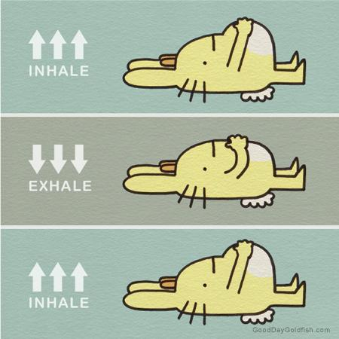
Example Anxiety Lecture Outline
Part I: Discussion
Part 2: Definitions
Part 3: Assessment
Part 4: Treatment
Handouts:
Anxiety Algorithm
Symptom Checklist
GAD-7
Diaphragmatic Breathing
PMR
L

Slide 21
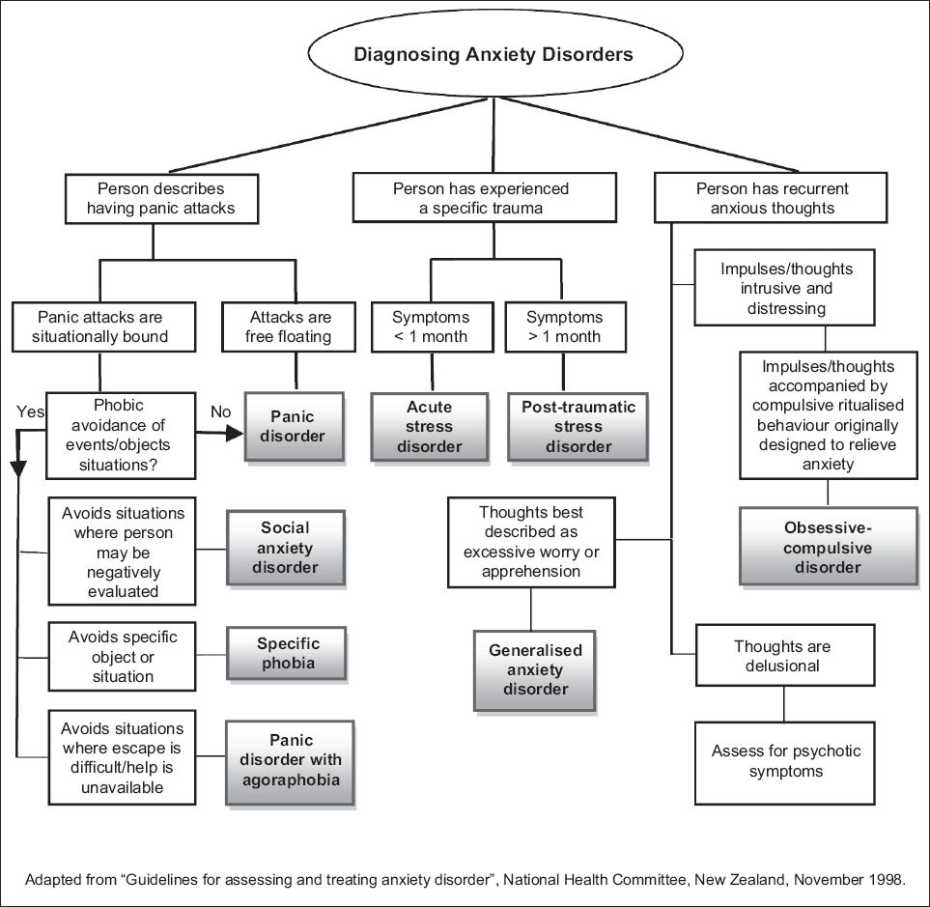
L

Slide 22
Shadowing Experience
Beyond role play
Therapy in real time
Ability to observe patient dynamics
Important communication and assessment tools
K
Notes:
3 MIN
Small group didactics, communication/assessment tools, therapy sessions (observation), debrief

Slide 23
Feedback
Lectures vs “Series”
Lecture scores: 4-5/5; Series scores: 9-10/10
“Curriculum reminded me that I chose medicine because
I care and inspired me to have better relationships
and rapport with patients for their benefit…”
“Appreciate the conversational tone
and student engagement.”
AM
Notes:
AMW
-Feedback tracked: lecture, after “series”
-Forms were given to students, rated lectures on a scale from 1 to 5 with 1 being “not helpful” and 5 being “very helpful”; also asked to describe what was useful about the lecture and what could potentially be improved
-Series was rated on a scale of 1 to 10 with 1 being “not helpful” and 10 being “very helpful”; students were also asked what other topics they would have liked to learn about and how they felt the curriculum may change their interactions with patients and their families in their future practices
-Overall students very engaged, had positive comments; would like to share some of those with you now
Feedback:
-”This curriculum reminded me that I chose medicine because I care and inspired me to have better relationships and rapport with patients for their benefit. It gave specific tools and qualities to consider using with that goal, and I thought the conversations about our collective individual experiences reinforced the lessons for me”

Slide 24
Feedback
“Watching therapy session discussion gave me a better sense of the role of a therapist.”
“Counseling techniques discussed will be
an asset in my clinical education.”
“Psych issues often seen as ‘not my problem’ by physicians...uncomfortable conversation...given tools that make me feel competent in this area and I believe I will use throughout my career.”
AM

Slide 25
Feedback
S/K/A

Slide 26
Challenges
Scheduling
Had to have some flexibility or creativity with keeping this weekly
Topic limitations
Had to coordinate which students would be in which lecture in order to not repeat
“Student Pick” lectures helped with this
AM

Slide 27
Take Home Points
7 months and going strong
Highlights
Students were engaged in the lectures
Students saw therapy sessions
Received more psychosocial tools
Hopefully expanded their thinking process about their own patients
Gave them some confidence about counseling
AM

Slide 28
Recommendations
Co-lead lectures: Instructor + BS
Check in 1-2 times/month
Aim for weekly lectures
Keep it light & discussion-based
Include “student-pick” lectures
Involve residents when possible – to teach or to learn
L

Slide 29
What are other residencies doing?
From our experience, this has been very useful. Have others engaged in something like this?
Thoughts? Questions?
AM

Slide 30
References
American Association of Colleges of Osteopathic Medicine (2017). AACOM Osteopathic Core Competencies. Retrieved August 20, 2017 from
ttp://www.aacom.org/ome/profdev/occ.
American Osteopathic Association (2016). Colleges of Osteopathic Medicine Accreditation. Retrieved September 1, 2017 from http://www.osteopathic.org/inside- aoa/accreditation/COM-accreditation/Pages/default.aspx
Benbassat, J., Baumal, R., Borkan, J. M., & Ber, R. (2003). Overcoming barriers to teaching the behavioral and social sciences to medical students. Academic Medicine, 78(4), 372-380.
Commission on Osteopathic College Accreditation. (2016). Accreditation of Colleges of Osteopathic Medicine. Chicago, IL. Offices of the American Osteopathic Association.
Cordingley, L., Peters, S., Hart, J., Rock, J., Hodges, L., McKendree, J., & Bundy, C. (2013). What psychology do medical students need to know? An evidence based approach to curriculum development. Health and Social Care Education, 2(2), 38-47.

Slide 31
References
Hodgson, J., Fox, M. & Lamson, A. (2014). Family therapists in primary care settings: Opportunities for integration through advocacy. . In J. Hodgson, A. Lamson, T. Mendenhall, & D. R. Crane (Eds.), Medical family therapy advanced applications (pp. 357-380). New York: Springer.
McGuinness, K. M. (2012). The prescribing clinical health psychologist: A hybrid skill set in the new era of integrated healthcare. J Clin Psychol Med Settings, 19(4), 434-440.
doi: 10.1007/s10880-012-9341-0.
Tsutsumi, A. (2015). A behavioral science/behavioral medicine core curriculum proposal for Japanese undergraduate medical education. BioPsychoSocial Medicine, 9(1), 24.
Vanselow, N., & Cuff, P. A. (Eds.). (2004). Improving medical education: enhancing the behavioral and social science content of medical school curricula. National Academies Press. https://books.google.com/books?hl=en&lr=&id=pJ- cAgAAQBAJ&oi=fnd&pg=PT21&dq=behavioral+science+curriculum+in+medical+schools &ots=k2wm0hG9hW&sig=SAD9K4glO89v_MNrZTY9- A0rKpU#v=onepage&q=behavioral%20science%20curriculum%20in%20medical%20scho ols&f=false

