Slide 1
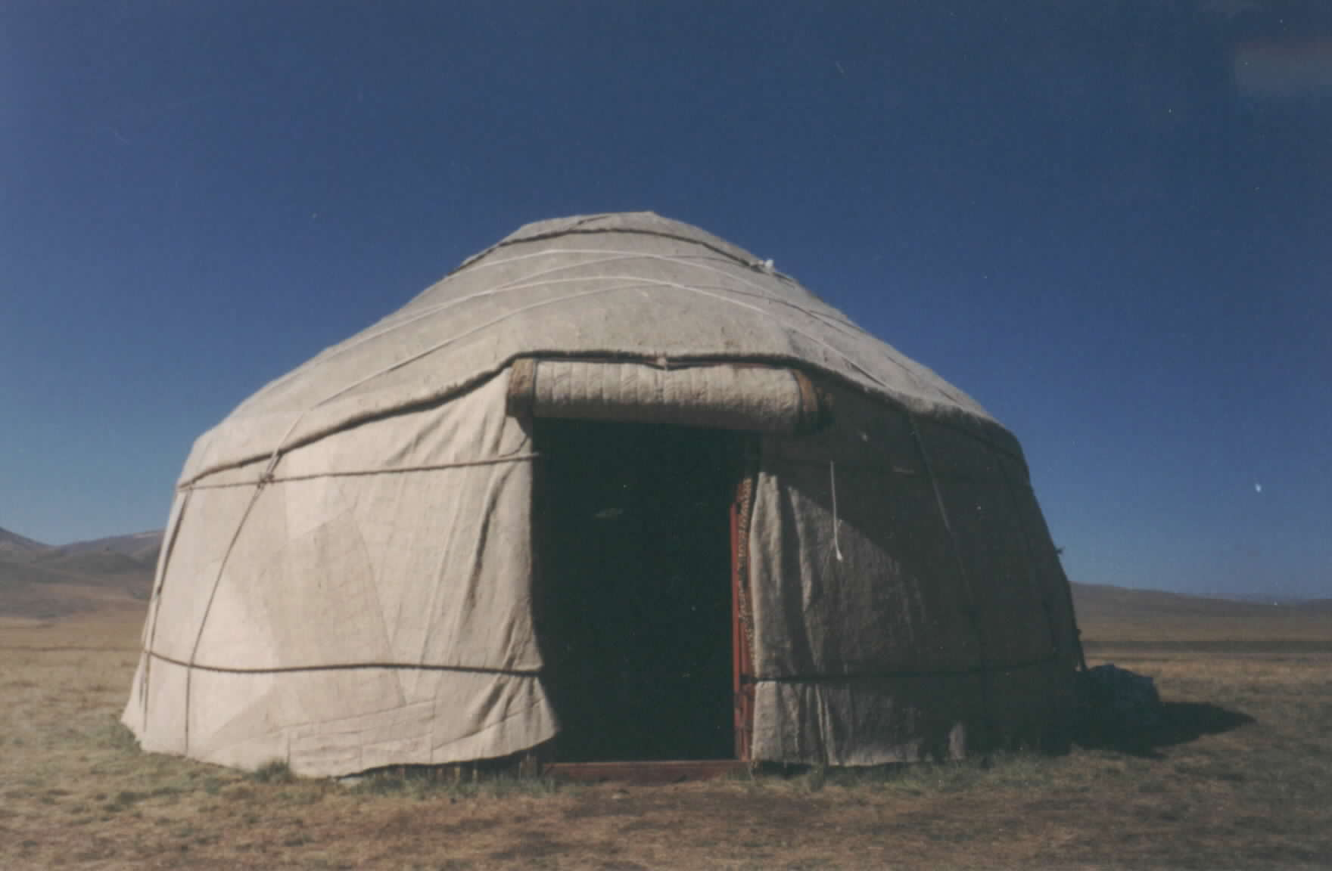
The First 20 Years of Family Medicine in Kyrgyzstan. What Has Been Sustainable?
Paul Fonken, MD
With input from Barton Smith, MD & Charley Hardison, MD

Slide 2
Training Programs Used to Establish FM in the Former Soviet Republic of Kyrgyzstan
Short Term
1. Training of trainers (1-yr. curriculum)
2. Retraining (4-month curriculum)
(“Specialists” retrained as “Family Group Practice” physicians)
Long Term
1. FM residency (2-year curriculum)
2. Continuing medical education (CME)
3. Quality Improvement System (QIS)

Slide 3
Effecting Change in Health Systems

Slide 4
Timeline for the Introduction of FM (1997-2006)

Slide 5
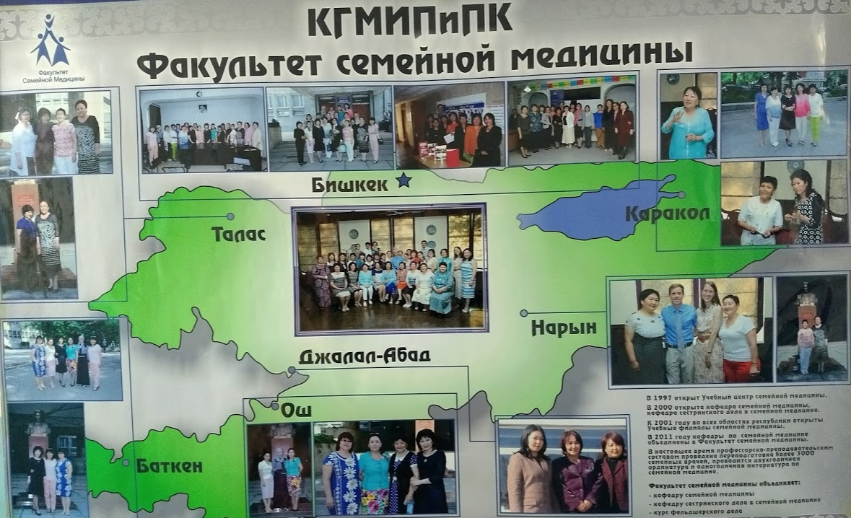
FM Depts. of National CME Institute & Med School
Faculty survey
completed in April 2018 by Paul Fonken
Barton Smith, MD
Attended the 20th anniversary FM celebration in May 2018

Slide 6
Long-term Results of the 1-Year TOT Program (71 FM Teachers Graduated1997-2002)
Family Medicine Training Centers (FMTC) still function in all 7 oblasts
% of original FM trainers still working as FMTC trainers:
about 50% at 10 years
about 25% at 20 years
In 2018 they ranked the TOT program effectiveness as 4.5/5
Attrition of the other original TOT graduates has been due to:
Working for other medical institutions
“Vertical” international health programs
Emigration (to Russia, Turkey, and US)
Pharmaceutical industry
Politics (one grad is a vice governor of an oblast (state)
Illness
Only a few new FM trainers have been added to the original group

Slide 7
Long-term Results of the 4-Month Retraining Program (2691 Family Group Practice Doctors Graduated1997-2006)
98% of the internist, pediatricians and gynecologist were retrained
The # of FGP physicians in the country is now less than ½ this
Current FM trainers ranked the effectiveness of the
Retraining program as 3.8/5
Restructuring into family group practices (FGPs) as 3.2/5
Family Group Practice concept failed in urban areas
Rural FGP physicians appreciated and used the training more

Slide 8
Long-term Results of Both 2-Year FM Residencies (Started in 1998)
Current FM trainers ranked FM residency effectiveness at 3.8/5 and they feel that interest in FM among medical students is decreasing
Medical schools in Bishkek graduates about 1000 doctors annually
Initial mandatory high-volume FM residency training failed with very few of the 200+ initial graduates actually working as family doctors
Voluntary FM residency: lower volumes (10-30/yr); better quality
Still only about half of FM grads practice family medicine
Only about 10 FM residency grads have practiced outside of the 2 main cities
Currently the 2 residencies each have only 12 resident per year.

Slide 9
Long-term Results of Continuing Medical Education Programs (Started in 2002)
Initial in-person training programs at FMTC’s worked well
Current FM trainers rank the CME program effectiveness as 3.8/5
This became less feasible as World Bank funds diminished
Expanded vertical programs by using the national FMTC network
HIV, Tb, pulmonary care, STI’s
Computer-based distance education
Current FM trainers rank the effectiveness of this at 4/5
Complicated to develop initially
Proven to be at least equally effective as in-person training
All FMTC’s now linked with nice video conferencing technology
Testing for maintenance of certification is now done electronically

Slide 10
Long-term Results of the “Family Group Practice Association” (Started in 1998)
Advocacy role for FGP doctors and clinics
Legal/policy issues
Quality improvement training and support
Public relations
Current FM trainers ranked the FGPA effectiveness at 3/5*
FGPA’s clinic-based quality improvement program
Initially fairly successful
2/3 of the current FM trainers feel that it is now ineffective*
Key barriers are the punitive managerial style and the lack of rewards for improving quality
*FM trainers work for a separate organization so may have a bias

Slide 11
Framework for Evaluating National Efforts to Develop Family Medicine
“Family Medicine Across the Globe: Developing Effective Solutions” by Joshua Freeman, MD Fam Med. 2018;50(6):417-9.
Enablers
Predisposing: elements inherited prior to FM program
Facilitating: elements created by the FM initiative and it’s partners
Reinforcing: helpful elements occurring in parallel to the FM initiative
Meta-enablers: Key elements common to successful FM programs
Keys to sustainability

Slide 12
Predisposing Enablers (Elements inherited prior to the FM initiative)
Policy Window
The Soviet medical system (adequate # of doctors, good access)
Oversupply of specialty physicians
Openness to change within Kyrgyzstan’s Ministry of Health
Economic pressures demanding change (loss of Soviet subsidies)
Increased international interest in the Central Asian Republics
National and international commitment and coordination regarding health system reform
Global realization that strengthening primary care is the key to improving health systems

Slide 13
Facilitating Enablers (Partnerships) (Elements created by the FM initiative and it’s partners)
Kyrgyzstan’s Min. of Health’s health reform programs (1996-2010)
Health systems delivery (“Family Group Practices” with internal quality improvement system)
Financing (single payer system and mandatory health insurance fund)
Legal and policy reforms
Education for primary care doctors, nurses and feldshers
World Bank funding for broad health systems reform
WHO promotion of primary care
USAID-Abt Associates-STLI-KSMI* partnership
KSMI allowed for institutionalization of all the efforts to establish FM
STLI provided long-term physicians and nurses to help train and support local FM trainers
USAID provided funding and networking
* KSMI=Kyrgyz State Medical Institute for Retraining and Continuing Education , STLI (Scientific Technology & Language Institute), USAID (US Agency for International Development)

Slide 14
Facilitating Enablers (Programs) (Elements created by the FM initiative and it’s partners)
Recruiting and training FM teachers from every oblast
Creating a FM Training Center in every oblast
Parallel primary care nursing training program
Retraining pediatricians, internists and ob/gyn’s in family medicine
FM residency programs
CME system
FGP association
Quality improvement systems
Faculty development conferences
Quick reference guide for FGP doctors

Slide 15
Reinforcing Enablers (Helpful elements occurring in parallel to the FM initiative)
USAID was open then to long-term “horizontal” programs to promote sustainable changes in health systems infrastructure
Other international groups with “vertical” programs were willing to use the “horizontal” training network to leverage their programs
Health care financing was reformed
Formation of a single payer system and mandatory health insurance fund
Closing of excess hospitals
Shifting more MOH funding toward primary care
Changes allowing the MOH to provide funding for the FM professional association & CME

Slide 16
Meta-Enablers (Key elements common to successful FM development initiatives)
Champions
Committed partnerships with:
Other specialties
National leaders
Financial leaders
Political will to address the country‘s most pressing health needs
Adaptability to define the role of family medicine for the setting

Slide 17
Champions (Meta-Enabler)
Dr. T. Chubakov – Rector of the Kyrgyz State Institute for CME
Local FM trainers from each oblast
Dr. Memoneliev – Minister of Health for the first several years

Slide 18
Committed Partnerships (Meta-Enabler)
National leaders: Ministry of Health, CME institute and Med. School
Other specialties: Some specialty support w/ vertical programs
Financial leaders: Ministry of Health, WB, USAID & others
STLI was a subcontractor for Abt Associates on USAID grant (12 yr)
AAFP and Physicians with Heart
In His Image FM residency
Many others

Slide 19
Political Will to Address Pressing Problems (Meta-Enabler)
Policy window created by independence from USSR
Openness to international input and funding
WHO support for primary care

Slide 20
Adaptability of the Family Medicine Model (Meta-Enabler)
Successful adaptations
Retraining of specialists to become FGP physicians in rural areas
Limiting FM to outpatient services
Developing a parallel program to train primary care nurses
Emphasis on clinical training, not just didactic
Using computer-based distance education

Slide 21
Barriers to FM Development
Resistance
Specialists
Patients
Medical Academy
Very specialty oriented
Reliance on didactic education
Rigid academic hierarchy: hard to introduce a new specialty
Sustaining Support of Partners & Champions
USAID shifted focus to vertical programs
Ministry of Health – frequent leadership changes
Frequent turnover in most vertical health programs
Lack of resources and capacity
Dependence on international funding
Emigration of health manpower

Slide 22
Keys to Sustainability
Take advantage of “policy windows” to advance FM
Horizontal long-term institutionalized health systems approach
Address health care delivery, financing, legal/policy framework simultaneously while educating primary care doctors & nurses
Develop and maintain a broad network of partners & champions
Create and support a FM association
Continue to adjust FM to the current environment
Make FM jobs rewarding and sustainable, especially in rural areas
Establish a team-based non-punitive culture including QI
Establish FM departments with faculty development tracks
Advance at least one FM doctor to the professor level
Ensuring that FM teachers care for patients regularly
Reform undergraduate training as the foundation of primary care

Slide 23
What is the Future of FM in KG?
The current FM trainers ranked their optimism for FM’s future at 4.2/5
The government is depending on FM to address the current rural health crisis
This seems to be another “policy window”

Slide 24
Current Rural Health Manpower Crisis in KG
Total # of doctors/1000 population: 1996 = 3.3 2014 = 1.8 per WB
The # of FGP doctors in the country is less than half the # in 1997
1/3 of FGP clinics have no doctor
>70% of the rural FGP doctors will retire soon (some are >80 y.o.)
Over 2/3 of the country’s population lives outside the 2 main cities
>50% of population has no access to an FGP doctor
Remote oblasts are especially at risk: Talas oblast has only 63 doctors (1/3500 population) and 43 feldchers (physician extenders)
Rural FGP clinics are also lacking nurses

Slide 25
Current MOH Plans for FM Development in KG
Mandatory rural family medicine service for “budget” students
Decentralized FM training outside the capital at FMTC
New TOT program for rural preceptors
Making rural primary care jobs more attractive
Reforming medical schools to graduate generalist doctors
Good progress with this the past 6 years with the Swiss Development & Cooperation agency

Slide 26
© 2018 American Academy of Family Physicians. All rights reserved.
All materials/content herein are protected by copyright and are for the sole, personal use of the user.
No part of the materials/content may be copied, duplicated, distributed or retransmitted
in any form or medium without the prior permission of the applicable copyright owner.

