Slide 1
Preparing Residents to Practice Integrated Behavioral Health
Competencies and Entrustable Professional Activities

Slide 2
Disclosures
This study was funded by the Society of Teachers of Family Medicine Project Fund.

Slide 3
Goals and Objectives
Synthesize study findings with professional experience
Evaluate competencies for residents practicing integrated behavioral health
Create strategies for workforce development

Slide 4
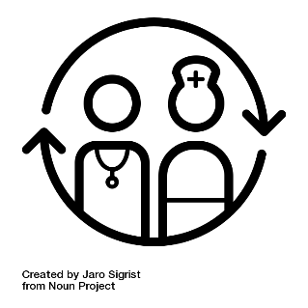
Current literature suggests a lack of identification in specific skills set needed for integrated behavioral health
Competencies have not clearly tracked IC skills needed¹
IBH skills are vital in the complex healthcare climate²
Difficulties exist in finding qualified clinicians and providing effective IBH services³
Challenges exist in practicing team based skills
Notes:
Note: If you would like, you can include the icon citation on the reference page.

Slide 5
Current Literature
Competencies have been a common language for residents and new physicians, yet we have not clearly tracked what specific skill set is needed for working in integrated care (Bernabeo & Holmboe, 2013; Swing, 2009)
Integration of behavioral health skills has been seen as a vital skill for physicians, yet the complexity of patient visits, time constraints and coordination challenges have been ongoing barriers for physicians (Hunter, Goodie, Oordt & Dobmeyer, 2009).
Organizations struggle to not only find qualified clinicians to integrate BH and primary care together (Hall et al., 2015), but providing effective delivery of integrated services to patients and families (Blount & Miller, 2009; Kathol et al., 2010)
After more than a decade since the Future of Family Medicine Project, providers are still challenged to practice team based skills that integrate other disciplines and providers.

Slide 6
Value of Using Competencies
Competency-based medical education (CBME)
Focus on outcomes
Emphasis on abilities and skill
De-emphasis on time-based training
Promotes learner-centered training and education
Frank et al. (2010) Competency-based medical education: Theory to Practice. Medical Teacher, 32, 638-645.

Slide 7
Value of Using Competencies
IBH competencies in residency training
Consensus on definitions and key concepts for training and education
Greater understanding of the IBH developmental trajectory and variability in learner needs
Curriculum innovation and effectiveness
Pragmatic inclusion and exclusion of curriculum

Slide 8
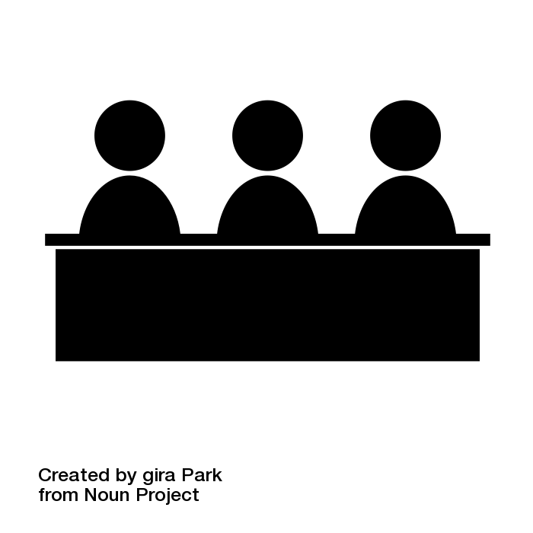
Method
10 Years GME
Teaching
Experience
Followed ACGME Committee process
Literature search
Content experts
Delphi study
Electronic survey: three rounds
“Essential, Compatible, or Irrelevant”
5+ Years IBH
Experience

Slide 9
Other IBH Competencies
2014
Primary Care Psychology Competencies (McDaniel)
BHP in Primary Care Competencies (SAMHSA/CIHS)
2015
Provider- and Practice-Level Competencies (AHRQ)
2016
Core Competencies for Behavioral Health Providers Working in PC (Farley Health Policy Center)

Slide 10
Round
1
24 completed survey
15 of 41 items received 80% consensus
Round
2
21 completed survey
10 of 15 items received 80% consensus
Round
3
21 completed survey
1 of 3 items received 80% consensus

Slide 11
Iterative Process
Experts learn from team
Experts rate items
Team revises, adds, removes items
New list of items
Team learns from experts

Slide 12
Delphi Study Results
Twenty-one experts identified 23 essential competencies divided into 7 domains
Professional Values
Collaboration & Teamwork
Screening & Assessment
Intervention
Interpersonal Communication
Socio-Cultural Competence & Adaption
Care Planning & Care Coordination
80%
consensus per competency

Slide 13
Screening and Assessment skills identified as a major integrated care competency for family medicine residents.
Twenty-one experts identified 23 essential competencies divided into 7 domains
Interpersonal Communication
Professional Values
Socio-Cultural Competence and Adaption
Collaboration and Teamwork
Example:
S&A 2: Work as part of a team to triage behavioral health care according to patient severity level
Behavior 2: Based on functionality and screener scores, resident triages patients to appropriate behavioral health services
Intervention
Screening and Assessment
Care Planning and Care Coordination

Slide 14
Competency Domains for Residents Practicing Integrated Behavioral Health
Interpersonal Communication
Collaboration & Teamwork
Screening & Assessment
Care Planning & Care Coordination
Intervention
Socio-Cultural Competence & Adaptation
Professional Values

Slide 15
Example

Slide 16
Working Group We Need Your Help!
Six Groups
Rate Each Competency and EPA
Record Responses
Debrief

Slide 17
Debrief
Facilitators report findings
Discussion
What do you like?
What do you not like?

Slide 18
Workforce Development: Best Practices
Efficient: flipped classroom approach
Online modules
Live skill-based workshop
Longitudinal
Practice-based experience
Ongoing live observation and feedback

Slide 19
Workforce Development
Observation
Lecture
Video
Competency
How would you teach this material?
What are best practices for helping residents learn new knowledge and skills?

Slide 20
Acknowledgement
Consultant: Larry Mauksch
Funding: STFM Project Fund
Contributors: Allison Bickett, Amber Hewitt, Bridget Beachy, David Bauman, Deepu George, Elizabeth Banks, Jennifer Carty, Jennifer Harsh, Laura Sudano, Leslie Allison, Linda Myerholtz, Maureen Healy, Max Zubatsky, Meredith Lewis, Molly Clark
Icons:
Icon “Panel” created by Gira Park from Noun Project
Icon “Talking” created by Suji from Noun Project
Icon “Global Healthcare” created by Delwar Hossain from Noun Project
Icon “Success” created by Gregor Crenar from Noun Project
Icon “Switching Healthcare” created by Jaro Sigris from Noun Project

Slide 21
References
Bernabeo & Holmboe, 2013; Swing, 2009
Hunter, Goodie, Oordt & Dobmeyer, 2009
Hall et al., 2015; Blount & Miller, 2009; Kathol et al., 2010

