Slide 1
Longitudinal Integrated Clerkships Clinical Teaching Pearls:
Opportunities and challenges with longitudinal relationships and continuity

Slide 2
Disclosures
We have no relevant disclosures

Slide 3
Please evaluate this presentation using the conference mobile app! Simply click on the "clipboard" icon on the presentation page.

Slide 4
Learning Objectives
Assess and incorporate specific methods of teaching that are relevant when students are learning in a longitudinal educational experience (e.g., LIC), such as increasing opportunities for continuity of care, student autonomy & ownership, patient navigation, and community engagement such as is common in the patient-centered medical home (PCMH) model of healthcare.
Emphasis will be placed on partnering with the other core clerkships (whether utilizing a LIC or not) and student evaluation; in particular, when multiple preceptors are involved.
Unifying threads: efficiency, self-directed learning, innovative documentation, team teaching- interprofessional education

Slide 5
Session Outline

Slide 6
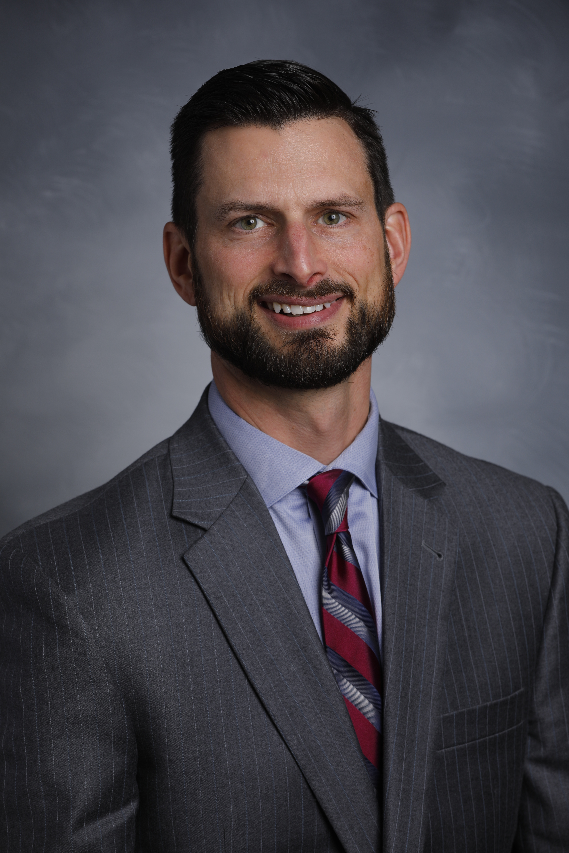
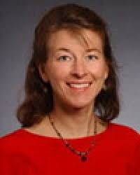
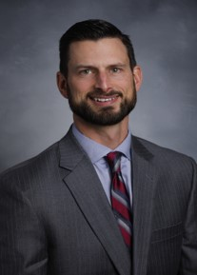
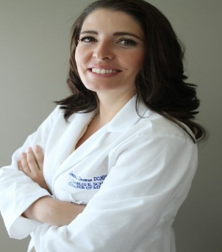
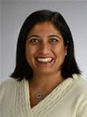
Speakers
Michele Birch MD
Associate Professor,
Director of Academic Services and Family Medicine Clerkships
University of North Carolina School of Medicine, Charlotte Campus
Michele.Birch@carolinashealthcare.org
Joanna Drowos DO, MPH, MBA
Clerkship Director, Community &Preventive Medicine,
Associate Chair, Integrated Medical Science Department
Charles E. Schmidt College of Medicine,
Florida Atlantic University
jdrowos@health.fau.edu
Kirby Clark MD
Director, Rural and Metro Physician Associate Programs
University of Minnesota Medical School
clark130@umn.edu
Mandi Sehgal MD
Associate Professor of Integrated Medical Science
Director, Geriatrics Curriculum Thread
Associate Director, M3 Geriatrics/Palliative Care Clerkship
Charles E. Schmidt College of Medicine
Florida Atlantic University
sehgalm@health.fau.edu

Slide 7
Core Elements of Longitudinal Integrated Clerkships (LICs)
Medical students participate in the comprehensive care of patients over time
Medical students have continuing learning relationships with these patient's clinicians
Medical students meet, through these experiences, the majority of the year's core clinical competencies across multiple disciplines simultaneously

Slide 9
Principles of Continuity
Continuity of patients, setting, teachers
Three themes define the differences between Block and Integrated clerkships: (Hauer K et al. Academic Medicine 2012;87(10):1-8)
Time: Continuity increases student autonomy
Purpose: Block students get “pimped” to assess knowledge; longitudinal students have collaborative and collegial discussions with their teachers.
Power: Longitudinal students experience a “developmental transfer of responsibility.”

Slide 10
Our Schools: Florida Atlantic University
The 134th allopathic (MD) medical school in North America
64 students per class
7+ affiliated community hospitals
120+ outpatient preceptors
1000+ new affiliate teaching faculty

Slide 12
Our Schools – University of Minnesota Medical School (RPAP/MetroPAP)
9 month rural LIC - now 46 years strong
Over 1500 RPAP graduates
Sites distributed across Minnesota
About 40 students per year (17% of class)
“MetroPAP” uses a similar LIC model for urban underserved sites
Foundation and engine = “primary preceptors”

Slide 14
Our Schools- University of North Carolina, Charlotte Campus
26 students per class at Charlotte Campus
874 bed community based teaching hospital
13 residencies, 18 fellowships
Shifts education to outpatient setting where 80% of health care occurs & engages CHS community providers
Outstanding outcomes in student & preceptor satisfaction

Slide 15
Innovation Opportunities in CLIC Weekly Schedule
Half day each week in Community Practices and CMC ED
Self-directed time: Follow patients across the continuum of care
CLIC Thread: Interdisciplinary education with simulation, ethics & ultrasound
Pulse Weekend: Inter-professional collaboration with administrative interns, CMO, & Patient Experience Team to identify opportunities for system improvement

Slide 16
Think-Pair-Share: 10 minutes
Discuss strategies used for clinical teaching specific to opportunities and challenges in LICs:
Which strategies work? Why?
Are these strategies efficient?
Possible topics: efficiency, self-directed learning, other teachers, documentation/HER, promoting ownership, students adding value

Slide 17
Sharing and Reflections – 15 Minutes

Slide 18
Thank you for your participation!
Articles to distribute
Sharing the wisdom of the room
Follow up conversations

Slide 19
References
Avery DM, Lavender PD, Guin SM, Yerby L, Taylor HM (2017) Why Family Physicians Want to be Longitudinal Integrated Clerkship Preceptors. J Family Med Community Health 4(1): 1099. https://www.jscimedcentral.com/FamilyMedicine/familymedicine-4-1099.pdf
Hauer KE, O’Brien BC, Hansen L, Hirsh D, Ma IH, Ogur B, Teherani A. More is better: students describe successful and unsuccessful experiences with teachers differently in brief and longitudinal relationships. Acad Med. 2012;87:1389–1396. doi: 10.1097/ACM.0b013e31826743c3. https://www.ncbi.nlm.nih.gov/pubmed/22914512
Hauer KE, Hirsh D, Ma I. The role of role: learning in longitudinal integrated and traditional block clerkships. Med Educ. 2012 Jul;46(7):698–710. https://www.ncbi.nlm.nih.gov/pubmed/22691149
Hirsh DA, Ogur B, Thibault GE. “Continuity” as an organizing principle for clinical education reform. N Engl J Med. 2007 Feb 22;356(8):858–5. https://www.ncbi.nlm.nih.gov/pubmed/17314348
Latessa, R., Schmitt, A., Beaty, N., Buie, S. and Ray, L. (2016), Preceptor teaching tips in longitudinal clerkships. Clin Teach, 13: 213–218. doi:10.1111/tct.12416
http://onlinelibrary.wiley.com/doi/10.1111/tct.12416/pdf
Worley P, Couper I, Strasser R, Graves L, Cummings B, Woodman R, Stagg P, Hirsh D. 2016. A typology of longitudinal integrated clerkships. Med Educ. 50:922–932.
http://onlinelibrary.wiley.com/doi/10.1111/medu.13084/abstract

