Slide 1
The A Team: Electronic Simulation of a Clinical Team Helps Learners Appreciate Benefits of Team-Based Care
Elaine Lee, MS 4
Margo Vener, MD, MPH
University of California, San Francisco

Slide 2
Disclosures
None

Slide 3
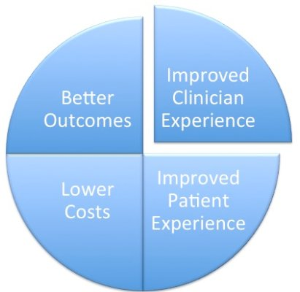
Background
Team-based care is part of the Quadruple Aim of Health Care. It is an innovative strategy for providing high quality primary care for patients and greater efficiency for the clinical team.
However, lacking clinical experience, students often struggle to appreciate the impact of key aspects of team based care.
Notes:
Why - Triple/ quadruple aim - Team-based care is an innovative strategy for providing high quality primary care for patients and greater efficiency for the clinical team.
What concerns – adopting/ integrating systems and supports necessary to facilitate transition
How - effective training on TBC core values

Slide 4
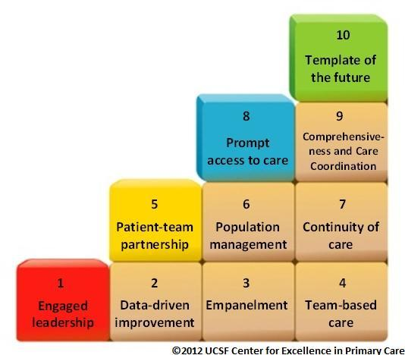
Background, cont’d
We assign the
“Ten Building Blocks of Highly Effective
Primary Care Delivery”
(Bodenheimer, et al); however…
Notes:
Although we assign the “Ten Building Blocks of Highly Effective Primary Care Delivery” (Bodenheimer, et al), students often do not have sufficient experience to appreciate the value of this approach.

Slide 5
Challenge
Students primarily see patients in office visits
Often not extensively engaged with the other functions of the clinical team (eg: panel management)
Hence, students miss the opportunity to see important functions of primary care team:
Proactive role in preventive care
Chronic care outreach, etc.
Notes:
Because students generally only see patients in office visits, they are often not extensively engaged with the other functions of the clinical team (eg: panel management, etc).
As a result, students miss the opportunity to see important functions of primary care including playing a proactive role in preventive care, offering chronic care outreach, etc.

Slide 6
Methods
Electronic simulation – goals:
Macroscopic
Benefits of team-based care
Pilot
25 – 3rd year medical students
Notes:
We created an electronic simulation so that learner could see the more macroscopic view and gain insight into the benefits of team-based care for patients, staff, providers and health care system function.
Piloted it with 25 third year students

Slide 7
“The A Team”
Potential visit types: acute, chronic, prevention, group visits, health coaching, and nurse visits
Clinical tasks for our team: patient phone calls and emails, medication refills, preventive care outreach, lab review, and health coaching
Notes:
We developed a virtual model of a clinical team that includes a physician, medical assistant, health coach, registered nurse, and nurse practitioner.
We created a patient panel of 1000 patients who would be seen in a month.

Slide 8
Demonstration
Roles of Team Members
Exercise

Slide 9
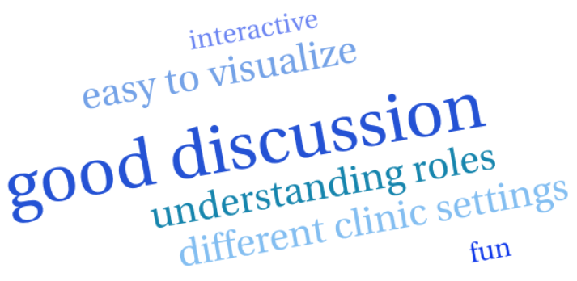
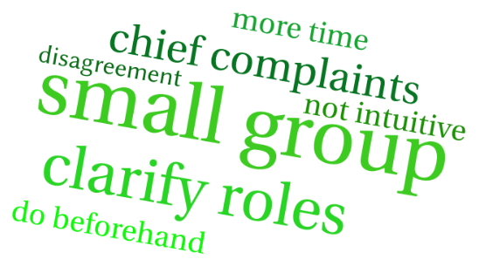
Evaluation
STRENGTHS
IMPROVEMENTS

Slide 10
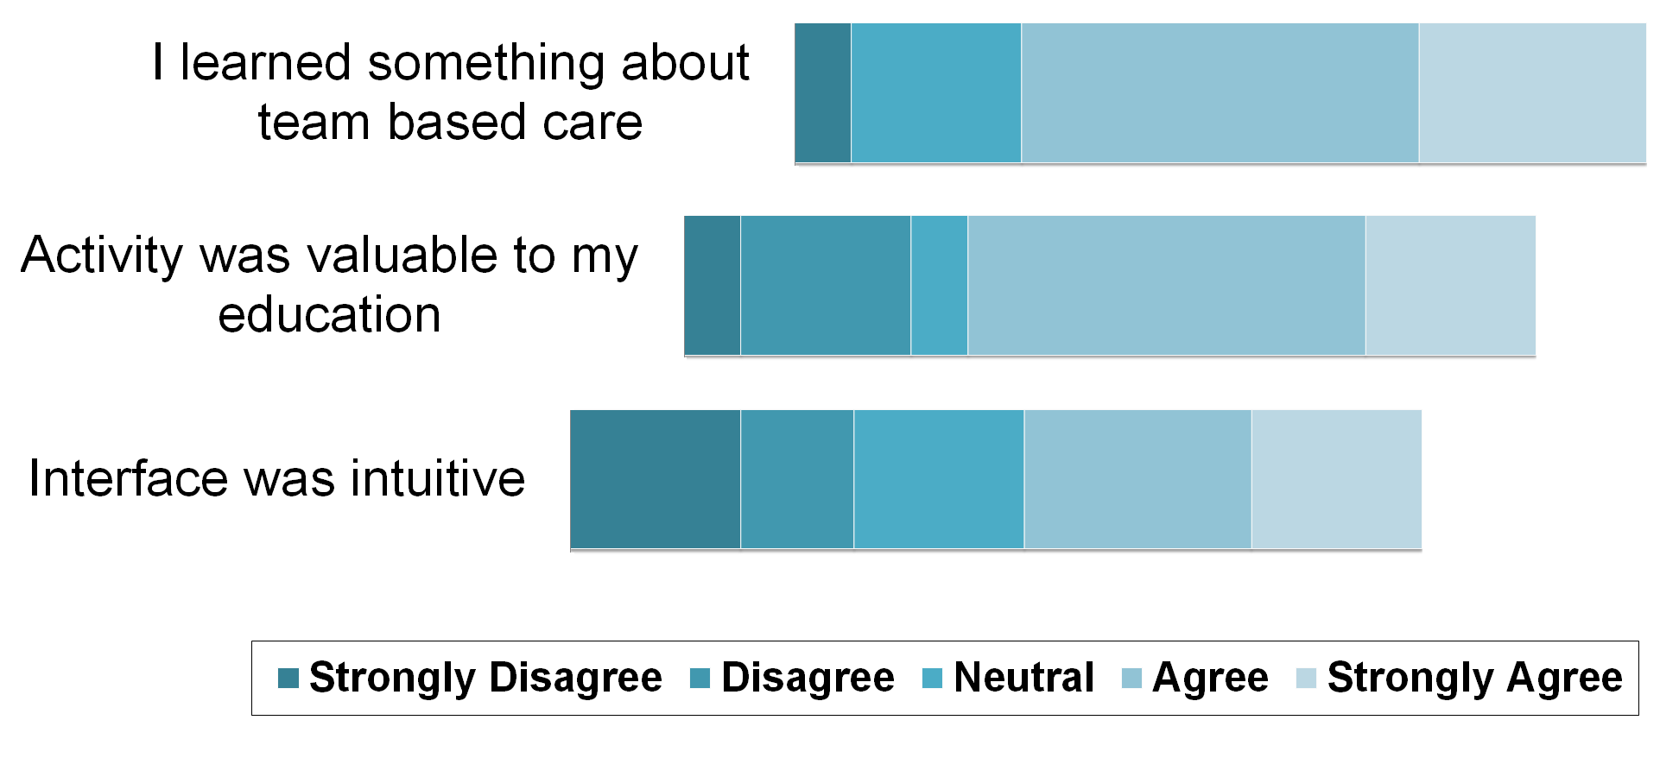
Results, continued
Disagree Agree
Notes:
Paper survey data

Slide 11
Next steps
Implement this simulation for all MS3s (170/year) and all PGY1s (15/year)
Evaluate the model by Likert scale about the logistics and value of the simulation
Conduct focus groups for more insight

Slide 12
What’s the point?
Notes:
Everyone loves a toy, but the simulation is only a stepping off point.
Goals is to engage students, and preceptors in a more in-depth discussion of the strengths and challenges of team based care.
Plan to have students discuss this exercise so they will be more astute observers at their clinical site, ask preceptors about Team Based Care and innovations at their site etc.

Slide 13
Discussion Questions
What are the challenges of teaching team-based care at your institution? What could be a role of an electronic simulation?
What are ways to get students involved in team-based care beyond electronic simulation (ie, engagement in actual work of the team)?
Notes:
(?) Q3

