Slide 1
Beyond Benzos: A Review of Pharmacological Treatment of Anxiety
The 40th Forum for Behavioral Science in Family Medicine
September 18-21, 2019
Chicago, Illinois
Kwanza Devlin, MD – Associate Program Director
Anshu Aggarwal, MD – PGY2
Community Memorial Hospital Family Medicine Residency Program
Menomonee Falls, Wisconsin

Slide 2
Disclosures
We have no conflicts of interest to disclose

Slide 3
Objectives
By the end of this session, learners will be able to:
Understand the evidence behind the use of non-benzodiazepine anxiolytics
Feel comfortable using our resource tool in a clinic setting to treat patients with anxiety

Slide 4
Anxiety??
DSM V – Generalized Anxiety Disorder (GAD), Social Anxiety Disorder (SAD), panic disorder (PD), and specific phobias
Not Obsessive/Compulsive and Trauma/Stress Related
Data is mostly DSM IV

Slide 5
First
Know your diagnosis (diagnoses) and level of impairment
Rule out other causes
Cognitive behavior therapy alone or with pharmacotherapy is almost always beneficial (except with BNZ)

Slide 6
Disorder | Definition | DSM-V Code
Generalized Anxiety Disorder | • Excessive, difficult to control anxiety and worry (apprehensive expectation) about multiple events or activities (e.g., school/work difficulties) • Suffer from somatic symptoms (tremors, palpitations, dizziness, muscle tension etc.) and psychic symptoms (difficulty concentrating, insomnia) | 300.02
Social Anxiety Disorder | • Marked, excessive or unrealistic fear or anxiety about social situations in which there is possible exposure to scrutiny by others, especially when they are the center of attention • Active avoidance of feared situation | 300.23
Panic disorder | • Recurrent unexpected panic attacks, in the absence of triggers • Persistent concern about additional panic attacks and/or maladaptive change in behavior related to the attacks • Often have physical manifestations of anxiety (e.g, palpitations, sweating, tremor, dry mouth, dyspnea, feeling of choking; chest pain; abdominal discomfort; feeling of unreality, paresthesia, etc.) | 300.01

Slide 7
Non-Prescription Medications

Slide 8
Herbal Supplements
Medications | What evidence has shown | Dosages
Kava | Mild-mod anxiety | 180-250 mg
Ginkgo Biloba | Dose dependent reduction | 240-480 mg
Chamomile | Mild GAD | Optimal dosage unknown
Echinacea | Mild-Mod anxiety | 40 mg
St Johns Wort | Non significant in SAD | -
Valerian Root | No evidence | -

Slide 9
Nutritional and neurotransmitter supplements
Medications | What evidence has shown | Dosages
Inositol | Panic disorder, OCD | 12-18 g
L Lysine and Arginine | GAD | 2.64-3 mg
Magnesium | Anxiety, anxiety related disorders | Unknown
5-Hydroxytryptophan | Panic disorder | 200 mg

Slide 10
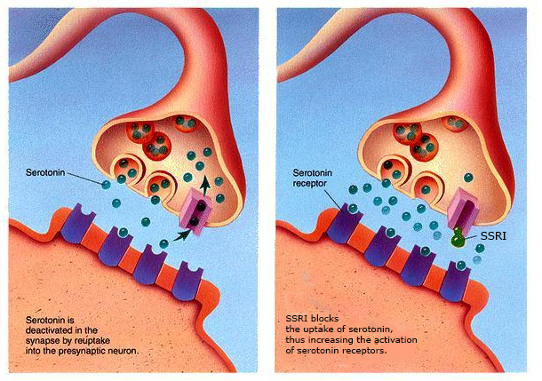
SSRIs and SNRIs

Slide 11
Medications that are FDA approved | What they are approved for | What evidence has shown | Dosages
Paroxetine | GAD, PD | PD, GAD, SAD | 20-50 mg
Citalopram | None | PD, SAD | 20-40 mg
Escitalopram | GAD | PD, GAD, SAD | 10-20 mg
Fluvoxamine | SAD | PD, SAD | 25-150 mg
Sertraline | None | PD, GAD, SAD | 50-150 mg
Fluoxetine | None | PD | 10-90 mg
Duloxetine | None | GAD | 60-120 mg
Venlafaxine | GAD, SAD, PD | GAD, SAD, PD | 75-250 mg

Slide 12
Evidence
Medication | Study Design/Comparison | Conclusion
Paroxetine | Meta-analysis and RCT | Better than placebo
Citalopram | Meta-analysis and RCT | Better than placebo
Escitalopram | Multiple RCT, open label, meta-analysis | Better than placebo
Fluovoxamine | Meta-analysis and RCT | Better than placebo
Sertraline | Meta-analysis and RCT | Better than placebo, = to buspirone
Fluoxetine | Meta-analysis, RCT | Better than placebo
Duloxetine | RCT | Better than placebo
Venlafaxine | RCT | Better than placebo, = to paroxetine
Notes:
Most of meta-analysis is for OCD studies

Slide 13
Considerations
Start off on a low dose and titrate slowly (after at least one week on the low dose)
Medication may take up to 6 weeks to work, usually takes 4 weeks to feel an effect
If the medication is ineffective, patients should try another SSRI or SNRI before switching classes
Medications affect the CYP 450 pathway
Pregnancy category C EXCEPT paroxetine (category D)
Jitteriness/Restlessness
Nausea/Vomiting
Headache
Fatigue
Sexual Dysfunction
Diarrhea/constipation
Appetite changes/weight gain
QTC prolongation
Fetal heart defect (paroxetine)

Slide 14
SSRI/SNRI Summary
SS/NRI's are first line for all anxiety disorders due to tolerability
Most are effective even though only a few are approved by the FDA
Patients should try at least two drugs in this category before switching to an alternative
Give 4-6 weeks for the medication to take effect.
All are safe in pregnancy except paroxetine

Slide 15
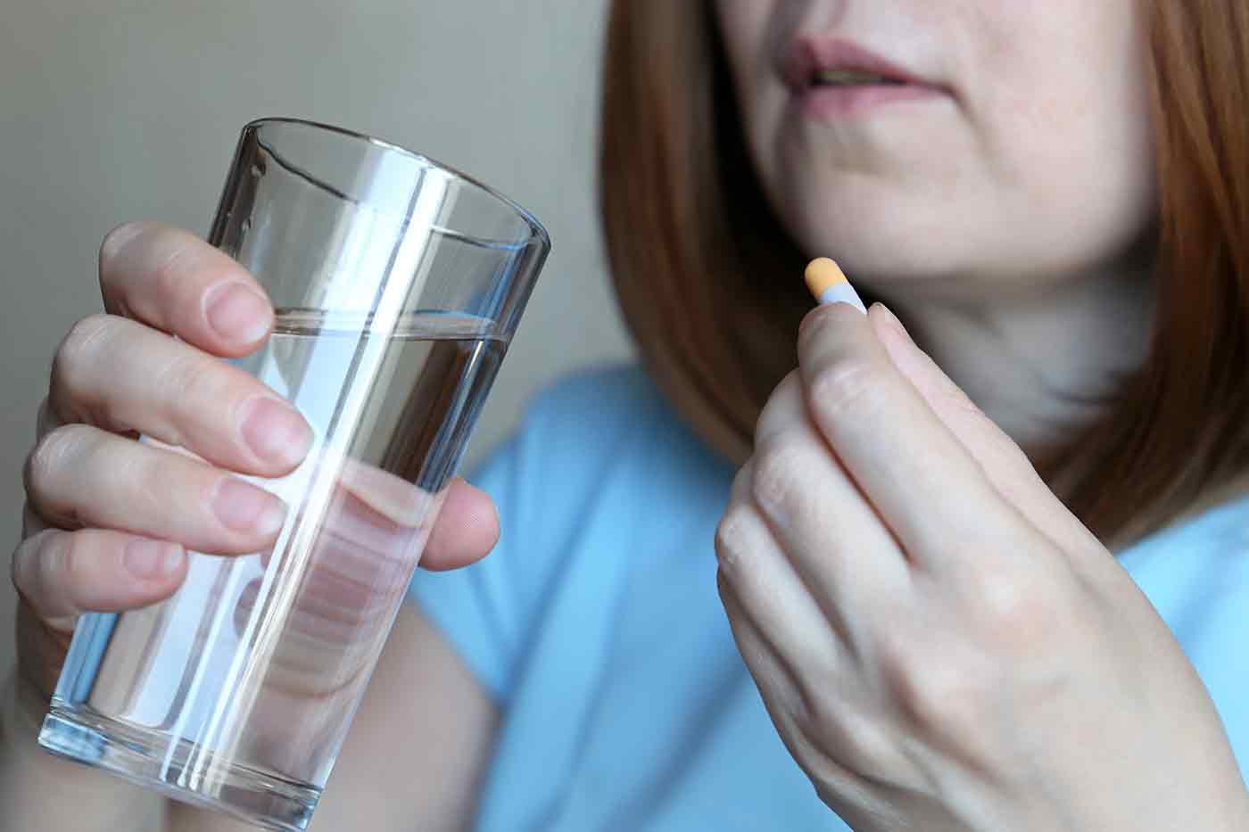
Tricyclics

Slide 16
What to Use
Medications that are FDA approved | What they are approved for | What evidence has shown | Dosages
Imipramine | None | GAD, PD, | 750-150 mg
Clomipramine | OCD | OCD, PD | 75-250 mg
Mirtazapine | None | PD | 7.5-45 mg

Slide 17
Evidence
Medication | Study Design/Comparison | Conclusion
Clomipramine | Open trial, Meta-analysis and RCT | Better than placebo, = to citalopram
Imipramine | Open trial, Meta-analysis and RCT | Better than placebo and trazadone for GAD.
Mirtazapine | RCT, open trial | Better than placebo, = to fluoxetine in PD
Notes:
Meta-analysis is OCD for clomipramine and imipramine, GAD for imipramine

Slide 18
Considerations
None of the TCA's are effective in social anxiety disorder
Often not the first choice due to the numerous side effects and interactions with other medications
Pregnancy Category C
Use cautiously in patients with suicidal ideation
Can be very helpful in people who also have migraines and neuropathy
Anticholinergic effects
Somnolence
Dizziness
CV side effects
Weight gain
Nausea
Headache
Sexual dysfunction

Slide 19
TCA Summary
Are often just as effective as SSRI's but are second line for PD/GAD due to side effects
Consider using them earlier in patient's who have significant neuropathy and migraines
Do not use in patient's with suicidal ideation

Slide 20
Antipsychotics

Slide 21
What to Use
Medications that are FDA approved | What they are approved for | What evidence has shown | Dosages
Prochlorperazine m. | GAD | GAD | Max 20mg/d x12wk
Trifluoperazine | GAD | GAD | Max 6mg/d x12wk
Aripiprazole |  | GAD adj, SAD adj, PD adj, OCD adj | 2-15 mg
Olanzapine |  | SAD, PD, GAD adj | 5-20 mg
Quetiapine | GAD | PD, Not SAD | 50-150 mg
Quetiapine XR |  | GAD | 50-150 mg
Risperidone |  | PD, SAD adj | 1-6 mg
Ziprasidone |  | OCD adj | 40-160 mg

Slide 22
The Evidence
Medication | Study Design/Comparison | Conclusion
Prochlorperazine maleate | Single-center RCT | Better than chlordiapoxide
Trifluoperazine | Multicenter RCT | Better than placebo
Aripiprazole | Prospective | Decr sx when added
Olanzapine | Small placebo RCT | Better than placebo
Quetiapine | Placebo RCTs | Better than placebo, = to antidepressants for PD
Quetiapine XR | 2 meta-analysis | “” for GAD
Risperidone | Meta-analysis of RCTs | Better than placebo, = to paroxetine
Ziprasidone | RCT (anxiety) | Not better than placebo

Slide 23
Considerations
Extrapyramidal effects
Anticholinergic effects
Hematologic effects
Endocrine – weight gain, DM, increased lipids (olanzapine>risperidone, quetiapine> aripiprazole
Sedation – quetiapine, olanzapine>risperidone, aripiprazole
QTc prolongation
Great for patients with co-morbid schizophrenia, schizoaffective dx, MDD with psychosis

Slide 24
Antipsychotic Summary
First generation can be helpful for GAD when used in short term ONLY
Second generation –
Quetiapine XR, olanzapine for GAD
Olanzapine for SAD
Quetiapine, olanzapine, risperidone for PD
Both have significant side effects which make them less than ideal treatments

Slide 25
Everything Else

Slide 26
What to Use – Azaspirones, H1 blockers, Other antidepressants, MAOIs
Medications that are FDA approved | What they are approved for | What evidence has shown | Dosages/day
Buspirone | GAD | GAD, SAD adj, Not PD, Not SAD, Not OCD | 20-60 mg
Hydroxyzine | Anxiety | GAD | 50-400 mg
Bupropion |  | GAD, SAD, Not OCD | 100-450 mg
Trazodone |  | GAD, Not PD | 25-400 mg
Phenelzine | Mixed anxiety/depr | SAD, PD | 45-90 mg
Tranylcypromine |  | PD, OCD | 30-60 mg

Slide 27
What to Use – GABA analogue, anticonvulsants, beta-blockers
Medications that are FDA approved | What they are approved for | What evidence has shown | Dosages/day
Gabapentin |  | SAD, Not PD, Not OCD | 300-1800* mg
Pregabalin |  | GAD, SAD, OCD adj | 300-600* mg
Divalproex |  | GAD, SAD, PD | 20-60 mg/kg
Levetiracetam |  | PD, Not SAD | 1000-3000 mg
Pindolol |  | PD adjunct, OCD adj | 5-40 mg
Propranolol |  | Not GAD, Not SAD, Not PD | 30-320 mg

Slide 28
The Evidence – Azaspirones, H1 blockers, Other antidepressants, MAOIs
Medication | Study Design/Comparison | Conclusion
Buspirone | Several RCTs | Better than placebo = BNZ, No benefit w/PD
Hydroxyzine | 3 RCTs | Better than placebo = BNZ
Bupropion | Non-blinded trial, RCT | Possible benefit for SAD, = escitalopram
Trazodone | RCT | = to diazepam
Phenelzine | RCT | Better than placebo = imipramine
Tranylcypromine | Randomized uncontrolled | Beneficial

Slide 29
The Evidence – GABA analogue, anticonvulsants, beta-blockers
Medication | Study Design/Comparison | Conclusion
Gabapentin | RCT | Better than placebo
Pregabalin | Multiple RCT | Better than placebo, = BNZ
Divalproex | RCT, non-blinded trial | Better than placebo for GAD, Some benefit for SAD & PD
Levetiracetam | Blinded RCT | Better than placebo
Pindolol | Non-blinded trial | Decr sx when added to fluoxetine
Propranolol | RCTs | No benefit

Slide 30
Considerations
Buspirone and hydroxyzine can be used in pregnancy
Bupropion may have anxiogenic effects, but can help ADHD sx
Bupropion, trazodone, MAOIs can also be used for depression
**There is some data using propranolol for performance anxiety and use given after exposure therapy for phobias**
Divalproex – black box – pancreatitis, fetal risk, and hepatotoxicity

Slide 31
Summary of "Everything Else"
Buspirone, although used for PD, is most efficacious for GAD
Beta blockers – not helpful for GAD, PD, or SAD
Bupropion – modest benefit for GAD and SAD, not FDA approved
MAOIs can help especially PD, but limited by patients' health risks and side effects
GABA – most helpful for social anxiety. Pregabalin better than gabapentin.
Of anti-convulsants, divalproex has broader coverage than levetiracetam, but more side effects

Slide 32
Benzodiazepines

Slide 33
What to Use
Medications that are FDA approved | What they are approved for | What evidence has shown | Dosages
Alprazolam | PD, GAD | PD, SAD, GAD | 0.25-9 mg
Lorazepam | GAD | PD, GAD | 2-6 mg
Clonazepam | PD, GAD | PD, SAD, Not OCD | 0.25-4 mg
Diazepam | GAD | PD, GAD | 2-40 mg

Slide 34
The Evidence
Medication | Study Design/Comparison | Conclusion
Alprazolam | Multiple RCT | Better than placebo, = other BNZ
Lorazepam | Multiple RCT | Better than placebo
Clonazepam | Multiple RCT | Better than placebo
Diazepam | Multiple RCT | Better than placebo

Slide 35
Considerations
Co-treatment with psychotherapy is less effective
May affect usefulness of other medications
Avoid with opioids, alcohol, and other concerning substances
Very high risk in patients with history of or thoughts of suicide by medication overdose
Risk for dependence, addiction, and tolerance
Discontinuation can be dangerous, weaning can take weeks to 18 months

Slide 36
Benzodiazepine Summary
Consider other options that have better safety profile
Best used for acute short-term use for patients with severe symptoms
Explain risk to patients before writing first prescription
Avoid long term use, but consider scheduled re-evaluation of benefits, risks, co-morbidities, indications and contraindications and consider weaning to lowest possible dose or discontinuation

Slide 37
Recommendations

Slide 38
General Rules
For GAD, PD, and SAD, SSRIs and SNRIs continue to be first line
Tricyclics and antipsychotics can be useful but have noted side effects to monitor
For GAD, after SS/NRI, buspirone, hydroxyzine, pregabalin and quetiapine
For PD, after SS/NRI, TCAs, MAOIs, and quetiapine
For SAD, after SS/NRI, pregabalin and gabapentin
Benzodiazepines can be effective but should be limited

Slide 39
Review of the Resource

Slide 40
The Pieces
Levels of Evidence
1 = Meta-analysis or >2 RCTs with placebo
2 = One RCT w/placebo or active comparison
3 = Uncontrolled trial with at least 10 subjects
4 = Anecdotal reports/Expert opinion
Treatment Recommendation
First Line = 1 or 2 w/clinical support for efficacy and safety
Second Line = 3 w/eff&safety or 1 w/safety concerns
Third Line = 4 w/eff&safety or 2 or 3 w/safety concerns
Not Recommended = 1 or 2 evidence noting lack of efficacy
Notes:
First line = 1 or 2 with safety. Second line = 1 with safety concerns or 3 w/safety. Third line = 2, 3 with safety concerns or 4

Slide 41
LET’S PRACTICE

Slide 42
Case #1 - Mary
42 yo, divorced with 2 kids, employed part time and cares for her mother who has dementia. Mary has no significant PMH. She was moderately depressed following her divorce 5 years ago and was offered antidepressants but declined them. Mary complains of feeling ‘stressed’ all the time and constantly worries about ‘anything and everything’. She describes herself as always having been a ‘worrier’ but her anxiety has become much worse in the past 12 months since her mother became unwell, and she no longer feels that she can control these thoughts. When worried, Mary feels tension in her shoulders, stomach and legs, her heart races and sometimes she finds it difficult to breathe. Her sleep is poor with difficulty getting off to sleep due to worrying and frequent wakening. She feels tired and irritable. She does not drink any alcohol.

Slide 43
What do you think she has?
Generalized anxiety disorder
What do you want to give her?
Sertraline, escitalopram, venlafaxine, duloxetine

Slide 44
Over the next 2 months, you have slowly increased to the max dose. She reports an improvement in her anxiety but still finds her worry distracting at times. She still struggles with sleep.
What can you do?
Quetiapine, risperidone, imipramine, hydroxyzine, trazodone

Slide 45
Case #2 - Mike
20 yo who is experiencing a significant amount of stress about school, noting that he’ll “probably flunk out.” He spends much of his day in his dorm room playing video games. When meeting new people, he has a hard time concentrating on the interaction because he is busy worrying about what they will think of him – he assumes they will find him “dumb,” “boring,” or a “loser.” Since starting college, he has been isolating more, turning down invitations from his roommate to go eat or hang out, ignoring his cell phone when it rings, and habitually skipping class. His concerns about how others view him are what drive him to engage in these avoidance behaviors.
Says he's healthy except for congenital long QT syndrome

Slide 46
What do you think he has?
Social anxiety disorder
What do you want to give him?
Pregabalin, gabapentin

Slide 47
Case #3- Jason
48 yo who has had a PMH of SAD for 30 years. Jason is seeing you for the first time today. Jason has tried multiple medications in the past including citalopram, venlafaxine, imipramine and buspirone. Jason has had no efficacy with these medications and is currently on alprazolam 0.5 mg four times a day.
When reviewing his chart, you discover Jason has a history of opioid abuse and is currently on suboxone (goes to a suboxone clinic).
Patient has no other health concerns.

Slide 48
What medication would you want to try next?
Pregabalin
What about his benzodiazepine?
Contraindicated with opioids
Start to wean by 10% every 1-2 weeks. Monitor very closely.

Slide 49
Questions??

Slide 50
References
Katzman, M, et al. Canadian clinical practice guidelines for the management of anxiety, posttraumatic stress and obsessive-compulsive disorders. BMC Psychiatry 2014, 14(Suppl 1):S1.
Ham, P. et al. Treatment of Panic Disorder. Am Fam Physician 2005;71:733-39,740.
Locke, A. et al. Diagnosis and Management of Generalized Anxiety Disorder and Panic Disorder in Adults. Am Fam Physician. 2015;91(9):617-624.
Sarris, Jerome, et al. “Plant-Based Medicines for Anxiety Disorders, Part 2: A Review of Clinical Studies with Supporting Preclinical Evidence.” CNS Drugs, vol. 27, no. 4, 2013, pp. 301–319., doi:10.1007/s40263-013-0059-9.
Boyle, Neil Bernard, et al. “The Effects of Magnesium Supplementation on Subjective Anxiety and Stress—A Systematic Review.” Nutrients, vol. 9, no. 5, 2017, p. 429., doi:10.3390/nu9050429.
Smriga, Miro, et al. “Oral Treatment with L-Lysine and L-Arginine Reduces Anxiety and Basal Cortisol Levels in Healthy Humans.” Biomedical Research, vol. 28, no. 2, 2007, pp. 85–90., doi:10.2220/biomedres.28.85.
Saeed, Sy Atezaz, et al. “Herbal and Dietary Supplements for Treatment of Anxiety Disorders.” Am Fam Physician, vol. 76, no. 4, 15 Aug. 2007, pp. 549–556.

