Slide 1
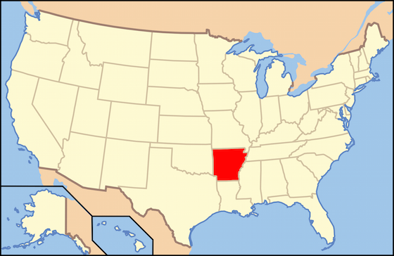
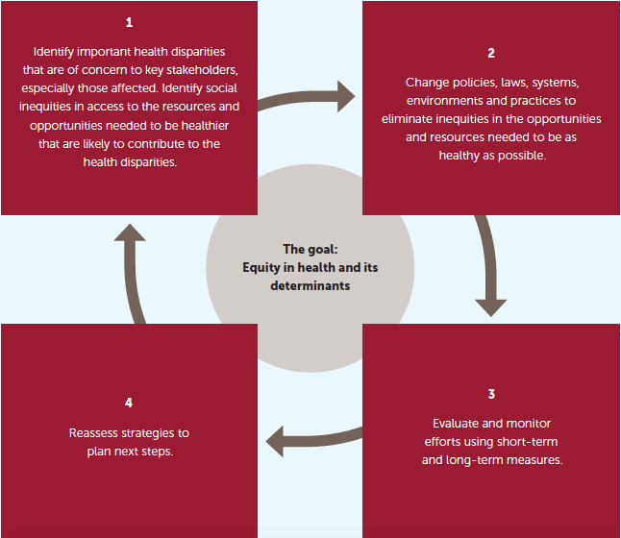
Poster Print Size:
This poster template is 24” high by 36” wide. It can be used to print any poster with a 2:3 aspect ratio including 36x54 and 48x72.
Placeholders:
The various elements included in this poster are ones we often see in medical, research, and scientific posters. Feel free to edit, move, add, and delete items, or change the layout to suit your needs. Always check with your conference organizer for specific requirements.
Image Quality:
You can place digital photos or logo art in your poster file by selecting the Insert, Picture command, or by using standard copy & paste. For best results, all graphic elements should be at least 150-200 pixels per inch in their final printed size. For instance, a 1600 x 1200 pixel photo will usually look fine up to 8“-10” wide on your printed poster.
To preview the print quality of images, select a magnification of 100% when previewing your poster. This will give you a good idea of what it will look like in print. If you are laying out a large poster and using half-scale dimensions, be sure to preview your graphics at 200% to see them at their final printed size.
Please note that graphics from websites (such as the logo on your hospital's or university's home page) will only be 72dpi and not suitable for printing.
[This sidebar area does not print.]
Change Color Theme:
This template is designed to use the built-in color themes in the newer versions of PowerPoint.
To change the color theme, select the Design tab, then select the Colors drop-down list.
The default color theme for this template is “Office”, so you can always return to that after trying some of the alternatives.
Printing Your Poster:
Once your poster file is ready, visit www.genigraphics.com to order a high-quality, affordable poster print. Every order receives a free design review and we can deliver as fast as next business day within the US and Canada.
Genigraphics® has been producing output from PowerPoint® longer than anyone in the industry; dating back to when we helped Microsoft® design the PowerPoint® software.
US and Canada: 1-800-790-4001 Email: info@genigraphics.com
[This sidebar area does not print.]
Health Equity Rounds:
Developing a Socially Accountable Consciousness in Medical Students
Arkansas
Chesley Murphy, BS, Leslie Stone, MD, MPH, William Ventres, MD, MA
Introduction
Context—UAMS/Arkansas
Discussion
REPLACE THIS BOX WITH YOUR ORGANIZATION’S
HIGH RESOLUTION LOGO
Many medical schools aim to transition from social responsibility to social responsiveness to social accountability in the education of their students.¹ The need for socially accountable medical education is arguably greater in states with poorer health outcomes. Schools across the nation are staggered along this “social obligation scale”—many currently lag behind society’s needs.¹
Formal curricula are difficult to change. Organic, student-led efforts can be effective in catalyzing reform. Health Equity Rounds demonstrates how such an effort can empower students as agents of change for socially accountable medical education.
Underlying issues: (1) Arkansas consistently ranks as one of the 5 least healthy states in the US,⁵ and (2) a public institution, UAMS is the state’s only health sciences university.
Current opportunities for educational experiences in health equity do exist at UAMS: All 1st and 2nd year medical students are required to volunteer at a student-run free clinic, and students may elect to rotate in rural primary care clerkships. New activities include a poverty simulation and a 4th year population health elective.
Health Equity Rounds is student-run. Having a champion faculty member has been helpful in identifying and arranging stimulating guests.
Health Equity Rounds is informal. Discussions over dinner cultivate fellowship and foster organic conversation, providing space for bridging knowledge gaps and uncovering biases.
Health Equity Rounds has as its intent introducing, discussing, and witnessing examples of health equity through fellowship of medical students and local agents of change. The impact of adverse social determinants of health is revealed by exposure to medical and non-medical experts.
Health Equity Rounds has fostered interest in disenfranchised and underrepresented groups. Partnerships have developed with groups such as the Student National Medical Association and the Rainbow Health Alliance.
Health Equity Rounds promotes the second “key step to advancing health equity”: developing a consciousness of social accountability in budding physicians.²
Definitions
Structure—Health Equity Rounds
Health Equity – The reduction and ultimate elimination of disparities in health and its determinants that adversely affect excluded or marginalized groups²
Social Responsibility – “The state of awareness to respond to society’s needs”³
Social Responsiveness – “The course of actions addressing society’s needs”³
Social Accountability – “The obligation [of medical schools] to direct their education, research and service activities towards addressing the priority health concerns of the community, region and/or nation they have a mandate to serve”⁴
Medical students, faculty members, and invited guests meet monthly for informal potluck dinners.
Guests are leaders from within and outside of medicine working for health equity and social justice. Over the course of an hour, they (1) describe their current work, (2) discuss how that work is important in Little Rock and Arkansas, and (3) explain the heart of what motivates them—the “why” behind their efforts. A reflective discussion amongst the group members concludes each Health Equity Rounds.
Actions
Key Steps to Advancing Health Equity
Key Questions
Example Topics to Date
Growth: How do we expand the core group of students?
Logistics: How can we optimize coordination of schedules?
Organization: Should we keep the group an Informal gathering?
Leadership: How can we grow faculty participation in health equity issues?
Race Relations in Arkansas: Past & Present | “High-Impact Health”: Caring for High-Risk/High-Need Patients
The “John Henryism” Hypothesis | Community Health Center Practice
“Deschooling MedEd”: Social Obligations in Medicine | Underserved Practice: Urban & Rural
HIV & Social Stigma | “State of the State”: Implementing Change via Health Systems
Conclusion
Health Equity Rounds is a medical student-led group at a health sciences university in Arkansas. Students meet to discuss health equity, witness examples of its pursuit, and foster the development of a social accountability consciousness. Such a model can be useful in other situations that offer limited formal opportunities for professional growth in these areas.
Contact
References
Boelen C. Why should social accountability be a benchmark for excellence in medical education? Educacion Medica. 2016; 17:101–105.
Braveman P, Arkin E, Orleans T, Proctor D, and Plough A. What is Health Equity? And What Difference Does a Definition Make? Princeton, NJ: Robert Wood Johnson Foundation, 2017.
Global Consensus for Social Accountability of Medical Schools. 2010. East London, South Africa: http://www.healthsocialaccountability.org.
Boelen C and Heck JE. Defining and measuring the social accountability of medical schools. Geneva: World Health Organization; 1995.
United Health Foundation. (2020). 2019 annual report of America’s Health Rankings. Retrieved from: https://www.americashealthrankings.org/explore/annual/measure/Overall/state/AR?edition-year=2019.
Chesley H. Murphy, BS
University of Arkansas for Medical Sciences
Email: chmurphy@uams.edu
Phone: 870-310-6414
Acknowledgement: We give thanks to the University of Arizona's CUP/Chuckwagon program, which provided a programmatic blueprint for us to follow.

