Slide 1
Can you get COVID from farts? How the Nerdy Girls blend science and humanism in defiance of disinformation
Sarah Coles, MD FAAFP
Program director
Colorado Plateau Family and Community Medicine Residency
North Country Healthcare
And Nerdy Girl

Slide 2
Disclosures
I am a volunteer author and editor for Dear Pandemic, as one of Those Nerdy Girls.
I do not have any financial conflicts of interest in relation to this program or presentation.
I am real nerdy. Like play Dungeons and Dragons kind of nerdy.
There will be fart jokes.

Slide 3
objectives
Define the infodemic and the role the family physician plays in combatting mis- and disinformation
Identify and utilize best practices in science communication
Utilize humanism to strengthen science communication to improve health literacy.

Slide 5
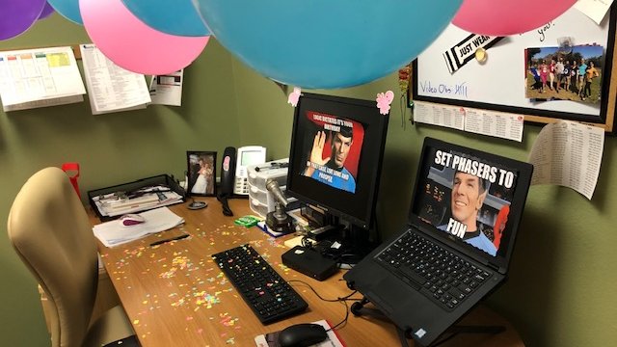

Slide 6
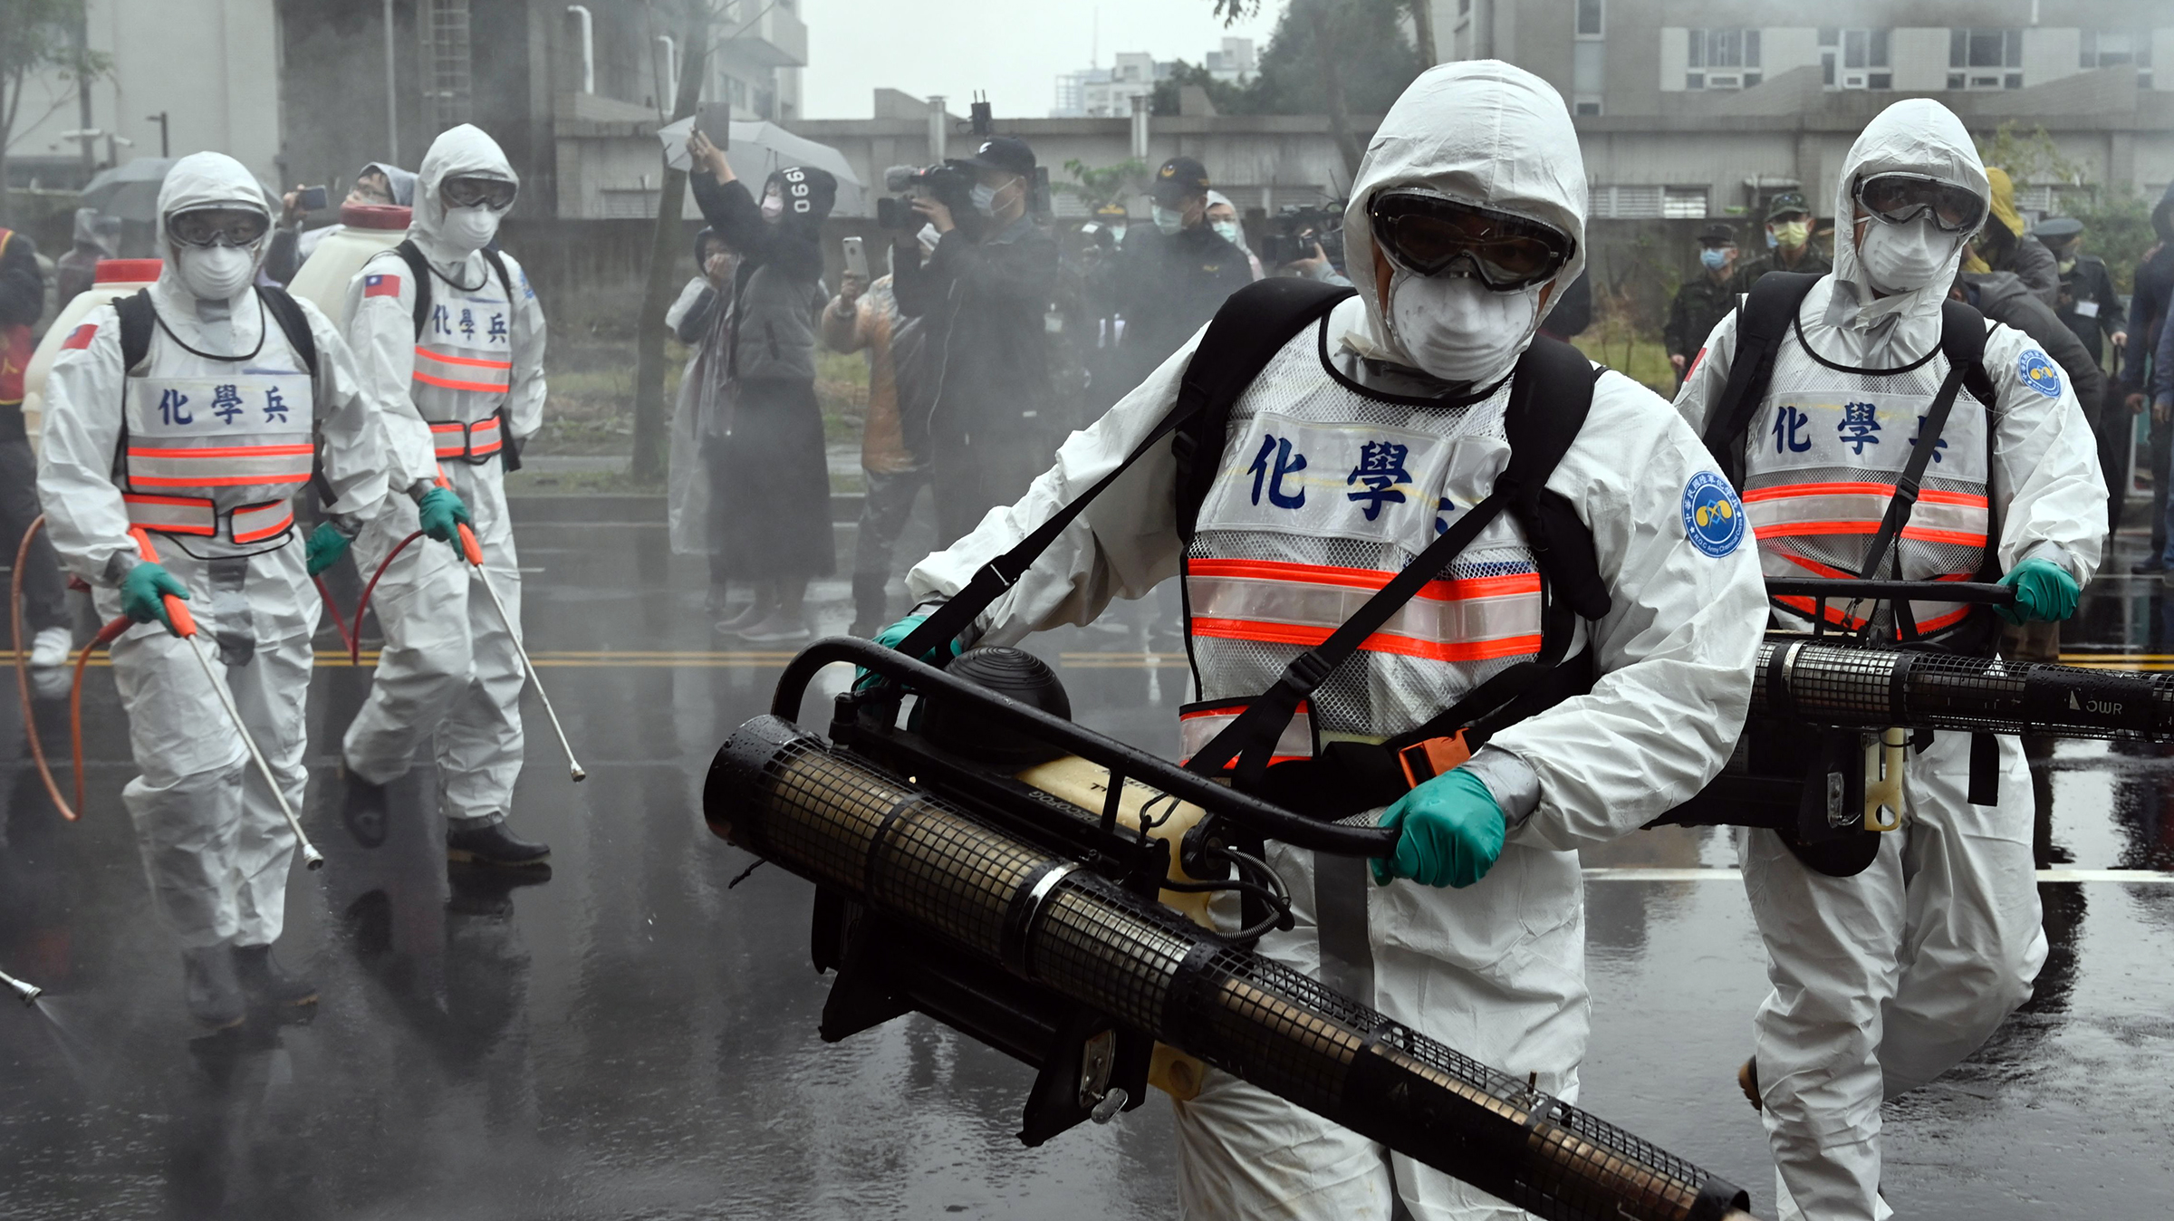
Notes:
March 11, 2020

Slide 7
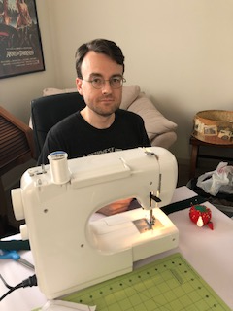
New world

Slide 8
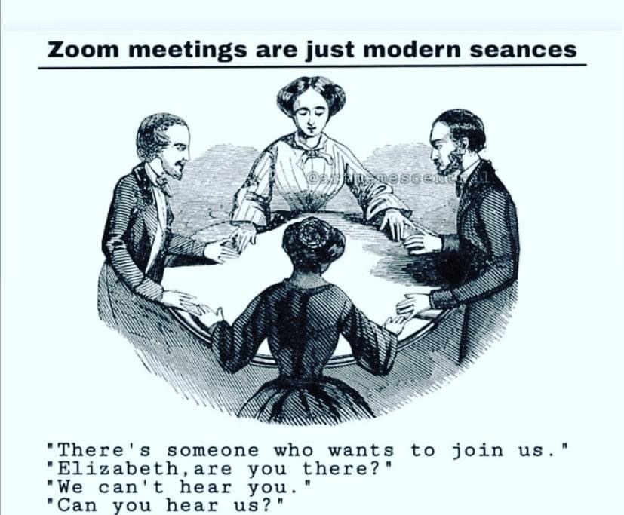

Slide 9
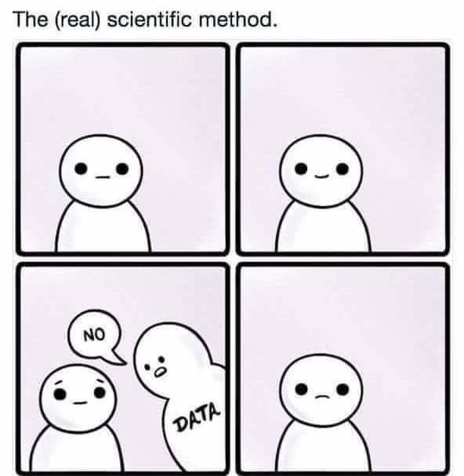

Slide 10
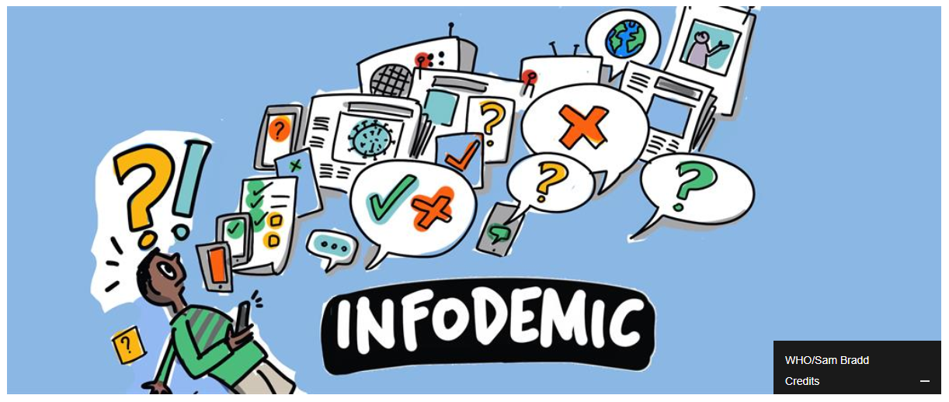
Notes:
World Health Organization: “Excessive amount of information about a problem, which makes it difficult to identify a solution.”
“They can spread misinformation, disinformation and rumours during a health emergency. Infodemics can hamper an effective public health response and create confusion and distrust among people.” — The United Nations Department of Global Communications (DGC), UN.org, 28 Mar. 2020
Misinformation and conspiracy theories have become increasingly prevalent since the start of COVID19 pandemic.
Lack of scientific and health literacy play a role, as does conspiratorial thinking, and purposeful and unintentional misinformation

Slide 11
Misinformation: false or inaccurate information
Disinformation: false information which is intended to mislead

Slide 12
Infodemic: Who Benefits?
Financial Gain:
Nutritional and “wellness” industries both invest heavily in and profit from anti-vaccination campaigns
Tech companies: Antivaccination content reaches 58 million online followers and generates $1 billion in revenue to tech
Political Gain:
Hungary: Prime Minister blamed Iranian students for the pandemic and George Soros for destroying Hungarian currency.
US: Pres Trump promotes unsafe or unproven treatments
Poland: State owned media claims opposition mayors enact policy that make the pandemic worse
Intellectual Conflict of Interest:
People with a strong core belief benefit from amplification of their message
Researchers promote material that is not peer reviewed
Notes:
Nutritional and wellness companies increase sales by casting doubt on traditional medicine and benefit from misinformation.
Source: https://www.counterhate.co.uk/anti-vaxx-industry?mc_cid=740d9a3543&mc_eid=6919eb05a1

Slide 13
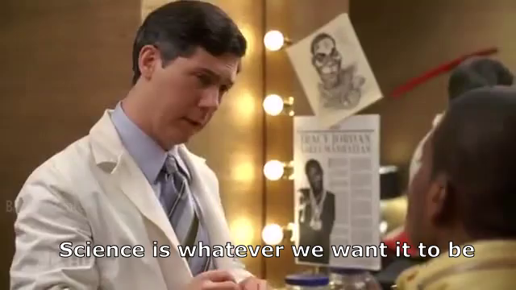
Medical infodemic
Immediate and widespread sharing of scientific information without vetting
Strong statements from healthcare professionals without evidence
Multiple credible seeming resources
Lack of EBM knowledge
Intellectual conflicts of interest

Slide 14
Social Media
Traditional Media
Political Leaders
Businesses
Healthcare professionals
Your Weird Uncle
Notes:
Amplified by many voices. Social media does not have any gatekeeping, allowing misinformation to spread easily. Consumers of conspiracy theories are more likely to “like” and share misinformation on social media.
For Zika, for example, Tweets about misinformation were 2x more common than debunking tweets

Slide 15
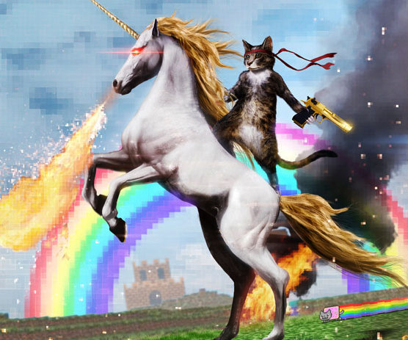
Notes:
Communication is different today than past: Internet, 24 hour news cycles
Mis and disinformation is EVERYWHERE. It spreads easily, quickly and is amplified
Health misinformation was viewed on Facebook 3.8 BILLION times in the 2020, and only 16% of the misinformation has a warning label
Types of misinformation: bogus cures (ex: Colloidal silver), Bill Gates backed a polio vaccine that causes paralysis, and quarantine “harms” public health
Social media platforms incentivize people to share content to get likes, comments, and other positive signals of engagement. These features help connect and inform people but reward engagement rather than accuracy, allowing emotionally charged misinformation to spread more easily than emotionally neutral content.
One study found that false news stories were 70 percent more likely to be shared on social media than true stories.
Algorithms that determine what users see online often prioritize content based on its popularity or similarity to previously seen content. As a result, a user exposed to misinformation once could see more and more of it over time, further reinforcing one’s misunderstanding. Some websites also combine different kinds of information, such as news, ads, and posts from users, into a single feed, which can leave consumers confused about the underlying source of any given piece of content.

Slide 16
Harms
Lower vaccination rates
Belief in false cures
Unsafe behaviors
Worsening health disparities
Poorer health outcomes
Lack of trust
Harassment and threats to public health and healthcare workers
Notes:
Brief exposure to COVID-19 vaccine misinformation made people less likely to want a COVID-19 vaccine.
Misinformation has also led to harassment of and violence against public health workers, health professionals, airline staff, and other frontline workers tasked with communicating evolving public health measures.

Slide 17
Conspiratorial Thinking

Slide 18
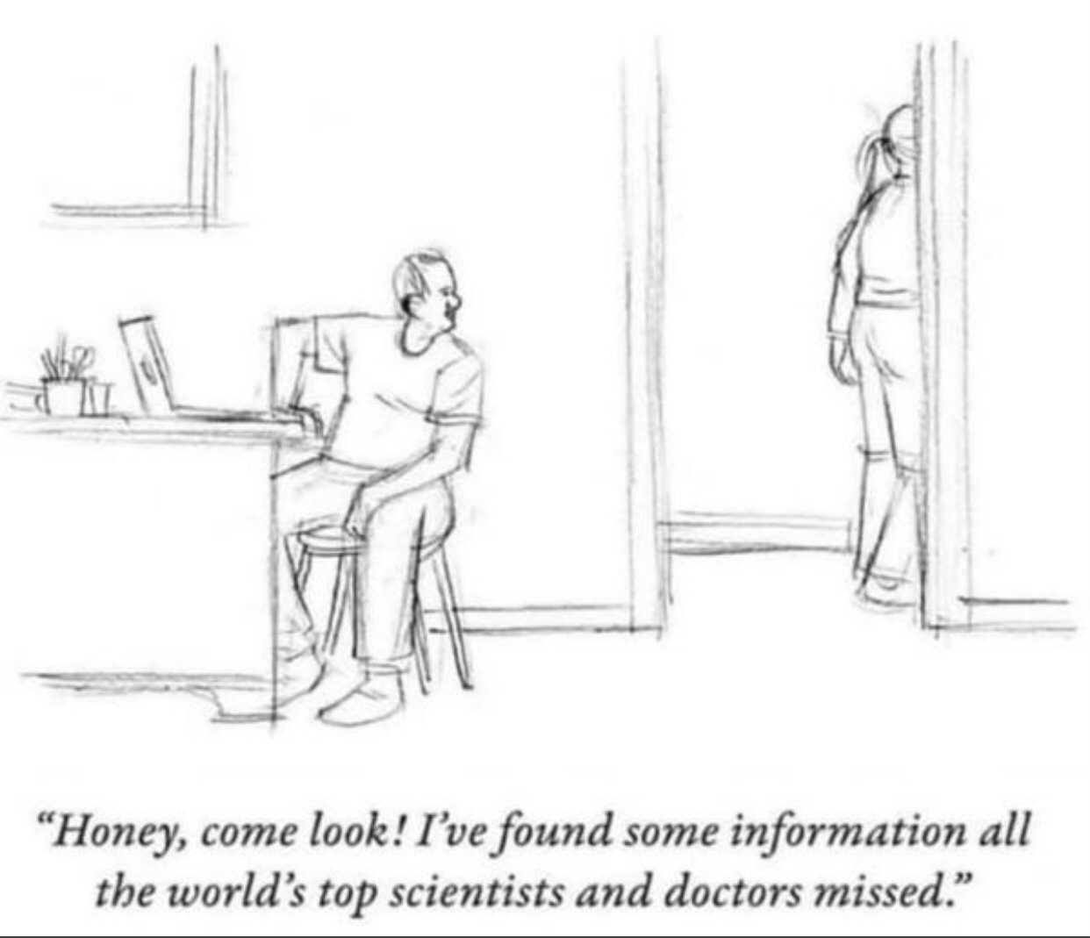

Slide 19
Conspiracy Theories
Provide comforting explanation during episodes of powerlessness, anxiety, uncertainty
Messaging around core emotions and values
Often use preexisting biases and prejudices
Social media amplifies
Feeds into confirmation bias and motivated reasoning
Highly effective
Notes:
“Conspiracy theorists also have an outsized influence despite their small numbers. An analysis of over 2 million comments on the subreddit site r/conspiracy found that while only 5% of posters exhibited conspiratorial thinking, they were responsible for 64% of all comments. The most active author wrote 896,337 words, twice the length of the Lord of the Rings trilogy!”

Slide 20
Conspiratorial Thinking
Notes:
Contradictory: Able to hold multiple contradictory beliefs at one time. Often, the commitment to believe the “official” account is stronger than believes a specific alternative explanation
Overriding suspicion: Extreme suspicion of the “official account”
Nefarious Intent: Motivations behind the situation are presumed to be nefarious
Something must be wrong: Convinced that “something” is wrong
Persecute victim: Often perceived and present themselves as victimized while at the same time the brave antagonist taking on the conspiracy
Immune to evidence: Evidence that counters the conspiracy is inherently seen as part of the conspiracy
Re-interpreting randomness: Belief that nothing occurs by accident
Source: https://www.climatechangecommunication.org/wp-content/uploads/2020/03/ConspiracyTheoryHandbook.pdf

Slide 21
Notes:
Interdisciplinary volunteer team of women comprised of researchers and clinicians with expertise in medicine, epidemiology, demography, health policy, economics, mental health, nursing, behavioral science, and immunology. We publish reliable, evidence based information about COVID-19, other health topicsm and information hygeine in simple, easy to understand language and concepts. We have six primary outlets for our content: our website, newsletter, Facebook, Twitter, Instagram, and Linkedin. We post 1-2 articles daily and cross post on each platform. Our messages short, focussed, and are amplified by our readership.

Slide 22
Origin Story
Notes:
The pandemic started out slowly, insidiously. People who were paying attention were rightly worried right away. I wasn’t one of them, by the way.
January 9th, the WHO announces a mysterious virus in China. By February, it was already in Iran, Italy, Spain, France, Germany, and the UK and by March 11 the WHO declares the COVID-19 pandemic. No one really understood what was happening. Information was changing daily and so rapidly it was impossible to keep up.
Malia Jones was an assistant profession at University of Wisconsin-Madison and researcher working at the intersection of infectious disease and social epidemiology, especially when it comes to infectious diseases and vaccines. She began to receive questions from friends and family about what was going on. What to do? How to stay safe? What does this all mean? So, she sent out an email with simple clear explanations of what was known and steps that could be taken. Lots of stuff she said was true, a lot of it wasn’t (it would turn out later) but it was the best available evidence at the time. People LOVED the concise, actionable message and starting forwarding it on to friends, like a chain letter of old. She was then asked to post it to Facebook and BAM! Internet celebrity. Her post went viral, so viral in fact she was invited on Dr. Phil.

Slide 23
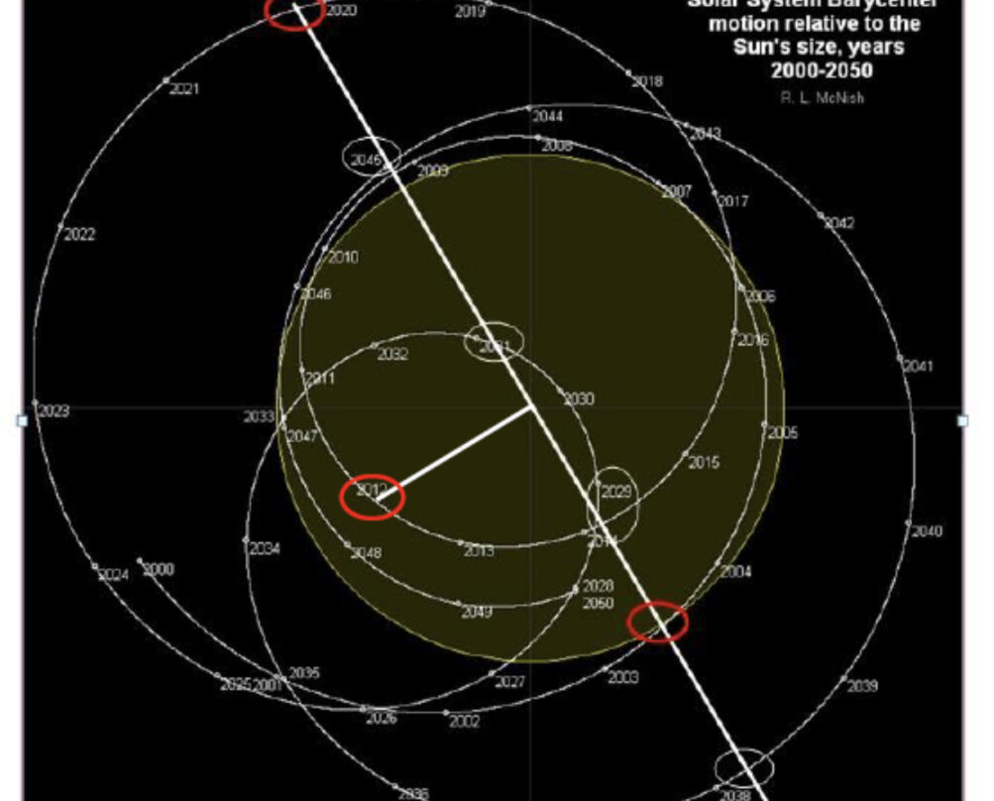
Huh?
Notes:
Her emails and socials became flooded with questions, concerns, and fears. And already misinformation and conspiracy theories. She was sent this star chart to prove…something? Something nefarious at least. She got a clipping of a Michael Chriton book to prove the virus was made in a lab. Allison Buttenhiem, social scientist who studies the behavioral aspects of infectious disease prevention, was also fielding questions on Facebook.

Slide 24
Notes:
They began to pull a team together, utilizing their network of women scientists and clinicians, and Dear Pandemic was born. By the end of March, the team include 10 PhD trained women. They jokingly referred to themselves as the Nerdy Girls. The name stuck.
How did I join? One of the Nerdy Girls was giving a townhall about misinformation to the AAFP. At the time, I was serving on the AAFP Commission on Health of the Public and Science and chaired the subcommittee on clinical policies and recommendations, which meant I was living and breathing COVID-19 not just in my clinical and educational roles, but in helping the AAFP building policy, clinical guidance, and reviewing the reams of data that were coming out daily to communicate what was good and what was not so good to family docs around the country. The AAFP CEO joked in the town hall that Dear Pandemic was missing a family doc and much to his surprise they said, “Yes we are! Know anyone?” That’s where I came in. I joined in August.

Slide 25
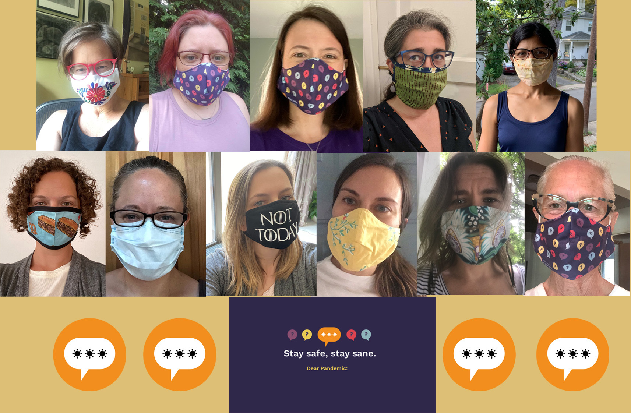

Slide 26
My Path to nerdy GirlDom

Slide 27
Dear Pandemic Stats
Over 5 million impressions/views per month
Over 200,000 users regularly follow on one of our outlets
Over 2000 questions answered
Querida Pandemia: >50K followers
Over 566 media appearances/interview
Selected to be in the Library of Congress Coronavirus Web Archive
Featured as Case Study by the World Health Organization “Innovative Concepts to Communicate Science”
Cited and featured in multiple journals, newspapers, media, community organizations, healthcare organizations

Slide 28
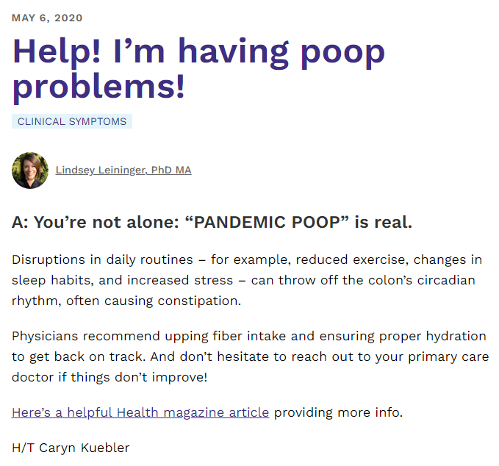
Notes:
This is the post that was entered in the Library of Congress

Slide 29
Notes:
Scales D, Gorman J, Jamieson KH. The Covid-19 Infodemic - Applying the Epidemiologic Model to Counter Misinformation. N Engl J Med. 2021 Aug 19;385(8):678-681. doi: 10.1056/NEJMp2103798. Epub 2021 May 12. PMID: 33979506.

Slide 30
Lessons Learned

Slide 31
Social media
Where the audience is
>100 million adults obtain health information online
Approximately 70% of adults make a decision about health based on online resources
Average person cannot find information sought 60% of the time
Timely
Daily content
Uses networks of individuals to spread messaging
Co-opt the tricks of misinformation for good
Yes. We read all the cringy stuff out there
Notes:
>100 million adults obtain health information online
Approximately 70% of adult consumers of healthcare reported making a decision about health based on online resources
Written Sources:
20% of below basic report getting information from the internet vs 42% basic vs 67% intermediate vs 85% proficient
Average person cannot find information sought 60% of the time

Slide 32
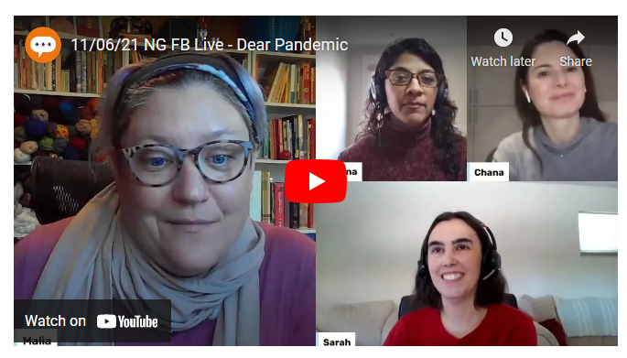
Two Way Communication
Readers can submit questions via Question Box
Many posts start with question and identify the asker
Communicate to the asker that we answered their question
Live videos where we take questions
Respond to comments on posts

Slide 33
Real Talk
Is Halloween canceled? How can I trick or treat safely?

Slide 34
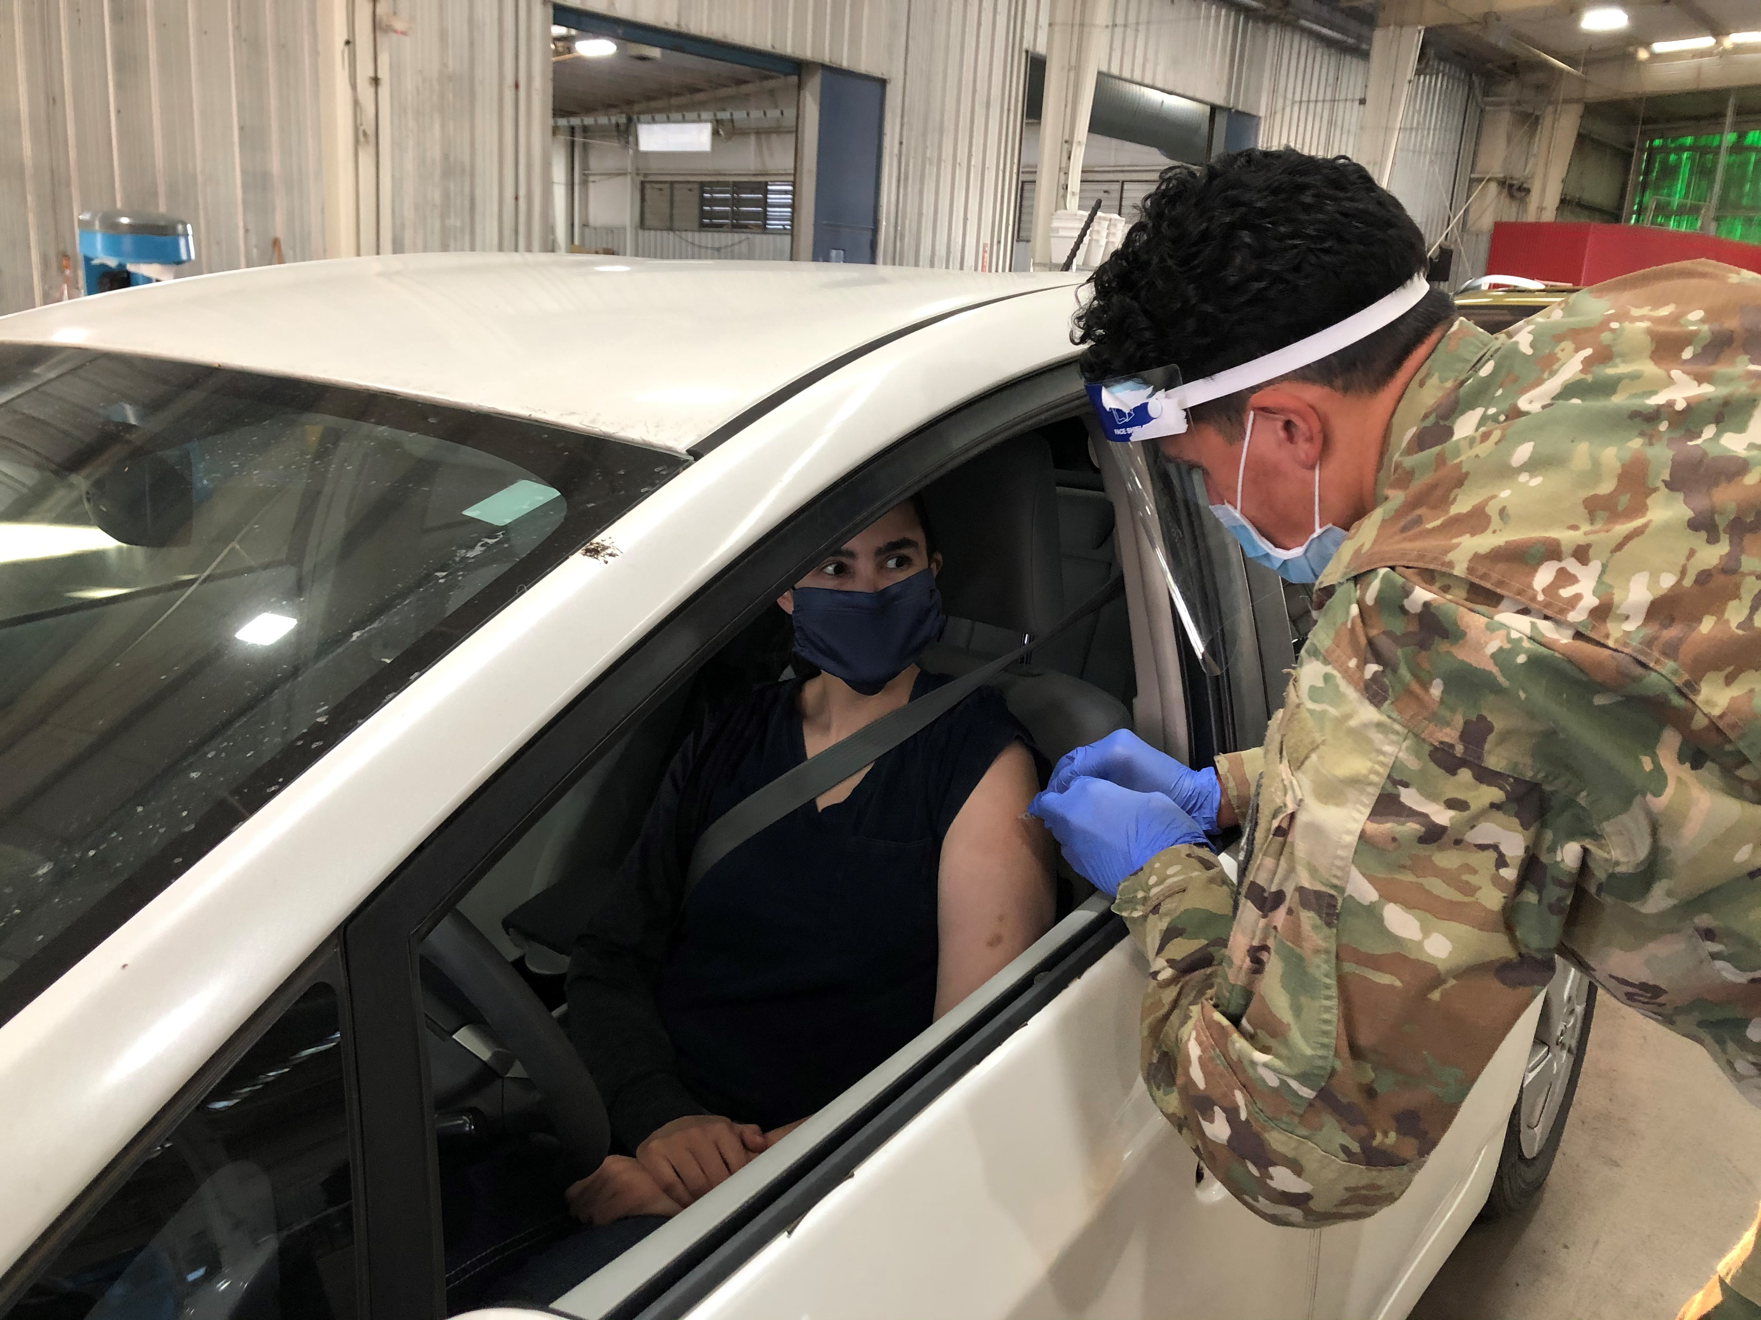
humanism

Slide 35
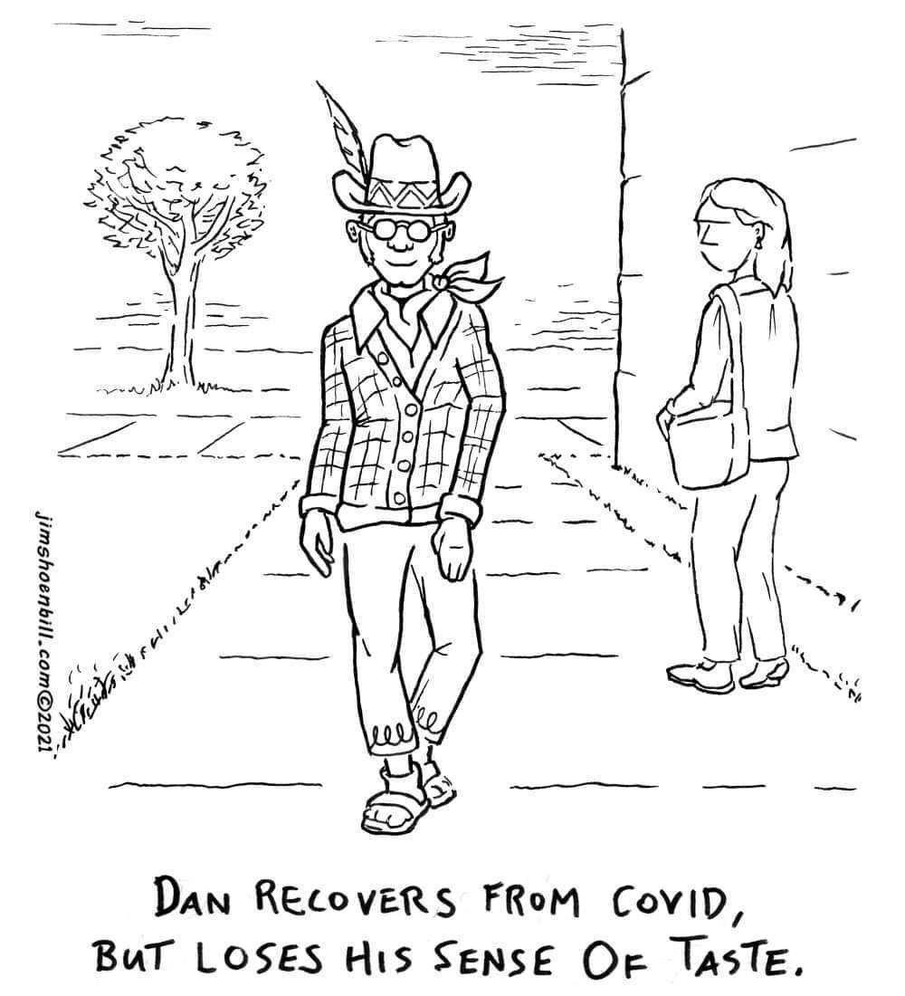
Humor
Captures attention
Effective at highlighting misinformation
Direct viewer to correct information embedded within the post
Marshal cognitive resources to “get the joke”
De-escalate strong emotions
Bolsters trustworthiness and likeability
Notes:
Sunday Funnies
Image Source: Creator: Jim Shoenbill | Credit: Jim Shoenbill via CartoonStock

Slide 36
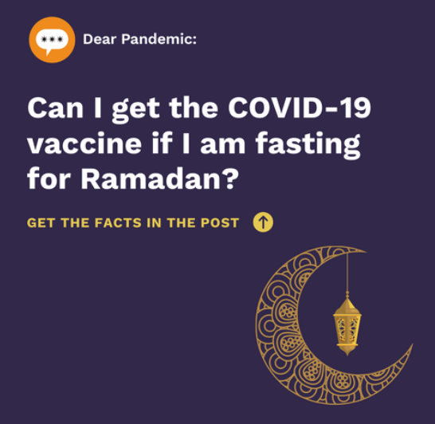
Cultural humility
Notes:
ASL interpreter for our videos

Slide 37
Trustworthy
Acknowledge uncertainty
Be transparent
Be timely
Easy to understand
Address affected populations
Partner with the community
Acknowledge uncertainty
Admit mistakes
Admit hard truths, even when it doesn’t support our preferred message
Non-partisan
Cite our sources
Revisit topics as information changes
Wide array of backgrounds

Slide 38
Prebunk
Attitudinal inoculation
Making people aware in advance that they might be misled
Effective at developing resilience to conspiracy theories
Teaches people about manipulative approaches using hypothetical example
Requires 2 steps:
Explanation of the threat, and refutation
More effective than debunking for vaccine conspiracy theories
Notes:
Research from Harvard University Emergency Preparedness, Research, Evaluation and Practice Program (EPREP) and American University showed that prebunking with a short, 30 second video caused participants to be more likely to recognize rhetorical strategies and reported lower support for sharing or supporting videos containing misinformation AND had a higher willingness to get the COVID-19 vaccine!
Manipulative approaches (like scapegoating, racist tropes, frightening images or music)
Piltch-Loeb R, Su M, Hughes B, Testa M, Goldberg B, Braddock K, Miller-Idriss C, Maturo V, Savoia E. Testing the Efficacy of Attitudinal Inoculation Videos to Enhance COVID-19 Vaccine Acceptance: Quasi-Experimental Intervention Trial; JMIR Public Health Surveill 2022;8(6):e34615. URL: https://publichealth.jmir.org/2022/6/e34615
2 step example: You might see things online pressure you not to get the COVID vaccine. They may make it sound like getting the vaccine will make you very sick. Actually, the vaccine is very safe and helps prevent severe illness and keep you out of the hospital if you got COVID.
Prebunking has been effectively utilized in messaging around alcohol use in teens, encouraging condom use, getting vaccines, and in non-healthcare areas (like climate change).

Slide 39
COVID misinformation
Trope or Strategy | Explanation
Corrupt Elites | Populist framing that corrupt elites are forcing lockdowns against the righteous and oppressed majority for gain
Sinister Origin | COVID was intentionally created in a “shadowy and suspicious” place. Government and intelligence agencies involved
Health Freedom | Co-opts language of choice (usually reproductive freedom language) and misapplies to vaccination. Frames public health as individual freedoms
Think of the Children! | Centered misinformation as campaign to protect children. Uses emotionally manipulative images
Do Your Own Research (DYOR) | States a conclusion and asks reader to DYOR.
Panic | Audio and visual cues intended to spark alarm
Notes:
Source: Hughes B, Miller-Idriss C, Piltch-Loeb R, Goldberg B, White K, Criezis M, Savoia E. Development of a Codebook of Online Anti-Vaccination Rhetoric to Manage COVID-19 Vaccine Misinformation. International Journal of Environmental Research and Public Health. 2021; 18(14):7556. https://doi.org/10.3390/ijerph18147556

Slide 40
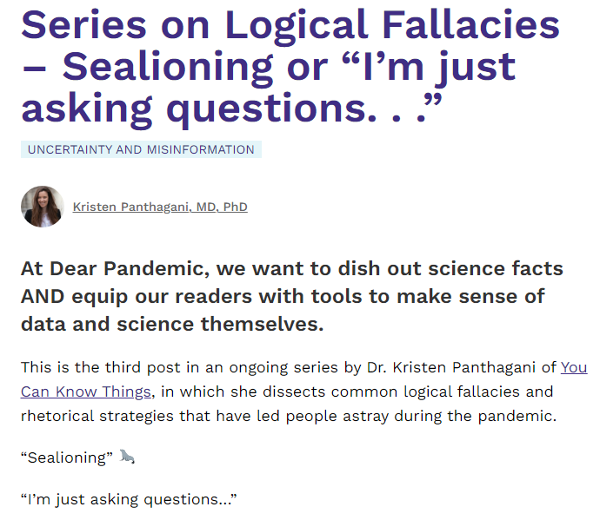
Notes:
Sealioning: This behavior, when repeated ad nauseum, is known as “sealioning,” where a person repeatedly asks questions or demands evidence, pretending to being engaged in honest enquiry, but refusing to be satisfied by any response provided. The goal is ultimately to spread doubt through questions and/or harass the person who is being questioned to the point of exhaustion, all while maintaining a pretense of humble enquiry.

Slide 41
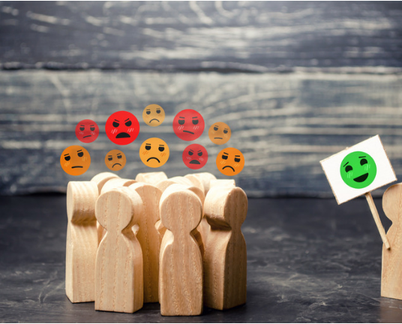
Debunk
Exposes a claim as being false or exaggerated
Fact-checking
Time consuming, reactive, resource heavy, and requires individual work
Notes:
Debunking is time intensive, resource heavy requires individual attention, and precision

Slide 42
Strategies
Fact Based
Logic Based
Source Based
Empathy Based
Notes:
Example: Microchips in a vaccine.
Fact based: There are no microchips in a vaccine
Logic based: Microchips are too big to fit into a vaccine and the government can already track your phone
Source Based: The WHO says there are no microchips in a vaccine
Empathy based: It must be very scary to think there are microchips in a vaccine, but I’m comforted that there are not.

Slide 43
Health literacy
25% of the population has limited literacy (<5th grade)
Average reading level is 8th grade.
12% have proficient health literacy
55% have limited numeracy

Slide 44
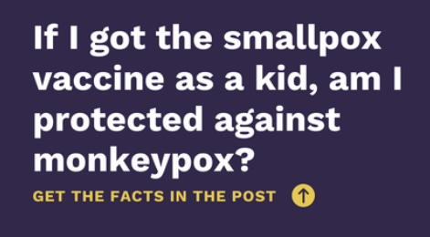
Written posts
Use plain language
< 8th grade reading level
Avoid jargon
Focus on 2-3 key messages and repeat them
Provide clear and simple information
Emphasize actionable things
Tailor information to audience
Cognizant of framing effects
Person first language
Write like we talk with our unique voices

Slide 45
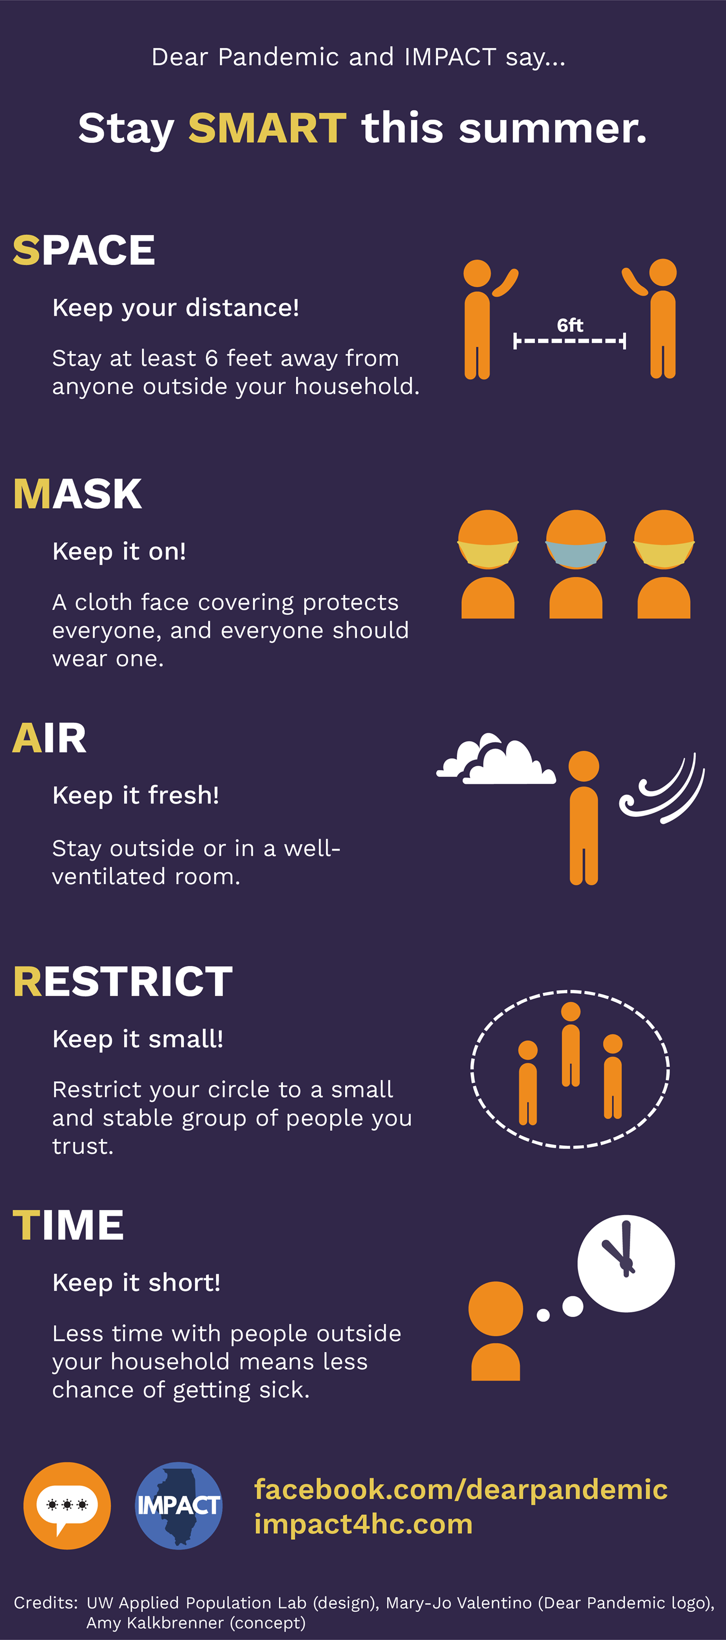
Empower Others
Encourage to think analytically
Affirm value critical thinking
Show empathy
Do not ridicule
Link to good resources
Notes:
Affirm Critical Thinking: Conspiracy theorists believe that they are critical thinkers who are not “tricked” by the official account

Slide 46
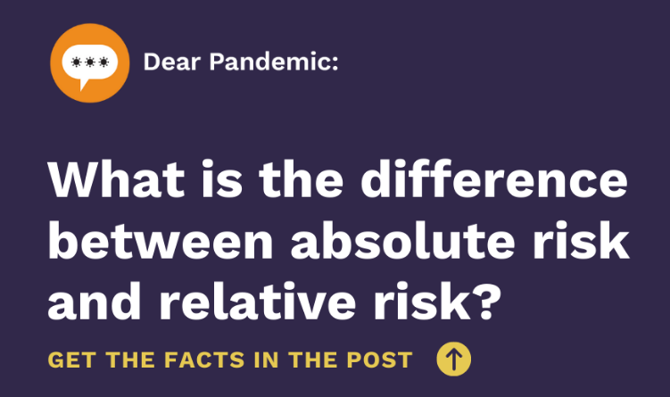
Equip our community
Promote skills
Information hygiene
Health literacy
Numeracy
Skeptical inquiry
Encourage engagement and contribution
Participate in community training events

Slide 47
equity
Women have unequal burden in the pandemic
Goal: give visibility to women scientists and the important role they can take in science translation
Initially, all white women
Recruited actively for diverse backgrounds, culture, race, ethnicity, belief systems

Slide 48
Support each other
We preview and review each others' posts
Slack channel
Brought together a “Nerdy Neighborhood” of fellow science communicators who speak to online and geographic communities across North America, South America, and Europe
Regular zoom meetings and virtual happy hours
Sharing our triumphs and challenges
No trolls allowed!

Slide 49
Challenges
All volunteer
Investing time and expertise into Dear Pandemic takes away from “productive” time or personal time
Need advocacy to promote science and health communication as integral work that is compensated

Slide 50
Summary of Strategies: Let’s Learn
Strategy | Implementation
L- Listening and Empathy Come First | Question and answer format builds rapport Allows content to be centered around needs of the readers/community Use empathy first communication style
E- Engage Partner | Find the right messenger Collaborate and seek info outside of your bubble (“Nerdy Neighborhood”) Identify partners with shared goals
T- Transparency is Non-negotiable | Cite sources Admit to errors or changing information Normalize ambiguity
S- Source and Vet Data Rigorously | Peer review each other’s posts Provide references Provide training on science literacy and critical thinking
LEARN | Learning science tactics by looking, examples, analogies, rules, and narratives

Slide 51
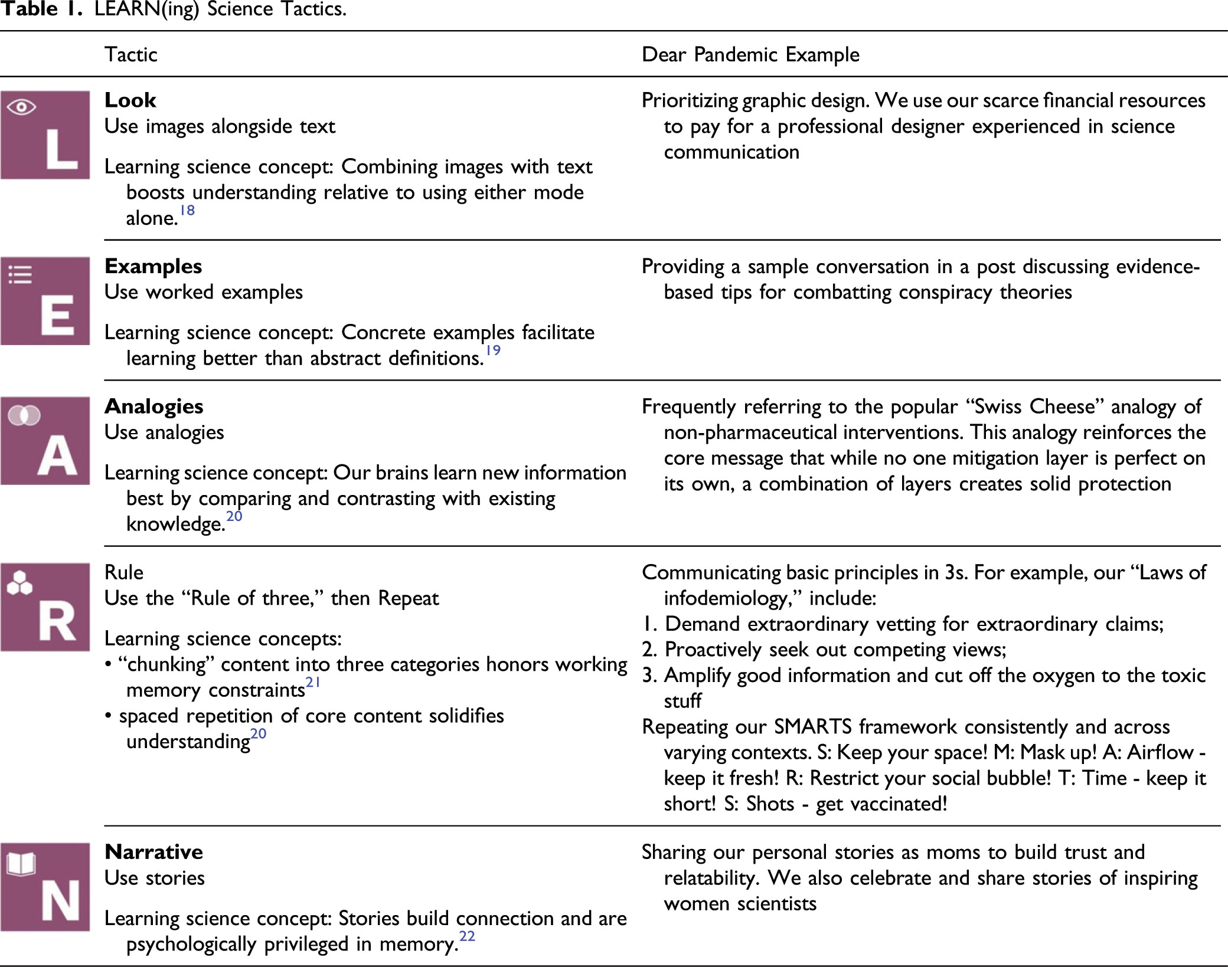

Slide 52
Let’s talk about you

Slide 53
Resources
Dearpandemic.org
Leininger LJ, Albrecht SS, Buttenheim A, et al. Fight Like a Nerdy Girl: The Dear Pandemic Playbook for Combating Health Misinformation. American Journal of Health Promotion. 2022;36(3):563-567. doi:10.1177/08901171211070956
Centers for Disease Control and Prevention. Risk Communication. https://www.cdc.gov/healthcommunication/risks/index.html#:~:text=Virtually%20every%20day%2C%20crisis%20and,their%20health%20and%20well%2Dbeing.
Communicating risk in public health emergencies: a WHO guideline for emergency risk communication (ERC) policy and practice. Geneva: World Health Organization; 2017. Licence: CC BY-NC-SA 3.0 IGO.
Conspiracy Theory Handbook: https://www.climatechangecommunication.org/wp-content/uploads/2020/03/ConspiracyTheoryHandbook.pdf
Scales D, Gorman J, Jamieson KH. The Covid-19 Infodemic - Applying the Epidemiologic Model to Counter Misinformation. N Engl J Med. 2021 Aug 19;385(8):678-681. doi: 10.1056/NEJMp2103798. Epub 2021 May 12. PMID: 33979506.
Hughes B, Miller-Idriss C, Piltch-Loeb R, Goldberg B, White K, Criezis M, Savoia E. Development of a Codebook of Online Anti-Vaccination Rhetoric to Manage COVID-19 Vaccine Misinformation. International Journal of Environmental Research and Public Health. 2021; 18(14):7556. https://doi.org/10.3390/ijerph18147556
Piltch-Loeb R, Su M, Hughes B, Testa M, Goldberg B, Braddock K, Miller-Idriss C, Maturo V, Savoia E. Testing the Efficacy of Attitudinal Inoculation Videos to Enhance COVID-19 Vaccine Acceptance: Quasi-Experimental Intervention Trial; JMIR Public Health Surveill 2022;8(6):e34615. URL: https://publichealth.jmir.org/2022/6/e34615
Pierri, F., Perry, B.L., DeVerna, M.R. et al. Online misinformation is linked to early COVID-19 vaccination hesitancy and refusal. Sci Rep 12, 5966 (2022). https://doi.org/10.1038/s41598-022-10070-w
Office of the Surgeon General (OSG). Confronting Health Misinformation: The U.S. Surgeon General’s Advisory on Building a Healthy Information Environment [Internet]. Washington (DC): US Department of Health and Human Services; 2021. PMID: 34283416.
https://cdn.who.int/media/docs/default-source/science-translation/case-studies-1/cs10_dearpandemic.pdf?sfvrsn=c17f16ce_4

Slide 54
THANK YOU
Sarah Coles, MD FAAFP
scoles@nchcaz.org
@sarahmwc
Dearpandemic.org

Slide 55
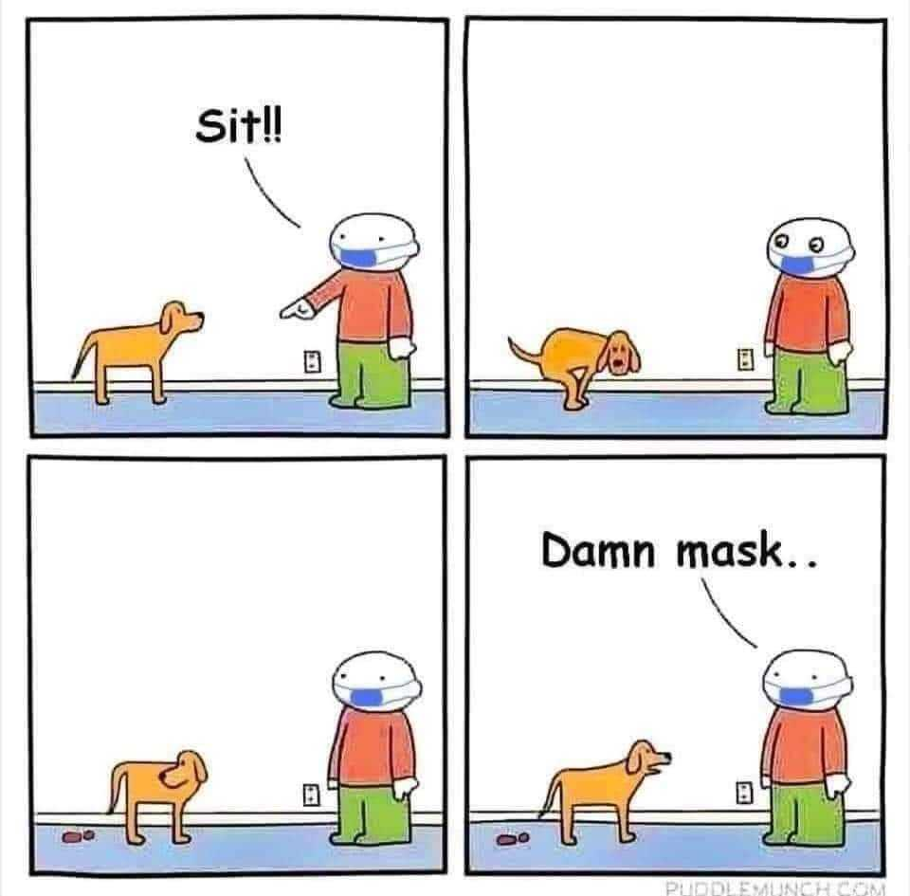
Questions?

