Slide 1
Teaching Lifestyle Medicine with an Interdisciplinary and Interprofessional Team
Ruben Hernán Hernández Mondragón, MD
Tamika Dawson, MD
Emilee Delbridge PhD
Rachael Hiday PharmD, MBA
Logan Guckien, MD

Slide 2
NOTHING TO DISCLOSE

Slide 3
LEARNING OBJECTIVES
Define the lifestyle medicine competencies for primary care and how to create an interdisciplinary and inter professional team
Apply the knowledge of Motivational Interviewing from the behavioral curriculum and integrated to Healthy lifestyle medicine
Compare evaluation tools to assess learning objectives for lifestyle medicine including case discussions and creating a complete healthy lifestyle medicine prescription plan
Identify opportunities within the medical curriculum to integrate some of the lifestyle medicine concepts and create learning alternatives to the learners

Slide 4
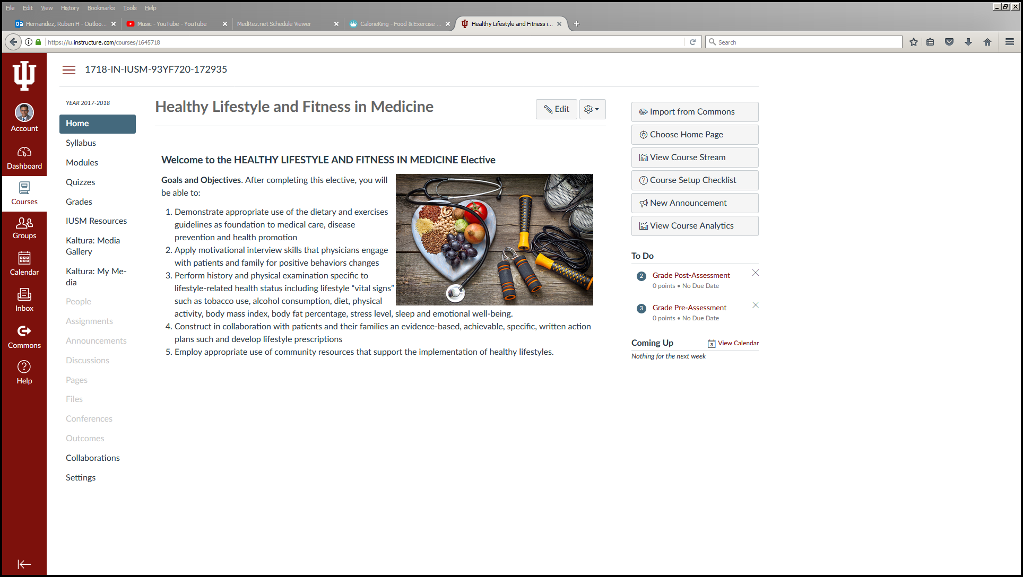

Slide 5
LIFESTYLE MEDICINE COMPETENCIES
LEADERSHIP
KNOWLEDGE
ASSESSMENT SKILLS
MANAGEMENT SKILLS
OFFICE AND COMMUNITY SUPPORT

Slide 6
 | Monday | Tuesday | Wednesday | Thursday | Friday
AM | Orientation | Nutrition | Counselling Session | Fitness | Sports Medicine
PM |  | Nutrition | Self Directive Learning | Fitness | Sports Medicine
 | Monday | Tuesday | Wednesday | Thursday | Friday
AM | Family Medicine | Nutrition | Counselling Session | Fitness | Clinical Pharmacy
PM | Family Medicine | Nutrition | wellness | Fitness | Clinical Pharmacy
 | Monday | Tuesday | Wednesday | Thursday | Friday
AM | Family Medicine | wellness | Counselling Session | Fitness | Sports Medicine
PM | Family Medicine | wellness | Self Directive Learning | Fitness | Sports Medicine
 | Monday | Tuesday | Wednesday | Thursday | Friday
AM | Family Medicine | Clinical Pharmacy | Counselling Session | Fitness | End of Elective
PM | Family Medicine | Clinical Pharmacy | wellness | Fitness | Project Presentation

Slide 7
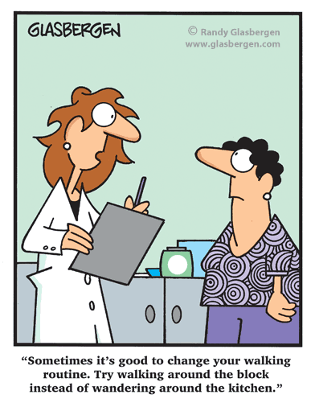
COACHING HEALTH BEHAVIORS MOTIVATIONAL INTERVIEWING

Slide 8
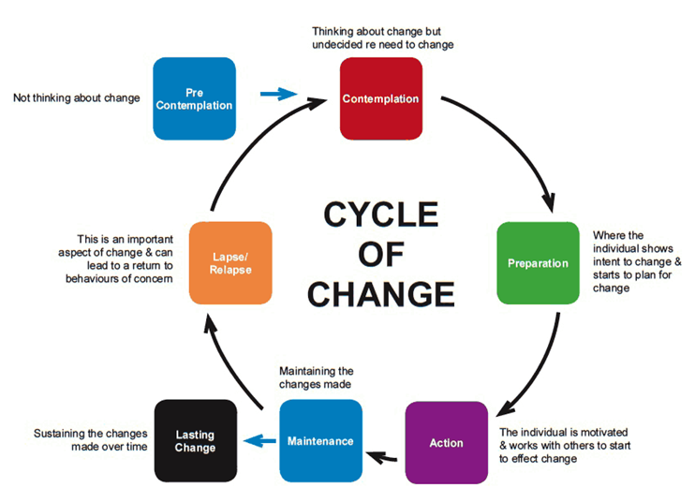
The What
Motivational Interviewing Theory & Skills
Process of change
Applied, experiential
Counseling Skills
Supportive
Change-focused

Slide 9
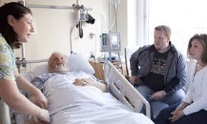
The Where
Integrated Behavioral Health
Counseling Sessions
Learner & Provider
Inpatient Teaching & Rounding
Monthly topics specific to IP
Patient care & Resident feedback
Debrief

Slide 10
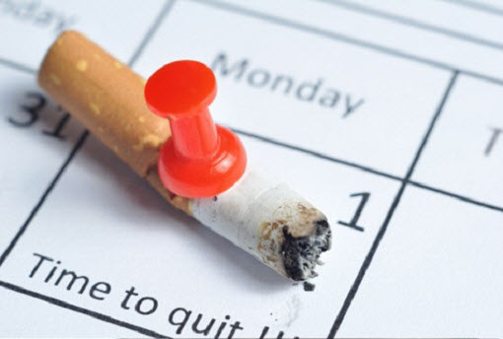
NUTRITION AND SMOKING CESSATION

Slide 11
Nutrition and Smoking Cessation
See a variety of patients for T2DM, cardiovascular risk reduction, and smoking cessation
Educate patients on healthy eating habits
Go through every meal with patient
Teach carb counting then apply to current diet
Help patient determine appropriate alternatives
DASH diet (limiting sodium)

Slide 12
Nutrition and Smoking Cessation
Smoking cessation
Assessing readiness to quit
Apply motivational interviewing skills
Educate patients on pharmacologic agents available to assist with quitting
Discuss triggers/barriers to quitting or staying smoke free
Help to determine ways to mitigate
Determine appropriate follow up

Slide 13
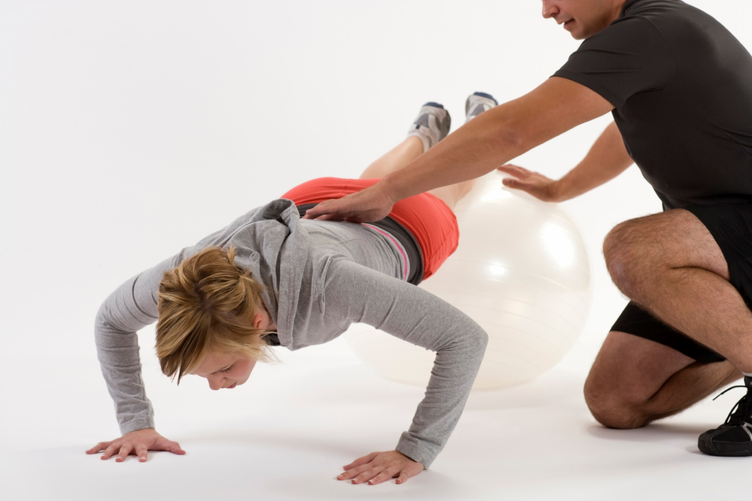
SPORTS MEDICINE Musculoskeletal Assessment

Slide 14
Musculoskeletal Assessment
Know your limitations:: ie. Knee pain, Back pain.
Start with the basics… Walk before you run
American College of Sports Medicine (ACSM) recommends a minimum of 150 min wk of moderate-intensity PA for overweight and obese adults to improve health; however, 200-300 min wk( was recommended for long-term weight loss

Slide 15
Musculoskeletal Assessment
Treat joint issues as they arise with conservative measures first
Consider getting a trainer to help modify.
Remember to listen to your body!!!

Slide 16
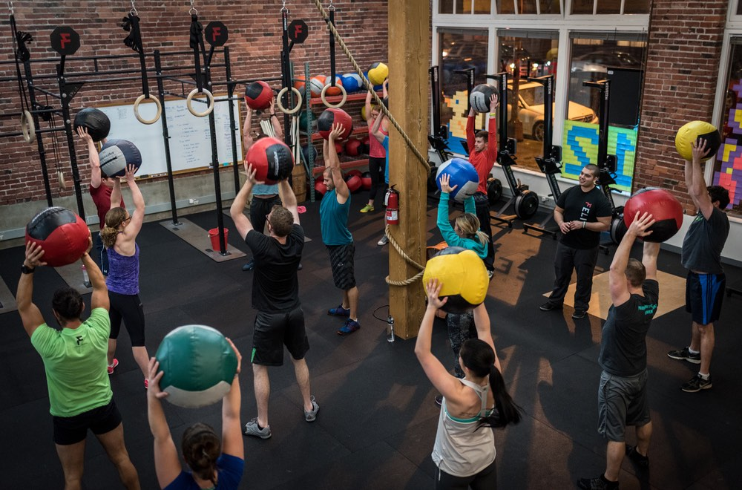
FITNESS TRAINER Nutrition and Physical Activity

Slide 17
RESULTS

Slide 18
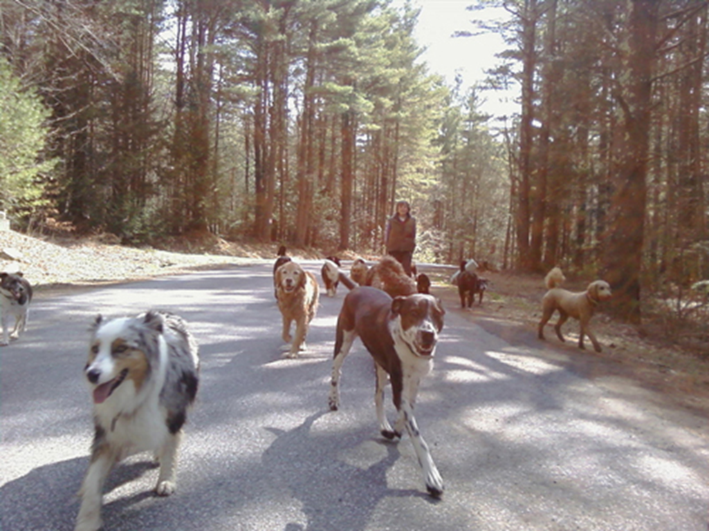
My Experience……..

Slide 19
Results
Question: Has this course been effective at improving medical student comfort with the subject of healthy lifestyle and fitness in the clinical setting?
Study design: Prospective cohort and cross sectional
Group: 6 medical students taking the elective
Methods: Pre and post-assessment surveys

Slide 20
Questions
Pre and post-survey
As a result of this elective I am prepared to discuss the current Dietary Guidelines for the Americans with patients
As a result of this elective, I am prepared to use motivational interviewing skills to engage patient’s on positive behavioral changes
As a result of this elective, I am prepared to calculate body fat percentage with a patient
As a result of this elective, I am prepared to construct a lifestyle prescription plan with a patient that requires lifestyle modification actions
As a result of this elective, I am familiar with the available resources within the community to provide healthy lifestyle support and education

Slide 21
Post-survey only
The information in this learning experience was useful to my future work as a physician
This elective was a worthwhile investment of my time
My medical knowledge on dietary and exercise guidelines will improve as a result of completing this elective
I would recommend this learning unit be used with future medical students
How much new information did you learn from this learning experience?

Slide 22
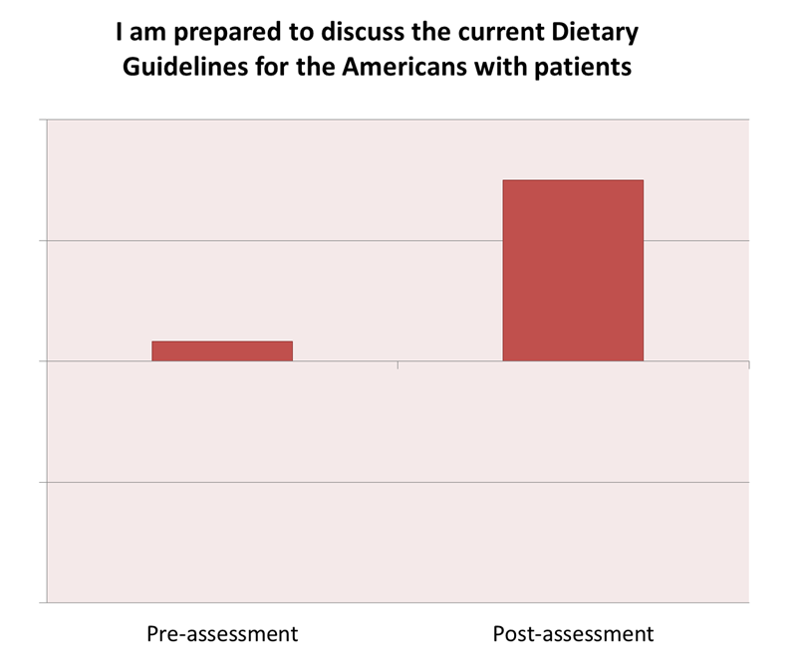
Strongly
Agree
Agree
Undecided
Disagree
Strongly
Disagree

Slide 23
Strongly
Agree
Agree
Undecided
Disagree
Strongly
Disagree

Slide 24
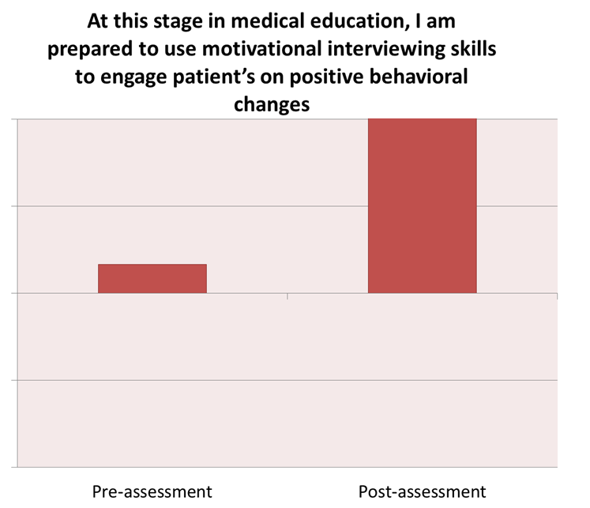
Strongly
Agree
Agree
Undecided
Disagree
Strongly
Disagree

Slide 25
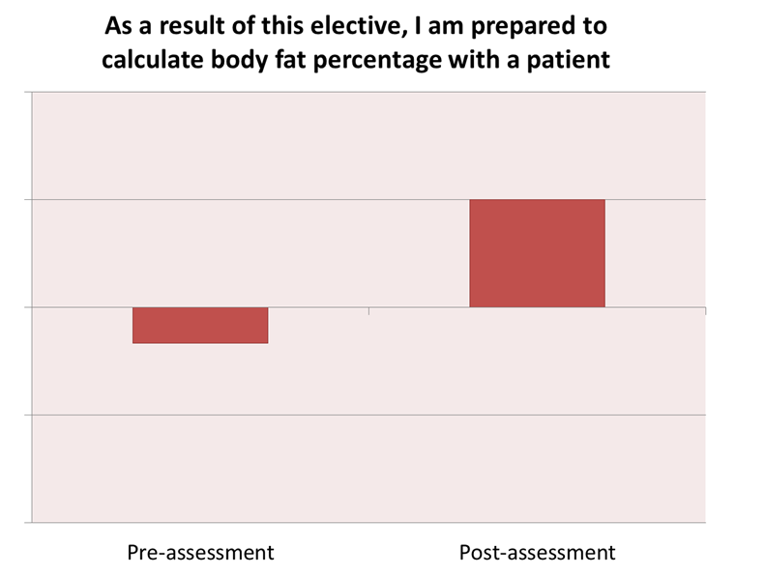
Strongly
Agree
Agree
Undecided
Disagree
Strongly
Disagree

Slide 26
Strongly
Agree
Agree
Undecided
Disagree
Strongly
Disagree

Slide 27
Strongly
Agree
Agree
Undecided
Disagree
Strongly
Disagree

Slide 28
Post-Assessment Only
 | Useful to future work as a physician | Worthwhile investment of time | Improved medical knowledge on dietary/exercise guidelines | Would recommend this unit for future students | How much new info did you learn
Strongly Agree | 6 | 5 | 4 | 5 | -- | --
Agree | 0 | 1 | 2 | 1 | 5 | Learned a great deal
Undecided | 0 | 0 | 0 | 0 | 1 | Learned a few new things
Disagree | 0 | 0 | 0 | 0 | 0 | Did not learn anything
Strongly Disagree | 0 | 0 | 0 | 0 | -- | --

Slide 29
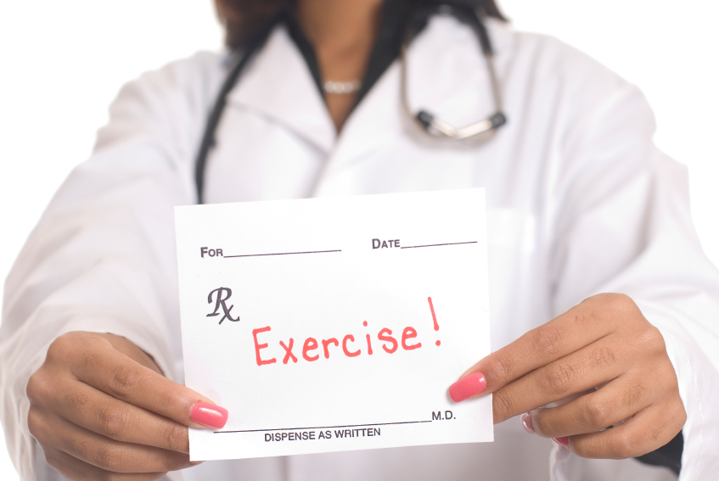
END OF ROTATION LIFESTYLE MEDICINEPRESCRIPTION PLAN

Slide 30
Course Assignment Healthy Lifestyle and Fitness in Medicine
The purpose of this assignment is to create a Lifestyle prescription plan to patient.
You will select a patient at the beginning of the course and perform a complete History and physical examination.
Apply the knowledge and skills learned from the Evidence based guidelines and the different multi-specialized instructors of the course to create a Dietary and Exercises plan.
Follow the patient for the course of 3 weeks and monitor progress providing motivational coaching, this can be done face to face or my phone.
At the end of the elective you will present a 10-15 minute PowerPoint presentation to the course directors and submit your presentation to the canvas site.

Slide 31
To complete the assignment you can answer the following questions about your patient:
Patient’s demographics: initials, age, gender, ethnicity.
Patient’s medical history (special attention on patient’s lifestyle change goal, past medical history, social history with especial interest in stress management, social support, detailed diet, exercises routine, sleep pattern, social, alcohol and or illicit drug consumption)
Patient’s physical exam, with special attention on BMI, body fat percentage, musculoskeletal range of motion and psychological description
Assessment. Attention to patient’s stage of readiness in modification of the lifestyle, strengths and limitations to achieve the goals created by the patient
What was the prescription plan created? Including diet recommendations, exercises routine, stress management techniques and appropriate resources provided

Slide 32
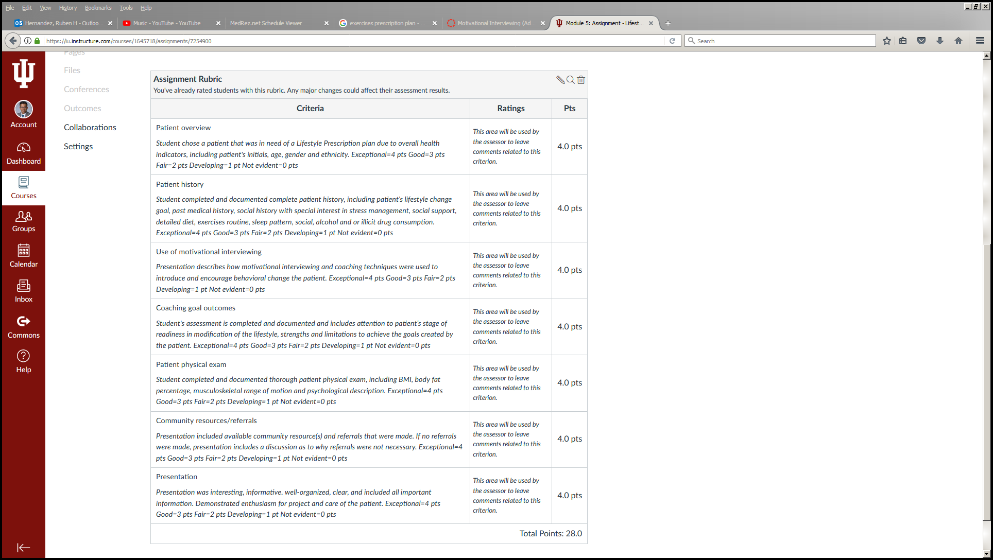

Slide 33
Questions? ruhernan@iupui.edu

