Slide 1
MENTORSHIP: Creating a Culture of Inclusivity
Jennifer Edgoose, MD, MPH; Melissa Stiles, MD;
Kacia Stevenson; Kjersti Knox, MD;
Ronni Hayon, MD; Sarina Schrager, MD, MS;
Andrea Martonffy, MD; Thomas Hahn, MD

Slide 2
Objectives
Describe mentorship as a tool to enhance inclusivity.
Apply the Mentorship Toolkit as a resource to support both mentors and mentees.
Explore how to expand and nurture mentorship in your institutions.

Slide 3
Disclosures
We have no disclosures.

Slide 4
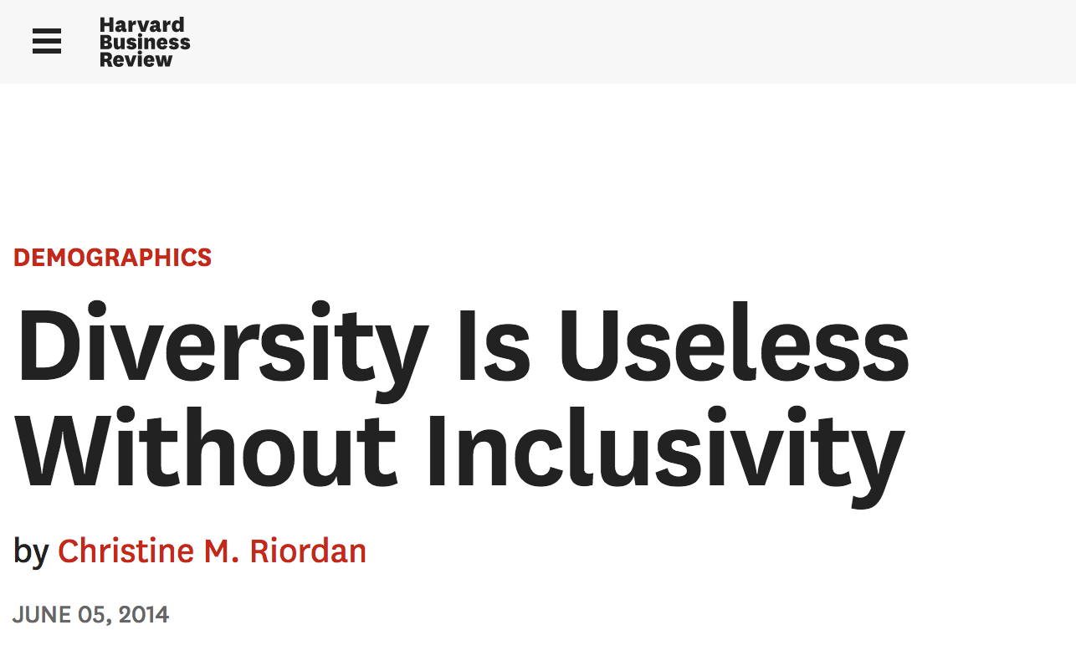

Slide 5
Inclusivity
The practice or policy of including people who might otherwise be excluded or marginalized, such as those who have physical or mental disabilities and members of minority groups.
https://en.oxforddictionaries.com/definition/us/inclusivity

Slide 6
Not merely being a member of a group
Not nationalism
Not nativism
Not merely being “part of the club”
Notes:
Nativism is the political policy of promoting the interests of native inhabitants against those of immigrants.

Slide 7
“Othering” and Belonging
“OTHERING”
BELONGING
“Othering” is a term that encompasses the many expressions of prejudice on the basis of group identities, and also provides a clarifying frame that reveals a set of common processes and conditions that propagate group-based inequality and marginality.
Belonging means more than just being seen. Belonging entails having a meaningful voice and the opportunity to participate in the design of social and cultural structures. Belonging means having the right to contribute to, and make demands of the group.
http://www.otheringandbelonging.org/editors-introduction/

Slide 8
Mentorship: Categories and Roles

Slide 9
Coach
“Coaching is unlocking a person’s potential to optimize their own performance. It is helping them to learn rather than teaching them.”
Whitmore, 2002

Slide 10
Advisor
“…..to give an opinion or suggestion to someone about what should be done “

Slide 11
Mentor
“ A trusted counselor or guide”
Notes:
The word was inspired by the character of Mentor in Homer’s Odyssey
The goddess Athena takes on his appearance in order to guide young Telemachus in his time of difficulty
The word mentor originates from Homer’s famous poem, The Odyssey. Mentor was an extremely wise man who supported and guided Telemachus on the search for his father, Odysseus. In Greek, mentor literally means “to endure”—to last through the ages.¹ In modern English, it is “a trusted counselor or guide.”²

Slide 12
COACH | ADVISOR | MENTOR
Establishes Goals | Task Specific Expertise | Broad Professional Expertise
Skill Development | Shorter duration of relationship | Longitudinal
Creates a Process of Discovery | Trust is implicit at the start | Trust Develops over time
Role Model | Professional only | Deeply Personal
 | Evaluator | Advocate
 | Residency Planner | Career Guide
Notes:
Roles blur---change over time

Slide 13
Mentorship Mapping

Slide 14
What is mentor mapping?
An opportunity to map mentors in different parts of your professional life and identify the roles they play.

Slide 15
Why mentor map?
Identify mentors who may have not realized are mentors
Identify people you want to have as a mentor
Identify areas that you are lacking in mentorship

Slide 16
How to mentor map
For each category of mentors, list your mentors.
You can make notes about how often you meet with that mentor or how they specifically help

Slide 17
How to mentor map
It is okay to:
List more than 1 mentor per category
List the same mentor under multiple categories
Leave a category blank if you don’t have mentors
List mentors outside of the DFM
Think of mentors for categories not listed

Slide 18
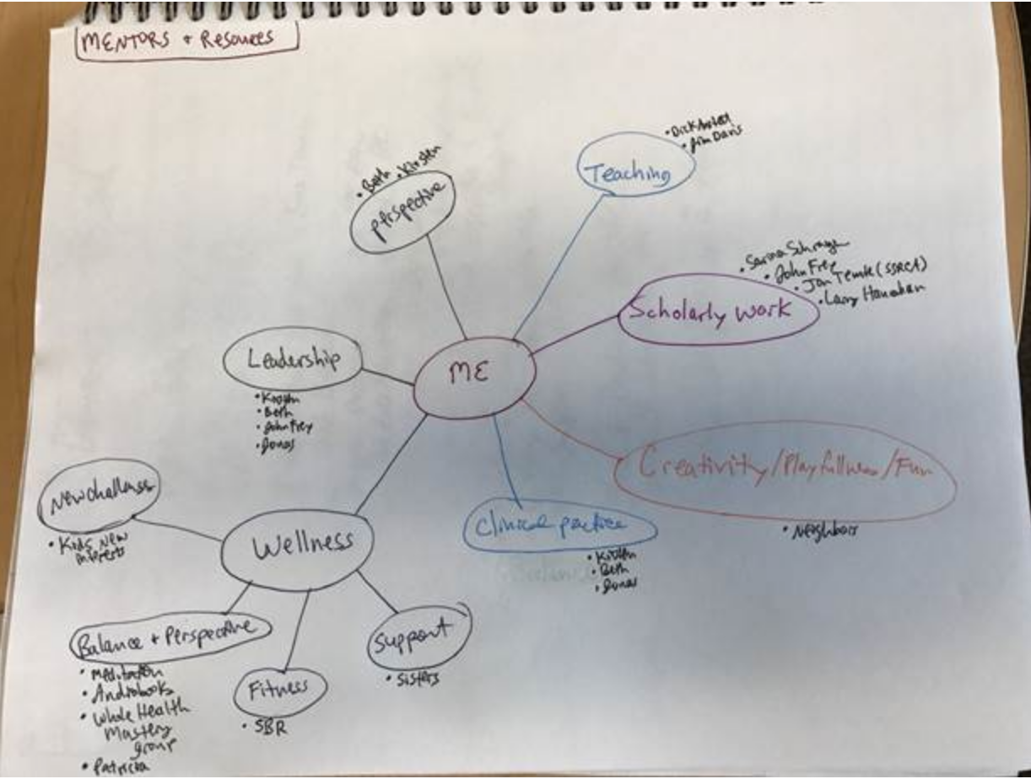
https://www.insidehighered.com/sites/default/server_files/files/Mentoring%20Map%5B1%5D(1).pdf
Notes:
https://www.insidehighered.com/sites/default/server_files/files/Mentoring%20Map%5B1%5D(1).pdf

Slide 19
Using the toolkit: Case studies

Slide 20
Our framing
Mentorship consists ideally of a “reciprocal, dynamic relationship between mentor and mentee that promotes the satisfaction and/or development of both.” (McGee, 2016)
Strong mentoring relationships that strive to mentor across difference have the potential to be transformative for mentor and mentee alike.
Mentorship can promote a more inclusive environment and can promote diversity.

Slide 21
A Framework

Slide 22
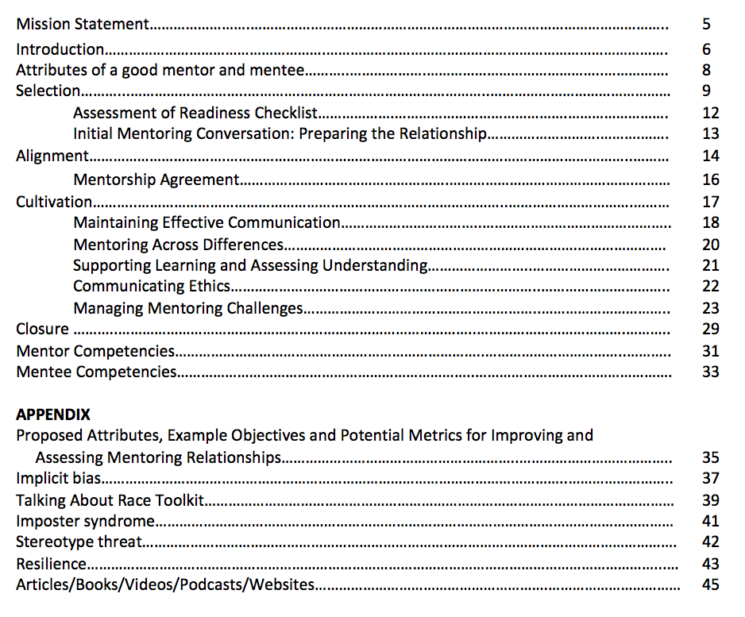
Table of Contents

Slide 23
Case 1
You are a new faculty member and have been assigned one of the first year residents as your new clinical advisee. You are excited to get to know her and invite her for lunch.
What could you consider before your luncheon?

Slide 24
Here is a template to consider: You could share this with your mentee in advance too (For example, mentees should think about what their learning and developmental goals are [#3]).
Adapted from Zachary L. The Mentee Guide: Making Mentoring Work for You, 2009, p. 50
p.13 of the Toolkit

Slide 25
At the meeting you could introduce this toolkit which is also for mentees. As an example, you may each want to complete this assessment after the initial meeting.
p. 12 of the Toolkit

Slide 26
Case 2
You’ve had an experience of being assigned to a mentee who didn’t respond to her emails in a timely manner so you had difficulty providing her with evaluation reviews on a regular basis.
What could help you?

Slide 27
Consider providing a clear agreement of expectations.
p. 16 of the Toolkit

Slide 28
Case 3
You are printing out something at clinic and notice a resident next to you is clearly frustrated. He tells you “I’m supposed to be learning skills of advocacy but every time I go to a meeting with my mentor she does all the talking and I don’t get to participate.”
What could you do?

Slide 29
There is a whole section for strategies for helping both mentors and mentees manage mentoring challenges.
p. 24 of the Toolkit

Slide 30
Case 4
Your mentee comes to you and is mad because her patient accused her of being a racist.
What do you do?

Slide 31
p. 39 of the Toolkit

Slide 32
Case 5
Your mentee, an African American male resident, was pulled over by the police for not making a full stop at a stop sign as he was rushing to a continuity delivery at 2am.
What do you do?

Slide 33
Think about having an open discussion about implicit bias and the experiences he’s been having as a resident.
p. 37 of the Toolkit

Slide 34
You may also want to review the section on stereotype threat.
p. 42 of the Toolkit

Slide 35
Group Discussion/Debrief
What are barriers to creating a culture of inclusivity at your institution?
What are strengths in your institution that promote a culture of inclusivity?
How can the toolkit support mentoring efforts at your institution

Slide 36
In summary
Mentorship has enormous capacity to promote a more inclusive climate.
Mentorship mapping can enable exploring and expanding mentorship opportunities
The Mentorship Toolkit has a myriad of resources to support both mentor and mentee
We hope you will take these tools and build or expand upon mentorship programming at your institutions.

Slide 37
Acknowledgements
Christine Athmann
Shiva Bidar-Sielaff
Angela Black
Jennifer Edgoose
Mary Fendry
Kjersti Knox
Robin Lankton
Angelica Salinas
Manuel Santiago
Kacia Stevenson
Lea Veltum
Special thanks to:
Angela Byars-Winston, Chris Pfund, Karin Silet, Stephanie House, and Melissa Stiles for their guidance, input and support; Ann Schensky for her administrative support; and Laura Cruz for her editorial support.

Slide 38
Mentorship Toolkit
http://www.fammed.wisc.edu/files/webfm-uploads/documents/diversity/Mentorship-Toolkit.pdf
For questions contact Jennifer Edgoose: jennifer.edgoose@fammed.wisc.edu

Slide 39
Please evaluate this presentation using the conference mobile app! Simply click on the "clipboard" icon on the presentation page.

