Slide 1
Forgotten, Silent, & Over-Ruled: Hearing the Voice of the Older Adult Patient
Ande Williams, MS¹
Amber Cadick, Ph.D., HSPP²
¹Indiana State University
²Union Hospital Family Medicine Residency

Slide 2
Objectives
Describe strategies for eliciting wants and needs of current patients prior to nursing home placement.
Identify adaptive equipment that can be used to enhance communication with nursing home patient.
Identify tools and strategies of balancing competing interests of patient, patient's family, and nursing home staff.

Slide 3
The Basics: Good Communication with Older Adults
Recognize personal stereotypes of older adults
Avoid speech that may be considered “elder-speak”(e.g., honey, darlin’, sweetie).
Address the person as “Mr., Mrs., Ms.” at initial meeting and then ask preference of patient
e.g.) May I call you James?
Use a lower pitched voice and limit the variability of pitch
Do not feel obligated to simplify vocabulary– except for medical jargon
Notes:
Note: information from pg 9

Slide 4
The Basics: Good Communication with Older Adults
Monitor Nonverbal Behaviors
Minimize background noise
Face older adults when you speak with them, with your lips at the same level as theirs
Pay close attention to sentence structure when conveying critical information
Use visual aides
Ask open-ended questions & genuinely listen
Notes:
Note: information from pg 9

Slide 5
The Basics: Optimizing Interactions Between Physicians & Older Patients
Express understanding & compassion about fears/uncertainties about aging process or chronic illnesses
Ask questions about living situation/social interactions

Slide 6
The Basics: Optimizing Interactions Between Physicians & Older Patients
Include older adults in conversation & engage in shared decision making
Customize care to reflect the individual’s belief system
Be alert to barriers to communication about symptoms (e.g., loss of independence or costs of diagnostic tests)
Avoid age assumptions when deciding on preventive care or providing information

Slide 7
The Basics: Optimizing Interactions Between Physicians & Older Patients
Use direct, concrete, and actionable language
Use humor & direct communication with non-Western older patients as well
Verify listener comprehension
Incorporate technical & emotional appeal when discussing treatment regimens
Help “tech-savvy” older adults with chronic illnesses find quality online resources

Slide 8
Discussing Advanced Planning
Forgotten, Silent, & Over-Ruled: Hearing the Voice of the Older Adult Patient

Slide 9
Discussing the Tough Stuff
At age 80, Mr. Abayo was proud of his independence and ability to get around. But, when he came to see Dr. Carli for a regular exam, he acknowledged that the trouble with his shoulder had started after he collided with another car at a four-way stop sign. “Many of my patients are worried about being safe drivers,” Dr. Carli said. After the exam, she spoke with Mr. Abayo and his son in her office. She told them that a lot of her older patients had decided to rely on family and friends for transportation. She gave Mr. Abayo a pamphlet on older drivers and the number of a local transportation resource that might be helpful.

Slide 10
Discussing the Tough Stuff
Older adults may have a “Don’t ask, don’t tell” policy with health care providers about decline in physical or mental functioning.
Results in “Hidden Health Issues” (e.g., depression or cognitive decline)

Slide 11
Ways to Start the Conversation
Take a universal, non-threatening approach
E.g.) “Many people your age” or “Some people taking this medication have trouble with…” or “I have to ask you a lot of questions, some that may seem silly. Please don’t be offended”
Tell anecdotes about patients in similar situations
Assure patients you will maintain confidentiality
Keep informative brochures visible in your office for a number of issues/conditions
May normalize or provide permission for patients to discuss such issues

Slide 12
End of Life Planning
Advanced directives or “living wills” are best discussed well before end-of-life or significant chronic illnesses emerge.
Making plans is important while the individual is still healthy
Plans can always be updated or changed overtime or as the individual’s health status changes
Should be discussed with all older adults regardless of health status

Slide 13
Discussing End of Life Planning
Talk about the steps the patient would want you to take in the event of certain conditions or eventualities (e.g., severe cognitive decline in dementia)
Also discuss long-term care preferences– allows patient to think about what he/she would want and encourages them to plan for that in the future (e.g., financial)
Discuss meaning of a health care proxy and how to select one
Provide information/forms for the patient to review, complete, and return
Keep documentation on file and encourage patient to share the plan with the family
Review the plan periodically with patient– specifically if patient’s health status changes

Slide 14
End of Life Planning Resources
The Conversation Project: www.theconversationproject.org
Aging with Dignity: www.agingwithdignity.org
Institute for Healthcare Advancement: www.iha4health.org
National Hospice & Pallative Care Organization: www.caringinfo.org
Nursing Home Compare: www.medicare.gov/nhcompare/home.asp
Eldercare Locator: www.eldercare.gov

Slide 15
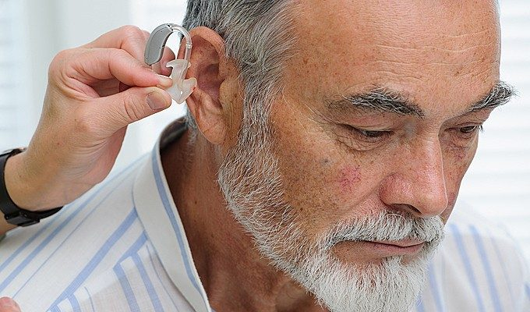
Sensory & Cognitive Deficits
Forgotten, Silent, & Over-Ruled: Hearing the Voice of the Older Adult Patient

Slide 16
Compensating for Hearing Deficits
Before starting– make sure the patient can hear you
If not, check to see if hearing aide is working or if excess earwax is present
Talk slowly in a clearly normal tone– shouting or speaking loudly can distort language
Avoid high-pitched voice
Face person directly, at eye level
Allows for lip reading and visual cues

Slide 17
Compensating for Hearing Deficits
Keep hands or other objects away from face when possible
Be aware of background noises
Give context for letters (e.g., “M” as in Mary) or visuals for numbers (e.g., holding up three fingers when saying the number 3)
Write things out when need be– always have a note pad handy
Tell the patient when you are changing topics
E.g.) pausing, speaking a bit more loudly, gesturing toward what will be discussed, asking a question, etc

Slide 18
Assistive Listening Devices
Hearing loop (or induction loop) systems: use electromagnetic energy to transmit sound
FM systems: use radio signals to transmit amplified sounds
Infrared systems: use infrared light to transmit sound
Personal Amplifiers (e.g., pocket talker)
Electronic communication which translates speech to text or pictures

Slide 19
Compensating for Visual Impairment
Make sure there is adequate lighting– especially on the speakers face– try to avoid glare
Make sure patient has necessary glasses
Make sure handwritten instructions are clear
SIZE OF FONT NEEDS TO BE READABLE
Use LARGE FONT or MAGNIFERS to help patients see material better
Consider alternatives: tape recording instructions, large pictures/diagrams, specially configured pill boxes

Slide 20
Compensating for Cognitive Impairment
Address person directly & gain patients attention with eye contact & sitting in front of them
Maintain positive communicative tone
Reassure the patient and acknowledge when they’re correct
Avoid speaking too slowly or too loudly
Help orient the person or gently help them find words
Pose different types of questions
Simplify sentences & rephrase if patient hears you but doesn’t understand
Use verbatim repetition or paraphrase sentences to facilitate comprehension
Follow up to make sure they recall any instructions

Slide 21
Question Examples
Close ended questions for specific information
“Would you like chicken or beef?” (Choice response)
“Are you hungry?” (Yes/No question)
Open-ended for encouraging conversation
Semantic memory is better than episodic
E.g.) “What movie would you like to watch?” is easier to answer than “What movie did you watch last night?”

Slide 22
Simplifying Sentences
Right vs. Left Branching:
Right: Main clause is followed by subordinate clause– e.g., Take your seat and you won’t miss the movie
Right is easier for patients with Dementia to understand
Left: embedded clause that interrupts the main clause– e.g., If you don’t want to miss the movie, you should take your seat
Avoid subordinating conjunctions
e.g.) although, if, even though, while, since, given, after, before, as long as, once, because, or unless

Slide 23
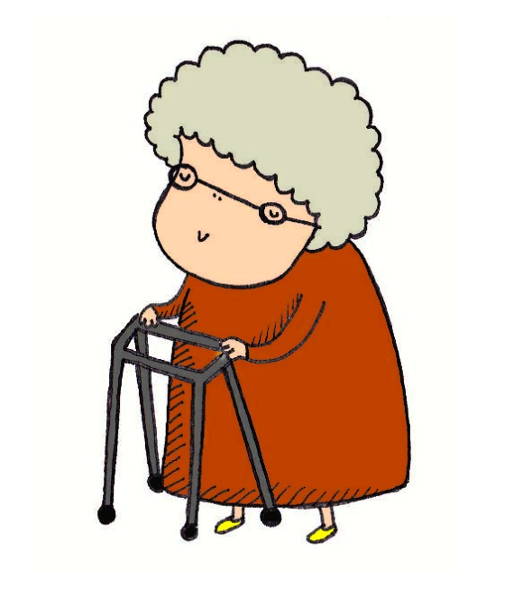
CASE EXAMPLE #1
You are talking with an older woman who you think may have a hearing impairment. You talk louder, but she still seems to have some problems hearing and understanding you. She also seems to have problems complying with instructions for taking medication and often returns to the office with the same problem.

Slide 24
RESOLUTION TO CASE #1
Hearing problems in older adults usually are not helped by talking louder. Indeed, louder talk can actually be more difficult to understand because it is usually at a higher pitch. Instead, focus on (1) always facing the patient directly at her level, (2) talking more clearly and only slightly louder, and (3) supplementing verbal recommendations with clear written instructions.

Slide 25
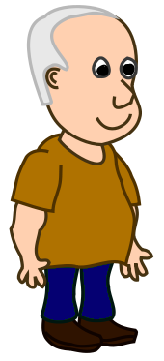
CASE EXAMPLE #2
As you talk with an older man about his diabetes, you get the feeling that he doesn’t really understand you, despite ensuring you that he does when you ask him. When you explain why and how to take the metformin that has just been prescribed, the patient appears to be listening, smiles, and nods his head “yes” in response to questions. Nonetheless, you sense that he will not be able to take the medication correctly when he returns home.

Slide 26
RESOLUTION TO CASE #2
After you provide information, ask the patient open-ended questions to elicit comprehension of the information. In this case, you might ask the patient to explain when and how he will take metformin. This “teach-back” strategy may be especially helpful if you set specific communication goals for the interaction (teach to goal)

Slide 27
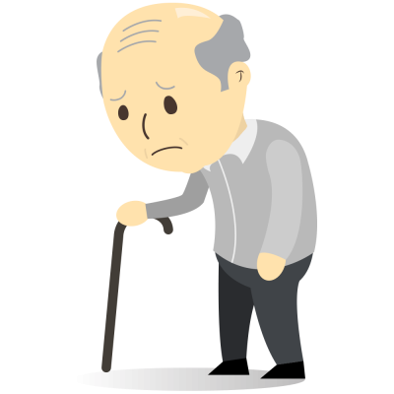
CASE EXAMPLE #3
You are in the middle of a patient visit that seems to be productive and progressing in a positive manner. All of a sudden, you begin to sense the patient has become quiet and withdrawn. Even direct questions—for example, “Is everything okay?” and “Is anything the matter?”—are met with sullen denials. You know you did something to contribute to this change in the patient’s demeanor, but you just can’t figure out what.

Slide 28
RESOLUTION TO CASE #3
One possible explanation is that in your effort to gather clinical information efficiently, you interrupted the patient on more than one occasion, and you often focused on the patient’s chart or your laptop rather than looking directly at the patient. If you exhibited these behaviors on a repeated basis, you may have been communicating to the patient that you either were not interested in or were not concerned about what he or she was saying. By monitoring and controlling your nonverbal behavior, you can avoid unintentionally sending messages to patients that create barriers to open and effective exchanges of messages and have the potential to significantly reduce patient satisfaction.

Slide 29
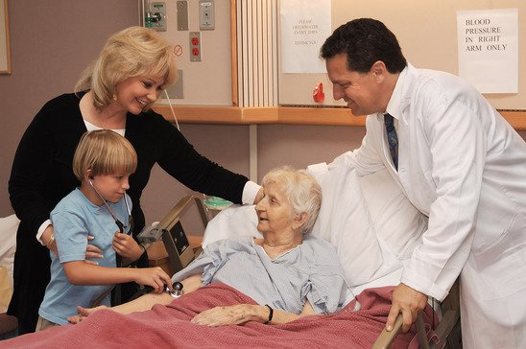
Trinity of Care: Patient, Family, Staff
Forgotten, Silent, & Over-Ruled: Hearing the Voice of the Older Adult Patient

Slide 30
Patient vs. Family
Mrs. Hill is an 85-year-old nursing home resident. She has lived in a facility since advanced heart disease made it impossible for her to live independently. Her adult children feel that life in a nursing home must be a nightmare. They want to do something, but they don’t know what. Moving her to one of their homes isn’t an option; visiting her makes them feel depressed. One day, her doctor chats with Mrs. Hill about life in the home. She tells him that this is one of the best times of her life—people prepare and deliver her meals, she has a comfortable room with a view of the gardens, and the place is very peaceful. Mrs. Hill is quite happy and has no desire to move.
How would you handle this situation???

Slide 31
Balancing Patient vs. Family
Families may try to make decisions for loved ones-- therefore, staff may need to set clear boundaries with family members– especially when the patient’s cognitive abilities are not significantly impaired
Require documentation of legal decision making power (e.g., health care agent or proxy, power of attorney, etc)
Get patient input about what he/she wants and stand up for the patient when necessary
Use some of the same skills as discussed before to help the patient and family work together on decision making

Slide 32
Staff vs. Family: Barriers to Good Communication
Institutional Barriers: understaffing, turnover, inadequate training, policies based on medical model, rigid outlines, poor intra-staff communication, and work schedules conflicting with family visits
Psychosocial/Family Barriers: guilt, clashes of cultures and values, unrealistic expectations, and conflicting responsibilities

Slide 33
Staff & Family: TALKKK Acronymn
6 preferred patterns of communication with family of cognitively impaired patients:
Tell them: providing information about loved one
Ask them: gain insight or hints about preferences/behaviors of the patient
Listen to Them: listen to frustrations– they may know something or have insight the staff could benefit from
Know their family member by relating and communicating: don’t be a robot… treat the patient as human
Be Knowledgeable about dementia (or their chronic illness)
Share Knowledge with the family: discuss disease progressions, what they can expect, etc
Notes:
Janice L. Palmer . Caregivers’ Desired Patterns of Communication with Nursing Home Staff— Caregivers’ Desired Patterns of Communication with Nursing Home Staff— Just TALKKK!. Journal of Gerontological Nursing, Volume 38, Number 4 (April 2012), pp. 47-54, <http://ejournals.ebsco.com/direct.asp?ArticleID=47BEB5785D39A1F7452E>
TELL: Providing simple summaries of the patient’s care may be helpful since patients may not always remember
ASK: The family member may be able to provide insight about the behaviors, previous hobbies/interests of the inidvidual
LISTEN: they may know how other staff have successfully cared for their loved one
KNOW: A phone call of “We just wanted to let you know…” or a smiling face or “going the extra mile” can be very beneficial

Slide 34
In Conclusion…
Good communication is KEY to working with older adults both in an outpatient or residential setting
Take the time to consider individual factors for each patient (e.g., level of independent functioning, sensory/cognitive impairment, psychosocial factors)
Approach all older adults with the a heart for empathy and a desire to undestand

Slide 35
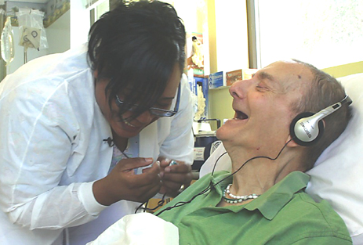
Thank you And have a wonderful day!
Any Questions????

