Slide 1
Hope for the World: Global Medical Education
Barry J. Bacon MD
Gatbel N. Chamjock PA

Slide 2
Hope for the World: Global Medical Education Disclosures:
“I have no dogs in this race…”

Slide 3
Hope for the World: Global Medical Education Gandhi
“Be the change you seek…” Gandhi

Slide 4
Hope for the World: Global Medical Education Abstract
Abstract: Education is one of the most important gifts we can bring to the world, especially where health disparities are rampant. Education provides information, knowledge, skills, self-reliance, access, connection to the rest of the world. Education is a long term intervention with outcomes markedly different from business as usual. More than these, education offers hope, especially to vulnerable populations such as refugees who have no future . Refugees represent some of the most impoverished of people in terms of access to education….

Slide 5
Hope for the World: Global Medical Education Abstract Continued
Abstract cont:
The resulting waste of brainpower and intelligence among refugees is one of the greatest wastes of human resources imaginable. It is therefore our duty and great privilege to advocate on behalf of such afflicted people groups and worthy of our time to invest ourselves in education opportunities to affect change in the world.

Slide 6
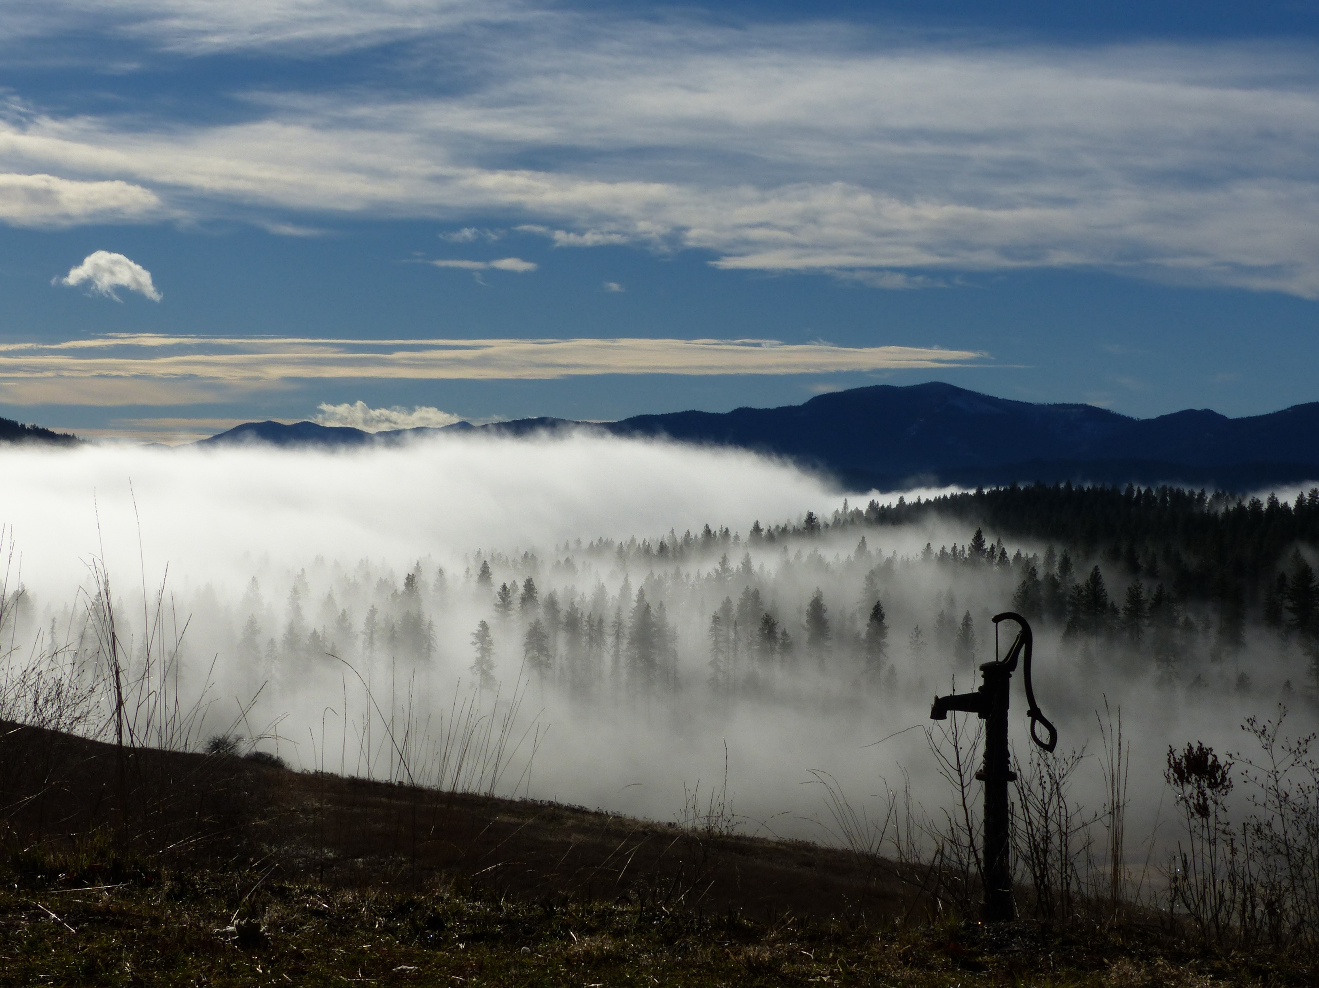

Slide 7
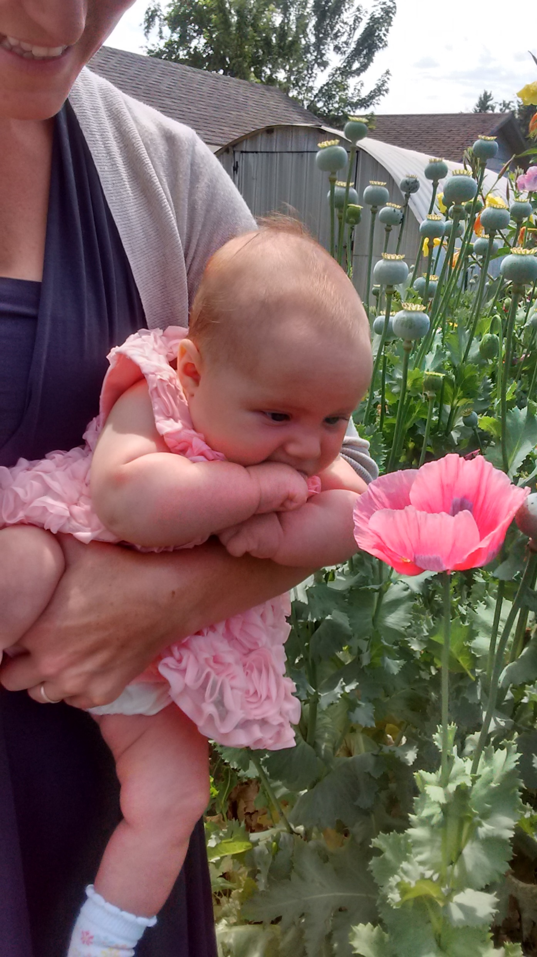

Slide 8
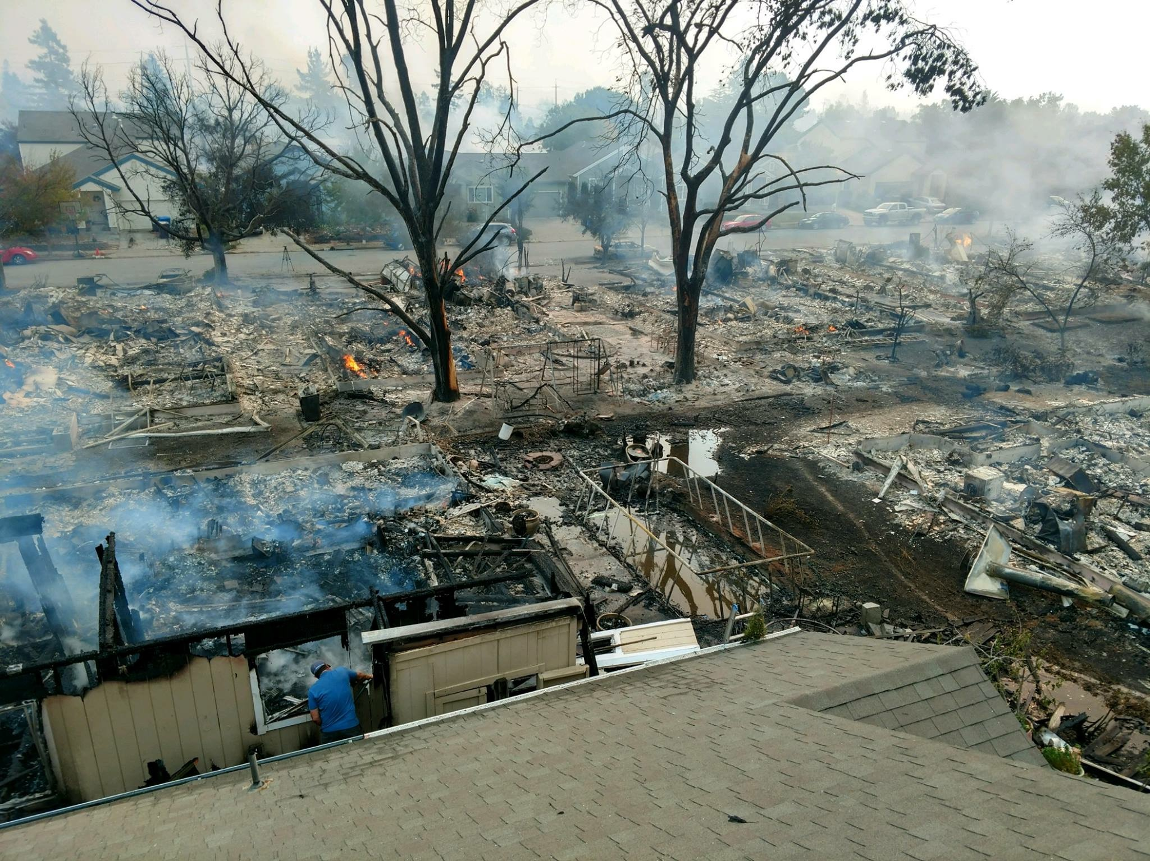

Slide 9
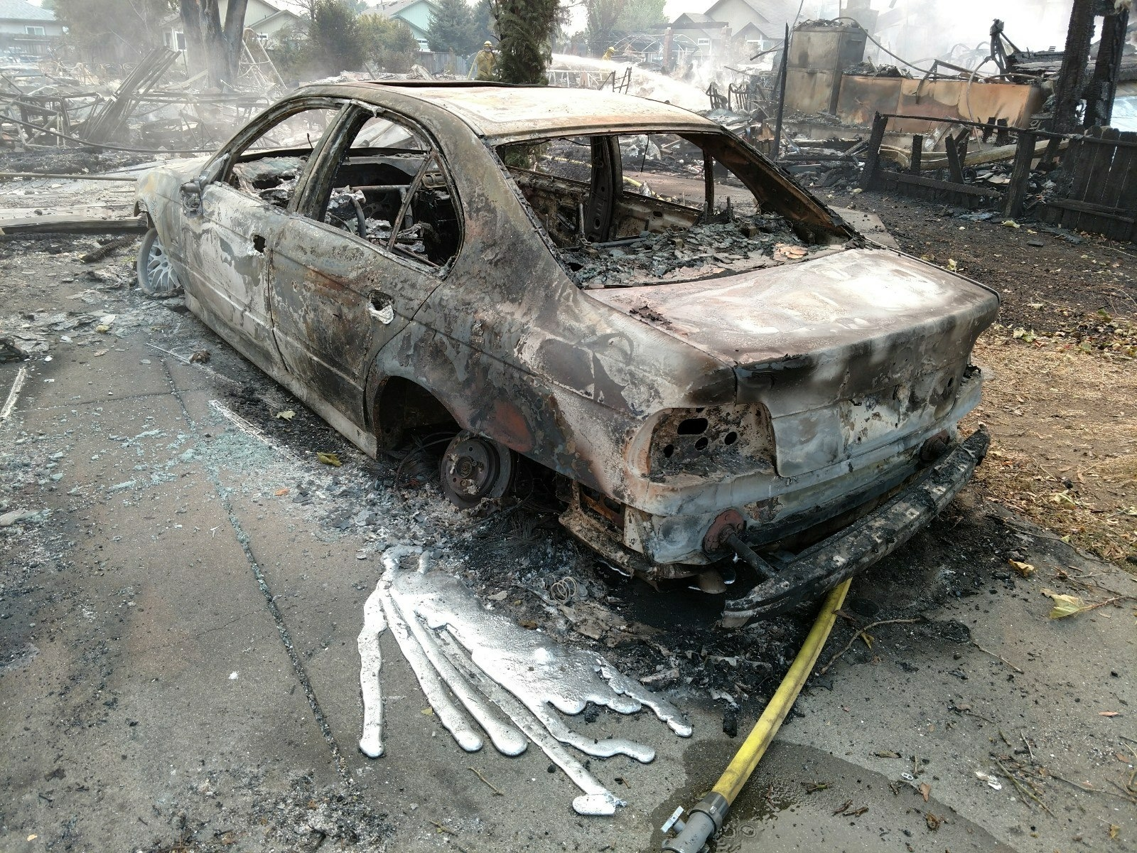

Slide 10
Global Health Perspective: Any one of us can become a refugee
Disaster can happen to anyone anywhere at any time
Humanitarian crises, whether natural or human induced, affect us all, no matter where they occur
Global health is a chance to see the world differently, and more than this, to change the way things are.

Slide 11
Hope for the World: Global Medical Education Objectives
Discuss health disparities among especially vulnerable people groups, including refugees, related to access to education.
List successful education interventions which have proven effective in changing health outcomes among refugee groups.
Advocate intelligently for education among vulnerable people groups

Slide 12
Global Education: What about Refugees?
Not since the end of the Second World War have there been as many globally displaced people as there are today.
25.4 million refugees worldwide
Additionally, 40 million internally displaced persons (UNHCR)
most refugees shelter in neighboring countries in developing regions in the hope of returning home quickly (i.e., 84 percent of the world’s refugees settled in developing regions in 2016
1 in every 110 people globally is either an asylum-seeker, internally displaced or a refugee
Average length of stay in a refugee camp is 17 years

Slide 13
Refugee Statistics UNHCR
CAR: Since 2013, nearly 1 million men, women and children have fled their homes
The number of people fleeing for their lives from Central America has grown by ten times in the past five years
More than 1.4 million people have taken chances aboard unseaworthy boats and dinghies across the Mediterranean
More than 3 million Iraqis have been displaced
conflict in South Sudan has claimed thousands of lives and driven 3.3 million people from their homes

Slide 14
More Refugee Statistics
Syrians continued to be the largest forcibly displaced population in the world, with 12 million people at the end of 2016. That’s more than half of the Syrian population
April 2018, an estimated 671,000 Rohingya children, women and men have fled
more than 2 million Ukrainians displaced
Nearly 20 million Yemenis need humanitarian assistance
2/3 of refugees come from just five countries: Syria, Afghanistan, South Sudan, Myanmar and Somalia.

Slide 15
Global Refugee Education: Statistics
91% of other children attend grade school; 61% of refugee children
83% of adolescents attend secondary school; 23% of refugees
36% of adults attend university; 1% of refugees
UNHCR partners with governments and international organisations to ensure quality protective education for refugee children and young people everywhere.

Slide 16
Global Refugee Education: UNHCR Declarations
Education is a basic human right, enshrined in the 1989 Convention on the Rights of the Child and the 1951 Refugee Convention.
Education protects refugee children and youth from forced recruitment into armed groups, child labour, sexual exploitation and child marriage. Education also strengthens community resilience.
Education empowers by giving refugees the knowledge and skills to live productive, fulfilling and independent lives.
Education enlightens refugees, enabling them to learn about themselves and the world around them, while striving to rebuild their lives and communities.

Slide 18
Global Education: What is being done?
European Commission Report:
Education plays a crucial role in helping migrants and refugees settle in new countries and environments.
The European Commission facilitates the exchange of good practices on the integration of migrants and funds relevant projects across the different levels of education:
(In Europe)

Slide 19
Global Refugee Tertiary Education: UNHCR’s response
Higher education is a priority for UNHCR and forms an integral part of our protection and solutions mandate.
Scholarship programmes in the first country of asylum
Connected Learning programmes
Establishment of complementary pathways to protection for refugees through higher education opportunities in third countries
Advocacy with ministries, universities and academia to expand access for refugee students to universities and to mitigate barriers that prevent refugees from enrolling in university

Slide 20
Global Refugee Tertiary Education: What about refugee camps?
“I cannot relocate to go to university…” Mariam, Kakuma Camp, Kenya
What about bringing education to highly vulnerable populations?

Slide 21
Global Refugee Tertiary Education On Site:
Connected Learning in Crisis Consortium (CLCC)
an innovative form of higher education that uses information technology to combine face-to-face and online learning
Since 2010, over 6.500 refugee learners in 11 countries
The CLCC is constantly growing, connecting humanitarian and academic actors such as the Australian Catholic University, Jesuit Worldwide Learning, Kenyatta University, Kepler, Moi University, Southern New Hampshire University, York University, and the University of British Columbia

Slide 22
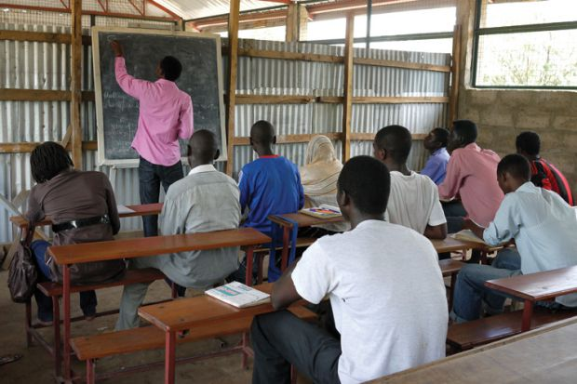

Slide 23
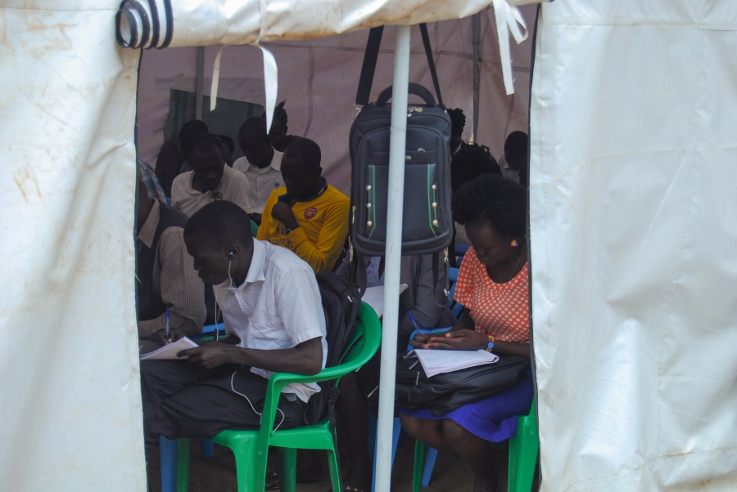

Slide 24
Global Education: What are the benefits for refugees?
“feelings of empowerment” and an “increased awareness and facility with psychosocial and interpersonal skills”
There was a lot of that as well (improved knowledge and skills), but there was also a sense of hope.
Times Higher Education World University Rankings: Interview of refugees in Kenya, Malawi, and Jordan.

Slide 25
Global Education: What are the challenges for refugees?
“main issue seemed to be a lack of understanding from US-based professors on the challenges faced by students”
“ability to access course and study materials, while having to balance family and other responsibilities
“linked to the specific context”
what non-governmental organisations are working there, what possible job opportunities or volunteer opportunities are available and then create a pipeline so that when students complete their coursework they don’t just drop off the cliff”

Slide 26
Global Medical Education: What are we missing?
What if we brought high quality medical education to a refugee dense population and invited them to join us in becoming part of their solution?
Could we improve health outcomes?
Could we improve health professional retention?
Could we improve access to tertiary education?
How can we address the perceived weaknesses of the current higher education model?

Slide 27
Medical Education for Refugees Near Refugees
Medical care is available
Health education is available
No formal medical education programs specifically to include refugees as students
Attempts have been thwarted by social and political unrest:
Kajo Keji Health Training Institute is rebuilding across the border in Uganda

Slide 28
Medical education for refugees near refugees Findings in Gambella
Gambella Medical School Project
First site visit, 2017; second site visit January 2018
Physician/population ratio for S Sudan is 1:100,000 (Unicef)
500,000 Ethiopian population
400,000 refugee population
Health disparities in the region
Inadequate staffing, high turnover of medical professionals
Inadequate access to primary and specialty care
Limited access to radiology studies, labs
Inadequate physical facilities

Slide 29
Gambella Medical School Site Visit Findings
Gambella University is highly supportive
Regional president, health and education secretaries, mayor are highly supportive
Minister of Health Dr. Amir is highly supportive
University recently expanded its facilities, including housing, library, study labs

Slide 30
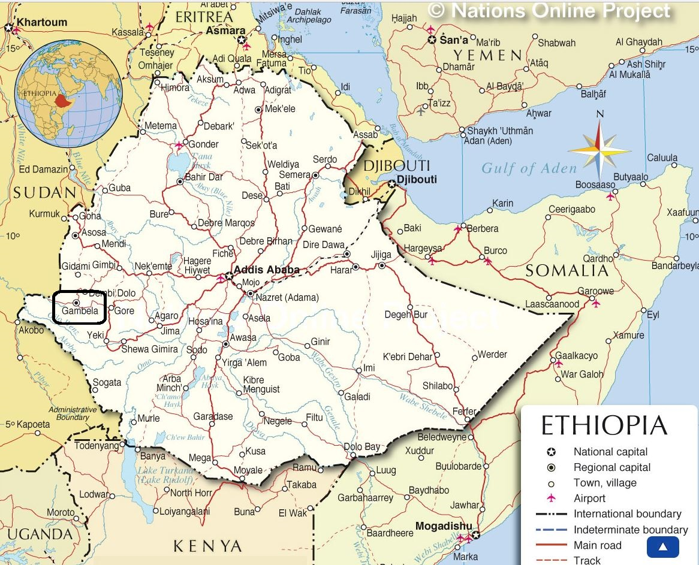

Slide 31
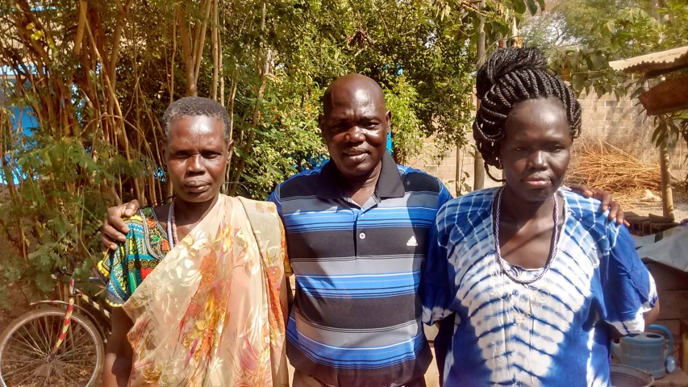

Slide 32
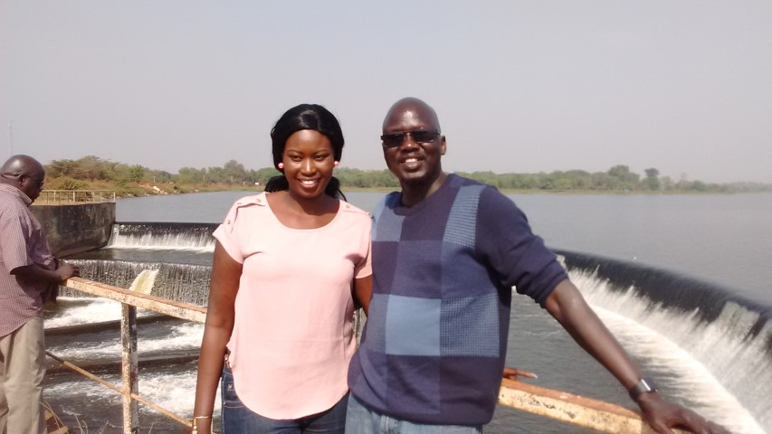

Slide 33
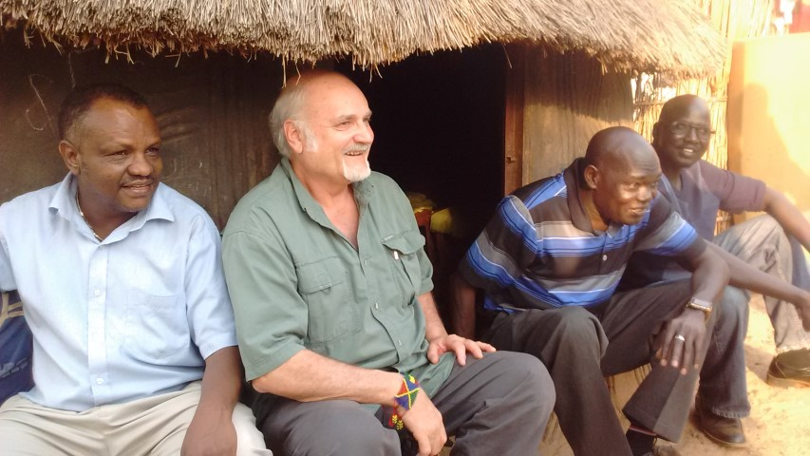

Slide 34
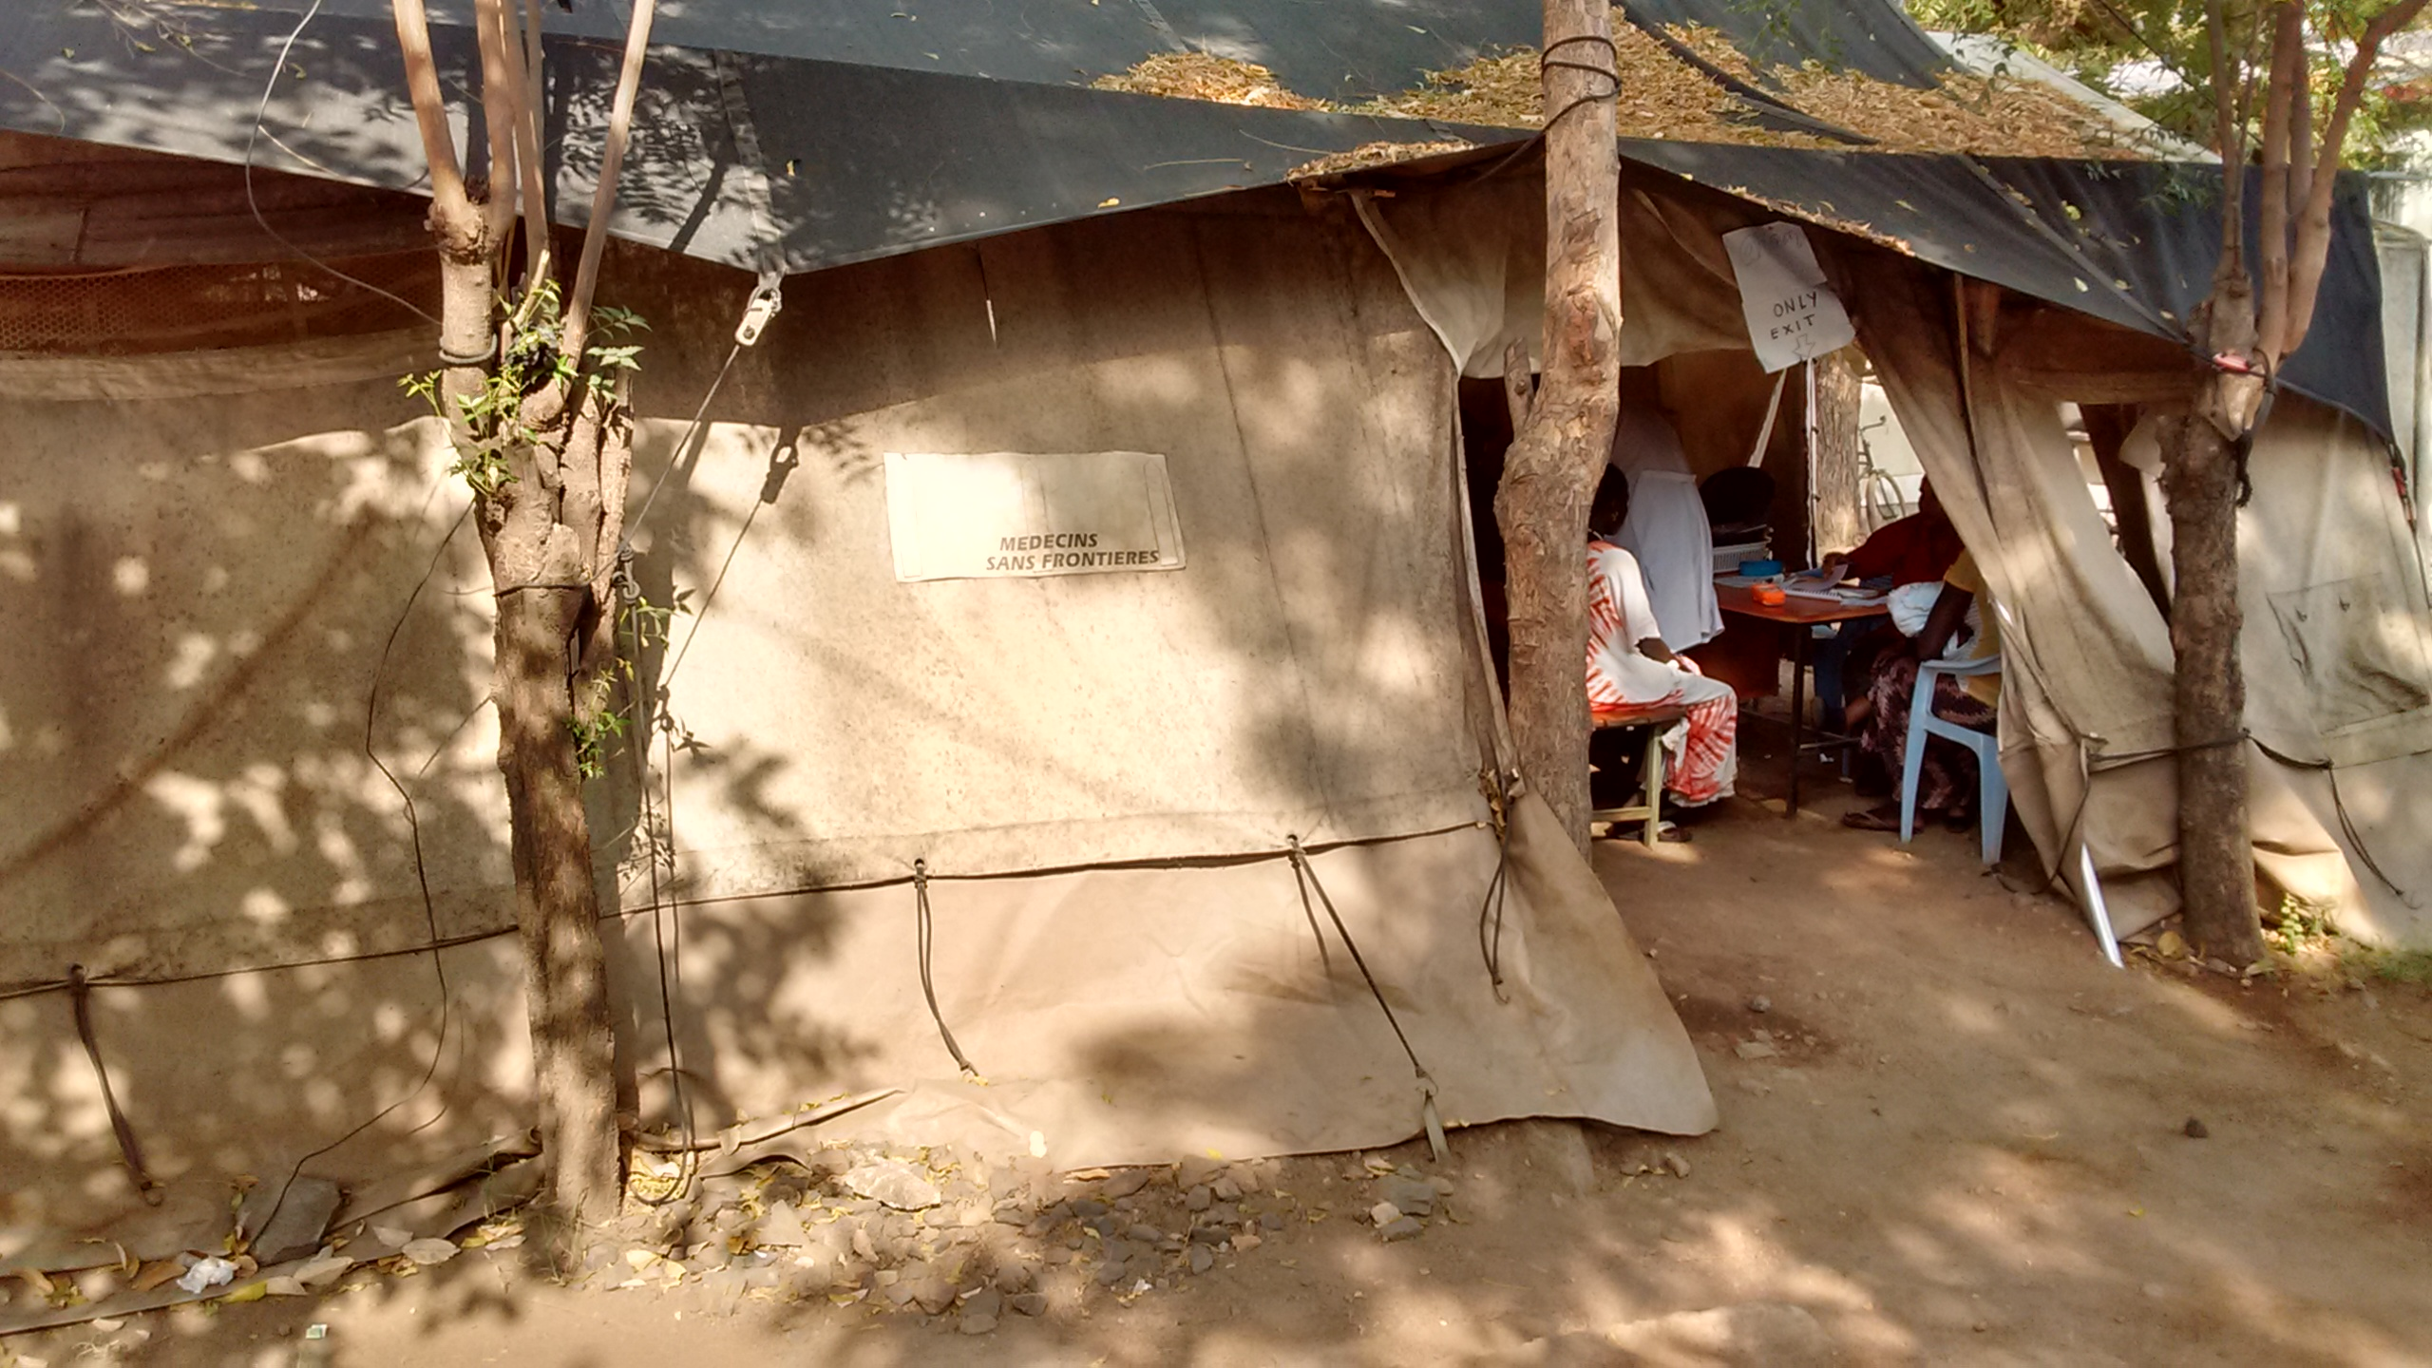

Slide 35
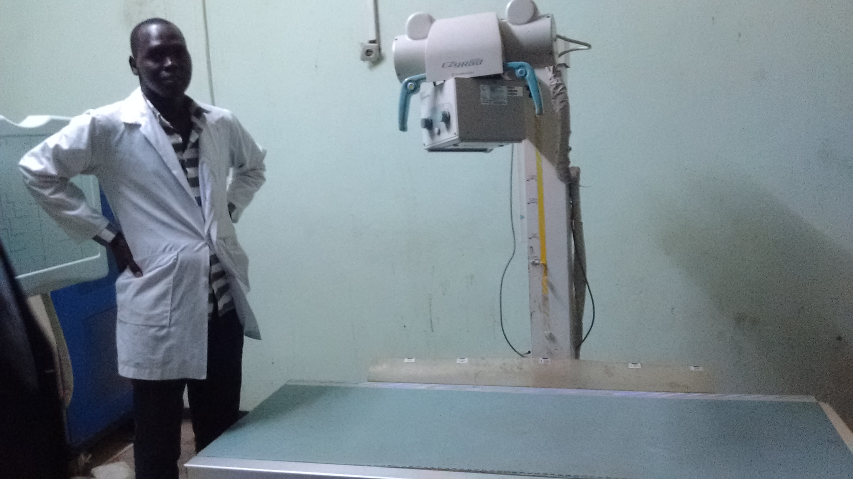

Slide 36
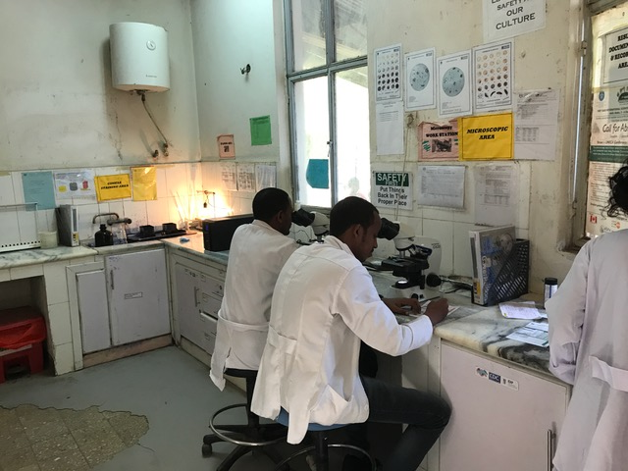

Slide 37
Gambella Medical School working principles
Local input and design
High quality medical education
Partnership with diaspora, U.S. and European partners
Remote education access through IT connections
Shore up local applicants’ likelihood of success starting in 11th grade
Team approach to medical education
Early clinical experiences in medical school
Mutually respectful learning environment, international students
Transform health outcomes
Expand to other health disciplines
Become an agent of peace

Slide 38
Gambella Medical School: Addressing Challenges
lack of understanding from US-based professors on the challenges: recruit professors from the diaspora; educate our US professors
“ability to access course and study materials: IT partnerships
Balance life and responsibilities: must be understanding of students’ unique challenges
“linked to the specific context”: African patients, diseases, tools
job opportunities or volunteer opportunities, create a pipeline: Ethiopian leadership clearly sees the need for long term physicians of various specialties in remote areas, including Gambella

Slide 39
Gambella Medical School Summary: Priorities
Support for this project is broad
Need for 11th and 12th grade education enhancement
Need for recruitment and retention of locally trained physicians
Need for improvement in healthcare delivery and services
Need for development of relationships with outside partners
Need to strengthen relationship university with hospital
Development of a teaching hospital

Slide 40
Gambella Medical School: Next steps
Diaspora requested to develop a scholarship fund
Partnerships for financial and educational support to be developed
Curriculum development to be completed
Educational support for Gambella area 11th and 12th grade students to improve medical school acceptance rates
Container of medical and education equipment to be sent to Gambella Hospital and University
Partnership with U.S. university to strengthen faculty support and learning opportunities

Slide 41
Gambella Medical School: Final word
We want to train excellent physicians but not for export
We want to build buildings but not to put our names there
We want to create a place for U.S. based learners but not for ourselves
It is the patient who is suffering that is our concern
Gambella University’s motto: “We are with the community”

Slide 42
Global Medical Education: Questions?

Slide 43
Global Medical Education: References
World Education News and Reviews 2018
UNHCR website
World Education Services website
European Commission Report
Times Higher Education World University Rankings
Gambellamed.com
Journal of Social Change 2014, Volume 6, Issue 1, Pages 15–26 ©Walden University, LLC, Minneapolis, MN
GlobalPost March 22, 2017 · 1:45 PM EDT By Julian Hattem

Slide 44
© 2018 American Academy of Family Physicians. All rights reserved.
All materials/content herein are protected by copyright and are for the sole, personal use of the user.
No part of the materials/content may be copied, duplicated, distributed or retransmitted
in any form or medium without the prior permission of the applicable copyright owner.

