Slide 1
2019 STFM Conference on
Practice & Quality Improvement

Slide 2
Setting
Benedict Family Medicine
Academic family medicine office with 10 physicians and an NP/BH Located UMass Memorial Medical Center in Worcester MA 17,000 visits/year.
Barre Family Health Center
One of three residency sites of the UMass Family Medicine Resideny
12 residents, *** physicians, and NP’s/PA/BH
40,000 visits/year

Slide 3
TAKING THE PAIN OUT OF OPIATE REDUCTION
CYNTHIA JEREMIAH MD
MARY LINDHOLM MD
Department of Family Medicine and Community Health
University of Massachusetts Medical School
UMass Memorial Health Care
Worcester Massachusetts

Slide 4
Disclosures
None

Slide 5
OBJECTIVES
Learn best practices of tapering high dose opiates vs. transitioning to Buprenorphine.
Managing comorbid conditions and/or acute pain in the context of an opioid taper
Understand the evidence behind use of adjunctive therapy to help with pain control
Show some standards to best utilize the EMR in the safe prescribing of opiates

Slide 6
Background/Literature
Indications for tapering long term opiates for non-cancer pain:
1. Inability to achieve or maintain anticipated pain relief or functional improvement despite reasonable dose escalation.
2. Intolerable adverse effects at the minimum dose that produces effective analgesia, with reasonable attempts at opioid rotation unsuccessful.
3. Persistent nonadherence with patient treatment agreement.
4. Deterioration in physical, emotional, or social functioning attributed to opioid therapy.
5. Resolution or healing of the painful condition.
Tapering Long-term Opioid Therapy in Chronic Noncancer Pain: 10.1016/j.mayocp.2015.04.003
Notes:
DOI:
10.1016/j.mayocp.2015.04.003

Slide 7
Risks
Short Term Risks Long Term Risk
Withdrawal 1.Relapse
Increased Pain 2.Function
Drop-Out 3.Medical-Legal Implications
Tapering Long-term Opioid Therapy in Chronic Noncancer Pain: 10.1016/j.mayocp.2015.04.003

Slide 8
Primary care management of opioid use disorders: Abstinence, methadone, or buprenorphine-naloxone?
Options are abstinence, taper to safer dose, Methadone, Buprenorphine.
Consider patient Factors:
High risk for drop-out → Methadone Recommended
High risk for toxicity → Buprenorphine Recommended
Bottom Line: Opioid agonist therapy is far more effective than abstinence in treating OUD.
Canadian Family Physician March 2017, 63 (3) 200-205; Anita Srivastava, Meldon Kahan and Maya Nader

Slide 9
Conversion from High-Dose Full-Opioid Agonists to Sublingual Buprenorphine Reduces Pain Scores and Improves Quality of Life for Chronic Pain Patients
35 patients, ages 24-66, on 200 mg-1370 mg (mean 500 mg) DME.
Switched them to Buprenorphine.
Conducted a retrospective chart analysis → pain levels and quality of life measures (pre- and 2 months post switch).
Pain Levels → decreased from 7.2/10 to 3.5/10
Quality of Life Measures → increased from 6.1 to 7.1
Pain Medicine, Volume 15, Issue 12, December 2014, Pages 2087–2094, https://doi.org/10.1111/pme.12520

Slide 10
When opioids fail in chronic pain management: the role for buprenorphine and hospitalization
Looked at 76 patients on high dose opiates, hospitalized them for an average of 2 days, to switch to Buprenorphine in a controlled setting.
DME >100’s mg
Followed up to 25 months post switch
⅔ reported moderate to dramatic improvement in pain and function, and there was an increase in employment rates.
Median Buprenorphine Dose was 8 mg
Am J Ther. 2013 Jul-Aug;20(4):316-21. doi: 10.1097/MJT.0b013e31827ab599

Slide 11
Evidence Based nonpharmacologic strategies for comprehensive pain care: the consortium pain task force white paper
Tick H, Nielsen A, Pelletier KR, et al. Evidence-based nonpharmacologic strategies for comprehensive pain care: the consortium pain task force white paper. Explore (NY). 2018;14(3):177–211.
Acupuncture-8-15 treatments over 10-12 weeks lasted 12 months
Spinal and joint manipulation -some safety issues
Massage
Mindfulness,meditation and relaxation
Yoga and Tai Chi

Slide 12
Nutrition and Pain
Anti-inflammatory Diet (non-starchy vegetables, fruits, legumes, nuts ,whole grains , low animal protein)
Curcuminoids-turmeric and ginger=NSAIDS
Micronutrient deficiency
Vitamin D
Magnesium
Omega-3 (not 6) fatty acids
PPI’s
Tick H, Nielsen A, Pelletier KR, et al. Evidence-based nonpharmacologic strategies for comprehensive pain care: the consortium pain task force white paper. Explore (NY). 2018;14(3):177–211.

Slide 13
Barre Buprenorphine Program
Patients are identified for the Suboxone Program (self, or provider)
History taken by provider at intake: substance(s), dose, frequency, method.
History of Suboxone use or prior suboxone program: can start directly on suboxone
Suboxone Naïve: must be in withdrawal to start

Slide 14
Barre Phases of Treatment
Stabilization: 0-3 months of treatment
Active: 4-7 months of treatment
Maintenance: >7 months of treatment

Slide 15
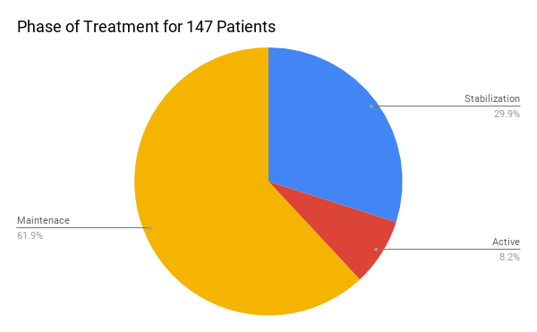

Slide 16
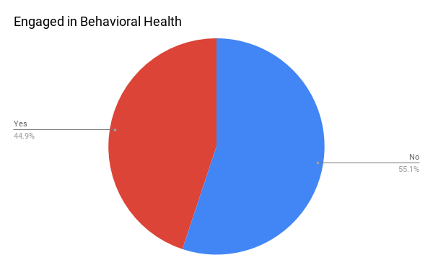

Slide 17
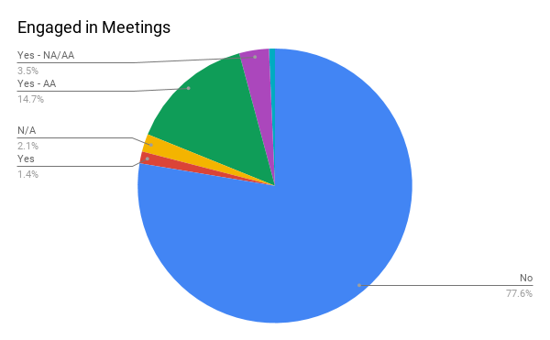

Slide 18
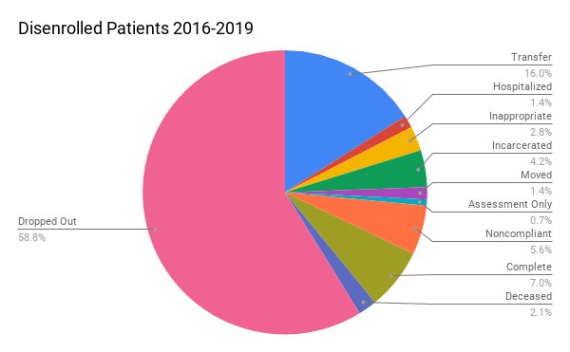

Slide 19
Benedict Case Problem
2018-Physician with 52 patients on chronic opioid therapy for pain retired
Half on >100 morphine mEq ( one on 936)
Many had transferred from pain clinics and had been cared for >20 years by the retiring physician
He agreed to try to start tapering them to at least </= 90 mEq dose of morphine

Slide 20
Benedict Opioid Treatment Goals
Chronic pain syndrome diagnosis will be documented.
The maximum opioid daily dose is established at 60 MME per day.
Explanation of high dose therapy will be documented in the record.
High dose patients will have pain management consultation and/or comprehensive assessment and institution of new non-opioid therapy every 12 months.
Urine drug screening (UDS) will be performed on all patients at least once a year
Patient agreement form will be documented for all patients.

Slide 21
Benedict Database Structure
Identifying info
PCP name
Initial dose levels and, when available, goals set by the departing physician.
Opioid MME doses – July 2018 - January 2019 - July 2019.
Number of UDS’s during the 12 months.
Controlled substance agreement (CSA) completion dates
Dual therapy with benzodiazepine
Naloxone prescription
Complications related to opioid use.
Adjunctive therapies.

Slide 22
Transfer Panel of 485 patients
52 patients using chronic Schedule II opioids
25 patients on high dose opioids
Dose range 112 – 936 MME
Dose average July 2018 269 MME
18 patients had set a plan to attempt to reduce use of opioids
3 patients transferred out of practice

Slide 23
12 Month Follow Up on 22 High Dose Opiate Patients
2 patients reduced dose to < 100 MME
2 patients transitioned to Buprenorphine therapy
(excellent pain management - suspected opioid hyperalgesia)
15 (68%) had DOA screening in past 12 months
11 (50%) documented advice to obtain naloxone
11 (50%) have current CSA in chart
18 (82%) have documented adjunctive therapies
3 patients receive dual therapy with a benzodiazepine

Slide 24
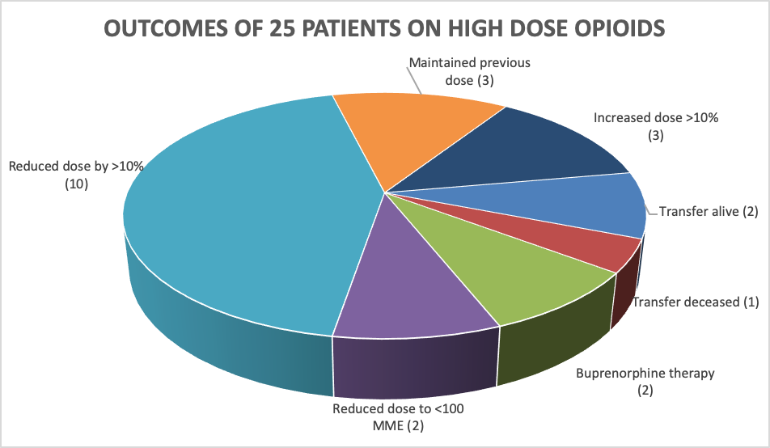

Slide 25
Benedict Data - 12 month follow up
N= 25 on high dose opioid
10 reduced dose >10%
2 reduced to <100 MME
3 maintain same dose
3 increased dose
2 → buprenorphine
3 transferred out (one died)
Total MME for panel:
Initial 5385
Jan ’19 4672 (87%)
Jul ’19 4541 (84%)
Subset with taper: 75% of initial dose
Notes:
COMPLICATIONS:
Transfers N= 3 Active patients N= 22
Emergency Dept Visits 3 Emergency Dept Visits 10
Hospital stays 1 Hospital stays 8
Death 1 Death 0
The one death occurred in a patient who is recorded as having a new PCP and who had a critical illness in July 2018. Date and cause of death unknown but he had end stage liver disease.
One active patient had a work-related injury.
Two patients had recurrent osteomyelitis complications (spine/foot).
One patient developed an allergic reaction to buprenorphine during a trial transition from oxycodone and he resumed oxycodone therapy.
One patient was identified as using non-prescribed benzodiazepines on drug screens, elevating the level of monitoring.

Slide 26
EPIC EMR Best Practices
Embedded PMP
Controlled Substance Agreement reminder when writing prescriptions
Formatted summary in EMR
Templated notes for OBOT team and provider

Slide 27
Screen shot of epic

Slide 28
Conclusions
Developing a standardized approach to chronic pain and addiction is possible (and improved buy in)
The EMR can help us with these patients
Patients need our care and expertise in treating chronic pain and addiction

Slide 29
Questions and Your Insights

Slide 30
Evaluate
Please evaluate this presentation using the conference mobile app! Simply click on the "clipboard" icon on the presentation page.

