Slide 1
Maternal Health in Zambia
Dan Jones D.O.
Family Medicine
Zimba Mission Hospital

Slide 2
Healthcare in Zambia
America
Life Expectancy = 79 years (WHO 2015)
Healthcare expenditure = $9,321 per capita (Global Burden of Disease Health Financing Collaborator Network Lancet 2017)
Zambia
Life Expectancy = 61 years (WHO 2015)
Healthcare expenditure = $216 per capita (Global Burden of Disease Health Financing Collaborator Network Lancet 2017)

Slide 3
Physician Workforce in Zambia
America
1 doctor for every 374 patients (WHO 2011)
22% are foreign medical graduate doctors (Young et al. FSMB 2015)
Zambia
1 doctor for every 16,666 patients (WHO 2011)
36% are expatriate doctors (GRZ Ministry of Labor 2011)

Slide 4
Fertility in Zambia
America
Crude Birth Rate = 12 per 1,000
Total Fertility Rate = 1.9 (UNICEF 2016)
Zambia
Crude Birth Rate = 40 per 1,000
Total Fertility Rate = 5.3 (UNICEF 2016)
9th highest birth rate in the world (top 10 countries are in Sub-Saharan Africa)

Slide 5
August 2007

Slide 6
Zimba Mission Hospital Established 1960
OB Catchment Area for 3 Health Districts
Population = 365,000 people (half of Vermont)
Size = 9,000 square miles (size of New Jersey)

Slide 7
30% Health Facility Utilization Rate For Giving Birth (2011)

Slide 8
Safe Delivery Kit For Home Birth

Slide 9
Retained Placenta at Siachitema RHC (October 2007)
No midwife
No oxytocin
No ketamine
No OR
No blood
No ambulance

Slide 10
Ruptured Uterus
Gravida 3
Previous stillbirth
Tried to deliver at RHC
No prior cesarean
July 2014
Gravida 5
No prior cesarean
Tried to deliver at home
February 2011

Slide 11
Ruptured Uterus
ZMH Maternity Ward
Period of 12 days
May 12 to 23, 2013
3 Ruptured Uterus Cases

Slide 12
Ruptured Uterus
Developed Countries
Incidence of Uterine Rupture with Previous Cesarean was < 1 per 1,000 (WHO BJOG 2005)
Rate = 0.1%
Least Developed Countries
Incidence of Uterine Rupture was 10 per 1,000 (WHO BJOG 2005)
Rate = 1%
75% of cases were in Unscarred Uterus

Slide 13
Ruptured Uterus
America
Incidence of Rupture of Unscarred Uterus was 1 in 16,849 (Miller et al. Obstetrics and Gynecology 1997)
Nigeria
Incidence of Uterine Rupture was 1 in 119 (Igwegbe et al. Nigerian Medical Journal 2015)

Slide 14
Obstetric Fistula
100 miles
4 hours
1 month
June 2013
1979
June 2013
75 miles
4 hours
3 months
June 2010

Slide 15
Obstetric Fistula
130,000 women in Africa develop obstetric fistula each year (Wall et al. Lancet 2006)
3.5 million are suffering from obstetric fistula worldwide (Wall et al. Lancet 2006)

Slide 16
Obstetric Fistula
Caused by prolonged, obstructed labor due to cephalopelvic disproportion (CPD)
Ischemia develops resulting in tissue necrosis and subsequent tract formation between bladder and vaginal
Vesicovaginal fistula (VVF) causes urinary incontinence

Slide 17
Maternal Death from PPH Post Cesarean (Nov. 2011)

Slide 18
Maternal Mortality (2015)
America
4 million births
550 maternal deaths
MMR = 14 per 100,000 (WHO 2015)
Zambia
645,000 births
1,500 maternal deaths
MMR = 244 per 100,000 (WHO 2015)

Slide 19
Causes of Maternal Mortality
Obstetric (Direct) (Say et el. Lancet 2014)
PPH = 27%
Eclampsia = 14%
Sepsis = 11%
Obstructed Labor = 9%
Non-Obstetric (Indirect) = 27%
Worsening of Chronic Condition
HIV related = 5% (Say et al. Lancet 2014)

Slide 20
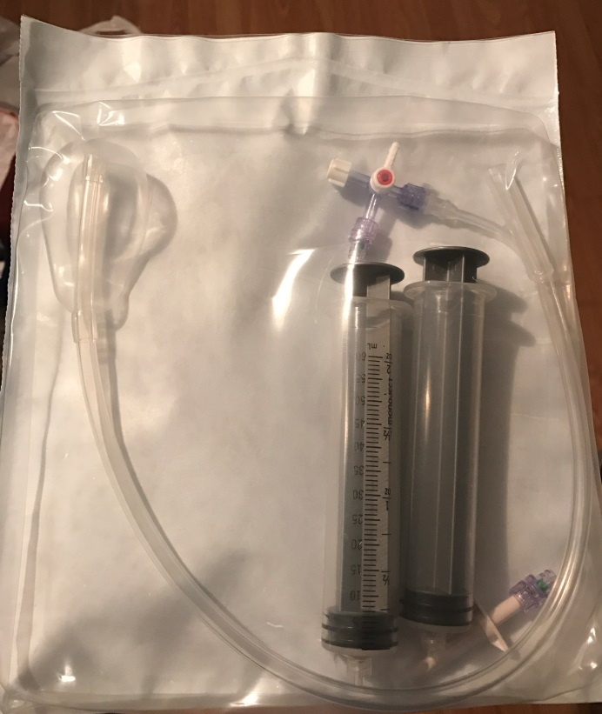
Uterine Balloon Tamponade
Uterine Atony
#1 Cause of PPH
High parity is risk factor (G13)
ZMH
Oxytocin
Misoprostol
UBT in resource-limited settings (Tindell et al. BJOG 2013)
Effective
Easy
Low risk of harm

Slide 21
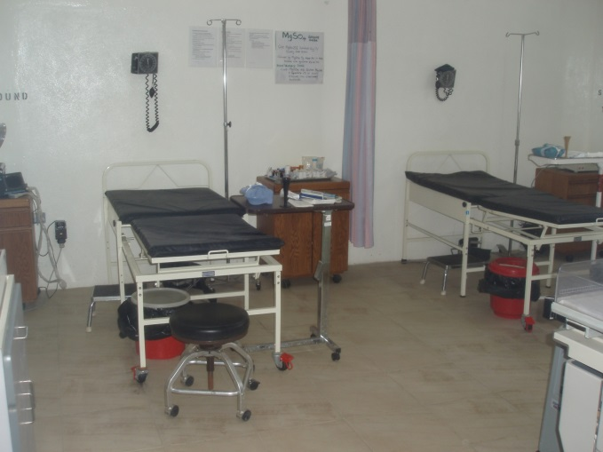
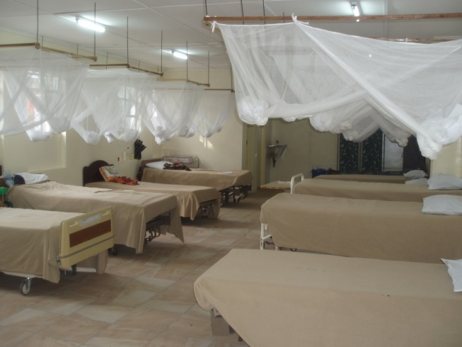
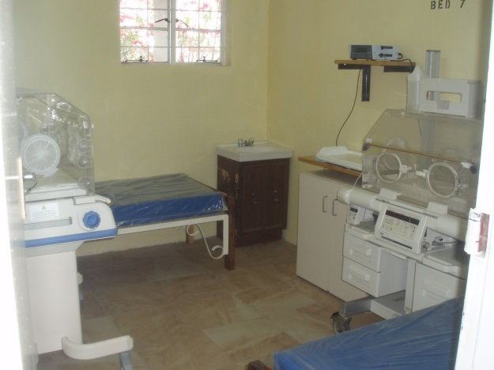
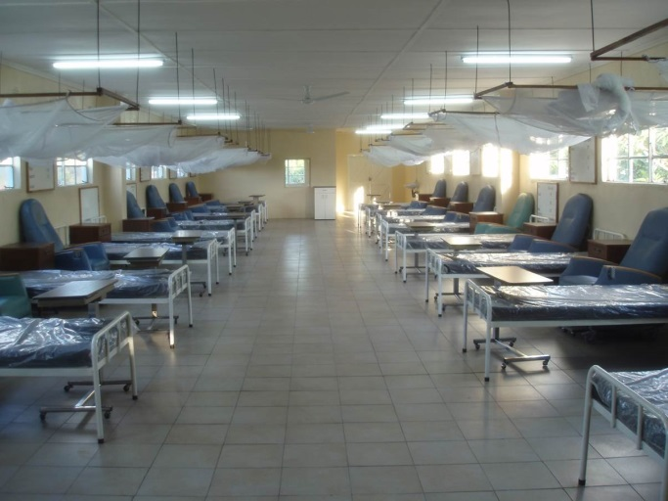
ZMH High Risk OB (Jan. 2014)

Slide 22
Cesarean Section Rate
National Cesarean Section Rate of between 10 and 15% is recommended (Gibbons et al. WHO 2010)
America
32% (Martin et al. U.S. Department of Health and Human Services 2016)
Zambia
3% (Gibbons et al. WHO 2010)

Slide 23
Cesarean Section Rate
Zimba Mission Hospital
11.3% primary institutional cesarean section rate (2014)
8.3% primary institutional cesarean section rate (2015)

Slide 24
Access to Emergency Obstetric Care (EMOC)
High quality obstetric and neonatal care can significantly reduce:
Maternal Death
Ruptured Uterus
Obstetric Fistula
Stillbirth/Early Neonatal Death due to Birth Asphyxia
Neonatal Death due to Prematurity

