Slide 1
A Student Did WHAT?!? Addressing Unprofessional Behavior
Leora Lieberman, MS-4
Robert Hatch, MD, MPH
Paige Barker, MD

Slide 2
Disclosures
We have no disclosures to report.

Slide 3
Objectives
On completion of this session, the participants should be able to:
Describe one finding from the literature relevant to professionalism lapses by medical students.
Describe two factors that can make it challenging to address unprofessional behavior by students.
Describe one system that might be used to better address unprofessional behavior by students.

Slide 4
Introduction
Each year up to 19% of medical students fail a professionalism assessment.
Professionalism is a core competency.
Studies have shown that unprofessional behavior in medical school correlates with future problems, including disciplinary action by licensing boards.
Unprofessional behaviors may be linked to patient safety issues.
It is important to identify and address unprofessional behavior.
It is difficult to raise and remediate these issues.
Notes:
Professionalism is a core competency as defined by Association of American Medical Colleges and the Accreditation Council for Graduate Medical Education.

Slide 5
Introduction
Difficulties to addressing unprofessional behavior:
Deciding whether a particular event/behavior is significant enough to require attention
Deciding how best to address the event/behavior
Determining whether the behavior is a one time, uncharacteristic action or part of a pattern of multiple unprofessional actions
Providing negative feedback is difficult and uncomfortable

Slide 6
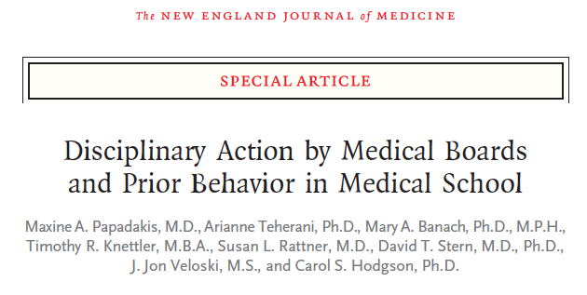
Disciplinary action of practicing physicians by medical board was strongly associated (3x more likely) with unprofessional behavior in medical school.
Notes:
After a landmark study at one institution showed a correlation between unprofessional behavior in medical school and future disciplinary action, this study sought to see if these findings were generalizable by conducting a larger study at 3 different medical schools including diverse locations and environments. In this case controlled study, they found that unprofessional behavior in medical school were 3x more likely to have future disciplinary action by state medical board.
Case Control Study
Cases: 235 graduates of 3 medical schools who received discipline from a state medical board
Control: matched physicians by medical school and graduation year, half also by specialty
Medical Schools: University of Michigan, Jefferson Medical College, UCSF
Disciplinary actions ranged from public reprimand to revocation of medical license
Each disciplined physician was matched to 2 control physicians one of which was also matched by specialty

Slide 7
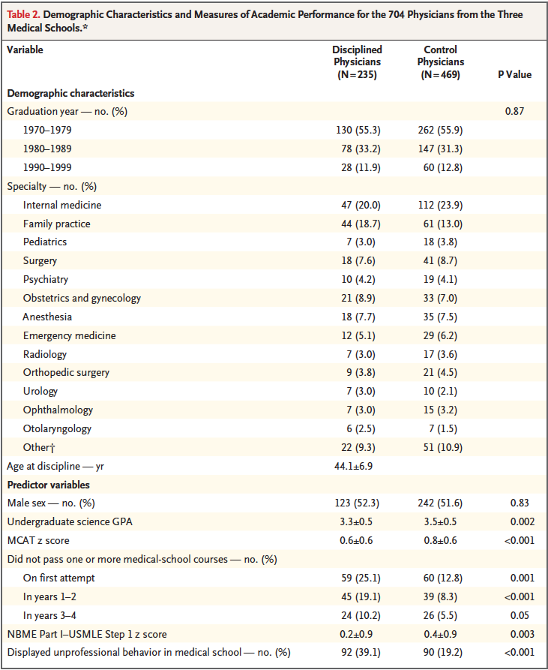
Disciplined MDs more likely than control MDs to have displayed:
Irresponsibility
Diminished capacity for self-improvement
Poor initiative
Impaired relationships with students/residents and faculty
Impaired relationships with nurses
Unprofessional behavior associated with being anxious, insecure, or nervous
Notes:
Disciplined physicians had slightly lower GPA, MCAT/NBME/USMLE scores slightly lower, twice as likely to not have passed at least one course on first attempt in med school
Disciplined physicians twice as high a proportion to have had unprofessional behavior in medical school
Example of irresponsible behavior: unreliable attendance at clinic, not following up on activities related to patient care
Example of diminished capacity for self-improvement: failure to accept constructive criticism, argumentativeness, display of poor attitude
Ex poor initiative: lack of motivation or enthusiasm or by passivity

Slide 8
Additional Studies
Unprofessional behavior in medical school associated with OR 2.15 for subsequent disciplinary action by state board (3).
Similar findings in internal medicine residents with low professionalism rating on resident annual evaluation summary showing a HR 1.7 for subsequent disciplinary action by state licensing board (2).
Unprofessional behaviors in a surgeon observed by patients was associated with surgical complications for the patients (1).
Cooper WO, Guillamondegui O, Hines OJ, et al. Use of unsolicited patient observations to identify surgeons with increased risk for postoperative complications. JAMA Surg. 2017; 152 (6): 522-9.
Papadakis MA, Arnold GK, Blank LL, et al. Performance during Internal Medicine Residency Training and Subsequent Disciplinary Action by State Licensing Boards. Ann Intern Med. 148:869-876.
Papadakis MA, Hodgson CS, Teherani A., et al. Unprofessional Behavior in Medical School is Associated with Subsequent Disciplinary Action by a State Medical Board. Academic Medicine. 2004; 79(3): 244-249.

Slide 9
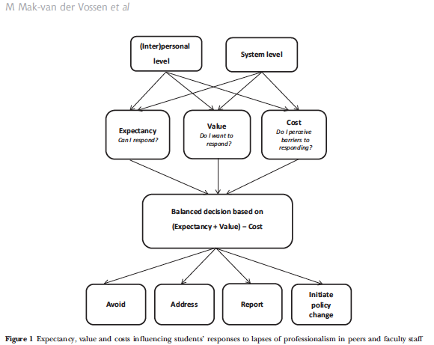
Students less likely to report lapses in professionalism:
- did not know how to respond
- believed responding was futile or
fearing retaliation.
Notes:
In this study, authors looked at the barriers for students to report unprofessional behaviors of peers or faculty. They found different actions after a witness in lapse in professionalism which including avoiding, addressing, reporting, and initiating policy change. The authors then go on to hypothesize that this is a result of balanced decision weighing expectancy, value, and cost.

Slide 10
The Way it Was….
When you were concerned about a student’s behavior, you:
Gave them benefit of doubt and said nothing
Discussed it with experienced faculty member to decide what to do
Informed Dean of Students of event but did not mention to student
(very kind man and student advocate)
Addressed it with student, with or without:
Mentioning it in their evaluation
Informing Dean of Students
Caused several problems
Multiple standards used and similar events treated very differently
Patterns of behavior by individual students were missed until quite late
Example

Slide 11
+
An Environment of Accountability
Notes:
With this background in mind, UFCOM sought to create an environment of accountability.
While we will only focus on the “Student Professionalism Lapse Report” today, it is important to give context to the overall system at play. While students must be given the opportunity to address and remediate unprofessional behaviors, if we are to create a true environment of professionalism, residents/faculty/and staff must be held to the same standards as well. So as we describe the student portal, recognize that a parallel system exists to address professionalism and mistreatment concerns from students about residents, faculty, and staff.

Slide 12
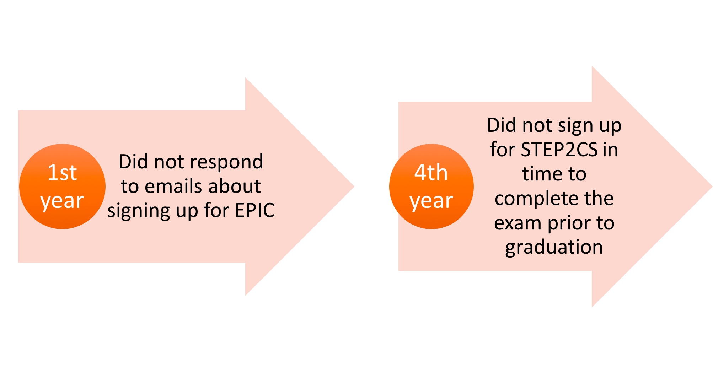
Notes:
When a student has a professionalism concern arise that is egregious, the situation will come before the Academic Status Committee, and if an adverse action takes place, this has implications for a students’ MSPE letter
Similar to what the articles listed before, we found that students who came before the committee often had prior, minor infractions that were not formally addressed or remediated

Slide 13
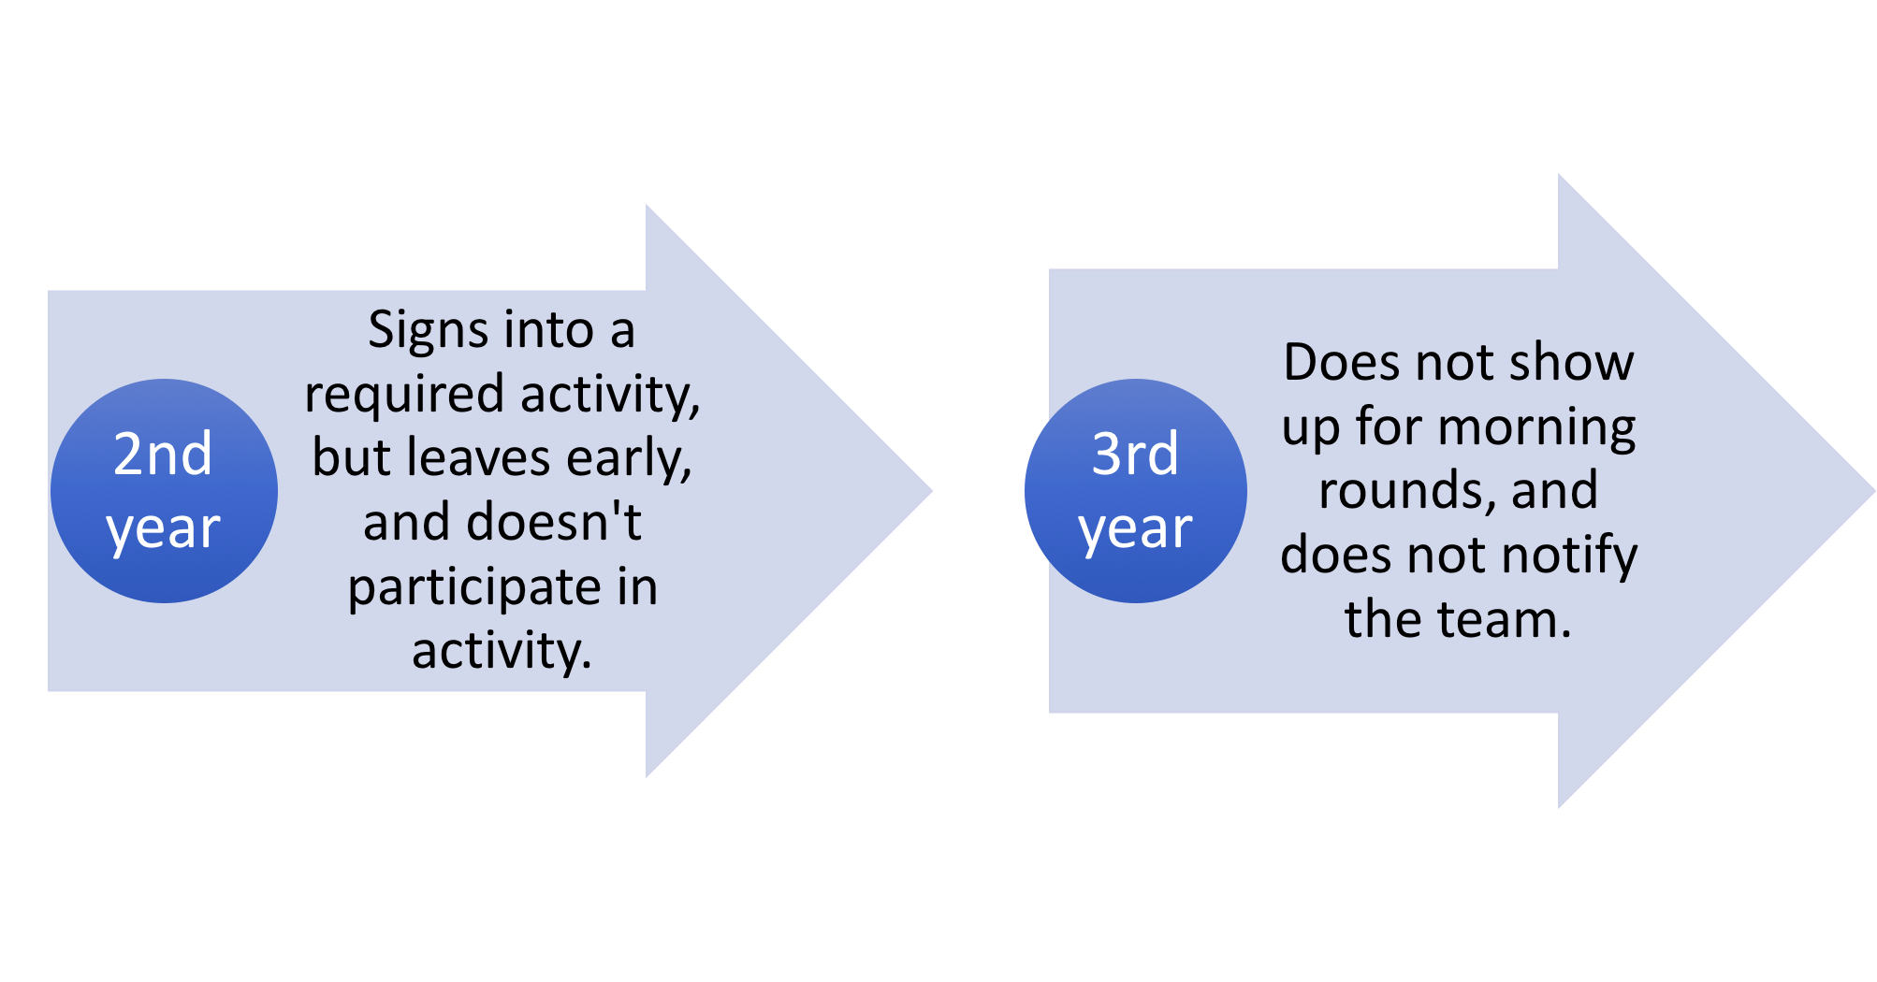
Notes:
While the initial offense may seem minor, the latter consequences have ramifications that not only affect the students’ future, but negatively impact patient care and effective team dynamics.

Slide 14
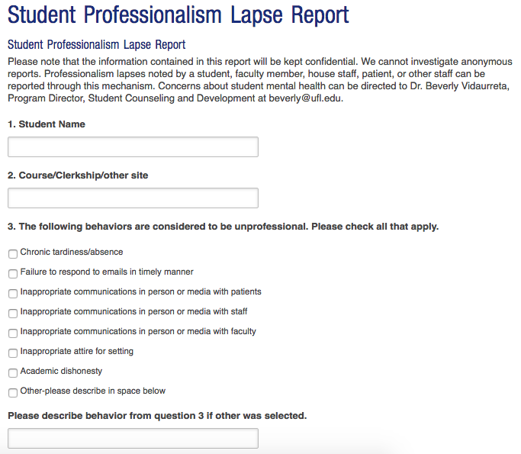
Notes:
Therefore, we wanted to create a system that would address these initial, minor offenses to (1) Provide constructive feedback rather than punitive repercussions, (2) to create a culture of accountability that places the integrity of our profession and patient care as paramount, (3) Take burden off of individual faculty members and course/clerkship directors (4) create a systematic solution which makes it easy to track outcomes and recognize patterns of repeated professionalism lapses.
This system is housed on the UFCOM Student Affair’s website, but also linked within EPIC, UF Shands’ EMR system

Slide 15
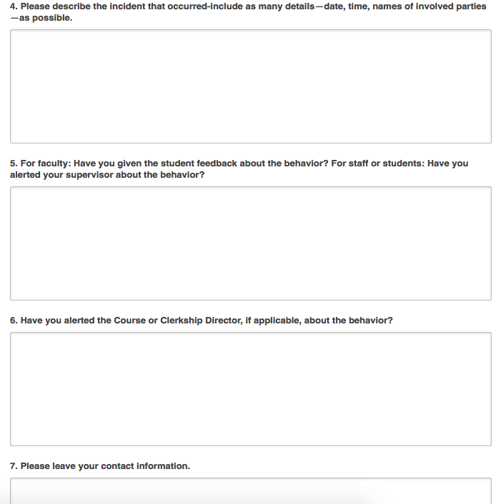
Notes:
Note, if the reporter is a faculty member, he or she must provide his or her name for the report to be considered. Non-faculty, residents, and students may submit anonymously
Additionally, faculty MUST have approached the student first, and given initial feedback. If a faculty member does NOT give a student feedback on the behavior first, the report will be immediately invalidated.

Slide 16
Notes:
Once submitted, all reports are initially filtered by the Dean of Student Affairs, the Assistant Dean for Medical Education, the Dean for Medical Education, and/or the Chair of the Academic Status Committee

Slide 17
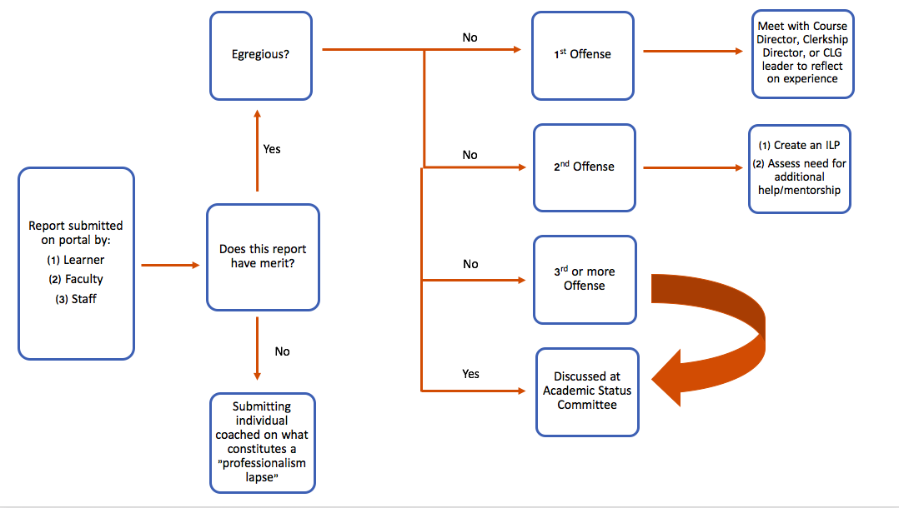
Notes:
After the merit of a submission has been verified, the report will follow the algorithm provided above

Slide 18
What do students think about this?
Lack of awareness of the portal
Don’t understand impetus of portal
Fear that the portal is punitive, and that documentation will harm their “permanent record”/MSPE letter
Fear of hurting camaraderie and trust amongst classmates
Desire more visibility and accessibility of administration
Notes:
To understand how students were receiving the new portal, and to better understand the barriers that would limit submissions, we led a task force amongst each class’s President and Vice President

Slide 19
UF College of Medicine Experience
Three submissions to date
By clinical faculty member, did not describe a professionalism issue; counseled on options for how to deal with what was reported and on appropriate use of this portal
By staff member (appropriate report of rude behavior)
By small group leader (appropriate report)
Fewer than expected. Possible reasons:
New system, faculty not fully aware of it
Faculty are told if they do not discuss with student before reporting, report will not even be looked at
During process of submitting report, faculty member decides no need to report (and perhaps only discusses it with the student)

Slide 20
Discussion and Questions

Slide 21
References
Cooper WO, Guillamondegui O, Hines OJ, et al. Use of unsolicited patient observations to identify surgeons with increased risk for postoperative complications. JAMA Surg. 2017; 152 (6): 522-9.
Mak-van der Vossen M., A. Teherani, W. A van Mook, et al. Investigating US medical students’ motivation to respond to lapses in professionalism. Medical Education. 2018; 52: 838-850.
Papadakis MA, Arnold GK, Blank LL, et al. Performance during Internal Medicine Residency Training and Subsequent Disciplinary Action by State Licensing Boards. Ann Intern Med. 148:869-876.
Papadakis MA, Hodgson CS, Teherani A., et al. Unprofessional Behavior in Medical School is Associated with Subsequent Disciplinary Action by a State Medical Board. Academic Medicine. 2004; 79(3): 244-249.
Papadakis MA, Teherani A., Banach MA, et al. Disciplinary Action by Medical Boards and Prior Behavior in Medical School. New England Journal of Medicine. 2005; 353(25): 2673-2682.

Slide 22
Please evaluate this presentation using the conference mobile app! Simply click on the "clipboard" icon on the presentation page.

