Slide 1
7
Habits of Highly
Posters
Scott Bragg, PharmD
Trident/Medical University of South Carolina FM Residency
Greg Castelli, PharmD
University of Pittsburgh Medical Center FM Residency
Krishna Desai, MD
Columbia University Medical Center/NYP FM Residency
MAY 7, 2018

Slide 2
(we stole the title from Stephen Covey)

Slide 3
Let’s talk about you...

Slide 4
Objectives
Recognize features of an exceptional poster
Construct a poster that facilitates the delivery of a concise message
Appraise example posters objectively for effective communication

Slide 5
Why Posters?
Quickest way to communicate your message
Disseminate valuable ideas, research findings
Networking
Visual aid to enrich your message
Fulfills ACGME requirement for faculty scholarly activities
Rowe N, et al. What impact do posters have on academic knowledge transfer? A pilot survey on author attitudes and experiences. BMC Med Educ. 2009 Dec 8;9:71.
Accreditation Council on Graduate Medical Education (ACGME), Educational Program, Residents’ Scholarly Activities. https://www.acgme.org/Portals/0/PFAssets/ProgramResources/120_scholarly-activity-guidelines.pdf. Accessed 9/5/17.
Notes:
quickest and succinct

Slide 6
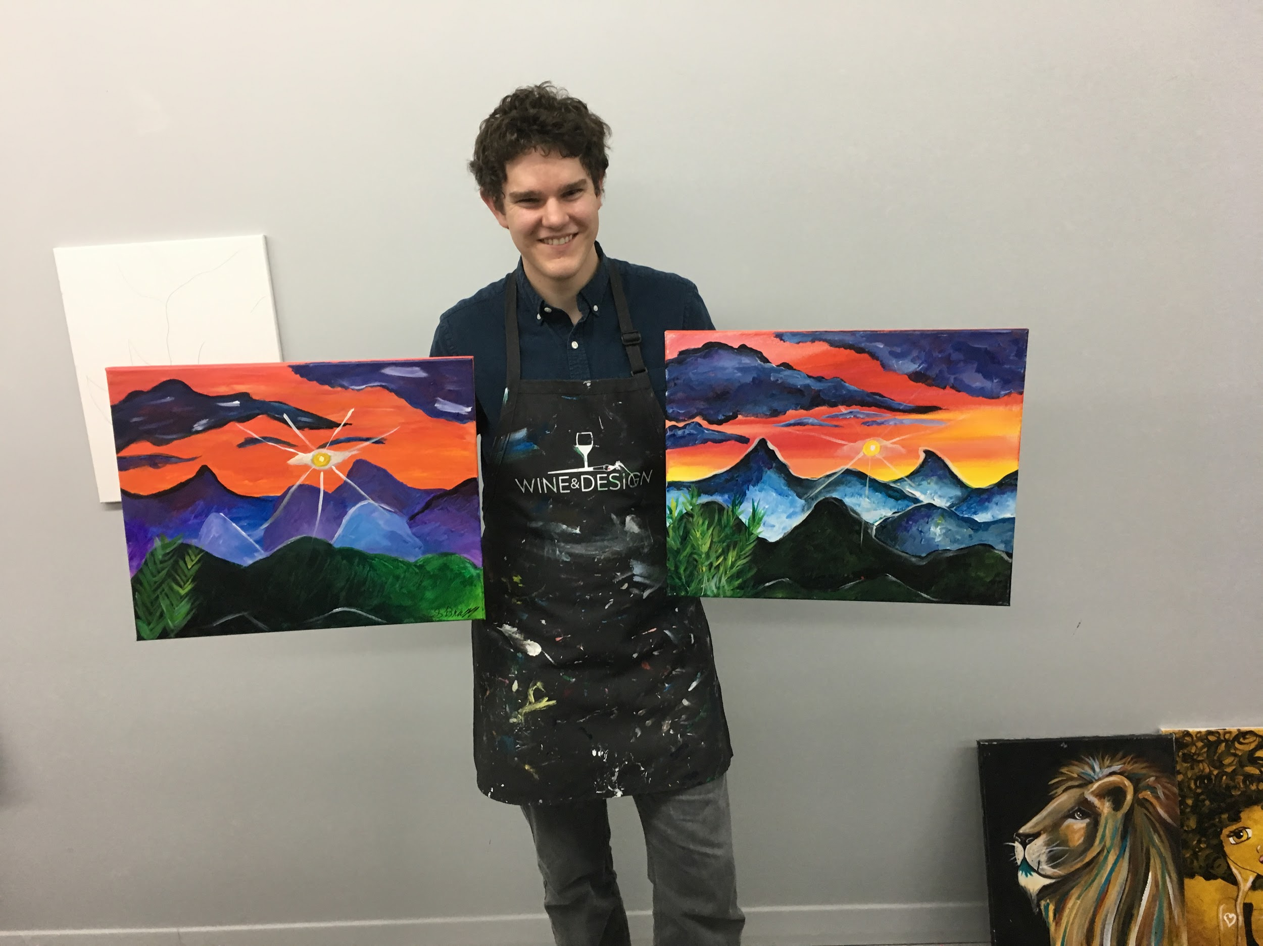
Gallery Walk

Slide 7
Gallery Walk
Please consider the following points as you reflect on the posters during the gallery walk
What is your initial impression?
Layout
-organization and logical flow
-visual appeal
-color scheme, patterns, neatness
Content
-aims/objectives clearly stated
-complexity of graphs, charts
-clear presentation of data
-conclusions relevant to objectives
Readability
-font size, font style, spacing
-amount of text
-grammar/spelling mistakes
Audience Engagement
-title
-does it stimulate interest & discussion?
-what drew you in?
Is there a memorable take home message?

Slide 8
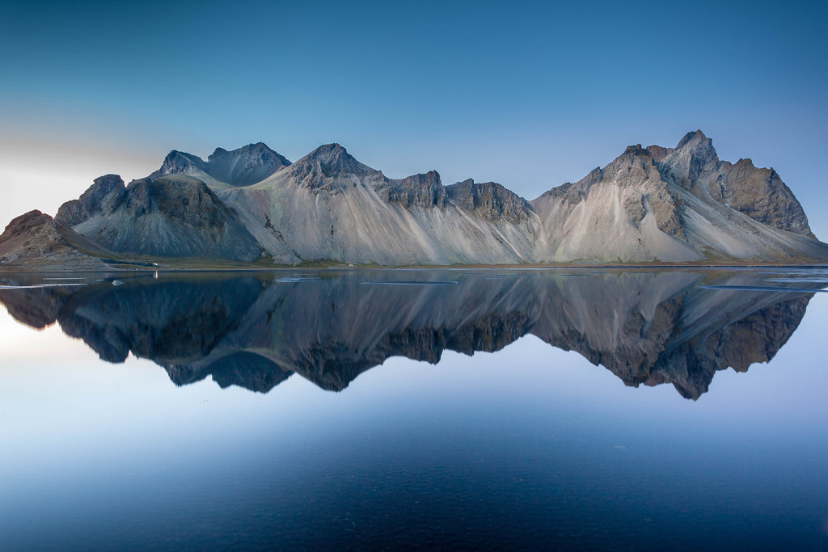
Notes:
Reflections

Slide 9
7 Habits of Highly Effective Posters
Notes:
PLAN: What is the purpose of the poster? Who is the audience? How big should my poster be? What is my timeline for data collection & the presentation?
TITLE: simple/direct, Grabs attention, targeted to audience, Use technology, Workshop it with others
IMAGES: Convey thoughts, talent, beauty, Inspire, Grab attention
POSTER MATERIAL:
Matte paper→ standard poster, cheap option
Glossy/photo quality→ captures rich, vibrant colors, yet reduces glare, & doesn’t get “slimy”
Fabric→ nice to transport; slightly more expensive and takes longer to print, but gives a different feel
Translucent backlit paper→ great quality, high resolution, but often more expensive

Slide 10
Habit #1: PLAN
What is the purpose of your poster?
Timeline: data collection and presentation
What message do you want to convey?
Who is your audience?
What size poster do you need?
Consider the space/location
Electronic vs. physical poster
Notes:
PLAN: What is the purpose of the poster? Who is the audience? How big should my poster be? What is my timeline for data collection & the presentation?
TITLE: simple/direct, Grabs attention, targeted to audience, Use technology, Workshop it with others
IMAGES: Convey thoughts, talent, beauty, Inspire, Grab attention
POSTER MATERIAL:
Matte paper→ standard poster, cheap option
Glossy/photo quality→ captures rich, vibrant colors, yet reduces glare, & doesn’t get “slimy”
Fabric→ nice to transport; slightly more expensive and takes longer to print, but gives a different feel
Translucent backlit paper→ great quality, high resolution, but often more expensive

Slide 11
Habit #2: Choosing Titles
“Teaching the ABC’s of OTC’s”
-Julie Adkison, Memorial Hermann Hospital System FMR
“Thinking Inside and Outside the Box: Resident Experiential Learning in Population Health.”
-Timothy Riley, Penn State Milton S Hershey Medical Center FMR
“Building Trust: Improving Morale Among Medical Assistants at a Family Medicine Teaching Clinic.”
-Magdalen Edmunds
“As Primary Care Transforms, So Does Resident Education: A Leadership Project in Curriculum Development.”
-Anna Laurie
“Early ChopChop-ing of Fruits and Vegetables Increases Consumption Amongst Children.”
-Brian Arndt, University of Wisconsin Madison FMR
Make it simple yet informative
Grab attention, catchy
Appropriate to your audience
Use technology
Workshop it with others
Notes:
PLAN: What is the purpose of the poster? Who is the audience? How big should my poster be? What is my timeline for data collection & the presentation?
TITLE: simple/direct, Grabs attention, targeted to audience, Use technology, Workshop it with others
IMAGES: Convey thoughts, talent, beauty, Inspire, Grab attention
POSTER MATERIAL:
Matte paper→ standard poster, cheap option
Glossy/photo quality→ captures rich, vibrant colors, yet reduces glare, & doesn’t get “slimy”
Fabric→ nice to transport; slightly more expensive and takes longer to print, but gives a different feel
Translucent backlit paper→ great quality, high resolution, but often more expensive

Slide 12
Habit #3: LIMIT TEXT

Slide 13
Habit #4: Use Graphics
Notes:
PLAN: What is the purpose of the poster? Who is the audience? How big should my poster be? What is my timeline for data collection & the presentation?
TITLE: simple/direct, Grabs attention, targeted to audience, Use technology, Workshop it with others
IMAGES: Convey thoughts, talent, beauty, Inspire, Grab attention
POSTER MATERIAL:
Matte paper→ standard poster, cheap option
Glossy/photo quality→ captures rich, vibrant colors, yet reduces glare, & doesn’t get “slimy”
Fabric→ nice to transport; slightly more expensive and takes longer to print, but gives a different feel
Translucent backlit paper→ great quality, high resolution, but often more expensive

Slide 14
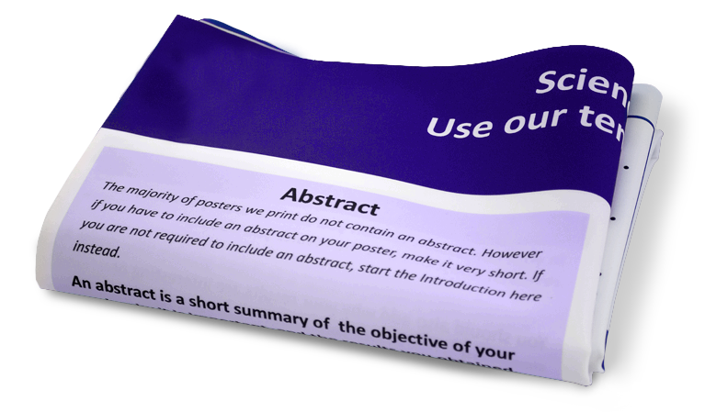
Habit #5: Choose Material
Matte paper
standard poster
cheapest option
Glossy paper
rich, vibrant colors
increases glare
doesn’t get “slimy”
Fabric
easy to transport
more expensive, unique feel
can look messy when not ironed
Translucent backlit paper
high quality and resolution
durable with lamination
requires lighted display
Notes:
PLAN: What is the purpose of the poster? Who is the audience? How big should my poster be? What is my timeline for data collection & the presentation?
TITLE: simple/direct, Grabs attention, targeted to audience, Use technology, Workshop it with others
IMAGES: Convey thoughts, talent, beauty, Inspire, Grab attention
POSTER MATERIAL:
Matte paper→ standard poster, cheap option
Glossy/photo quality→ captures rich, vibrant colors, yet reduces glare, & doesn’t get “slimy”
Fabric→ nice to transport; slightly more expensive and takes longer to print, but gives a different feel
Translucent backlit paper→ great quality, high resolution, but often more expensive

Slide 15
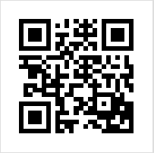
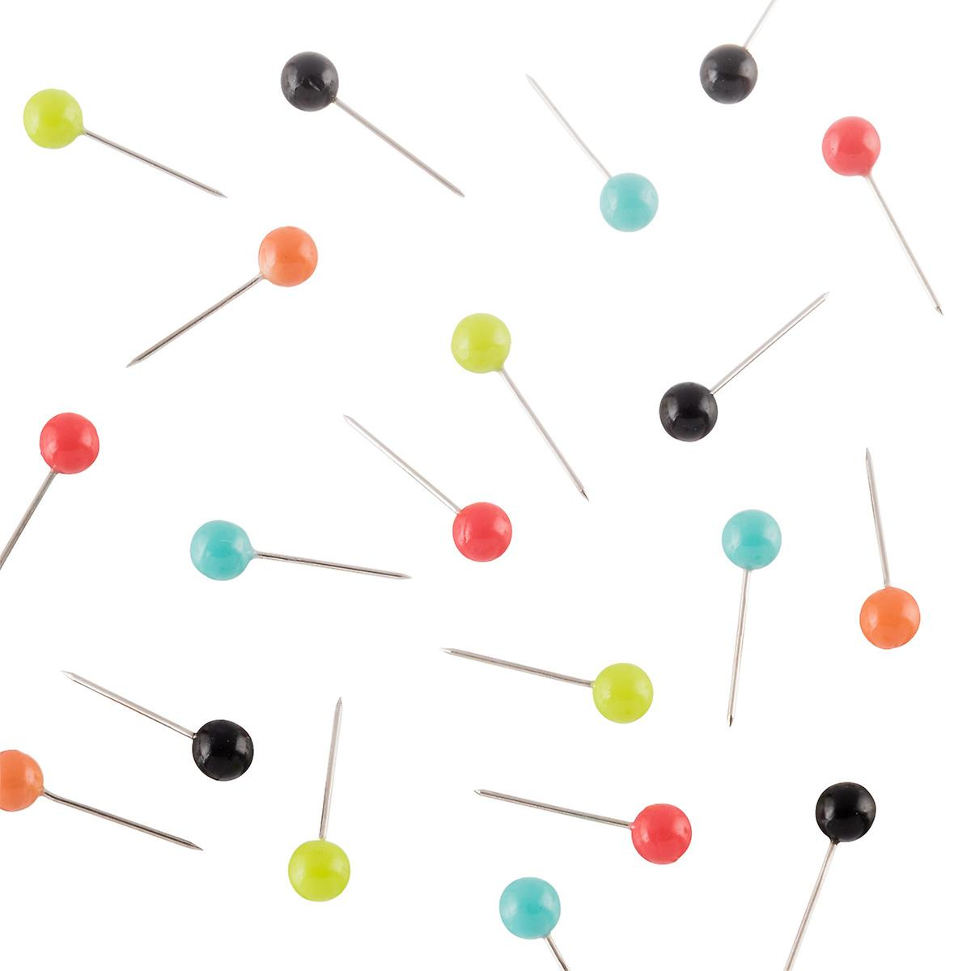
Habit #6: Be Creative
Make your poster interactive
sticky notes
pushpins
survey questions
Use QR codes for references
Engage your audience
Have fun!
Notes:
PLAN: What is the purpose of the poster? Who is the audience? How big should my poster be? What is my timeline for data collection & the presentation?
TITLE: simple/direct, Grabs attention, targeted to audience, Use technology, Workshop it with others
IMAGES: Convey thoughts, talent, beauty, Inspire, Grab attention
POSTER MATERIAL:
Matte paper→ standard poster, cheap option
Glossy/photo quality→ captures rich, vibrant colors, yet reduces glare, & doesn’t get “slimy”
Fabric→ nice to transport; slightly more expensive and takes longer to print, but gives a different feel
Translucent backlit paper→ great quality, high resolution, but often more expensive

Slide 16
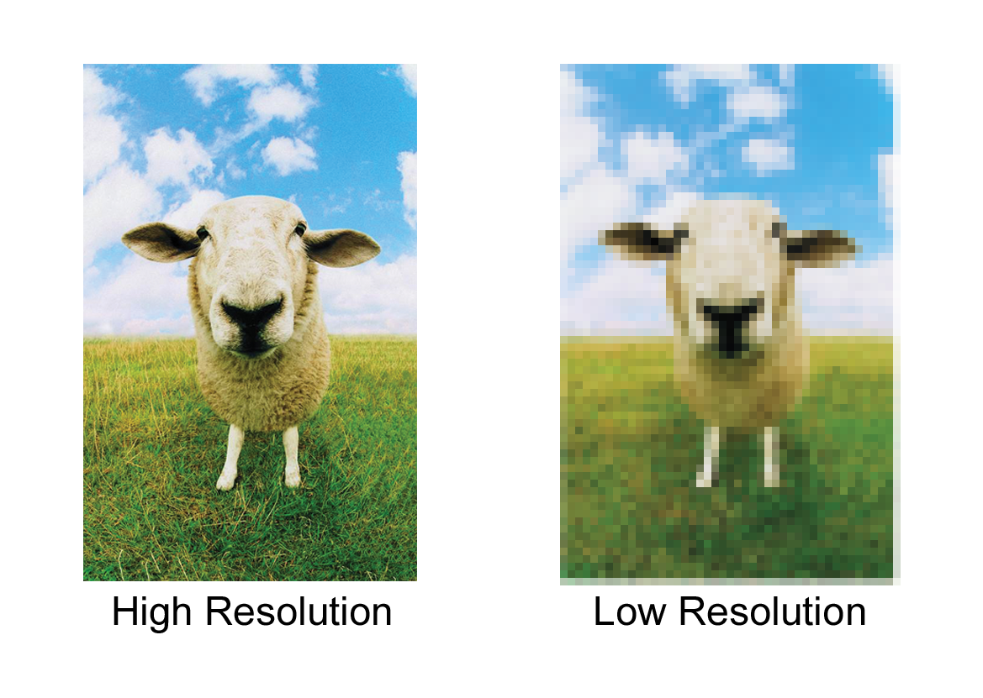
Habit #7: Avoid Pitfalls
Font size
too small
too fancy
should be able to read from 6 ft distance
no smaller than 24 pt size font
Low resolution images
Unnatural flow
Too complex
Notes:
PLAN: What is the purpose of the poster? Who is the audience? How big should my poster be? What is my timeline for data collection & the presentation?
TITLE: simple/direct, Grabs attention, targeted to audience, Use technology, Workshop it with others
IMAGES: Convey thoughts, talent, beauty, Inspire, Grab attention
POSTER MATERIAL:
Matte paper→ standard poster, cheap option
Glossy/photo quality→ captures rich, vibrant colors, yet reduces glare, & doesn’t get “slimy”
Fabric→ nice to transport; slightly more expensive and takes longer to print, but gives a different feel
Translucent backlit paper→ great quality, high resolution, but often more expensive

Slide 17
Resources
www.posterpresentations.com
“How to make a poster in Powerpoint”

Slide 18
Resources: Where To Print
Your own institution
Order online (e.g., www.makesigns.com )
Brick and mortar stores (e.g., FedEx Office)
Print color poster handouts & other supplementary material
Expect to pay ~$100 for 4 x 6 poster (more if you procrastinate)

Slide 19
Final Tips
Have others review your poster for typos; get feedback!
Send for print early (check turnaround time)
Pin color handouts to board
Networking opportunities
have business cards ready
Review display time/room, arrive early!

Slide 20
REFERENCES
Accreditation Council on Graduate Medical Education (ACGME), Educational Program, Residents’ Scholarly Activities. https://www.acgme.org/Portals/0/PFAssets/ProgramResources/120_scholarly-activity-guidelines.pdf. Accessed 9/5/17.
American College of Physicians. Preparing a Poster Presentation.
https://www.acponline.org/membership/residents/competitions-awards/abstracts/preparing/poster. Accessed 9/5/17.
Hamilton CW. At a glance: a stepwise approach to successful poster presentations. Chest. 2008 Aug;134(2):457-459. doi: 10.1378/chest.08-1078.
Singh MK. Preparing and presenting effective abstracts and posters in psychiatry. Acad Psychiatry. 2014 Dec;38(6):709-15.
Wood GJ, et al. Writing abstracts and developing posters for national meetings. J Palliat Med. 2011 Mar;14(3):353-9. doi: 10.1089/jpm.2010.0171.
Rowe N, Ilic D. What impact do posters have on academic knowledge transfer? A pilot survey on author attitudes and experiences. BMC Med Educ. 2009 Dec 8;9:71.

Slide 21
Please evaluate our presentation using the conference mobile app!
Simply click on the "clipboard" icon on the presentation page.

Slide 22
Scott Bragg, PharmD
braggsc@musc.edu
Trident/Medical University of South Carolina FM Residency
Krishna Desai, MD
kmd2180@cumc.columbia.edu
Columbia University Medical Center/NYP FM Residency

Slide 27
