Slide 1
RESEARCH IS A TEAM SPORT!
Sandra Burge, PhD
Alex Reed, PsyD, MPH

Slide 2
Scholarship: Excellence Built on Peer Review
Research is give-and-take.
Good researchers share their findings with each other.
Individuals improve their own work by learning from others’ methodologies, findings, and experiences.
This is why we write.
This is why we present our findings.
Our professional societies are learning communities.

Slide 3
Research is a Team Sport!
Carole Bland (1986, 1992) identified keys to research success, including people-resources:
Mentors
Peers who value research
Socialized to value scholarship
Specialized assistance
Professional networking

Slide 4
Objectives
to identify areas of research interest among behavioral science educators
to identify peers with similar interests
to initiate research collaborations for future studies

Slide 5
Meet RRNeT Residency Research Network of Texas

Slide 6
Step 1. BRAINSTORM IDEAS FOR RESEARCH
On a post-it note, write a research idea that interests you.
Write LARGE with a fat pen
Use 7 words or less
One idea per note
3 notes per person
You don’t have a research idea? Instead, write:
Something you have observed clinically that you wondered about, or
A topic that interests you, or
A topic you want to learn more about

Slide 7
Step 2. STICK YOUR IDEAS ON THE WALL AND CLUSTER THEM

Slide 8
Step 3. NAME EACH CLUSTER
MD Wellness
SBIRT
burnout
alcohol
drugs
wellness
screening
resilience
opioids
MD depression
Brief interventions

Slide 9
Step 4. FORM A GROUP AROUND YOUR FAVORITE CLUSTER
Introduce yourselves to each other.
What resources can you bring to a project about this topic? Such as…
personal skills or experiences
local resources (experts, funding)
subjects, research assistants

Slide 10
Step 5. BRAINSTORM A RESEARCH PROJECT
Worksheet
Research Minutes

Slide 11
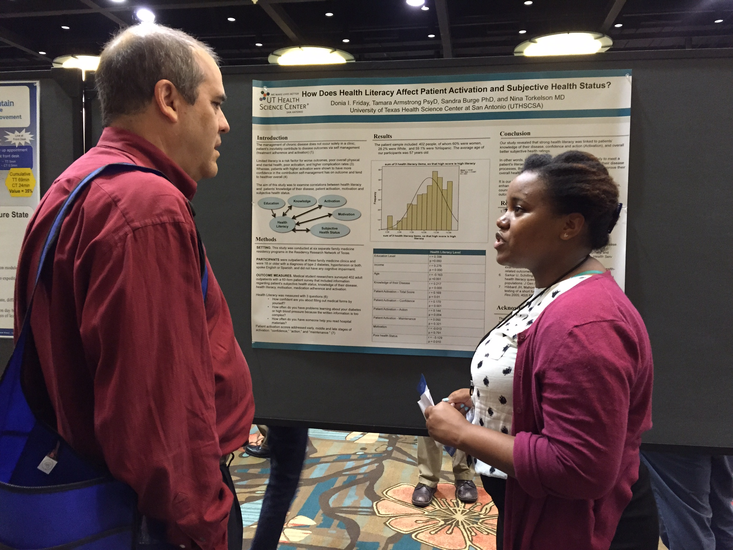
Step 6. SHARE YOUR RESEARCH QUESTION OR STUDY AIM OR HYPOTHESIS

Slide 12
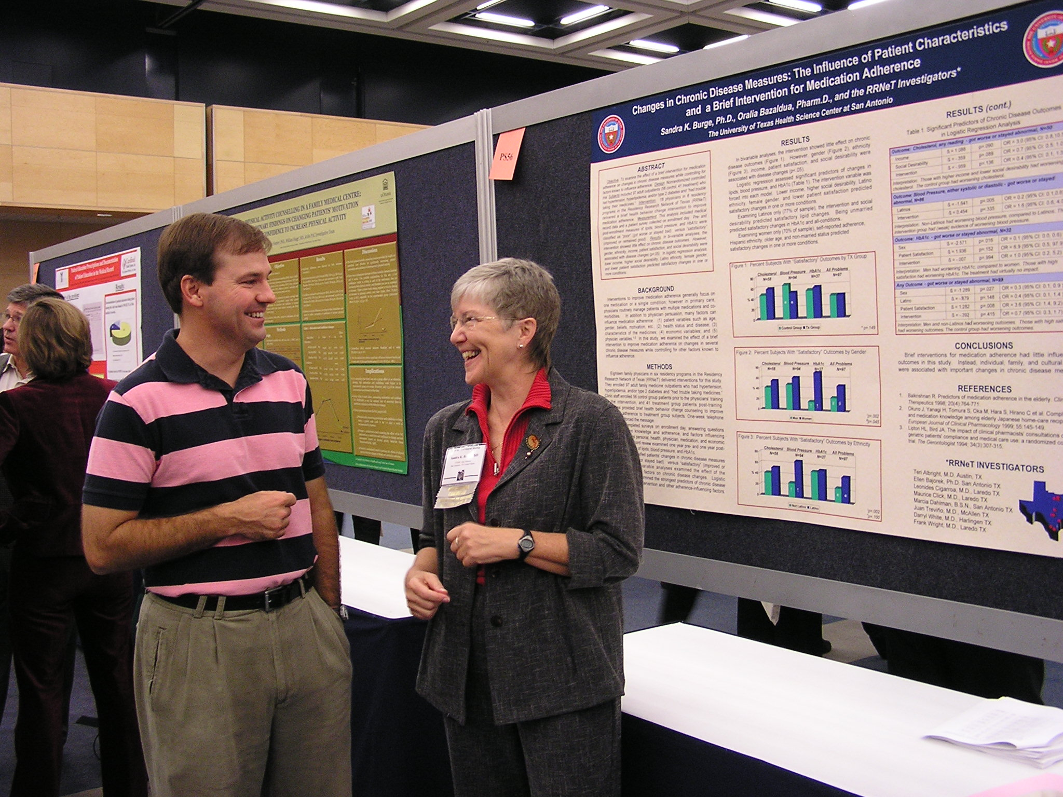
Final Step(s). BUILD COLLABORATIONS SHARE YOUR WORK ACT SCHOLARLY!

