Slide 1
Hypertension in a OneWorld Health Rural Nicaraguan Ambulatory Clinic: Prevalence and Management
Jennifer Lee, DO

Slide 2
Objectives
Introduction to CDC/PAHO Global Standardized Hypertension Treatment Project
Discuss findings from the initial assessment of El Viejo
Discuss challenges of research in a developing country
Discuss future research questions

Slide 3
CDC/PAHO Global Standardized Hypertension Treatment
Launched in 2011
Implemented in some Latin American and Caribbean regions
Goals:
Identify barriers to treatment
Standardize care
Improve delivery systems

Slide 4
Nicaragua
Population: 6 million
Life expectancy: 73
Top causes of death:
- Ischemic heart disease (15.5%)
- Stroke (9.2%)
- Kidney disease (7.1%)
- Diabetes mellitus (5.7%)
Limited research on hypertension
Prevalence
Management/Quality
Barriers to care
Access
Cost
Education
*Country statistics by WHO and UN partners

Slide 5
METHODS

Slide 6
Methods
Cross sectional study
Based on 349 ambulatory care patient charts from a single clinic in El Viejo, Nicaragua, and interviews of clinic staff
Created an abstract form to capture data from medical records:
patient demographics
area of population served
reasons for seeking care
prevalence of hypertension and prescribing practices and
local cultural beliefs.

Slide 7
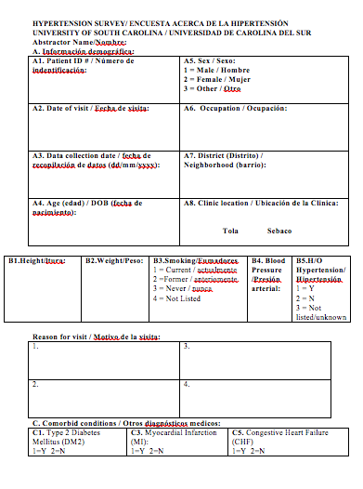
Methods
Data gathering
Challenges:
Foreign language
Paper charts/illegibility
Incomplete charting
No postal address
Limited resource setting

Slide 8
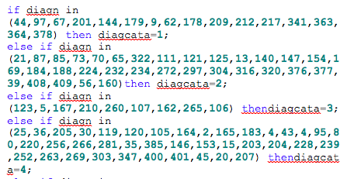
Methods
Data Analysis
Epidata – software used for data entry
Data from the instrument entered into Epidata
SAS 9.4 – statistical analysis program
Basic analysis of the data to present a descriptive analysis of the data collected

Slide 9
Questions to Answer from the data:
What is the prevalence of hypertension in this population?
Who comes to the clinic (age, gender)?
What area does the clinic serve?
What hypertension medications are being prescribed?
Do medications prescribed differ from the national registry?
Does the data support the notion that chronic disease is a problem in Nicaragua?
Does the data reflect the beliefs/practices of the people?

Slide 10
RESULTS

Slide 11
Demographics - Gender
Males - (114)
Females - (231)

Slide 12
AGE
MEAN = 44.2 Years (SD = 17.53)
MEDIAN = 44 Years
RANGE = 18 – 92 Years old

Slide 13
Population Served
El Viejo
= 1km
Neighborhoods:
23% - Light Blue
10% - Pink
10% - Dark Blue
9% - Gray
8% - Green
4% - Yellow
Total: 64% within El Viejo
and within 3km of clinic (1.8 miles)
1km
★

Slide 14
Diseases
1 – UTI
2 – Hypertension
3 – Hyperlipidemia
4 – Anemia
5 – Low Back Pain
6 – Constipation
7 – Hepatic Steatosis
8 – Bronchitis
9 – Diabetes Mellitus Type 2
10 – Acute diarrhea

Slide 15
1-Gastrointestinal
2-Genitourinary
3-Endocrine/metabolic
4-Cardiovascular
5-Musculoskeletal
6-OB/Gyn
7-Renal
8-Respiratory
9-Other
10-ENT
11-Psychiatric
12-Skin/Derm
13-Neurologic
14-Blood/Lymph
⬇

Slide 16
BLOOD PRESSURE (Entire Sample = 349)

Slide 17
Hypertension at 60 and older
BP < 150/90 – (53)
BP > 150/90 – (20)
*note that only 7% of the population of Nicaragua is >60

Slide 18
Follow up?
Yes - (150)
No – (189)

Slide 19
1 – Omeprazole
2 – Levofloxacin
3 – Ibuprofen
4 – Novalgina
5 – Intrafer (iron)
6 – Ketorolac
7 – Meneparol
8 – Ciprofloxacin
9 – Cefixime
10 – Omega 3

Slide 20
Medication on National Formulary
Diuretics
HCTZ
HCTZ + Amiloride
ACE Inhibitors
Enalapril
Captopril
ARBs
- Losartan
Calcium Channel Blockers
- Amlodipine
- Nifedipine
- Atenolol

Slide 21
Outreach Survey Results (Sebaco)
Notes:
Where do you usually obtain your prescriptions?

Slide 22
Outreach Survey Results (Sebaco)
Notes:
If you have missed a dose of your medication in the past six months, what was/were the reason(s) for missing a dose?

Slide 23
Study Weaknesses
Limited information due to sparse/incomplete charting
Limited data about patient compliance and past medical history
Visiting non-Nicaraguan doctors may have skewed results
Reliance upon local population for determination of patient residence

Slide 24
Study Strengths
Sample size (349 charts)
Identified areas of incomplete or non-existent documentation
Incorporation of cultural beliefs in interpretation of significance and meaning of data outcomes

Slide 25
Conclusions
Hypertension is one of the most common diagnoses given at the El Viejo clinic
Improved documentation could provide insight into specific risk factors, trends, and compliance
There is a need for private clinics and pharmacies that provide affordable care and medications
Convenience, reliability, and the patient’s perception of the integrity of provider and medication influence adherence

Slide 26
Future Questions
Will an intervention program based of of the CDC/PAHO framework work for El Viejo?
Will strengthening the physician-pharmacist-patient relationship improve compliance?
Will the intervention create more accurate and robust documentation?
Why are broad-spectrum antibiotics being used?
How are prescribing habits influenced by the patient’s expectation in the private clinic setting?

Slide 27
References
CDC/PAHO
Formulario Nacional de Medicamentos 7th Edición 2014

