Slide 1
How to Bring About Knowledge and Change Through FMIG
Early, Often and Holding On

Slide 2
Presenters
Joyce Jeardeau
University of Wisconsin, Madison
Peter Cao
University of Minnesota, Twin Cities
Porsha Clayton
Emory University School of Medicine, Atlanta

Slide 3
Goals
Highlight the resources available to FMIG Student Leaders, Faculty Advisors and Staff Advisors that will help facilitate a successful and strong FMIG
Stepping stones for success - milestones?
Identify best practices - what’s working

Slide 4
Objectives
Provide information to help other FMIGs grow, and for schools who don’t currently have an FMIG to consider starting one
Show the value of a successful FMIG in institutions, the community, and in Family Medicine recruitment
Demonstrate how Community, Innovation, and Purpose are the focus of a successful FMIG

Slide 5
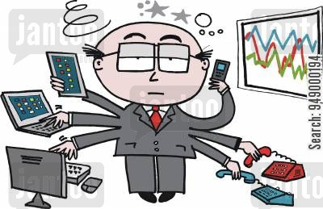
Our Roles in FMIG
Joyce – FMIG staff advisor, administrative support,
and large event planner
Peter – Same!?
Porsha – Same!?

Slide 6
What do they (students, staff or faculty) already know?
?
Family Medicine? Who we are?
FMIG?
Medical education?

Slide 7
In the Beginning…
How does your school introduce students to Family Medicine?

Slide 9
Not just reaching out but also reaching in - Where is your community?

Slide 10
Innovation

Slide 11
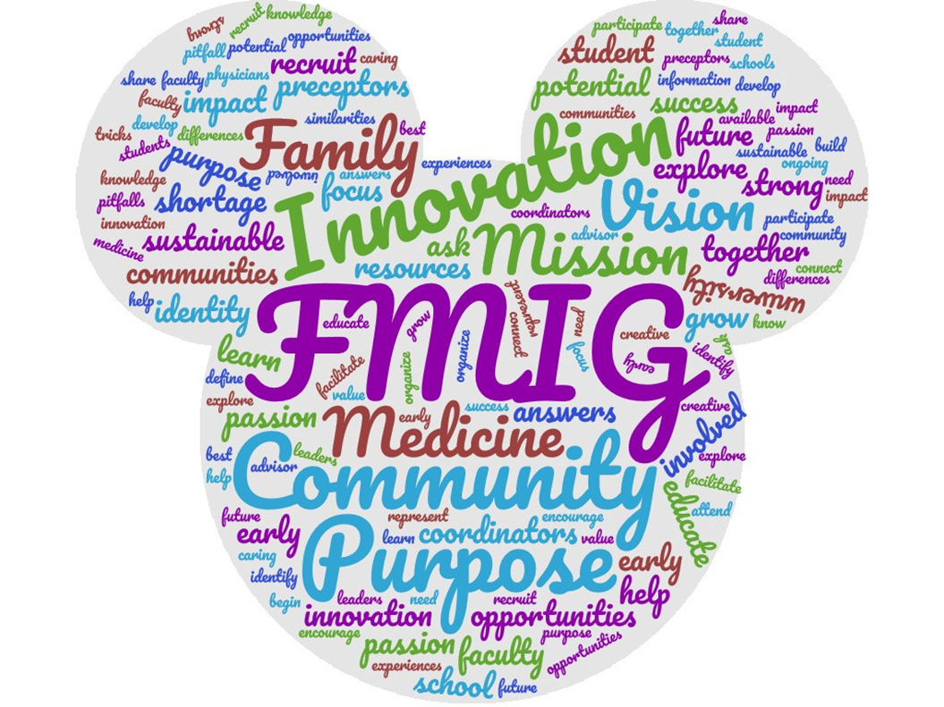
Creative Ideas - What are yours?

Slide 12
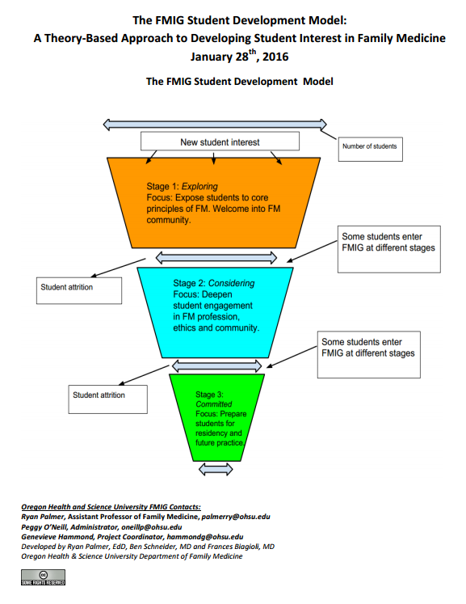

Slide 13
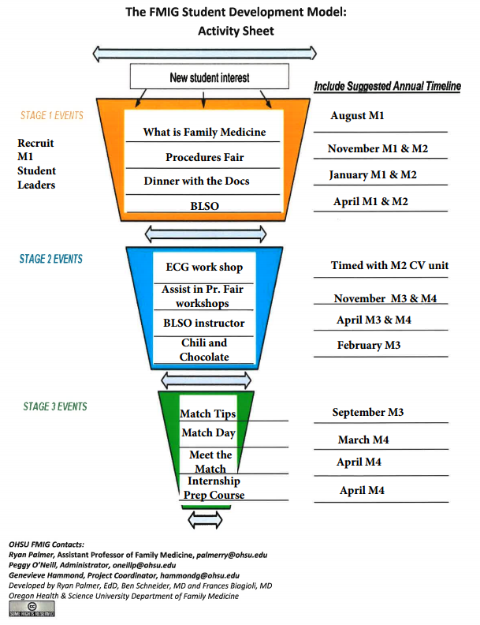

Slide 14
Purpose

Slide 15
Why and What
Mission Statement:
The mission of EUSOM FMIG is to build excitement and support for Family Medicine among Emory health professional students. We do this by educating students about the diversity and breadth of family practice and creating opportunities for longitudinal mentorship.
How to fulfill our Purpose:
Building excitement and support for Family Medicine through Lunch Time Talks, Dinner Panels, Procedure Fairs, Networking Events
What’s your purpose and how will you fulfill it?

Slide 16
You can make a difference in Family Medicine
It can start with your FMIG
I loved this event! It was great to connect with family med professionals and be exposed to procedures that I likely wouldn't see for a couple of years!
I love the hands on nature of this event. It reminds me of why I went into medicine and helps me stay excited and motivated in the classroom setting. It is obvious how much all of the doctors love their job.
I LOVED IT. I had the opportunity to speak to Allison Couture, a family medicine resident, during the GYN procedures workshop; she was a great teacher and also gave valuable insight into why she chose/enjoys family medicine.
The personal stories that painted a comprehensive & authentic picture of FM.
Excellent speaker! Was not aware of so many opportunities in FM! Also, loved the statistics

Slide 17
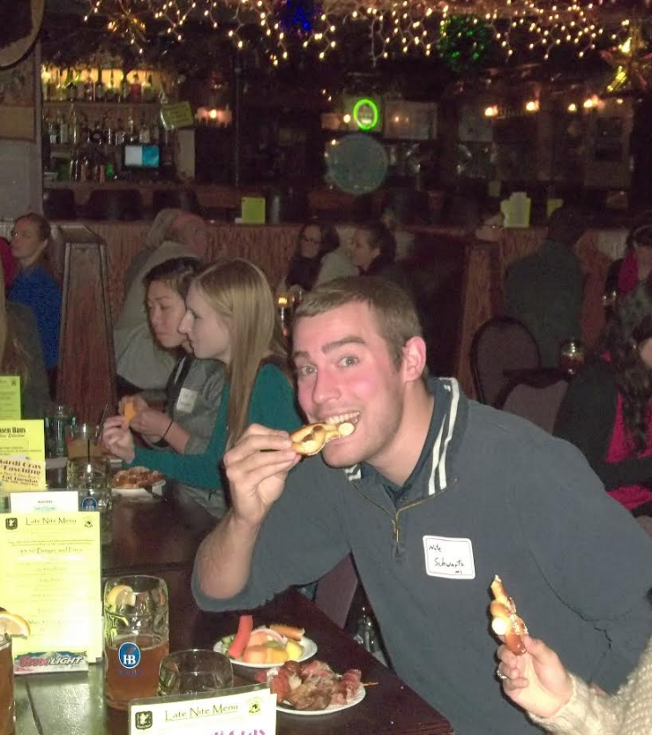
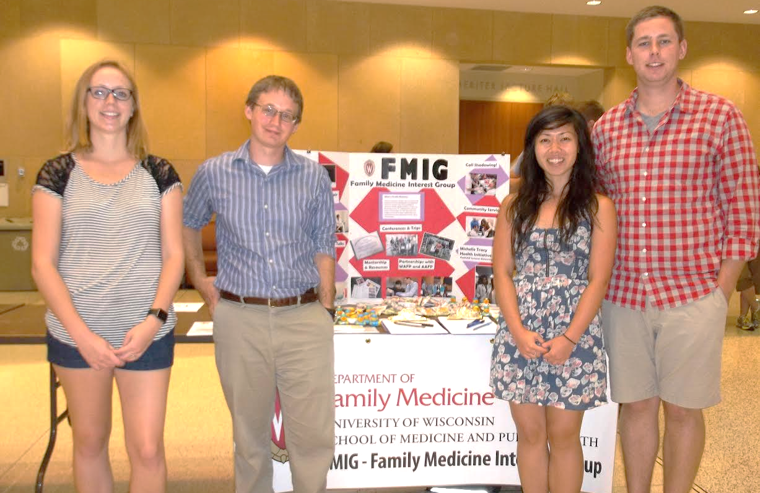
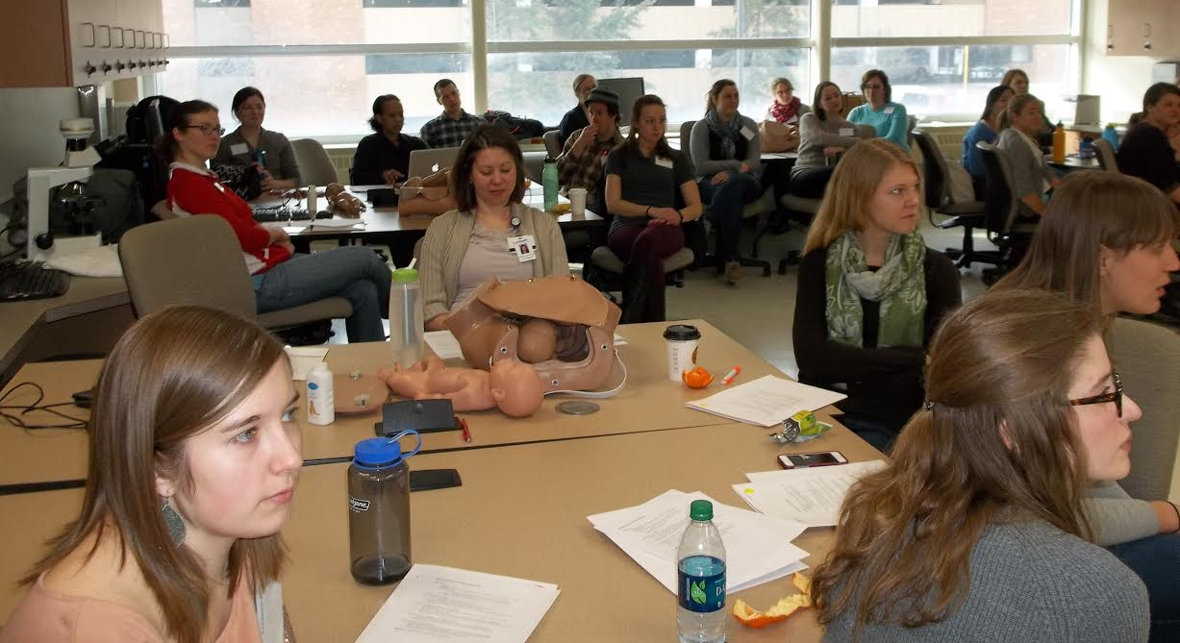

Slide 18
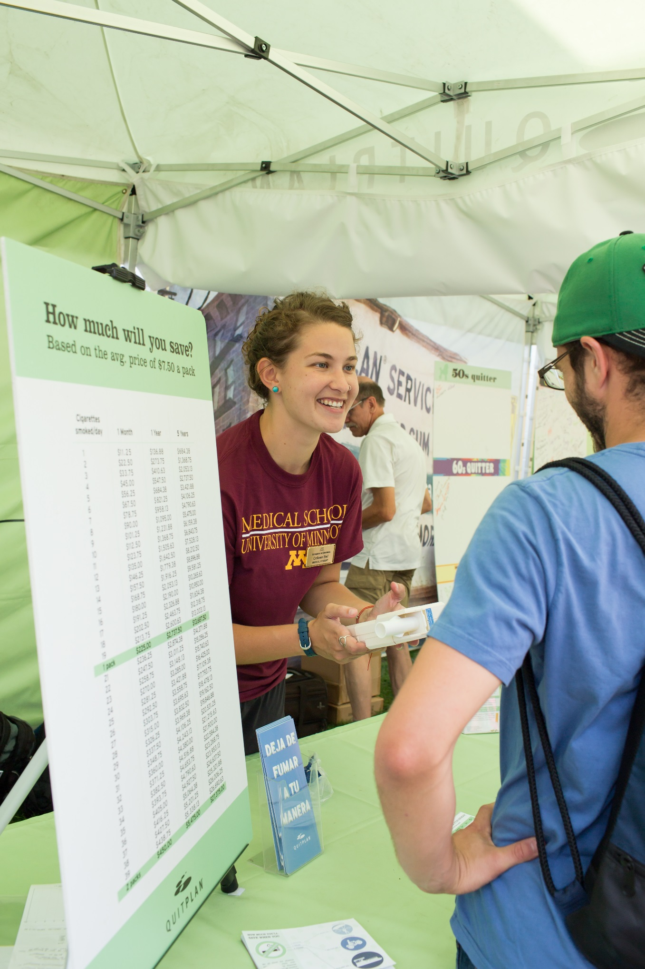

Slide 19
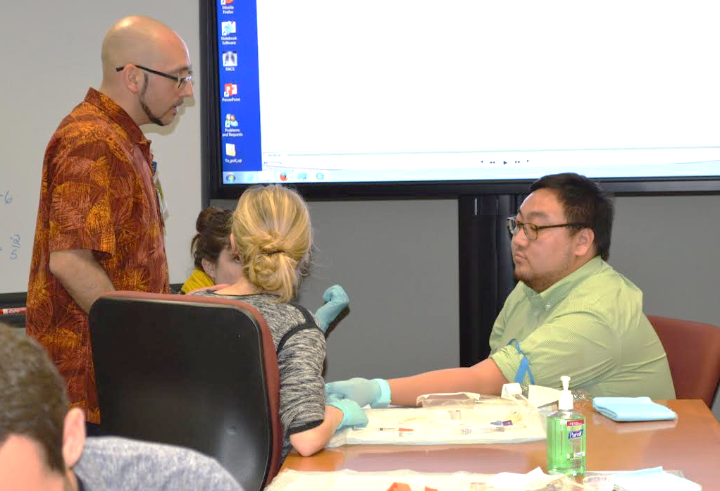
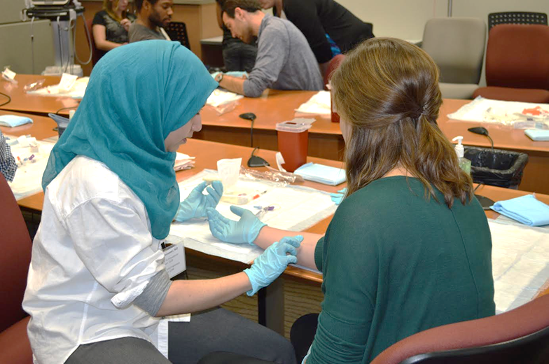
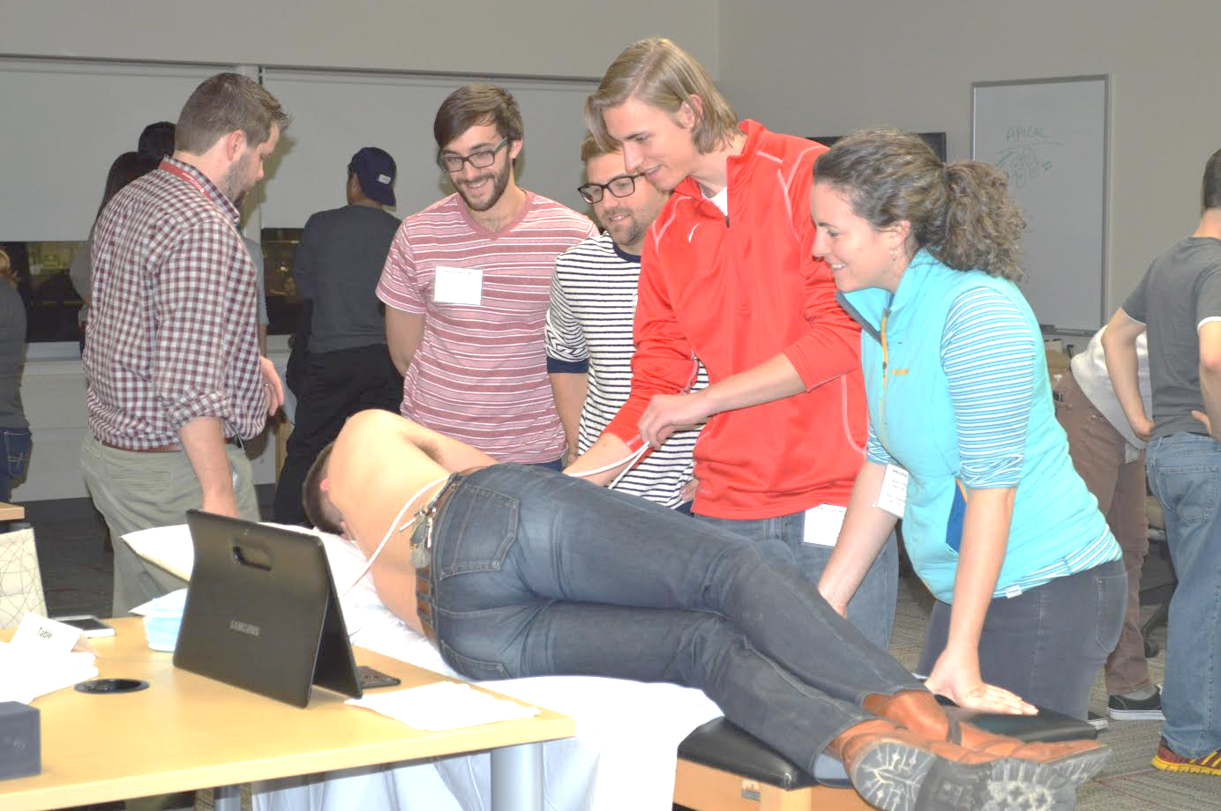
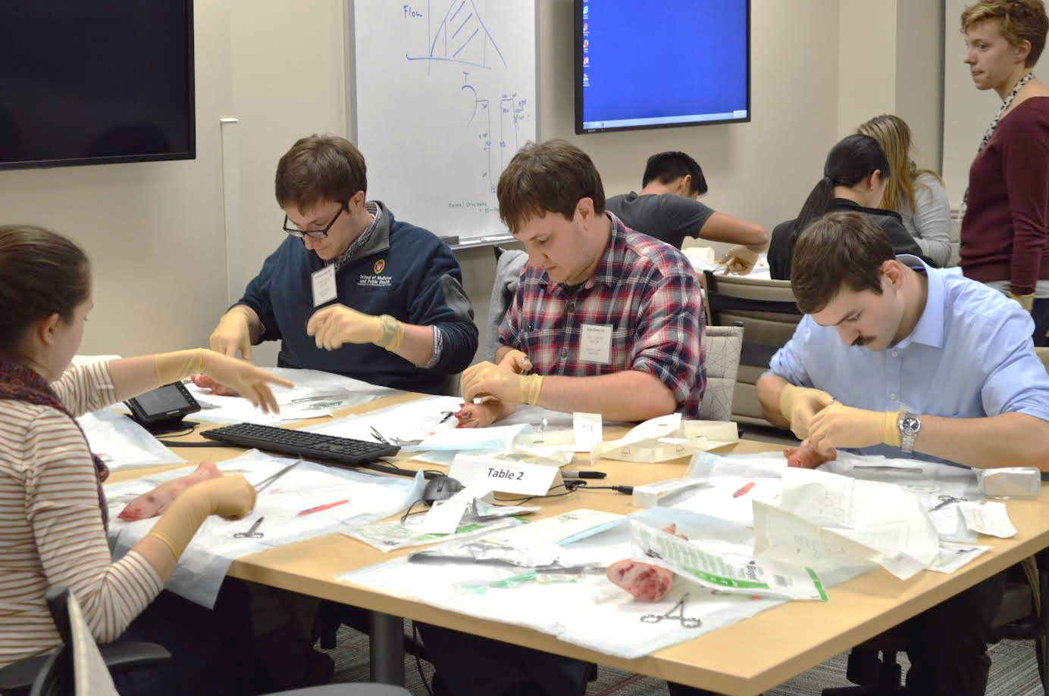

Slide 20
Acknowledgements and Resources
AAFP – for the use of information on their website
word cloud template tool: http://www.wordclouds.com
FMIG Network Faculty and Staff Advisors and Supporters Online Community – please join!
www.aafp.org/medical-school-residency/internal/online-community/fmig-faculty-community-form.html

Slide 21
Please evaluate this presentation using the conference mobile app! Simply click on the "clipboard" icon on the presentation page.

