Slide 1
Overcoming Implementation Barriers to Using an Electronic Medical Record System in the Rural LMIC Primary Care Clinic Setting
Kathy Z. Chang, MD, MPH, FAAFP
Bridget Nandawula, Clinical Officer

Slide 2
Affiliations
Kathy Z. Chang, MD, MPH, FAAFP
VP Health, Chair - Medical & Health Committee / Engeye, Inc.
Bridget Nandawula, Clinical Officer
Clinic In-Charge, Engeye Health Clinic / Engeye Health Projects, LTD

Slide 3
Conflict of Interest Statement
Kathy Chang is involved as a volunteer with the non-profit organization whose example is described in this presentation. She has not received any financial compensation for this activity or presentation.
Bridget Nandawula is a salaried staff member of Engeye Health Clinic in Uganda. She has not received any financial compensation apart from the cost of travel and conference fees for her activities in the US or this presentation.
Notes:
Ask for participants to introduce themselves and where they are working/partnered.
What are they hoping to get out of today's presentation.

Slide 4
Group assessment
What setting are you involved in?
Why are you hoping to get out of this presentation/discussion?
What type of medical record system are you currently using?
Is anyone else creating their own system?
Do you have specific questions about system maintenance?

Slide 5
Learning Objectives
Compare the difference between ICD-10 and ICPC-2 coding utility in LMIC¹ versus US-based practice.
Evaluate components of electronic medical record (EMR) design that can be adopted in a rural LMIC primary care setting.
Recognize potential problems with implementing and maintaining an EMR in a rural LMIC setting.
LMIC = low- and middle-income countries
Notes:
Key words: continuity of care, chronic non-communicable diseases, electronic medical record, design and implementation, clinic workflow, grant writing, donor feedback, data collection and maintenance
Knowledge, competency, and/or performance gaps:
Awareness of strategies for improving management of chronic non-communicable diseases in rural LMIC settings.
Ability to describe the process needed for implementation of an EMR for longitudinal monitoring and evaluation for primary care in the rural LMIC setting.
Understanding of technical components and support required for maintenance of an EMR system in the rural LMIC setting.

Slide 6
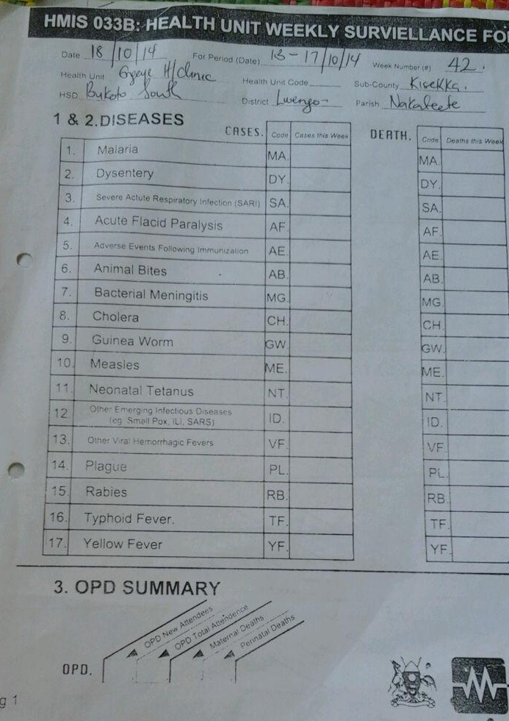
Background LMIC need
Chronic non-communicable diseases create a larger burden for management need in LMIC due to health system challenges
Health Information Systems (HIS) show promise to improve health care
Most available electronic medical record systems have been focused on high profile illnesses (e.g. HIV, TB, malaria)
Notes:
Health Information Systems (HIS) shows promise
how to implement within resource constraints
applicability of evidence from HIC to LMIC
Jawhari review study intent:
sub-Saharan slums (no published info on review)
intervention attributes for deployment success
categories of benefits and harms
forms of inquiry being use
describe where uncertainty remains
Jawhari findings:
most EMR focus on HIV and TB management
little reported on effect of EMR on primary care practices + general health outcomes
experimental inquiry rare and lack level of detail on methods/findings
I would add that most EMR systems used in LMIC are also concentrated on high load referral centers.
Health Systems Challenges (Bloomfield 2014)
prophylaxis and prevention
detection and diagnosis
linkage to care
follow-up/retention to care
quality of care
coordination of care

Slide 7
Update on Evidence for EMR in LMIC
“State-of-the-art” review, 2016 (BMC Medical Informatics and Decision Making)
749 citations -> 32 reports relevant/applicable
sub-Saharan Africa, community-based clinics
no reports of long-term sustained initiatives
experience-based case studies with best practice recommendations
Reference: Jawhari et al. Benefits and challenges of EMR implementations in low resource settings: a state-of-the-art review. BMC Medical Informatics and Decision Making. 2016; 16:116. https://doi.org/10.1186/s12911-016-0354-8
Notes:
Jawhari et al. Focus - they wanted to look at “slum settings” for EMR use - is this relevant/applicable/useful?

Slide 8
Update on Evidence for EMR in LMIC
Implementation success criteria review, 2015 (JAMIA, 47 articles met inclusion, 7 success criterion)
Categories: ethical, financial, functionality, organizational, political, technical, training
Main criteria for success:
Functionality of implemented system >
Organizational structure and support >
Availability of technical infrastructure
3 to 5 year return on investment
Lacking evaluation of concrete application to health care
Reference: Fritz et al. Success criteria for electronic medical record implementation in low-resource settings: a systematic review. Journal of the American Medical Informatics Association. 2015; 22(2):479-488. https://doi.org/10.1093/jamia/ocu038
Notes:
Fritz et al. - Implementation success criteria: “based on the DeLone and McLean model of information systems success.21 Their seven dimensions of information quality, system quality, service quality, use, intention to use, user satisfaction, and net benefits comprise a broad range of aspects and stakeholders. If we define the ultimate success to be a benefit for the user, all those dimensions will have a role to play.”
only looked at design, planning, rollout, and initial EMR use
Categories for Success/Failure:
Ethical - includes regulatory and cultural issues
Financial - resources and funding
Functionality - system architecture and functions
Organizational - focuses on (managerial) circumstances within the organization itself
Political - includes legal health policies and country-wide circumstances
Technical - including infrastructure
Training - including educational background and knowledge
Important global information was usually missing, such as the numbers of users, how long the EMR had been used, the amount of data being processed, or where the funding came from. These points underline that detailed evaluation studies using robust and reliable methodologies are needed, especially in low-resource settings.9For example, guidelines on how to do and report good evaluations such as described in good evaluation practice in health informatics (GEP-HI) and statement on reporting of evaluation studies in health informatics (STARE-HI).27,28

Slide 9
Utility of Electronic Medical Record (EMR)
Potential benefits from Canadian PwC study:
Reduce time pulling charts
More accurate laboratory result management
Scheduling
Billing
Improved legibility and automation of clinical documentation
Reduce order entry time
Improve information access for encounter management
Reference: PwC - Canada Health Infoway (2013). The emerging benefits of electronic medical record use in community-based care. https://www.pwc.com/ca/en/industries/healthcare/publications/electronic-medical-record-use-community-based-care.html
Notes:
Lead-in: So what’s out there for well-resourced settings about EMR benefits?
these factors describe improved efficiency of practice management

Slide 10
Utility of Electronic Medical Record (EMR)
Potential benefits from Canadian PwC study:
Reduce time pulling charts
More accurate laboratory result management
Scheduling
Billing
Improved legibility and automation of clinical documentation
Reduce order entry time (and clinic workflow)
Improve information access for encounter management
Reference: PwC - Canada Health Infoway (2013). The emerging benefits of electronic medical record use in community-based care. https://www.pwc.com/ca/en/industries/healthcare/publications/electronic-medical-record-use-community-based-care.html
Notes:
What we’ve found useful in our low-resource primary care clinic setting in rural Uganda Difference in practice being first-come, first-served structure (rather than scheduled visits) and that we don’t keep paper chart repository (though nearby larger HIV centers do)

Slide 11
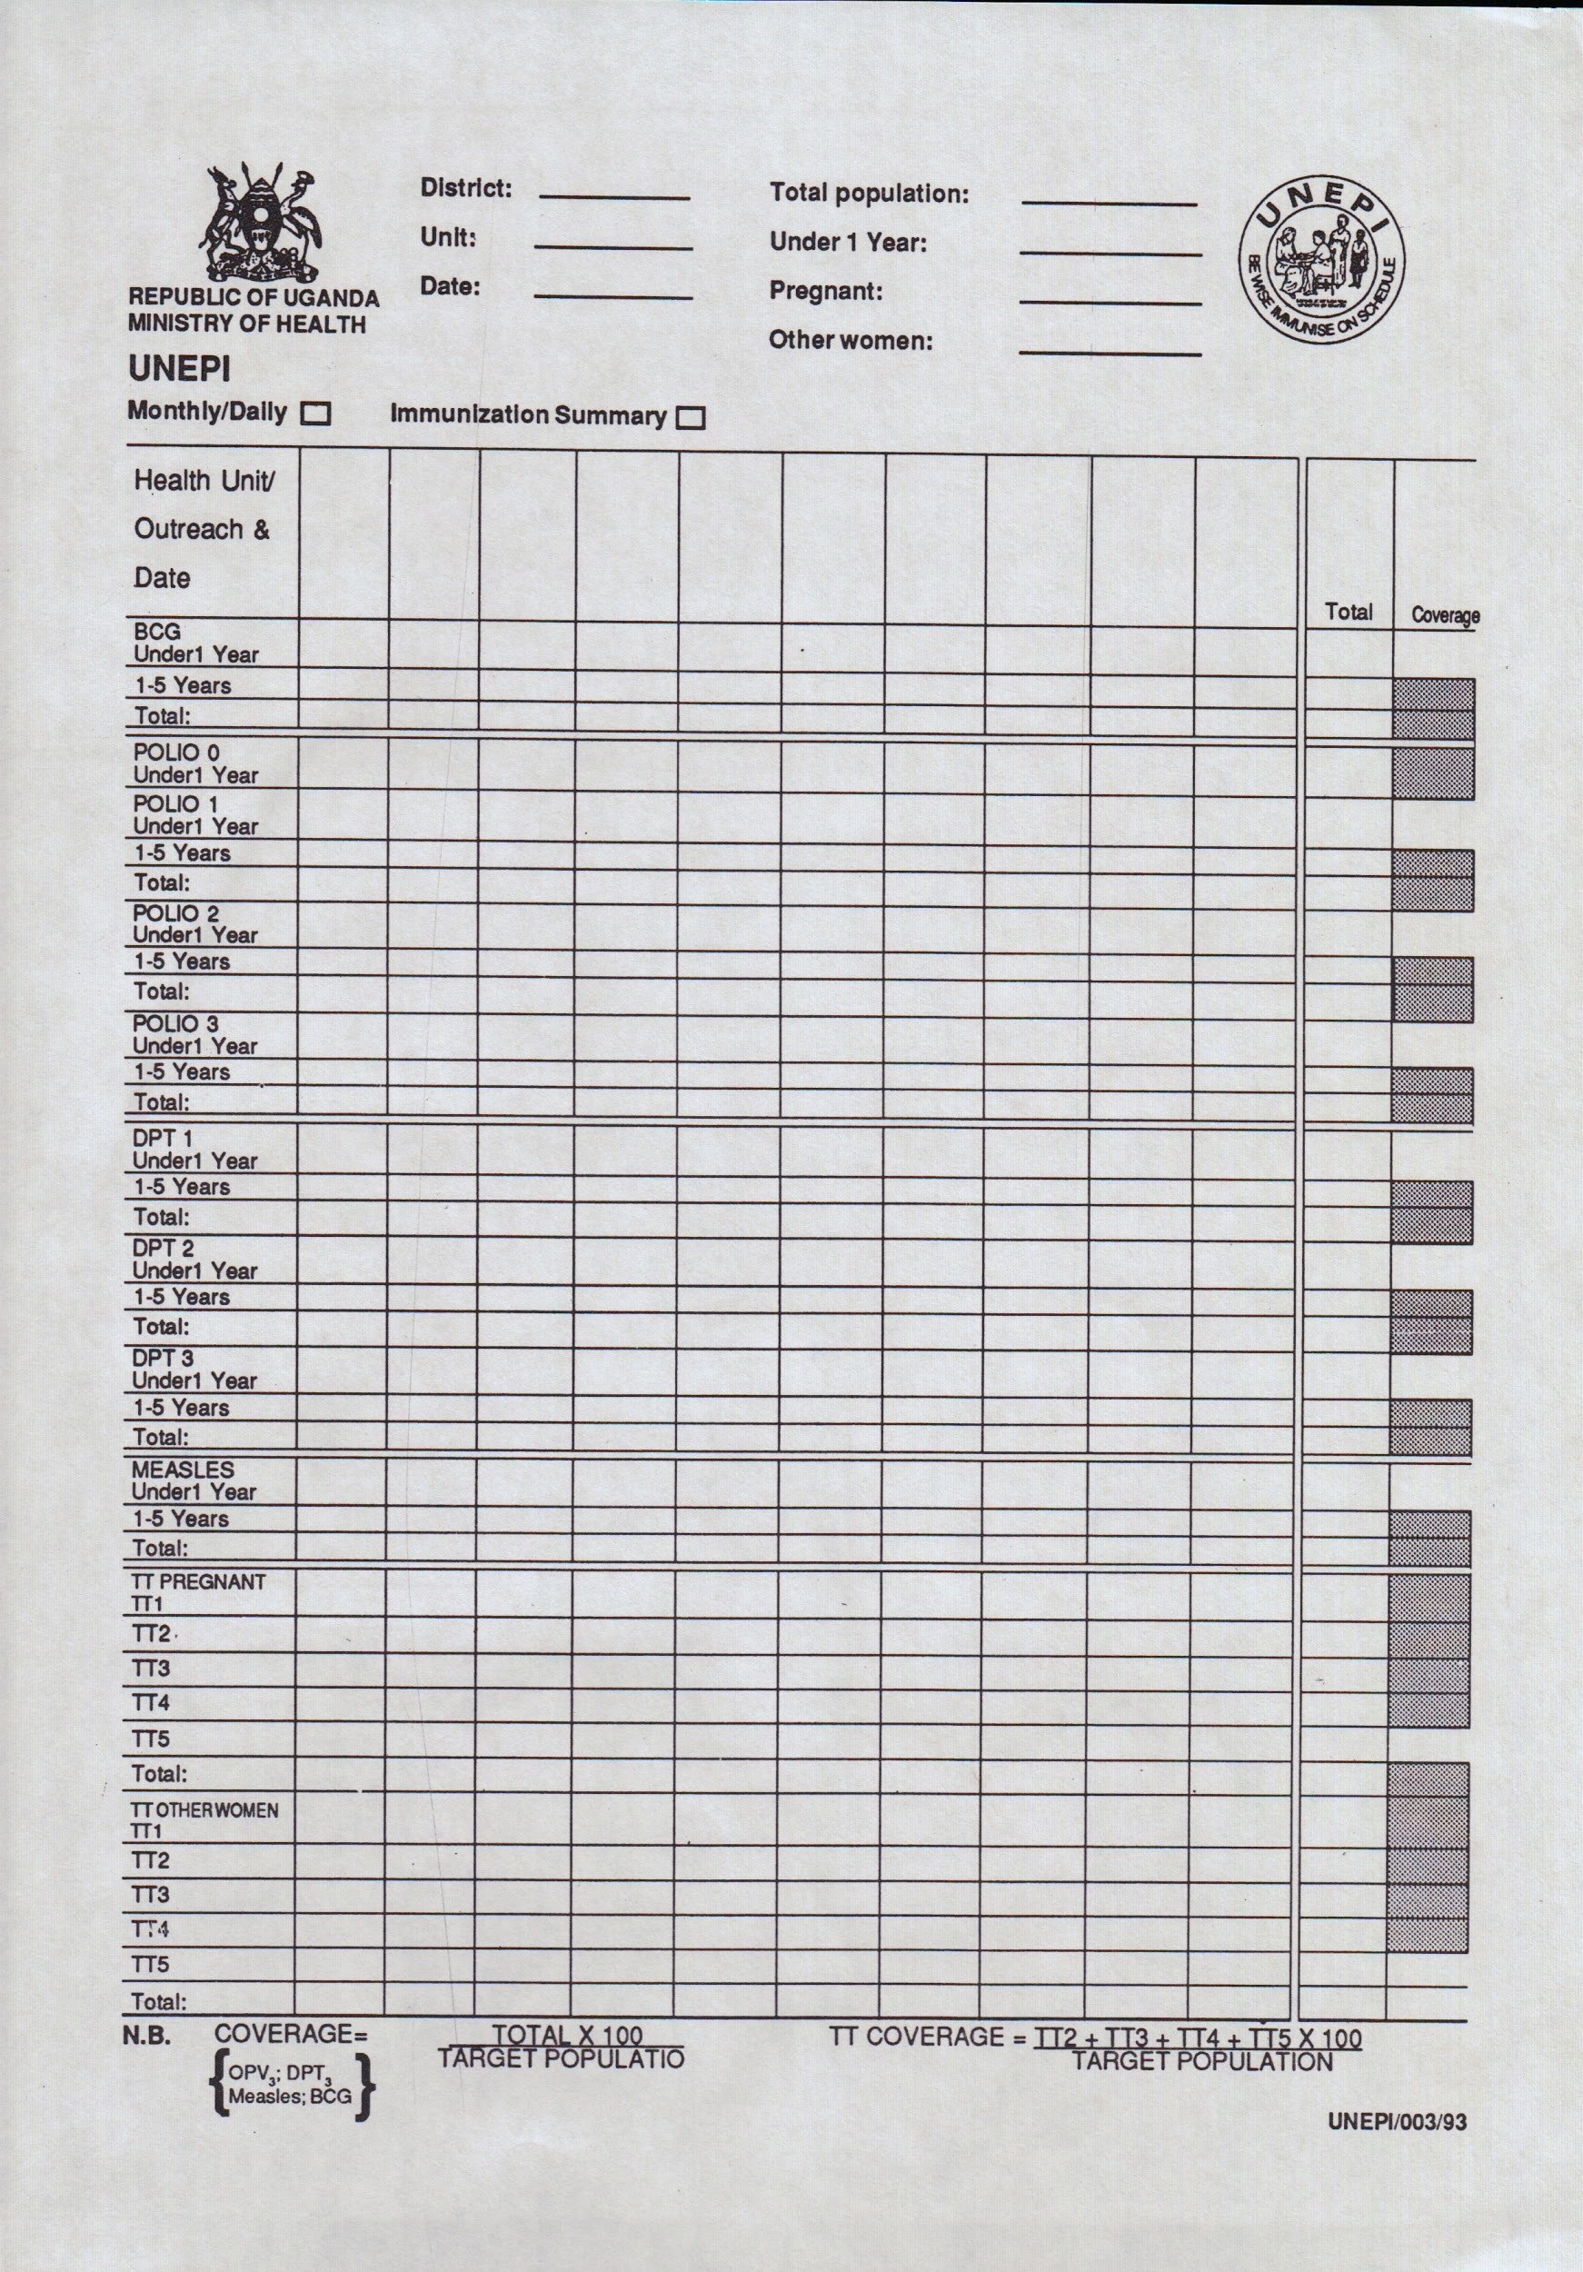
Problems for EMR in rural LMIC
Usefulness
Incompleteness of data
Inconsistencies in data collection and processing
Inaccuracy or incorrectness
Infrequent feedback on data quality
Reference: Ndabarora et al. Systematic review of health data quality management and best practices at community and district levels in LMIC. Information development, UWC Research Repository. 30(2):103-120. https://doi.org/10.1177/0266666913477430
Notes:
Ndabarora et al. Systematic review of health data quality management and best practices at community and district levels in LMIC. Information development, UWC Research Repository. 2013; 30(2):103-120. https://doi.org/10.1177/0266666913477430

Slide 12
Data in EMR use
No LMIC country reporting data completeness over 50%
Concerns:
Is the data reliable enough to inform on evaluating programs/disease outcomes? (Can it be used for making decisions/plans?)
Will using EMR data speed use of wrong or poor data?
Reference: Ndabarora et al. Systematic review of health data quality management and best practices at community and district levels in LMIC. Information development, UWC Research Repository. 30(2):103-120. https://doi.org/10.1177/0266666913477430
Notes:
Incompleteness of data
Inconsistencies in data collection and processing
Inaccuracy or incorrectness
Infrequent feedback on data quality

Slide 13
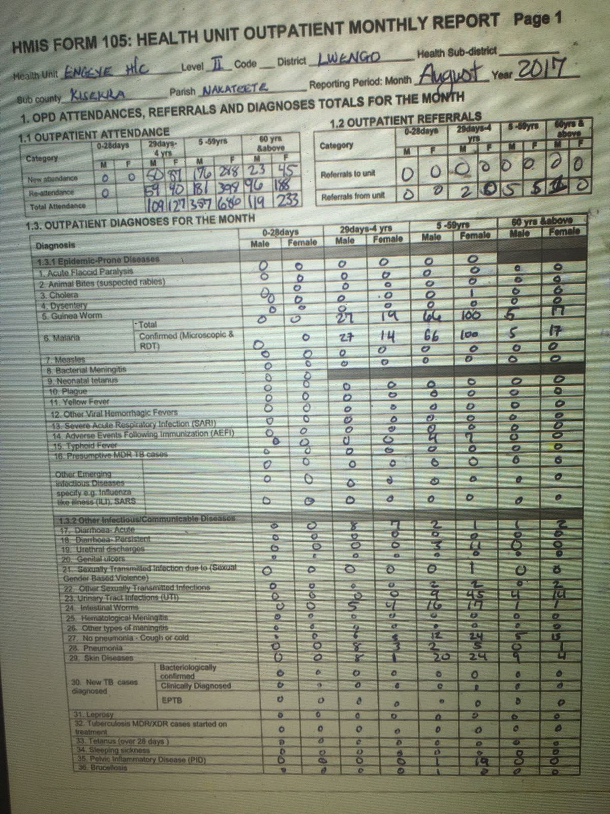
Problems for EMR in LMIC
Implementation
information literacy
unclear policies
inflexible systems
overloading forms for multiple report uses
inadequate facilities
resources
management commitment
collaboration in conception
Reference: Ndabarora et al. Systematic review of health data quality management and best practices at community and district levels in LMIC. Information development, UWC Research Repository. 2013; 30(2):103-120. https://doi.org/10.1177/0266666913477430
Notes:
Ndabarora et al. Systematic review of health data quality management and best practices at community and district levels in LMIC. Information development, UWC Research Repository. 2013; 30(2):103-120. https://doi.org/10.1177/0266666913477430

Slide 14
Problems for EMR in LMIC
Maintenance
data quality checks
use of health information to plan health interventions
personnel satisfaction
strong leadership
management w/standards
staff training
technical support expertise
Source: https://gifer.com/en/7ooh
Reference: Ndabarora et al. Systematic review of health data quality management and best practices at community and district levels in LMIC. Information development, UWC Research Repository. 2013; 30(2):103-120. https://doi.org/10.1177/0266666913477430
Notes:
Ndabarora et al. Systematic review of health data quality management and best practices at community and district levels in LMIC. Information development, UWC Research Repository. 2013; 30(2):103-120. https://doi.org/10.1177/0266666913477430

Slide 15
EMR success factors in LMIC
Infrastructure/Technical
reliable electric power/internet connection
clear policy for HIMSª
multiple use for patient care and clinical support/referrals
integration with HIMS systems
HIMS = Health Information Management System
Notes:
Information management/use, not just Information Technology. Doesn’t solve everything to just buy equipment. (wikipedia)
Information Culture is the part of organizational culture where evaluation and attitudes towards information depend on the situation in which the organization works. In an organization everyone has different attitudes, but the information profile must be explained, so the importance of information should be realized by executives. The Information Culture is also about formal information systems (technology), common knowledge, individual information systems (attitudes), and information ethics.

Slide 16
EMR success factors in LMIC
Infrastructure/Technical
Management
reliable electric power/internet connection
clear policy for HIMSª
multiple use for patient care and clinical support/referrals
integration with HIMS systems
grow “information culture”
training^{b} of data collectors and users
feedback on data quality
timely quality health data to improve health service delivery
HIMS = Health Information Management System
computer literacy, data management process
Notes:
Information management/use, not just Information Technology. Doesn’t solve everything to just buy equipment. (wikipedia)
Information Culture is the part of organizational culture where evaluation and attitudes towards information depend on the situation in which the organization works. In an organization everyone has different attitudes, but the information profile must be explained, so the importance of information should be realized by executives. The Information Culture is also about formal information systems (technology), common knowledge, individual information systems (attitudes), and information ethics.

Slide 17
Utility of simple EMR in LMIC
MMRS (Mosoriot, Kenya)
image example of MMRS from article
“Proof of concept” type study: simple EMR + PDA use can be used for longitudinal care and disease management
Acute respiratory infections, f/u at 7 and 30 days
no discussion on practice change after the study
Reference: Diero et al. A computer-based medical record system and personal digital assistants to assess and follow patients with respiratory tract infections visiting a rural Kenyan health centre. BMC Medical Informatics and Decision Making. 2006; 6(21). https://doi.org/10.1186/1472-6947-6-21
https://bmcmedinformdecismak.biomedcentral.com/articles/10.1186/1472-6947-6-21
Notes:
Reference: Rotich et al. Installing and implementing a computer-based patient record system in sub-Saharan Africa: the Mosoriot Medical Record System. Journal of the American Medical Informatics Association. 2003; 10(4):295-303. https://doi.org/10.1197/jamia.M1301
Image source: https://bmcmedinformdecismak.biomedcentral.com/articles/10.1186/1472-6947-6-21

Slide 18
Available EMR systems for LMIC primary care
OpenMRS (https://openmrs.org)
Bahmni (www.bahmni.org)
Mosoriot Medical Record System (MMRS) (UI, Moi U - Kenya)
AMPATH Medical Record System (AMRS) (www.ampathkenya.org)
TimmyCare Global EMR (https://timmyglobalhealth.org)
Backpack EMR ($ - www.backpackemr.com)
OCEMR (on GitHub - Engeye, Uganda)
Notes:
https://blog.capterra.com/top-7-free-open-source-emr-software-products/
VistA (VA Health); OSEHRA
FreeMED
OpenEMR
One Touch EMR
NOSH
Solismed
Other resources: ThoughtWorks (www.thoughtworks.com)
Partners In Health – uses OpenMRS
AMPATH MRS - HIV/AIDS focus, paper encounter forms, duplicated into EMR by data entry
MMRS - rural Kenya, primary care, data entry at check-in and check-out, clinical paper forms

Slide 19
EMR design concepts
Define Goals
Who wants it?
What problem are we trying to solve?
What type of data is needed to inform practice improvement?
What type of data is needed for grant writing and donor feedback?
Notes:
otherwise is it worth it?
what’s the point?

Slide 20
Components of EMR design
Basics
Setting-specific
trackable data fields
diagnosis coding
user computer literacy
power availability
internet availability
hardware maintenance & cost
software backup & upgrades
hospital vs. clinic
large integrated departments vs. stand-alone rural site
IT support
Special attention areas:
privacy
security
use of standards
special user requirements

Slide 21
Data in EMR use
Key Ideas of Data Model design (Mamlin, AMRS, 2005)
Collaboration
Scalability
Flexibility
Rapid form design
Clinically useful
Use of standards
Support high-quality research
Web-based with support for intermittent connections
Low cost
Notes:
Reference: Mamlin BW, Biondich PG. AMPATH Medical Record System (AMRS): Collaborating Toward An EMR for Developing Countries. AMIA Annual Symposium Proceedings. 2005; 2005:490-494. PMID: 16779088
Collaboration - develop systems openly and use common infrastructure for “best of breed” modules
Scalability - from thousands of patients and 100K observations to 10K patients with 1M observations
Flexibility - not limit to HIV-care, include general medical care
Rapid form design - be able to modify data collection to moving targets
Clinically useful - won’t be used if it’s not - be able to provide feedback to providers
Use of standards - to maximize flexibility and extensibility of system
Support high-quality research - with non-ambiguous coded data
Web-based with support for intermittent connections - not always reliable power or internet connections, but internet-based tech offers increased scalability
Low cost - cost can’t prohibit adoption if meant to be available to LMIC, system nuts/bolts should be downloadable for free

Slide 22
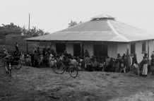
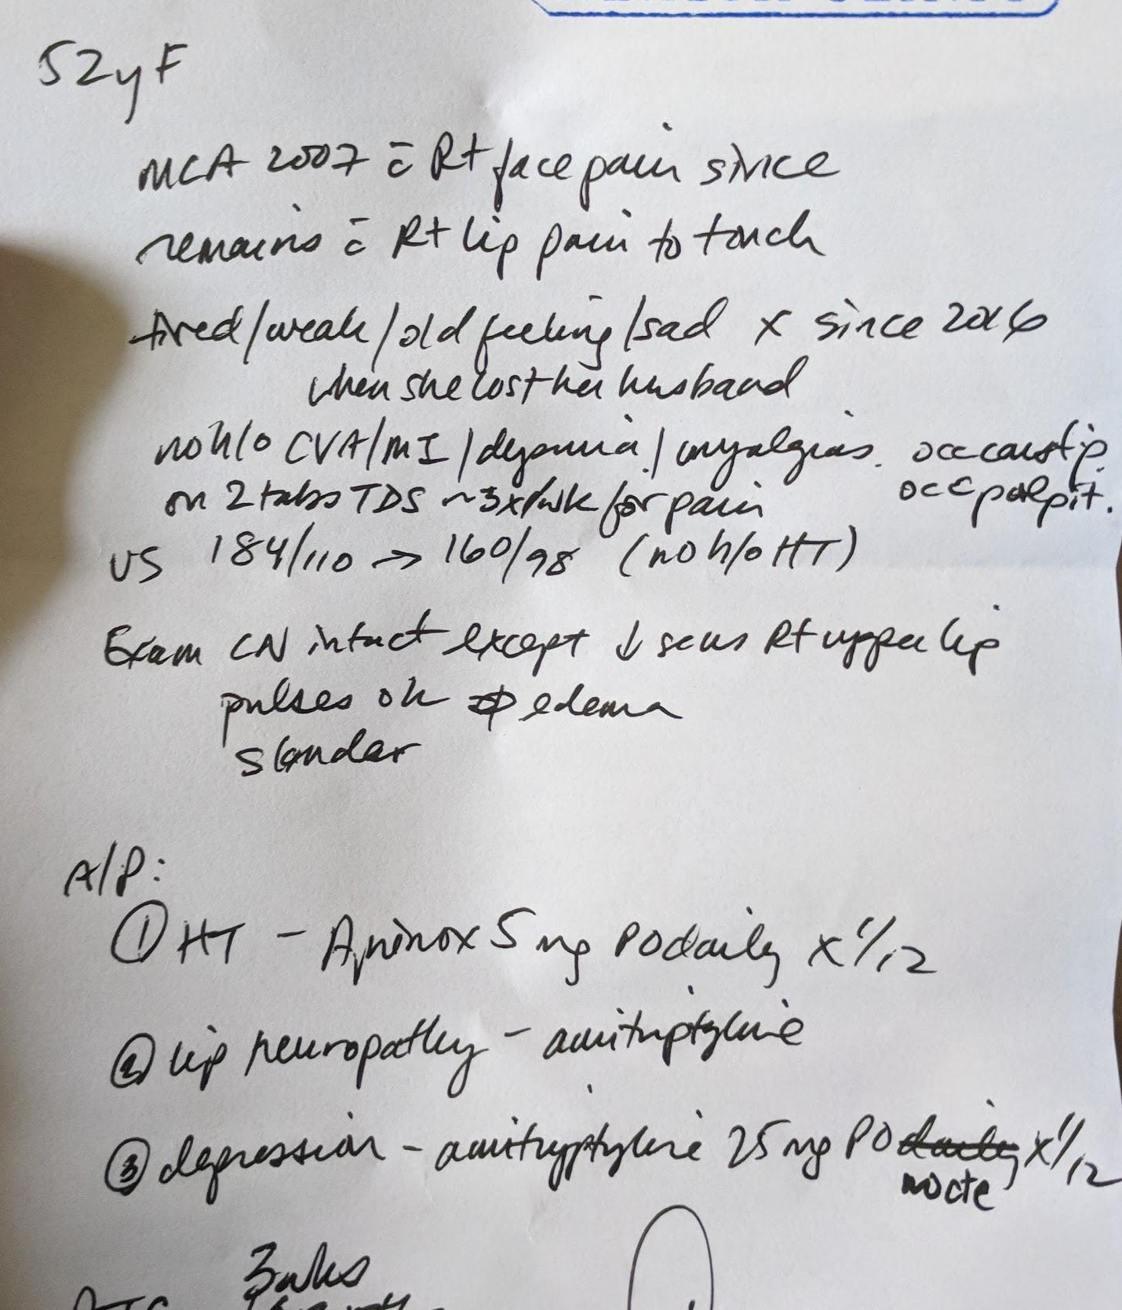
Our specific clinic needs
Clinic workflow needed better efficiency
Replace the “blue books” for improved continuity of care
Billing consistency/transparency
Improve sustainability:
Grant writing
Donor feedback
Notes:
Emphasize that our design was a specific design to meet a specific need
Sustainability – improve ability to provide donor feedback and inform grant writing

Slide 23
EMR design process
Brainstorm/collaborators:
long-time volunteer pharmacist
system administrator
family physician
Framework of the user interface pages:
basic SOAP note
track old visits
visual clinic flow progress
some reporting capability
Main capture points:
suggested top 10 presenting complaints
diagnoses (background coded to ICPC-2)
meds ordered
immunizations ordered
labs ordered
billing suggestion
tracking referrals
provider work statistics
Notes:
also to help with communication between clinic staff and stations

Slide 24
Diagnosis coding
ICD-10 (1942 pages)
ICPC-2 (2 pager)
ICD-10-CM TABULAR LIST of DISEASES and INJURIES Table of Contents 1 Certain infectious and parasitic diseases (A00-B99) 2 Neoplasms (C00-D49) 3 Diseases of the blood and blood-forming organs and certain disorders involving the immune mechanism (D50-D89) 4 Endocrine, nutritional and metabolic diseases (E00-E89) 5 Mental, Behavioral and Neurodevelopmental disorders (F01-F99) 6 Diseases of the nervous system (G00-G99) 7 Diseases of the eye and adnexa (H00-H59) 8 Diseases of the ear and mastoid process (H60-H95) 9 Diseases of the circulatory system (I00-I99) 10 Diseases of the respiratory system (J00-J99) 11 Diseases of the digestive system (K00-K95) 12 Diseases of the skin and subcutaneous tissue (L00-L99) 13 Diseases of the musculoskeletal system and connective tissue (M00-M99) 14 Diseases of the genitourinary system (N00-N99) 15 Pregnancy, childbirth and the puerperium (O00-O9A) 16 Certain conditions originating in the perinatal period (P00-P96) 17 Congenital malformations, deformations and chromosomal abnormalities (Q00-Q99) 18 Symptoms, signs and abnormal clinical and laboratory findings, not elsewhere classified (R00-R99) 19 Injury, poisoning and certain other consequences of external causes (S00-T88) 20 External causes of morbidity (V00-Y99) 21 Factors influencing health status and contact with health services (Z00-Z99)
Divided into 17 chapters by body systems
Reflects the content of primary care
Easier and consistent coding (only ~1300 codes)
Now mapped to ICD-10 as well
Source: http://www.who.int/classifications/icd/adaptations/icpc2/en/
Source: https://www.cms.gov/Medicare/Coding/ICD10/2019-ICD-10-CM.html
Notes:
reference WONCA

Slide 25
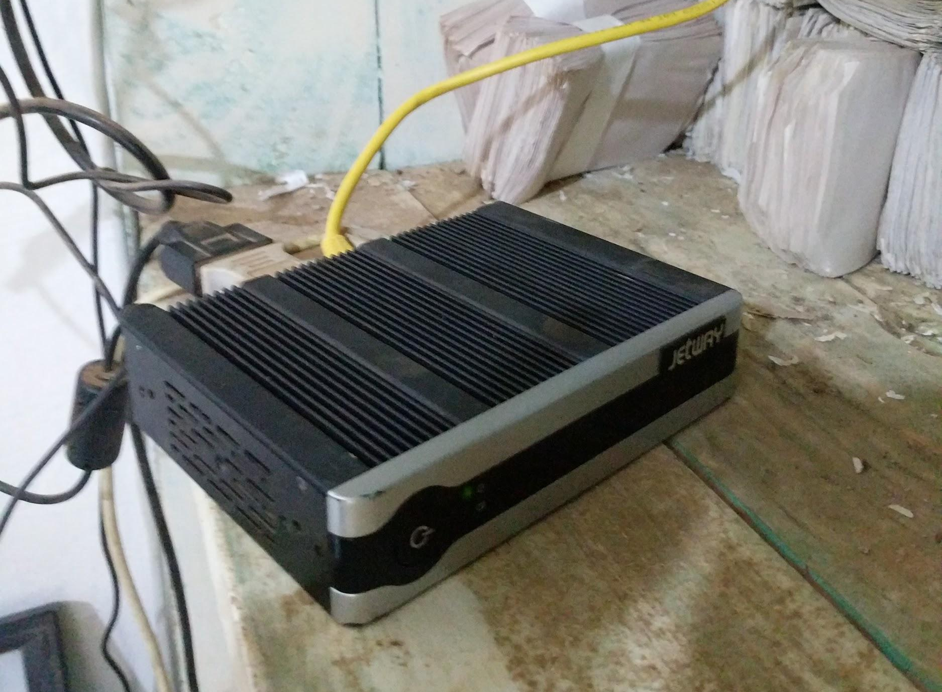
OCEMR design
Concern for processing speed and data file size
Hardware/Equipment choices
durability and resiliency of server, low-cost workstations
wireless intranet for flexibility/scalability
IT support availability
intended remote access for servicing after initial implementation
reduced ICPC-2 options to most common based on review of diagnoses seen from previous volunteer medical teams and kept generic “NOS” option for each system
Notes:
was a lot easier to troubleshoot and maintain when we were on-site for 18 months.

Slide 26
OCEMR design
Scalability
Can increase ICPC-2 to full diagnoses listed and add others
Can expand server processor and memory size
Can add any number of workstations dependent on router and server capacity
Can create other reports as needed with codified data
Not all data is codified – free text boxes versus “click boxes” for presenting symptoms/complaints

Slide 27
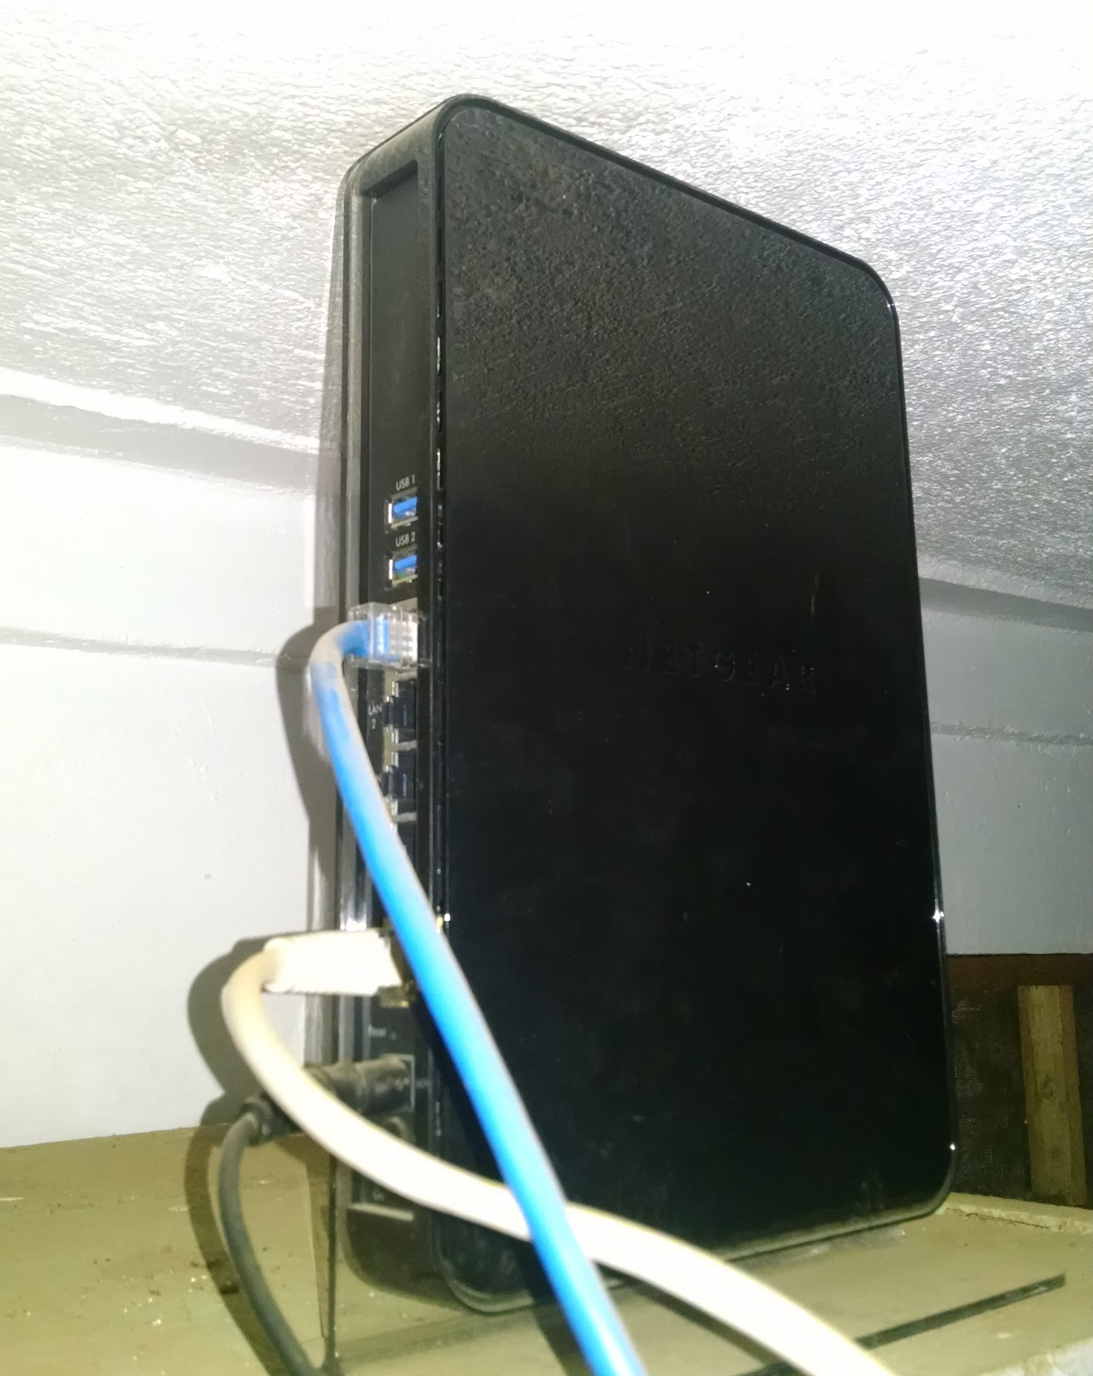
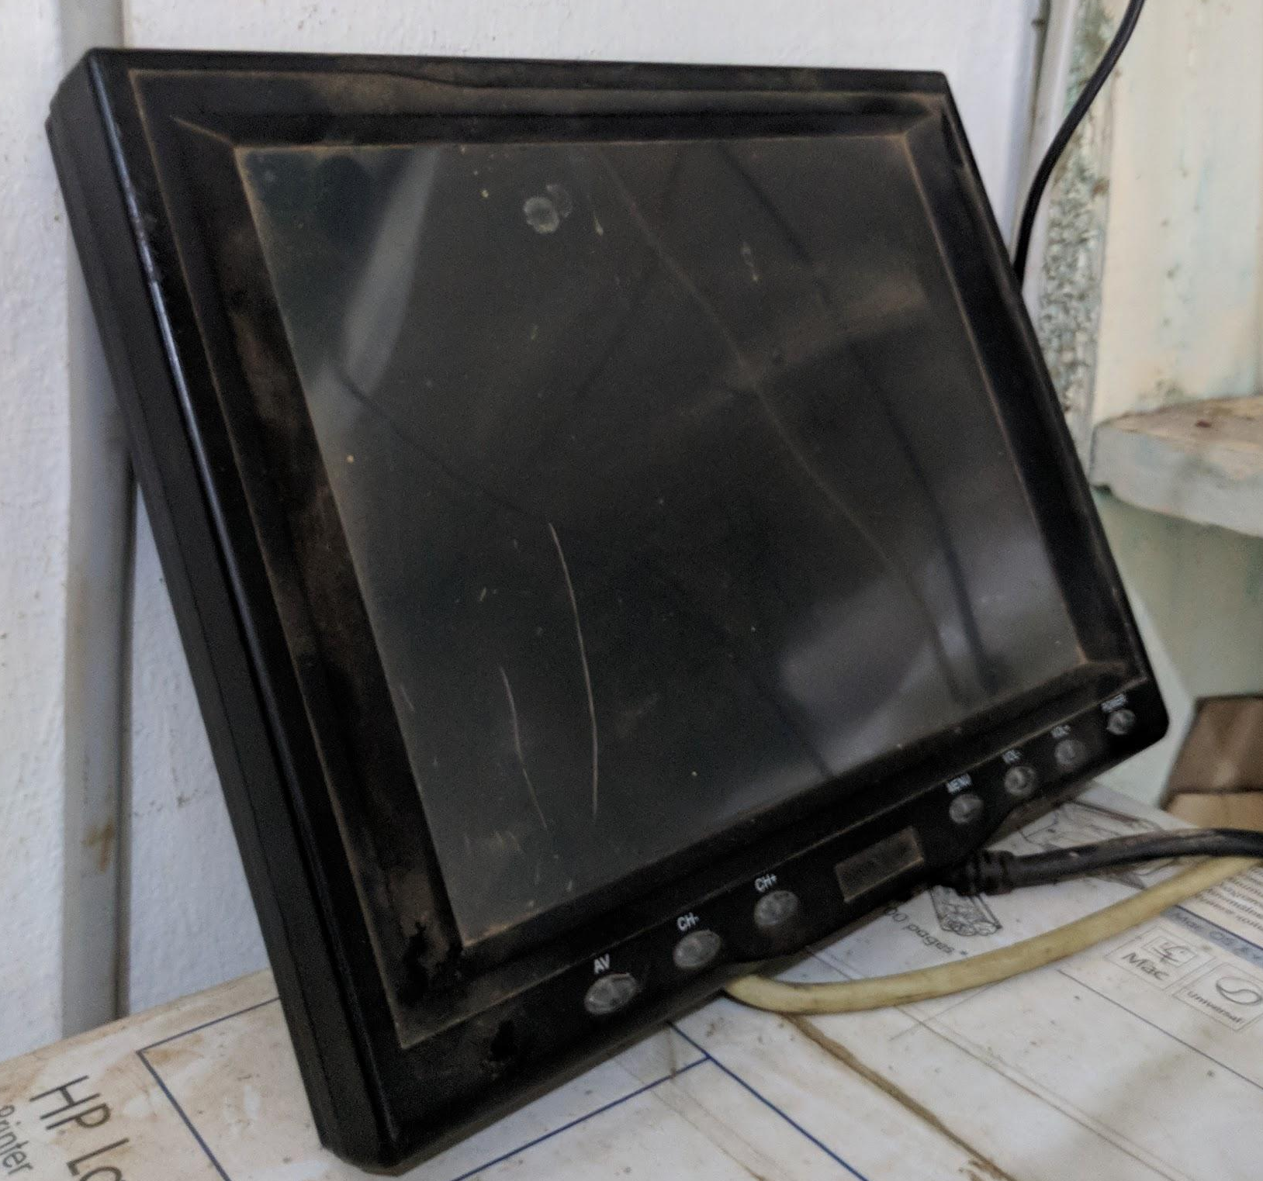
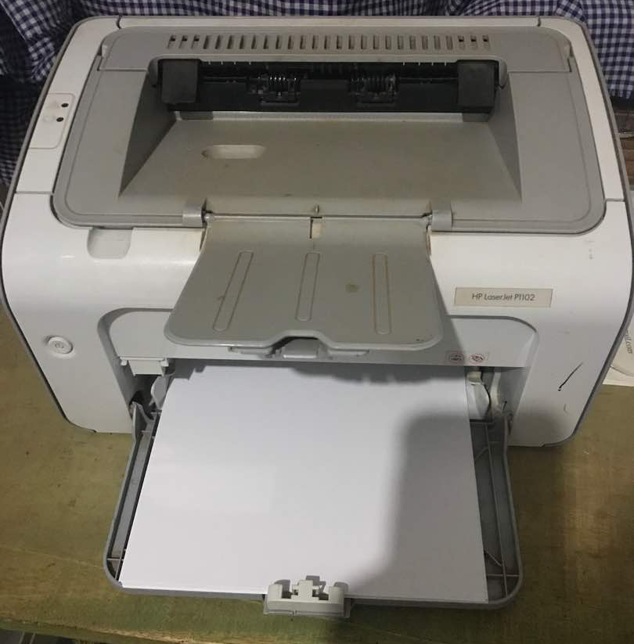
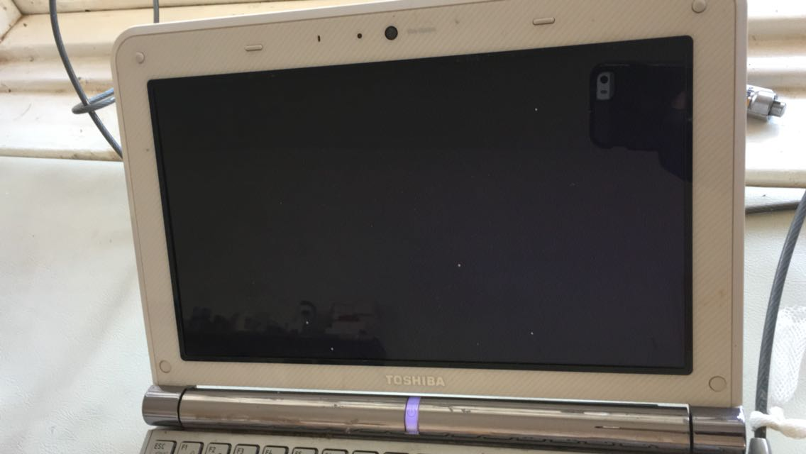
OCEMR initial installation
connected as needed
local cell modem w/data SIM
hardwired connection
wireless router
4G SSD server
screen and keyboard for server access
UPS backup power source
printer (wireless capable)
low power use netbooks
clinician station 1
clinician station 2
lab station
dispensary station
full laptop in registration
Notes:
Jan 2011 at Engeye

Slide 28
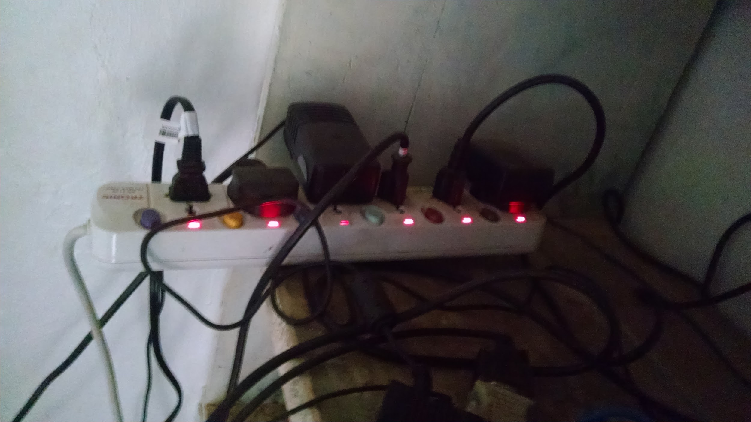
EMR Implementation Process
Pre-testing system in US
Small team on-site for 2 weeks with coder, 2 clinical EMR trainers, 2 additional computer-literate volunteers.
Brought equipment setup for server box/screen/keyboard, wireless router, wiring, netbooks, computer locks, coded one netbook as a backup server
Existing full laptop computers incorporated,
but used much more power
Bought extra wiring, power strips
Cell antenna for router
Later brought signal booster with extra wiring

Slide 29
Barriers to Implementation
coding needed to be modified on-site
limited on-site support time (2 weeks)
staff computer literacy and typing skills
Ugandan MOH HMIS reporting form wasn’t initially available/anticipated
increased power usage with no grid-tie
printer cartridge availability
increased cost of associated supplies (paper)
Notes:
good thing Sarah was there to continuing helping after we left
worse power issues with larger teams and team computers
teams not bringing their own laptops and wanting to borrow workstations

Slide 30
System maintenance issues
Hardware upgrades
Updates included new set of netbooks twice, some donated laptops
Addition of extra computer storage area
Power usage increase => Need solar upgrade to support increased system power usage – slightly better after grid-tie but no longer sufficient
IT support pathway -> urgent need, WhatsApp or call, 2 AM in the US

Slide 31
Barriers to EMR system Maintenance
local IT support of unreliable expertise
inconsistent internet connectivity
power interruptions
novice computer users attempting reboot
usual senescence of equipment
risk of theft
buying replacements locally versus transporting equipment
Notes:
Lessons learned
Having the computers and EMR leads some to believe it is more robust and featured than it is – by local leaders (District administrator asking for reports), patients (assuming the computer should allow the practitioner to diagnose anything “magically”) and visitors (why doesn’t the internet work? Or why can’t you just pull up all old meds and order that way? And scan their paper records in BTW…)
Having the EMR leads to concerns not usually brought up in LMIC but may be commonplace in the USA – HIPPA and security of patient health information – PHI if not legislated there? Equipment security needs and compound security needs increase.
Parallel usual equipment upkeep problems but exacerbates it
Technical components – need physical and software maintenance but can’t connect.
Hardware needs upgrading regularly, just like in the US. Some degradation with heat/dust worse than protected server environment in US/cities. Choice of equipment needs to consider tolerance to heat, dust, minimal maintenance.
New options now – hardwire lines and internet service providers offering new options that are not cell signal based!
Risk of theft to equipment and data.
Data usage – Windows boxes suck data with updates, employees using Facebook, internet and power usage for cell phones instead of workstations.
Power usage of donated older machines.
How to dispose of retired and broken equipment?
Repurpose donated machines into other projects?
Increases staff computer literacy, but has learning curve, can develop bad cheat shortcuts and bad habits to get through the EMR (garbage in, garbage out). Pinching cords, maintaining workstation clean/computers/power plugs/unplugging/locks – all new habits to learn. Viruses from flash drives used anywhere else locally.
Local IT is intermittent and variable in quality, not always ideal. City versus rural access.
Remote IT may not be connectable or available at the time of need. Online connection crucial if cloud-based or remote support is needed or intended.
Monitoring users - there’s a difference with medical terminology acumen and quality of data input into the system

Slide 32
What we can measure
Legacy Daily Patient Report - matches standard clinician OPD log report
Diagnosis Patient Report - search by diagnosis code and age/date parameters
Diagnosis Tally Report - tally of diagnoses used by date range
Lab Tally Report - tally of labs ordered by date range
Med Tally Report - tally of meds ordered by date range
Clinician Tally Report - number of patients seen per clinician by date range
Outstanding Accounts
HMIS Form 105 (inaccurate)

Slide 33
What we hope to measure
automate HMIS 105 monthly reporting
track utilization and outcomes with new maternity center
locally generated clinical question quality improvement queries

Slide 34
Examples of data informing practice
Ex. Top 10 communicable diseases
collaborative logic model for VHT training and community education outreach
Ex. Revising supervision policy and volunteer expectations
based on review of medical student charting
Ex. 2013 retrospective chart review on diarrheal illness encounters, by village frequency
semi-randomized survey of highest and lowest frequency villages by VHTs for habits
targeted community education
Notes:
One of the big issues is lack of feedback
Clinic personnel are not aware of their performance due to lack of supervision to address data quality issues
example - new clinicians practice - have access to give them teaching points and learning opportunities (ex. Depo-Provera)
example - Bridget to share her ideas/experiences - ie. CME weekly with staff

Slide 35
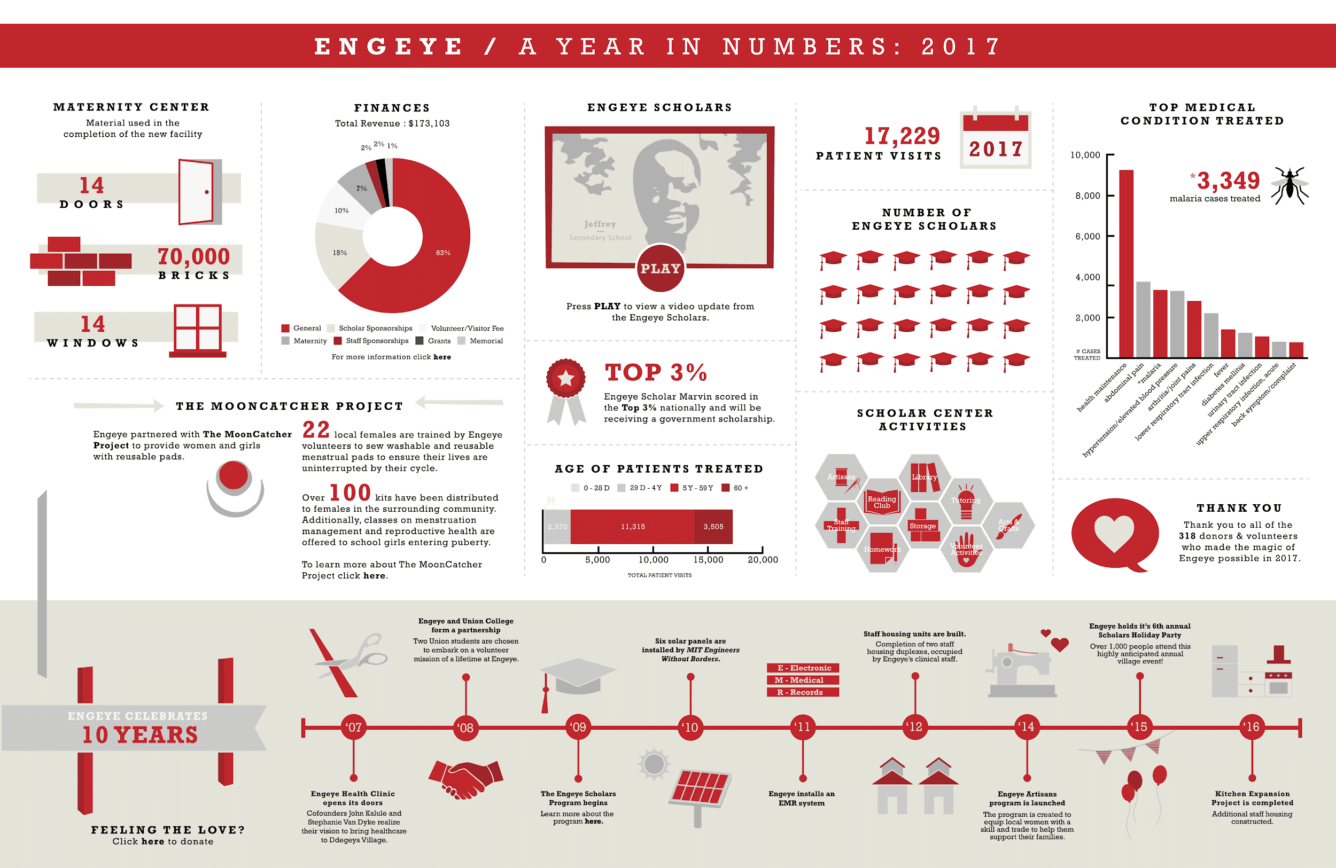
Examples of data for grants/fundraising
Ex. Follow-up data 2011 on malaria cases seen/treated in pediatrics
for grantor feedback after donation of new microscope to lab
Ex. Annual report donor infographic
Ex. Tracking distribution of kits
Maama kits (clean delivery kits)
mosquito nets
Notes:
outputs vs. outcomes
quantitative vs. qualitative data
data analysis
can it inform our practice to make it better?

Slide 36
Anticipated Consequences
Maintenance needs/costs
Teaching computer competency
Documentation time

Slide 37
Unintended Consequences
Visitor/learner perception skewed on “normal”
Visitor expectations of “rural care”
Patient expectations
Potential employees
Data usage (Windows updates, Facebook, etc.)
Outsider expectations (officials, etc.)
Notes:
Visitors – skewed understanding of normal clinic/health center flow in Uganda, expectations for internet vs working intranet
Patients – “magic” computer should know everything, not bringing health records, stop-by to “check it out” along the highway

Slide 38
Monitoring Users
Ugandan clinicians
US-based visiting medical students/residents/preceptors
MPH interns
Non-affiliated visitors
Notes:
Monitoring users - there’s a difference with medical terminology acumen and quality of data input into the system
MPH interns – understand reporting and statistics better, but can be very trusting of the data when the input is not trustworthy. Reliability with medical terminology is variable based on student’s past work/life experience.
US-based visiting medical students/residents/preceptors – usually catch on quickly because they’re used to an EMR system and clinic workflow, but still need hierarchy of supervision. Ex. M2 ordering inappropriate meds for clinical diagnosis – is it lack of medical knowledge or lack of EMR familiarity?
Ugandan clinicians – EMR review brings up several clinic management opportunities, but have to be careful to not be punitive given prevailing culture of intellectual isolation for most providers. We can monitor the balancing of the workload, similar to ER or Urgent Care queues in the US – helps with sense of fairness and provides feedback to non-medical supervisors of staff efficiency. Though it seems to have been pretty fair for first-come-first served without discrimination because you can’t really tell what the patient is coming for. Quality of care – review of documentation or med prescribing trends can bring up issues to review with new/visiting clinicians, providing CME opportunities for all staff to learn from. Caveat – computer literacy improves but they also learn bad shortcuts or feel weighed down by slow typing skills.

Slide 39
User Perspective
US-based learners and Ugandan clinicians
Features versus function (usually complaints more from US > Ugandan)
Some visitors wish for more complex features (“Why can’t it do this”)
Some visitors wish for paper (“I didn’t come to Africa to have to use a computer”)
Value-added to increase computer literacy skills and improve information available to clinicians to provide patient care

Slide 40
Pulling Data from the System
Initial basic reports with nuances to interpreting the data
HMIS was added later and buggy – undergoing review to make it functional
Chart review is possible, but time intensive and usually done by visitors/volunteers, would be better if local clinicians could formulate their own clinical or process questions and query the system to inform their work
“Garbage in, garbage out”
Problem for future – changing data to any other system won’t be possible without intensive re-coding (requires volunteers), risk losing the data and need to start fresh
Notes:
Initial basic reports with nuances to interpreting the data
HMIS was added later and buggy – undergoing review to make it functional
Brute force chart review is possible, but time intensive and usually done by visitors/volunteers, would be better if local clinicians could formulate their own clinical or process questions and query the system to inform their work
** add examples of reports from this data – donor numbers, grant feedback, writing new grants, informing clinicians
Problem for future – changing data to any other system won’t be possible without intensive re-coding, would lose the data and need to start fresh

Slide 41
Chronic disease management
Benefit for management of chronic non-communicable diseases in rural LMIC
Detail to help clinicians target clinical care improvement
Modify coding to suit what you want to capture
Reduce patient confusion
Improve clinic workflow and communication efficiency
Enables targeted patient education or community outreach initiatives
Issues for consideration:
Reviewing patient care also brings to light visiting clinician errors in care
“Ideal” perception/experience/understanding of the local health care and system by visitors new to LMIC?
Notes:
Benefit for management of chronic non-communicable diseases in rural LMIC
Handwritten register log books track basic information, and HMIS reports tally this high-level overview but this is lacking the detail to help clinicians target clinical care improvement.
Framework of the user interface pages can be modified to suit what you want to capture.
Clinic workflow improvements help reduce confusion of patients jumping queue or when not called in timely manner, but still has hiccups with accidentally deleting a patient from the queue or taking longer for visits because typing or having more information to review.
ACCURACY of information improved (not dependent on patient recall or bringing records in)
Allow for areas to target patient education or community outreach initiatives (water/sanitation MPH)
Questions for consideration:
Is this better for patient care daily versus helping reduce visitors errors in care?
Does this change “ideal” perception/experience/understanding of the local health care and system by visitors new to LMIC?
Are the visiting Learners getting a skewed perception because they aren’t using the little blue books?
Is this a Pilot project/example and innovation versus just providing better primary care/spreading that it’s possible, just the way we want to do it better?

Slide 42
OCEMR Demo
Demo link: https://ocemr.kremlor.net/accounts/login/
Sample orientation and demonstration of OCEMR system
(OCEMR – Open Clinic Electronic Medical Records)
Notes:
How is this different from other available systems – less complex, ideally redundant and stable, without need for remote IT support – but still requires some local IT understanding and maintenance (as with any system).
Ideal (working on version OCEMR 2.0) would be “server in a box” plug-and-play setup, with workstation recommendations/configurations.
Open source software – can be configured however each local clinic wants it – but still needs IT support. Unless they choose the standard format. But then they’re stuck with just this system and format, but most of these clinics are in silos anyhow.

Slide 43
Review of primary care EMR design
Simpler design – broader application, uptake by local staff easier
Success dependent on computer literacy/skills
Meet the specific need at your site
What’s the goal? (Is it worth the hassle?)
Is it sustainable/maintainable? (Who’s pushing for it?)
What’s the maintenance/upgrade plan? (It will need it)

Slide 44
References
Bloomfield et al. Mobile health for non-communicable diseases in Sub-Saharan Africa: a systematic review of the literature and strategic framework for research. Globalization and Health. 2014; 10:49. https://doi.org/10.1186/1744-8603-10-49
Diero et al. A computer-based medical record system and personal digital assistants to assess and follow patients with respiratory tract infections visiting a rural Kenyan health centre. BMC Medical Informatics and Decision Making. 2006; 6(21). https://doi.org/10.1186/1472-6947-6-21
Fraser et al. Implementing electronic medical record systems in developing countries. Informatics in Primary Care. 2005; 13:83-95.
Fritz et al. Success criteria for electronic medical record implementation in low-resource settings: a systematic review. Journal of the American Medical Informatics Association. 2015; 22(2):479-488. https://doi.org/10.1093/jamia/ocu038
Jawhari et al. Benefits and challenges of EMR implementations in low resource settings: a state-of-the-art review. BMC Medical Informatics and Decision Making. 2016; 16:116. https://doi.org/10.1186/s12911-016-0354-8
Lozano et al. Global and regional mortality from 235 causes of death for 20 age groups in 1990 and 2010: a systematic analysis for the Global Burden of Disease Study 2010. The Lancet. 2012; 380:2095-128. https://doi.org/10.1016/S0140-6736(12)61728-0
Mamlin BW, Biondich PG. AMPATH Medical Record System (AMRS): Collaborating Toward An EMR for Developing Countries. AMIA Annual Symposium Proceedings. 2005; 2005:490-494. PMID: 16779088
Ndabarora et al. Systematic review of health data quality management and best practices at community and district levels in LMIC. Information development, UWC Research Repository. 2013; 30(2):103-120. https://doi.org/10.1177/0266666913477430
Peiris et al. Use of mHealth systems and tools for non-communicable diseases in low- and middle-income countries: a systematic review. Journal of Cardiovascular Translational Research. 2014; 7(8):677-91. https://doi.org/10.1007/s12265-014-9581-5
PwC - Canada Health Infoway (2013). The emerging benefits of electronic medical record use in community-based care. https://www.pwc.com/ca/en/industries/healthcare/publications/electronic-medical-record-use-community-based-care.html
Rabkin M, El-Sadr WM. Why reinvent the wheel? Leveraging the lessons of HIV scale-up to confront non-communicable diseases. Global Public Health. 2011; 6(3):247-256. https://doi.org/10.1080/17441692.2011.552068
Rotich et al. Installing and implementing a computer-based patient record system in sub-Saharan Africa: the Mosoriot Medical Record System. Journal of the American Medical Informatics Association. 2003; 10(4):295-303. https://doi.org/10.1197/jamia.M1301

Slide 45
© 2018 American Academy of Family Physicians. All rights reserved.
All materials/content herein are protected by copyright and are for the sole, personal use of the user.
No part of the materials/content may be copied, duplicated, distributed or retransmitted
in any form or medium without the prior permission of the applicable copyright owner.

