Slide 1
AN INTERDISICPLINARY APPROACH TO TEACHING MEDICAL HUMANITIES TO MILLENNIAL LEARNERS
Samantha Plasner D.O.
Assistant Professor
Meagan Vermeulen M.D.
Assistant Professor/Associate Program Director
Department of Family Medicine
Rowan University SOM

Slide 2
“Where ever the art of medicine is loved there is also a love of humanities.”
-Hippocrates

Slide 3
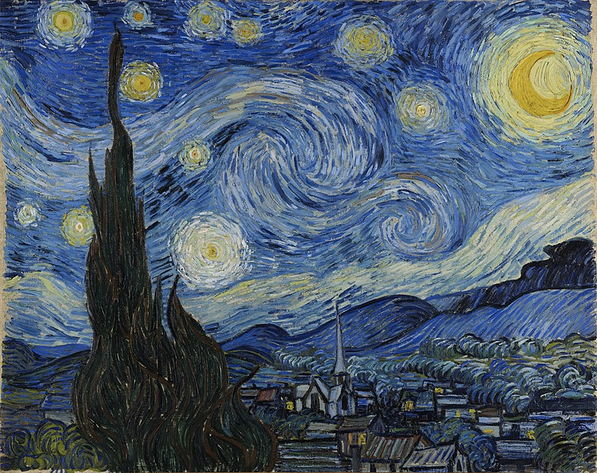
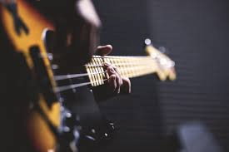
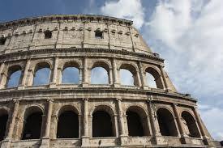
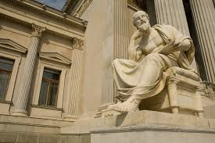
HUMANITIES…

Slide 4
PRE MED STUDENT MAJORS
* US NEWS AND WORLD REPORT

Slide 5
Goals and Objectives
Identify common barriers in teaching millennial medical students empathy, humanism, and communication
Identify resources for developing an interdisciplinary approach for teaching “soft skills” to millennials
Develop a plan for implementing an alternative approach for teaching the art of medicine and monitoring student responses to such a program

Slide 6
“Challenging Traditional Premedical Requirements as Predictors of Success in Medical School: The Mount Sinai School of Medicine Humanities and Medicine Program”
Academic Medicine August 2010 N Kase MD, D Muller MD
Compared outcomes for ~650 medical students
Traditional vs Alternative Assurance Program
Equivalent academic performance
Humanities majors were more likely to do research and pursue primary care and psychiatry career paths

Slide 7
What Is Medical Humanities?
“An interdisciplinary field concerned with understanding the human condition of health and illness in order to create knowledgeable and sensitive health care providers, patients, and family caregivers”
*as defined by Craig Klugman, Phd, Medical Humanities

Slide 8
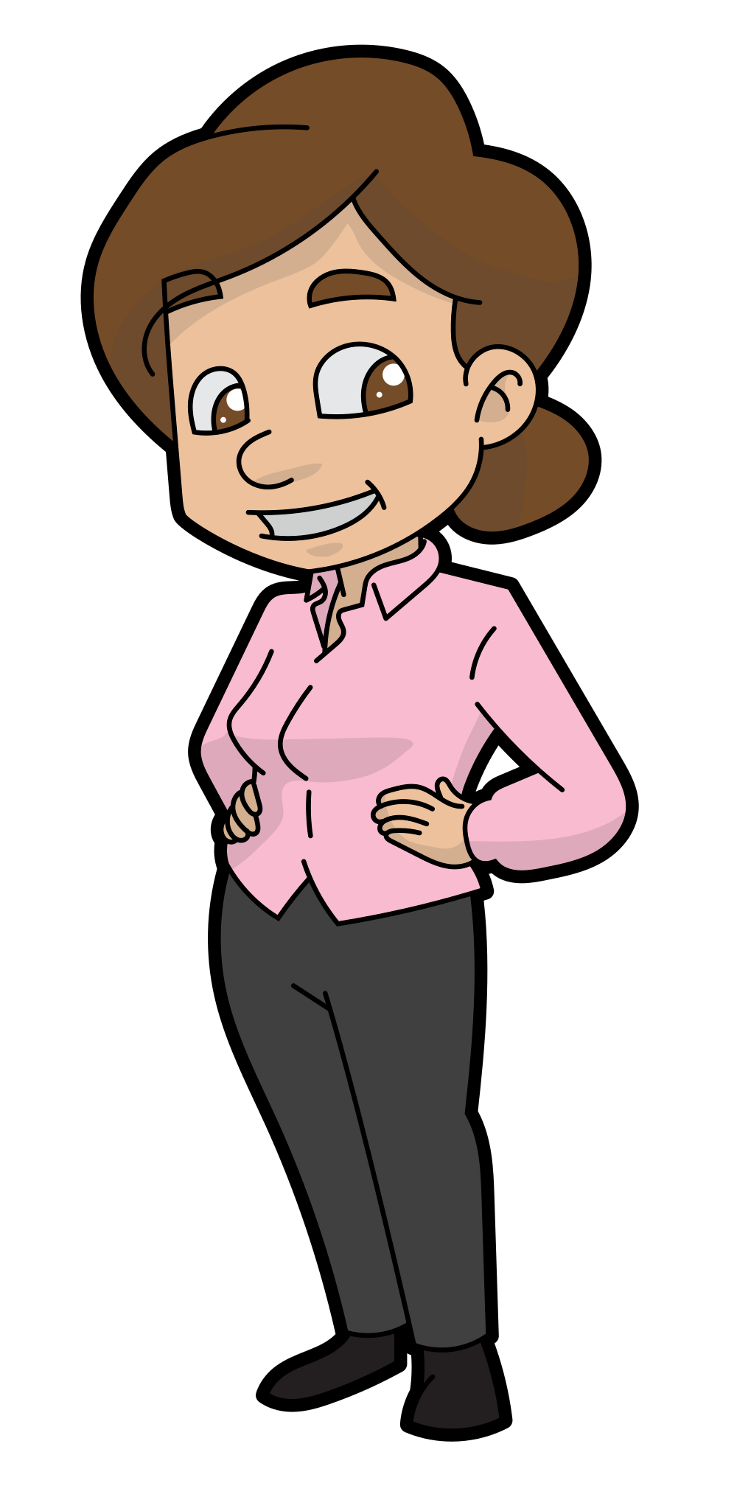
Treat an illness vs Treat a person
asthma
ASTHMA

Slide 9
Importance of Being Empathetic
Emotion researchers generally define empathy as “the ability to sense other people’s emotions, coupled with the ability to imagine what someone else might be thinking or feeling”
Significant links with patients’ satisfaction with their physicians, interpersonal trust, and compliance with physicians’ recommendations
“Empathy and rapport should never be sacrificed in the service of obtaining data”
-Stanley E. Althof, PhD.

Slide 10
Empathy Declines During Medical School
Most likely to occur in clinical years
Mistreatment of student doctor
Vulnerable ideals
Lack of social support
Increased amount of work

Slide 11
Consequences Of Loss Of Empathy…
Reduced quality of care
Decline in physician well being
*Burnout

Slide 12
Burnout
45%-71% of Medical Students Report Symptoms of Burnout
Overall wellbeing is worse for age-matched peers

Slide 13
Dichotomy in Medical Education
MEDICAL EDUCATION
Emphasis on technical skills, efficiency, medical knowledge
PATIENTS
Look for compassion, empathy, professionalism

Slide 14
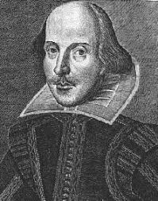
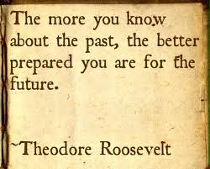
WHAT CAN MEDICAL HUMANITIES DO FOR MEDICAL STUDENTS?
ART: teaching skills of observation
LITERATURE: allows students to experience someone else's life,
view world from another’s place
MUSIC: engage active listening skills
HISTORY: explore diversity of the human experience

Slide 15
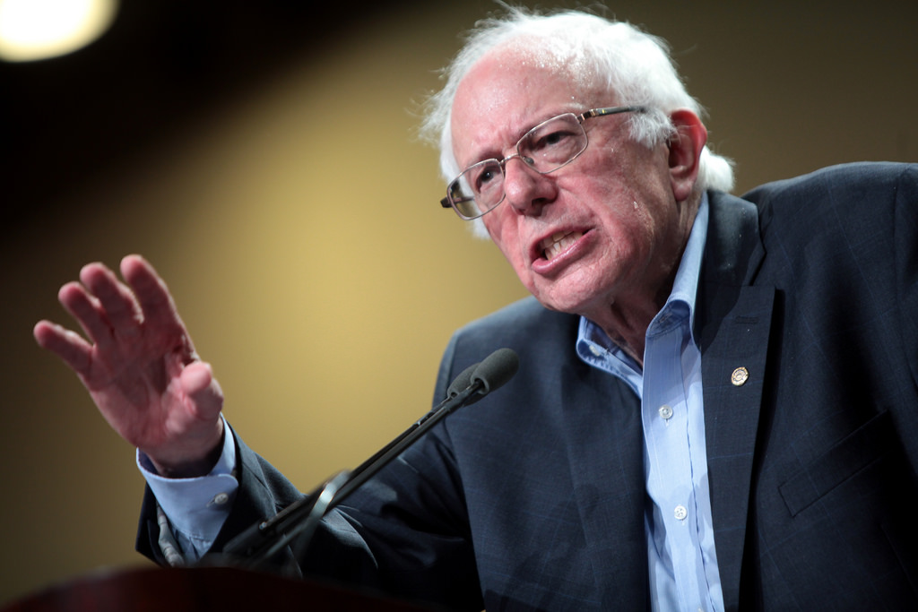
BARRIERS TO HUMANITIES IN MEDICAL EDUCATION

Slide 16
CREATING THE CURRICULUM
AN INTERDISCIPLINARY APPROACH
RECRUIT EXPERTS FROM OTHER FIELDS
INTER NOT MULTI-DISCIPLINARY
UNDERSTANDING THE LEARNER
INTERGENERATIONAL DYNAMIC
MILLENIALS (1982 - 2000)
TECH SAVY
COMMUNICATION
SKEPTICAL OF HIERARCHY
ANXIOUS IN NEW LEARNING ENVIRONMENTS

Slide 17
SELECTIVE FORMAT
Topic Introduction
Each Student Chooses
a Selective
Duration of 4 weeks
*All students experience Mindfulness
Notes:
ALL STUDENTS EXPERIENCE AN INTRO TO MINDFULNESS
BRIEF INTRO TO THE OTHER 4 OPTIONS ARE GIVEN
HIGHLIGHT SKILLS THAT THE STUDENT MAY DERIVE FROM THE SELECTIVE
STUDENTS RANK THEIR TOP 3 SELECTIONS
THEN SPEND 4 WEEKS (4X 2 HOUR SESSIONS EXPLORING THEIR CHOSEN TOPIC)

Slide 18
TOPICS COVERED
1. Mindfulness Based Stress Reduction
2. Why Don’t You Trust Me? I Am A Doctor!
3. Do You Want The Good News Or The Bad News?
4. Storytelling And Medicine
5. Who Gets Sick With What And Why

Slide 19
AIMS OF HUMANITIES SELECTIVES
PROVIDE MENTORSHIP
PROMOTE STUDENT PHYSICIAN WELLNESS
PROVIDE TOOLS FOR STUDENT DOCTORS
PLANT SEEDS OF RESILIENCE FOR THE FUTURE

Slide 20
REFERENCES
M louis -Courvoisier and A Wenger “How to make the most of history and literature in the teaching of medical humanities…” Medical Humanities 2005 31: 51-54.
Jane Macnaughton “The humanities in medical education: context outcome and structures” J Med Ethics: Medical Humanities 2000; 26: 23-30.
Silke Dennhardt, Travis Apramian et al “Rethinking research in the medical humanities: a scoping review and narrative synthesis of quantitative outcome studies” Medical Education 2016;50: 285-299.
Craig Klugman “Medical Humanities Teaching in North American Allopathic and Osteopathic Medical Schools” J Med Humanities (On Line) 07 November 2017
Kenneth S. Warren MD “The Humanities in Medical Education” Annals of Internal Medicine. 1984; 101: 697-701.
Caroline Wächtler, Susanne Kundin “Humanities for medical students? A qualitative study of a medical humanities curriculum in a medical school program” BMC Medical Education 2006; 6: 16.
Borges, Michele PhD; Manuel, R Stephen et al “Comparing Millennial and Generation X Medical Students at One Medical School” Academic Medicine: June 2006; 81: 571-576.
David Roberts; Lori R Newman et al “Twelve tips for facilitating Millennials’ learning” Medical Teacher (On Line) 2012; 1-5.
Fares, Jawad et al. “Stress, Burnout and Coping Strategies in Preclinical Medical Students.” North American Journal of Medical Sciences 8.2 (2016): 75–81. PMC. Web. 7 Apr. 2018.Jane Macnaughton “The humanities in medical education: context outcome and structures” J Med Ethics: Medical Humanities 2000; 26: 23-30.

Slide 21
REFERENCES
Dyrbye, Liselotte N. MD, MHPE; West, Colin P. MD, PhD; Satele, Daniel; Boone, Sonja MD; Tan, Litjen MS, PhD; Sloan, Jeff PhD; Shanafelt, Tait D. MD “Burnout Amongst U.S. Medical Students, Residents, and Early Career Physicians Relative to the General U.S. Population” Academic Medicine Issue: Volume 89(3), March 2014, p 443–451
Anthony Montgomery “The inevitability of physician burnout: Implications for interventions” Burnout Research Volume 1, Issue 1 2014 Pages 50-56
Hojat, Mohammadreza et al. “Patient Perceptions of Physician Empathy, Satisfaction with Physician, Interpersonal Trust, and Compliance.” International Journal of Medical Education 1 (2010): 83–87. PMC. Web. 7 Apr. 2018.
Muller, D., & Kase, N. (2010). Challenging Traditional Premedical Requirements as Predictors of Success in Medical School: The Mount Sinai School of Medicine Humanities and Medicine Program. Academic Medicine, 85(8), 1378-1383. doi:10.1097/acm.0b013e3181dbf22a

