Slide 1
Duct Tape and Extra Fuses:
Repairing Medical Devices Abroad
Myles Stone, MD, MPH

Slide 2
Objectives
Determine which medical devices are reasonable for various project scopes and budgets
Fix the most common causes of medical device failure and perform basic medical device maintenance.
Describe the basic principles of common electronic devices and understand the differences between electrical systems around the world
Notes:
Key principles

Slide 3
Introduction
WHO: Availability, Accessibility, Appropriateness, and Affordability
Focus on outcomes
Case studies
Electrical 101
Device repair
Notes:
-Med Devices Everywhere: Lab equipment, IUDs, X ray machine, artificial joints
-Refrigerators, light bulbs
-WHO Department of Essential Health Technologies
-Medical devices you don’t need and don’t bring don’t require repairs
-Gnomes who gasp and scurry when you make eye contact with them

Slide 4
Activity Disclaimer
ACTIVITY DISCLAIMER
It is the policy of the AAFP that all individuals in a position to control content disclose any relationships with commercial interests upon nomination/invitation of participation. Disclosure documents are reviewed for potential conflicts of interest (COI), and if identified, conflicts are resolved prior to confirmation of participation. Only those participants who had no conflict of interest or who agreed to an identified resolution process prior to their participation were involved in this CME activity.
Myles Stone has indicated he has no relevant financial relationships to disclose.

Slide 5
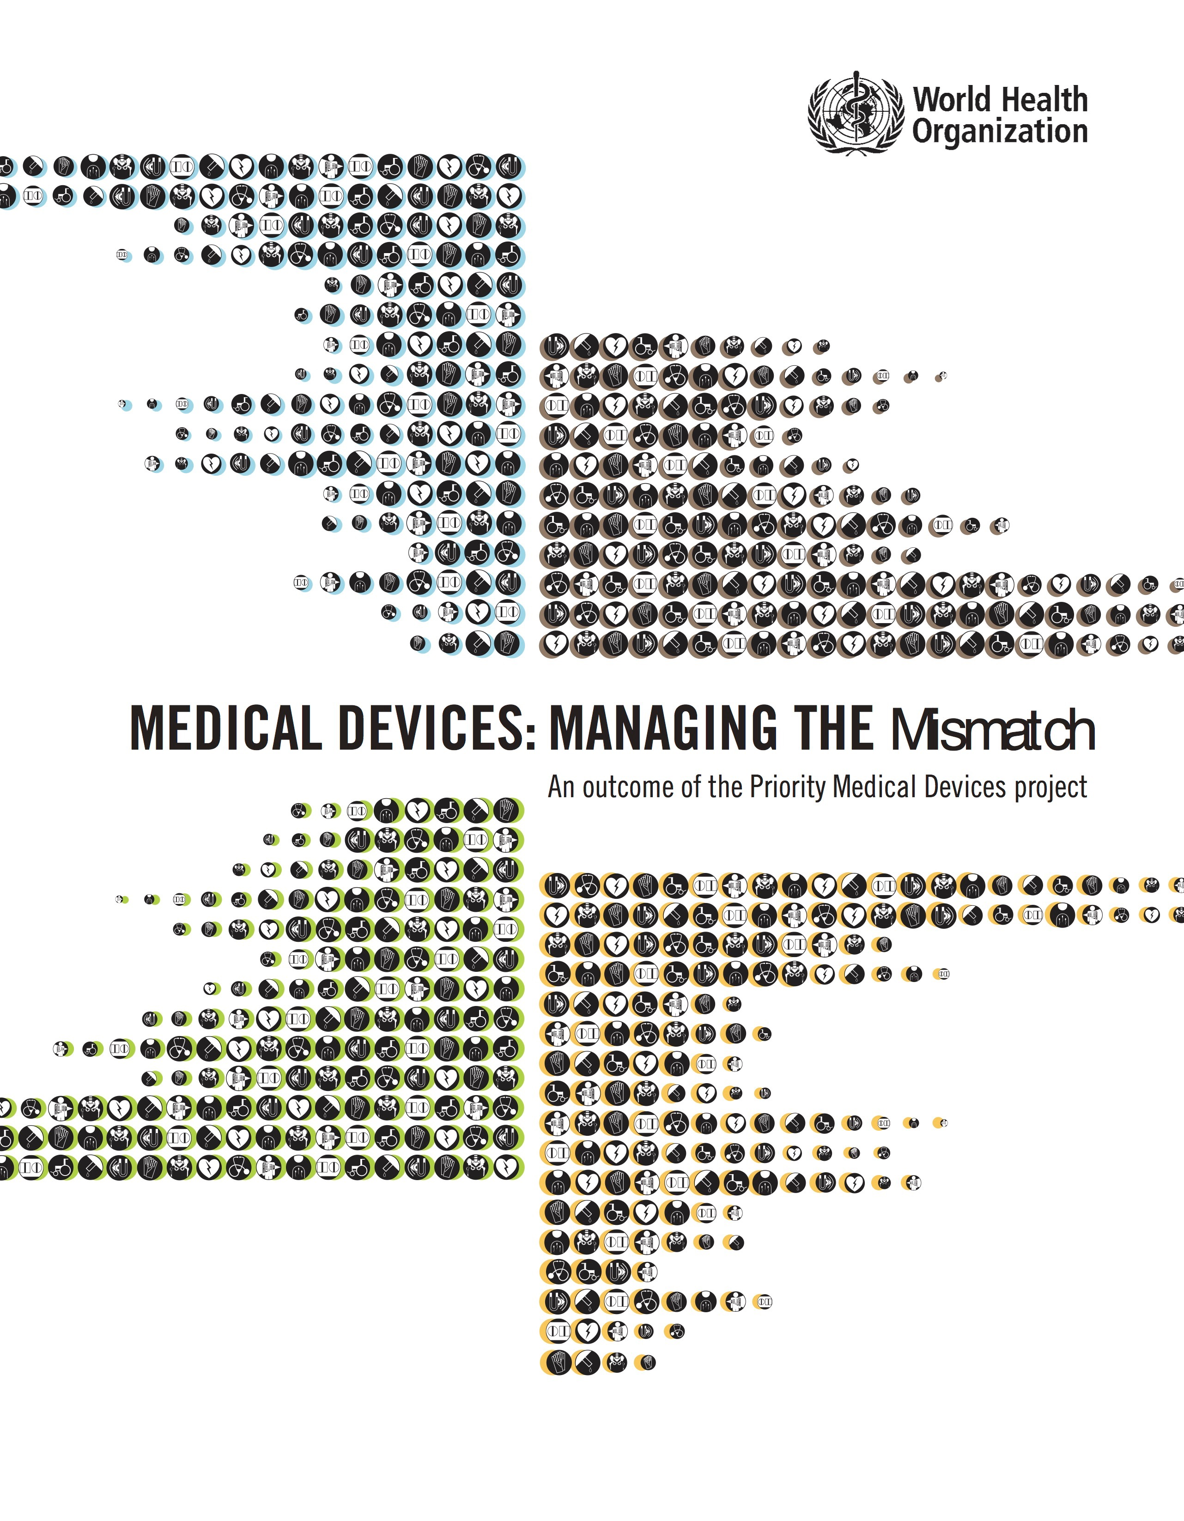
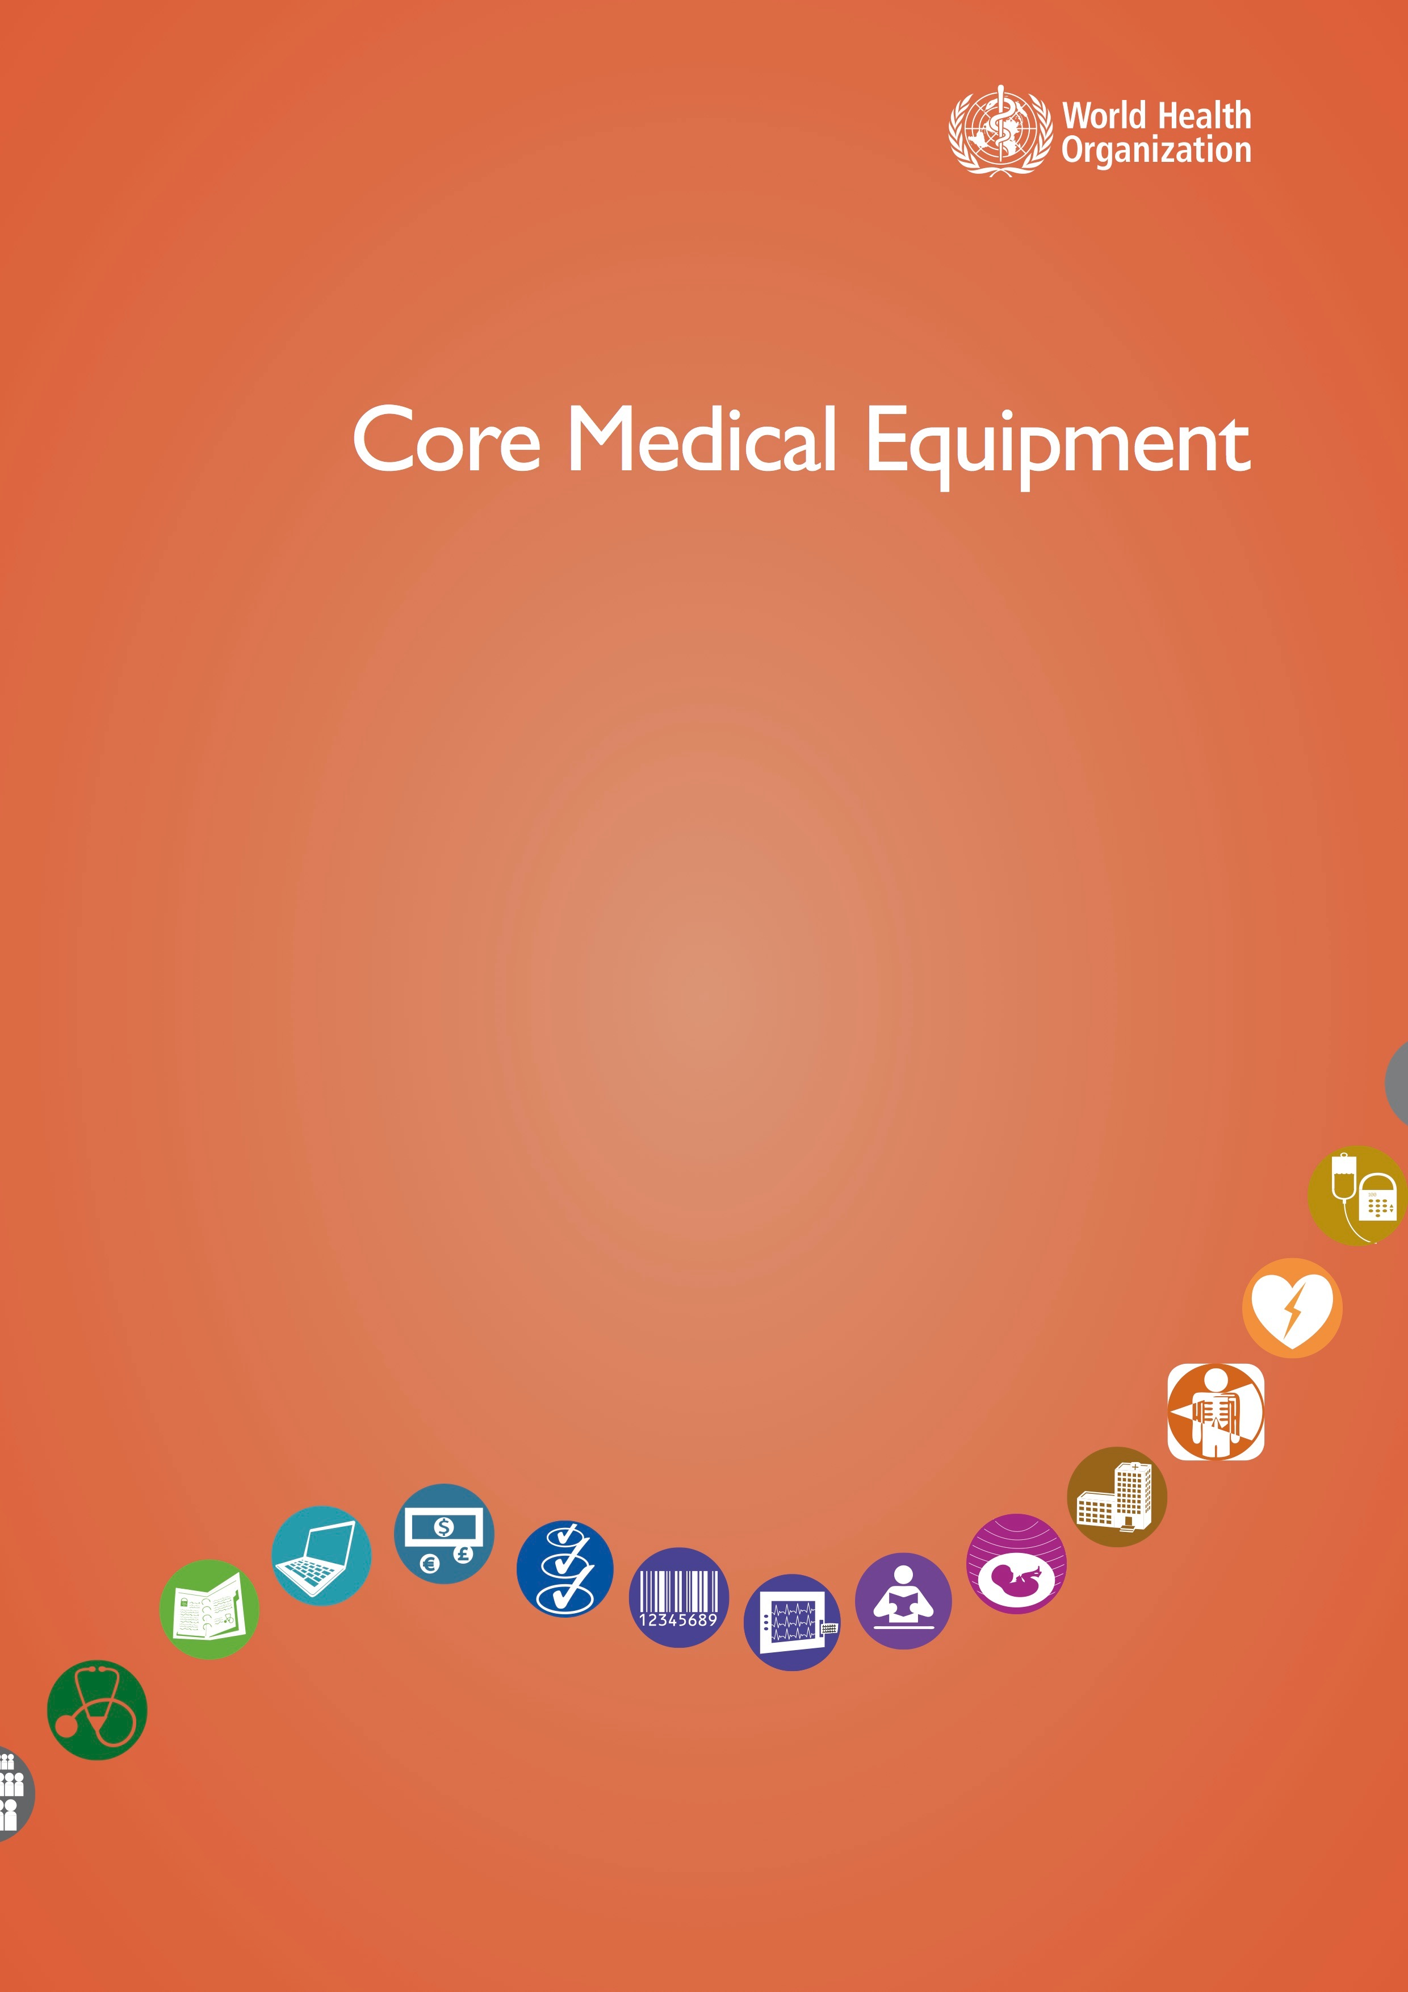
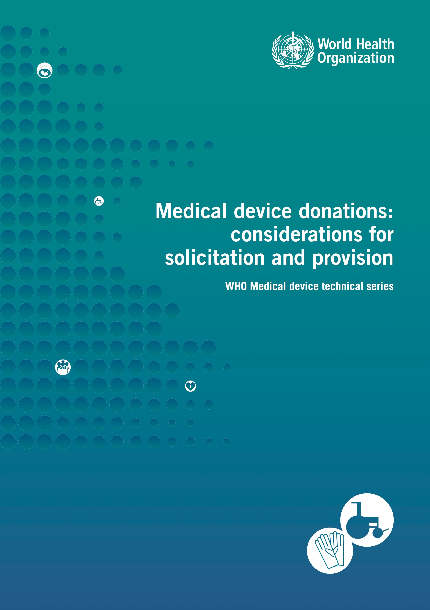
WHO Dept of Essential Health Technologies
Notes:
-Medical Devices: Managing the Mismatch
-Great publications, worth downloading

Slide 6
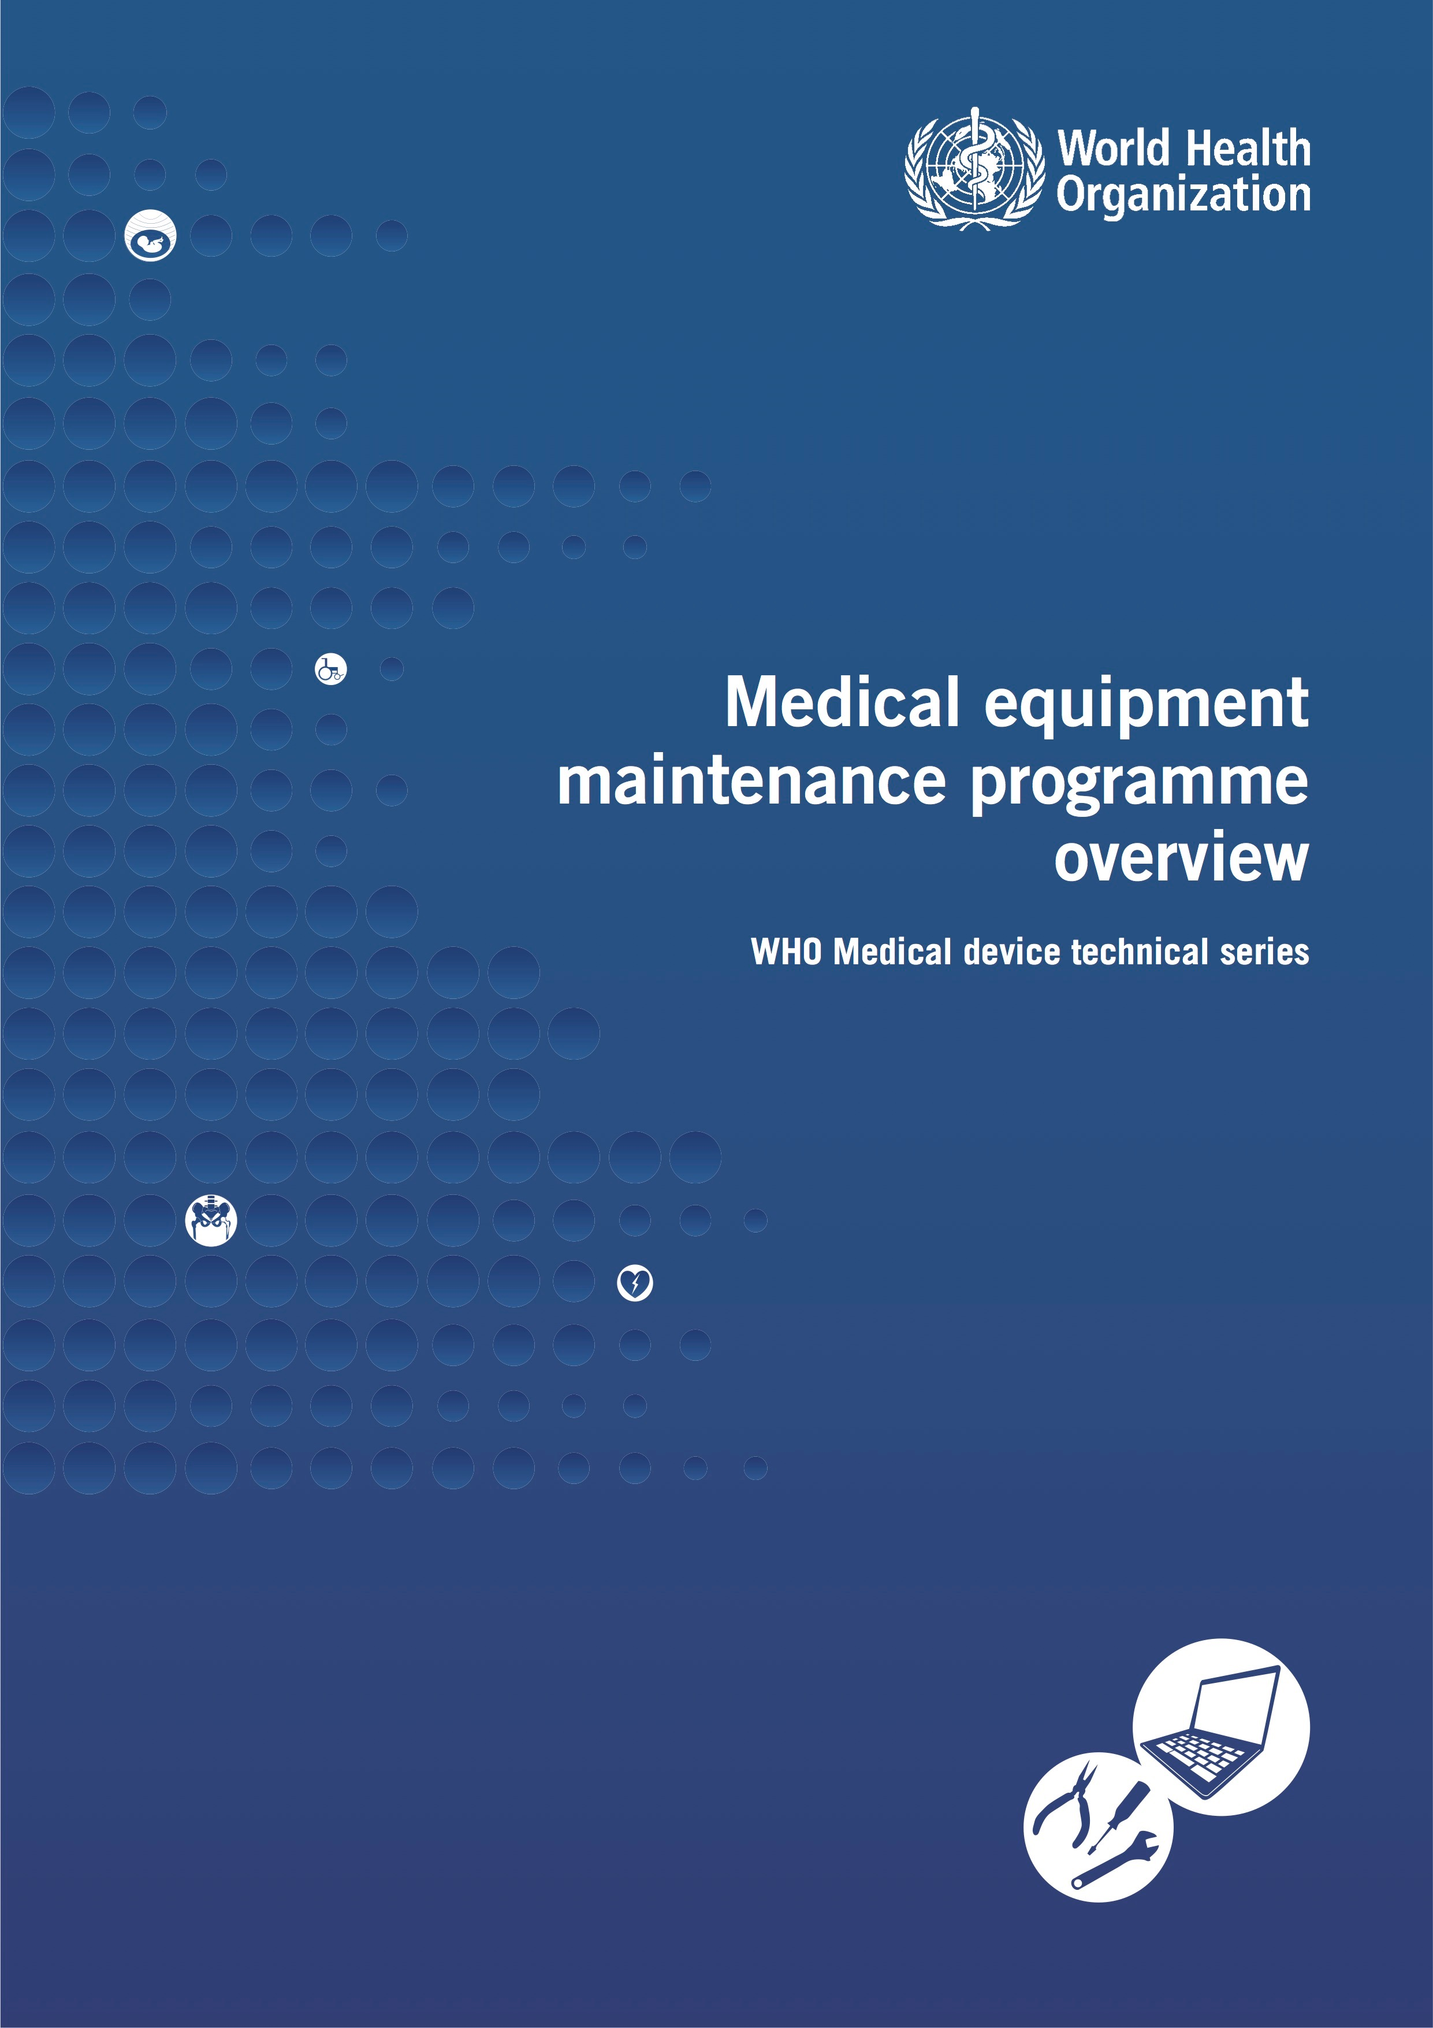
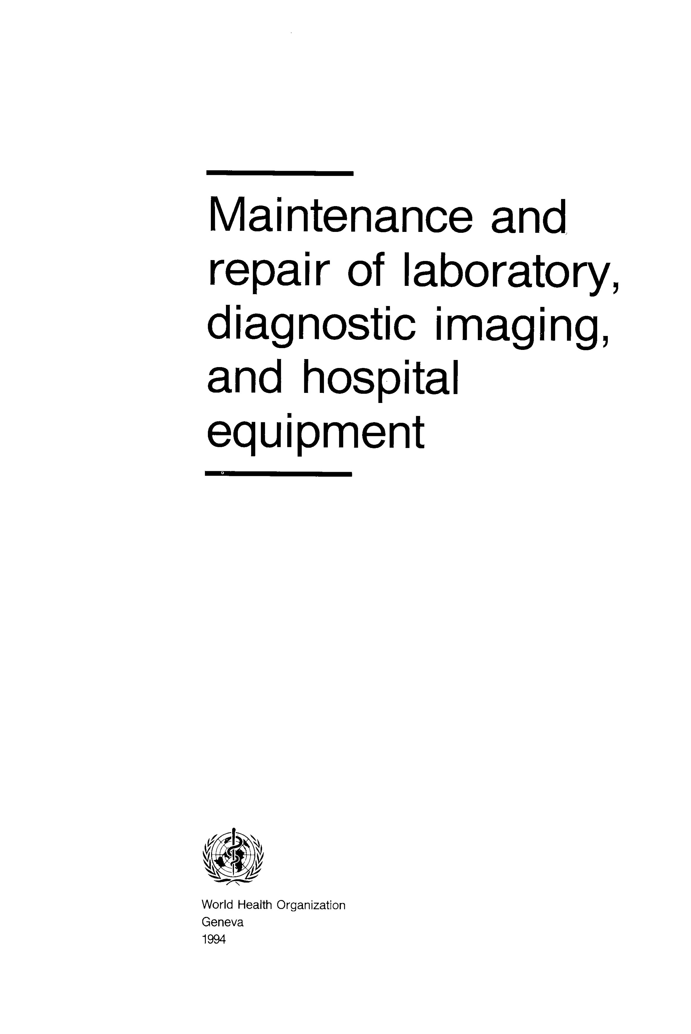
WHO Dept of Essential Health Technologies

Slide 7
Devices Worth Using
WHO: Priority Medical Devices
75% of donated/relief aid devices unused
Outcomes and benefits should drive device selection, not marketing or physician preference
Notes:
-Let’s discuss what makes sense for your projects
-I started out thinking what devices are the most important to bring? Wrong question.

Slide 8
Developing a Plan
Availability: What devices are on the market?
Accessibility: Patients’ ability to use and benefit from them.
Appropriateness: Scientifically valid, feasible within community’s health resources.
Affordability: Can the system and/or patient pay for it?
Notes:
WHO built a matrix for several diseases, and evaluated published guidelines for what devices may be useful

Slide 9
Key Medical Devices in High-burden Diseases
Tuberculosis
HIV/AIDS
Diarrheal Diseases
Malaria
Lower Respiratory Infection
Perinatal conditions
Malignant Neoplasms
Diabetes Mellitus
Unipolar depression
Cataracts
Hearing loss, Adult
Ischemic heart disease
Cerebrovascular disease
COPD
Road Traffic Accidents
Notes:
From guidelines published after 2000 for 15 high burden diseases

Slide 10
Tuberculosis
CXR increasingly affordable, but not always accessible
Lab testing limited, and often not affordable
Bacterial culture affordable, but not appropriate
Notes:
6 week culture time

Slide 11
Perinatal Conditions
Resuscitation equipment needed (not affordable)
Fetal monitors aren’t practical (appropriate) in low resource environments
Oxygen delivery systems with precise flow meters aren’t affordable
Newborn Auditory Screening Device not often available
Notes:
Monitors: Power supply issues

Slide 12
Lower Respiratory Infections
Pneumonia leading cause of death in children under 5
Often viral
Pulse oximeter and O2 delivery
Specific diagnostic testing generally not affordable
Notes:
Affordable, but not accessible (training, maintenance)

Slide 13
Ischemic Heart Disease
Prevention information needs to be more available
ECGs and cardiac biomarker testing not often accessible
Risk factor testing often not affordable
Are AEDs appropriate?
Notes:
-Not accessible at decision making level
-Aspirin and thrombolytics

Slide 14
Stroke
Emphasis needs to be on availability of prevention info
CTs and MRIs often not affordable or accessible
Appropriateness of assistive devises

Slide 15
Road Accidents
Traffic lights, speed control, seatbelts
Access to ET intubation, Ultrasound
X Ray critical, and increasingly affordable
Basic trauma tools (chest tubes, hemostatic dressing) are affordable and appropriate in most settings

Slide 16
Malaria
Confirmation by microscopy or rapid testing before treatment
Fever is an inappropriate screening test
Rapid tests not stable able 30 deg C (appropriateness)
Notes:
Treating is currently cheaper than diagnosing

Slide 17
COPD
Spirometry Appropriate?
Nebulizers often not accessible
Ventilation support
Notes:
-Depends, are inhalers or nebulizers available?
-Power concerns

Slide 18
Imaging
WHO: Only 20-30% of medical cases worldwide require imaging beyond clinical exam.
Of those 80-90% of problems can be solved with XR and US

Slide 19
Commonly Mentioned Devices
Basic XR
Ultrasound
ECG machine
Pulse ox
Refrigerator
Microscope

Slide 20
WHO Core Medical Devices
Analyzer, Laboratory
Apnea Monitors
Auditory Function Screening Device
Bilirubinometer
Blood Gas/pH/Chemistry POC Analyzer
Blood pressure monitor
Clinical Chemistry Analyzer
Colonoscope
Cryosurgical Unit
Cytometer
Defibrillator, External
Densitometer, Bone
Electrocardiograph, ECG
Fetal Heart Detector, Ultrasonic
Fetal monitor
Glucose Analyzer
Incubator, Infant
Mammography unit
Monitor, Telemetric, Physiologic
Peritoneal Dialysis Unit
Pulmonary function analyzer
Scanning Systems, CT, MRI, US
Transcutaneous Blood Gas Monitor
Ventilator, Intensive Care or portable
Videoconferencing system,Telemedicine
Warming Unit, Radiant, Infant
Whole Blood Coagulation Analyzer
Notes:
-About 50 devices
-More detailed guide for MCH

Slide 21
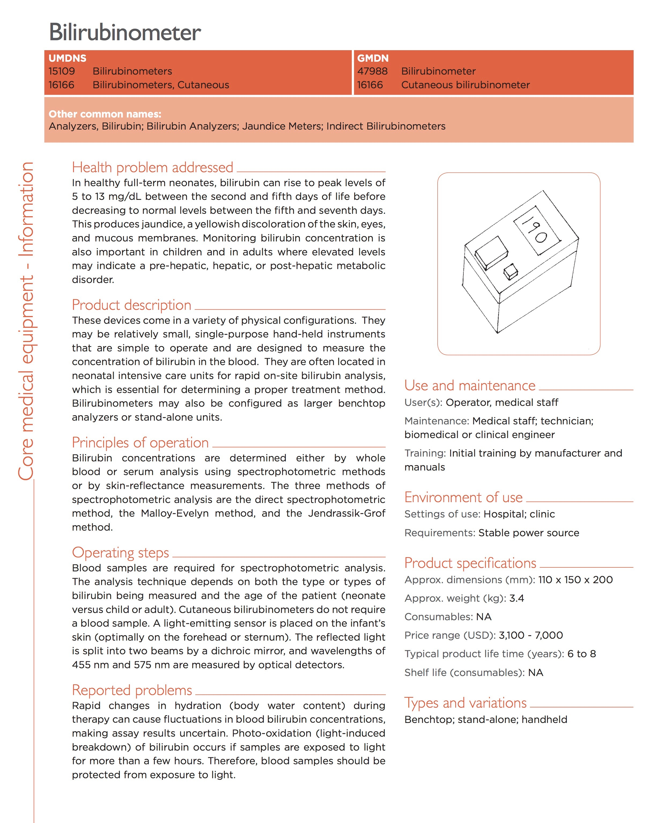
Notes:
Essential medical devices
Health problem addressed
Product description
Principles of operation
Operating steps
Reported problems
Use and maintenance
Environment of use
Product specifications
Types and variations

Slide 22
Donations
WHO Guidelines:
The donation should benefit the recipient to the maximum extent possible;
The donation should respect the wishes and authority of the recipient and conform to existing government policies and administrative arrangements;
If the quality of an item is unacceptable in the donor country, it is also unacceptable as a donation;
All donations should result from a need expressed by the recipient.

Slide 23
Device Planing Wrap Up
Start with public health problem, work backwards to device
Availability, Accessibility, Appropriateness, and Affordability
Consult WHO resources, other guidelines

Slide 24
Keeping Devices Working
Preventative Maintenance vs. Corrective Maintenance
Spares and consumables
Tools and techniques

Slide 25
Preventive Maintenance
PM schedule
Often specified by manufacturer, otherwise assess risk
Check cords and connections
Lubricate moving parts
Replace batteries, o-rings
Check level of paper and other consumables
Label device with date of maintenance, keep central log
Remove batteries for long periods of storage
Notes:
-Risk assessment in Medical Equipment Maintenance guide
-Sample PM checklist for common devices (EKG, infusion pump)

Slide 26
Corrective Maintenance (Repairs)
Learn your devices
X ray, patient monitors, electrosurgical unit, blood pressure device, EKG most likely to need repairs
Find a repair or users manual
Common Causes of Downtime:
Loose connections
Blown fuses
Out of supply
Parts worn out
Notes:
-XR 6.2 repairs/device/year
-Monitors: 2.08
-Electrosurgical unit 1.96
-BP 1.79
-ECG: 1.76

Slide 27
Tool Kit
Multimeter
6 way screwdriver
Watchmaker screwdrivers
Allen set (metric, standard)
Pliers
Adjustable wrench
Flashlight
Torx? Check fittings
Light oil (tri-flo, not wd-40)

Slide 28
Electrical 101
Electrons flowing from point A to point B
Voltage/Amplitude as a waterfall
DC vs. AC
Purpose of grounding
Fuse vs. breaker
Electric vs. electronic
Voltage adapter vs. plug adapter
The different grids you will encounter
Notes:
-Show outlet for grounding
-Small is hot
-Green dot on plug
-EKG just became unsynchronized defibrillator

Slide 29
Outlet Types Around the World

Slide 30
Electrical Supply Around the World

Slide 31
Thinking Like an Engineer
Unplug the device!
Start with what works, and move forward
Learn where the fuse box is
Check power before and after fuses
Should the faulty part be repaired or replaced?
Can parts be taken from other down devices?

Slide 32
Pre-project Checklist
Determine area health resources and needs
Identify any medical device required to meet health needs
Check devices for consumables
Bring extra paper, batteries, fuses (consider O-rings and other consumables)
Determine type of area electrical grid and bring plug/voltage adapters as needed
Pack tool bag
myles.stone.md@gmail.com

Slide 33
References
World Health Organization. Medical Devices: Managing the Mismatch: An Outcome of the Priority Medical Devices Project. Geneva: World Health Organization, 2010.
"Country Data - Global Atlas of Medical Devices 2014 Update." World Health Organization. Accessed August 10, 2016. http://www.who.int/medical_devices/countries/en/#V.
Friesen, Jason, Dean Patterson, and Kevin Munjal. "Cardiopulmonary Resuscitation in Resource-limited Health Systems–Considerations for Training and Delivery." Prehospital and Disaster Medicine Prehosp. Disaster Med. 30, no. 01 (2014): 97-101. doi:10.1017/s1049023x14001265.
Topham, W. Sanford. "The Cost of a Clinical Engineering Department." Journal of Clinical Engineering 1, no. 1 (1976): 24-28. doi:10.1097/00004669-197610000-00004.

Slide 34
Further Reading
Medical Devices: Managing the Mismatch (Priority Medical Devices)
Lutz, Harald, and Hassen A. Gharbi. Manual of Diagnostic Ultrasound in Infectious Tropical Diseases. Berlin: Springer, 2006.
WHO: Manual of diagnostic ultrasound
The WHO manual of diagnostic imaging
WHO: Core Medical Devices
WHO: Interagency list of medical devices for essential interventions for reproductive, maternal, newborn and child health
WHO: Medical equipment maintenance programme overview
WHO: Medical device donations: considerations for solicitation and provision
WHO: A stepwise approach to identify gaps in medical devices (availability matrix and survey methodology)

