Slide 1
“SUGAR” Demo: Simulation Use for Global Away Rotations
Ann Evensen, MD, FAAFP – U of WI School of Medicine and Public Health
Kinsey Dittmar, M2 - UT Health San Antonio School of Medicine and UTHealth Houston School of Public Health

Slide 2
Learning objectives
At the conclusion of this session, participants will be able to:
Describe the process for accessing the Simulation Use for Global Away Rotations (SUGAR) program to better prepare resident physicians for common global health emotional challenges
Experience and debrief one or more common challenges in providing care in low- resource settings

Slide 3
Disclosure
We did not create SUGAR
But you will see that easy dissemination and adaptation was the goal of the developers
We have permission to present this material from Dr. Sabrina Butteris, University of Wisconsin School of Medicine and Public Health, Department of Pediatrics.

Slide 5
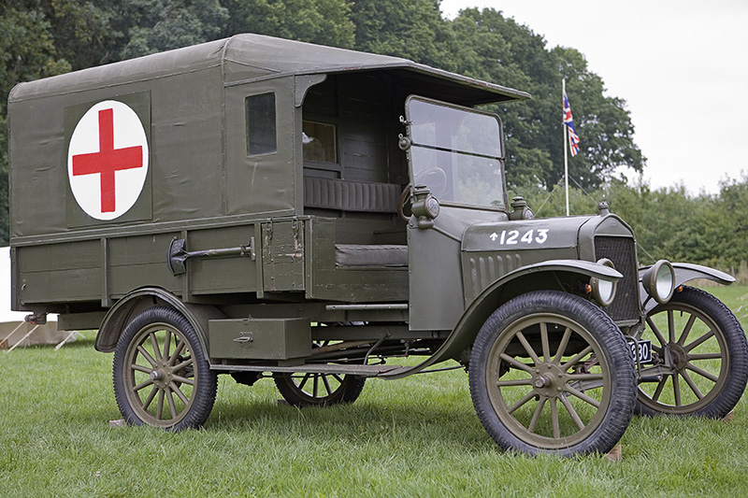
Today’s Lecture: Malaria 101
Didactics
Medical knowledge
Most commonly in person
More recently on-line modules
36% of programs offer clinical preparation*
Reading
Assigned
Self-Directed
1:1 Time
Mentorship (82%)*
Facilitated post trip debriefing (77%)*
Traditional Preparation is Passive
Cultural Preparation
Striving for cultural humility
Awareness of medical sub-cultures
Expecting and managing culture shock
36% offer cultural prep
Health, Safety, Language
Travel logistics
Safety/Insurance
+/- Language Preparation (15%)
*Nelson et al, Pediatrics, 2008
Notes:
Traditional preparation, when offered, has included combinations of lectures or online modules, assigned reading, discussions of culture, health and safety abroad, and ideally faculty mentoring.

Slide 6
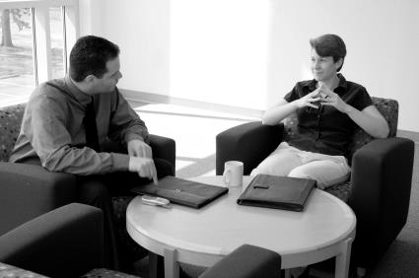
Today’s Lecture: Malaria 101
Didactics
Medical knowledge
Most commonly in person
More recently on-line modules
Reading
Assigned
Self-Directed
Difficulty in handling the emotional obstacles encountered abroad is frequently discussed in post-trip debriefing, yet this is rarely addressed in pre-trip preparation
Traditional Preparation is Passive
Cultural Preparation
Striving for cultural humility
Awareness of medical sub-cultures
Expecting and managing culture shock
Health, Safety, Language
Travel logistics
Safety/Insurance
+/- Language Preparation
Notes:
Yet residents frequently report that the hardest part of adjusting to these rotations is the difficulty handling the emotional obstacles which commonly occur when working with limited resources. Little has been available to prepare residents for these types of challenges.

Slide 7
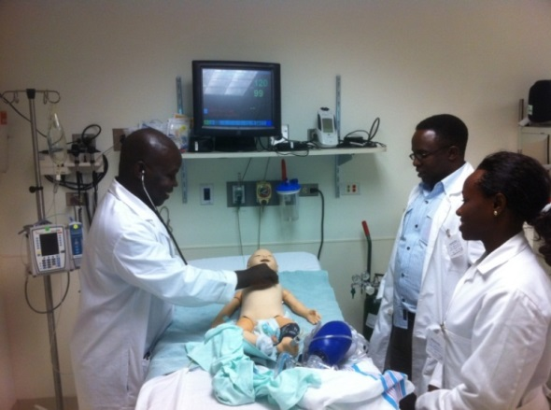
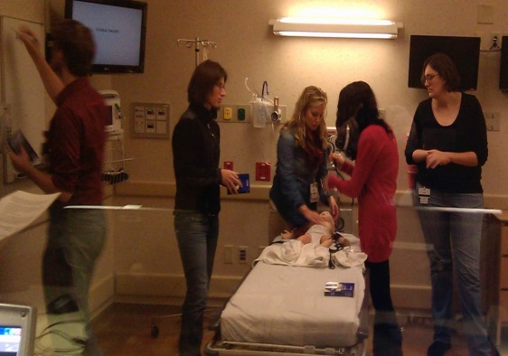
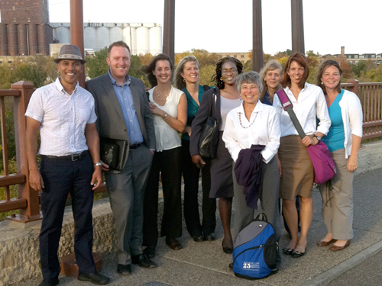
+
+
Can we use simulation to prepare for common emotional challenges encountered abroad, rather than just medical preparation?
→
Notes:
In 2012, in a meeting of the Midwest Consortium of Global Child Health Educators, a seven institution collaborative, members began discussing if we could build off the work some of us were already doing in simulation with global health learners, to prepare residents for these common emotional challenges. At this meeting the concept of SUGAR was born.

Slide 8
SUGAR and Spin Off Investigators
Sabrina Butteris, MD
Laura Houser, MD
Scott Hagen, MD
Sarah Webber, MD
Katy Miller, MD
Amanda Becker, MD Lisa Umphrey, MD
Heather Peto, MD
Cynthia Anderson, MD
Michael Pitt, MD Cindy Howard, MD
Tina Slusher, MD
Brinda Desai, MD
Andrew Kiragu, MD
Chuck Schubert, MD
Stephen Warrwick, MD
Alisha George, MD
Amy Rule, MD
Rachel Bensman, MD
Jennifer Watts, MD
Rebecca Liggin, MD
Philip Fischer, MD
Jane Rosenman, MD
Grace Arteaga, MD
Molly Shane, MD
Heather Lukolyo, MD
Nicole St. Clair, MD
Jacquelyn Kuzminksi, MD Lindsey Troy, MD
Chad Verico, MD
Towsend Cooper, MD
Notes:
We’d like to thank all of the SUGAR Spin-Off Investigators leading current projects and welcome the formation of others. I am happy to take any questions

Slide 9
Target Emotion Adaptive Characteristic
Frustration
Adaptability
Floundering
Awareness of Resources
Failure
I thought I knew what to do but patient is getting worse
Adjustment (Humility)
I know what to do at home but I can’t do it here.
I don’t know what to do for this condition?
Futility
Am I the only one who cares? Why are we doing this?
Acknowledgement
Notes:
We identified four common themes. which we called the Four Fs, for the types of emotions residents reported feeling on these electives and paired each with a target adaptive characteristic (the Four As) which we hoped could be achieved through the simulation and structured debriefing. For example, to simulate the experience of frustration, where residents know what to do back home but are unable to do so at their site, we developed cases such as a presentation of a patient in Diabetic Ketoacidosis where residents often know what to do – start an insulin drip, check serial glucoses, etc. In the simulated case, however, they are told there is no pump, are handed a vial of insulin, and a glucometer with instructions in Arabic and three strips remaining. In all cases, residents encounter obstacles to their expected interventions, and through dynamic problems solving and structured debriefing using a validated debriefing script, ideally reach the adaptive characteristic, in this case, Adaptability.
We created cases foreach of the emotions frustration, floundering (where the resident encounters a new disease they are likely not familiar with), failure (where what they expect to work doesn’t yield the intended results), and futility (such as confronting the need to stop resuscitation on a neonate because of lack of access to a ventilator) and piloted across the seven institutions in our consortium.

Slide 10
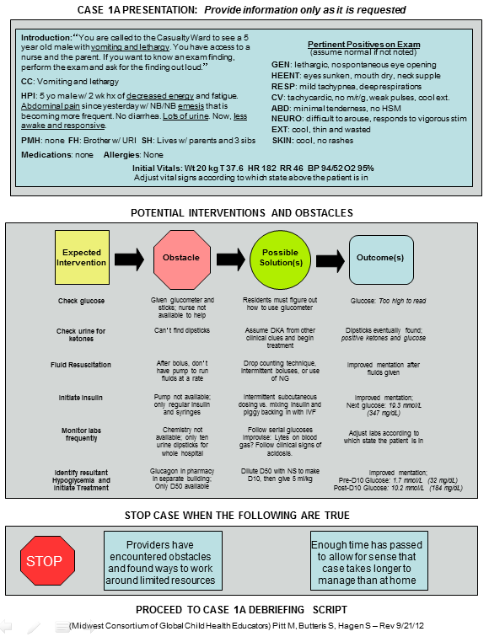
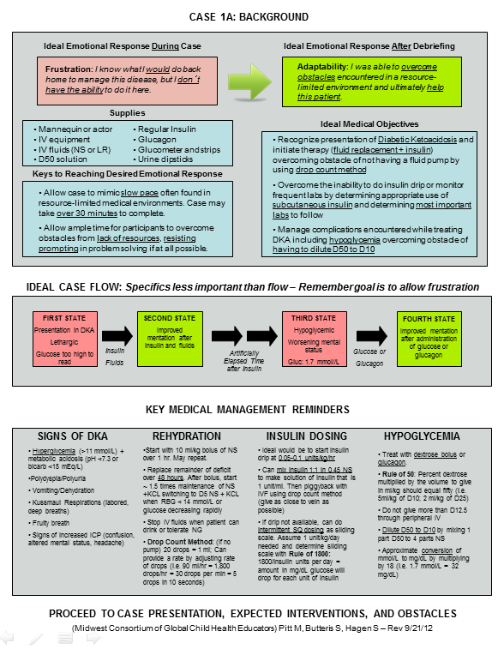
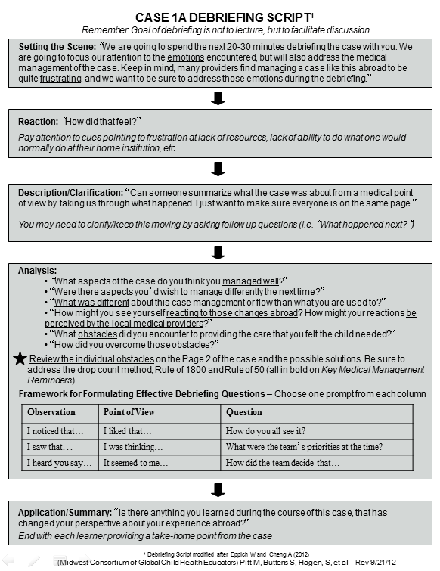
2 pg outline + 1 pg debriefing script for each case

Slide 11
sugarprep.org
Notes:
We opted to create our own training website as a way to provide access to the curriculum, track downloads, and be able to provide updates and improvements with ease. We purchased the website domain sugarprep.org and a website design template for total of $300. We recorded an annotate live sugar sessions and created training videos to orient to the curriculum and debriefing process.
We worked with a web developer at one of our institutions who helped us create the site where facilitators could receive this video training, and upon completing, download the cases for free after inputting their contact information.

Slide 12
Early results published…
Now what?
Notes:
During the year of the pilot we had 160 learner encounters. As this is intended to be a talk about dissemination, we will not discuss the results today beyond saying that residents found the simulations elicited strong emotions mirroring those encountered abroad, found the sessions useful in preparation, anticipated changes to their preparation, and continued to find the sessions valuable on reflection from returning from their electives.
After getting this exciting data, and publishing the results, we were at a point as the original investigators where we needed to decide what was next

Slide 13
SUGAR developers stated goal:
If the idea works, make it as easy as possible for others to use it and adapt it
Notes:
Despite the fact that we were essentially all junior faculty, and aware that traditional dissemination patterns were what was recognized for credit at our respective promotion committees, we felt early on that if the idea worked, we wanted to make it as easy as possible for others to use it and adapt it right away.

Slide 14
6 countries, hundreds of facilitators
Notes:
In six countries

Slide 15
SUGAR Spin Offs
New Cases (OB, Family Medicine, Surgery, Immigrant Health, Med Students, Nurses, Clinic)
SUGAR PEARLS (Procedural Education for Adaptation to Resource Limited Settings)
SUGAR CANE (Cases about Non-Medical Events)
SPICE (SUGAR: Practical Insights from Core Educators)
Notes:
Other spinoffs include
SUGAR CANE (cases about non-medical events) which focuses on preparation for situations such the need for urgent medical evaluation or evacuation for the resident.
SPICE (SUGAR: Practical Insight from Core Educators) which is surveying the trained facilitators for tips and tricks on how they’ve implemented SUGAR at their home institutions
As well as several people taking the lead on new cases in different fields and for different audiences.

Slide 16
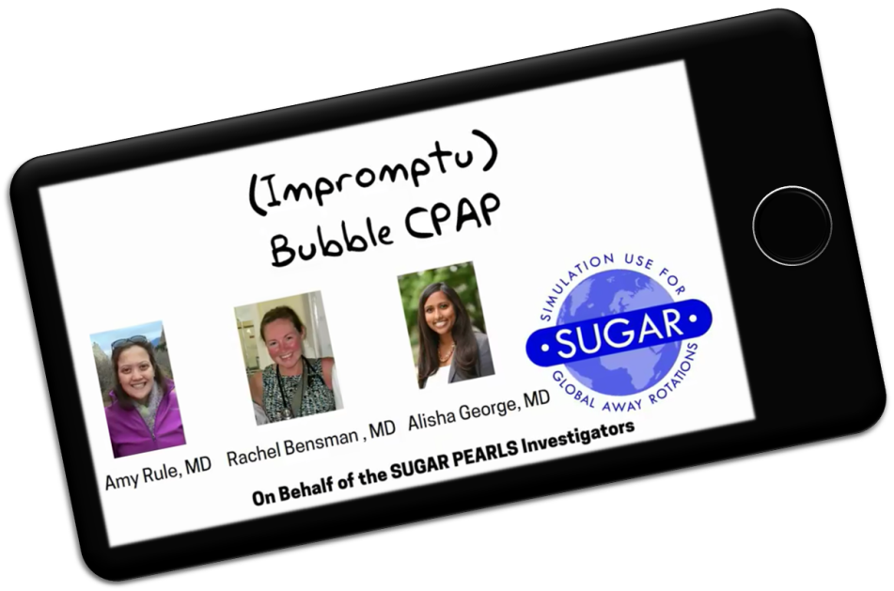
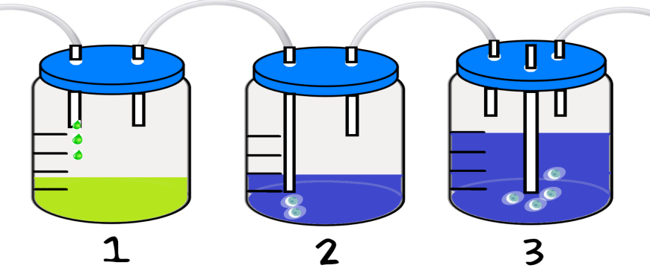
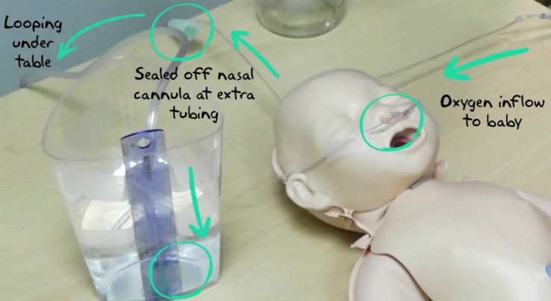
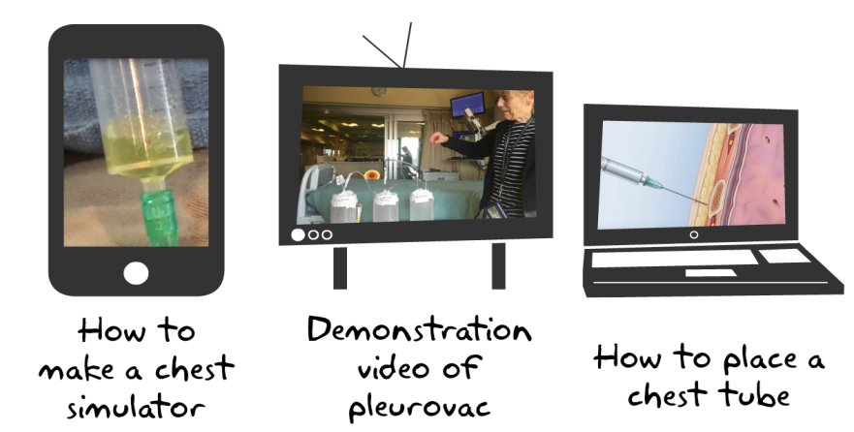
Notes:
such as bubble CPAP, improvised pleuorvac chest tube drainage systems, improvised IO needless, burn care, and more. These videos are now also available for free at sugarprep.org

Slide 17
Let’s try it!
sugarprep.org

Slide 18
© 2018 American Academy of Family Physicians. All rights reserved.
All materials/content herein are protected by copyright and are for the sole, personal use of the user.
No part of the materials/content may be copied, duplicated, distributed or retransmitted
in any form or medium without the prior permission of the applicable copyright owner.

