Slide 3
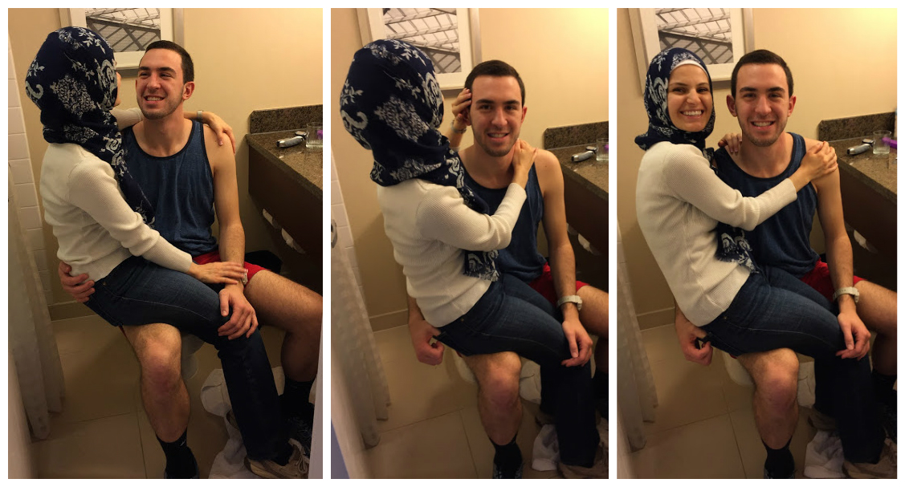

Slide 4
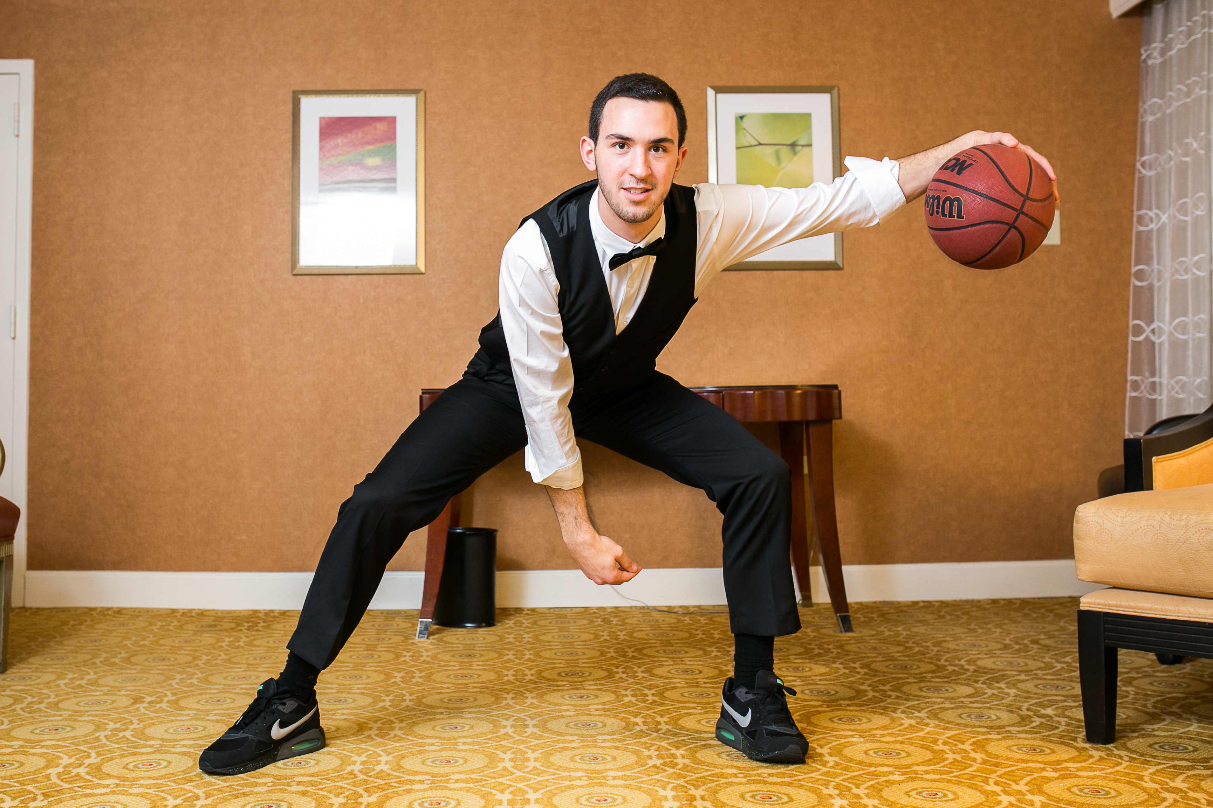
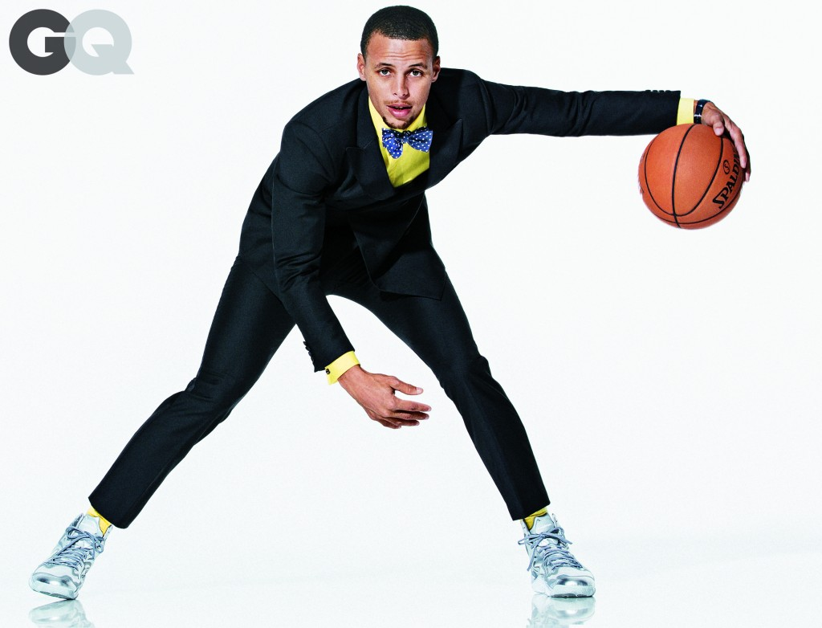

Slide 5
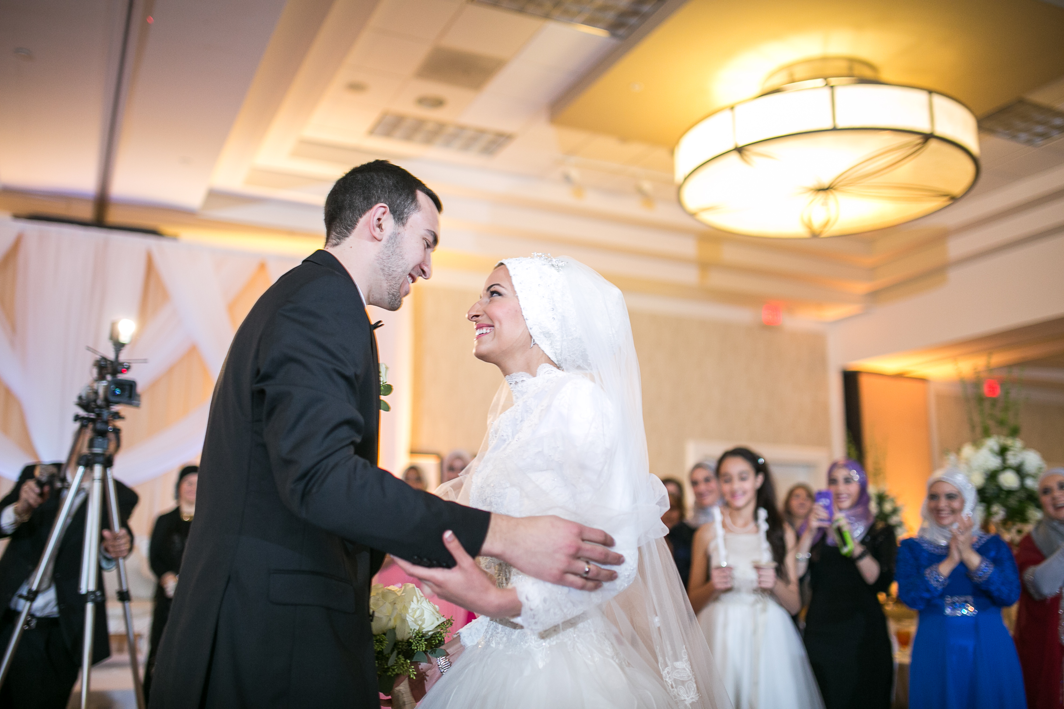

Slide 6
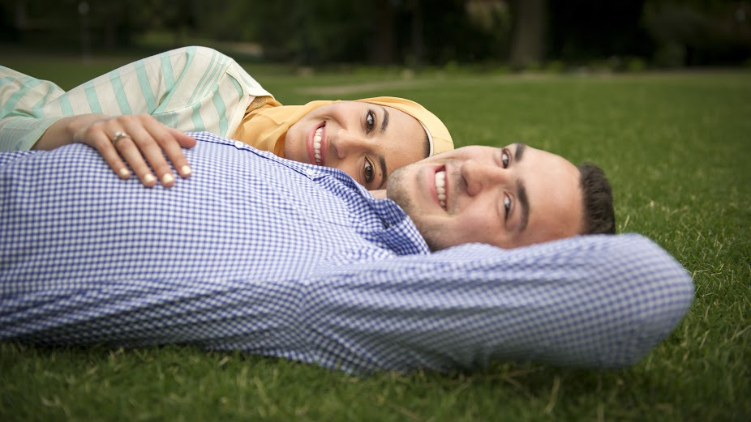

Slide 7
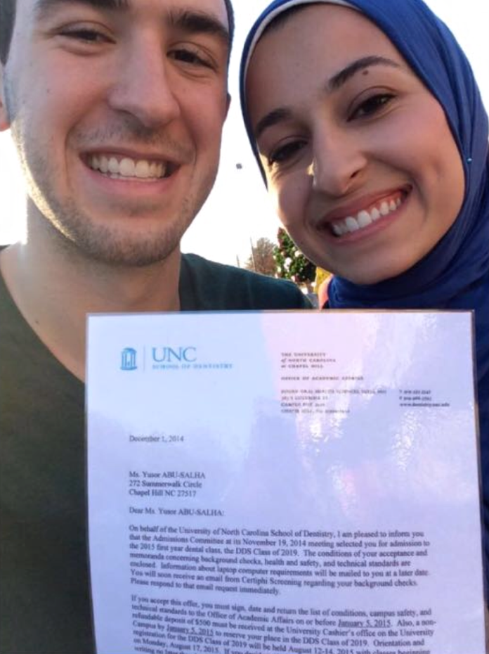

Slide 8
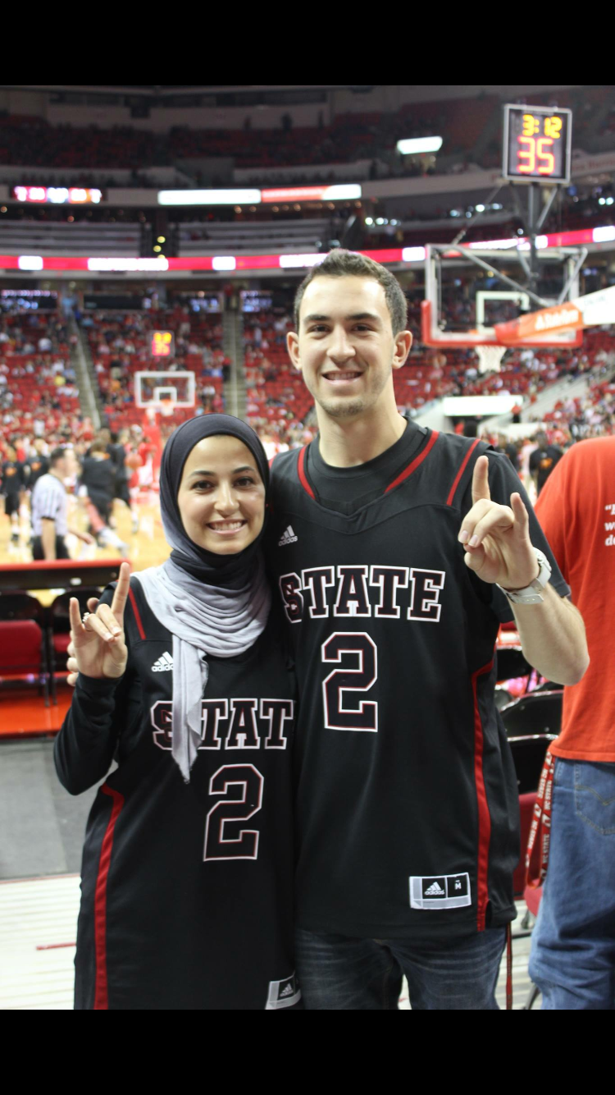

Slide 9
Notes:
Yusor basketball vine: <iframe src="https://vine.co/v/hdh0gwtIMXg/embed/simple" width="600" height="600" frameborder="0"></iframe><script src="https://platform.vine.co/static/scripts/embed.js"></script>

Slide 10
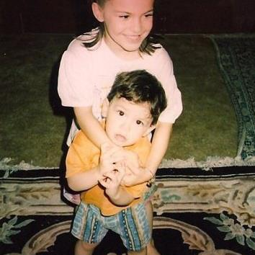

Slide 11
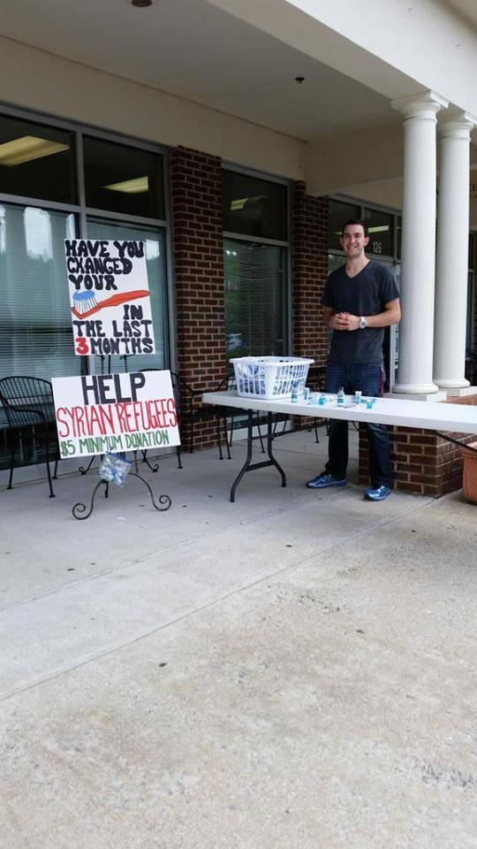

Slide 12
Notes:
Play Youtube Clip of Project Refugee Smiles 0:04-0:49
https://www.youtube.com/watch?v=jXWryn60-aM

Slide 14
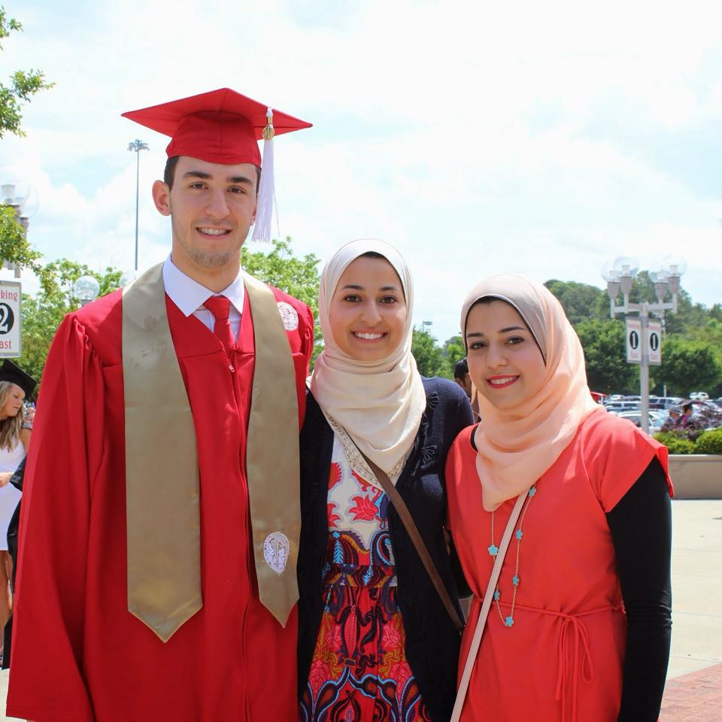

Slide 19
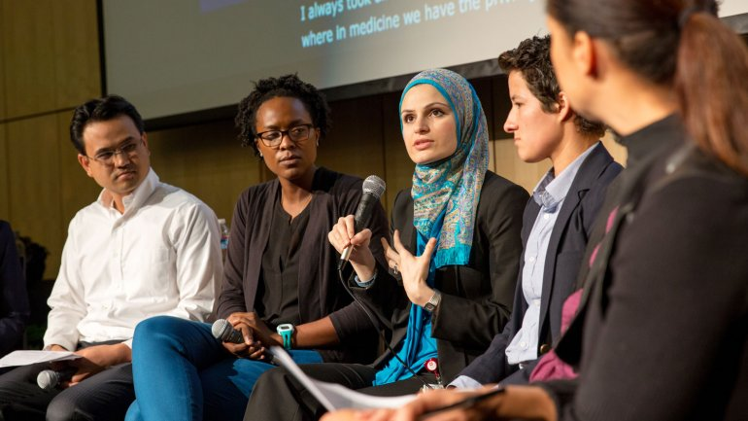

Slide 20
Deah | Yusor | Razan

