Slide 1
Incorporating Teaching of Maternity Care in Family Medicine Through Computerized Simulation Models
TuERE COULTER, MD
CARNAI SIMPSON, MD
CHRIS SIMPSON, MD
UNIVERSITY OF TEXAS MEDICAL BRANCH At GALVESTON

Slide 2
OBSTETRICAL TRAINING IN FAMILY MEDICINE
The Advanced Life Support in Obstetrics (ALSO) Course Prepares the maternity care team To handle obstetric emergencies
More than 80% of Family Medicine residency programs require ALSO training as part of their curriculum
Historically the course took place over 2 days
Beginning on June 1, 2018 ALSO Courses will be offered as a blended 1 day course

Slide 3
WHAT IS The Mini-ALSO COURSE?
a ½ day series of stations that focus on obstetric high yield topics
designed to assist residents in passing the ALSO Certification
Simulation models are used at various stations as residents work in groups to master each competency
Notes:
Focuses on: FHT tracings, Shoulder Dystocia, Assisted Vaginal deliveries, and Postpartum hemorrhage

Slide 4
Organization of the Mini-ALSO Course
Timing: 4 HOURS OF protected TEACHING time
Tools: a simulation lab or portable simulation models, copies of fetal heart tracings, vacuum/forceps, food coloring, chuck pads
Design: designated stations with 2 “teachers” and 5-10 “learners”
Station 1: Fetal Heart Tracings
Station 2: PPH
Station 3: Assisted-Vaginal Delivery and Shoulder Dystocia

Slide 5
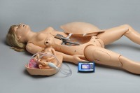
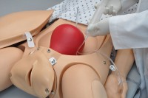
Cost of Simulation model 1
Gaumard: Noelle Simulator $33,995.00

Slide 6
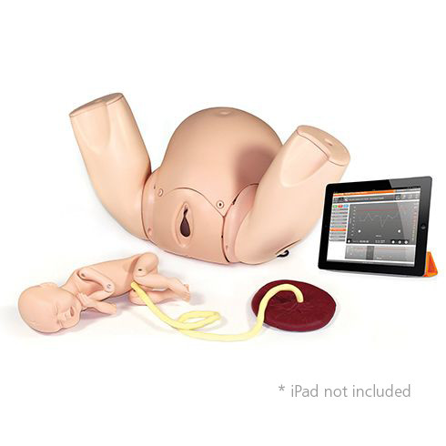
Cost of SIMULATION MODEL 2
Limbs & Things: Prompt Flex Birthing Simulator: $8000.00

Slide 7
Workshop Benefits for Faculty
Benefits for faculty “teacher”
Ability to assess resident knowledge and readiness for wards
Ability to evaluate teaching method and receive feedback
Ability to demonstrate practical hands-on application of techniques used in obstetric emergencies
Assessment of resident ability to teach co-residents
Dedicated time to train residents for care of obstetric patients on the wards

Slide 8
Resident Teacher

Slide 9
Resident Teacher Curriculum
ACGME Residency Review Committee for Family Medicine recommends that senior residents serve in supervisory roles (both ensuring patient safety, and teaching junior residents and students) during their training
Each residency program is responsible for its own curriculum

Slide 10
Resident Teacher Benefits
Acting in an educational role reinforces the resident-teacher’s own learning
Teaching skills developed during residency translate into teaching skills that are used in independent practice
Residents who graduate with excellent teaching skills often provide better care to patients through patient education and more effectively engage their patients in shared medical decision making
Notes:
residents who teach about a subject increase their own knowledge of that topic

Slide 11
Resident Teacher Benefits
Residents with strong teaching skills can also be more effective team leaders
Physician-teachers can employ their public speaking skills to improve the health of their community by improving medical knowledge, increasing public health awareness, or undertaking legislative advocacy
Notes:
Provides the ability to give and receive feedback, and to assess and address team members’ learning needs

Slide 12
Resident Teacher Benefits
Developing and assessing residents’ teaching skills also provides opportunities to identify and engage with skills and interest in academic careers that will help train future generations of family physicians

Slide 13
RESIDENT LEARNER

Slide 14
L&D EMERGENCIES
Fetal heart tracings
Identify the differences in Category I-III tracings
Able to establish a specific, organized approach to reading FHT’s
Solidify knowledge on various obstetrical conditions observed with FHTs

Slide 15
L&D emergencies
Postpartum hemorrhage
More familiar with medications used in PPH and the Contraindications for each
More confident in how to effectively communicate with the team to effectively manage PPH

Slide 16
L&D EMERGENCIES
SHOULDER DYSTOCIA, ASSISTED VAGINAL DELIVERY
Comfortable/confident with managing these emergencies on the L&D floor
More familiar and comfortable with proper use of instruments
Allowed the opportunity to improve my technique and timing of shoulder dystocia, PPH

Slide 17
WORKSHOP BENEFITS FOR LEARNERS
Hands-on learning experience
Team building exercise
Simulation setting builds confidence in residents to feel better prepared for various obstetric emergencies
Repetition and muscle memory emphasized through simulation workshop

Slide 18
QUESTIONS??

Slide 19
THANK YOU!!

