Slide 1
Easing the Transition to Citizenship: The N-648
Paula Mahon, MD
Health Care for the Homeless, Manchester NH

Slide 2
Diagnostic codes for N-648
PTSD / anxiety
Depression
Hearing loss
Mutism / aphasia
Organic brain syndrome - secondary to closed head trauma
Senile dementia
Mental retardation
Multi-infarct dementia secondary to diabetes or hypertension
Schizophrenia
Hydrocephalus
Hepatic encephalopathy

Slide 4
Post-traumatic stress disorder screening questions
Do you have trouble sleeping?
If yes, do you have recurrent nightmares?
If yes, how often?

Slide 5
Post traumatic stress disorder criteria DSM-5
Exposure to threatened death, serious injury or sexual violence either directly or as a witness
Presence of intrusive symptoms occurring after the event, such as distressing memories and dreams
Persistent avoidance of stimuli associated with the event
Negative alterations in cognition and mood marked by amnesia, diminished interest in activities, persistent inability to experience happiness

Slide 6
Marked alterations in arousal and reactivity as evidenced by hypervigilance, irritable or angry outbursts, exaggerated startle, problems with concentration, and sleep disturbance lasting more than one month impairing social and occupational function

Slide 7
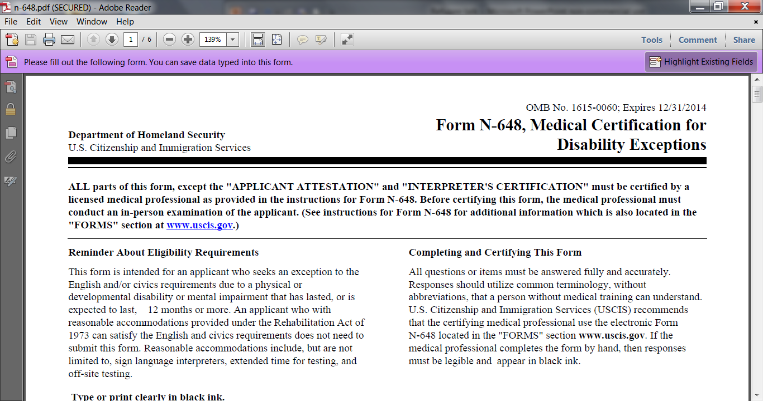
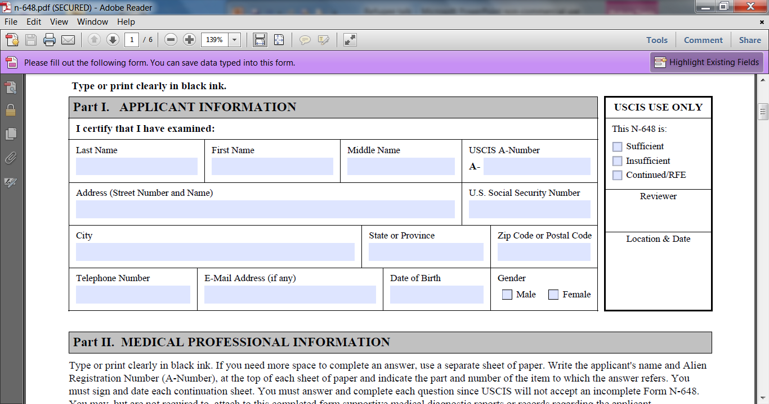

Slide 8
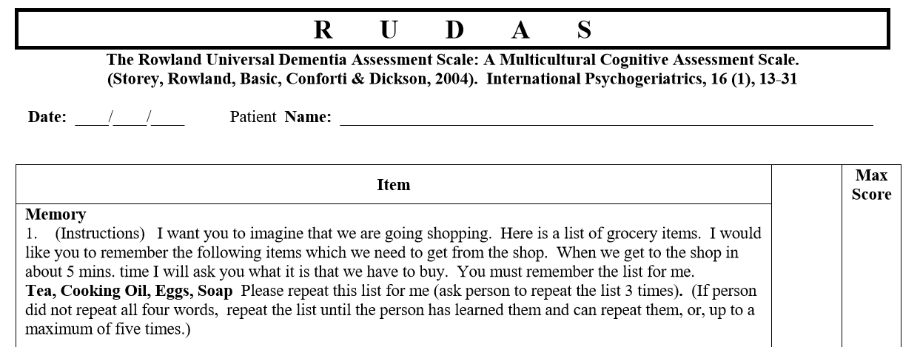

Slide 11
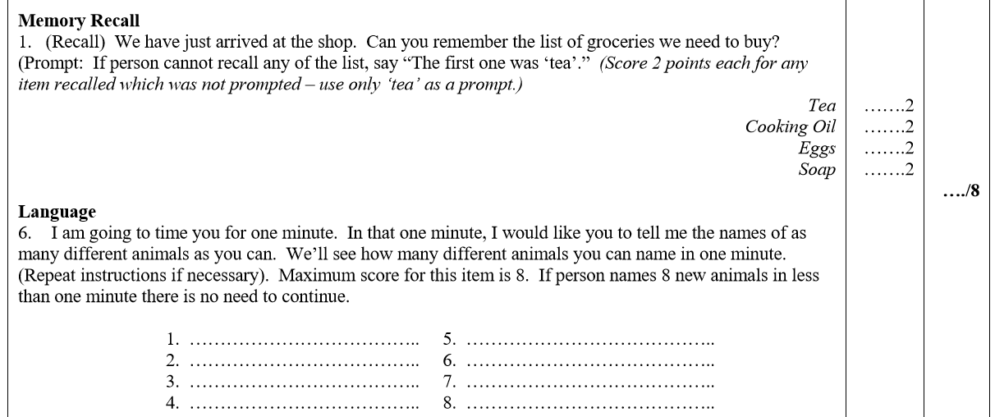

Slide 12
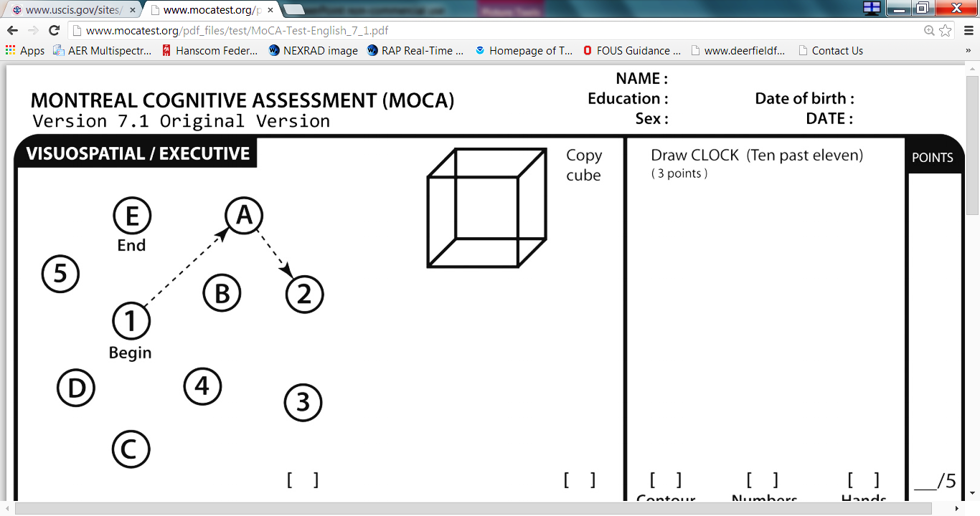
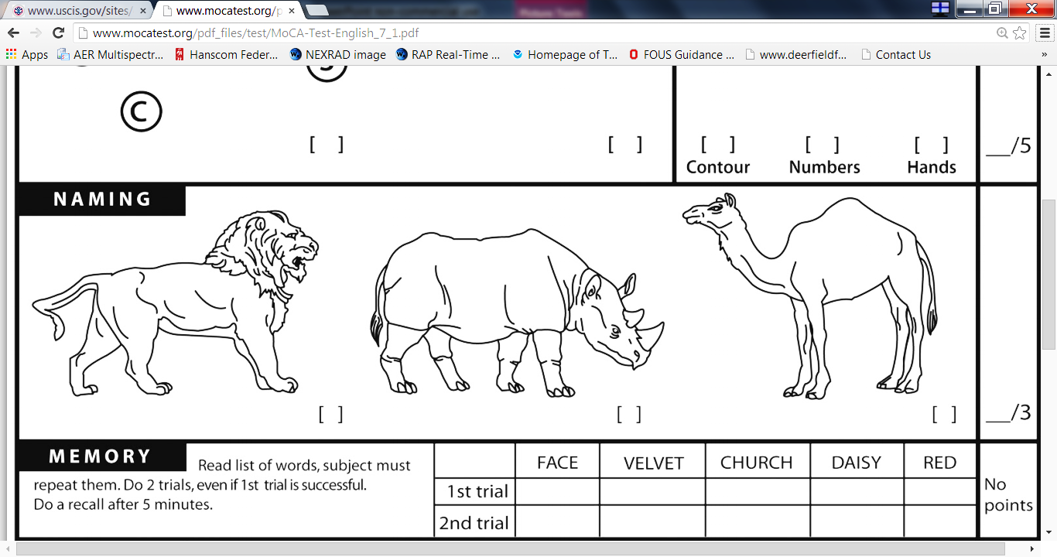
VELVET
DAISY

Slide 13
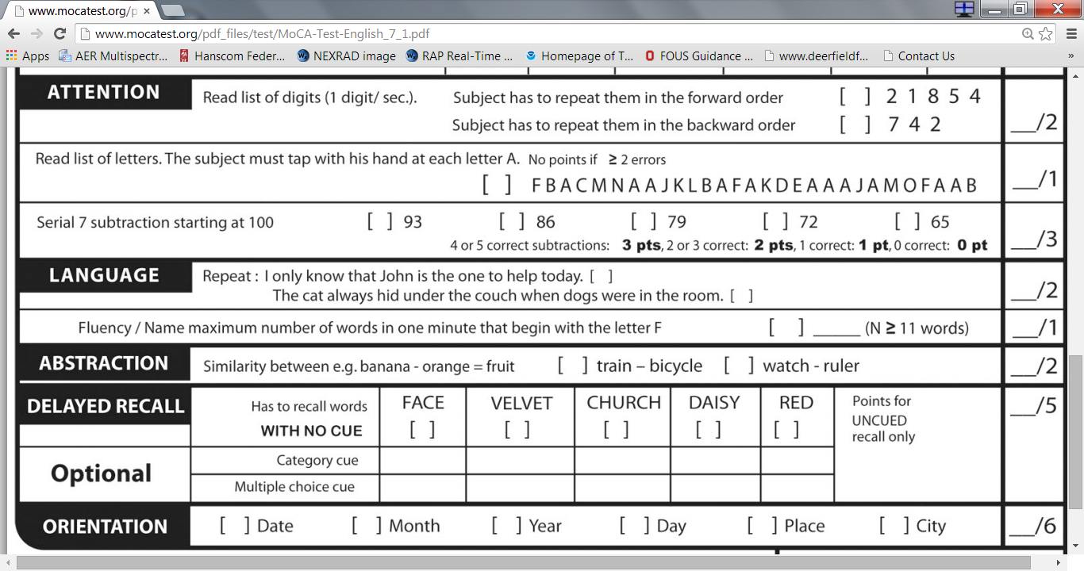

Slide 14
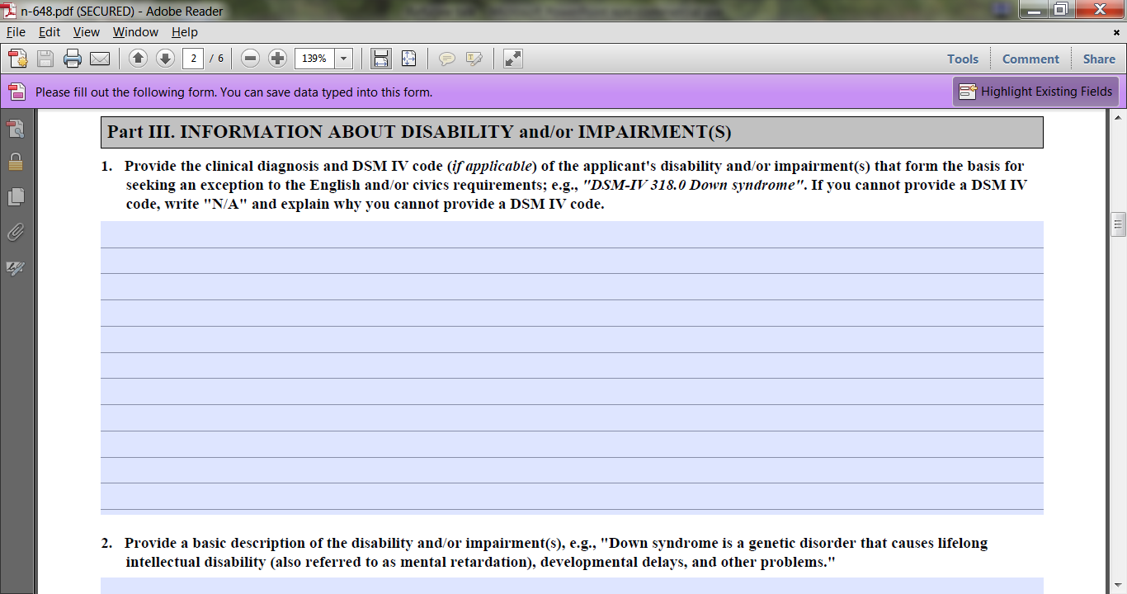
Documenting disabilities

Slide 15
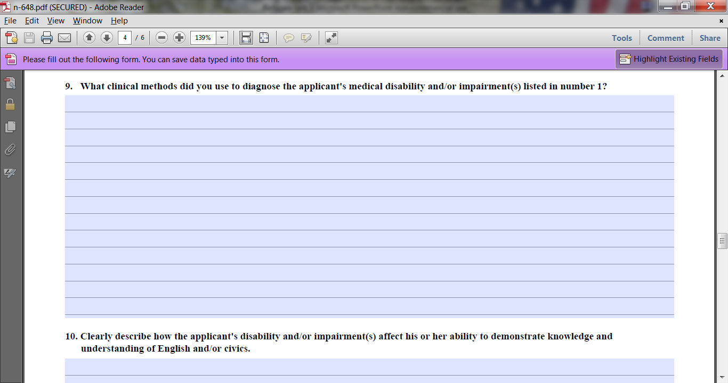
Documenting disabilities

