Slide 1
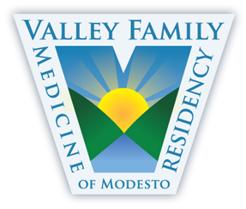
The Cuban Model of the Patient-Centered Medical Home Three Decades in the Making: How Cuba's Neighborhood Consultorio Truly Integrates Family into Medicine
Jade Bito-Onon, DO
Laravic Flores, MD
Shraddha Shah, MD
Valley Family Medicine Residency
Modesto, CA

Slide 2
Activity Disclaimer
ACTIVITY DISCLAIMER
It is the policy of the AAFP that all individuals in a position to control content disclose any relationships with commercial interests upon nomination/invitation of participation. Disclosure documents are reviewed for potential conflicts of interest (COI), and if identified, conflicts are resolved prior to confirmation of participation. Only those participants who had no conflict of interest or who agreed to an identified resolution process prior to their participation were involved in this CME activity.
Jade Bito-Onon DO, Laravic Flores MD, Shraddha Shah MD have indicated they have no relevant financial relationships to disclose.

Slide 3
“I want to join so many others in saluting Cuba’s health-care system, rooted in primary health care, which has yielded outstanding results — lower infant mortality, higher life expectancies, universal coverage. This is a model for many countries around the world.”
Former UN Secretary-General Ban Ki-moon in his remarks to officials
during his 2014 visit at Escuela Latinoamericana de Medicina
(ELAM / Latin American School of Medicine) in Cuba

Slide 4
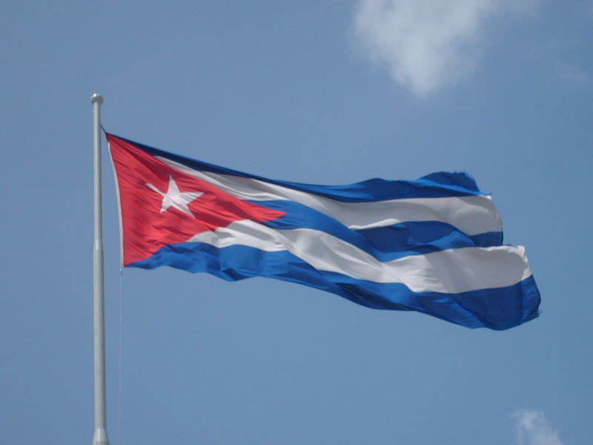
Cuban Health System
UNIVERSAL
FREE OF CHARGE
ACCESIBLE
REGIONALIZED
PREVENTIVE
At the reach of everyone:
In rural and urban areas
No matter the political affiliation
No matter the race
No matter the gender
No matter the religion or atheism
With community and intersectoral participation
With an internationalist conception
COMPREHENSIVE

Slide 5
Cuban National Health Indicators
Population: 11, 239, 114
Birth rate: 10.4 per 1000
Life expectancy: 78.45 years
Infant mortality rate: 4.3 per 1000
Total # doctors: 90,161 (80.2 per 10,000 inhabitants)
Total # family doctors: 46, 302 (51% of total # doctors)
Ratio doctors-inhabitants: 1:124
Anuario Estadístico de Salud 2016, Ministerio de Salud Pública; La Habana, Cuba

Slide 6
Legal Foundations of the
Cuban Health System
Article 49:
Everyone has the right to be medically attended and their health protected. The state guarantees this right.
The guarantee of this right is written down in Public Health Law 41
Notes:
Artículo 49 de la Constitución de la República de Cuba (SALUD PUBLICA BOOK, p.333)
La Constitución del Estado Socialista cubano fue proclamada en acto solemne el 24 de febrero de l976 y aprobada en referéndum por 97,7 % de los votantes. Esta constitución sustituye a la de l940 y deja establecido de forma explícita en el artículo 49 el derecho constitucional a la protección de la salud de la forma siguiente:
“Todos tiene derecho a que se atiendan y proteja su Salud. El Estado garantiza este derecho.”

Slide 7
Principles of the Cuban Health System
Outlined in Public Health Law 41, Article 4:
Social and state character of medicine in Cuba
Accessible and free services
Focus on prevention
Adequate application of science and technology
Community participation
Internationalism and collaboration
Planned integration and development
Notes:
Asamblea Nacional del Poder Popular aprobó el l3 de julio de l983 la Ley No. 4l de la Salud Pública (SALUD PUBLIC BOOK, p.333)

Slide 8
Brief History of the Cuban Health System
1959 New distribution of hospitals post-revolution
(increase in number of rural hospitals)
1st national vaccination campaign
1962 Antipolio campaign begins
1972 Creation of community policlinics
1984 Beginning of family doctor and nurse program
Notes:
There are two sets of reforms, one in 1960 and the other in 1990, defining the structure of the Medical system today. The reforms of 1960 focused on distribution of healthcare services so that medical services were provided to all citizens. Prior to the revolution, there was only one rural hospital in all of Cuba. This fact reflected the dire need for change in the allotment of services.

Slide 9
1990 Reforms (The “Special Period”)
Decrease the effects of the economic crisis on the population by:
increasing popular participation at the local level
focusing resources on vulnerable groups
(women, children <7yo, elderly);
emphasizing the manufacture of essential drugs in Cuba
integrating natural and traditional medicine (NTM)
Notes:
The reforms of 1990, after the onset of the special period, focused on decreasing the effects of the economic crisis on the population and included the following modifications: “increasing popular participation and involvement of grassroots councils and committees in decisions that affect health priorities at the local level; focus of resources on vulnerable groups (women, children less than seven, the elderly); emphasis on the manufacture of essential drugs in Cuba; and the integration of traditional medical treatment into the Westernized medical system”.

Slide 10
Government Responsibilities for Health Care
Before 1980: System completely centralized - Ministry of Public Health had full control over how resources were spent, what the disease priorities were, and public health strategies
Since 1980: System has been decentralized - disease priority, identification and health promotion occur at the local levels; Resource allocation is however still central.
In 1984 the Family Doctor/Nurse Program was implemented in an attempt to ensure that there was a family doctor and nurse in each neighborhood.
Notes:
The Cuban government assumes full responsibility for the healthcare of its citizens. Before 1980 the system was completely centralized: the Ministry of Public Health had full control over how resources were spent, what the disease priorities were, and public health strategies. Since 1980, the system has been decentralized so that disease priority identification and health promotion occur at the local levels. Resource allocation is however still central. In 1984 the Family Doctor/Nurse Program was implemented in an attempt to ensure that there was a general doctor and nurse in each neighborhood.

Slide 11
National Health System Structure
Health Center
Administration
Political Sector
Ministry of Public Health
National Popular Assembly
Institutes
Provincial Administrative Council
Provincial Popular Assembly
Hospitals
Policlinics
Municipal Administrative Council
Municipal Popular Assembly
Health Area
Health Area
Popular Council
Basic Work Group
(Family Dr & Nurse)
Basic Work Group
(Family Dr & Nurse)
Consultorio
Consultorio

Slide 12
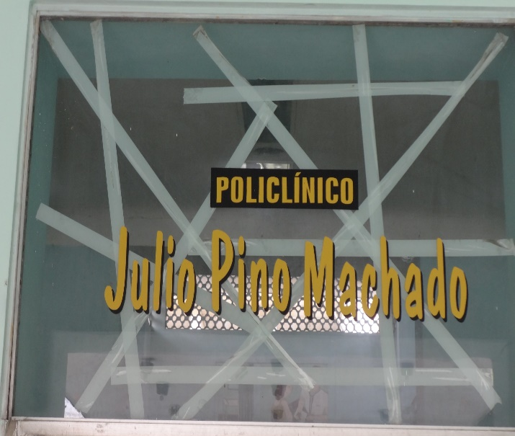
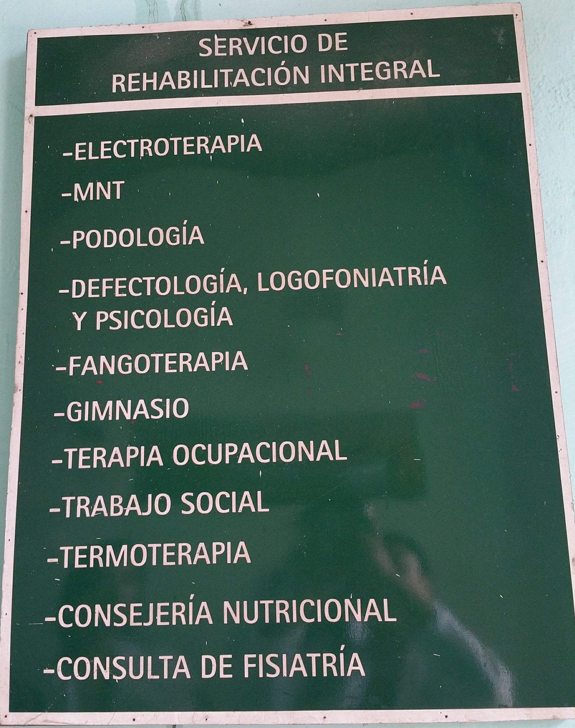
What is a policlínico?
Community Medicine Model
Primary care specialists (Internal Medicine, Pediatrics, Ob-Gyn) – clinic appts & house visits
Services provided:
Ultrasound
X-Rays
Laboratory services
EKG
Endoscopy
Physical Therapy & Rehabilitation
Ambulatory Surgery
Emergency care
Family planning
Consultation for breast pathologies
Consultation for Hypertension
Other specialty consultations (e.g. OB/Gyn, Internal Med, Psych, etc)

Slide 13
Programs implemented in policlínicos
Maternal-Child Health
Adult Medical Services
Dental Services
Transmissible Disease Control
Urban and Rural Hygiene
Nutritional Hygiene
School Hygiene Programs
Workplace Hygiene Programs

Slide 14
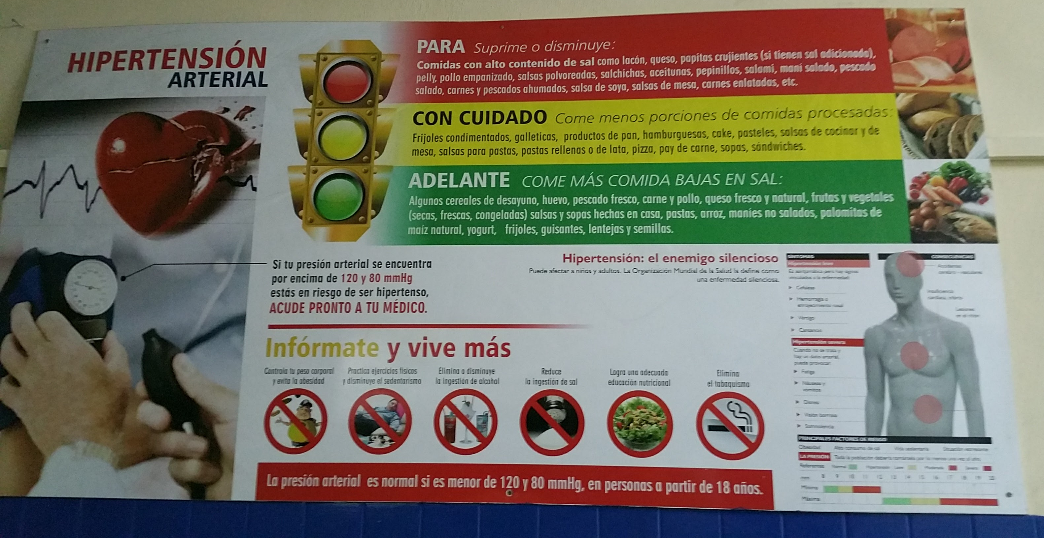

Slide 15
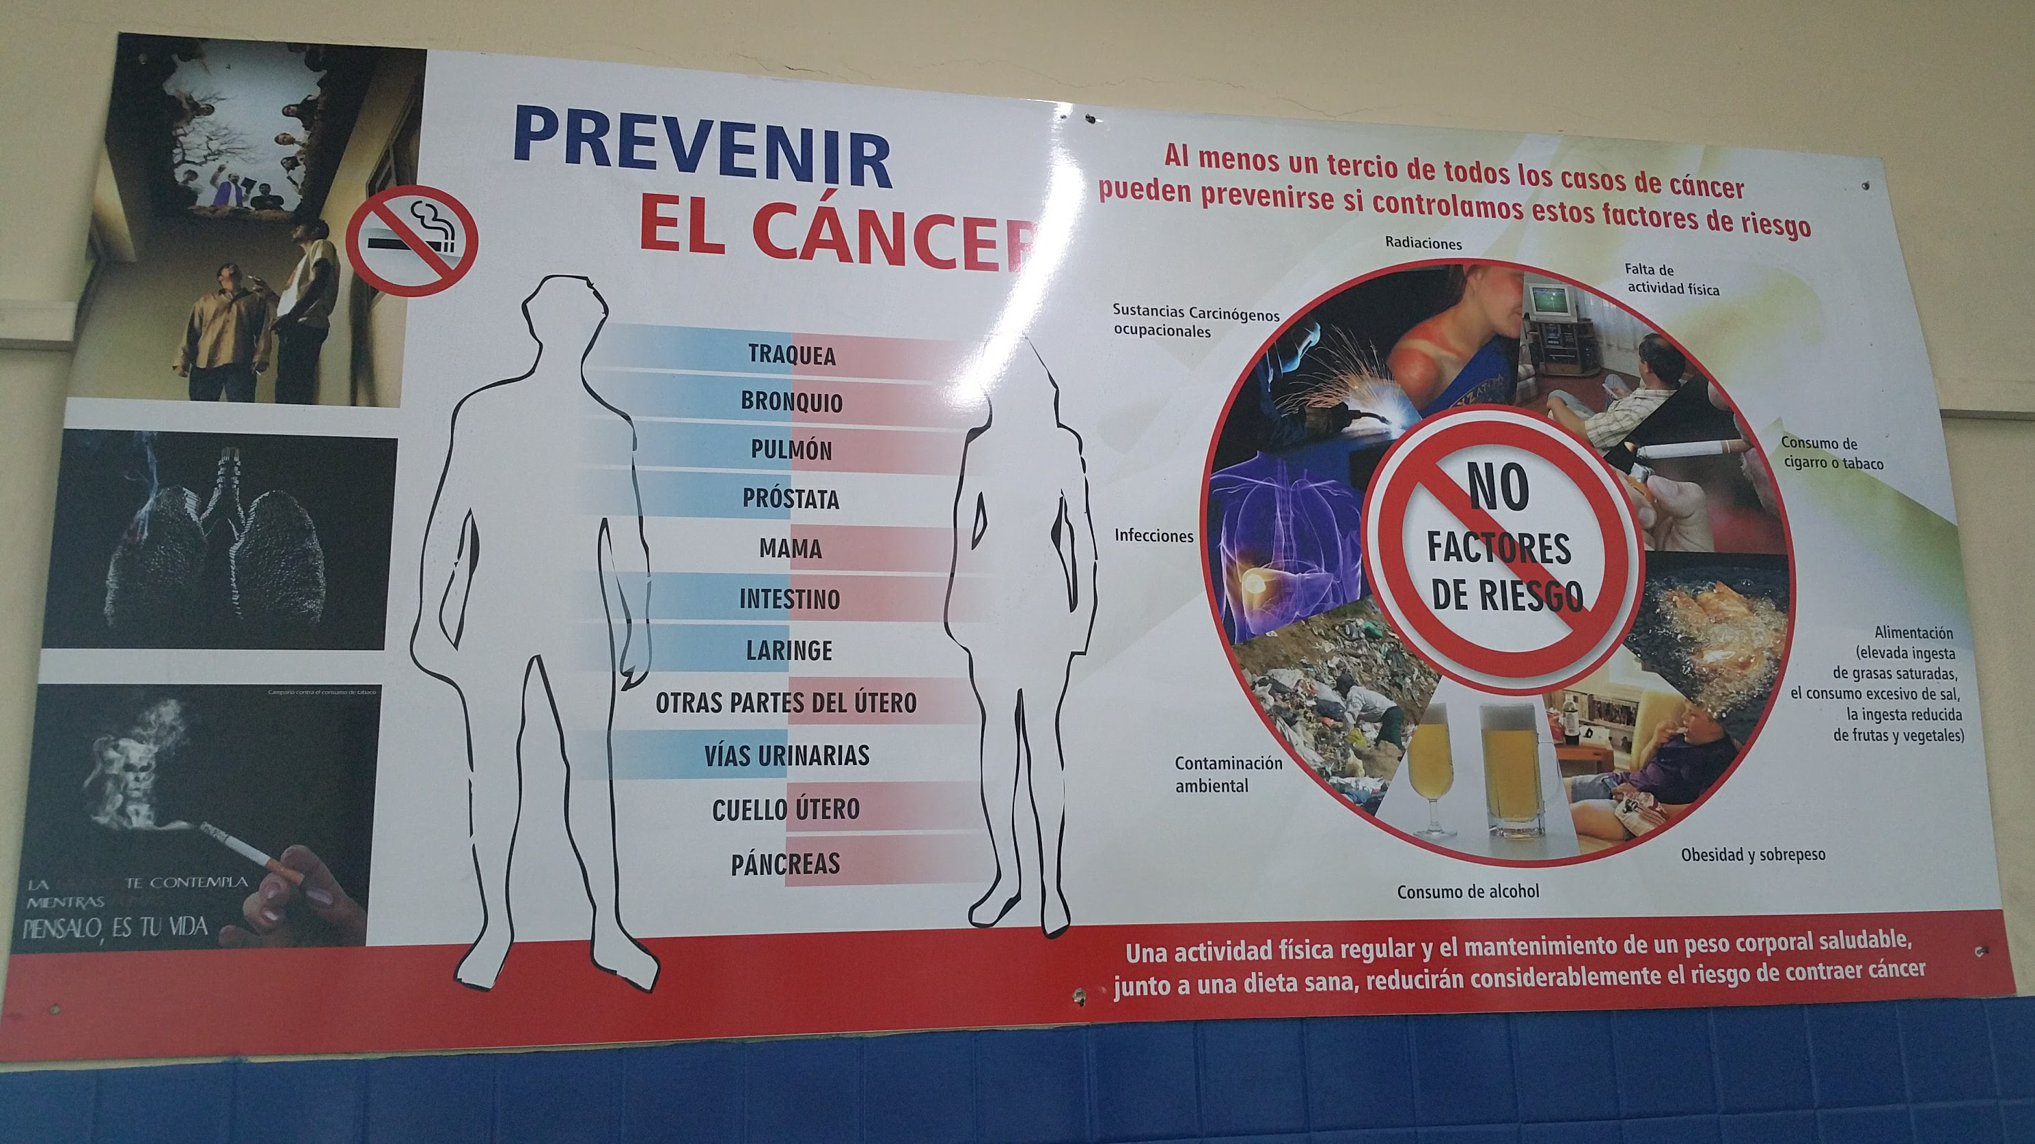

Slide 16
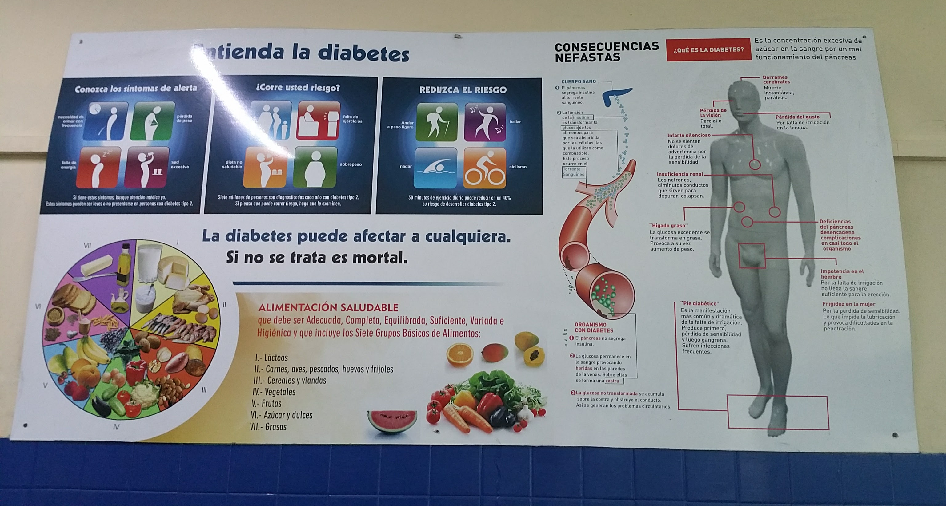

Slide 17
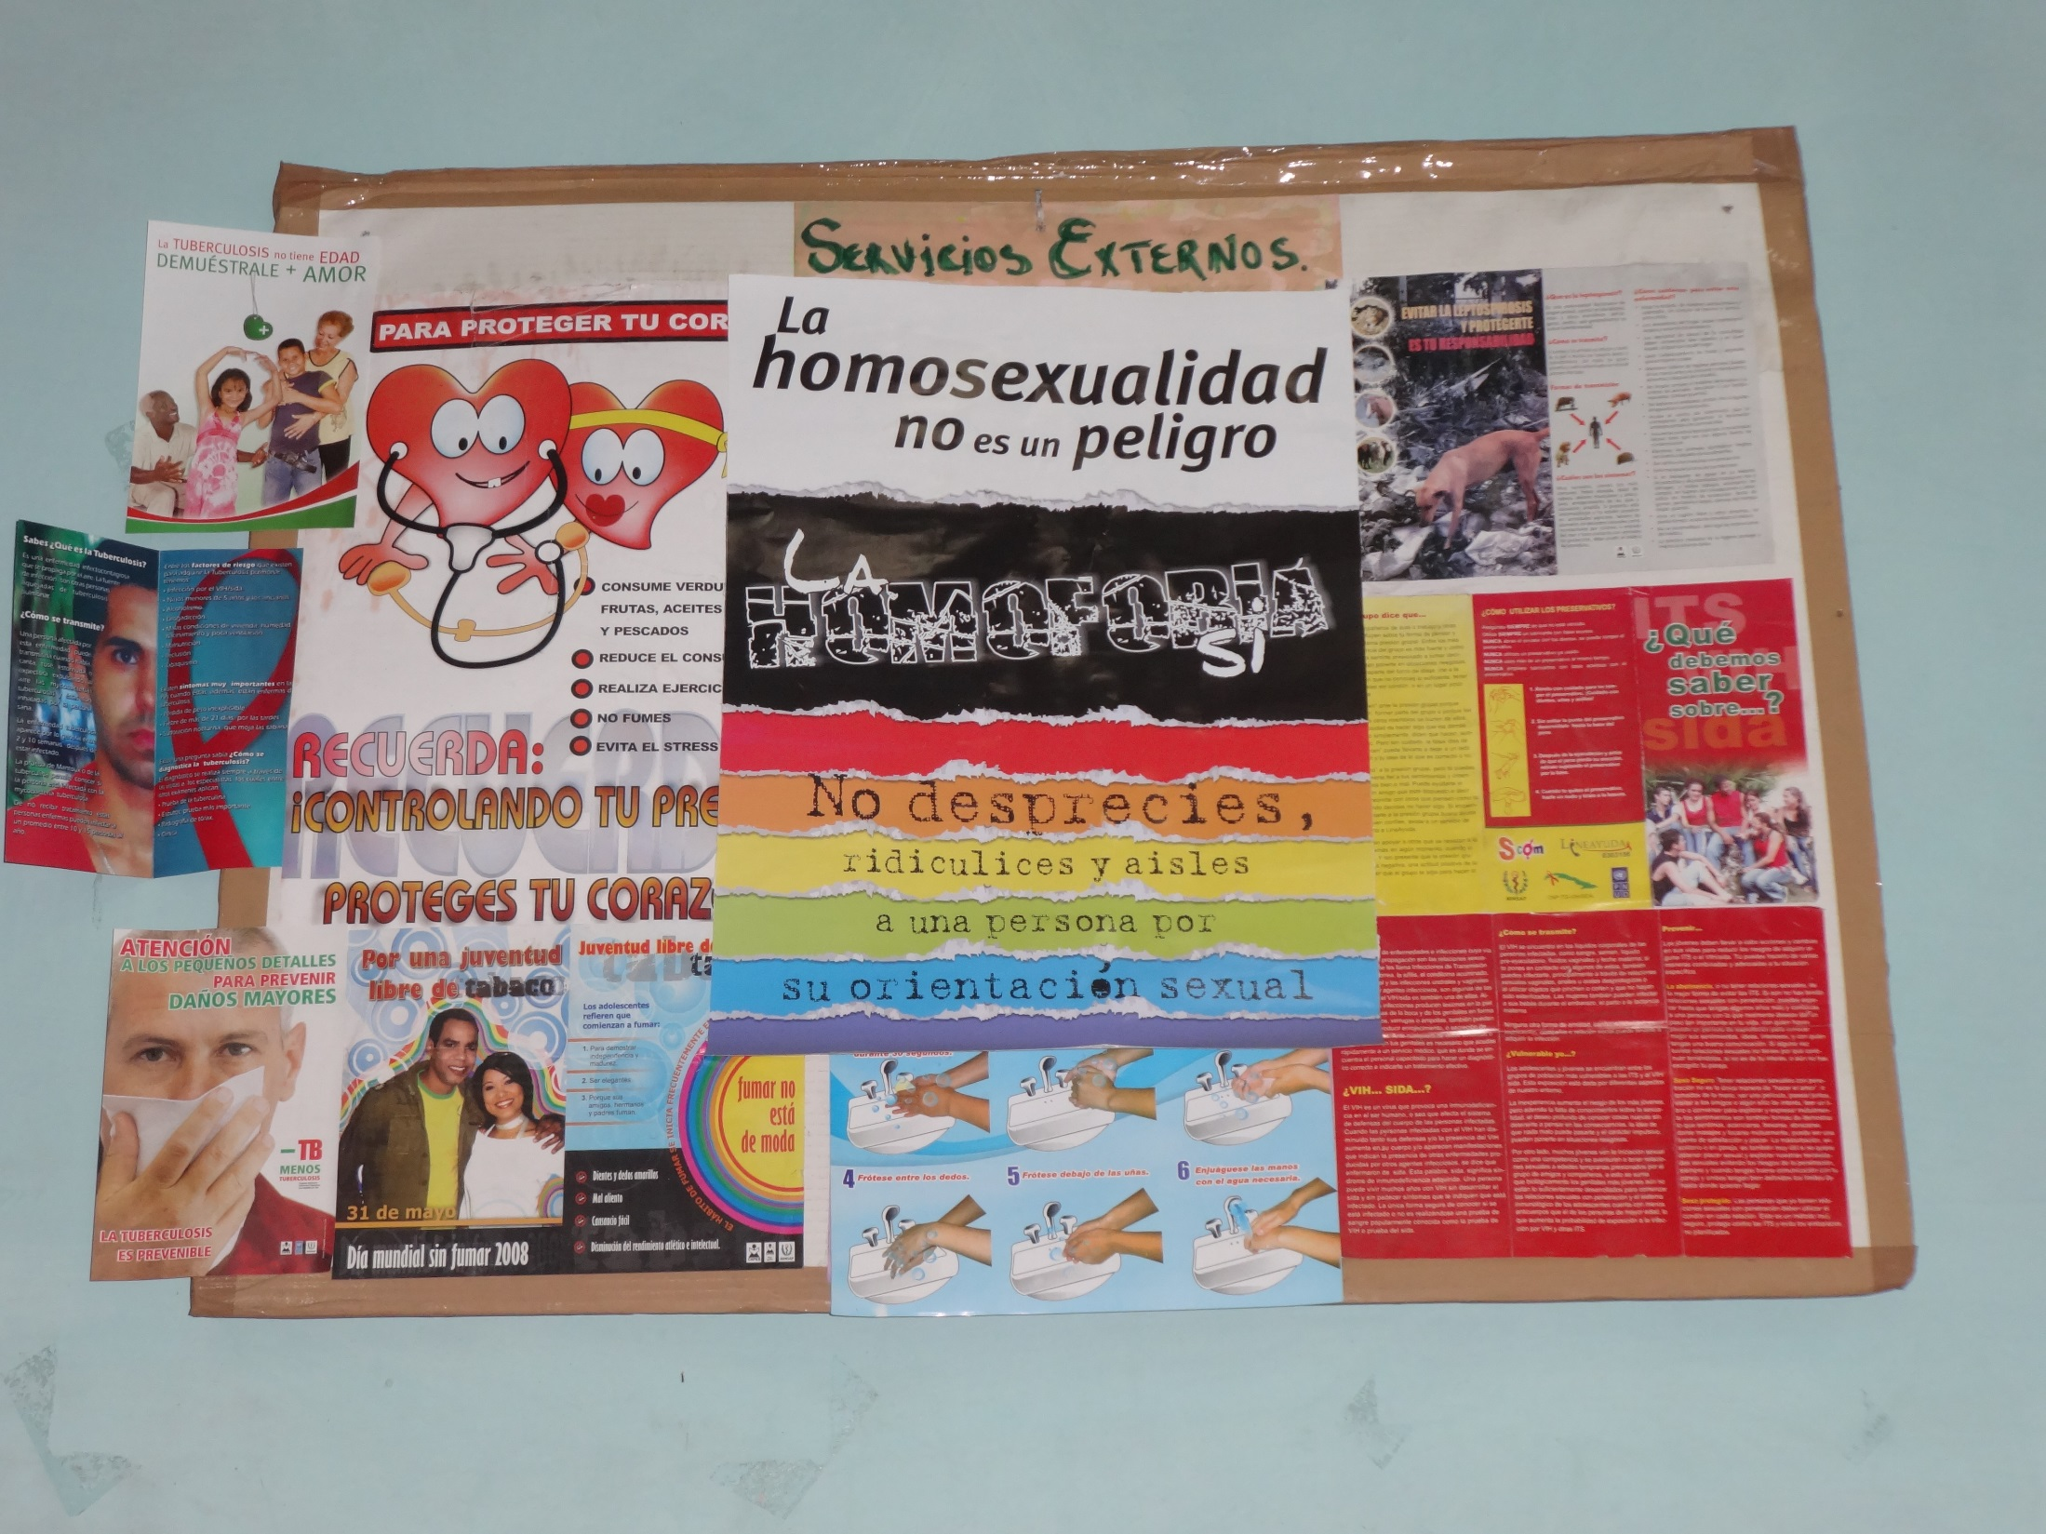

Slide 19
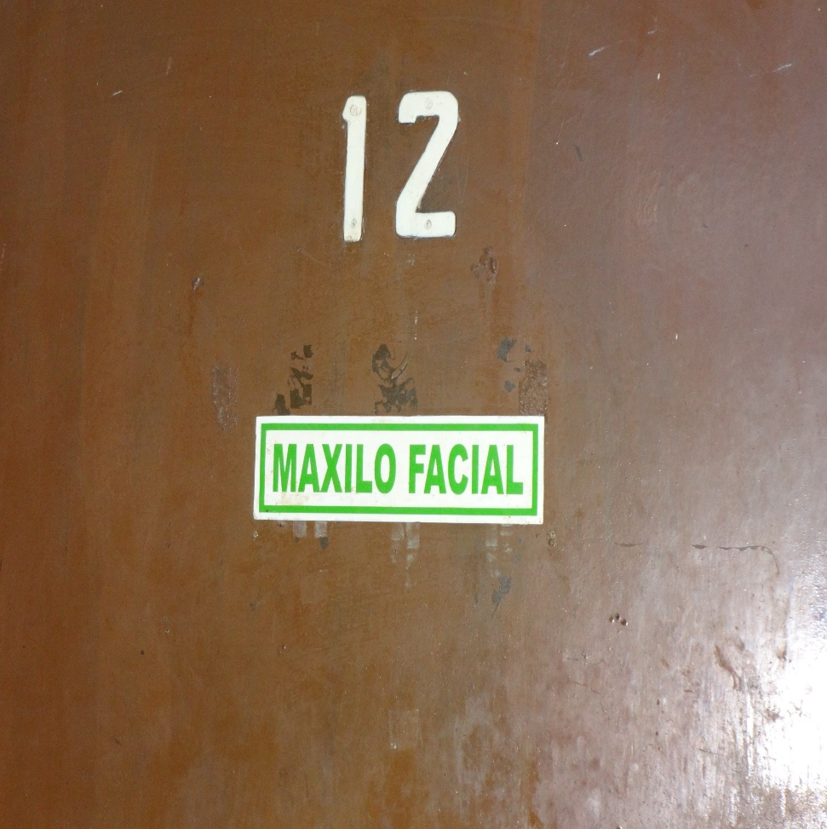
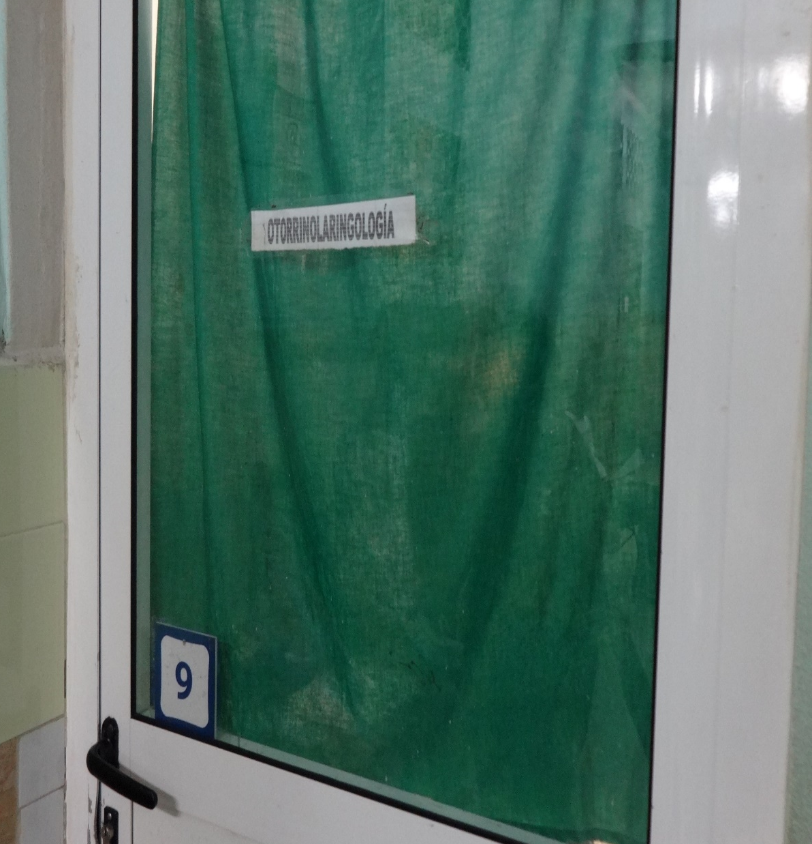

Slide 20
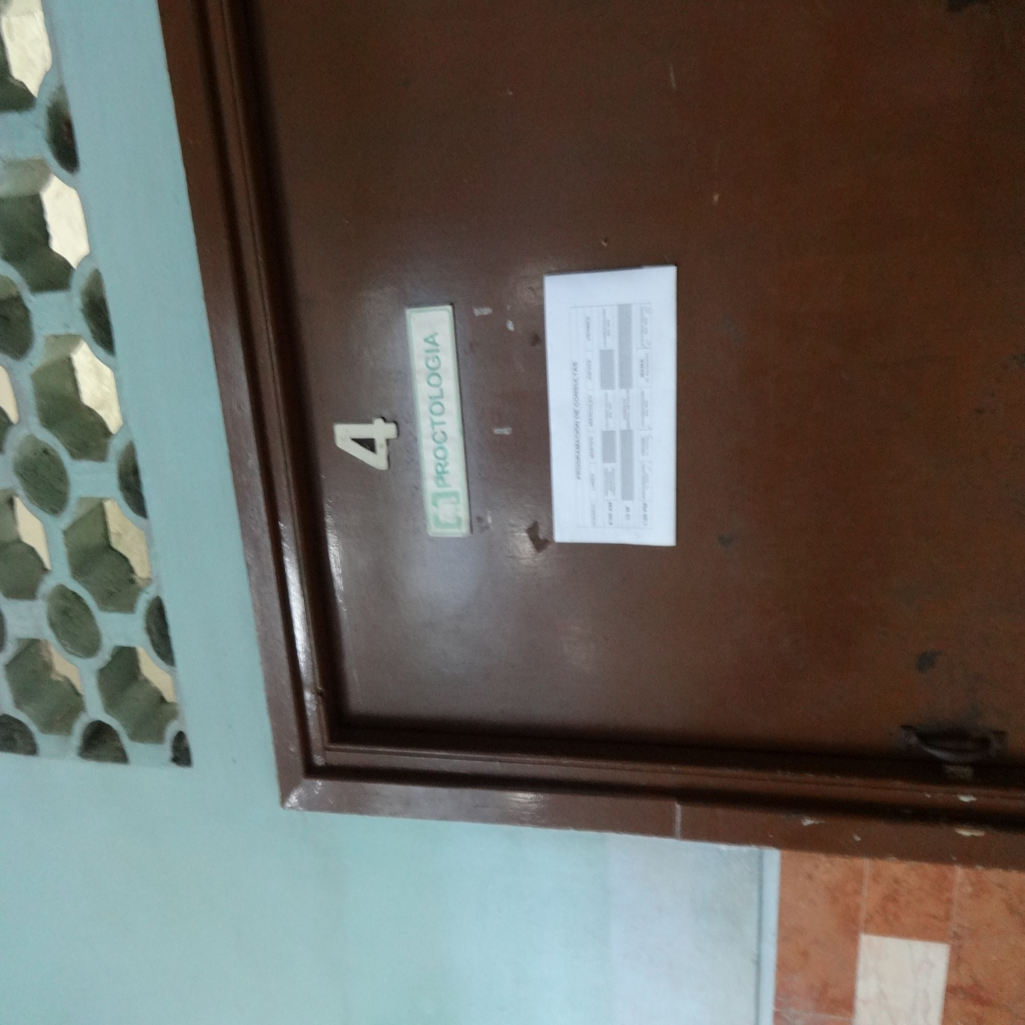
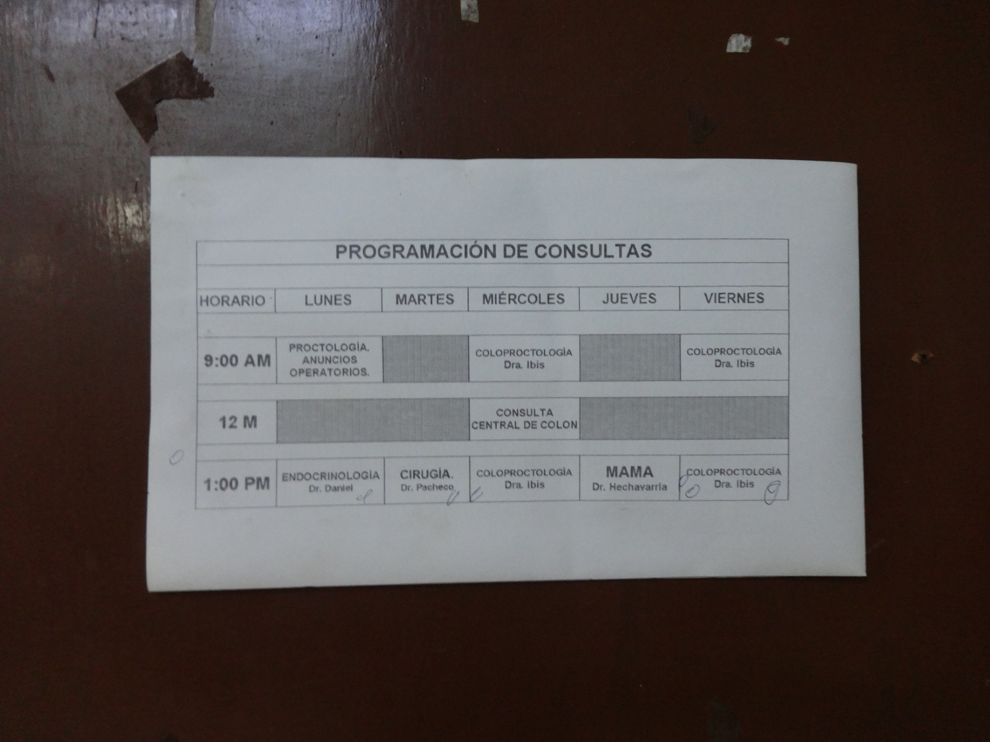

Slide 21
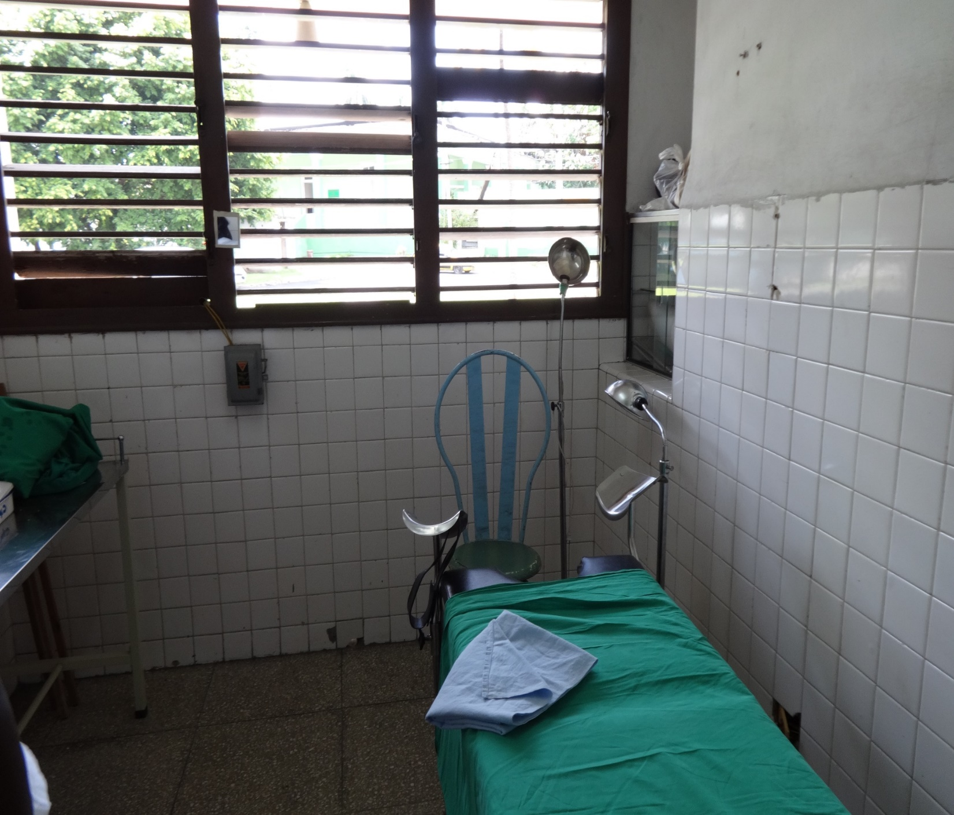

Slide 22
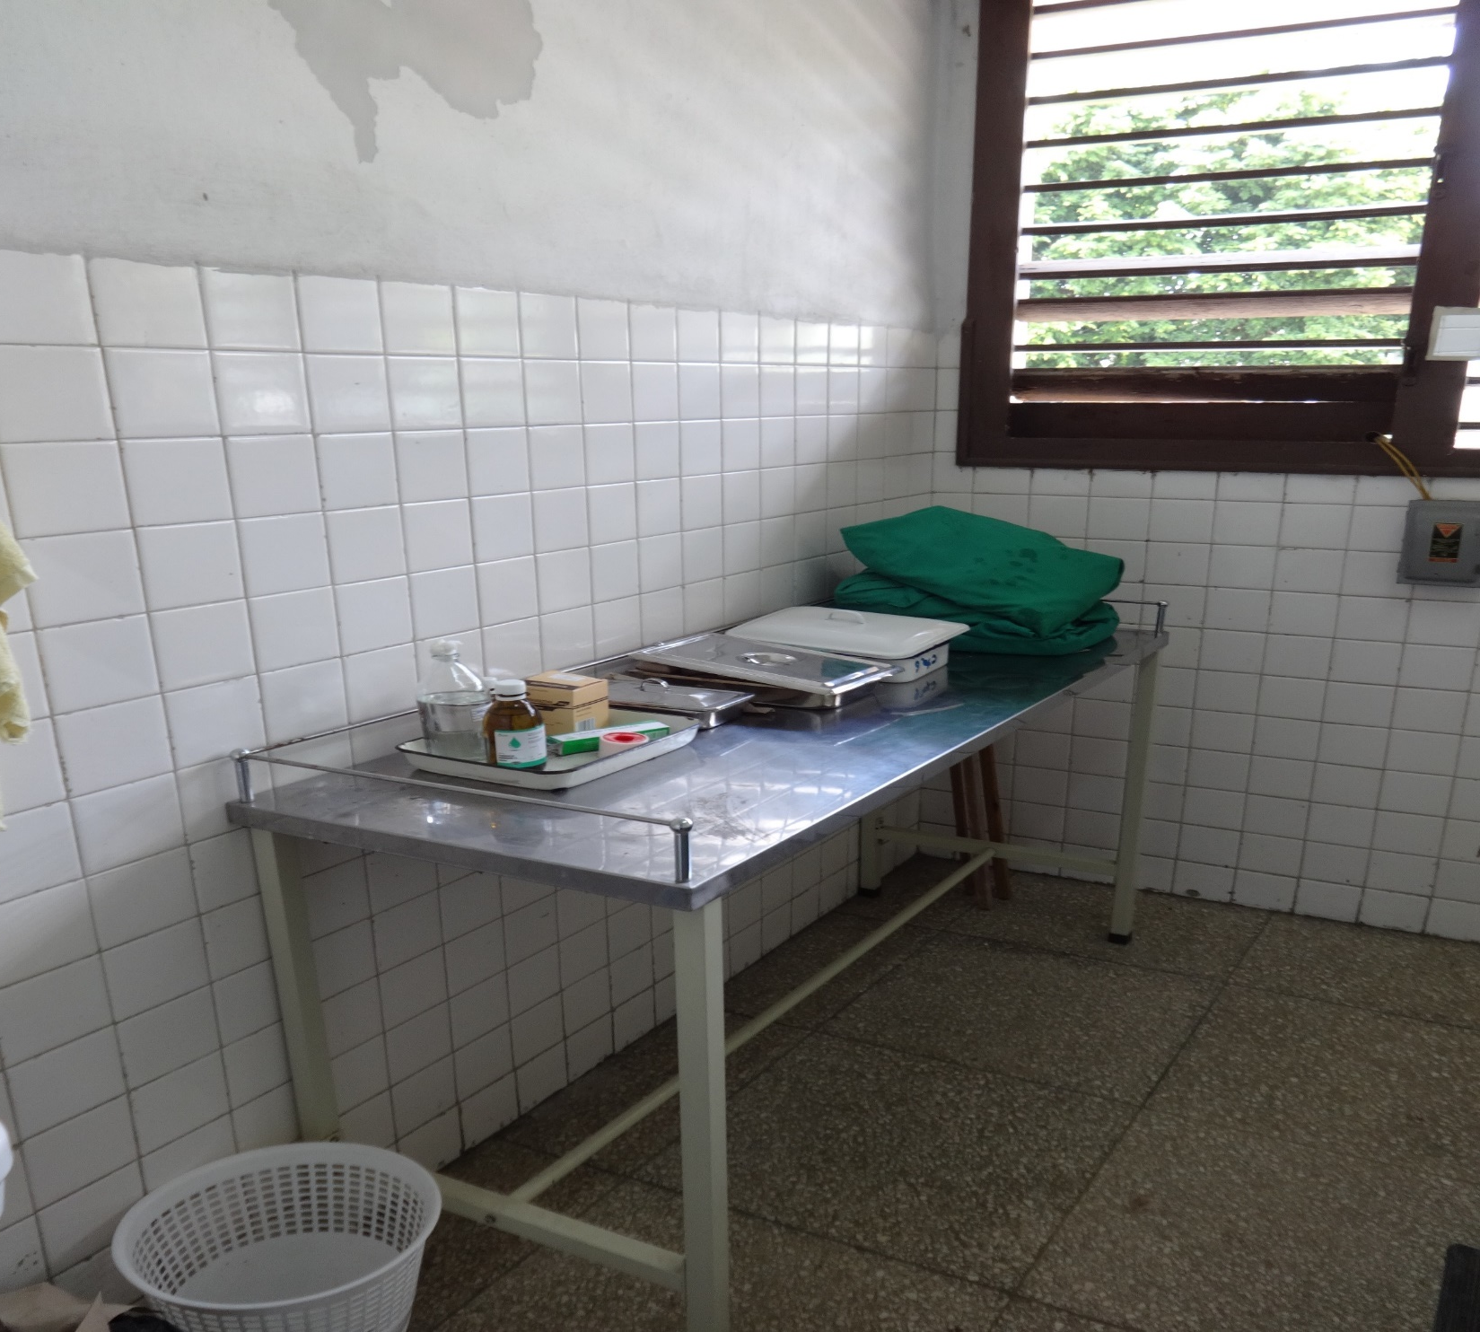

Slide 24
Notes:
For all Cuban practicing physicians, a portion of their medical education is dedicated to learning complementary and alternative medicine (CAM) along with traditional allopathic medicine so that they are competent to utilize and educate their patients on multiple treatments. In Cuba, these practices are known as “natural and traditional medicine” and is an integration of the concepts, values, and practices of allopathic and nonallopathic medicine. As a result, physicians have the ability to incorporate both allopathic and alternative therapies to their patients based on their needs which is beneficial when resources such as drug medication are limited or can be avoided. Examples of these treatments include acupuncture, trigger point injections, massage, heat therapy, fangotherapy (mud), cupping, transcutaneous nerve stimulation, laser/photo therapy, yoga, meditation, and herbal medicine.

Slide 25
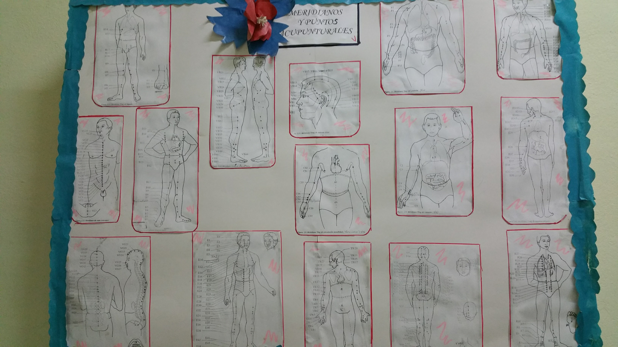
Natural and Traditional Medicine
Notes:
For all Cuban practicing physicians, a portion of their medical education is dedicated to learning complementary and alternative medicine (CAM) along with traditional allopathic medicine so that they are competent to utilize and educate their patients on multiple treatments. In Cuba, these practices are known as “natural and traditional medicine” and is an integration of the concepts, values, and practices of allopathic and nonallopathic medicine. As a result, physicians have the ability to incorporate both allopathic and alternative therapies to their patients based on their needs which is beneficial when resources such as drug medication are limited or can be avoided. Examples of these treatments include acupuncture, trigger point injections, massage, heat therapy, fangotherapy (mud), cupping, transcutaneous nerve stimulation, laser/photo therapy, yoga, meditation, and herbal medicine.

Slide 26
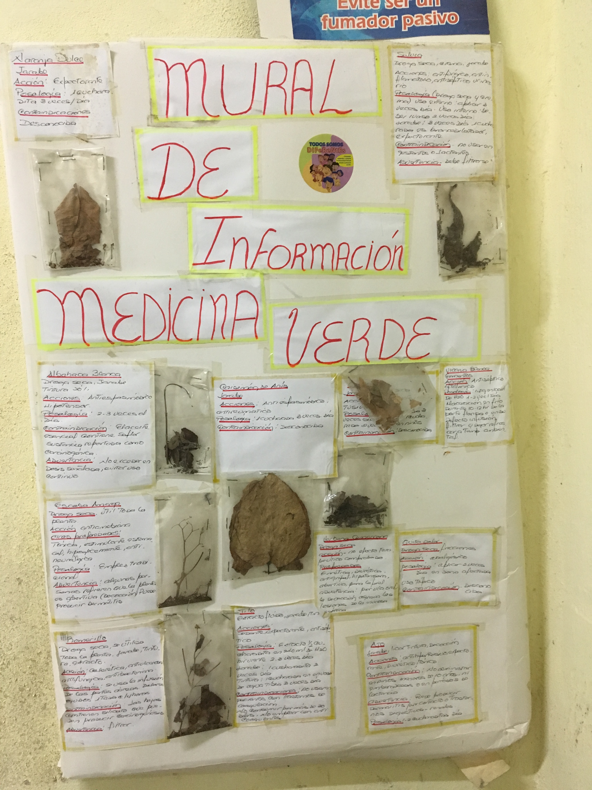
Natural and Traditional Medicine

Slide 27
Family Medicine in Cuba
Medicina General Integral (MGI)
General Integral (Integrative) Medicine
General
affecting or concerning all or most people, places, or things; widespread
not specialized or limited in range of subject, application, activity, etc.
Integral / Integrative
necessary to make a whole complete; essential or fundamental;
included as part of the whole rather than supplied separately
serving or intending to unify separate things
combining allopathic and complementary therapies
Medicine
the science or practice of the diagnosis, treatment, and prevention of disease
Definitions taken from: Apple Macintosh Dictionary

Slide 28
Family Medicine in Cuba
“…El médico será algo más que alguien que atiende a uno que se enferma y va al hospital, sino que tendrá un papel especial en la medicina preventiva, … , en fin será un ‘Guardián de la Salud.’ ” (1983)
“…, se hizo todo un programa, se creó un nuevo concepto, convertimos la generalidad en una especialidad: la medicina general integral, un concepto asociado a la idea del médico de la familia.” (1997)
- Fidel Castro Ruz

Slide 29
What is a consultorio?
Local house or apartment in the neighborhood converted into a family doctor’s clinic
Basic Work Team = Family Doctor + Nurse
General Integrative Medicine model (bio-psycho-social model)
Focus on health promotion and prevention
Epidemiological Assessment (Annual Health Assessment) of designated health area
Dispensarización (population health management and risk assessment)
Notes:
In the 1980’s, Cuba had sufficient human & material resources. But community policlinics underutilized, emergency rooms still overwhelmed, community wasn’t satisfied – consultorio system created out of the demands of the communities – now there is a family doctor in every neighborhood.

Slide 30
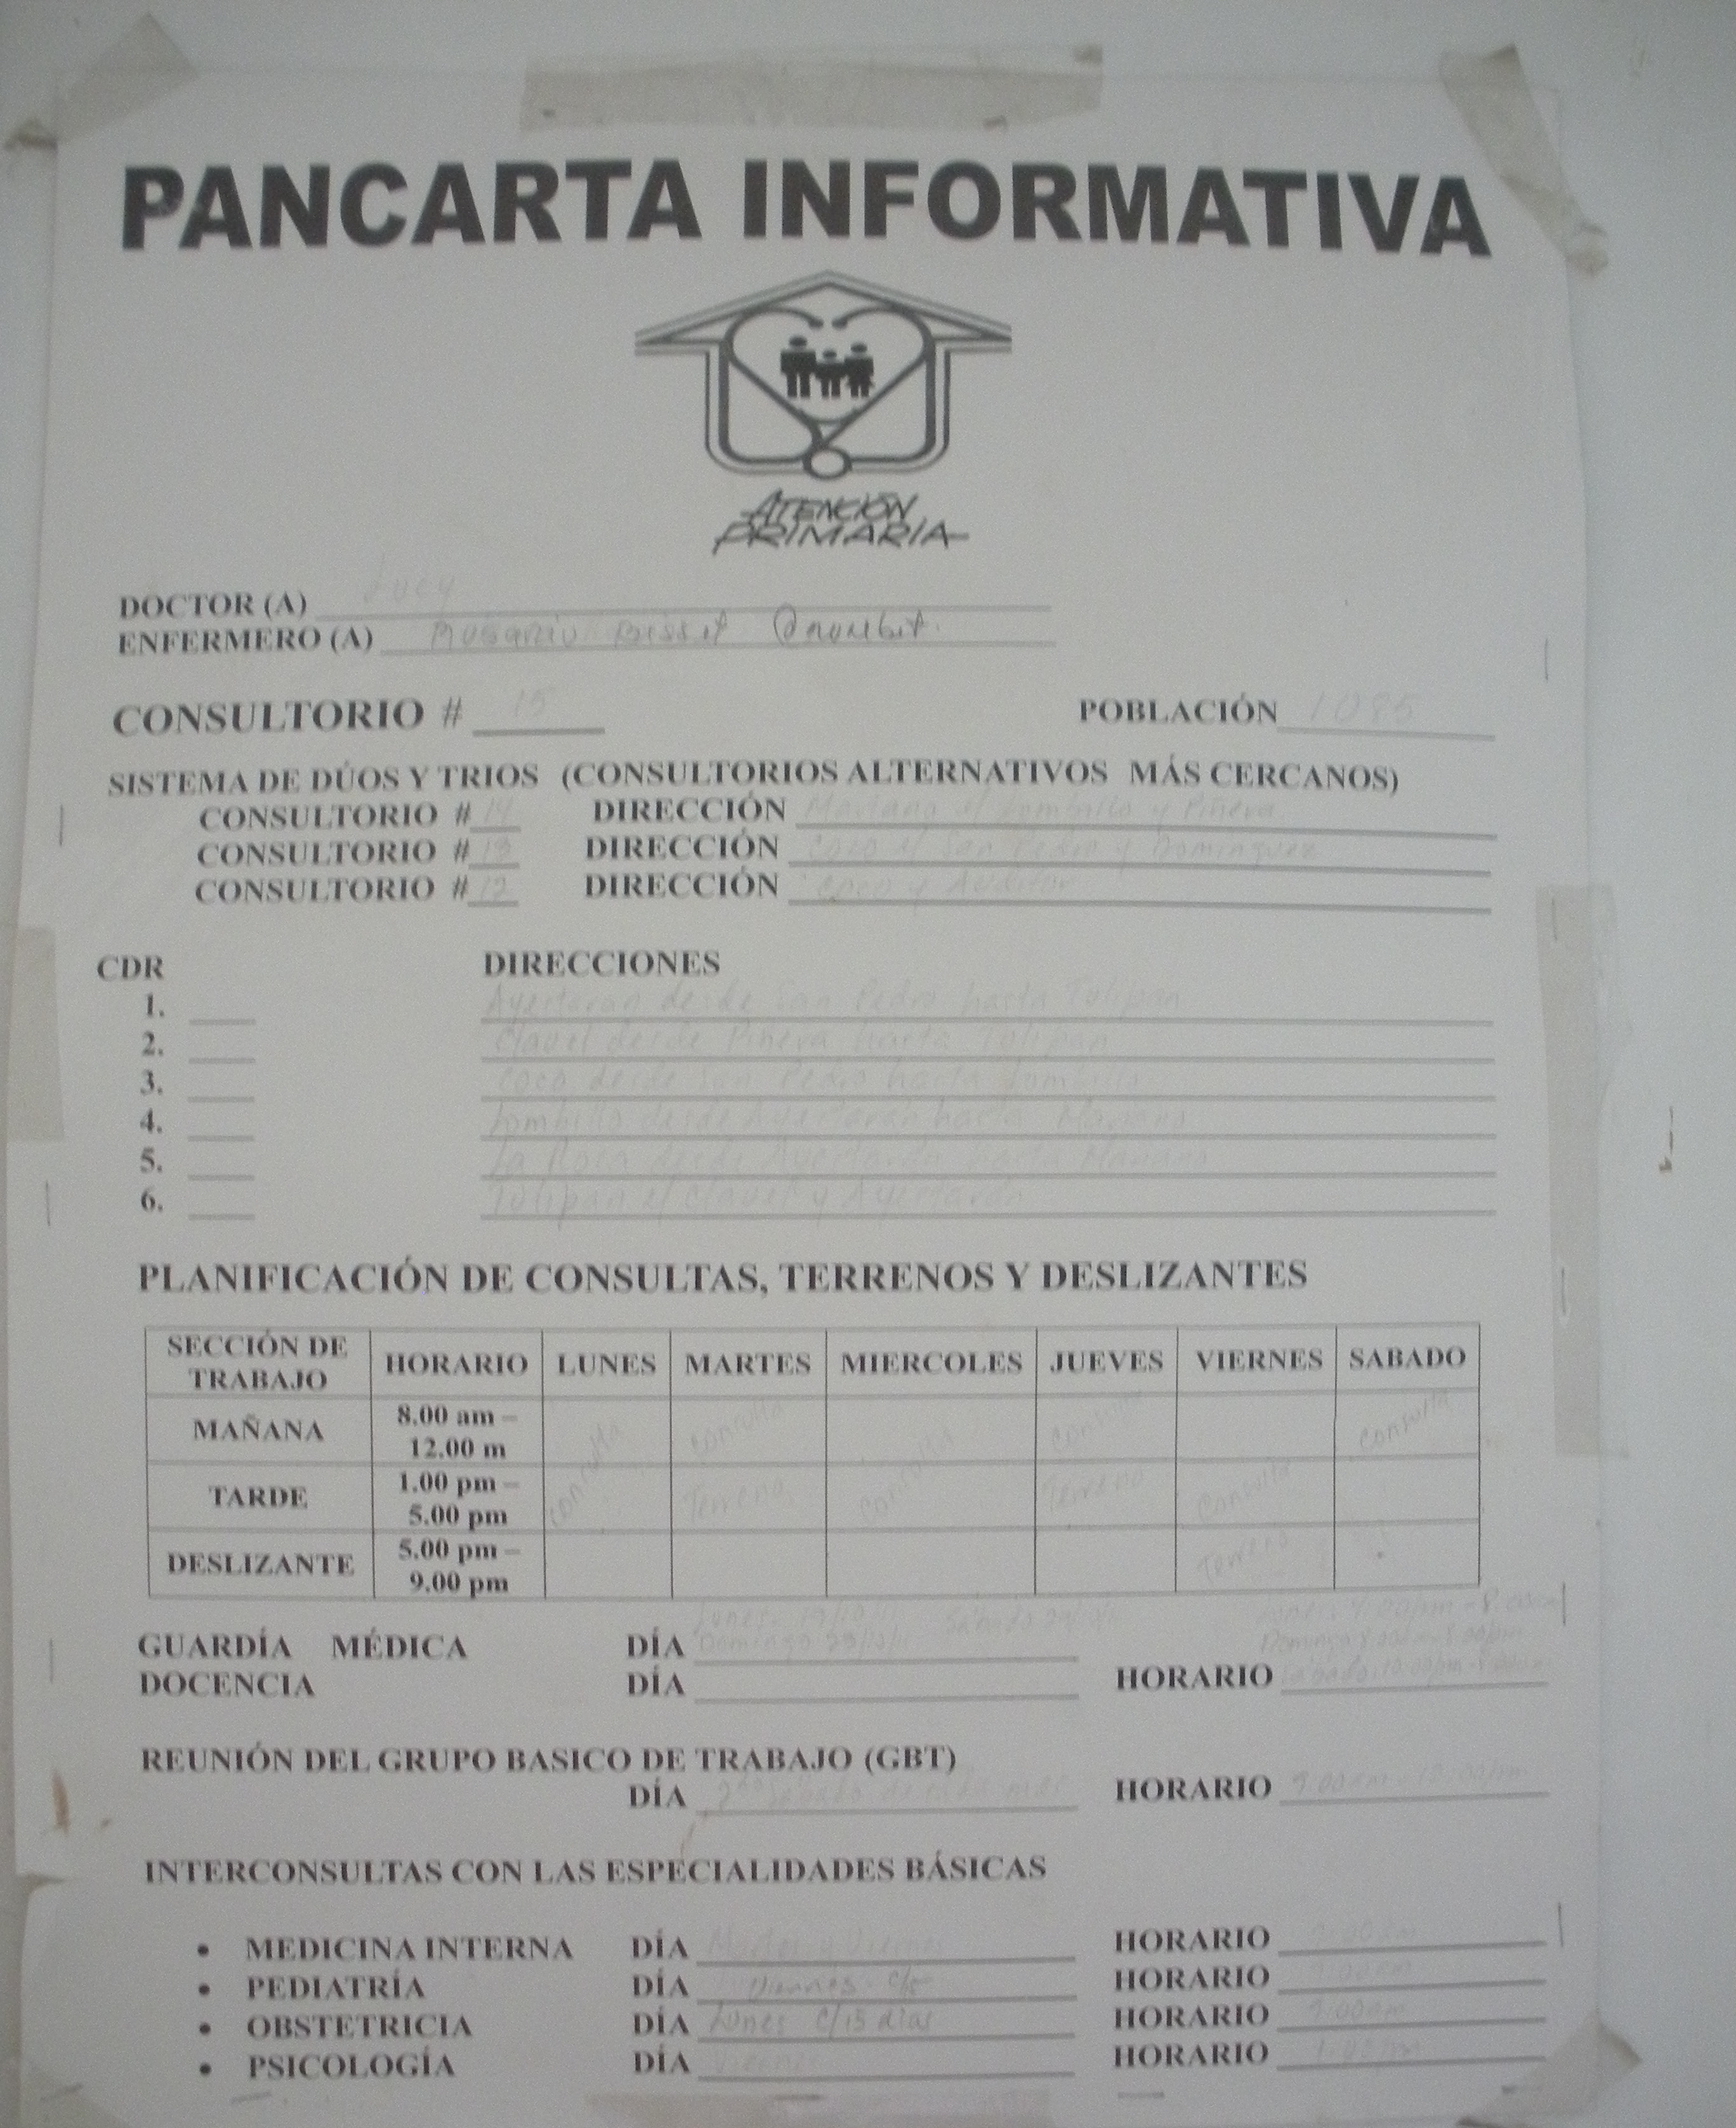

Slide 32
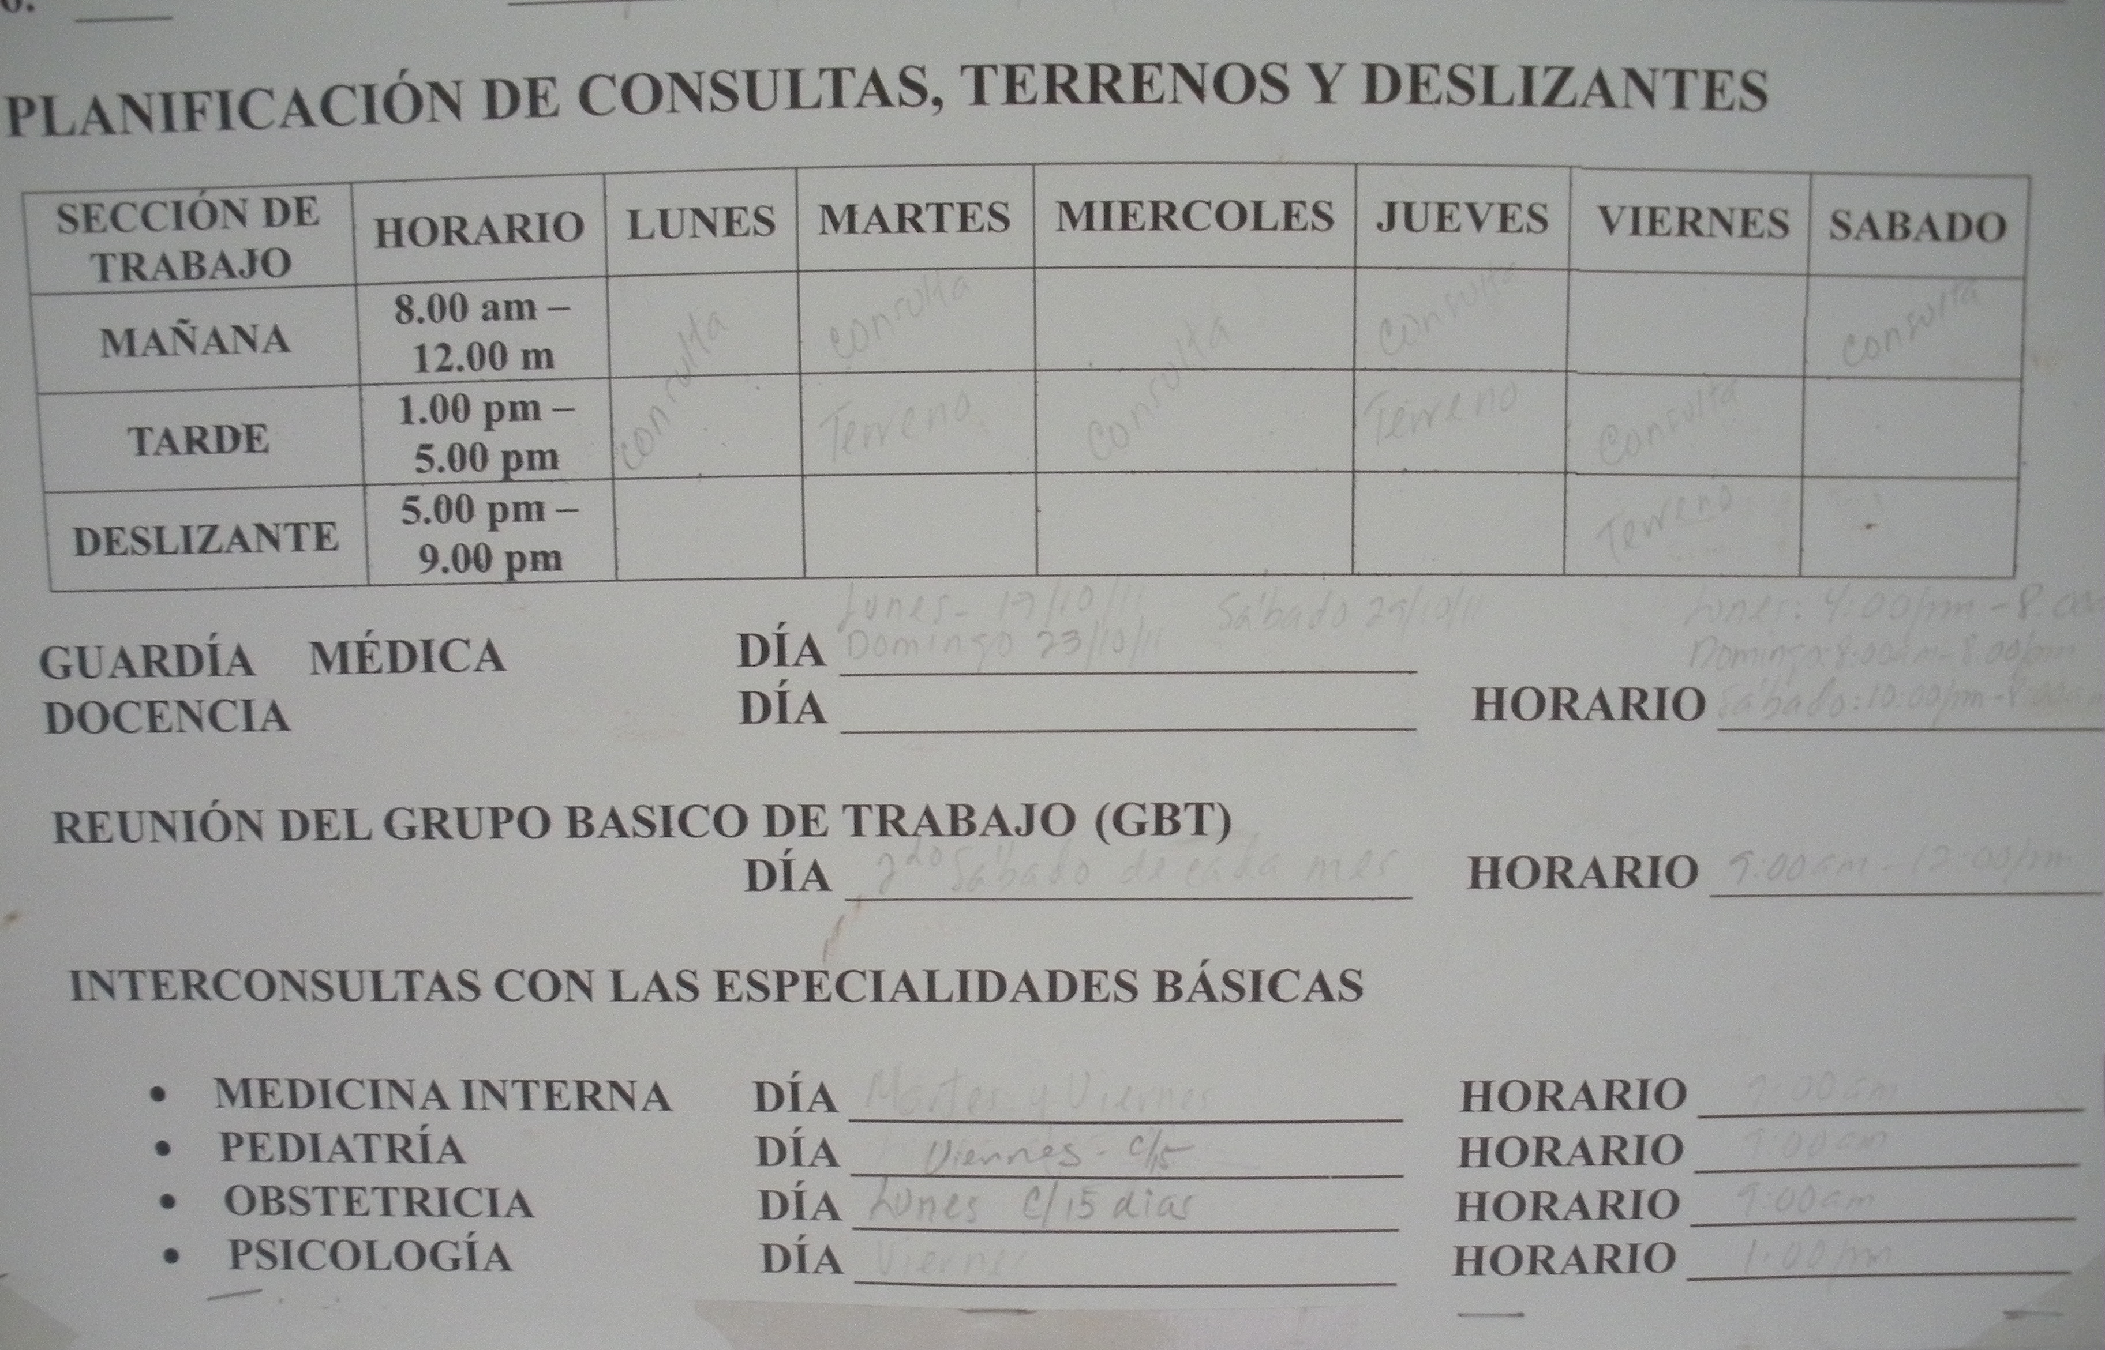

Slide 35
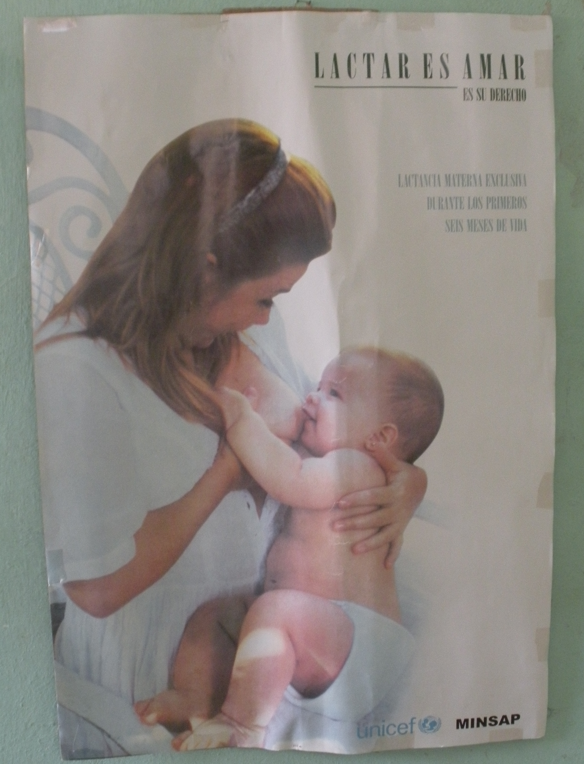

Slide 36
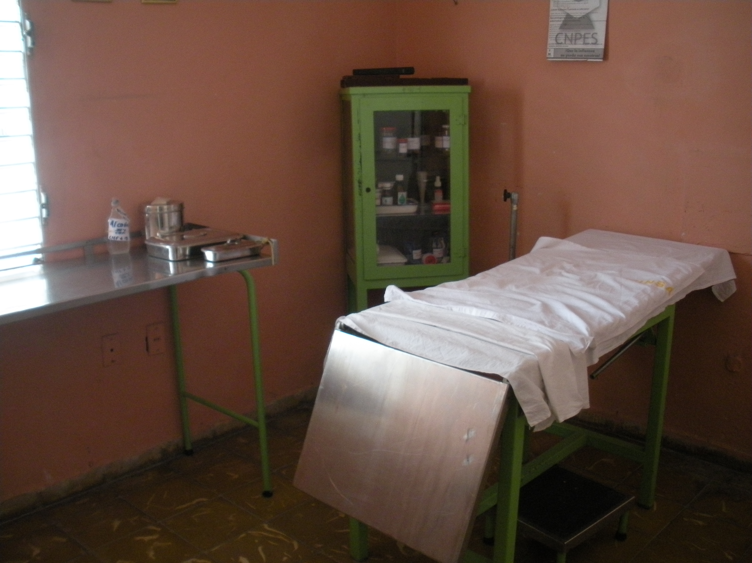
Exam Room

Slide 37
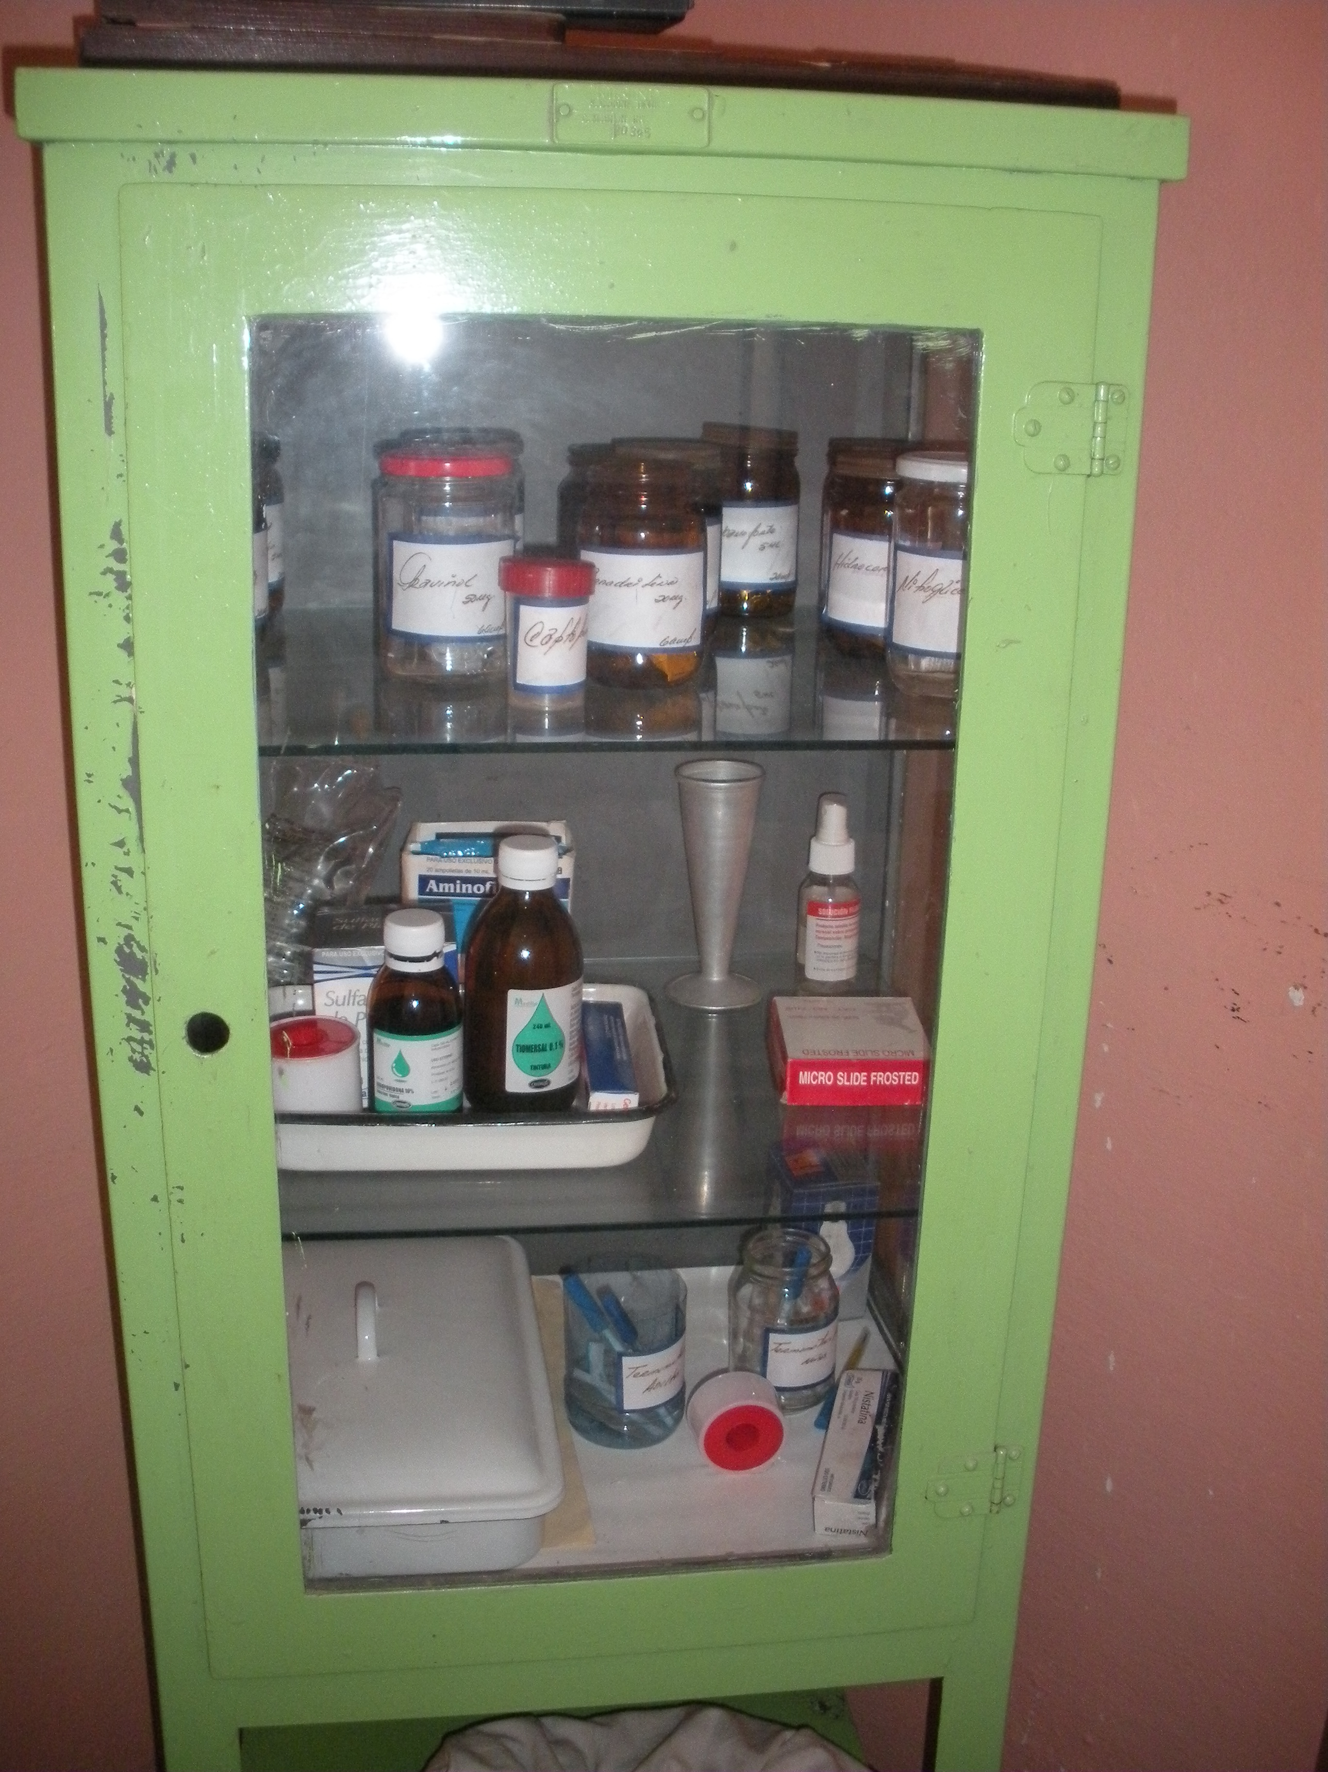

Slide 38
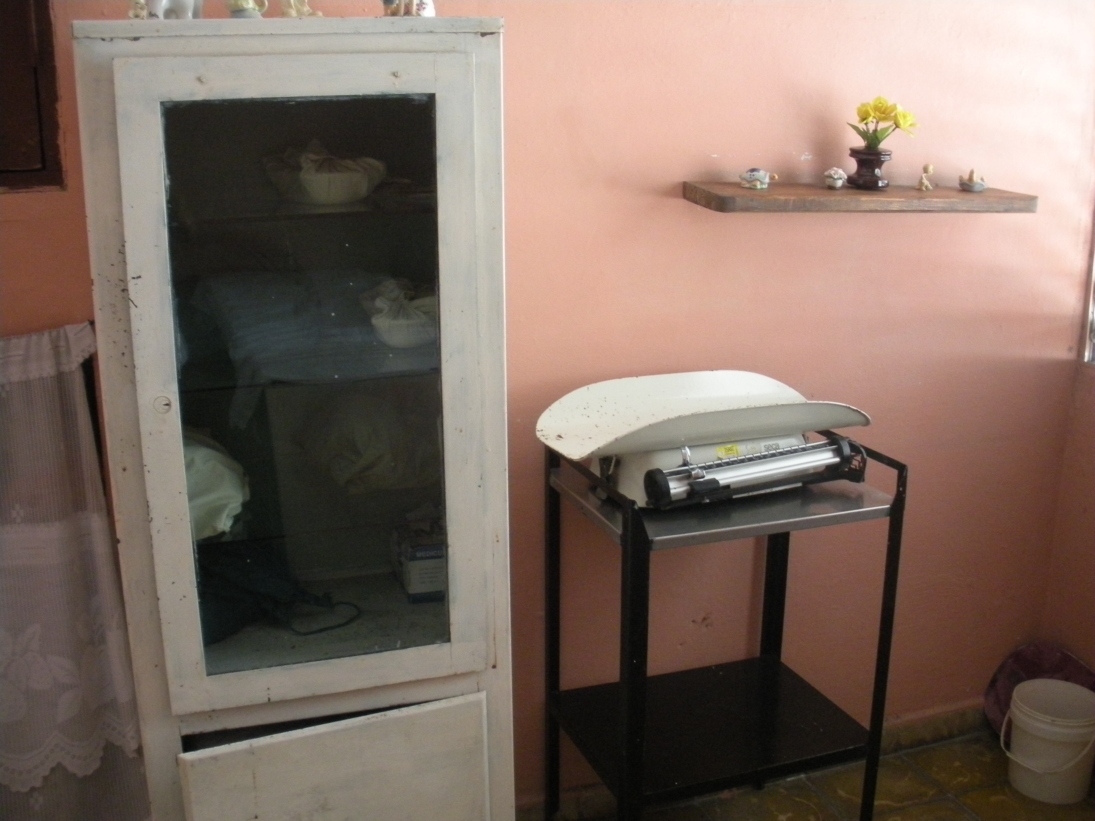

Slide 39
Family & Patient Charts

Slide 40
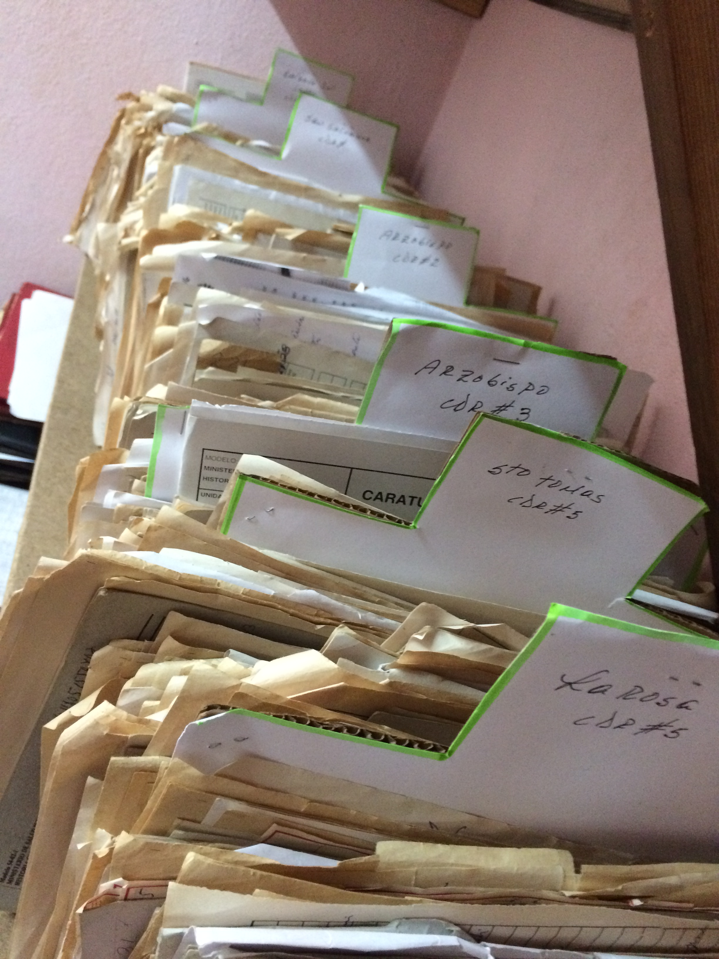
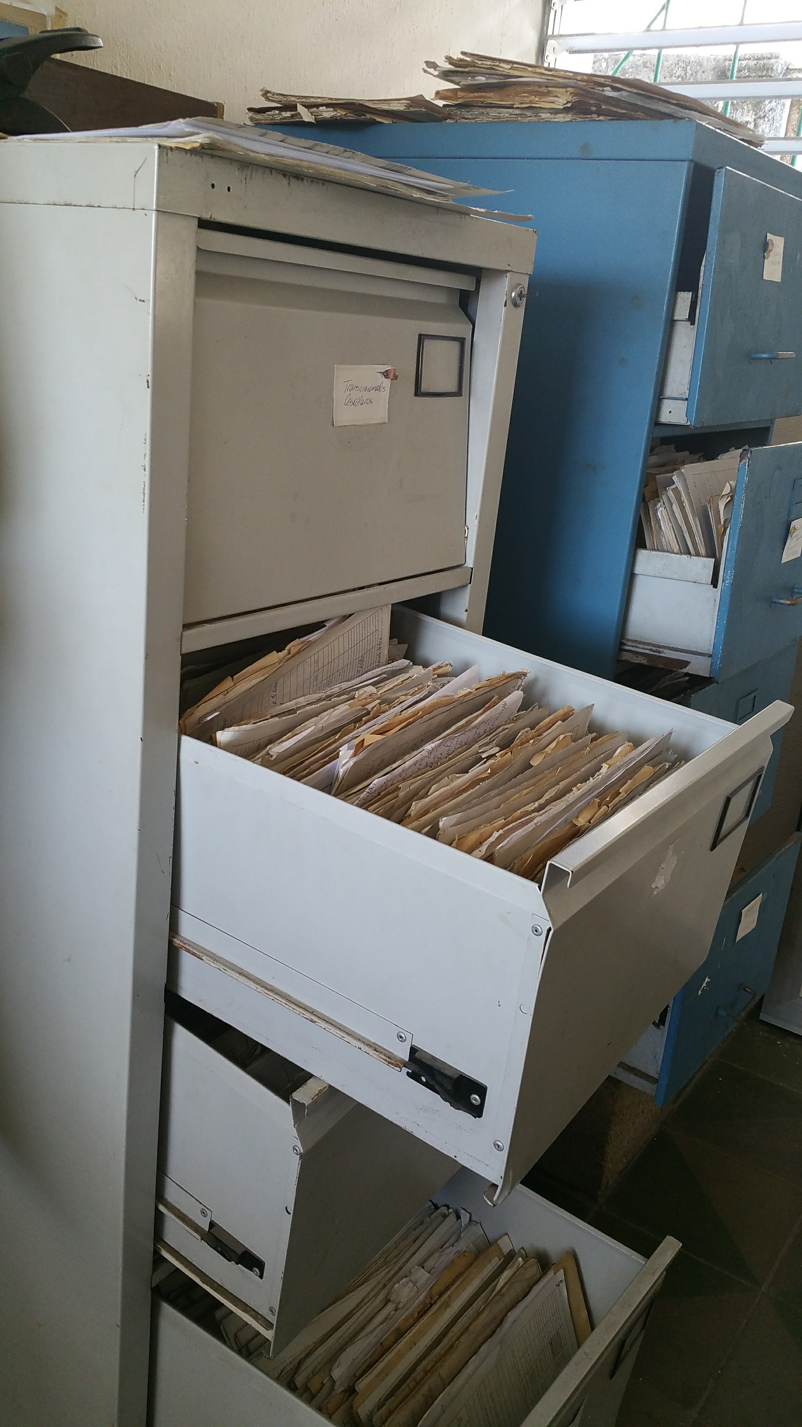
Family & Patient Charts
Notes:
Charts organized by manzanas (neighborhood blocks by street address)

Slide 41
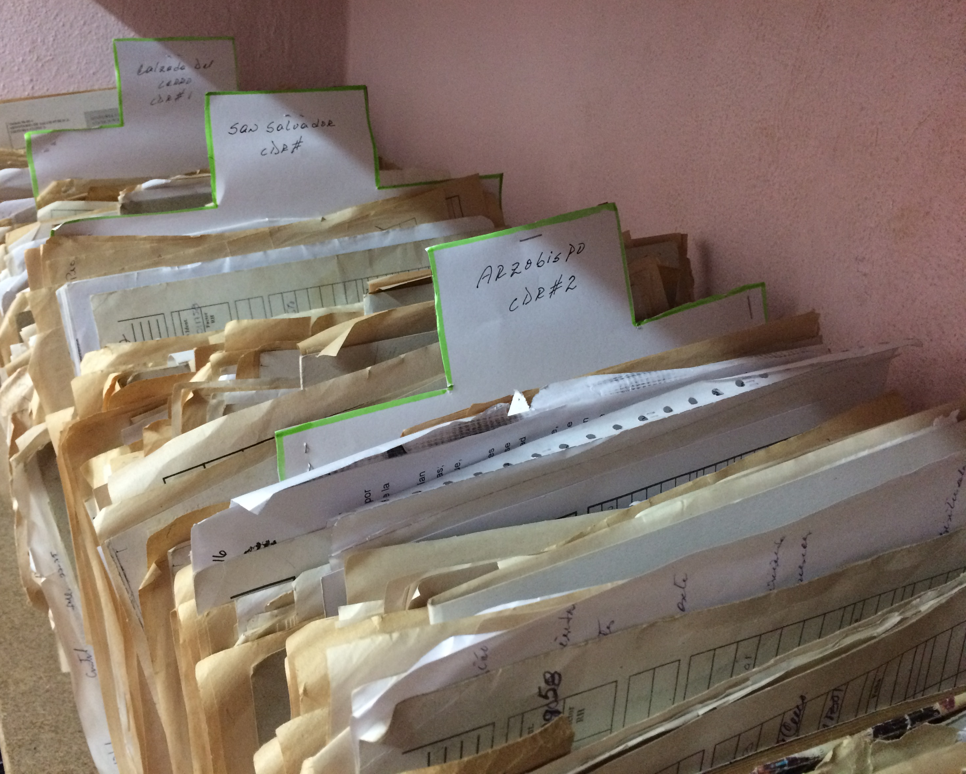
Family & Patient Charts
Organized according to manzanas (neighborhood blocks) and street address
Charts filed by households found within each street
Family Charts with associated individual patient charts
Family doctors know exactly where their patients live and who lives within each household
House visits are common and frequent

Slide 42
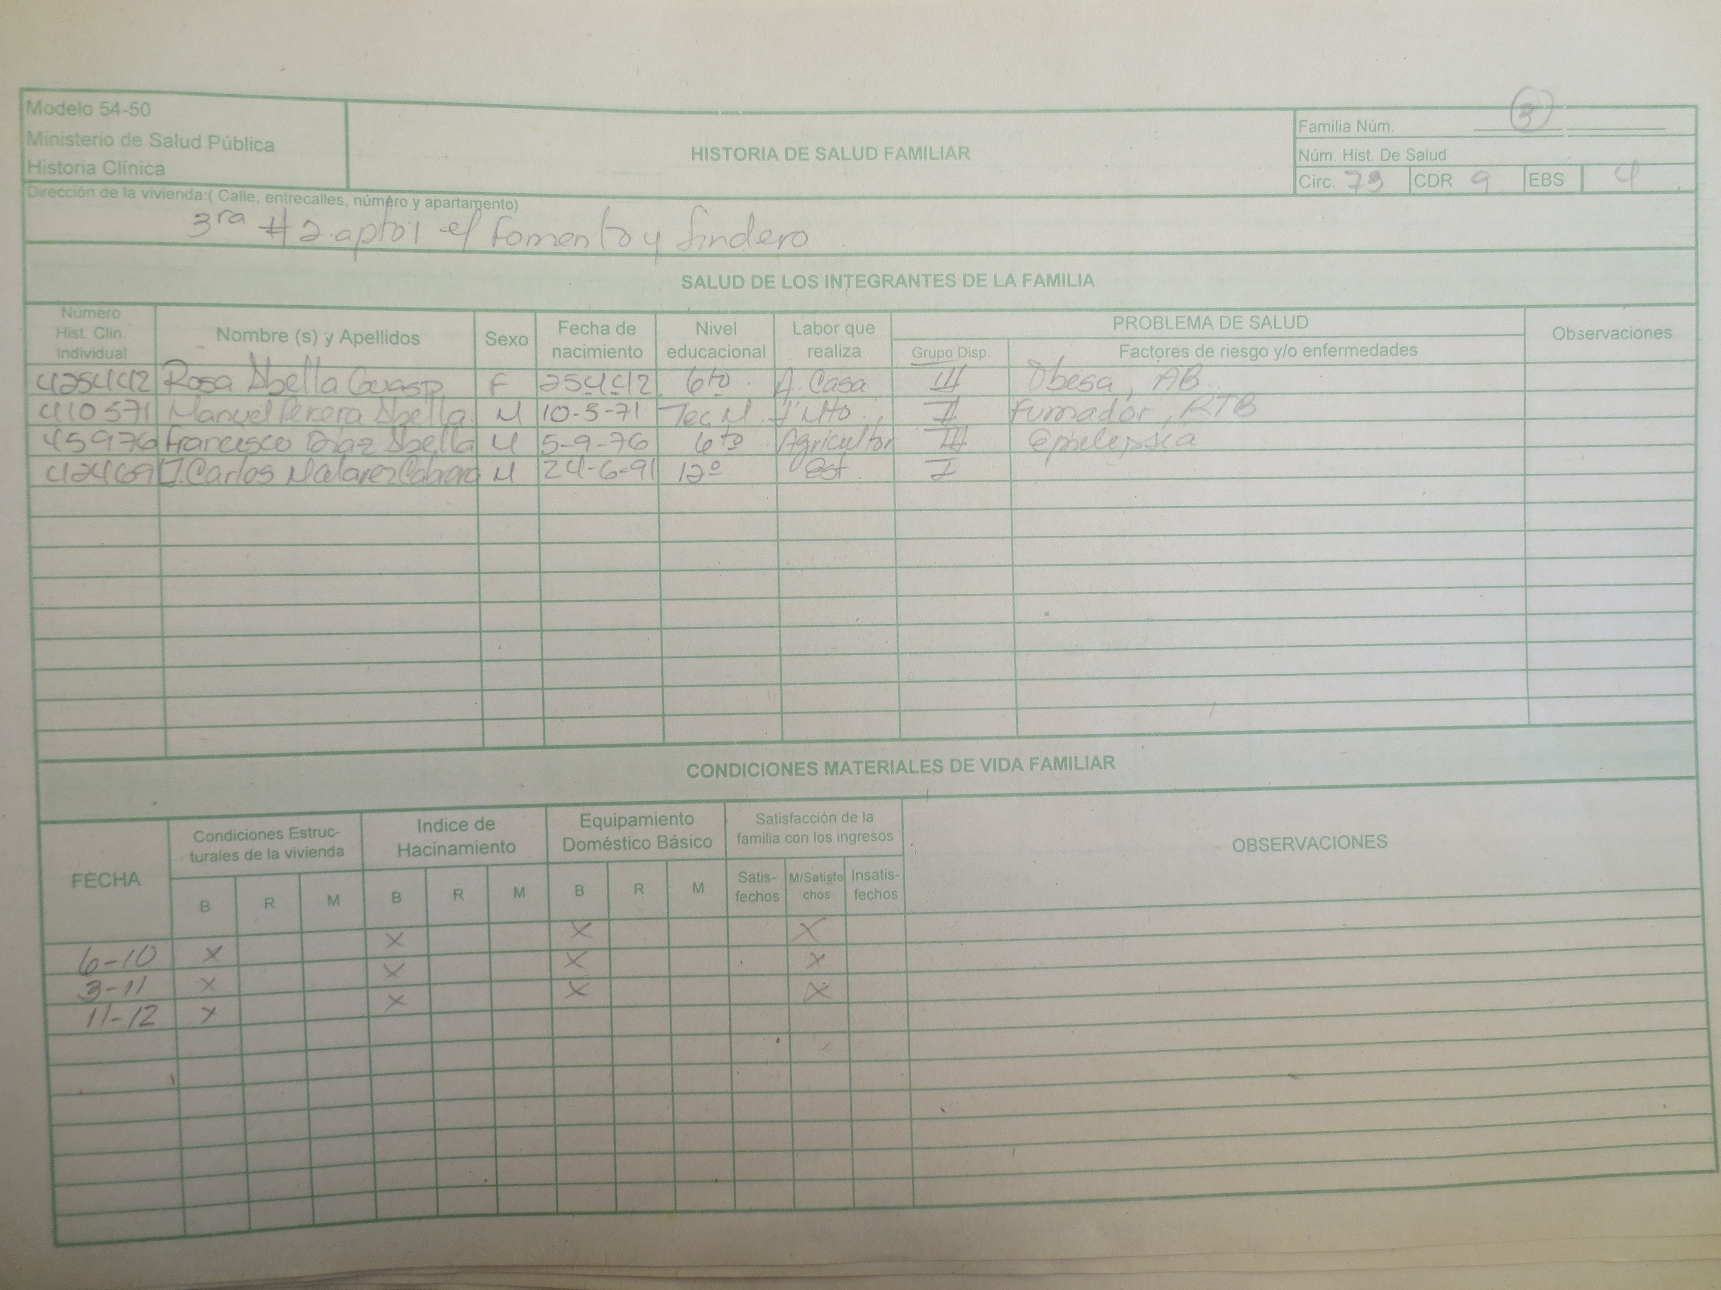
Family Charts & Dispensarización
Notes:
All Cuban physicians are trained in epidemiology and public health, as these are required components integrated in the medical curriculum. Those who choose to specialize in Medicina General Integral (General Integrative Medicine – Cuba’s equivalent to the specialty of Family Medicine) receive even more training during their residency on population health management, as one of the primary responsibilities for family physicians who work in the consultorio is to conduct an Annual Health Analysis and Action Plan for their designated health area. Cuba has a system of organizing health information not only by utilizing individual patient charts, but in addition, every household has a designated family chart as well. Information incorporated in the family chart includes: home address, all individuals who live in the household with their names, individual patient chart number, date of birth, gender, educational level, occupation, health status, and any risk factors and/or medical conditions they have. Information regarding socioeconomic factors that can affect the family’s health is also included in the family chart as well (e.g. home hygiene, structural living conditions that may be a safety risk, perception/satisfaction with family income, etc).

Slide 43
Family Charts & Dispensarización
All Cuban physicians are trained in epidemiology and public health - required components integrated in the medical curriculum.
Health information is organized by individual patient charts AND designated family chart
Individual’s health status is determined by method of dispensarización = risk stratification
Categorize every individual into a designated health group:
Group I – apparently healthy with no risk factors
Group II – risk factors but without a diagnosed medical condition (e.g. smoking)
Group III – diagnosed medical condition(s) but without complications/sequelae (e.g. DM)
Group IV – diagnosed medical condition with complications (e.g. DM with amputation).
Family physicians able to analyze:
an individual’s health
the family’s health, and in turn, the community’s health as well.
Efficient model for population health management
Enables family physicians to create
Annual Health Analysis Report for their designated health area
Action Plan to target major health and social concerns identified in the community.
Notes:
An individual’s health status is determined by the method of dispensarización, which is a method of risk stratification that Cuba utilizes and trains all physicians to be able to categorize every individual into a designated health group: Group I – apparently healthy with no risk factors, Group II – risk factors but without a diagnosed medical condition (e.g. smoking), Group III – diagnosed medical condition(s) but without complications/sequelae (e.g. diabetes), Group IV – diagnosed medical condition with complications (e.g. diabetes with amputation). With this model of health system organization, family physicians are able to analyze both an individual’s health and the family’s health, and in turn, the community’s health as well. This system is an efficient model for population health management that enables physicians to create an Annual Health Analysis report for their designated health area via information obtained through family charts, as well as required home inspections and community surveys conducted by the nurse and family physician. In conjunction with the Annual Health Analysis, family physicians also create an Action Plan to target the major health concerns identified in the community.

Slide 44
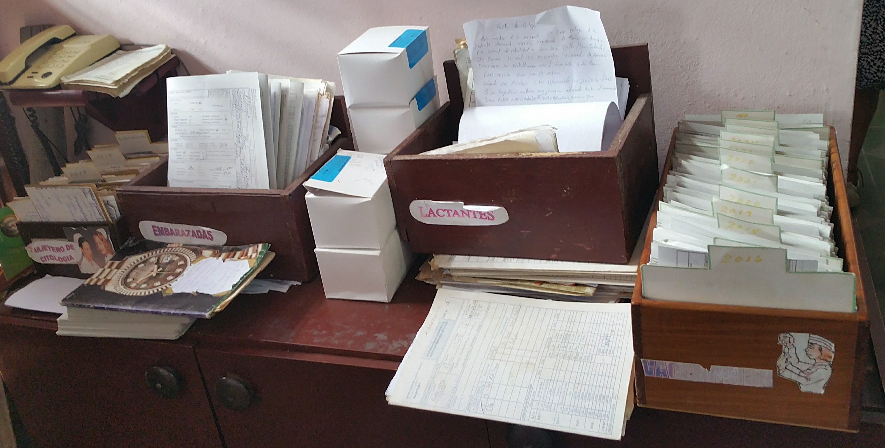
Maternal and Child Health

Slide 45
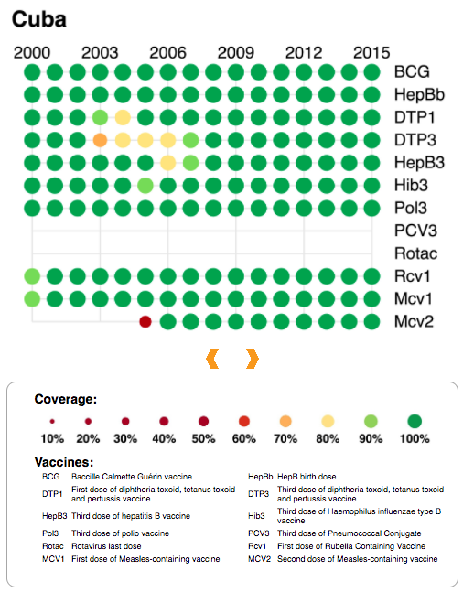
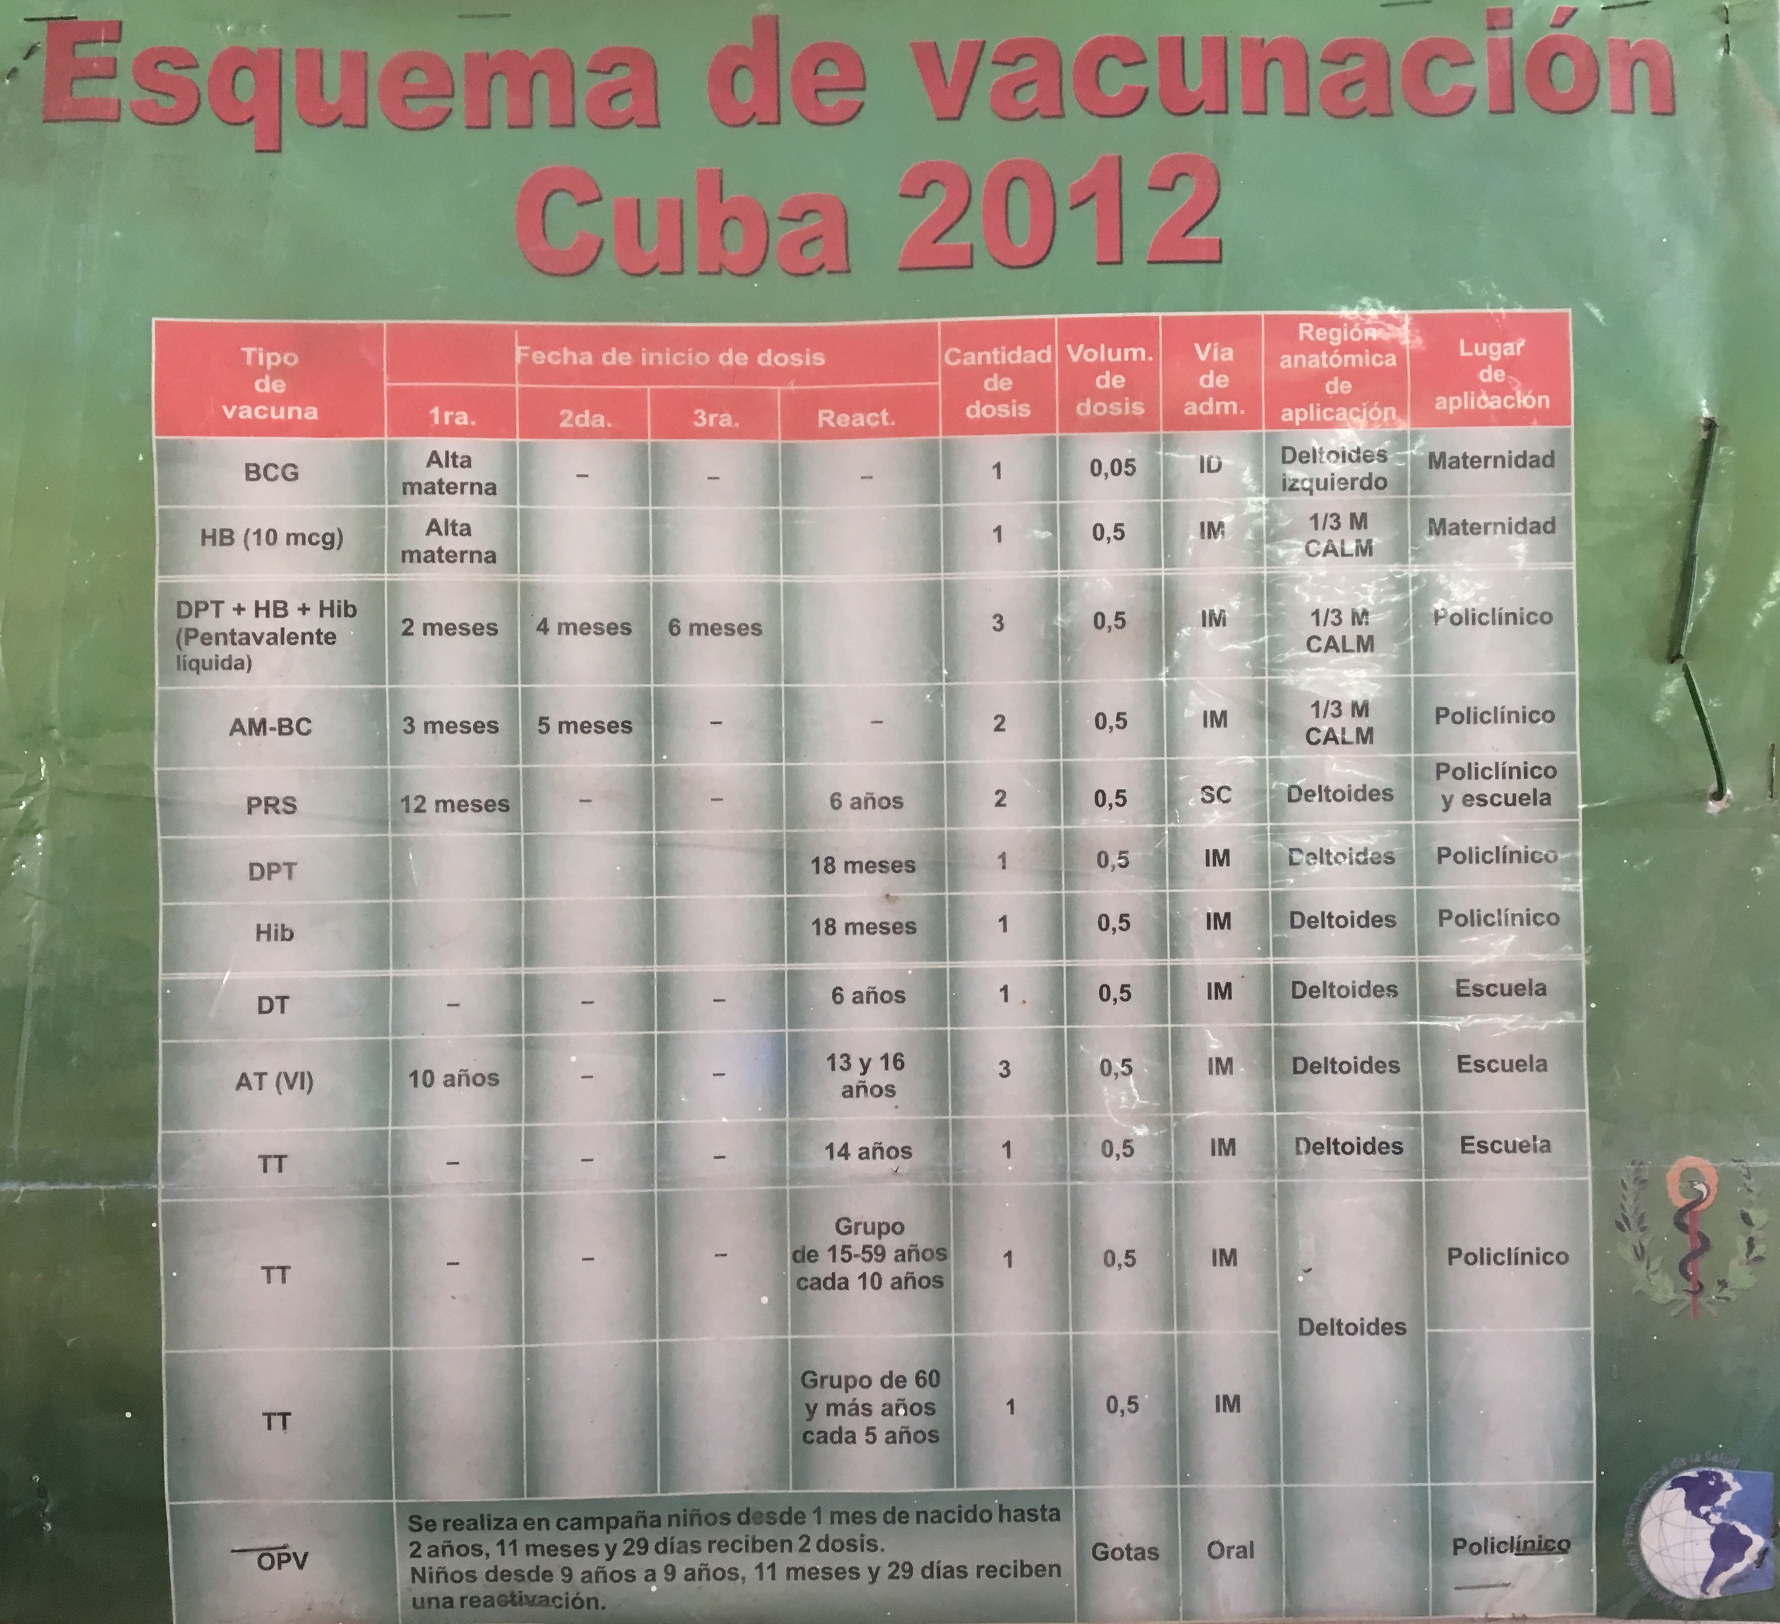
Pediatric Health
Cuba has an infant mortality rate of 4.0, comparable to or better than many industrialized nations.
Vaccination coverage is 100% (or nearly 100%) for indicated vaccines for pediatric population
Emphasis on infant, child and adolescent health – ensure adequate health education, anticipatory guidance and close follow-up for pediatric population.
Well-child checks every month - close monitoring to ensure all patients are up to date on visits and vaccines
Notes:
Cuba has an infant mortality rate of 4.0 (per 1,000 live births), comparable to or better than many industrialized nations. Vaccination coverage is 100% (or nearly 100%) for indicated vaccines for the pediatric population . These statistics can be contributed to Cuba’s emphasis on infant, child and adolescent health, ensuring adequate health education, anticipatory guidance and close follow-up for the pediatric population. Well-child checks are scheduled every month, with close monitoring to ensure all patients are up to date on their visits and vaccines. For any patients who miss their monthly visit, the nurse at the consultorio is persistent in contacting the parents, and will go to the family’s home if needed, to inform them their child is due for their well-child exam. If the child still has not come in for their visit despite being notified by the nurse, the family physician will conduct a home visit to identify any barriers that may be preventing the parent from coming in, emphasize again the importance of the well-child visit, and let them know to come into the clinic as soon as possible. Health education and anticipatory guidance is provided at every visit and incorporated into comprehensive pediatric cards that are given to every newborn upon delivery, which include valuable information such as: immunization schedule, the child’s personal growth curve, nutrition and infant feeding guide for the first year, milestones the child should reach at each age group, and home safety education.

Slide 46
Vaccination Program
Notes:
Cuba has an infant mortality rate of 4.0 (per 1,000 live births), comparable to or better than many industrialized nations. Vaccination coverage is 100% (or nearly 100%) for indicated vaccines for the pediatric population . These statistics can be contributed to Cuba’s emphasis on infant, child and adolescent health, ensuring adequate health education, anticipatory guidance and close follow-up for the pediatric population. Well-child checks are scheduled every month, with close monitoring to ensure all patients are up to date on their visits and vaccines. For any patients who miss their monthly visit, the nurse at the consultorio is persistent in contacting the parents, and will go to the family’s home if needed, to inform them their child is due for their well-child exam. If the child still has not come in for their visit despite being notified by the nurse, the family physician will conduct a home visit to identify any barriers that may be preventing the parent from coming in, emphasize again the importance of the well-child visit, and let them know to come into the clinic as soon as possible. Health education and anticipatory guidance is provided at every visit and incorporated into comprehensive pediatric cards that are given to every newborn upon delivery, which include valuable information such as: immunization schedule, the child’s personal growth curve, nutrition and infant feeding guide for the first year, milestones the child should reach at each age group, and home safety education.

Slide 47
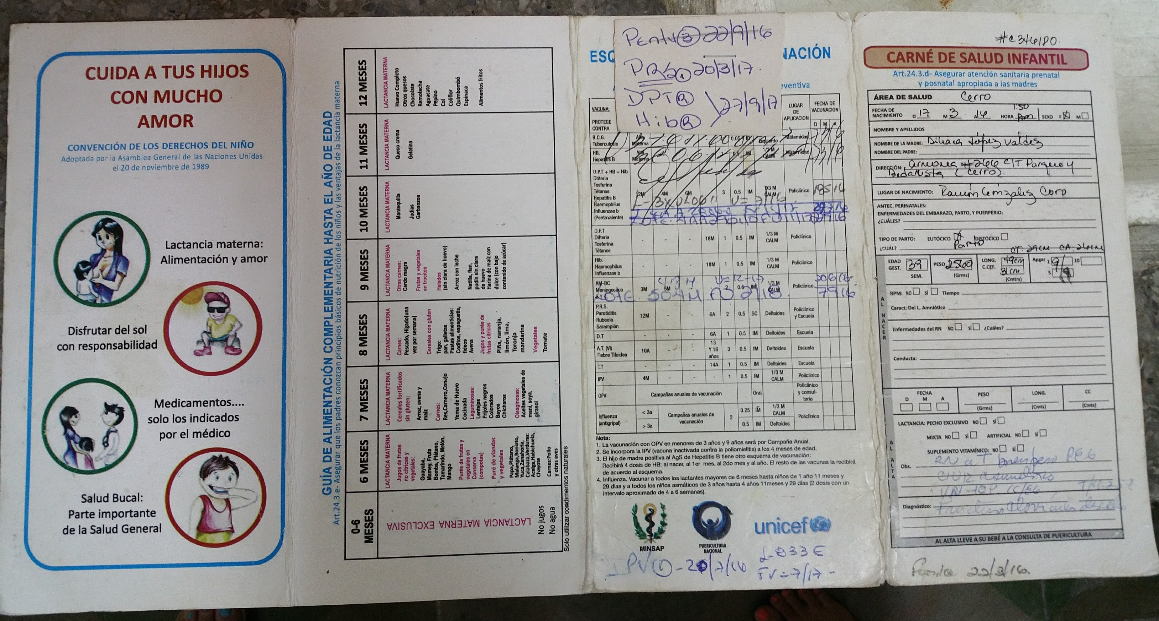
Pediatric Health
Notes:
Health education and anticipatory guidance is provided at every visit and incorporated into comprehensive pediatric cards that are given to every newborn upon delivery, which include valuable information such as: immunization schedule, the child’s personal growth curve, nutrition and infant feeding guide for the first year, milestones the child should reach at each age group, and home safety education.

Slide 48
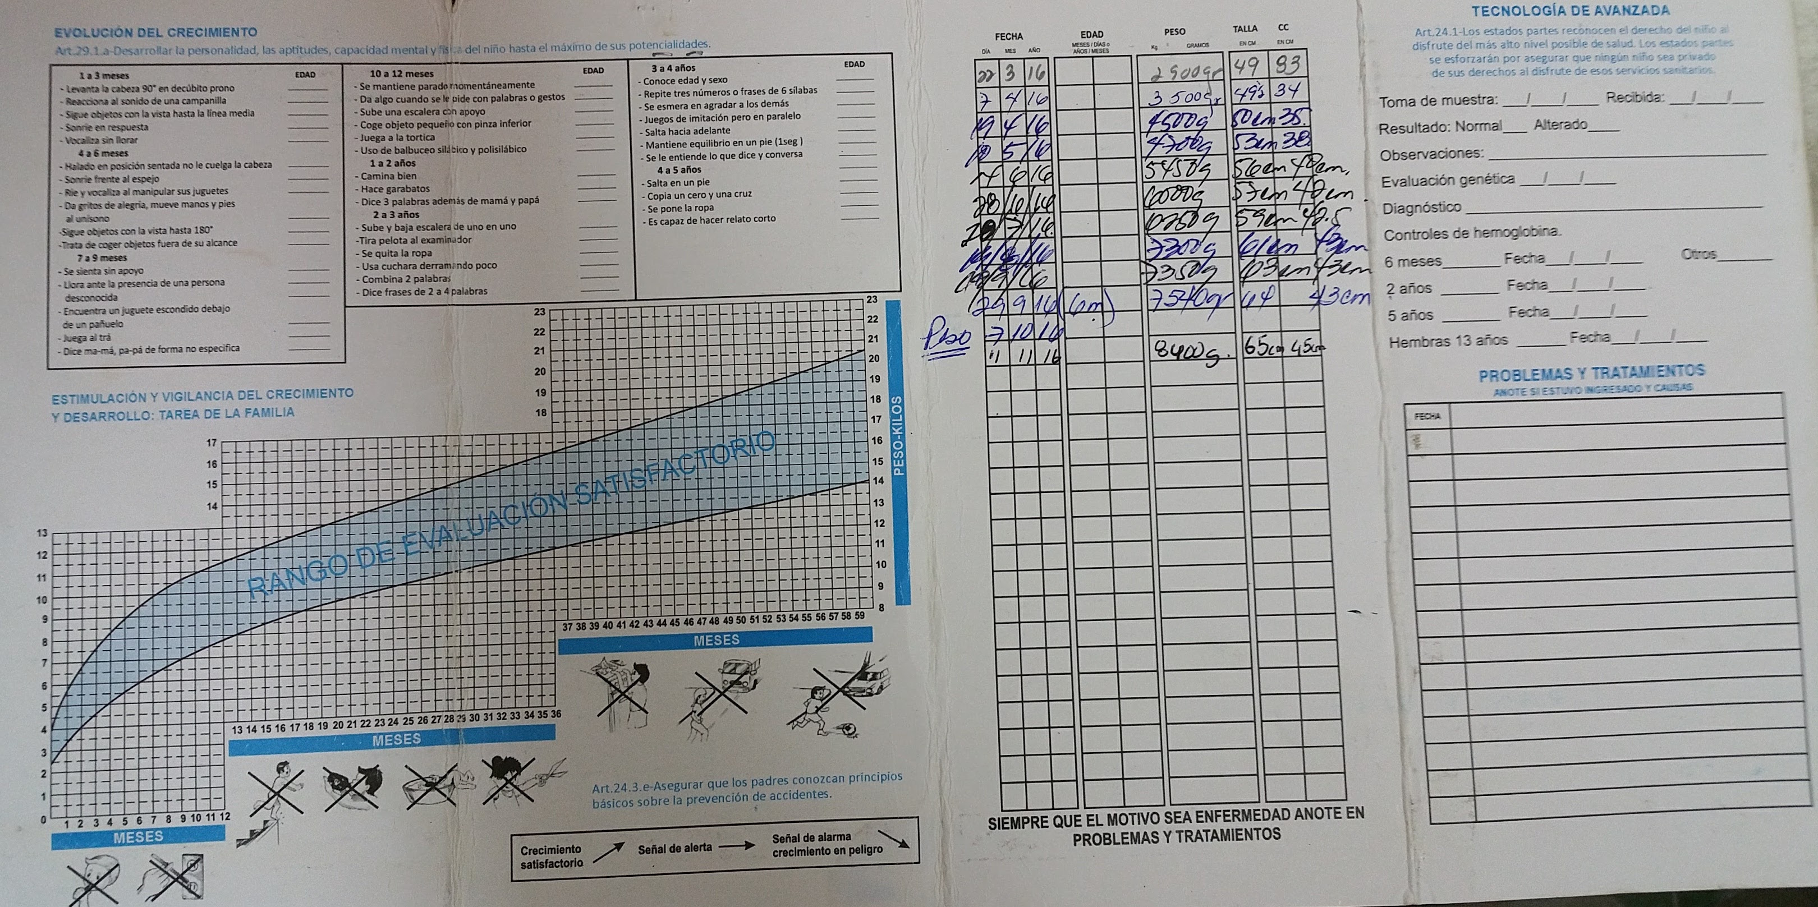
Pediatric Health
Notes:
Health education and anticipatory guidance is provided at every visit and incorporated into comprehensive pediatric cards that are given to every newborn upon delivery, which include valuable information such as: immunization schedule, the child’s personal growth curve, nutrition and infant feeding guide for the first year, milestones the child should reach at each age group, and home safety education.

Slide 49
Maternal Health
In June 2015, Cuba became first country in the world to receive validation from WHO that it had eliminated mother-to-child transmission of HIV and syphilis
Milestones such as this highlight the success of Cuba’s maternal health program, due in large part to the major emphasis Cuba places on maternal health

Slide 50
Maternal Health
100% of all pregnant women receive at least four or more prenatal visits
All births are attended by a trained physician at a maternity hospital
Routine visits with family physician at the consultorio and interval Ob-Gyn consults with specialists who also see patients at the consultorio

Slide 51
Maternal Health
Close monitoring of OB patients – follow up any patient who misses any visits
Education is huge component to maternal health
Comprehensive OB card given to all patients at initial OB intake, keep throughout pregnancy until delivery
OB card includes: thorough OB Hx, info from every visit, any lab/US results, and educational information on adequate prenatal and postpartum health
Any patient identified as high-risk is referred for admission to a hogar materno
community-based regional maternity home for antenatal monitoring
ensure healthy birth outcomes and prevent maternal and infant complications

Slide 52
Maternal Health

Slide 53
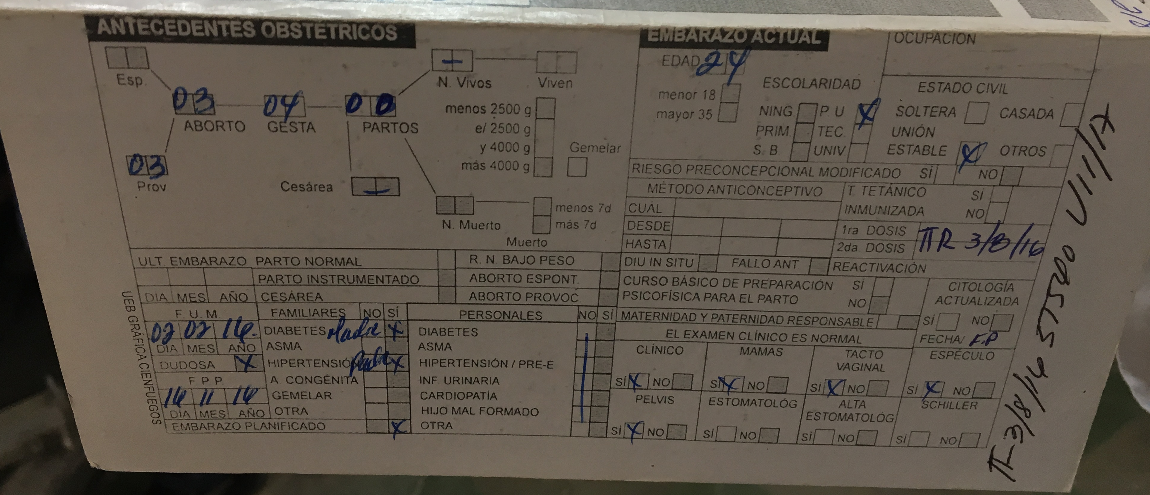
Maternal Health

Slide 54
Public Health and Preventive Medicine:
Dengue and Zika Outreach and Surveillance

Slide 55
Public Health and Preventive Medicine:
Dengue and Zika Outreach and Surveillance
Notes:
Like many tropical countries, dengue is endemic in Cuba. One of the rare but fatal complications of dengue is hemorrhagic dengue, which can lead to hemorrhagic shock and death. To prevent such complications and mortality, Cuba implements preventive community outreach conducted by the consultorio nurse and family physician for their designated health area. They conduct door-to-door outreach, providing dengue prophylactic medication and identifying any febrile patients with signs and symptoms of dengue that may require hospital admission.

Slide 56
Public Health and Preventive Medicine:
Dengue and Zika Outreach and Surveillance

Slide 57
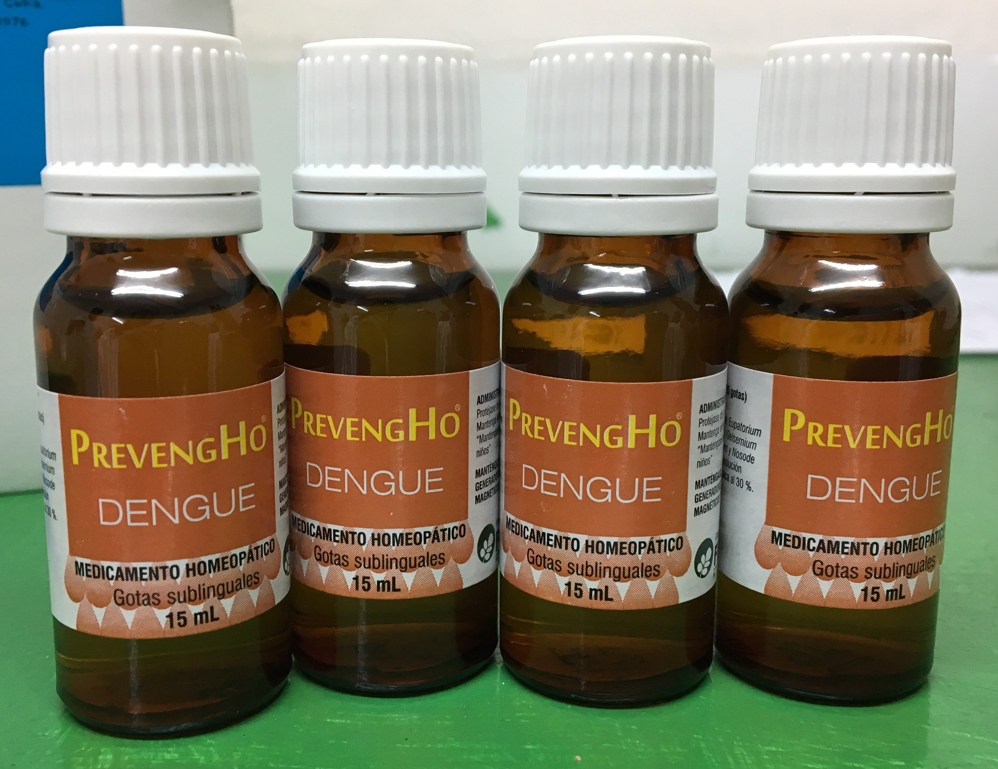
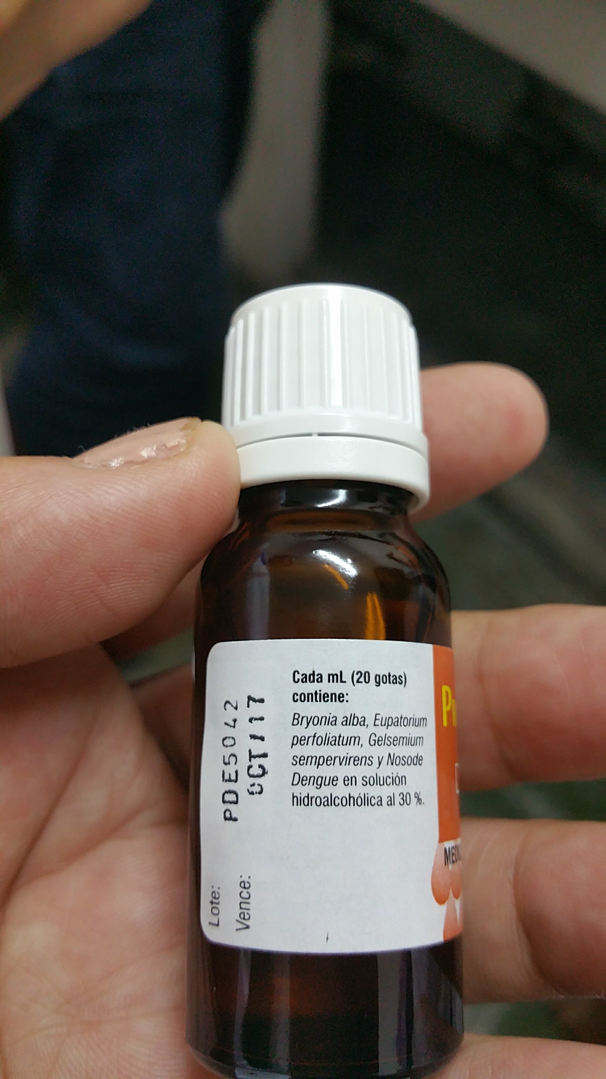
Public Health and Preventive Medicine:
Dengue Prophylaxis

Slide 58
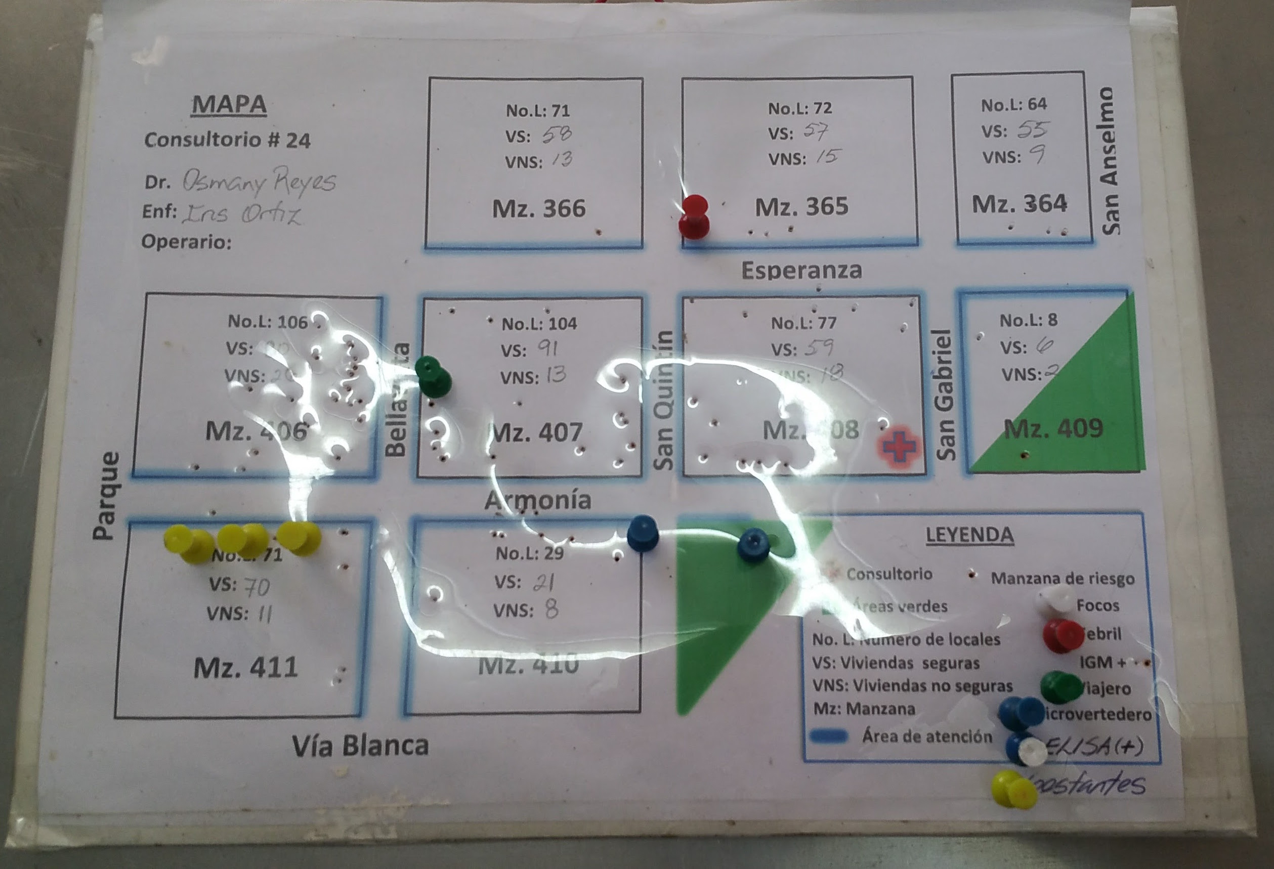
Public Health and Preventive Medicine:
Zika Surveillance for Pregnant Women
Notes:
With the rise of Zika cases globally in recent years and its associated risk of anencephaly, Cuba has now implemented Zika surveillance in pregnant women. Each consultorio has a map of their designated health area, and all pregnant women are identified on the map, as well as any febrile cases in the area. If there are any febrile cases in the vicinity of a pregnant patient, that patient is screened for Zika and automatically referred to a genetic specialist who will conduct a thorough evaluation and perform serial ultrasounds for sonographic surveillance of any potential congenital malformations throughout the duration of the pregnancy.

Slide 59
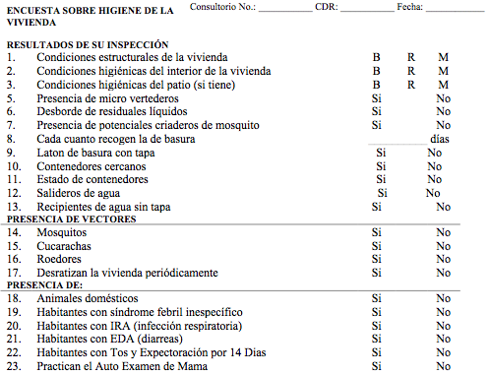
Encuestas / Community Surveys:
Home Inspections

Slide 60
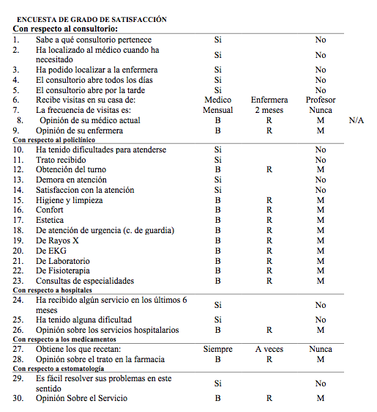
Encuestas / Community Surveys:
Satisfaction with
Health Services

Slide 61
Encuestas / Community Surveys:
Anti-Dengue Campaign

Slide 62
Health Analysis & Action Plan

Slide 63
Medical School Curriculum: Overview
All classes are taught in Spanish
Pre-medical study (1 semester or 1 year): prior to Year 1, for those who want to review pre-med sciences and/or improve their fluency in Spanish
Years 1-2: ELAM Campus (basic sciences/policlinics)
Years 3-6: Salvador Allende Campus (clinical rotations)
Interactive problem-based learning; oral and written evaluations
Emphasis on bio-psycho-social model, primary healthcare (MGI model), community medicine, public health and prevention, and hands-on internship experiences

Slide 64
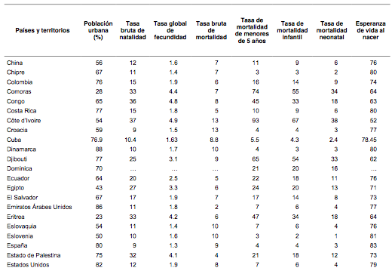
Health Statistics (2016): International Comparisons
Country / Territory
Urban population (%)
Birth Rate
Pregnancy
Rate
Mortality rate
Infant Mortality rate
(<1 yo) (every 1000 live births)
Neonatal Mortality rate
Life Expectancy (years)
Overall Fertility
Rate
Mortality rate children less than 5 years old
Data from:
Anuario Estadístico de Salud 2016, Ministerio de Salud Pública; La Habana, Cuba
Source: Anuario Estadístico de Salud 2016, Ministerio de Salud Pública; La Habana, Cuba
Source: Anuario Estadístico de Salud 2016, Ministerio de Salud Pública; La Habana, Cuba

Slide 65
Health Statistics (2016): Cuba & U.S.
Country / Territory
Urban population (%)
Birth Rate
Overall Fertility
Rate
Mortality
Rate
Mortality rate children less than 5 years old
Infant Mortality rate
(<1 yo) (every 1000 live births)
Neonatal Mortality rate
Life Expectancy (years)
Source: Anuario Estadístico de Salud 2016, Ministerio de Salud Pública; La Habana, Cuba

Slide 66
“We are a small country but we have been able to show how much can be done when it is wanted if human resources from any place can be well used.”
~Fidel Castro Ruz

Slide 67
References
Alvarez Sintes, Rodriguez et al. Temas de Medicina General Integral. La Habana: Editorial Ciencias Médicas, 2001
Batista Moliner, Ricardo et al. Analisis de la Situación de Salud: Algunas Consideraciones Metodológicas y Prácticas. Septiembre 1998
Dresang, L. T. et al. Family Medicine in Cuba: Community-Oriented Primary Care and Complementary and Alternative Medicine. JABFM, 2005. 18(4), 297-303. doi:10.3122/jabfm.18.4.297
Ministerio de Salud Pública. Anuario Estadístico de Salud 2016. La Habana: Editorial Ciencias Médicas, 2017
Sánchez Santos, Leonardo et al. Introducción a la Medicina General Integral. La Habana: Editorial Ciencias Médicas, 2001
Toledo Curbelo, Gabriel et al. Fundamentos de Salud Pública. La Habana: Editorial Ciencias Médicas, 2005
WHO Global Health Observatory Visualizations: Immunization coverage country punchcards, Cuba. World Health Organization. http://apps.who.int/gho/data/node.wrapper.immunization-cov?x-country=CUB
World Health Organization. “WHO validates elimination of mother-to-child transmission of HIV and syphilis in Cuba,” http://www.who.int/mediacentre/news/releases/2015/mtct-hiv-cuba/en/ (January 30, 2015)

Slide 68
Acknowledgements
Escuela Latinoamericana de Medicina (ELAM / Latin American School of Medicine)
Cuban Ministry of Public Health
IFCO / Pastors for Peace
Medical Education Cooperation with Cuba (MEDICC)
AAFP
Valley Family Medicine Residency of Modesto
Stanislaus Medical Society
Dr. Osmany Reyes
Dr. Gustavo
Medical supplies and medication donations from:
UCSF Remedy, MedShare Inc., Dr. Tushar Modi, Dr. Recto De Leon

Slide 69
Havana, Cuba
Botanical Gardens
Bici-taxis in Old Havana
Capitolio Building
Streets of Old Havana

Slide 70
Questions / Travel to Cuba / More info Contact:
Jade Bito-Onon: jbitoonon@schsa.org
Laravic Flores: laflores@schsa.org
Shraddha Shah: sshah@schsa.org

