Slide 1
Precepting in the Patient’s Presence in a Free Clinic
Nathan F. Bradford, MD
Amanda Davis, MD
Brian James Mulroy, DO
Stoney Abercrombie, MD
Scott Kellner, MD

Slide 2
Disclosures
none

Slide 3
Introduction
Traditional model of clinical teaching
Comfortable for educators and learners alike
Concerns surrounding precepting in the patient’s presence
Hippocratic method
Observe all.
Study the patient rather than the disease.
Recent study showing benefits
Power, DV et al. Precepting Medical Students in the Patient’s Presence: A Randomized Controlled Trial in Family Medicine Clinic. Fam Med. 2017 Feb;49(2):97-105

Slide 4
Methods
Biweekly continuity clinic at Anderson Free Clinic
Divided 3rd year medical students into PIPP and traditional
Surveyed patients after every encounter
Collected feedback from patients and students

Slide 5
How good was the student at… | Poor | Fair | Good | Very Good | Excellent | Does Not Apply
Making you feel at ease: introducing him/herself, explaining his/her position, being friendly and warm towards you, treating you with respect; not cold or abrupt)
Letting you tell your “story”: giving you time to fully describe your condition in your own words; not interrupting, rushing or diverting you
Really listening (paying close attention to what you were saying; not looking at the notes or computer as you were talking)
Being interested in you as a whole person (asking/knowing relevant details about your life, your situation; not treating you as “just a number”)
Fully understanding your concerns: (communicating that he/she had accurately understood your concerns and anxieties; not overlooking or dismissing anything)
Showing care and compassion: (seeming genuinely concerned, connecting with you on a human level; not being indifferent or “detached”)
Being positive: (having a positive approach and a positive attitude; being honest but not negative about your problems)
Explaining things clearly (fully answering your question; explaining clearly, giving you adequate information; not being vague)
Helping you to take control (exploring with you what you can do to improve your health yourself; encouraging rather than “lecturing” you)
Making a plan of action with you (discussing the options, involving you in decisions as much as you want to be involved; not ignoring your views)

Slide 6
How good was the student at… | Traditional | PIPP
Making you feel at ease | 76% | 76%
Letting you tell your “story” | 80% | 86%
Really listening | 81% | 86%
Being interested in you as a whole person | 70% | 79%
Fully understanding your concerns | 77% | 82%
Showing care and compassion | 79% | 86%
Being positive | 77% | 82%
Explaining things clearly | 75% | 93%
Helping you take control | 79% | 82%
Making a plan of action with you | 79% | 92%

Slide 7
MS3 Survey Results
Does the precepting in the patient room affect medical student empathy?
Using a validated tool – the Jefferson Scale of Empathy (JSE).
20 statements graded on a 1-7 scale, higher total score = more empathy.
Average JSE score is 114.3±10.4 (1).
JSE scores decline from the beginning of 3rd year to the end (2).
Hojat M, Mangione S, Nasca TJ, Cohen MJM, Gonnella JS, Erdmann JB, Veloski JJ, Magee M. The Jefferson Scale of Physician Empathy: development and preliminary psychometric data. Educ Psychol Measurement 2001;61: 349–65.
Hojat M, Mangione S, Nasca TJ, Rattner S, Erdmann JB, Gonnella JS, Magee M. An empirical study of decline in empathy in medical school. Med Educ 2004;38(9):934-941.

Slide 8
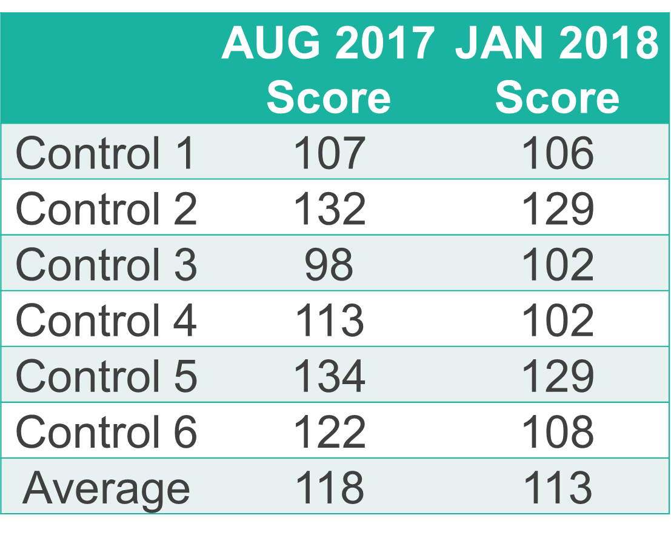
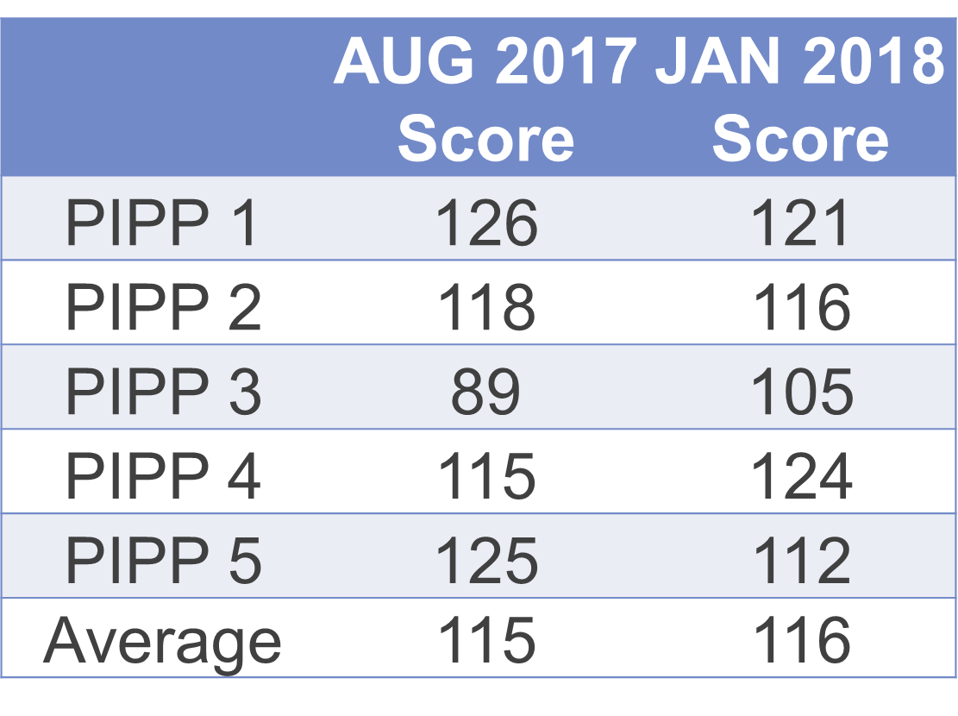
MS3 Empathy Scores

Slide 9
Jefferson Scale of Empathy: Example Statements
Graded on 1-7 scale from strongly disagree to strongly agree.
Empathy is a therapeutic skill without which the physician’s success is limited.
Patients feel better when their physicians understand their feelings.
Asking patients about what is happening in their personal lives is not helpful in understanding their physical complaints.

Slide 10
MS3 Feedback
Amanda will insert video here.

Slide 11
Please evaluate this presentation using the conference mobile app! Simply click on the "clipboard" icon on the presentation page.

