Slide 1
Association Between Antidepressant Use and Time to Incident Hypertension
Matthew A. Breeden, MD
Department of Family and Community Medicine
Saint Louis University School of Medicine
Notes:
As we all know, these are two very common primary care issues. We were interested in looking into the effects of ADM on blood pressure in a primary care population, given the high prevalence of both HTN and ADM use.

Slide 2
Disclosures
Nothing to disclose

Slide 3
Hypertension
Age-adjusted prevalence: 29.6%
Approximately 48% achieve control
Directly related to heart disease and stroke
Which are the first and fourth leading causes of death, respectively
Source(s): (Gillespie, Hurvitz et al. 2013)

Slide 4
Antidepressants
Several classes
Tricyclic Antidepressants (TCAs)
Selective Serotonin Reuptake Inhibitors (SSRIs)
Serotonin-Norepinephrine Reuptake Inhibitors (SNRIs)
Norepinephrine and Dopamine Reuptake Inhibitors (NDRIs)
Atypical Antidepressants

Slide 5
Antidepressants
Widely used
11% of US population age 12 and up
Frequently used for other indications, especially TCAs and SNRIs
Varying data regarding influence on blood pressure, some of it conflicting
Source(s): (Olfson and Marcus 2009, Pratt, Brody et al. 2011)
Notes:
A recent study showed that only ~ 15% of TCA prescriptions were for depression and anxiety indications, with the bulk being written for pain, insomnia, and migraines. Similarly, SNRIs are very commonly written for pain and fibromyalgia. SSRIs are largely written for diagnoses related to depression and anxiety.

Slide 6
Objectives
Investigate whether antidepressant medication (ADM) use in primary care population is associated with development of hypertension
Determine if certain classes of drugs, or even individual drugs, have more robust associations

Slide 7
Methods
Data source: Primary Care Patient Data Registry
33661 patients
Covers July 1, 2008 to June 30, 2015
De-identified data
Urban and suburban academic primary care clinics in St. Louis, MO metro area.

Slide 8
Methods
Inclusion criteria
18 years old with completed demographic data
At least one visit in two-year washout period (July 1, 2008 to June 30, 2010)
At least one visit in five-year follow-up period
Patients with existing hypertension diagnosis in washout period were removed
Final sample size: 6244 adult patients without pre-existing hypertension

Slide 9
Methods
Study design
Retrospective cohort, survival model
Cox proportional hazards models used to calculate hazard ratios
Predictor variable
Antidepressant medication treatment
One or more prescriptions for any antidepressant
Analyzed both by ADM class and individual ADM
Three types of treatment defined
ADMs with recognized risk of increasing BP
ADMs not previously associated with increased risk
No prescription for ADM
Outcome
Time to incident hypertension (using ICD-9 codes)

Slide 10
Methods
Covariates
Selected based on associations with HTN and/or depression
Age, race, gender, marital status, neighborhood socioeconomic status (nSES), high clinic utilization, current smoker, substance use disorder, depression, anxiety disorder, obesity, hyperlipidemia, type II diabetes, vascular disease
Utilized clinic utilization to control for selection bias
Due to space constraints, we have omitted marital status, nSES, and high clinic utilization from this presentation

Slide 11
Table 1. Distribution of sociodemographics, covariates, and 5-year cumulative incidence of HTN among adult, primary care patients, overall and by ADM exposure (n=6,244)
Variable, no. (%) | Total (n=6,244)
Hypertension | 774 (12.4)
Age, mean (sd) | 46.4 (15.6)
Race: White | 4297 (68.8)
Sex: Female | 3949 (63.2)
Current smoker | 1164 (18.6)
Substance use | 190 (3.0)
Depression | 771 (12.4)
Anxiety | 665 (10.7)
Obese | 2365 (37.9)
Hyperlipidemia | 1429 (22.9)
Type II Diabetes | 391 (6.3)
Vascular Disease | 605 (9.7)
Note: ADM = antidepressant medication; BP- = No effect on blood pressure; BP+ = Increases blood pressure
Notes:
Highlight 12.4 percent developed hypertension (essentially five year incidence). Consistent with other studies of hypertension. Can point out validity of data, given high proportion of anxiety/depression on ADMs. Minimal age differences.

Slide 12
Table 2. Distribution of sociodemographics and covariates among adult, primary care patients by 5-year cumulative HTN incidence outcome (n=6,244)
Variable, no. (%) | HTN – No (n=5,470) | HTN – Yes (n=774) | HR (95% CI)ª
Age, mean (sd) | 44.7 (15.2) | 58.1 (13.4) | 1.04 (1.03-1.05)
Race: White | 3867 (70.7) | 430 (55.6) | 0.57 (0.49-0.65)
Sex: Female | 3478 (63.6) | 471 (60.9) | 0.90 (0.78-1.04)
Current smoker | 963 (17.6) | 201 (26.0) | 1.56 (1.32-1.83)
Substance use | 162 (3.0) | 28 (3.6) | 1.64 (1.12-2.39)
Depression | 681 (12.5) | 90 (11.6) | 1.05 (0.85-1.32)
Anxiety disorder | 603 (11.0) | 62 (8.0) | 0.85 (0.66-1.11)
Obese | 1973 (36.1) | 392 (50.6) | 2.16 (1.87-2.49)
Hyperlipidemia | 1152 (21.1) | 277 (35.8) | 2.11 (1.82-2.45)
Type II Diabetes | 267 (4.9) | 124 (16.0) | 3.40 (2.81-4.12)
Vascular Disease | 482 (8.8) | 123 (15.9) | 2.12 (1.75-2.58)
Note: HTN = hypertension; HR=hazard ratio; CI=confidence interval, ª Unadjusted hazard ratios. Comorbidities treated as time dependent variables

Slide 13
Table 3. Survival models, hazard ratios and 95% confidence intervals of the relationship of ADM treatment group and time to incident HTN among adult primary care patients (n=6,244)ª
 | Unadjusted HR (95% CI) | Overall adjusted HR (95% CI)
ADM
No ADM | 1.00 | 1.00
ADM-BP- | 1.10 (0.90-1.34) | 1.08 (0.87-1.33)
ADM-BP+ | 1.30 (1.08-1.57) | 1.20 (0.97-1.49)
Age |  | 1.04 (1.03-1.05)
Race: White |  | 0.60 (0.52-0.71)
Sex: Female |  | 0.93 (0.80-1.08)
Current smoker |  | 1.43 (1.21-1.70)
Substance use disorder |  | 1.19 (0.80-1.76)
Depression |  | 0.88 (0.68-1.13)
Any anxiety disorder |  | 0.90 (0.68-1.18)
Obese |  | 1.78 (1.54-2.07)
Hyperlipidemia |  | 1.07 (0.91-1.26)
Type II Diabetes |  | 1.62 (1.31-1.99)
Vascular Disease |  | 0.99 (0.81-1.22)
Note: ADM=antidepressant medication; BP- = No effect on blood pressure; BP+ = Increases blood pressure ; ª ADM treatment and Comorbidities treated as time dependent variables

Slide 14
Table 4. Distribution of ADM drug class and type among primary care patients by 5-year cumulative hypertension incidence outcome, and hazard ratios (95% CI) (n=6,244) ª
Drug class/type, no. (%) | HTN – No (n=5,470) | HTN – Yes (n=774) | HR (95% CI)ª
Any TCA | 322 (5.9) | 60 (7.8) | 1.53 (1.17-1.99)
Amitriptyline | 238 (4.4) | 48 (6.2) | 1.64 (1.23-2.20)
Desipramine | 13 (0.2) | 6 (0.8) | 3.09 (1.38-6.89)
Any SSRI | 1237 (22.6) | 161 (20.8) | 1.02 (0.86-1.21)
Citalopram | 430 (7.9) | 59 (7.6) | 1.14 (0.87-1.48)
Escitalopram | 314 (5.7) | 37 (4.8) | 0.91 (0.65-1.26)
Fluoxamine | 260 (4.8) | 27 (2.5) | 0.84 (0.57-1.23)
Paroxetine | 194 (3.6) | 21 (2.7) | 0.82 (0.53-1.27)
Sertraline | 354 (6.5) | 46 (5.9) | 1.05 (0.78-1.41)
Note: HTN = hypertension; HR=hazard ratio; CI=confidence interval; ª Unadjusted hazard ratios from survival model. Drug type/class treated as time dependent variables

Slide 15
Table 4. Distribution of ADM drug class and type among primary care patients by 5-year cumulative hypertension incidence outcome, and hazard ratios (95% CI) (n=6,244) ª
Drug class/type, no. (%) | HTN – No (n=5,470) | HTN – Yes (n=774) | HR (95% CI)ª
Any SNRI | 356 (6.5) | 54 (7.0) | 1.26 (0.95-1.66)
Desvenlafaxine | 41 (0.8) | 5 (0.7) | 1.08 (0.45-2.59)
Venlafaxine | 194 (3.6) | 22 (2.8) | 1.02 (0.67-1.56)
Duloxetine | 150 (2.7) | 30 (3.9) | 1.55 (1.08-2.24)
Any other | 699 (12.8) | 94 (12.1) | 1.03 (0.83-1.28)
Bupropion | 427 (7.8) | 58 (7.5) | 1.08 (0.83-1.42)
Trazodone | 285 (5.2) | 39 (5.0) | 0.98 (0.71-1.35)
Mirtazapine | 84 (1.5) | 12 (1.6) | 1.09 (0.62-1.93)
Note: HTN = hypertension; HR=hazard ratio; CI=confidence interval; ª Unadjusted hazard ratios from survival model. Drug type/class treated as time dependent variables

Slide 16
Table 4. Distribution of ADM drug class and type among primary care patients by 5-year cumulative hypertension incidence outcome, and hazard ratios (95% CI) (n=6,244) ª
Drug class/type, no. (%) | HTN – No (n=5,470) | HTN – Yes (n=774) | HR (95% CI)ª
Any TCA | 322 (5.9) | 60 (7.8) | 1.53 (1.17-1.99)
Amitriptyline | 238 (4.4) | 48 (6.2) | 1.64 (1.23-2.20)
Desipramine | 13 (0.2) | 6 (0.8) | 3.09 (1.38-6.89)
Any SNRI | 356 (6.5) | 54 (7.0) | 1.26 (0.95-1.66)
Desvenlafaxine | 41 (0.8) | 5 (0.7) | 1.08 (0.45-2.59)
Venlafaxine | 194 (3.6) | 22 (2.8) | 1.02 (0.67-1.56)
Duloxetine | 150 (2.7) | 30 (3.9) | 1.55 (1.08-2.24)
Note: HTN = hypertension; HR=hazard ratio; CI=confidence interval; ª Unadjusted hazard ratios from survival model. Drug type/class treated as time dependent variables

Slide 17
In Summary
TCAs have significant association with development of HTN
Duloxetine, but not other SNRIs, associated with development of HTN
All other ADMs lack significant association

Slide 18
Venlafaxine
Long associated with elevated blood pressure
Dose-dependent effect
Most significant at > 300mg/day
Uncommon to reach these doses in primary care
Source(s): ("Effexor(R) [package insert]. Wyeth Pharmaceuticals, Inc., Philadelphia, PA; February 2008.," ; Thase 1998)

Slide 19
Duloxetine
Studies show less significant impact on blood pressure
Caution still advised in prescribing
Source(s): (Westanmo, Gayken et al. 2005, Wohlreich, Mallinckrodt et al. 2007)

Slide 20
Tricyclic Antidepressants
Older drugs, more side effects
More often associated with orthostatic hypotension than hypertension
Severe blood pressure elevations in overdose
No longer commonly used for depression/anxiety
More likely to be used for pain, migraines, insomnia
Source(s): (Carvalho, Sharma et al. 2016, Wong, Motulsky et al. 2016)

Slide 21
Discussion
SSRIs continue to maintain safe profile in relation to HTN
More informed understanding of SNRIs, including appropriate vigilance
Renewed vigilance with TCAs
Need for further investigation into area

Slide 22
Limitations
Retrospective
Limited by health record prescription data, impossible to ensure adherence
No control for pain as co-morbidity, which could affect blood pressure

Slide 23
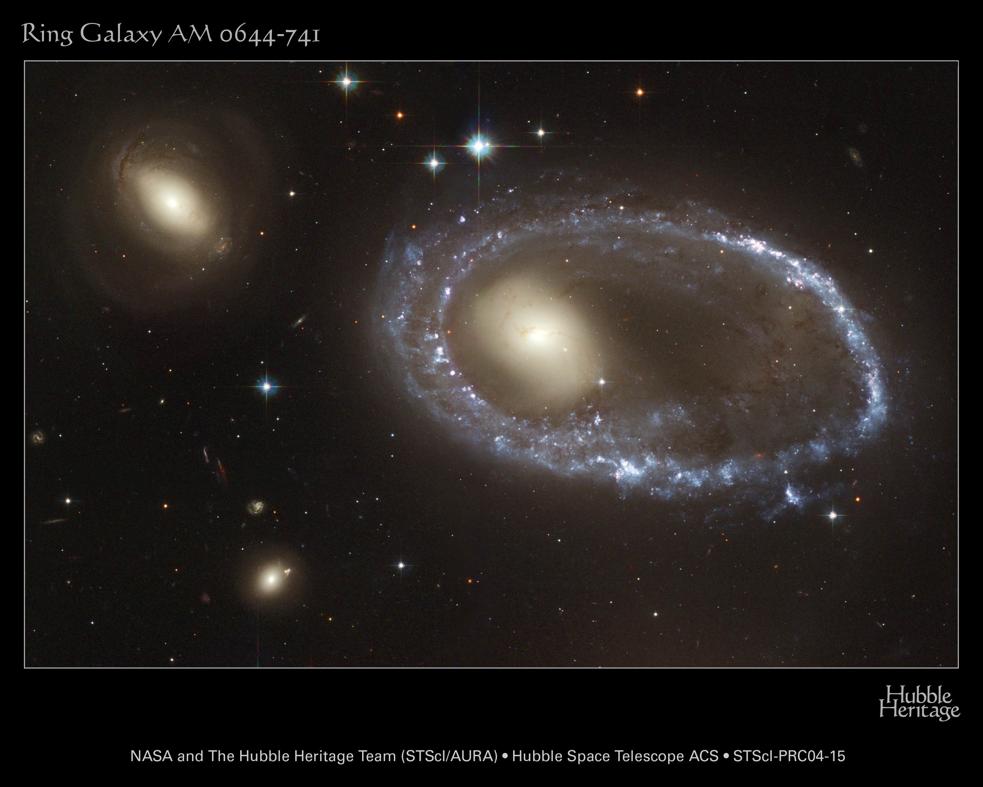

Slide 24
References
"Effexor(R) [package insert]. Wyeth Pharmaceuticals, Inc., Philadelphia, PA; February 2008.".
Carvalho, A. F., M. S. Sharma, A. R. Brunoni, E. Vieta and G. A. Fava (2016). "The Safety, Tolerability and Risks Associated with the Use of Newer Generation Antidepressant Drugs: A Critical Review of the Literature." Psychother Psychosom 85(5): 270-288.
Gillespie, C. D., K. A. Hurvitz, C. Centers for Disease and Prevention (2013). "Prevalence of hypertension and controlled hypertension - United States, 2007-2010." MMWR Suppl 62(3): 144-148.
Olfson, M. and S. C. Marcus (2009). "National patterns in antidepressant medication treatment." Arch Gen Psychiatry 66(8): 848-856.
Pratt, L. A., D. J. Brody and Q. Gu (2011). "Antidepressant use in persons aged 12 and over: United States, 2005-2008." NCHS Data Brief(76): 1-8.
Thase, M. E. (1998). "Effects of venlafaxine on blood pressure: a meta-analysis of original data from 3744 depressed patients." J Clin Psychiatry 59(10): 502-508.
Westanmo, A. D., J. Gayken and R. Haight (2005). "Duloxetine: a balanced and selective norepinephrine- and serotonin-reuptake inhibitor." Am J Health Syst Pharm 62(23): 2481-2490.
Wohlreich, M. M., C. H. Mallinckrodt, A. Prakash, J. G. Watkin and W. P. Carter (2007). "Duloxetine for the treatment of major depressive disorder: safety and tolerability associated with dose escalation." Depress Anxiety 24(1): 41-52.
Wong, J., A. Motulsky, T. Eguale, D. L. Buckeridge, M. Abrahamowicz and R. Tamblyn (2016). "Treatment Indications for Antidepressants Prescribed in Primary Care in Quebec, Canada, 2006-2015." JAMA 315(20): 2230-2232.

Slide 25
Please evaluate this presentation using the conference mobile app! Simply click on the "clipboard" icon on the presentation page.

