Slide 1
Incorporating the use of Models and Simulators in the Physical Diagnosis training of Second year Medical Students Rebecca Moore, D.O. Aubrey M. Olson, D.O., M.S.Ed. Rowan University School of Osteopathic Medicine Stratford, New Jersey

Slide 2
Disclosures
We have no disclosures.

Slide 3
Objectives
Demonstrate how the use of different modalities and simulators in the physical diagnosis course improves diagnostic training in our second year students.
Explore how to incorporate modalities and simulators into the physical diagnosis lab.
Identify novel approaches by which we can challenge our medical students, diagnostically, in the pre-clerkship years with the incorporation of these simulators and teaching modalities.

Slide 4
Background
Traditionally, the first and second years of medical school are completed in the classroom via lectures.
Our second year students are provided with comprehensive didactics on pathology of organ systems and how to conduct a physical exam.
Much of clinical learning occurs during the third and fourth year of medical school.
The challenge becomes preparing the second year students for that transition into the third year, where they are comfortable interacting with patients and performing an accurate physical exam at the same time.
We were challenged to develop a system that would accurately teach these physical diagnostic skills and transfer them to a real life clinical environment and situation
Notes:
While all medical students are taught how to perform a general physical exam, very often the Osteopathic structural exam is not incorporated into physical exam education for most medical school curriculum.
The separation of osteopathic structural skills and physical diagnosis skills leaves students with the monstrous task of how to incorporate both exams into patient care.
It is expected that Osteopathic Principles and Practices are implemented into the care of the patient and the management plan in order to pass COMLEX PE.

Slide 5
Background (continued)
During the development of the second year On Doctoring course, which is responsible for teaching physical examination methods, we encountered some challenges:
How do we get the students to connect the pathology they have learned in the classroom to the physical exam they are performing on a healthy real life peer?
Our second year students often difficult for them to associate the pathology with the findings of their physical exam in an actual clinical setting.
Students often feel intimidated when they get into clinical situation and find that they do not maximize their clinical skills.
Students must be educated in a manner which best prepares them for an actual patient encounter and to know in which direction of the physical exam they should go with regard to chief complaint and history for the patient.
Must associate specific clinical findings with diseases in a manner that can help them formulate an appropriate assessment and plan.
Notes:
While all medical students are taught how to perform a general physical exam, very often the Osteopathic structural exam is not incorporated into physical exam education for most medical school curriculum.
The separation of osteopathic structural skills and physical diagnosis skills leaves students with the monstrous task of how to incorporate both exams into patient care.
It is expected that Osteopathic Principles and Practices are implemented into the care of the patient and the management plan in order to pass COMLEX PE.

Slide 6
Our Goal
Utilize different modalities and simulators in order to develop a stronger physical diagnosis exam for the first and second year medical students.
Use Models and Simulators to expose students to pathology early on in their medical career
Allows students to maximize their physical diagnosis skills.
Provide for more personalized, one-on-one feedback in real time for each student from a physician-educator
Notes:
Integrate the Osteopathic structural exam into the physical diagnosis material
Utilize educators from both the Osteosciences Department and the Family Medicine Department, who are integral to teaching both the general physical exam and the Osteopathic structural exam in the first and second year of medical school
Interdisciplinary approach, to incorporate examination methods from both courses, Osteopathic Manipulative Medicine (OMM) and Physical Diagnosis, to facilitate student integration of both into patient care.
Integrate the Osteopathic structural exam into the physical diagnosis material, so that both courses, Osteopathic Manipulative Medicine (OMM) and Physical Diagnosis can parallel each other, seamlessly, and students can have facilitation in integrating both into patient care.

Slide 7
The Challenges
Simulators are expensive
How do we find the best simulators with the funding granted?
How do we provide a small group simulator encounter with limited resources?
How do we fit this in an already packed curriculum?
How do we make this a worthwhile experience for the students?
Notes:
Both the Osteosciences Department and Family Medicine were isolated with regard to the didactics in the first and second year, with very little overlap.
Family Medicine responsible for On Doctoring I and II courses (physical diagnosis and interpersonal communications)
Osteosciences Department responsible for OMM I and II courses
General Curriculum is systems based, and both the OMM courses and On Doctoring Courses try to follow the curriculum with their didactic sessions
Courses taught independently of each other:
On Doctoring never discussed osteopathic considerations in core curriculum.
OMM never discussed diagnostic skills and professionalism and interpersonal skills in core curriculum.
Limited resources making it impossible to examine students from physical diagnosis all of the way through the Osteopathic Structural exam
Class size of approximately 168
Standardize patient laboratory with 10 examination rooms
9 hours session in which to examine all students for practical exams
Student performance on CSCE (Mock COMLEX PE) and COMLEX PE were not reflective of student’s ability to integrate both physical exam and Osteopathic Structural exam and treatment into a patient encounter

Slide 8
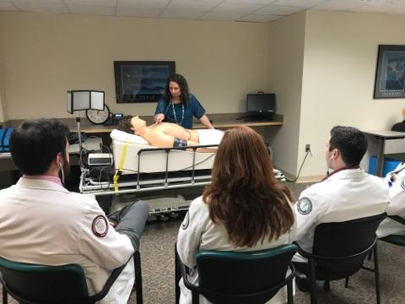
Simulators
Notes:
Led by educators who cross-teach in both courses and remediate CSCE and COMLEX PE failures
On Doctoring: Asked all lecturers to include a slide of Osteopathic Considerations into their physical diagnosis lectures
All laboratory sessions go through physical diagnosis and then discuss osteopathic structural exam considerations and treatment
OMM: Asked all table trainers to take students through a patient from entering the office with a complaint to ROS and physical exam and then following through to Osteopathic Structural Exam
Physical Diagnosis Practicals: now include most important aspects of Osteopathic Structural Exam
OMM Practicals: now include grading for professionalism and interpersonal communications

Slide 9
Cardiology Module
Learning Objectives
• Review and refine cardiac examination skills
• Auscultate and distinguish between abnormal heart sounds.
• Practice and refine your skills with your colleagues outside of lab time.
Skills to Review:
1) Arterial Pulse Assessment- Assess Rate and Rhythm
2) Carotid Pulse Assessment- Shape, Amplitude
3) Auscultation for Carotid Bruits
4) Blood Pressure Assessment
5) Assessment of Jugular Venous Pressure Vertical dist. from right atrium (<9 cm)
6) Cardiac Examination
a. Inspection b. Palpation c. Percussion d. Auscultation (normal heart sounds)
7) Osteopathic structural assessment for Cardiovascular system

Slide 10
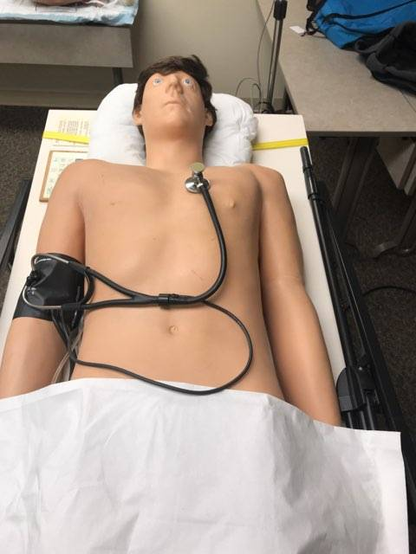
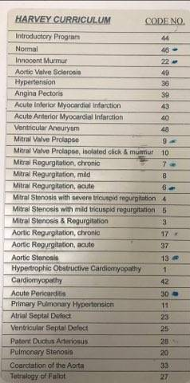
Cardiology Module -- Simulator
Harvey – Cardio/Pulm
Led by physician
Students have individual headphones
Cardiac sounds change depending on placement of stethoscope
Harvey, Laerdal UM142

Slide 11
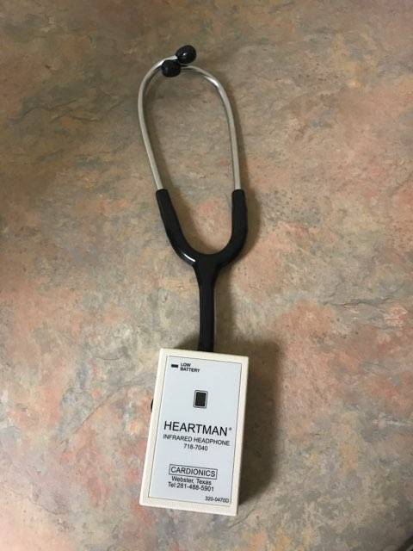
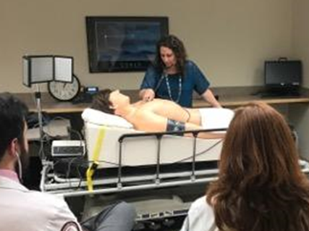
Cardiology Module
Notes:
Replacement for Slide 9

Slide 12
Pulmonary Module
Learning Objectives
• Review and refine pulmonary examination skills.
• Auscultate and distinguish between abnormal lung sounds.
• Write appropriate physical exam findings.
• Practice and refine your skills with your colleagues outside of lab time.
Skills to Learn:
I. Respiratory Rate Assessment- Assess Rate and Rhythm
II. Pulmonary / Chest Examination
a. Inspection b. Palpation c. Percussion d. Auscultation (normal lung sounds)
III. Voice Transmission Tests
a. Tactile Fremitus b. Bronchophony c. Whispered Pectoriloquy d. Egophony
IV. Osteopathic Structural Exam

Slide 13
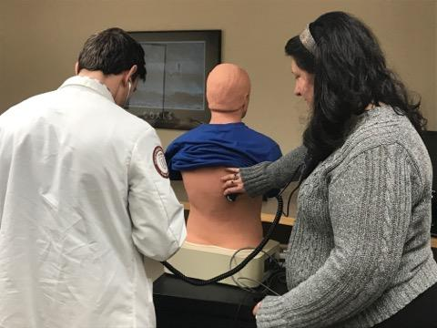
Pulmonary Module -- Simulators
Harvey
SAM – Pulm/GI
Led by physician
Students have individual headphones
Pulmonary sounds change depending on placement of stethoscope
Sam, Cardionics 904015
Notes:
Replacement Slide 10

Slide 14
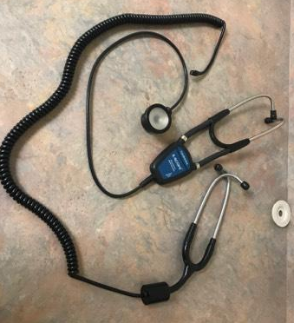
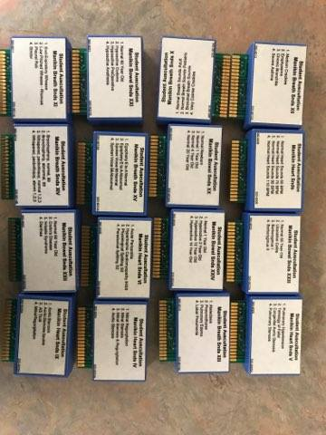
Pulmonary Module

Slide 15
Gastroenterology Module
Learning Objectives
• Review and refine abdominal examination skills.
• Auscultate and distinguish between abnormal abdominal sounds.
• Write appropriate physical exam findings.
• Practice and refine your skills with your colleagues outside of lab time.
Skills to Learn:
I. Abdominal Exam
a. Inspection b. Auscultation c. Percussion d. Palpation
II. Special Tests
a. Ascites
i. Shifting dullness ii. Fluid wave iii. Whispered Pectoriloquy iv. Egophony
b. Murphy’s sign c. Lloyd’s sign d. Rebound tenderness
e. Appendicitis
i. Rovsig’s sign ii. Obturator Sign iii. Psoas Sign
III. Osteopathic Structural Exam

Slide 16
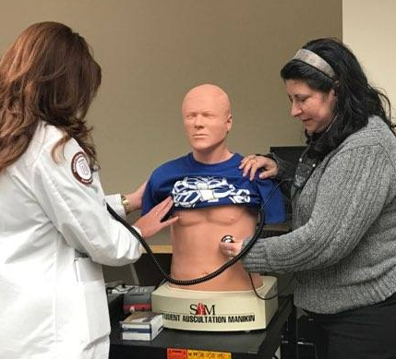
Gastroenterology Module -- Simulators
SAM – Pulm/GI
Led by physician
Students have individual headphones
Pulmonary sounds change depending on placement of stethoscope

Slide 17
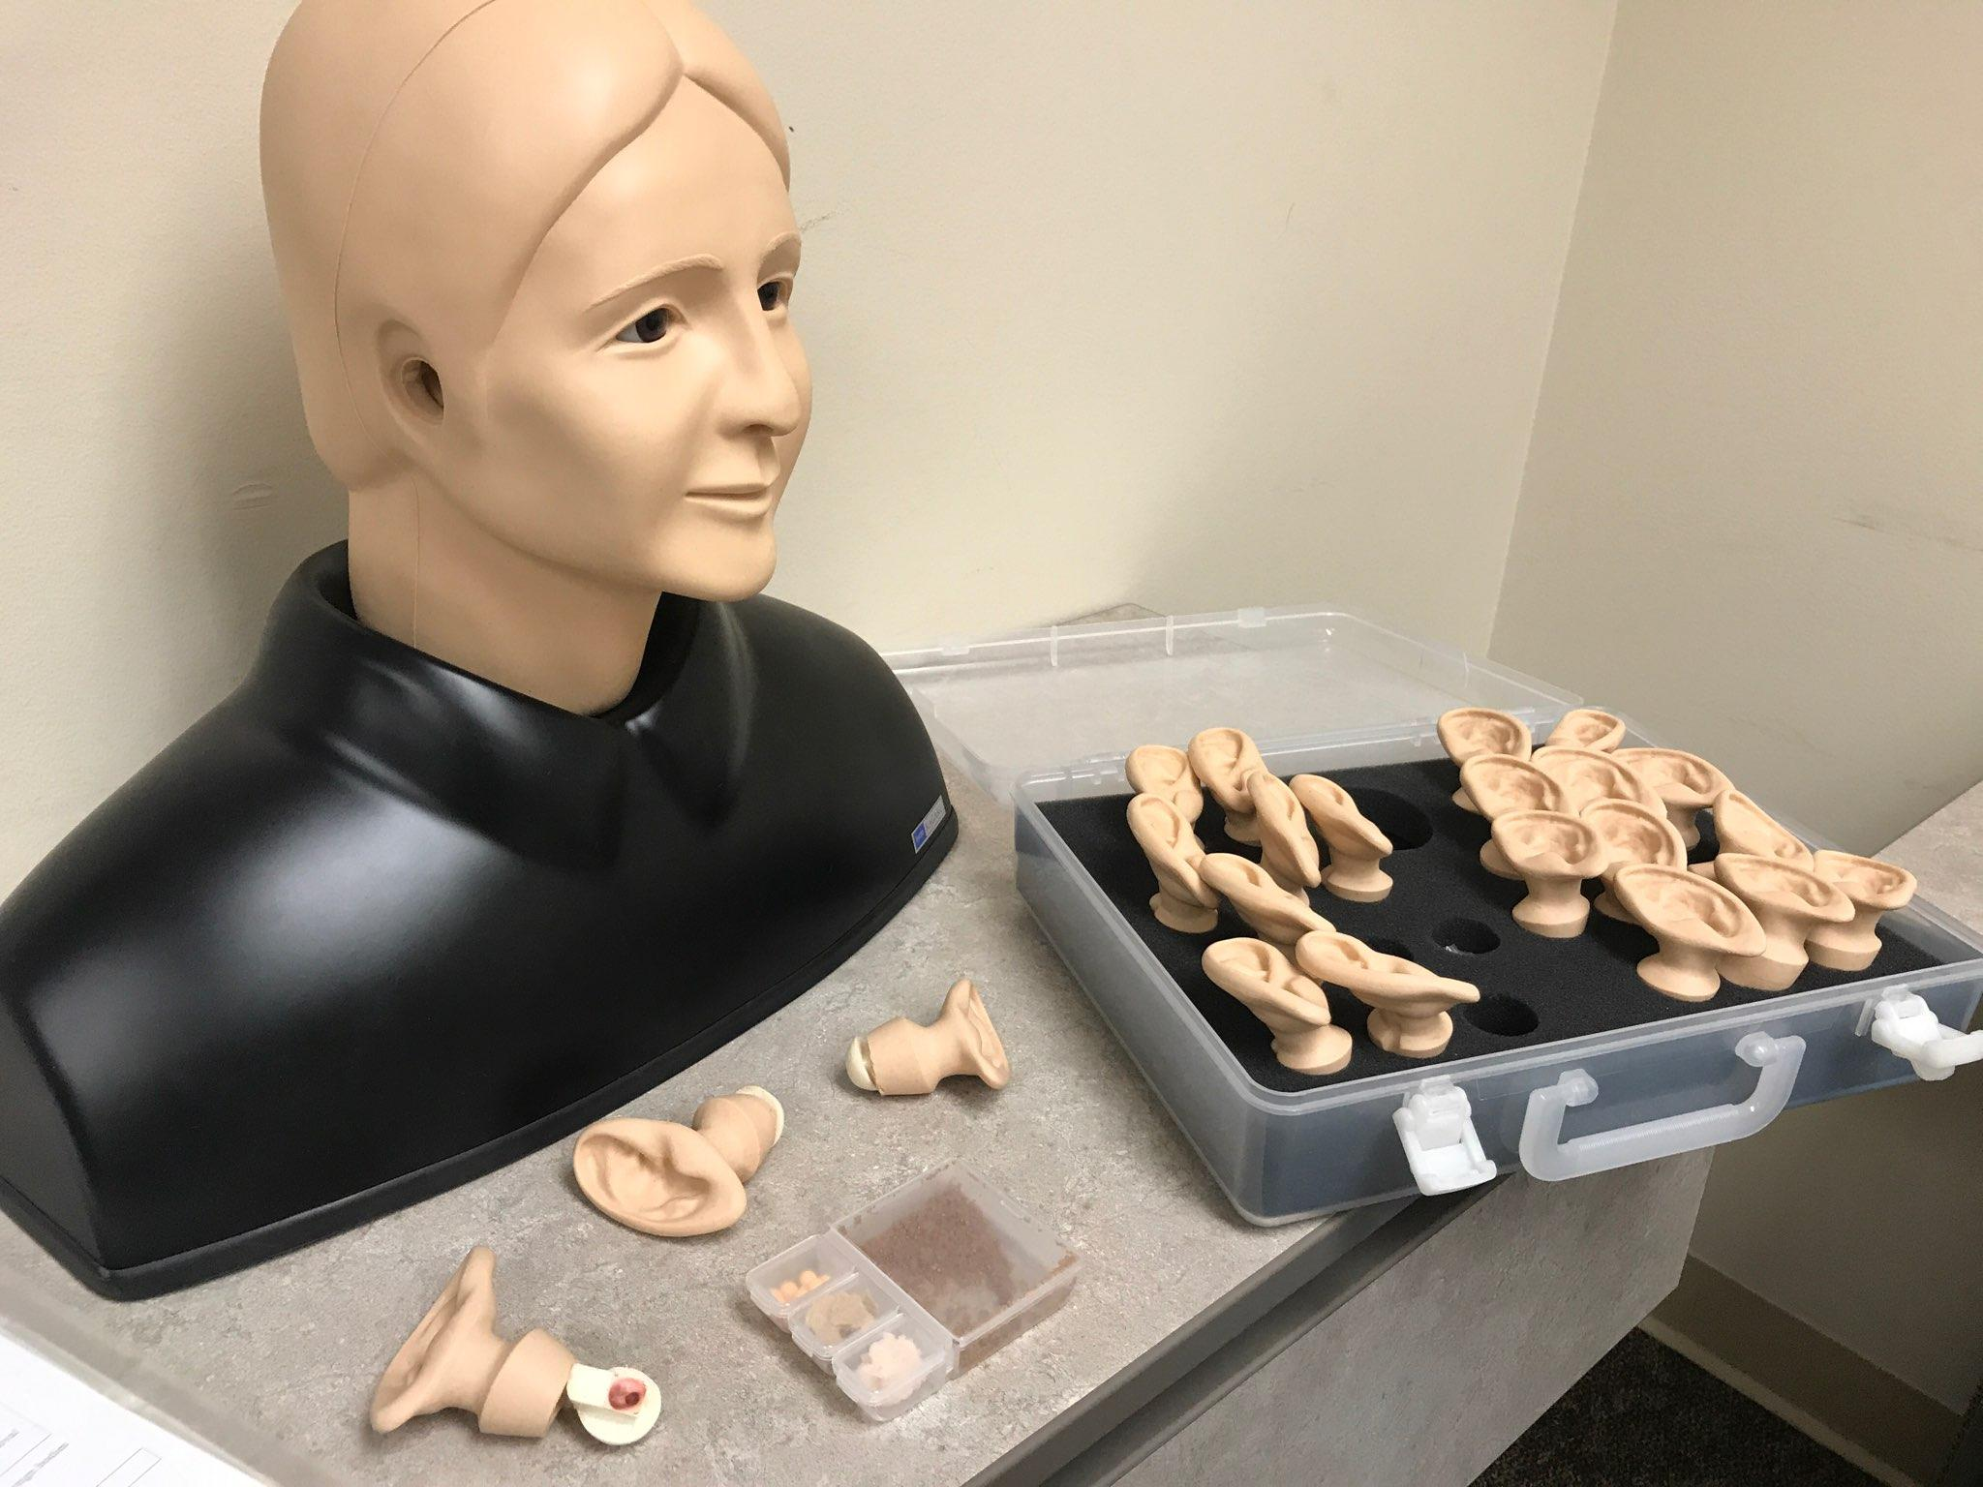
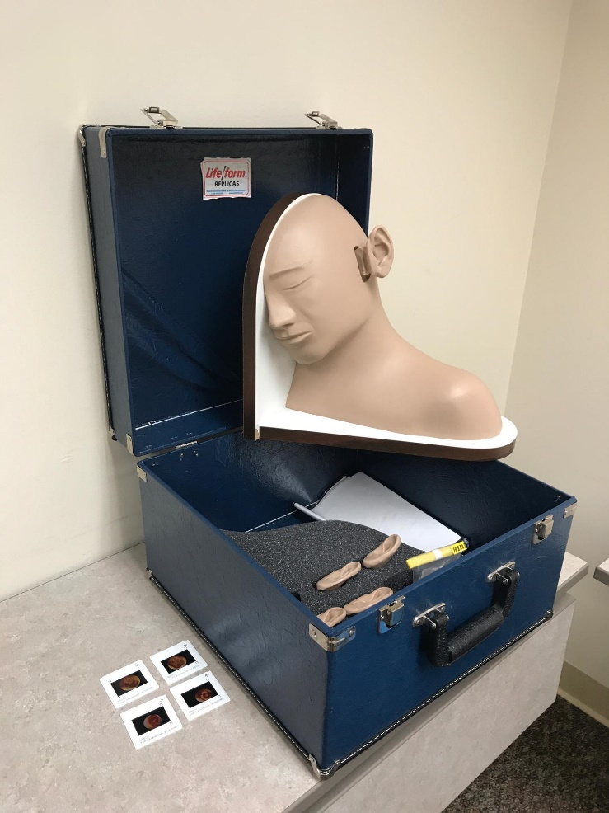
HEENT Module -- Simulators
Ear Exam Sim, Kyoto Kagaku 663
Ear Exam Sim, Life form LF1019U

Slide 18
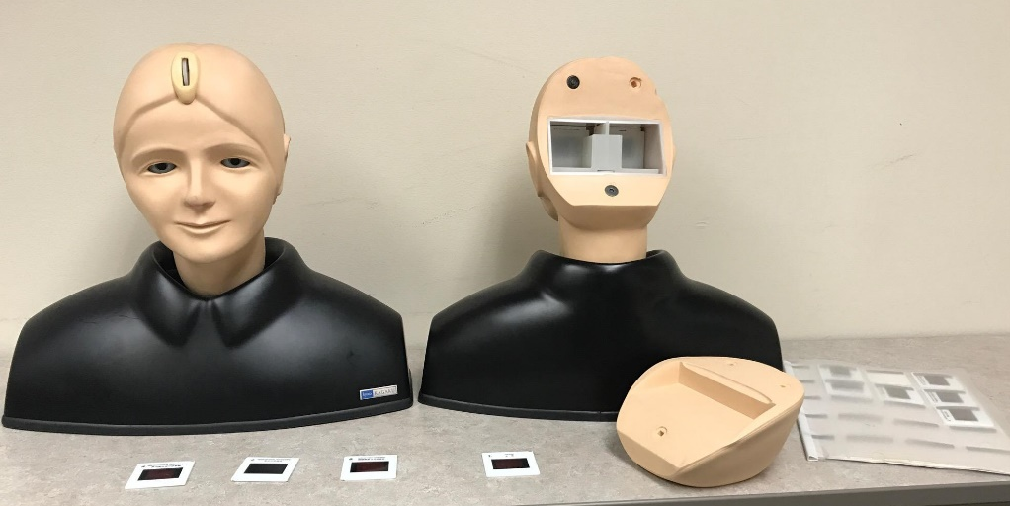
Ophthalmology Simulator
Eye Exam Sim, Kyota Kagakuzero 807762

Slide 19
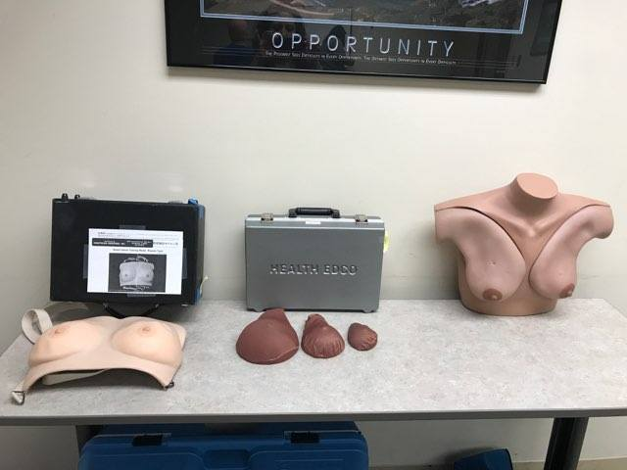
Women’s Health Module

Slide 20
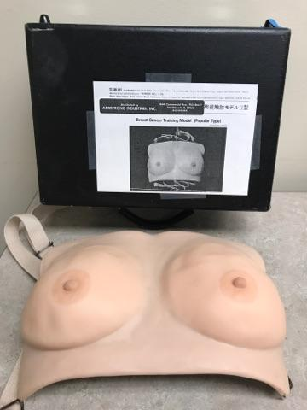
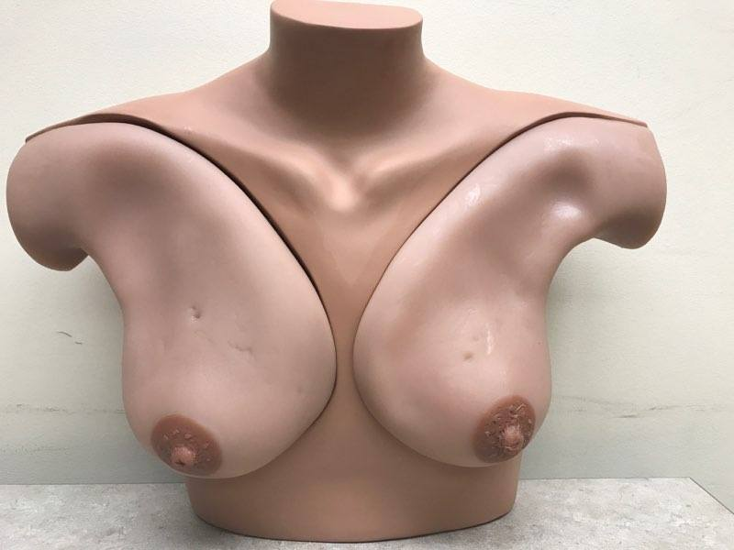
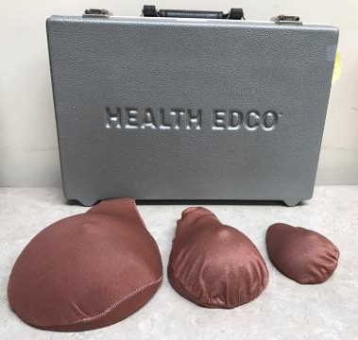
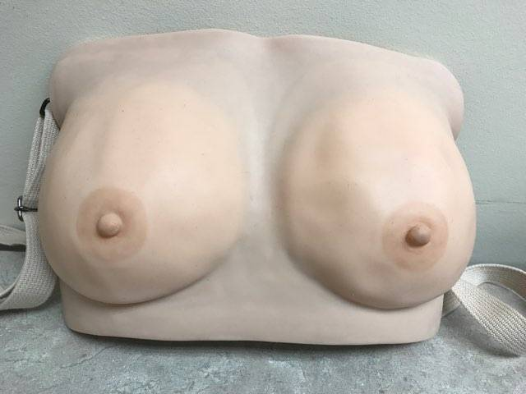
Breast/Axilla Simulators
3 Size Training Breast, Health Edco
Breast Exam Sim, Gaumard S230.42
Tanslucent BSE Model, Armstrong Industries UMD13220

Slide 21
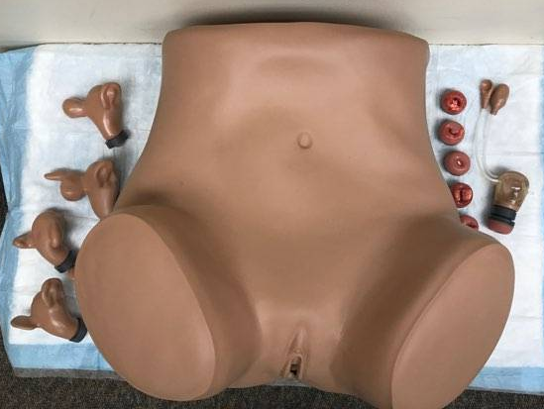
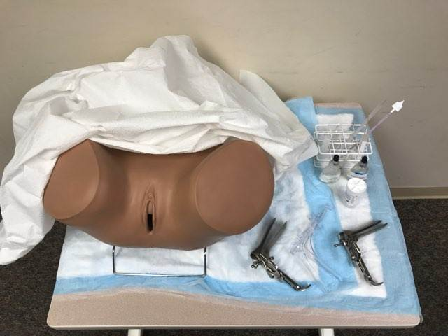
Female Pelvic Simulators
Gyn Sim (Sue), Gaumard S503

Slide 22
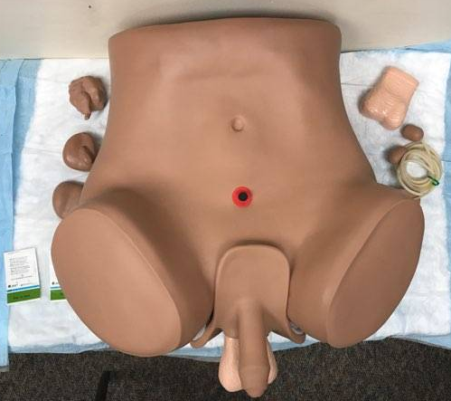
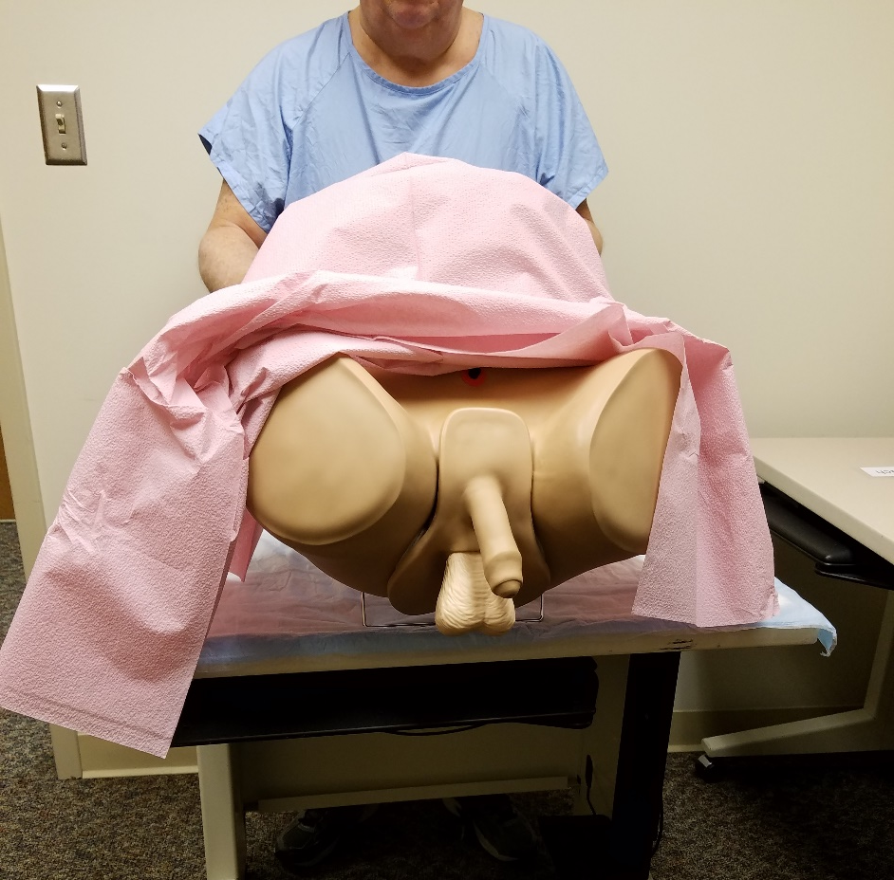
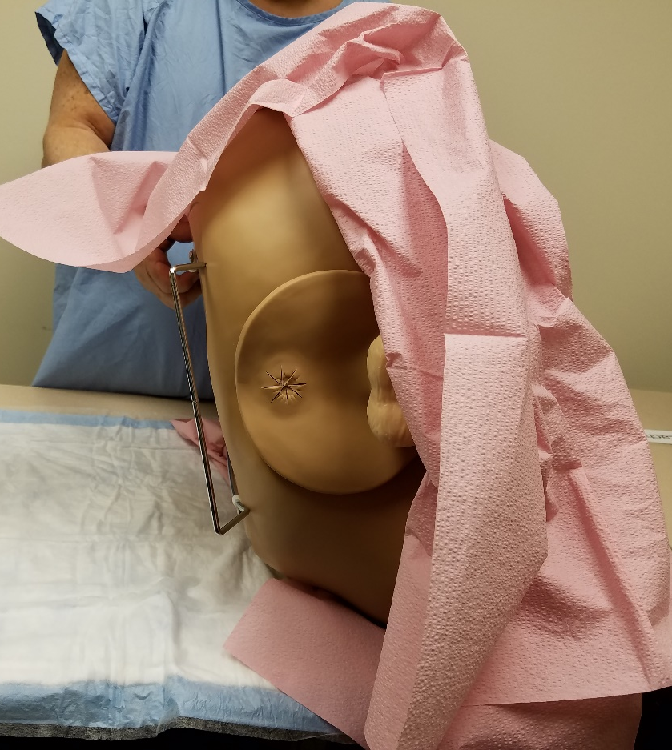
Men’s Health Module
Male Care Sim (Zack), GaumardS 230.11 ZACK

Slide 23
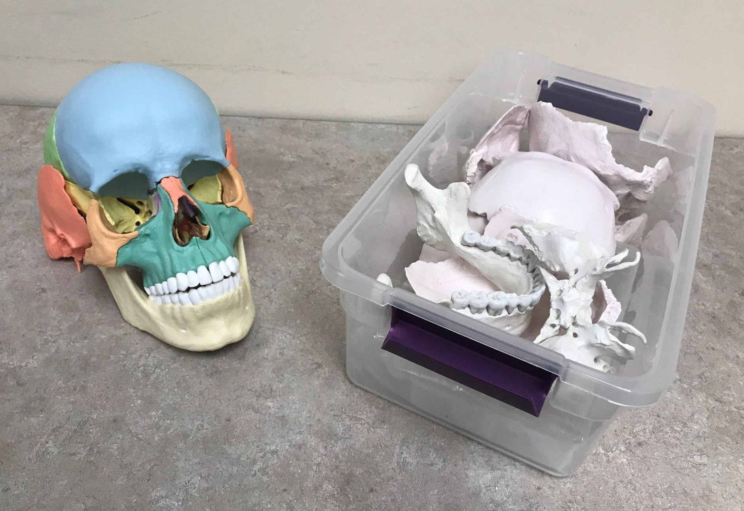
Cranial Simulators
Bone Clones (Skull), Erler Zimmer

Slide 24
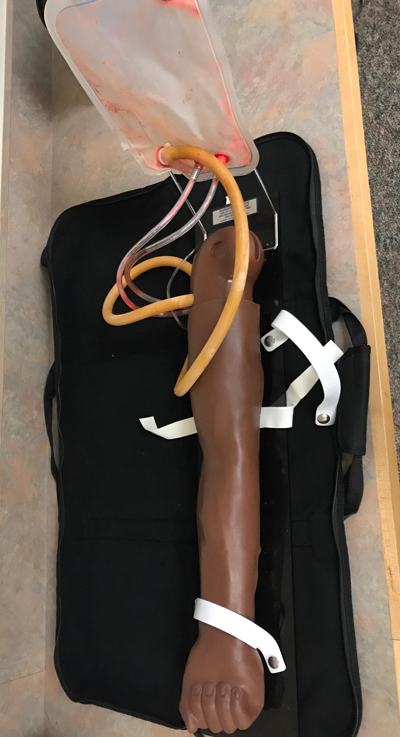
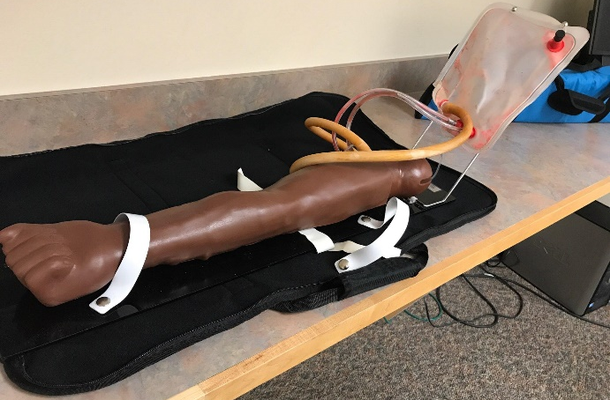
Phlebotomy Simulator
Pt Right Training Arm, Gaumard S402.100R.M

Slide 25
Simulation Lab

Slide 26
References
1. He-Ya Ren, zhi-Jing Sun, Lan Zhu, Jing-He Land, Hui Pan and Xia Wu. “A Curriculum Using Simulation Models to
Teach Gynecology and Obstetrics o Trainees”. China Medical Journal. April 20, 2017; 130(8)L 997-1000.
2. Fatimah Lateef. “Simulation based learning: Just like the real thing”. Journal of Emergency Trauma Shock.
2010 Oct-Dec; 3(4): 348-352
A special thank you to Sima Bennett, Kathy Roderique, and Jen Mangaro for their invaluable help in this endeavor.

