Slide 1
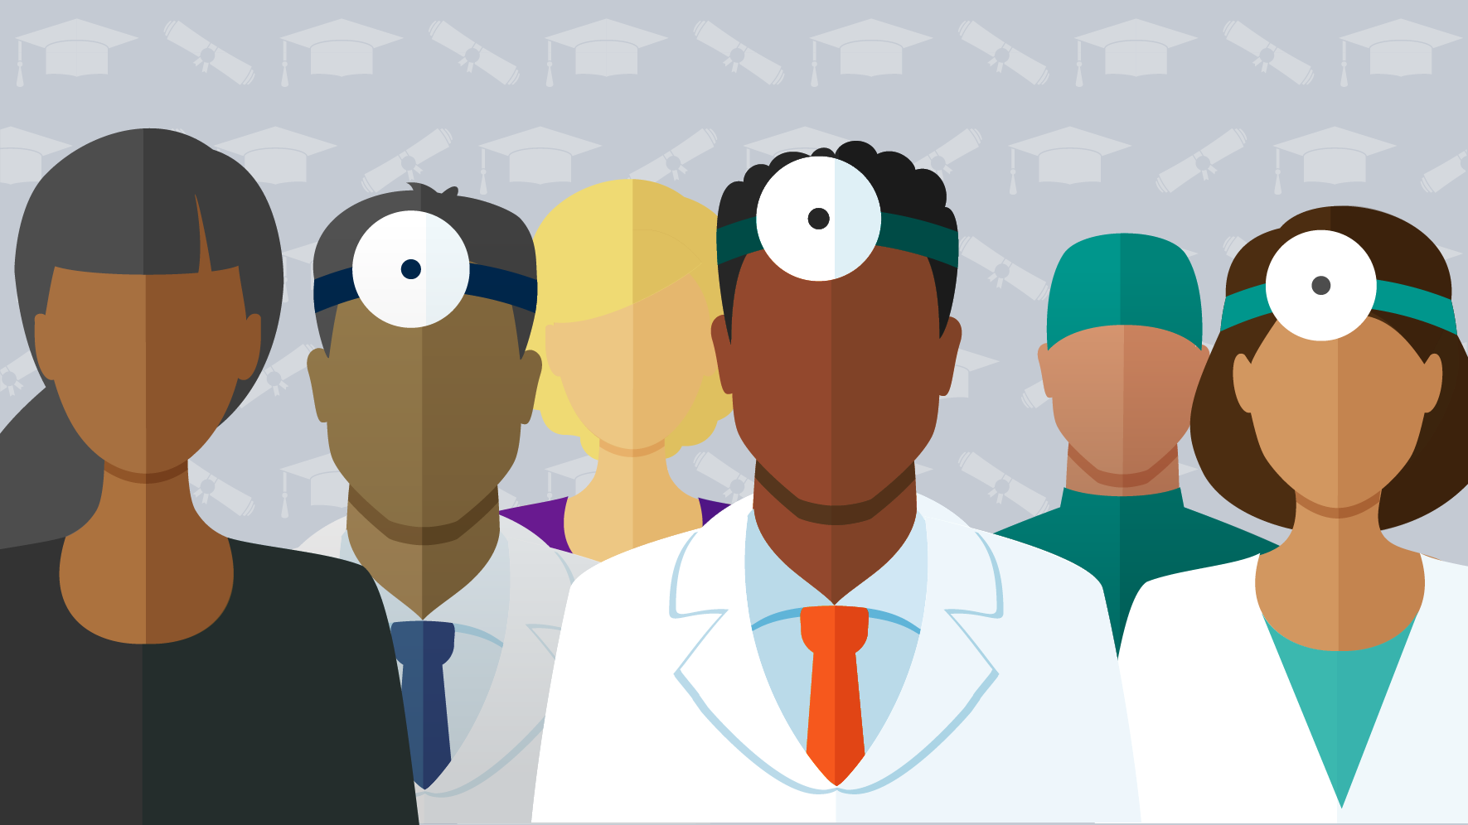
In Health Professions
Diversity and Bias
Dr. Christina Johnson
Dr. Judith Washington
Susan Gross
Notes:
OBJECTIVES: Upon completion of the program, attendees should be able to:
Discern how health equity can be affected by the lack of diversity in the physician workforce
Recognize obstacles faced by underrepresented in clinical medicine, medical education and attending physicians and faculty
Express how lack of diversity in physician workforce impacts health care disparities
Identify ways to decrease these disparities by implementing curriculum in social justice, advocacy and community engagement in medical education
Images:
https://www.credibly.com/wp-content/uploads/2013/03/physicians.jpg
https://www.newswise.com/images/uploads/2016/10/20/UMH_L_PreMed-022x.png
https://www.ama-assn.org/sites/ama-assn.org/files/styles/article_stub_800_x_600/public/wire/Media%20Root/2018-03-07-index-COACHDIVERSITY.jpg?itok=Qi37cirQ
https://media.gettyimages.com/vectors/flat-design-diverse-medical-professionals-themed-icon-with-shadow-vector-id1011636970

Slide 2
Objectives
Discern how health equity can be affected by the lack of diversity in the physician workforce.
Recognize obstacles faced by underrepresented in clinical medicine, medical education and attending physicians and faculty.
Express how lack of diversity in physician workforce impacts health care disparities.
Identify ways to decrease these disparities by implementing curriculum in social justice, advocacy and community engagement in medical education

Slide 3
The Contract
Listen with respect
Be honest
Push your growing edge
Judgement-free zone
Participate
No quick fix
Disconnect from technology (for the most part…)

Slide 4
Pre-Survey Thank you for completing this survey.
Your results are anonymous and will help us to evaluate and improve future lectures, workshops and research.
Notes:
https://www.surveymonkey.com/r/HX3J72X

Slide 5
Why?
Be present.
Be engaged.
Be a little uncomfortable…

Slide 6
Close your eyes…
Imagine your journey from your home to the hospital - from the time you woke up until the time you arrived in this room.
What did you do?
What devices or technologies did you encounter?

Slide 7
Your ride to work
5000 BC
1992
Bed
Alarm clock
Hygiene
Check schedule
Ate breakfast
Gas in car
Drive to work
1850
Bed springs
1780
Alarm clock
5000 BC
Toothpaste
1830
Indoor plumbing
1992
Smartphone
1400
Coffee
1870
Combustion engine
1950
Interstate Highway

Slide 8
The Point:
You did not likely create of much of what you encounter on a daily basis.
The systems used to manufacture, distribute and sell those items were here before you were born.

Slide 9
U.S. History
1600 | 1700 | 1800 | 1900 | 2000
Medical School History
Upenn
1765
AAMC
1876
AAFP
1969
Native American Displacement, Denial of Citizenship, Civil Rights
Latino American Displacement, Denial of Citizenship, Civil Rights
Jim Crow
War on Drugs
Black Lives Matter
Slavery
Civil Rights
Gender/Pay Inequality
1920
19thAmendment
1965
Voting Rights
Asians
Native Americans
African-Americans
Inequality of Voting Rights
Women
LGBTQI Rights
Historic inequalities are a part of American history.
They affect opportunities in pay, housing, education, voting rights, immigration, citizenship, military service, home ownership and health care.
Notes:
These things are baked into the framework of this country and they affect people in this country every day. This is why saying ‘this no longer exists’ is not true.
Latino American civil rights timeline: http://www.pbs.org/latino-americans/en/timeline/
In 1965 the Voting Rights Act (VRA) put an end to individual states' claims on whether or not Natives were allowed to vote through a federal law. Section 2 of the VRA states that, "No voting qualification or prerequisite to voting, or standard, practice, or procedure, shall be imposed or applied by any State or political subdivision to deny or abridge the right of any citizen of the United States to vote on account of race or color".^{[60]}
https://i.pinimg.com/originals/74/15/18/741518857d75ef133a7dbbca426a2f46.jpg - colorful timeline
https://cdn-images-1.medium.com/max/1600/1*JqNDSUG4uRiz3vWT4MXuYA.jpeg – white supremacy timeline
\https://glc.yale.edu/acceptance-America - The Gilder Lehrman Center for the Study of Slavery, Resistance, and Abolition

Slide 10
Definitions

Slide 11
Definition #1: URM
Underrepresented in medicine means those ethnic populations that are underrepresented in the medical profession relative to their numbers in the general population. ​

Slide 12
URM and Medical School Diversity
U.S. Population 2017
U.S. Medical School Population 2017
African American, Hispanic, or American Indian and Pacific Islander students collectively make up only ~25% of all medical school students while representing almost 33% of the national population.
AAMC 2018, US Census 2017
Notes:
Matriculants: White (51.2, Native Hawaiian 0.1, Hispanic 6/4, AA 6.5, Asian 19.8, Am Ind 0.3, - White/Asian= 71%, Others combined = 13.3

Slide 13
URM and Medical School Admissions
Average MCAT Score for Applicants and Matriculants | 505.6
American Indian or Alaska Native | 498.6
Asian | 507.9
Black or African American | 497.1
Hispanic or Latino | 499.9
Native Hawaiian or Pacific Islander | 502.8
White | 507.1
Multiple Ethnicity | 504.4
Matriculants to medical school have similar test scores.
AAMC 2018
Notes:
Differences in averages reflect approximately < 10 questions.
https://students-residents.aamc.org/applying-medical-school/article/how-new-mcat-exam-scored/
Reddit: https://www.reddit.com/r/Mcat/comments/4impgc/help_us_determine_the_scoring_scale_for_the_aamc/
Physical Sciences Out of 59 questions
126: 39-42, 127: 43-46, 128: 47-49
129: 50-52
130: 53-55
131: 56-57
132: 58-59
CARs: Out of 53
122: 27-28
123: 30-31
124: 33-35
125: 36-38
126: 39-40
127: 41-42
128: 43-45
129: 46
130: 47-48
131: 49
132: 50-52
BIO
125: Up to 40
126: 41-43
127: 44-46
128: 47-49
129: 50-51
130: 52-54
131: 55-56
132: 57-59
Psych/Soc
124: 35-38/39
125: 40-41
126: 42-44
127: 45-48
128: 49-50
129: 51-53
130: 54-55
131: 56
132: 57-59

Slide 14
Medical School Diversity
Black or African American applicants have lower medical school acceptance rates than peer applicants.
AAMC 2018

Slide 15
URM and Medical School Admissions
Asians, Hispanics and African-Americans are accepted at similar rates regardless of the number of applicants.
AAMC 2018

Slide 16
URM and Medical School Graduates
Hispanic or Latino graduates show a notable gap between 2011 matriculants (8.5%) and 2015 graduates (4.6%).
Notes:
Percentages of medical school graduates by race and ethnicity have remained consistent over time. Whites (58.8%) and Asians (19.8%) continue to represent the largest proportion of medical school graduates, with the two groups composing more than three-quarters of medical students graduating in 2015. Also for 2015, Whites make up 47.8% of applicants and 51.2% of matriculants and remain the majority of graduates. The 2015 medical school graduates comprise 5.7% Black or African Americans and 4.6% Hispanic or Latinos.

Slide 17
URM and Medical School Diversity
African American, Hispanic, or American Indian and Pacific Islander faculty members collectively make up only 9% of academic medicine while representing almost 33% of the national population.
AAMC 2018
Notes:
Currently, 39% of full-time faculty are female; however, female faculty from some racial and ethnic minority groups continue to be underrepresented in academic medicine. Only 4% of full-time faculty identify as Black or African American, Latino or Hispanic, Native American or Alaska Native, or Native Hawaiian or Pacific Islander females. This stark racial and ethnic disparity among full-time faculty is mirrored at the department chair level, with women of color representing only 3% of department chairs in academic medicine.³

Slide 18
URM and Medical School Diversity
Only 4% of full-time faculty identify as Black or African American, Latino or Hispanic, Native American or Alaska Native, or Native Hawaiian or Pacific Islander females.
AAMC 2018
Notes:
Currently, 39% of full-time faculty are female; however, female faculty from some racial and ethnic minority groups continue to be underrepresented in academic medicine. Only 4% of full-time faculty identify as Black or African American, Latino or Hispanic, Native American or Alaska Native, or Native Hawaiian or Pacific Islander females. This stark racial and ethnic disparity among full-time faculty is mirrored at the department chair level, with women of color representing only 3% of department chairs in academic medicine.³

Slide 19
URM and Medical School Diversity
Income > $100,000 (%)
American Indian or Alaska Native | 51.8
Asian | 64.4
Black or African American | 40.3
Hispanic or Latino | 44.6
Native Hawaiian or Pacific Islander | 55.6
White | 72.5
Medical school matriculants often come from middle and upper income families across racial and ethnic groups. Compared with their peers, Black or African American (31%), Hispanic or Latino (29%), and Asian (16%) matriculants are more likely to have parents with a combined gross income under $50,000.
AAMC 2018
Notes:
In 2015, medical school matriculants often come from middle and upper income families across racial and ethnic groups. More than 70% of White, 60% of Asian, and 50% American Indian or Alaska Native and Native Hawaiian or Other Pacific Islander matriculants have a parents whose combined gross income over $100,000. Hispanic or Latino and Black or African American matriculants, at more than 40%, report a parental combined gross income over $100,000. Compared with their peers, Black or African American (31%), Hispanic or Latino (29%), and Asian (16%) matriculants are more likely to have parents with a combined gross income under $50,000.

Slide 20
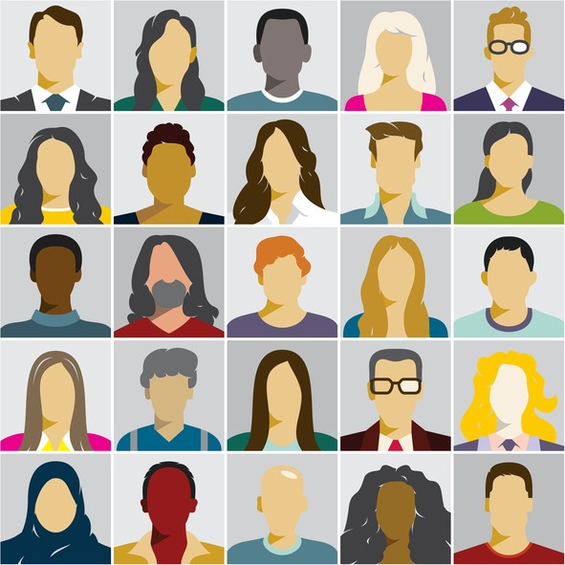
What Fewer URM in Medical Education Means for You
Fewer economically diverse colleagues.
Fewer URM colleagues.
Fewer URM faculty.
Less exposure to diversity in your professional life.
AAMC 2018
Notes:
Currently, 39% of full-time faculty are female; however, female faculty from some racial and ethnic minority groups continue to be underrepresented in academic medicine. Only 4% of full-time faculty identify as Black or African American, Latino or Hispanic, Native American or Alaska Native, or Native Hawaiian or Pacific Islander females. This stark racial and ethnic disparity among full-time faculty is mirrored at the department chair level, with women of color representing only 3% of department chairs in academic medicine.
Image: https://www.insidehighered.com/sites/default/server_files/styles/large/public/media/iStock-641115106.jpg?itok=MH9eXCjW

Slide 21
Definition #2 Health Equity
Center for Prevention MN 2018
Notes:
https://www.youtube.com/watch?v=tZd4no4gZnc
Health Equity:
Health Equity is “attainment of the highest level of health for all people. Achieving health equity requires valuing everyone equally with focused and ongoing societal efforts to address avoidable inequalities, historical and contemporary injustices, and the elimination of health and health care disparities.” – National Partnership for Action to End Health Disparities. U.S. Department of Health and Human Services.
www.hhs.gov. http://www.minorityhealth.hhs.gov/npa/templates/browse.aspx?lvl=1&lvlid=34

Slide 22
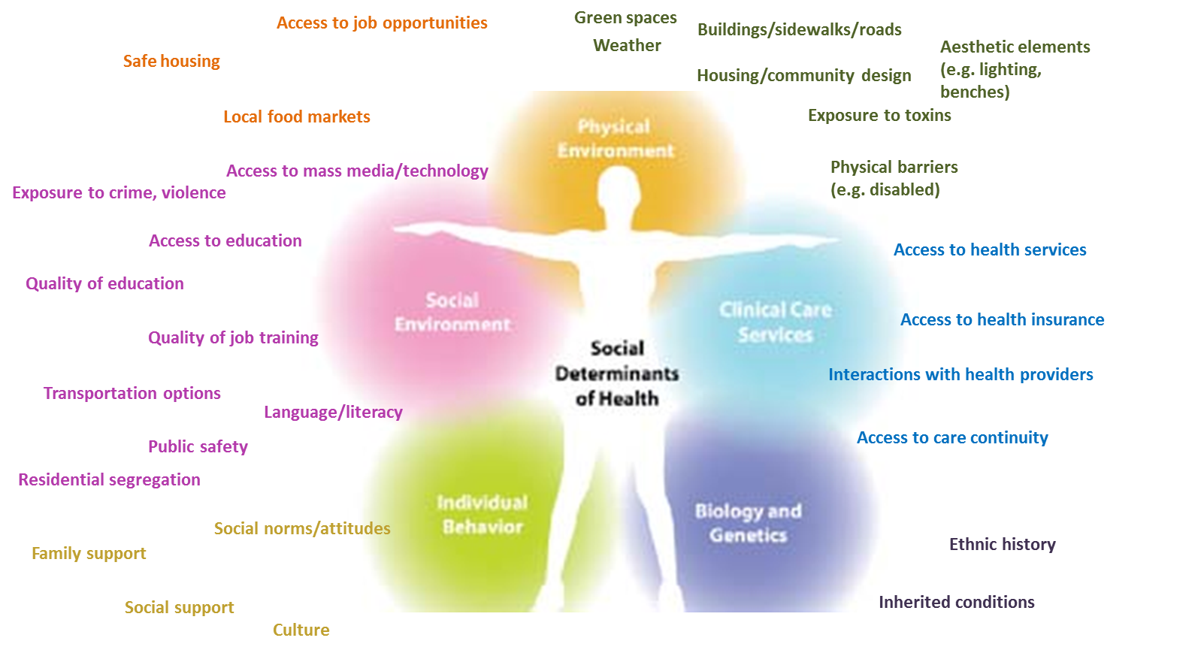
Factors that Influence Health Equity
Our job is to offer the same quality of care to all patients, eliminate biased behavior towards patients, and encourage participatory decision making.
Notes:
Next: Physician – patient concordance (http://www.annfammed.org/content/6/3/198.full) and health care disparities
Cultural competency and health outcomes

Slide 23
Factors that Influence Health Equity: Stereotype and Bias
Stereotype | Bias
Preconceived idea | Personal preference
Example: Women are accommodating and emotional; men are self-confident and aggressive. | Example: Preferring a male leader to a female leader.
Most of us hold and are influenced by biases and stereotypes.
Notes:
Think of stereotypes and labels and beliefs.
Biases are preference and beliefs.
Stereotypes are sometimes more often recognized than biases.
Our job is to offer the same quality of care to all patients, eliminate biased behavior towards patients, and encourage participatory decision making.
Health Disparities:
A health disparity is “a particular type of health difference that is closely linked with social, economic, and/or environmental disadvantage. Health disparities adversely affect groups of people who have systematically experienced greater obstacles to health based on their racial or ethnic group; religion; socioeconomic status; gender; age; mental health; cognitive, sensory, or physical disability; sexual orientation or gender identity; geographic location; or other characteristics historically linked to discrimination or exclusion.” – National Partnership for Action to End Health Disparities. U.S. Department of Health and Human Services.
www.hhs.gov. http://www.minorityhealth.hhs.gov/npa/templates/browse.aspx?lvl=1&lvlid=34
Healthcare Disparities:
Health care disparities are “racial or ethnic differences in the quality of health care that are not due to access-related factors or clinical needs, preferences, and appropriateness of intervention.” — Smedley, BD, Stith AY, Nelson AR. Institute of Medicine. Committee on Understanding and Eliminating Racial and Ethnic Disparities in Health Care, Board on Health Policy, Institute of Medicine. Washington, DC: National Academy Press; 2002. Unequal Treatment: Confronting Racial and Ethnic Disparities in Health Care.

Slide 24
Explicit Bias vs. Implicit Bias
Explicit Bias | Implicit Bias
Expressed directly | Expressed indirectly
Aware of bias | Unaware of bias
Operates consciously | Operates subconsciously
Example: “I like Whites more than Latinos” | Example: One sits further away from a Latino than a White individual.
You may be impacted by bias whether or not it is conscious or unconscious.
Notes:
Unconscious (or unrecognized).
Example of explicit bias: Those patients on opioids are all drug addicts and manipulative. Perhaps you prefer English-speaking patients.
Bias is culturally rooted, and generally directed at value and belief systems different from our own. Bias falls into the realm of the unconscious when it transcends our moment-to-moment perception and awareness. the impact of bias may not be different whether it is conscious or unconscious. Both can create inequities in opportunity and treatment, and also very poor decision-making (cook ross)

Slide 25
Evidence

Slide 26
Implicit Bias Affects Healthcare
Physicians harbor the same biases as the general population.
Am J Public Health. 2015 December; 105(12): e60–e76; BMC Med Ethics. 2017; 18: 19
Biases contribute to poor visit communication and poor ratings of care.
Am J Public Health. 2012;102:979–987; Ann Intern Med. 2003;139:907-915; Ann Fam Med 2013;11:43-52
Adversely affect promotion, publication and grant attainment.
Ginther DK, et al. Science. 2011; 333:1015.
Contributes to health disparities.
Institute of Medicine 2002; JAMA. 2005;294:473-481
Notes:
https://www.youtube.com/watch?v=ze7Fff2YKfM

Slide 27
Implicit Bias Affects Healthcare
https://www.youtube.com/watch?v=ze7Fff2YKfM
Notes:
Int J Health Serv. 2011;41(2):231-8.
Estimating the economic burden of racial health inequalities in the United States.
LaVeist TA¹, Gaskin D, Richard P.

Slide 28
Implicit Bias Affects Healthcare
Samuel Cartright, M.D. Report on the diseases and physical peculiarities of the Negro race.
De Bow's Review. Southern and Western States
Volume XI, New Orleans, 1851
AMS Press, Inc. New York, 1967
Biases in patient care are often rooted in historical stereotypes.
Notes:
https://www.youtube.com/watch?v=ze7Fff2YKfM
Cartwright is best known as the inventor of the 'mental illness' of drapetomania, the desire of a slave for freedom, and an outspoken critic of germ theory.

Slide 29
Implicit Bias Affects Healthcare
Samuel Cartright, M.D. Report on the diseases and physical peculiarities of the Negro race.
De Bow's Review. Southern and Western States
Volume XI, New Orleans, 1851
AMS Press, Inc. New York, 1967
Biases in patient care are often rooted in historical stereotypes.
Notes:
https://www.youtube.com/watch?v=ze7Fff2YKfM
Cartwright is best known as the inventor of the 'mental illness' of drapetomania, the desire of a slave for freedom, and an outspoken critic of germ theory.

Slide 30
Implicit Bias Affects Healthcare
‘This review reveals the persistence of racial and ethnic disparities in acute, chronic, cancer, and palliative pain care across the lifespan and treatment settings, with minorities receiving lesser quality pain care than non-Hispanic whites.’
Biases in patient care are often rooted in historical stereotypes.
Notes:
This review reveals the persistence of racial and ethnic disparities in acute, chronic, cancer, and palliative pain care across the lifespan and treatment settings, with minorities receiving lesser quality pain care than non-Hispanic whites.

Slide 31
Implicit Bias Affects Healthcare
‘A substantial number of white laypeople and medical students and residents hold false beliefs about biological differences between blacks and whites and demonstrates that these beliefs predict racial bias in pain perception and treatment recommendation accuracy. It also provides the first evidence that racial bias in pain perception is associated with racial bias in pain treatment recommendations.’
Biases in patient care are often rooted in historical stereotypes.
Notes:
https://www.youtube.com/watch?v=ze7Fff2YKfM
Blacks have thicker skin, blacks have stronger immune systems.

Slide 32
Implicit Bias Affects Healthcare
Physicians harbor the same biases as the general population.
BMC Med Ethics. 2017 Mar 1;1891):19
Biases contribute to poor visit communication and poor ratings of care.
Am J Public Health. 2012;102:979–987; Ann Intern Med. 2003;139:907-915; Ann Fam Med 2013;11:43-52
Adversely affect promotion, publication and grant attainment.
Ginther DK, et al. Science. 2011; 333:1015.
Contributes to health disparities.
Institute of Medicine 2002; JAMA. 2005;294:473-481
Notes:
https://www.youtube.com/watch?v=ze7Fff2YKfM

Slide 33
Implicit Bias Affects Professional Interactions
Academic Medicine: May 2003 - Volume 78 - Issue 5 - p 500-508
Biases influence differences in faculty salaries, ranks, tracks, leadership positions, resources, and perceptions of academic climate…
Notes:
https://journals.lww.com/academicmedicine/Fulltext/2003/05000/Gender_Differences_in_Academic_Advancement_.15.aspx
A total of 198 faculty members completed the questionnaire. The data showed significant gender differences in faculty salaries, ranks, tracks, leadership positions, resources, and perceptions of academic climate. On average, women earned $12,777 or 11% less than men, after adjusting for rank, track, degree, specialty, years in rank, and administrative positions (p < .0003). Of female faculty, 62% were assistant professors (49% of women were non–tenure-eligible assistant professors), while 55% of male faculty were promoted and tenured. Almost a third of women reported being discriminated against, compared with only 5% of men (p < .00001).

Slide 34
Biases influence hiring, performance evaluations, promotion, perception of leadership ability, perception of skills, perception of communication…
Unconscious Bias in Faculty and Leadership Recruitment: A Literature Review
AAMC Analysis in Brief, Volume 9, Number 2, August 2009
https://www.aamc.org/media/5826/download
Notes:
https://link.springer.com/article/10.1023/A:1018839203698

Slide 35
…Letters of recommendation, review of grant applications, applicant selection, and job opportunities.
Unconscious Bias in Faculty and Leadership Recruitment: A Literature Review
AAMC Analysis in Brief, Volume 9, Number 2, August 2009
https://www.aamc.org/media/5826/download
Notes:
https://www.aamc.org/media/5826/download

Slide 36
Your Biases Effect Your Medical Education
Biases influence patient interactions.
Biases influence patient outcomes.
Biases influence your interactions with your colleagues.
AAMC 2018
Notes:
Currently, 39% of full-time faculty are female; however, female faculty from some racial and ethnic minority groups continue to be underrepresented in academic medicine. Only 4% of full-time faculty identify as Black or African American, Latino or Hispanic, Native American or Alaska Native, or Native Hawaiian or Pacific Islander females. This stark racial and ethnic disparity among full-time faculty is mirrored at the department chair level, with women of color representing only 3% of department chairs in academic medicine.
Image: https://www.insidehighered.com/sites/default/server_files/styles/large/public/media/iStock-641115106.jpg?itok=MH9eXCjW

Slide 37
Stand Up
Stretch
Breathe

Slide 38
Group Work
A
A
B
B
Bring your phone!!!

Slide 39
1. Theater of the oppressed - URM medical student
Scenarios and small groups have to negotiate
E.g. – purchasing books, applying for rotations, housing, > given general income, social outings during medical school, saving money, fun travel, interesting electives
Goal: understanding issues URM face
2. Privilege Walk
OBJECTIVES:
Participants will be able to:
Recognize that privilege is unearned
Recognize the diversity present within the group
Explain different types of privilege
Recognize the importance of not making assumptions
Recognize the value of diversity
3. Advocacy – Identifying Bias
Each person responds to when they felt bias, what they did, how it affected them
Skit with biased behavior
Goals: explore how biases impact your education/medical school experience, learn to acknowledge your biases
Notes:
A, A – B, B

Slide 40
Recognition

Slide 41
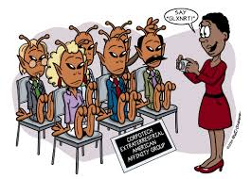
Implicit Bias and Common Interactions
Affinity
Preference for people who share qualities with you or someone you like
Wow – this person does everything I do…we should pick them!
https://lh3.googleusercontent.com/proxy/5KOKoo1IreZgIdQQqvrRWEgULbaSF8sCSqYT0rgaCkNngAhE6hjrfMeVPhTvXlchVeh0LBWangK-rgPuOCybNJ8fDtEuwMlxQzLCgjEuAQIBjBK3-4QLICox
Notes:
Patients may be at greater risk of exposure to implicit bias due to their age, body habitus, color, disability, economic status, gender identity, immigration status, mental health, nationality, race/ethnicity, religion, or sexual orientation.
Affinity – Preference for people who share qualities with you or someone you like
Anchoring – Tendency to rely too heavily on the first piece of information offered when you are making decisions
Attribution – Tendency to attribute other people’s successes to luck or help from others and attribute their failures to lack of skill or personal shortcomings
Beauty – Assumptions about people’s skills or personality based on their physical appearance and tendency to favor people who are more attractive
Confirmation – Selective focus on information that supports your initial opinion(s)
Conformity – Tendency to be swayed too much by the views of other people
Contrast – Assessment of two or more similar things by comparing them with one another rather than looking at their individual merits
Gender – Preference for one gender over the other
Halo – Focus on one particularly positive feature about a person that clouds your judgement
Horns – Focus on one particularly negative feature about a person that clouds your judgement

Slide 42
Implicit Bias and Common Interactions
Anchoring
Tendency to rely to heavily on the first piece of information offered when you are making decisions.
‘The candidate is qualified but is older …’
https://thumbs.dreamstime.com/z/recruitment-ageism-concept-unfairness-employment-problem-seniors-human-resources-department-hire-people-under-isolated-172105959.jpg
Notes:
Patients may be at greater risk of exposure to implicit bias due to their age, body habitus, color, disability, economic status, gender identity, immigration status, mental health, nationality, race/ethnicity, religion, or sexual orientation.
Affinity – Preference for people who share qualities with you or someone you like
Anchoring – Tendency to rely too heavily on the first piece of information offered when you are making decisions
Attribution – Tendency to attribute other people’s successes to luck or help from others and attribute their failures to lack of skill or personal shortcomings
Beauty – Assumptions about people’s skills or personality based on their physical appearance and tendency to favor people who are more attractive
Confirmation – Selective focus on information that supports your initial opinion(s)
Conformity – Tendency to be swayed too much by the views of other people
Contrast – Assessment of two or more similar things by comparing them with one another rather than looking at their individual merits
Gender – Preference for one gender over the other
Halo – Focus on one particularly positive feature about a person that clouds your judgement
Horns – Focus on one particularly negative feature about a person that clouds your judgement

Slide 43
Implicit Bias and Common Interactions
Attribution
Tendency to attribute other people’s successes to luck or help from others and attribute their failures to lack of skill or personal shortcomings
https://www.youtube.com/watch?v=1jBAetCVYwc
Notes:
Attribution: https://www.youtube.com/watch?v=1jBAetCVYwc
Patients may be at greater risk of exposure to implicit bias due to their age, body habitus, color, disability, economic status, gender identity, immigration status, mental health, nationality, race/ethnicity, religion, or sexual orientation.
Affinity – Preference for people who share qualities with you or someone you like
Anchoring – Tendency to rely too heavily on the first piece of information offered when you are making decisions
Attribution – Tendency to attribute other people’s successes to luck or help from others and attribute their failures to lack of skill or personal shortcomings
Beauty – Assumptions about people’s skills or personality based on their physical appearance and tendency to favor people who are more attractive
Confirmation – Selective focus on information that supports your initial opinion(s)
Conformity – Tendency to be swayed too much by the views of other people
Contrast – Assessment of two or more similar things by comparing them with one another rather than looking at their individual merits
Gender – Preference for one gender over the other
Halo – Focus on one particularly positive feature about a person that clouds your judgement
Horns – Focus on one particularly negative feature about a person that clouds your judgement

Slide 44
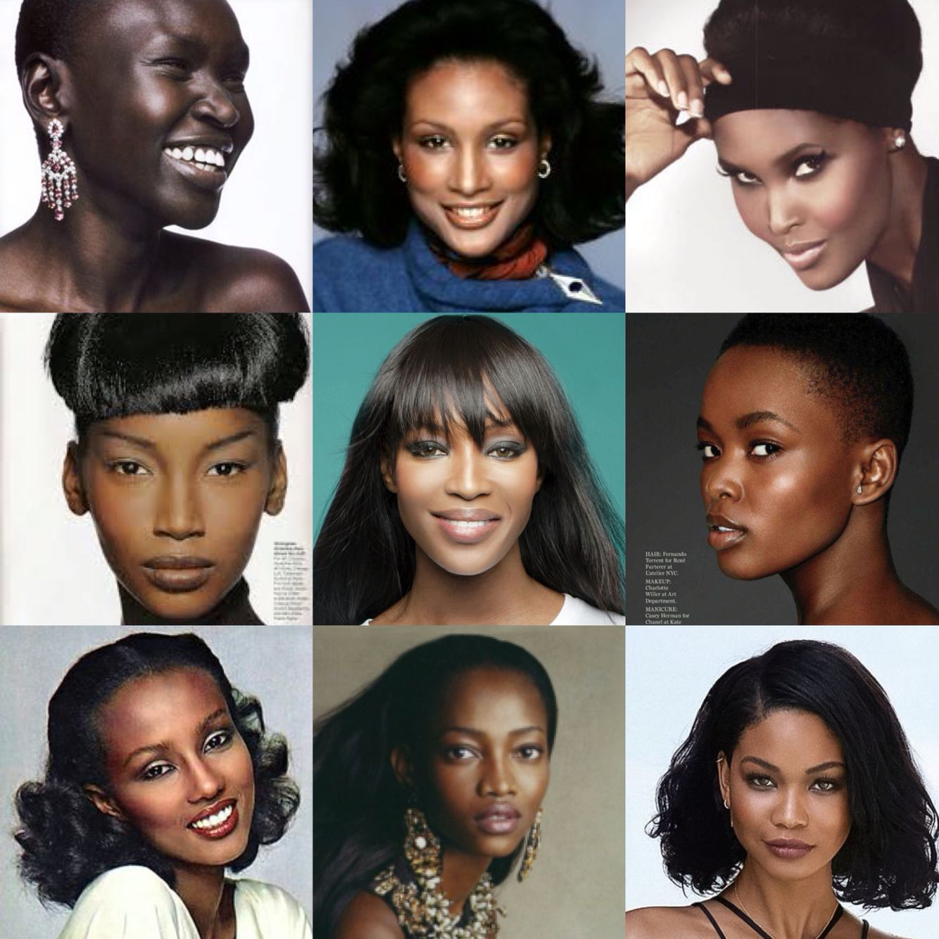
Implicit Bias and Common Interactions
Beauty
Assumptions about people’s skills or personality based on their physical appearance and tendency to favor people who are more attractive
https://i.pinimg.com/originals/0d/5e/21/0d5e213ae0e90afed203dcde94f550cc.jpg
Using photos in your review processes.
Notes:
Patients may be at greater risk of exposure to implicit bias due to their age, body habitus, color, disability, economic status, gender identity, immigration status, mental health, nationality, race/ethnicity, religion, or sexual orientation.
Affinity – Preference for people who share qualities with you or someone you like
Anchoring – Tendency to rely too heavily on the first piece of information offered when you are making decisions
Attribution – Tendency to attribute other people’s successes to luck or help from others and attribute their failures to lack of skill or personal shortcomings
Beauty – Assumptions about people’s skills or personality based on their physical appearance and tendency to favor people who are more attractive
Confirmation – Selective focus on information that supports your initial opinion(s)
Conformity – Tendency to be swayed too much by the views of other people
Contrast – Assessment of two or more similar things by comparing them with one another rather than looking at their individual merits
Gender – Preference for one gender over the other
Halo – Focus on one particularly positive feature about a person that clouds your judgement
Horns – Focus on one particularly negative feature about a person that clouds your judgement

Slide 45
Implicit Bias and Common Interactions
Confirmation
Selective focus on information that supports your initial opinion(s).
‘They came from this school so that’s why they don’t have ____’.
https://www.verywellmind.com/thmb/PNUaRIgPrRjVV7oQ7Jqaz9YQuqk=/1333x1000/smart/filters:no_upscale()/what-is-a-confirmation-bias-2795024_FINAL-7c3ed57bf47a4c7fa0cb98920fcd041c.png
Notes:
Patients may be at greater risk of exposure to implicit bias due to their age, body habitus, color, disability, economic status, gender identity, immigration status, mental health, nationality, race/ethnicity, religion, or sexual orientation.
Affinity – Preference for people who share qualities with you or someone you like
Anchoring – Tendency to rely too heavily on the first piece of information offered when you are making decisions
Attribution – Tendency to attribute other people’s successes to luck or help from others and attribute their failures to lack of skill or personal shortcomings
Beauty – Assumptions about people’s skills or personality based on their physical appearance and tendency to favor people who are more attractive
Confirmation – Selective focus on information that supports your initial opinion(s)
Conformity – Tendency to be swayed too much by the views of other people
Contrast – Assessment of two or more similar things by comparing them with one another rather than looking at their individual merits
Gender – Preference for one gender over the other
Halo – Focus on one particularly positive feature about a person that clouds your judgement
Horns – Focus on one particularly negative feature about a person that clouds your judgement

Slide 46
Implicit Bias and Common Interactions
Conformity
Tendency to be swayed too much by the views of other people
‘Everyone else seemed to like them...’
https://i.ytimg.com/vi/NyMGHZdn_W0/maxresdefault.jpg
Notes:
Patients may be at greater risk of exposure to implicit bias due to their age, body habitus, color, disability, economic status, gender identity, immigration status, mental health, nationality, race/ethnicity, religion, or sexual orientation.
Affinity – Preference for people who share qualities with you or someone you like
Anchoring – Tendency to rely too heavily on the first piece of information offered when you are making decisions
Attribution – Tendency to attribute other people’s successes to luck or help from others and attribute their failures to lack of skill or personal shortcomings
Beauty – Assumptions about people’s skills or personality based on their physical appearance and tendency to favor people who are more attractive
Confirmation – Selective focus on information that supports your initial opinion(s)
Conformity – Tendency to be swayed too much by the views of other people
Contrast – Assessment of two or more similar things by comparing them with one another rather than looking at their individual merits
Gender – Preference for one gender over the other
Halo – Focus on one particularly positive feature about a person that clouds your judgement
Horns – Focus on one particularly negative feature about a person that clouds your judgement

Slide 47
Implicit Bias and Common Interactions
Contrast
Assessment of two or more similar things by comparing them with one another rather than looking at their individual merits
https://hbr.org/resources/images/article_assets/2016/04/apr15-18-90786576-bor.jpg
Comparing employees to each other instead of to a company standard.
Doesn’t allow for individualization of strengths/merit.
Notes:
Patients may be at greater risk of exposure to implicit bias due to their age, body habitus, color, disability, economic status, gender identity, immigration status, mental health, nationality, race/ethnicity, religion, or sexual orientation.
Affinity – Preference for people who share qualities with you or someone you like
Anchoring – Tendency to rely too heavily on the first piece of information offered when you are making decisions
Attribution – Tendency to attribute other people’s successes to luck or help from others and attribute their failures to lack of skill or personal shortcomings
Beauty – Assumptions about people’s skills or personality based on their physical appearance and tendency to favor people who are more attractive
Confirmation – Selective focus on information that supports your initial opinion(s)
Conformity – Tendency to be swayed too much by the views of other people
Contrast – Assessment of two or more similar things by comparing them with one another rather than looking at their individual merits
Gender – Preference for one gender over the other
Halo – Focus on one particularly positive feature about a person that clouds your judgement
Horns – Focus on one particularly negative feature about a person that clouds your judgement

Slide 48
Implicit Bias and Common Interactions
Gender
Preference for one gender over the other
The male candidate will probably be less trouble for the office…
https://t3.ftcdn.net/jpg/02/90/20/26/360_F_290202665_TDVsNqcfhNCFBKVWATlBDylIqEHt1myK.jpg
Notes:
Patients may be at greater risk of exposure to implicit bias due to their age, body habitus, color, disability, economic status, gender identity, immigration status, mental health, nationality, race/ethnicity, religion, or sexual orientation.
Affinity – Preference for people who share qualities with you or someone you like
Anchoring – Tendency to rely too heavily on the first piece of information offered when you are making decisions
Attribution – Tendency to attribute other people’s successes to luck or help from others and attribute their failures to lack of skill or personal shortcomings
Beauty – Assumptions about people’s skills or personality based on their physical appearance and tendency to favor people who are more attractive
Confirmation – Selective focus on information that supports your initial opinion(s)
Conformity – Tendency to be swayed too much by the views of other people
Contrast – Assessment of two or more similar things by comparing them with one another rather than looking at their individual merits
Gender – Preference for one gender over the other
Halo – Focus on one particularly positive feature about a person that clouds your judgement
Horns – Focus on one particularly negative feature about a person that clouds your judgement

Slide 49
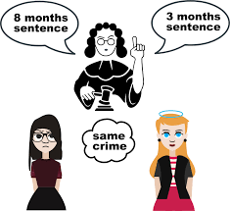
Implicit Bias and Common Interactions
Halo
Focus on one particularly positive feature about a person that clouds your judgement
https://encrypted-tbn0.gstatic.com/images?q=tbn:ANd9GcSli3ydyA_pQzgSG-8lasmtQZtwVOgAojjF0g&usqp=CAU
Notes:
Patients may be at greater risk of exposure to implicit bias due to their age, body habitus, color, disability, economic status, gender identity, immigration status, mental health, nationality, race/ethnicity, religion, or sexual orientation.
Affinity – Preference for people who share qualities with you or someone you like
Anchoring – Tendency to rely too heavily on the first piece of information offered when you are making decisions
Attribution – Tendency to attribute other people’s successes to luck or help from others and attribute their failures to lack of skill or personal shortcomings
Beauty – Assumptions about people’s skills or personality based on their physical appearance and tendency to favor people who are more attractive
Confirmation – Selective focus on information that supports your initial opinion(s)
Conformity – Tendency to be swayed too much by the views of other people
Contrast – Assessment of two or more similar things by comparing them with one another rather than looking at their individual merits
Gender – Preference for one gender over the other
Halo – Focus on one particularly positive feature about a person that clouds your judgement
Horns – Focus on one particularly negative feature about a person that clouds your judgement

Slide 50
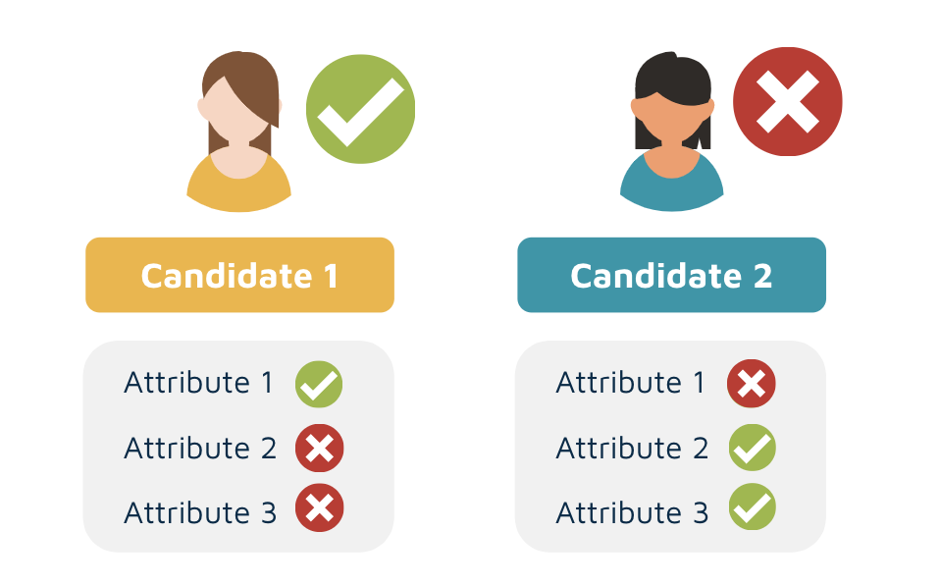
Implicit Bias and Common Interactions
Horns
Focus on one particularly negative feature about a person that clouds your judgement
https://assets-global.website-files.com/5b1e83cea247157206d50024/602266570f9e2b4c96a97401_Screenshot%202021-02-09%20at%2010.04.35.png
I didn’t like his suit…
Notes:
Patients may be at greater risk of exposure to implicit bias due to their age, body habitus, color, disability, economic status, gender identity, immigration status, mental health, nationality, race/ethnicity, religion, or sexual orientation.
Affinity – Preference for people who share qualities with you or someone you like
Anchoring – Tendency to rely too heavily on the first piece of information offered when you are making decisions
Attribution – Tendency to attribute other people’s successes to luck or help from others and attribute their failures to lack of skill or personal shortcomings
Beauty – Assumptions about people’s skills or personality based on their physical appearance and tendency to favor people who are more attractive
Confirmation – Selective focus on information that supports your initial opinion(s)
Conformity – Tendency to be swayed too much by the views of other people
Contrast – Assessment of two or more similar things by comparing them with one another rather than looking at their individual merits
Gender – Preference for one gender over the other
Halo – Focus on one particularly positive feature about a person that clouds your judgement
Horns – Focus on one particularly negative feature about a person that clouds your judgement

Slide 51
Advocacy

Slide 52
Mitigation of Implicit Bias
Riddle:
A father and son get in a car crash and are rushed to the hospital. The father dies. The boy is taken to the operating room and the surgeon says, “I can’t operate on this boy, because he’s my son.”
How is this possible?
Notes:
Patients may be at greater risk of exposure to implicit bias due to their age, body habitus, color, disability, economic status, gender identity, immigration status, mental health, nationality, race/ethnicity, religion, or sexual orientation.
Affinity – Preference for people who share qualities with you or someone you like
Anchoring – Tendency to rely too heavily on the first piece of information offered when you are making decisions
Attribution – Tendency to attribute other people’s successes to luck or help from others and attribute their failures to lack of skill or personal shortcomings
Beauty – Assumptions about people’s skills or personality based on their physical appearance and tendency to favor people who are more attractive
Confirmation – Selective focus on information that supports your initial opinion(s)
Conformity – Tendency to be swayed too much by the views of other people
Contrast – Assessment of two or more similar things by comparing them with one another rather than looking at their individual merits
Gender – Preference for one gender over the other
Halo – Focus on one particularly positive feature about a person that clouds your judgement
Horns – Focus on one particularly negative feature about a person that clouds your judgement

Slide 53
Mitigation of Implicit Bias
Riddle:
A father and son get in a car crash and are rushed to the hospital. The father dies. The boy is taken to the operating room and the surgeon says, “I can’t operate on this boy, because he’s my son.”
How is this possible?
40-75% of people can’t solve this riddle because they’re unable to imagine the surgeon is a woman. The surgeon is the boy’s mother.
Notes:
Patients may be at greater risk of exposure to implicit bias due to their age, body habitus, color, disability, economic status, gender identity, immigration status, mental health, nationality, race/ethnicity, religion, or sexual orientation.
Affinity – Preference for people who share qualities with you or someone you like
Anchoring – Tendency to rely too heavily on the first piece of information offered when you are making decisions
Attribution – Tendency to attribute other people’s successes to luck or help from others and attribute their failures to lack of skill or personal shortcomings
Beauty – Assumptions about people’s skills or personality based on their physical appearance and tendency to favor people who are more attractive
Confirmation – Selective focus on information that supports your initial opinion(s)
Conformity – Tendency to be swayed too much by the views of other people
Contrast – Assessment of two or more similar things by comparing them with one another rather than looking at their individual merits
Gender – Preference for one gender over the other
Halo – Focus on one particularly positive feature about a person that clouds your judgement
Horns – Focus on one particularly negative feature about a person that clouds your judgement

Slide 54
Mitigation of Implicit Bias
Acknowledge
Address
Advocate
Notes:
https://www.youtube.com/watch?v=ze7Fff2YKfM

Slide 55
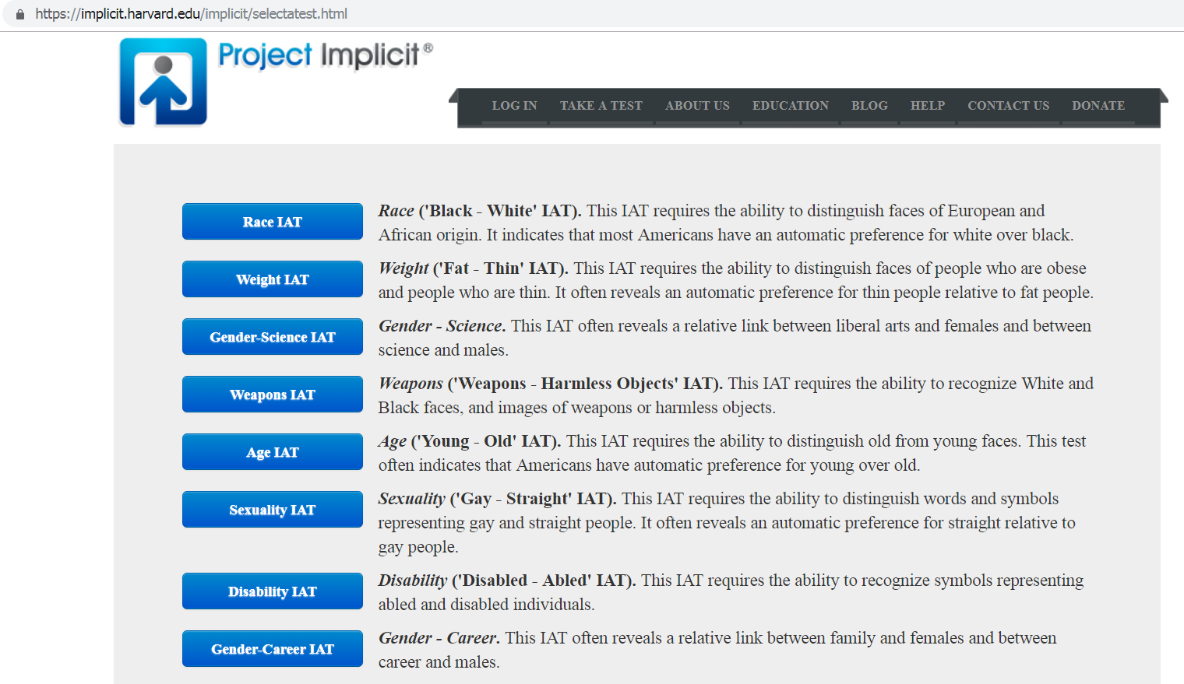
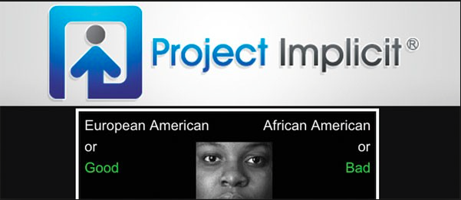
Mitigating Bias: Acknowledgement
https://implicit.harvard.edu/implicit/takeatest.html
Acknowledge areas in which you are biased.

Slide 56
Mitigating Bias: Acknowledgement
Acknowledgement Pitfalls:
Dismissing your belief as a part of your history or culture.
‘I don’t see color’. This erases what may be important to that person and reflects your privilege.
Retreating to comfort and away from uncomfortable feelings and emotions.
Acknowledge your belief and examine how it influences your behavior.
Notes:
My Culture Made Me Do It: Lay Theories of Responsibility for Automatic Prejudice Eric Luis Uhlmann HEC Paris Brian A. Nosek University of Virginia
Own the belief – acknowledge your role in acting on it. Saying ‘it’s how I grew up’ is dismissive, and removes the responsibility from you to address the belief.
Promote multicultural NOT colorblind messaging (Wilton et al., 2015). History, culture, skin color are real. Saying ‘you don’t see them’ diminishes their importance and reflects your privilege (removes you from having to acknowledge their experience).
In retreating to comfort, you allow yourself to become the subject of conversation and sympathy and deflect the discussion about race (or whatever the uncomfortable issue)

Slide 57
Mitigating: Address it Head On
Use Evidence-Based Medicine | Preference vs. What’s ‘Right’
Use Interpreter Services | Acknowledge Difference
Be Open to Feedback | Acknowledge Discomfort
Rethink ‘Normal’ | Challenge your Stereotypes
Directly confront and challenge your biases.
Notes:
Addressing is working on ways to evaluate your bias and how it influences your behaviors.
Normal ideas – what is ‘normal’ to you? Why is it normal? Does normal mean ‘right’ to you? In what ways? (This includes language, food, beliefs, habits and preferences (i.e. culture)).
To acknowledge difference, you have to be curious about what people think and believe.

Slide 58
Unpacking Bias: Address (Examples)
Are there trends in the care gaps in your practice (eg – screening, testing, vaccination)?
Are there trends in patient access (eg - ability to schedule appointments)?
How do you evaluate staff in your office?
How do you promote staff in your office?
How do you select candidates for interview?
Do you acknowledge the differences among your staff and coworkers?
Notes:
As a clinician, it is your job to provide evidence-based medicine to our patients.
Example: Have you asked your patients about HIV screening? ([N.B. – guidelines are currently under review].
If you did not ask, why? Was the patient asexual or between partners? Was the visit not related to screening? Or, were there times that you assumed you knew their status? Were you uncomfortable asking the question? Did you make an assumption that because of their sexual orientation, age, appearance, or socioeconomic status that they were at lower risk?

Slide 59
You define your medical school culture
Where are your classmates from? Do they share the same resources as you?
Can you recognize any biases that you have towards your colleagues?
Can you recognize any biases that you have towards your instructors?

Slide 60
Advocacy – Health Equity
How well do you know your patient’s culture and history? Their environment?
Can you recognize any biases that you have towards your patients?
Have any of your beliefs affected your treatment decisions?

Slide 61
Summary
Everyone harbors implicit biases.
When physicians have implicit bias, it can affect patient interactions and outcomes, and can affect professional relationships.
Each provider should recognize, challenge and mitigate implicit biases in their practice.
Notes:
Our role is not to point out to you what your biases are, but to give you tools to become aware of your own biases (acknowledge), be mindful to actively confront your biases (address), and to confront biased behavior when you see it (advocate).

Slide 62
Appendix: Definitions
White Privilege: Any advantage, opportunity, benefit, head start, or general protection from negative societal mistreatment, which persons deemed white will typically enjoy, but which others will generally not enjoy. These benefits can be material, social, or psychological.
White supremacy: An historically based, institutionally perpetuated system of exploitation and oppression of continents, nations and peoples of color by white peoples and nations of the European continent for the purpose of maintaining and defending a system of wealth, power and privilege.
Racism: A system of structuring opportunity and assigning value based on the social interpretation of how one looks (“race”). It unfairly disadvantages some individuals and communities, unfairly advantages other individuals and communities, and saps the strength of the whole society through the waste of human resources.
Race: is a social construct. There is no biological basis for race, in fact there is more genetic variation (about 85%) within any given ethnic group than between ethnic groups, be they Swedes, Kikuyu or Hmong. In fact there are no characteristics, no traits, not even one gene that turns up in all members of one so called race yet is absent from others. Race was created as a social construct to divide people in order to prevent the majority of people from rising up against those with wealth and power. It has been woven into the very fabric of our society. While it is not a biological reality, it has a very real and profound social reality and impact on the lives of people of color.

Slide 63
Appendix: Definitions
Colorblind etiology: a position of white privilege that disregards the impact of race and/or skin color on lived experiences either consciously or unconsciously, and ultimately serves to maintain racial inequality with belief that race no longer matters in contemporary America, that racism no longer exists in the U.S., and/or that existing patterns of inequality are due to individual failures alone.
White fragility: a state in which even a minimum amount of racial stress becomes intolerable, triggering a range of defensive moves. These moves include the outward display of emotions such as anger, fear, and guild, and behaviors such as argumentation, silence, and leaving the stress-inducing situation.
Structural Oppression: the dynamic way in which history, culture, ideology, public policies, institutional practices, and personal behaviors and beliefs interact to maintain a hierarchy – based on race, class, gender, sexuality, and/or other group identities – that allow the privileges associated with the dominant group and the disadvantages associated with the oppressed, targeted, or marginalized group to endure and adapt over time.

Slide 64
Additional References
Addressing Racism in Medical Education. An Interactive Training Module. T White-Davis| J Edgoose | JSB Speights | K Fraser| JM Ring | J Guh| GW Saba. Fam Med. 2018;50(5):364-368.
A checklist to facilitate cultural awareness and sensitivity. PS Seibert | P Stridh-Igo| CG Zimmerman. J Med Ethics 2002;28:143-146
Notes:
https://jamanetwork.com/journals/jamanetworkopen/fullarticle/2703945

Slide 65
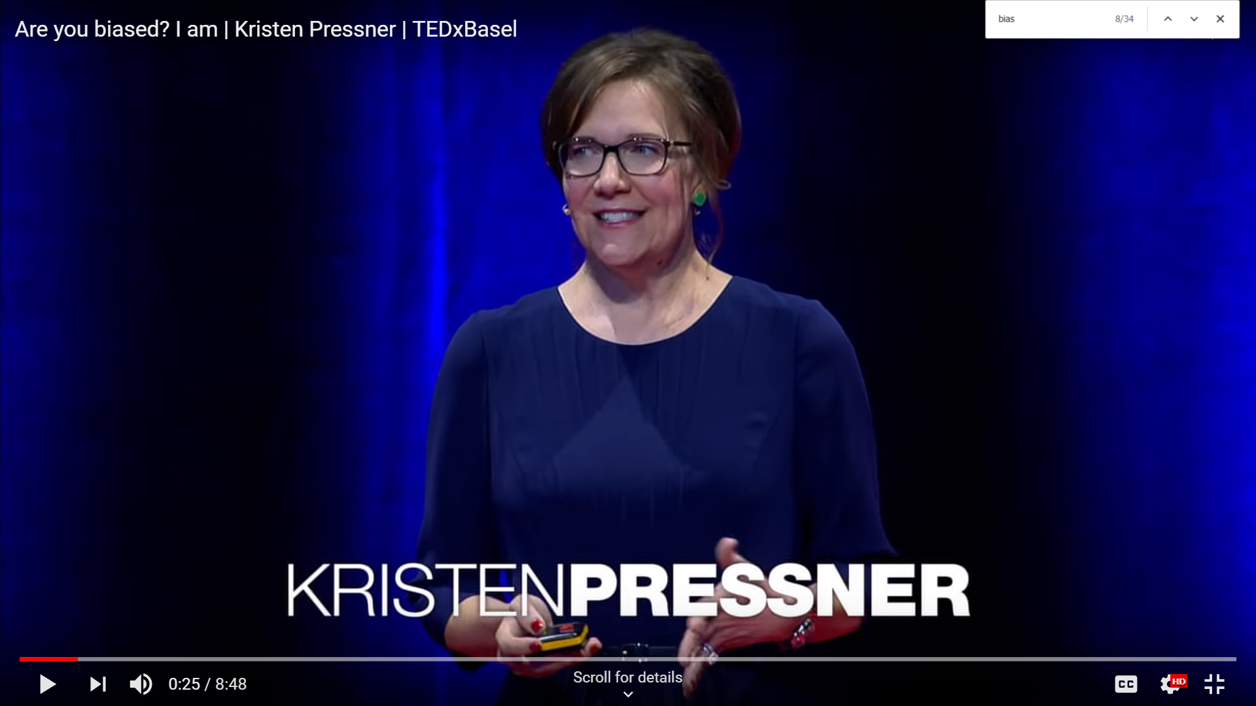
Appendix: Exploring Bias (Bonus Video)
https://www.youtube.com/watch?v=Bq_xYSOZrgU

Slide 66
Post-Survey Thank you for completing this survey.
Your results are anonymous and will help us to evaluate and improve future lectures, workshops and research.
Notes:
https://www.surveymonkey.com/r/XNVNCMZ

