Slide 1
All About Community Acquired Pneumonia
Joshua Steinberg MD
UHS Wilson Family Medicine Residency
Binghamton, NY

Slide 2
Case 1
It’s March.
56 year old woman sees you in the office
c/o 4 days of cough, sweats, chills, myalgias, fever yesterday 102.7, green sputum, mild SOB, pain in R side chest, and feeling awful
on exam T 101.6, HR 103, RR 22, BP 137/81, O2 sat 94% RA, and has coarse crackles in middle of R posterior chest on exam. You don’t appreciate signs/symptoms of other diseases like CHF, PE, etc.
What are the chances she has pneumonia?
Certainty (90-100% chance)
Likely (80-90%)
Iffy (30-80%)
Unlikely (< 30%)

Slide 3
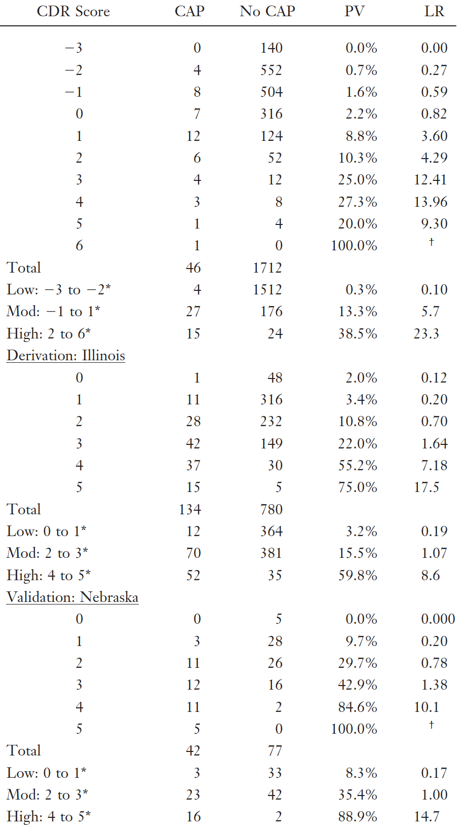
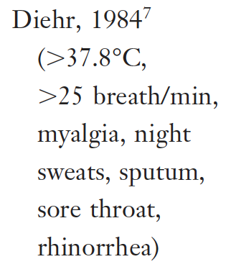
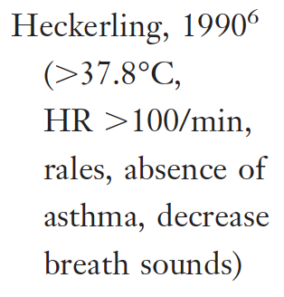
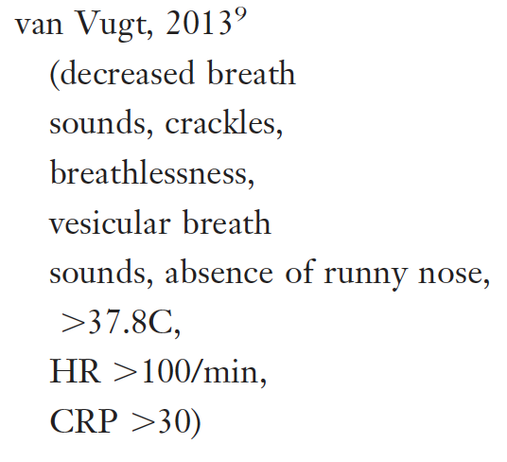
Key take-home 1: History & exam suggestive, but to diagnose pneumonia with certainty, need CXR
Evidence: Systematic Review of Dx
Notes:
They looked at lots of schemes (called clinical decision rules or CDR’s). No matter the study or the approach, no scheme was very good at ruling in pneumonia. All the predictive value percentages are lousy.

Slide 4
Key take-home 2: Often don’t have to be certain, just suspicious enough to treat
Case 1 a
It’s March.
56 year old woman sees you in the office
c/o 4 days of cough, sweats, chills, myalgias, fever yesterday 102.7, green sputum, mild SOB, pain in R side chest, and feeling awful
on exam T 101.6, HR 103, RR 22, BP 137/81, O2 sat 94% RA, and has coarse crackles in middle of R posterior chest on exam. You don’t appreciate signs/symptoms of other diseases like CHF, PE, etc.
What are the chances she has pneumonia?
Certainty (90-100% chance)
Likely (80-90%)
Iffy (30-80%)
Unlikely (<30%)
How certain do you have to be???

Slide 5
Case 2
It’s March.
26 year old woman sees you in the office
c/o 4 days of cough, sweats 1st day but none since, no chills or myalgias, Tmax 99.7, no sputum, no SOB, no CP
on exam T 99.1, HR 73, RR 16, BP 137/81, O2 sat 97% RA, normal exam (no crackles, focal air mvmt deficits).
What are the chances she has pneumonia?
Likely (80-100%)
Iffy (30-80%)
Unlikely (10-30%)
No way (< 10%)

Slide 6
Key take-home 3: Normal vitals rules out pretty well, normal vitals & exam rules out very well
Evidence: Systematic Review of Dx

Slide 7
You’ve got this patient with pneumonia.
What’s causing it?
We usually never find out.
Blood cultures positive 5-14%
Sputum studies vary widely but generally 15-30% yield.
So we proceed empirically based upon where pneumonia developed, severity, and risk factors.
?
?
?
?
?

Slide 8
Key take-home 4: Comm Acq Pneu: - comm. dwelling Hosp Acq Pneu: - 48+ hours in hosp. HCAP: - gone
Definitions
Community Acquired Pneumonia: pneumonia which develops in community dwelling patients
Hospital Acquired Pneumonia: pneumonia which occurs 48 hours or more after hospital admission, which was not incubating at the time of admission, and does not follow intubation (would be ventilator acq pneumonia)
Healthcare Associated Pneumonia (HCAP) is gone: used to suspect that patients in community but with contact with healthcare (nursing home, dialysis, wound care, recent hosp, recent IV ABX) had pathogens more like hospital acq. pneumonia than community acq. pneumonia and had risk of resistant organisms (MRSA, PAerug). But this turned out not to be true.
We will discuss Community Acquired Pneumonia the rest of this talk

Slide 9
Case 3
63 year old male smoker sees you in the office
c/o 5 days of green productive cough, shaking chills, Tmax 103.1, feels ”like crap”
on exam T 101.8, HR 112, RR 23, BP 137/81, focal crackles L base
You diagnose community acquired pneumonia
Admit to hospital?
manage inpatient
manage outpatient

Slide 10
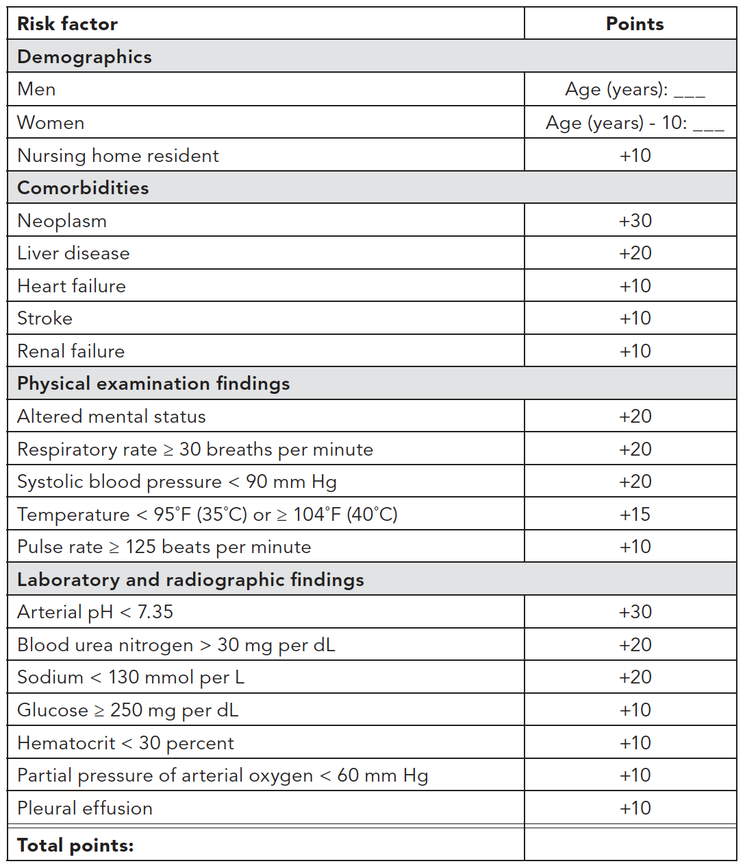
Key take-home 5: Use a mortality prediction tool to admit those at risk of death
Evidence: Site of Care decision
Pneumonia
Severity index
Notes:
So what are these clinical prediction tools? Well, here’s the Pneumonia Severity Index, the PSI. Higher scores correlate with higher mortality, and ya don’t want your patient to die, so put those at risk of death in the hospital.
Trouble is, the PSI is ridiculously complicated and relies on lab tests like CBC & BMP which you certainly won’t have in an office setting and tests like ABG which we don’t get on most ER patients.

Slide 11
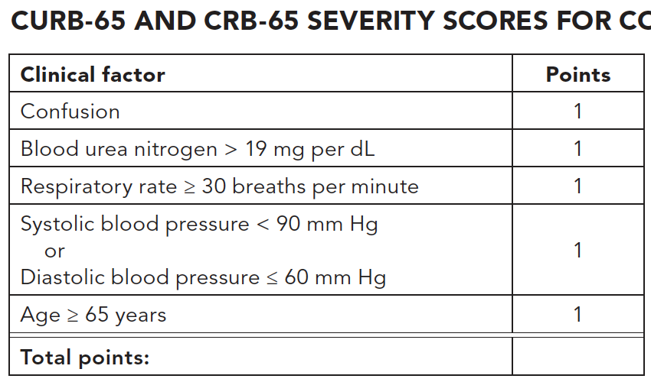
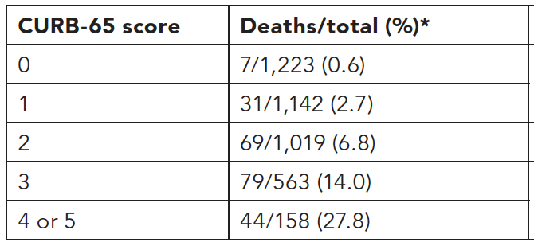
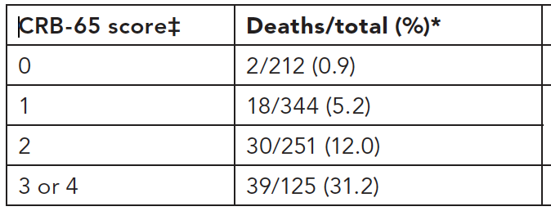
Key take-home 5: Use a mortality prediction tool to admit those at risk of death, like CURB-65 or CRB-65. PO, O2 sat, too.
Evidence: Site of Care decision
...
Notes:
Here are the CURB-65 and CRB-65 scores. These are simpler, more user friendly, and CRB doesn’t even require any labs. 2 pts or more on CURB-65 warrants inpatient, and 1 or 2 on the CRB-65.
Don’t forget. If considering outpatient therapy, patient can’t be nauseated or vomiting cuz they’re gonna have to take PO antibiotics. And can’t be hypoxic. And have to have good support and ability to f/up.

Slide 12
Case 4
77 year old male in ER needs admission
c/o 4th day of green productive cough, shaking chills, Tmax 102.6, feels ”like crap”
on exam mildly confused, T 101.8, HR 130, RR 32, BP 98/52, focal crackles RUL, big opacity on CXR, wbc 3.1, BUN 32, Creat 1.3
You diagnose community acquired pneumonia
Where in the hospital?
regular medical floor
intensive care unit

Slide 13
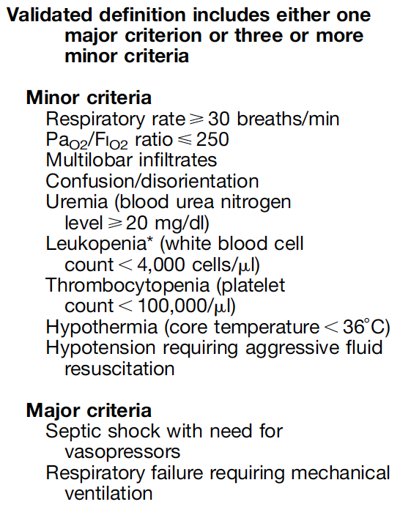
Key take-home 6: ICU (severe CAP) ≥ 3 minor or ≥ 1 major criteria
Evidence: Site of Care decision
Notes:
Here are the CURB-65 and CRB-65 scores. These are simpler, more user friendly, and CRB doesn’t even require any labs. 2 pts or more on CURB-65 warrants inpatient, and 1 or 2 on the CRB-65.
Don’t forget. If considering outpatient therapy, patient can’t be nauseated or vomiting cuz they’re gonna have to take PO antibiotics. And can’t be hypoxic. And have to have good support and ability to f/up.

Slide 14
back to Case 3
63 year old male smoker sees you in the office
c/o 5 days of green productive cough, shaking chills, Tmax 103.1, feels ”like crap”
on exam T 101.8, HR 112, RR 23, BP 137/81, focal crackles L base
You diagnose community acquired pneumonia
Based on CRB-65 of 0, you plan to manage outpatient.
What further testing do you order?
Blood culture
Sputum gram stain & culture
Pneumococcal urinary Ag
Legionella urinary antigen
e) Influenza molecular assay
Procalcitonin
MRSA nasal swab for PCR

Slide 15
Key take-home 7: Outpatient CAP gets little or no testing
ATS-IDSA: Outpatient testing
Recommend against blood cultures, sputum culture and gram stain, procalcitonin, and urinary antigen testing
Influenza testing (nucleic acid amplification assay preferred) only if Flu is circulating in community AND if test results will influence mgmt of patient.
Legionella urinary antigen to be considered only if there is reason to believe patient exposed to outbreak (travel history, etc.)

Slide 16
back to Case 4
77 year old male in ER needs admission
c/o 4th day of green productive cough, shaking chills, Tmax 102.6, feels ”like crap”
on exam mildly confused, T 101.8, HR 130, RR 32, BP 98/52, focal crackles RUL, big opacity on CXR, wbc 3.1, BUN 32, Creat 1.3
Based upon multiple minor criteria, admit to ICU
What further testing do you order?
Blood culture
Sputum gram stain & culture
Pneumococcal urinary Ag
Legionella urinary antigen
e) Influenza molecular assay
Procalcitonin
MRSA nasal swab for PCR

Slide 17
Key take-home 8: inpatient tests see cool table
ATS-IDSA: Inpatient testing
Blood cultures & sputum cx/stain: not for everyone, yield is low. Get for certain populations
ICU patients (severe CAP)
when covering for MRSA or PAerug
when previously infected anywhere MRSA, PAerug
when hospitalized and received IV ABX within 90 days
Pneumococcal urinary antigen ICU only
Legionella urinary antigen if in ICU or if patient at risk for exposure to outbreak (travel history, etc.)
Influenza test all (NAAT preferred) when Flu circulating
Procalcitonin no one, does not guide admit or treatment
Swab noses for MRSA for cases above (ICU, when covering MRSA, when prev infected MRSA, hosp & IV ABX 90 days) to facilitate test-and-escalate or cover-and-de-escalate strategies (will discuss in ABX)

Slide 18
Key take-home 8: inpatient tests see cool table
ATS-IDSA: Inpatient testing

Slide 19
Case 5
47 year old male former smoker sees you in the office
c/o 4th day green productive cough, shaking chills, Tmax 102.2, feels ”like crap”
on exam T 101.8, HR 107, RR 18, BP 137/81, focal crackles L upper lung field
You dx CAP. CRB-65 = 0, you plan outpatient treatment.
What antibiotic(s) do you put him on?
Amoxicillin
Keflex
Doxycycline
Ciprofloxacin
e) Azithromycin
Clarithromycin
TMP-SMX

Slide 20
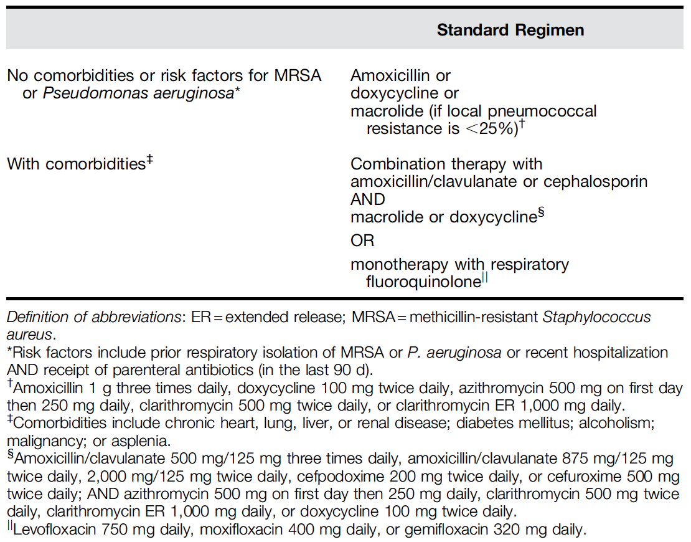
Key take-home 9: Outpatient ABX based upon healthy vs. c0morbidities
ATS-IDSA: Outpatient Antibiotics
Amox 1 gm TID
Doxy 100 mg BID
Macrolide
(Azith 500 then 250 qD or
Clarithro 500 BID or ER 1000 qD)
only when local resistance
S. Pneumo < 25%
Beta-lactam & Macrolide-or-Doxy
Amox-clav 500/125 TID or 875/125 BID
or 2000/125 BID or Cefpodoxime 200 mg BID
or Cefuroxime 500 BID
-and-
Azith 500 then 250 qD or
Clarithro 500 BID or 1000 ER qD or
Doxy 100 mg BID
OR
Respiratory fluoroquinolone
Levoflox 750 mg qDay
Moxiflox 400 mg qDay
Gemiflox 320 mg qDay
Healthy
Comorbidities with risk of poor outcomes and drug resistance
chronic heart, lung, liver, renal dz; diabetes; EtOH; malignancy; asplenia
Risk MRSA and/or PAerug: they don’t really say! Vaguely suggest covering for MRSA and/or PAerug, and then note such pts probably rare, as they are sick and might be inpatients.

Slide 21
ATS-IDSA: Inpatient Antibiotics
Recurring theme in hospital patient recommendations:
Standard Antibiotic Regimen
Standard regimen, test, escalate if pos MRSA/PAerug
Broad coverage, test, de-escalate if neg MRSA/PAerug

Slide 22
Case 6
61 year old female in the ER
c/o 6th day green productive cough, shaking chills, Tmax 101.2, can’t keep anything down x2 days, feels ”like crap”
on exam T 101.8, HR 107, RR 23, BP 137/81, focal crackles L upper lung field, O2 sat 90%, BUN & Creat up mild AKI
You dx CAP. CRB-65 = 1, you plan inpatient treatment.
What antibiotic(s) do you put her on?
Ampicillin
Ceftriaxone
Doxycycline
Ciprofloxacin
e) Azithromycin
Clarithromycin
TMP-SMX
Tobramycin

Slide 23
ATS-IDSA: Hosp floor Antibiotics
cover standard,
test MRSA and/or PAerug, escalate if pos
cover broad, test,
de-escalate if neg
cover broad, test,
de-escalate if neg
Beta-lactam & Macrolide
Amp-Sulbactam 1.5-3 gm q6 hrs
Cefotaxime 1-2 gm q8 hrs
Ceftriaxone 1-2 gm qDay
Ceftaroline 600 mg q12 hrs
and
Azith 500 mg qDay or Clarithro 500 mg BID
OR
Resp fluoroquinolone
Levofloxacin 750 mg qDay or
Moxifloxacin 400 mg qDay
Beta-lactam & Macrolide
Amp-Sulb, Cefotax, Ceftriax , Ceftaro
and
Azith or Clarithro
OR
Resp fluoroquinolone
Levofloxacin or Moxifloxacin
AND
MRSA coverage
Vanco or Linezolid
discontinue if cx’s or nasal PCR neg MRSA
Resp Fluoroquin or Macrolide
Levofloxacin or Moxifloxacin
or
Azith or Clarithro
AND
PAerug coverage
Pip/Tazo 4.5 gm q6 hrs
Cefepime 2 gm q8 hrs
Ceftazidime 2 gm q8 hrs
Imipenem 500 mg q6 hrs
Meropenem 1 gm q8 hrs
Aztreonam 2 gm q8 hrs
discontinue if cx’s neg PAerug
Beta-lactam & Macrolide
Amp-Sulb, Cefotax, Ceftriax , Ceftaro
and
Azith 500 mg qDay or Clarithro 500 mg BID
OR
Resp fluoroquinolone
Levofloxacin 750 mg qDay or
Moxifloxacin 400 mg qDay
escalate with coverage MRSA or PAerug if pos

Slide 24
ATS-IDSA: ICU Antibiotics
cover broad, test,
de-escalate if neg
cover broad, test,
de-escalate if neg
cover broad, test,
de-escalate if neg
Beta-lactam & Macrolide
Amp-Sulb, Cefotax, Ceftriax , Ceftaro
and
Azith or Clarithro
OR
Beta-lactam & Resp fluoroquin
Amp-Sulb, Cefotax, Ceftriax , Ceftaro
and
Levofloxacin or Moxifloxacin
AND
MRSA coverage: Vanco or Linezolid
AND
PAerug coverage: Pip/Tazo, Cefepime, Ceftaz, Imipenem, Meropenem, Aztreonam
discontinue if cx’s/PCR MRSA or PAerug if neg
Beta-lactam & Macrolide
Amp-Sulbactam 1.5-3 gm q6 hrs
Cefotaxime 1-2 gm q8 hrs
Ceftriaxone 1-2 gm qDay
Ceftaroline 600 mg q12 hrs
and
Azith 500 mg qDay or Clarithro 500 mg BID
OR
Beta-lactam & Resp fluoroquin
Amp-Sulb, Cefotax, Ceftriax , Ceftaro
and
Levofloxacin 750 mg qDay or
Moxifloxacin 400 mg qDay
Beta-lactam & Macrolide
Amp-Sulb, Cefotax, Ceftriax , Ceftaro
and
Azith or Clarithro
OR
Beta-lactam & Resp fluoroquin
Amp-Sulb, Cefotax, Ceftriax , Ceftaro
and
Levofloxacin or Moxifloxacin
AND
MRSA coverage
Vanco or Linezolid
discontinue if cx’s or nasal PCR neg MRSA
Resp Fluoroquin or Macrolide
Levofloxacin or Moxifloxacin
or
Azith or Clarithro
AND
PAerug coverage
Pip/Tazo 4.5 gm q6 hrs
Cefepime 2 gm q8 hrs
Ceftazidime 2 gm q8 hrs
Imipenem 500 mg q6 hrs
Meropenem 1 gm q8 hrs
Aztreonam 2 gm q8 hrs
discontinue if cx’s neg PAerug

Slide 25
Key take-home 10: Inpatient ABX based upon standard therapy, MRSA & PAerug coverage, test-and-escalate or de-escalate strategies
Hospital & ICU antbiotics details
nasal MRSA for PCR is a really good test
if negative has high concordance with MRSA not causing pneumonia (high NPV, negative predictive value, good at ruling out), rules out MRSA CAP, can stop MRSA coverage if using
if positive, means MRSA CAP possible but far from ruled in, await cultures to rule in or rule out
what are these “locally validated risk factors”? ATS-IDSA says local rates of MRSA and Pseudomonas pneumonia vary enough that they don’t want to publish simple rules, even though they know we want them to! So they encourage communities to come up with their own “locally validated risk factors” for MRSA and Pseudomonas.
since “locally validated risk factors” don’t exist yet (if ever, kinda aspirational), have to follow other indications and recommendations for approaches to treatment, escalation, and de-escalation

Slide 26
Case 7
44 year old male comparative literature professor sees you in the ER
c/o 5 days of green productive cough, shaking chills, Tmax 103.1, feels ”like crap”, everyone else at home sick
on exam T 101.8, HR 112, RR 23, BP 137/81, focal crackles L base. Influenza A positive.
You dx CAP & Influenza. CRB-65 = 0, treat outpatient.
How do you treat?
it’s the flu, just give Oseltamivir (or similar)
too late for Oseltamivir, just give antibacterials
give both Oseltamivir and ABX
too late Oseltamivir, and it’s Influenza pneumonia, give just supportive treatment

Slide 27
Key take-home 11: Treat influenza and pneumonia with flu antiviral and antibacterial antibiotics
ATS-IDSA: Influenza
Applies to outpatient and inpatient.
Regardless of duration of illness, give flu antiviral agent (like oseltamivir). This is not just Influenza, it’s Influenza and pneumonia.
Give antibacterial antibiotics. Whatever the appropriate regimen for the patient, give it. Influenza is a strong risk for co-infection with Staph aureus, Pneumococcus, H. flu, and more. In setting of flu, patient might have bacterial co-infection now, or might have it as a complication soon, so cover as any community acquired pneumonia patient.

Slide 28
Case 8
71 year old female patient sees you in the ER
sudden dysarthria, facial droop, R arm weakness, mild confusion noted by family, brought in by family also noting cough
on exam T 100.8, HR 112, RR 21, BP 117/61, focal crackles R base, CXR confirms infiltrate.
You dx stroke and aspiration pneumonia.
How do you treat?
elevate head of bed, no ABX, it’s just pneumonitis
Clindamycin for aspiration pneumonia
Ceftriaxone & Azith for community acq pneumonia
Clinda and Metronidazole for anaerobe double-coverage

Slide 29
Key take-home 12: Except in cases of abscess or empyema, no special coverage recommended in aspiration pneumonia
ATS-IDSA: Aspriation Pneumonia
You always thought aspiration pneumonia was a special different case. ATS-IDSA guideline challenges that notion.
All pneumonia is aspiration pneumonia
The presence of anaerobes in patients who aspirated is lower than previously appreciated.
ATS-IDSA recommends against special additional anaerobic coverage except in cases of abscess and empyema.

Slide 30
Case 9
72 year old male patient admitted to hospital floor with fever, vomiting, SOB, hypoxia, productive cough, leukocytosis, and infiltrate LLL on CXR. Dx’ed CAP.
After 3 days of IV ABX, he’s doing much better. Cough reduced. O2 sat room air mid-90’s. Afebrile, vitals normalized. Vomiting resolved, feeling good on his feet.
Can you switch to PO ABX? How long total ABX duration?
don’t switch until 5 days IV ABX
got better so quickly that it wasn’t the ABX, stop now
switch to PO when meets stability criteria, ≥5 days total
10 days ABX for CAP, 15 for MRSA or PAerug

Slide 31
Key take-home 13: Shorter ABX fine, aim for 5+ days, use stability criteria
ATS-IDSA: Antibiotic mgmt
When switching IV to PO ABX, switch when patient hemodynamically stable, clinically improving, able to take meds by mouth, and has normal GI tract function
When switching IV to PO, try to use same agent or stay within same antibiotic class.
Much evidence on short courses of ABX in CAP. ATS-IDSA recommends at least 5 days total (or more), 7 (or more) in cases of MRSA or PAerug.
For hospitalized pts can consider stopping ABX altogether when at least 5 days therapy, afebrile 48-72 hours, and no more than 1 criteria for instability:
SBP ≤ 90, HR ≥ 100, RR ≥ 24, O2 sat ≤ 90%, temp ≥ 37.8° deg C, altered mentation, inability to take PO

Slide 32
Case 10
69 year old female smoker discharged home after treatment for community acquired pneumonia, seeing you for hosp f/up (”TCM”) visit.
Feeling well, finished last pill of ABX yesterday. Vitals good, exam unremarkable.
You remember recommendations regarding follow-up chest xray after pneumonia.
Do you get follow-up CXR?
yes, 6 weeks after finishing ABX
yes, 12 weeks after finishing ABX
no, no follow-up CXR
no CXR, patients like this need conventional CT Chest

Slide 33
Key take-home 14: No f/up CXR
ATS-IDSA: f/up CXR
In the old days, there was recommendation to get f/up CXR to make sure nothing like cancer is amiss, obscured by acute pneumonia on initial CXR yet suggested by acute pneumonia.
ATS-IDSA now says no follow-up CXR. Interesting reasons.
There may be some cancers among patients with acute pneumonia, perhaps 1-4%, almost always among smokers. But f/up CXR is not very good at finding them. Study of VA patients (male, heavy smokers) found 9% lung cancer in followup surveillance. But mean time to dx after CAP was 297 days, and only 27% of which were found in first 90 days after CAP, suggesting that f/up CXR wasn’t good at finding cancers that may be afoot.
Plus these smokers typically warrant low-dose CT Lung CA screening anyway, so if you’re gonna check for cancer, do the right best evidence-supported test.

Slide 34
Key take-home 15: There’s an app for that...
Key take home points, lot to keep straight
1) History & exam suggestive, but to diagnose pneumonia with certainty, need CXR
2) Often don’t have to be certain, just suspicious enough to treat
3) Normal vitals rules out pretty well, normal vitals & exam rules out very well
4) CAP: comm dwelling; HAP 48+ hrs in hosp; HCAP: gone.
5) To decide inpatient vs. outpatient, use a mortality prediction tool for risk of death, like CURB-65 or CRB-65. PO, O2 sat, too.
6) To decide hospital floor vs. ICU, admit to ICU (severe CAP) for ≥ 3 minor or ≥ 1 major criteria
7) Outpatient CAP get little or no testing
8) Inpatient CAP warrants some but not all patients getting tests, see table
9) Outpatient ABX based upon healthy vs. c0morbidities
10) Inpatient ABX based upon standard therapy, MRSA & PAerug risks, with test-and-escalate or test-and-deescalate strategies
11) Treat influenza and pneumonia with flu antiviral and antibacterial antibiotics.
12) Aspiration pneumonia warrants standard CAP treatment, no special anaerobic coverage except in cases of abscess or empyema.
13) Shorter ABX courses fine, aim for 5+ days, use stability criteria
14) No follow-up CXR

Slide 35
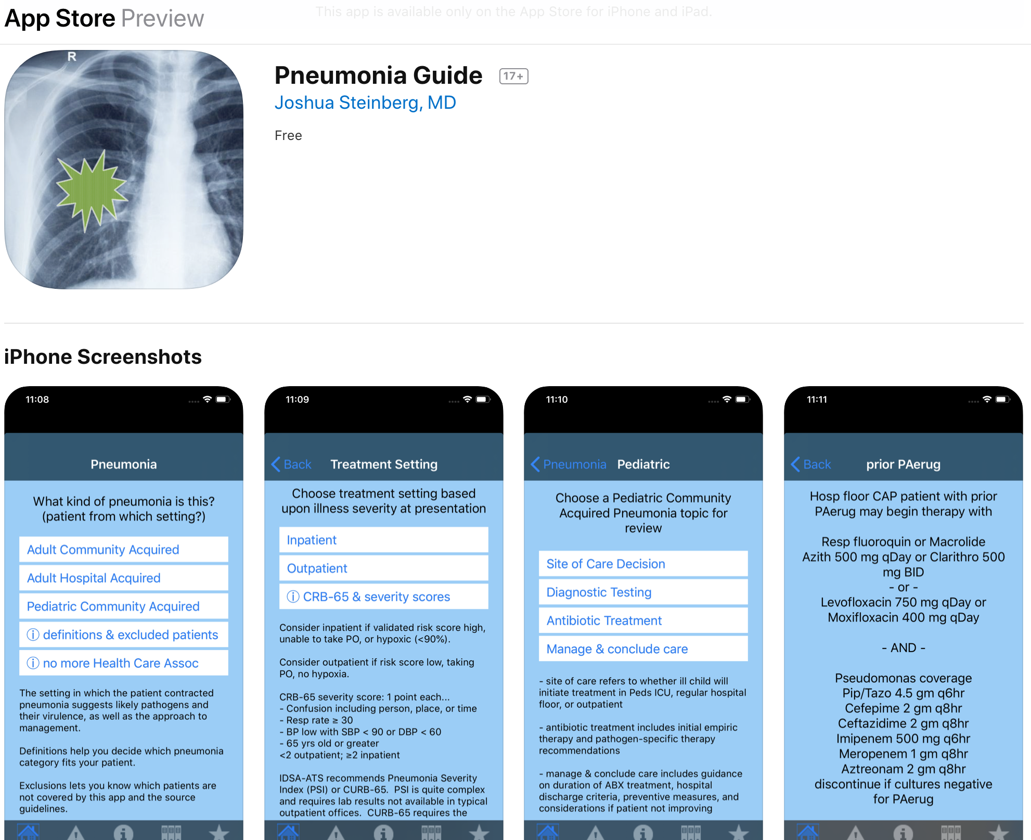
free CAP 2019 HAP 2016 Ped CAP 2011 iPhone only

