Slide 1
STFM: The Path To Better
Twitter: @drjoshuatepper

Slide 2
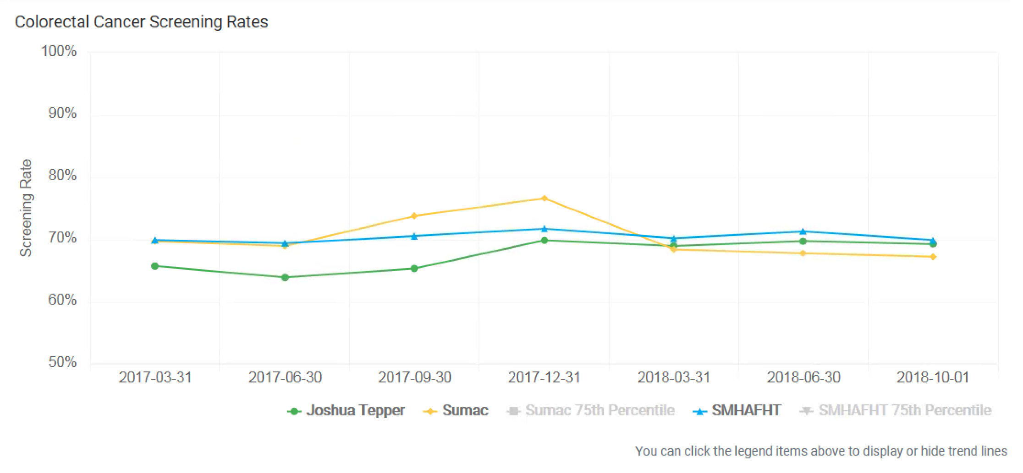

Slide 3
Since stopping sleep medication, it's become necessary to put everything on pause due
to various (sic) instabilities. This includes getting dental and optical work done, seeking a mental health professional, returning to work, maintaining personal hygiene, relationships, and a host or other issues.
A little about me:

Slide 4
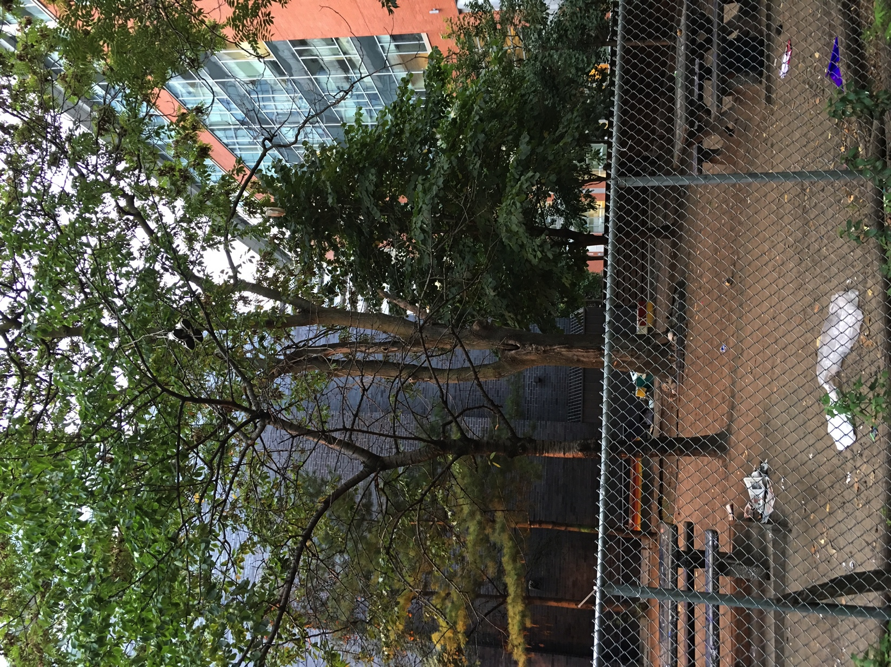

Slide 5
Teaching
Research
Clinical
Care

Slide 6
Teaching
Research
Clinical
Care
Quality
Improvement

Slide 7
Path To Better
Data & Narrative
Information
Skills
Knowledge
Leadership
Improvement
Failure

Slide 8
Know Where We Are Going
Better Outcomes
Improved Clinician Experience
Improved Patient Experience
Lower Costs

Slide 9
Change Our DNA
1. The family physician is a skilled clinician
2. Family Medicine is a community based discipline
3. The family physician is a resource to a defined practice
4. The patient-physician relationship is central to the role of the family physician
5. The family physician embraces a culture, skillset and practice of quality improvement
Notes:
9

Slide 10
Since stopping sleep medication, it's become necessary to put everything on pause due
to variuos instabilities. This includes getting dental and optical work done, seeking a mental health professional, returning to work, maintaining personal hygiene, relationships, and a host or other issues.
A little about me:

Slide 11
Thank You

Slide 13
What Motivates Us:
Dan Pink, Drive

Slide 14
