Slide 1
Better than a Crystal Ball:
A Longitudinal Sub-I Project to
Prepare for the Future of Primary Care
Sara Corderman, MD, SUNY Downstate College of Medicine
Lea Hoff, MD, Kaiser Permanente Santa Rosa

Slide 2
DISCLOSURES
We have no conflict of interest to disclose.

Slide 3
OVERVIEW
Introduction
The “Future of Primary Care” elective
The "Future of Primary Care Workbook"
Student projects and student feedback
Future directions

Slide 4
OVERVIEW
Introduction
The “Future of Primary Care” elective
The "Future of Primary Care Workbook"
Student projects and student feedback
Future directions

Slide 5
HISTORY
Sub-I Capstone Project in Summer 2019 for the “Future of Primary Care” elective
Goal: Develop a workbook that formally integrates critical thinking about the "future of primary care" (FPC) into the Sub-I curriculum

Slide 6
Inspired by the current wave of primary care innovation and the coming “primary care revolution”^{1,2}

Slide 7
Students are excited about the future of primary care! But structured curriculum is scarce...
Notes:
Image: https://www.ebay.com/itm/60mm-Clear-Glass-Crystal-Ball-Photography-Lens-Sphere-Magic-Meditate-Home-Mascot-/264454747134

Slide 8
PUBMED
Extensive literature on why medical students do or do not choose primary care³⁻⁹ and suggestions to attract them¹⁰⁻¹⁴
Interventions mostly target increasing student interest in primary care generally¹⁵⁻¹⁸
Robust literature on primary care transformation¹⁹⁻²⁵
Absent: Interventions that use the innovative nature of primary care to retain and increase medical student interest

Slide 9
How do we close this gap?

Slide 10
OVERVIEW
Introduction
The “Future of Primary Care” elective
The "Future of Primary Care Workbook"
Student projects and student feedback
Future directions

Slide 11
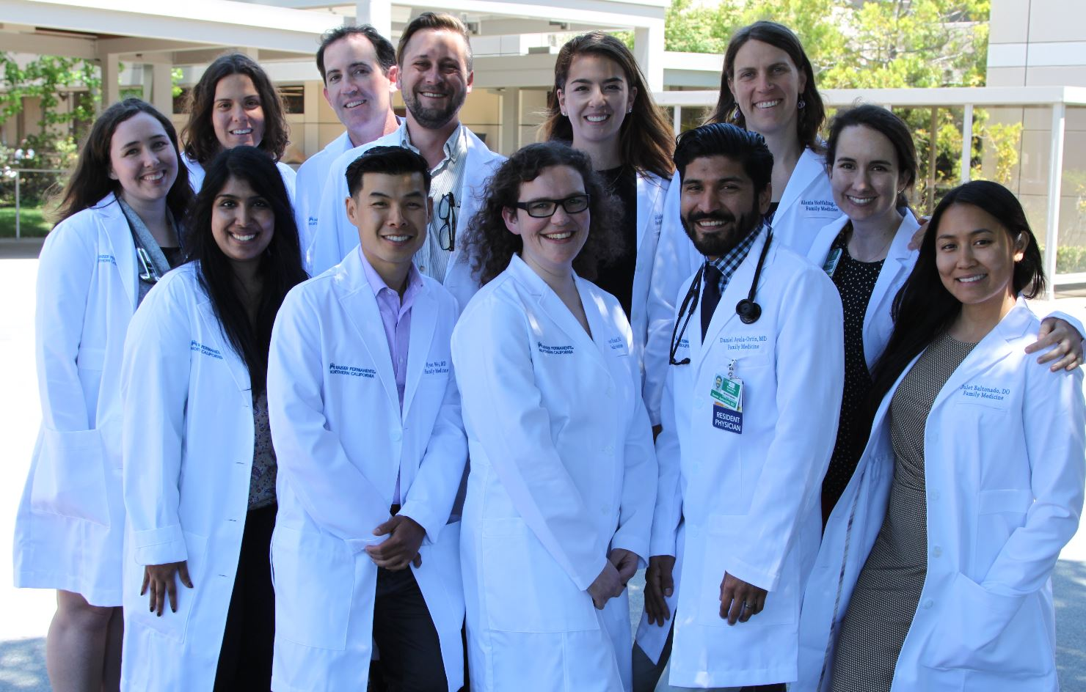
New residency since June 2018 (6-6-6)
4-week Sub-Internship
1-2 students per month
Northern California: 1h North of San Francisco

Slide 12
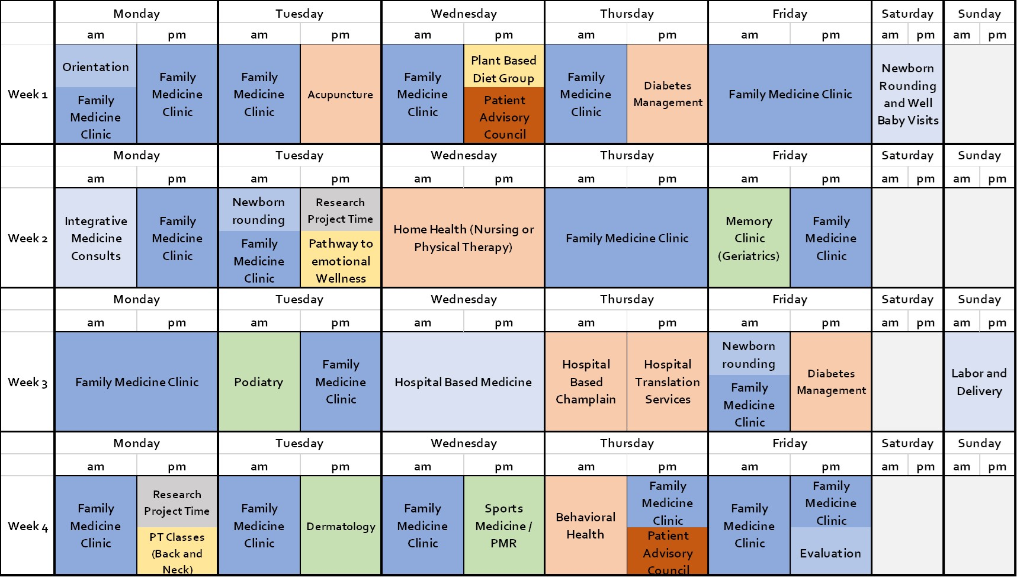
Sample elective schedule

Slide 13
OVERVIEW
Introduction
The “Future of Primary Care” elective
The "Future of Primary Care Workbook"
Student projects and student feedback
Future directions

Slide 14
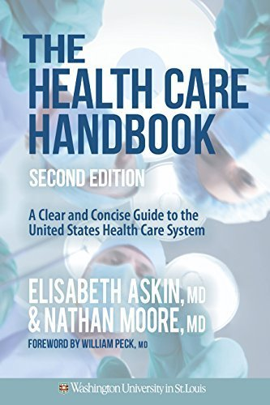
INSPIRATION
Written by medical students, for medical students
Required reading at many medical schools
Notes:
Image: https://www.amazon.com/Health-Care-Handbook-Elisabeth-Paperback/dp/B00ZT11KIG

Slide 15
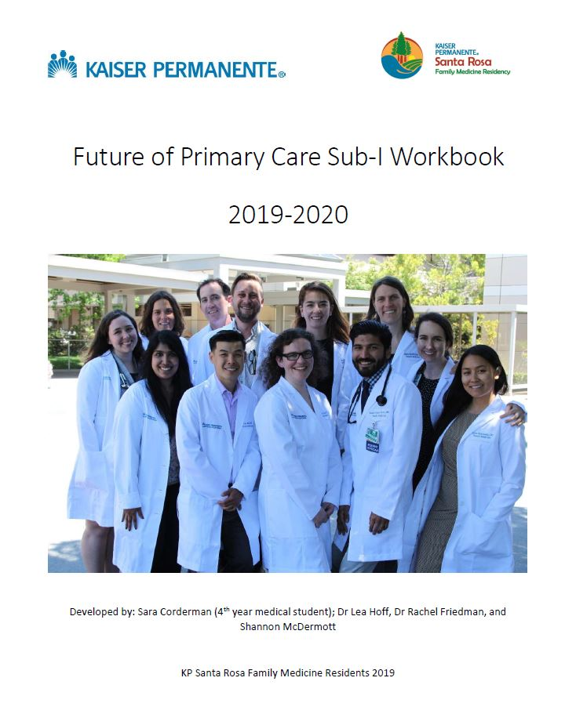
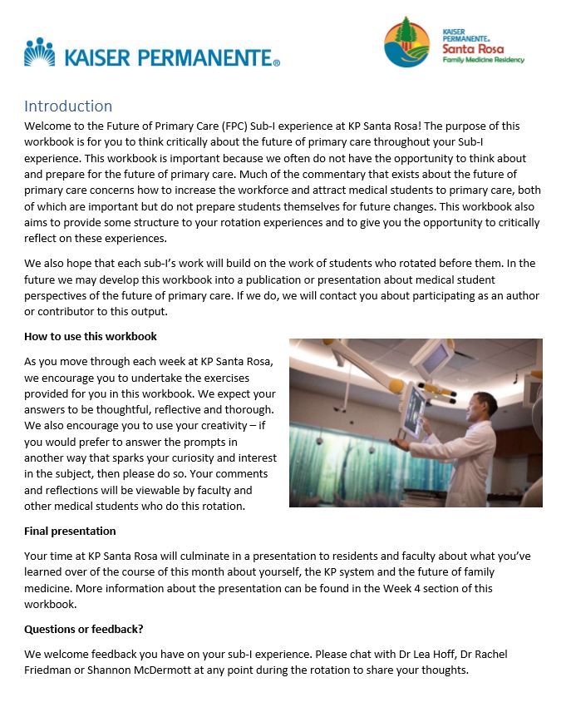
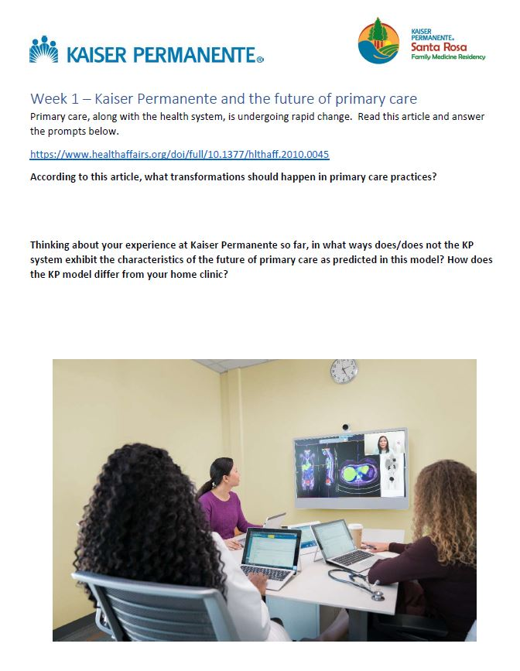
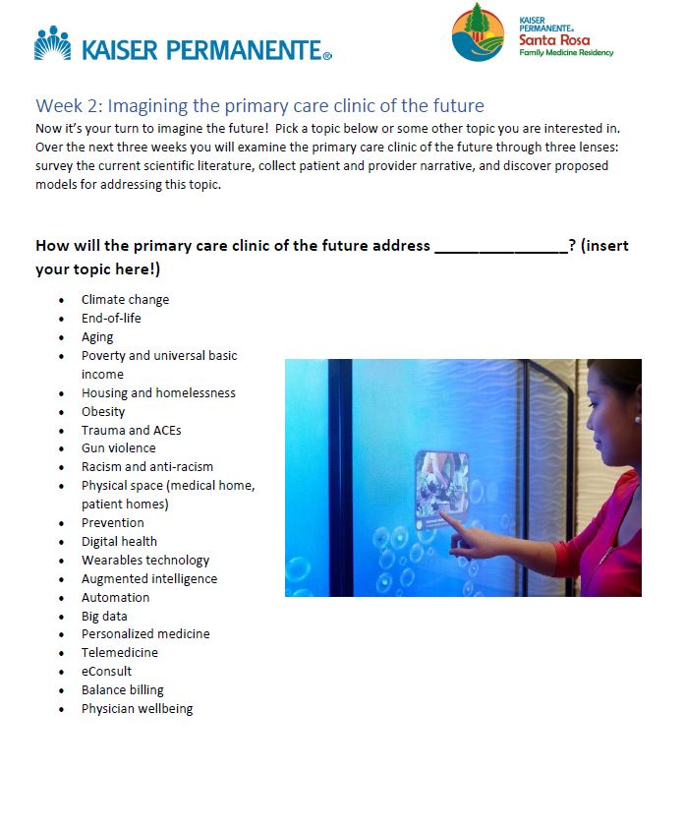
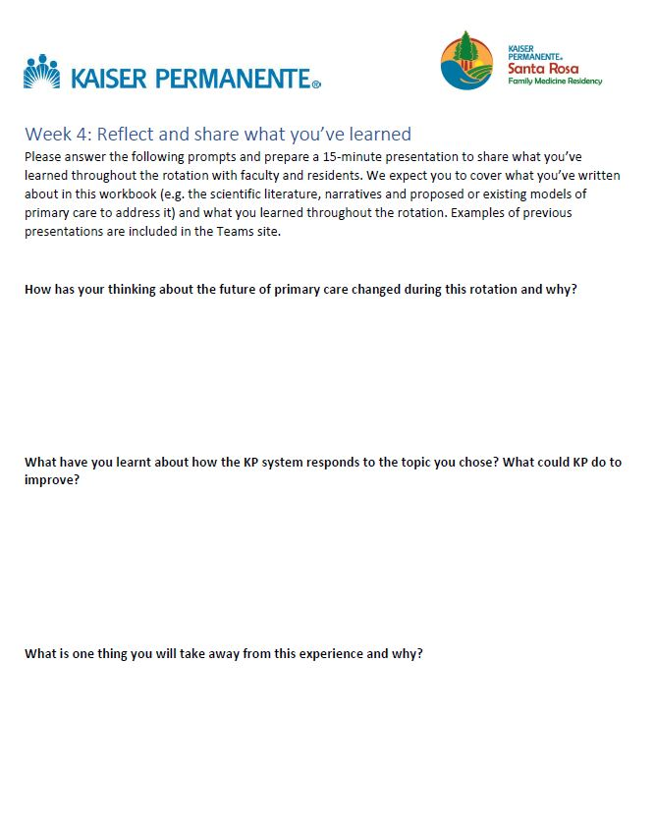
The FPC Workbook
Workbook, not handbook
Divided into 4 weeks
Incorporates questions that provoke reflection and self-testing at every stage

Slide 16
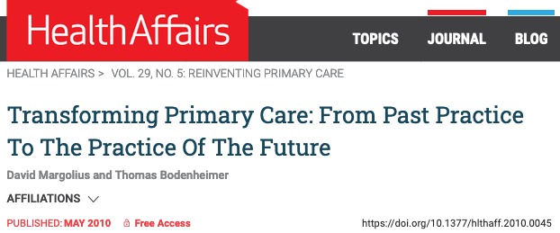
WEEK 1: Kaiser Permanente and the future of primary care
Notes:
Margolius D, Bodenheimer T. Transforming primary care: from past practice to the practice of the future. Health Aff (Millwood) 2010;29(5):779–784. doi: 10.1377/hlthaff.2010.0045. [PubMed] [CrossRef] [Google Scholar]

Slide 17
WEEK 2: Imaging the primary care clinic of the future
“How will the primary care clinic of the future address _______?”

Slide 18
ENDLESS TOPICS
Collaborative care
Diversifying medicine
POCUS
Food and nutrition
Digital health
AI
Blockchain
Big data
Personalized medicine
Climate change
Aging
Poverty and universal basic income (UBI)
Housing and homelessness
Obesity
Trauma and ACEs
Gun violence
Racism and anti-racism
Physical space (medical home, patient homes)

Slide 19
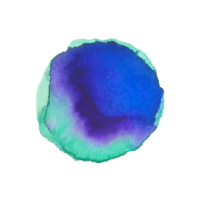
THREE-SIDED APPROACH
Literature review
Proposed models
Patient & provider narrative

Slide 20
WEEK 3:
Narrative review, the patient voice and addressing bias
Notes:
Image: https://www.amazon.com/MasBros-LensBall-Crystal-Photography-Accessory/dp/B07JNRYL3K

Slide 21
WEEK 4: Reflect and share what you’re learned
15-minute presentation:
FPC topic
KP observations
Impact of the rotation

Slide 22
OVERVIEW
Introduction
The “Future of Primary Care” elective
The "Future of Primary Care Workbook"
Student projects and student feedback
Future directions

Slide 23
5 STUDENTS: TOPICS SO FAR
POCUS and the Future of Primary Care
Food as Medicine: Reimagining the Primary Care Office Through Nutrition
Diversifying Medicine
Collaborative Care Teams: The Key to Care Delivery
Community and Patient Responsive Practice

Slide 24
“The workbook helped me organize my thoughts and guide my reflection through this rotation”
“I used the workbook to [...] reflect on the larger picture when it comes to the future of primary care which is not an opportunity I have had elsewhere in medical school”
“I feel grateful to have had the opportunity to research and share about a topic I am passionate about”
“Thank you for an overall incredible rotation!”

Slide 25
ONE STUDENT’S IMPRESSION OF THE KP MODEL
Salaries instead of fee-for-service means truly patient-centered care
Recognizes that the small things are big – which makes a big difference in culture
Truly team-based
PHASE
Convenience = adherence & coordination

Slide 26
OVERVIEW
Introduction
The “Future of Primary Care” elective
The "Future of Primary Care Workbook"
Student projects and student feedback
Future directions

Slide 27
NEXT STEPS
Keep using on rotation
Create a student-made curriculum on the future of primary care
Disseminate beyond KP for other rotation sites to adapt (Check the STFM Online Resource Library!)
Notes:
Image: https://creativemarket.com/Andy_Dean_Photog/2898472-Welcome-To-The-Future-Road-Sign

Slide 28
Thank you!
Questions?
“It’s not just whether primary care docs will get more money and control. It’s whether we rebuild our healthcare system around them.”
- Joe Flower, author of Healthcare Beyond Reform: Doing it Right for Half the Cost
Notes:
Image: https://pixels.com/featured/crystal-ball-photography-michael-crowder.html
Quote: https://www.medicaleconomics.com/medical-economics-blog/where-future-primary-care-headed

Slide 29
EVALUATE
Please evaluate this presentation using the conference mobile app by scrolling to the bottom of the session description.

Slide 30
REFERENCES (1)
Ellner AL, Phillips RS. The Coming Primary Care Revolution. J Gen Intern Med. 2017;32(4):380–6. doi: 10.1007/s11606-016-3944-3. [PMC free article]
Allencherril, J. The Future of Primary Care: One Medical Student's View. J Participat Med. 2014;6(14).
Erikson CE, Danish S, Jones KC, Sandberg SF, Carle AC. The role of medical school culture in primary care career choice. Acad. Med. 2013;88:1919–26. doi: 10.1097/ACM.0000000000000038. [PubMed]
Fritz EM, van den Hoogenhof S, Braman JP. Association between medical student debt and choice of specialty: a 6-year retrospective study. BMC Med Educ. 2019;19(1):395. Published 2019 Oct 28. doi:10.1186/s12909-019-1797-2 [PubMed]
Phillips JP, Petterson SM, Bazemore AW, Phillips RL. A retrospective analysis of the relationship between medical student debt and primary care practice in the United States. Ann Fam Med. 2014;12(6):542–549. doi:10.1370/afm.1697 [PubMed]
Schwartz MD. The US, primary care workforce and graduate medical education policy. JAMA. 2012;308:2252–3. doi: 10.1001/jama.2012.77034. [PubMed]
Scott I, Gowans M, Wright B, Brenneis F, Banner S, Boone J. Determinants of choosing a career in family medicine. Can. Med. Assoc. J. 2011;183:E1–8. doi: 10.1503/cmaj.091805. [PMC free article]
Senf JH, Campos-Outcalt D, Kutob R. Factors related to the choice of family medicine: a reassessment and literature review. J. Am. Board Fam. Pract. 2003;16:502–12. doi: 10.3122/jabfm.16.6.502. [PubMed]
Youngclaus JA, Koehler PA, Kotlikoff LJ, Weicha JM. Can medical students afford to choose primary care? an economic analysis of physician education debt repayment. Acad. Med. 2013;88:16–25. doi: 10.1097/ACM.0b013e318277a7df. [PubMed]
Fincher R-ME. The road less traveled—attracting students to primary care. N. Engl. J. Med. 2004;351:630–2. doi: 10.1056/NEJMp048054. [PubMed]

Slide 31
REFERENCES (2)
Hepworth J, Davis A, Harris A, et al. The four pillars for primary care physician workforce reform: a blueprint for future activity. Ann Fam Med. 2014;12(1)83–87 [PMC free article]
Schwartz MD, Basco WT, Grey MR, Elmore JG, Rubenstein A. Rekindling student interest in generalist careers. Ann. Intern. Med. 2005;142:715–24. doi: 10.7326/0003-4819-142-8-200504190-00040. [PubMed]
Sheline B, Tran AN, Jackson J, Peyser B, Rogers S, Engle D. The primary care leadership track at the Duke University School of Medicine: creating change agents to improve population health. Acad. Med. 2014;89:1370–4. doi: 10.1097/ACM.0000000000000305. [PubMed]
Volpintesta EJ. How can we get students to chose primary are careers? Acad. Med. 2013;88:1789. doi: 10.1097/ACM.0000000000000015. [PubMed]
Campos-Outcalt D, Senf J. A longitudinal, national study of the effect of implementing a required third-year family practice clerkship or a department of family medicine on the selection of family medicine by medical students. Acad. Med. 1999;74:1016–20. doi: 10.1097/00001888-199909000-00016. [PubMed]
Hawthorne MR, Dinh A. Meeting the demand of the future: a curriculum to stimulate interest in careers in primary care internal medicine. Med Educ Online. 22(1):1340780. doi:10.1080/10872981.2017.1340780 [PubMed]
Hodge B, Hyman K, Latessa R. Training for future generations: innovations in the medical education of physicians in North Carolina. N C Med J. 2019;80(3):163-166. [PubMed]
Pfarrwaller E, Sommer J, Chung C, Maisonneuve H, Nendaz M, Junod Perron N, Haller DM. Impact of interventions to increase the proportion of medical students choosing a primary care career: a systematic review. J Gen Intern Med. 2015;30:1349–1358. doi: 10.1007/s11606-015-3372-9. [PMC free article]
Barnes KA, Kroening-Roche JC, Comfort BW. The developing vision of primary care. N Engl J Med. 2012 Sep 6;367(10):891–3. DOI: http://dx.doi.org/10.1056/NEJMp1204487 [PubMed]

Slide 32
REFERENCES (3)
Bitton A, Ellner A, Pabo E, et al. The Harvard Medical School Academic innovations collaborative: transforming primary care practice and education. Acad. Med. 2014;89:1239–44. doi: 10.1097/ACM.0000000000000410. [PubMed]
Bodenheimer T. A lesson from the trenches—a high functioning primary care clinic. N. Engl. J. Med. 2011;635:5–8. doi: 10.1056/NEJMp1104942. [PubMed]
Bodenheimer T. Primary care - will it survive. N. Engl. J. Med. 2006;355:861–4. doi: 10.1056/NEJMp068155. [PubMed]
Bodenheimer T. Transforming care. N. Engl. J. Med. 2008;359:2086–9. doi: 10.1056/NEJMp0805631. [PubMed]
Brienza RS. At a crossroads: the future of primary care education and practice. Acad Med. 2016;91:621–623. [PubMed]
Sinsky CA, Willard-Grace R, Schutzbank AM, Sinsky TA, Margolius D, Bodenheimer T. In search of joy in practice: a report of 23 high-functioning primary care practices. Ann. Fam. Med. 2013;11:272–8. doi: 10.1370/afm.1531. [PMC free article]

