Slide 1
Failure As Fuel for Developing Resilience and Fostering Self-Exploration
Lisa S. Gussak, MD
University of Massachusetts Medical School
Worcester MA
Kathryn Fraser, PhD
Halifax Health Family Medicine Residency,
Daytona Beach Florida
Notes:
This is a presentation with pairing and sharing

Slide 2
NO DISCLOSURES

Slide 3
Objectives
Describe the effects of failure in medicine and medical education
List business concepts that positively address failure
Share personal failures
Learn to use failures positively as growth opportunities

Slide 4
Our audience…
Notes:
Would like to get an idea of who is doing hands on teaching, didactic vs clinical, program directors, leadership, students, residents.

Slide 5
Why Failure?
Seeing my students struggle
Writings in the popular press
Personal reflection
Examining learning environment
Notes:
Students with little experience with failure
Particularly in sports literature, Sabrina Williams essay I sent around, also in business literature.
: M&M, individual quiet conversations, not institutionally discussed

Slide 6
Success consists of going from failure to failure without loss of enthusiasm
Winston Churchill
Notes:
This is where we’d like to get to..
In many fields success is elusive.
Consider the creative arts: writers and actors are told to expect failure
Scholars cite Mozart as the most successful creative genius and accept that he had a 60-70% “HIT RATE”.

Slide 7
Failure literature
Limited information in medicine
More robust discussion in creative arts, business and sport literature
First order failure: common
Second order failure: M&M, root-cause
Notes:
Medicine: hard lit search
Medicine: much more literature related to burnout, depression, and the impact of failure on these.
Increasingly RESILIENCE as key to preventing burnout and depression and it’s importance in managing setbacks, failures, etc.
First order: run out of gloves in a room COMMON, easy to fix, usually fixed at local level
Second order: looks at causes and systems, goal is not to assign blame (although blame is experienced) and rarely deals with emotional aspect.

Slide 8
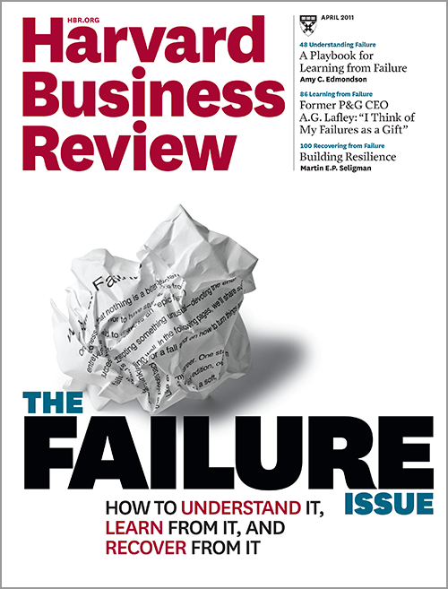

Slide 9
Notes:
Our learners possess inability and encounter many complex processes and uncertainty:
We try to teach them hypothesis testing, i.e develop a DDX
We know this and accept it.
We want them to accept this too and learn to ASK FOR HELP

Slide 10
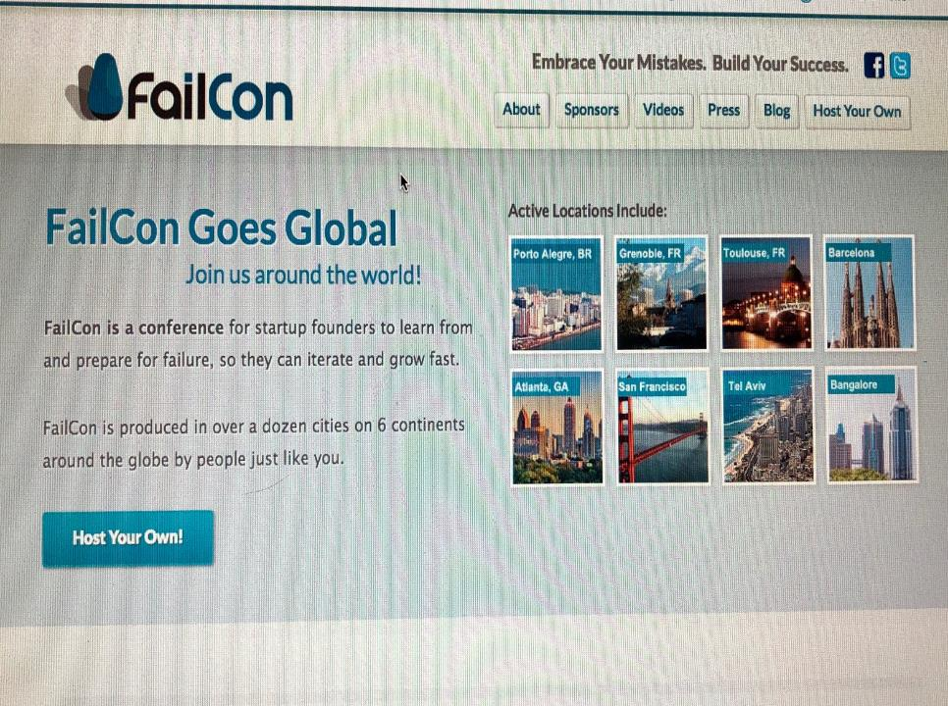
Notes:
FailCon Tag line: Stop being afraid of failure and start embracing it

Slide 11
Failure literature
Common theme = failure is fuel for reflection and improvement
JK Rowling: “The Fringe Benefits of Failure and the Importance of Imagination”
Abby Wambach: ”Wolfpack”
Notes:
IN SPORTS and BUSINESS
Rowling: her 2008 graduation speech at Harvard speaks about “being set free by her failure when 6 years out of college she was a divorced, single-parent, jobless, poor with a typewriter and a big idea”, and having her greatest fear (failing) realized, she was able to begin rebuilding her life.
Of course we love the story of the BIG FAILURE WITH HUGE RECOVERY, like hers. Just as we love the idea that all great start-ups began in a garage.
Wambach: “Imperfect men have been empowered and permitted to run the world since the beginning of time. It’s time for imperfect women to grant themselves permission to join them.”

Slide 12
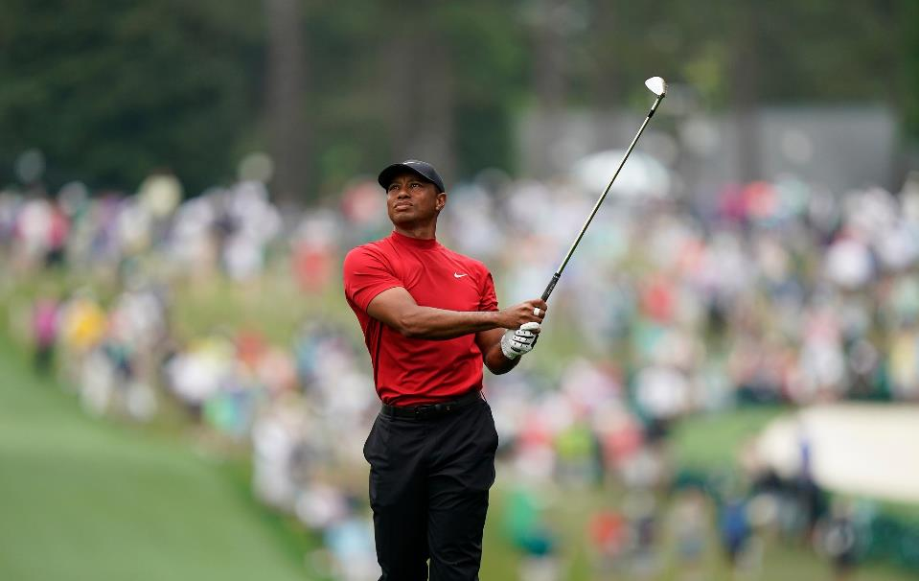
Tiger Woods and the Game of Life:
Golf is all about how you react when you get a bad bounce
Thomas Friedman NYT 4.15.19
Notes:
READ THIS
Friedman says: “Golf is the sport most like life, because it’s played on an uneven surface”
Good and bad bounces are an integral part of the game, and it’s really about how you manage the good and bad bounces

Slide 13
“Tiger Woods and the Game of Life”
“And that leads to another way that golf is so much like life. Each and every round is a journey, and like all of life’s journeys, it’s never a straight line. It’s always full of crazy bounces, self-inflicted mistakes, and unexpected detours, and therefore always a journey of discovery about yourself and your playing partners. And if you love the game, it’s an everlasting journey in search of self improvement.”

Slide 14
Stanford: Resilience Project
“7 Epic Fails Brought to You by the Genius Mind of Thomas Edison (Smithsonian 2013)
How Failure in the Classroom is More Instructive than Success (Chronicle of Higher Education, 2014)
What if the Secret to Success is Failure? (NY Times Magazine, 2011)
All I Need to Know, I Learned When I Failed Out of College (Huffington Post, 2014)
Notes:
This is becoming a topic addressed at the undergraduate level, this is from Stanford.
Also strong curriculum at SMITH COLLEGE
Hopefully if this approach becomes more common, our students will arrive with experience and tools for managing set-backs

Slide 15
Resilience
Ability of the learner to maintain a sense of confidence in the face of failure or adversity
Resilience is enhanced when one has a connection with a trusted other who maintains confidence in the learner
Intelligence and good executive functioning promote effective problem solving

Slide 16
Risk Factors Impacting Resilience
Depression/anxiety with impaired functioning that can be marked and/or threaten safety,
Perfectionism: self-oriented, other-oriented, or socially prescribed
“Imposter Syndrome”: female > male, underrepresented minority, difficulty gaining admission
BLAME and SHAME from others heightens emotional impact
Notes:
In medicine we like “just enough” perfectionism to be great at paying attention to detail
Same with “a bit” of OCD and “just enough” TYPE A
But too much of all of these, we know is not good. We don’t’ know how much is too much, but we know it when we see it….
Difficult with admissions: e.g. English major admitted despite low science scores

Slide 17
Protective in failure
Longitudinal relationships: mentors, faculty, peers
Discussion: ASKING
Re-challenging
Support:
Empathy
Confidence
SHARING
Notes:
ASK:
Experience with failure, times when things did not work out as planned
Coping with failure: how, with whom, what help
SHARING: we will have different comfort levels in sharing our own foibles, but we suggest developing your own failure story, that you CAN and WILL share. In same way we tell students to prep for their residency interviews, with prepared answers to anticipated questions.

Slide 18
Exploring personal failure
Pair up with someone who has the same color handout as you
Discuss a failure
Brief, specific, include emotion
Notes:
Let’s practice talking about a failure experience Brief, concise, from any part of life, specific example with emotion noted
DEEP listening
3-5 min

Slide 19
Don’t fear failure. Not failure, but low aim, is the crime. In great attempts it is glorious even to fail. -Bruce Lee
Don’t fear failure. Not failure, but low aim, is the crime.
In great attempts, it is glorious even to fail. -Bruce Lee
Notes:
This slide is to give the advice of not letting fear of failure shut you down.

Slide 20
FAILURE in Medicine
“Rising to the level of your incompetence”
“Who am I and who do I strive to be?”
“The dangers of feeling like a fake”
“Professional Identity Formation…for humanistic, resilient physicians”
Notes:
This slide is a summary of how physicians/residents/med students describe their failure experiences
Study 1-
-aims to develop a deeper understanding of the impact of underperformance, real or imagined
-28 physicians interviewed about underperformance
-many questioned the validity of their achievements
-success viewed as “rising to the level of your incompetence”
-recognize that not only underperformers struggle
-we must create space for physicians to share their struggles
Study 2-
-highlights the fundamental nature of shame, guilt and pride
-how does this apply to key elements of med ed—perfectionism, prof id formation, and motivation
-aims to encourage self-conscious emotions and develop resilient approaches to learning
Study 3-
-”neurotic impostors”
-classic symptoms—fear of failure, fear of success, perfectionism, procrastination, and workaholism
-how can we support the complex iterative process of PIF within personalized curricular approaches
Study 4-
-3 ideas
-reflective writing
-mindful clinical practice
-professional development portfolio
-”collaborative learning environment”
-”bridges from theory to practice”

Slide 21
Professional Identity Formation
Educational Experience
Faculty Roles
Student Goals
Role modeling
Mentoring
Accurate evaluation
Timely feedback
Failure as opportunity
Professional values
Moral principles
Actions
Aspirations
Ongoing aspirations
Professional Identity
Notes:
Students should learn to embrace failure as part of PIF. It is an important part of becoming a physician.
Part of the educational experience includes helping students develop professionally, such as in dealing with failure.
Faculty should aim to give feedback in a way that is productive and fosters opportunity.
Students should learn the importance of developing moral principles as part of the learning experience.
Honest, growth producing relationships can enhance the learner’s prof identity

Slide 22
EI is related to
Positive Dr/Pt relationship
Increased empathy
Teamwork and communication
Stress management
Notes:
Reviewing failures in positive, growth producing ways promotes EI

Slide 23
Emotionally Intelligent Learning Community
Promotes wellness
Allows for admitting mistakes
Fosters communication, collaborate and conflict resolution
Joanne Cohen-Katz, PhD. et. al
Notes:
Can we create an atmosphere that fosters learning from positive and negative feedback without inducing shame?

Slide 24
How do we teach learners to honestly review their mistakes?
Notes:
They are busy
They have LOTS and OTS of things to do
So do we

Slide 25
What was the experience? Describe the context, key issues, and strengths and weaknesses.
What could you have done better?
What lessons did you learn?
What were you trying to achieve? What were the consequences?
How can you move on from this?
Self Reflection Exercise
Adapted from:“John’s Model for Self Reflection”

Slide 26
Let’s practice…
Return to your pair
Discuss your partner’s failure example with them using the model
Notes:
Each pair go through the model. We will debrief as a large group.

Slide 27
What was the experience? Describe the context, key issues, and strengths and weaknesses.
What could you have done better?
What lessons did you learn?
What were you trying to achieve? What were the consequences?
How can you move on from this?
Self Reflection Exercise
Adapted from:“John’s Model for Self Reflection”
Notes:
I put this here so they can look at it while doing the exercise.
3- 5 min

Slide 28
Self-care facilitates self-reflection
Talk to others
Eat healthy
Get moving
Do your hobbies
Use your spiritual resources

Slide 29
Advice for mentors
SHARE your failure experiences
“Don’t just do something, sit there”
Expect this will be uncomfortable
Watch for risk factors
Recognize students at risk for difficulty managing failure
Notes:
SHARING: we will have different comfort levels in sharing our own foibles, but we suggest developing your own failure story, that you CAN and WILL share.
Don’t avoid the hard conversations

Slide 30
In closing…
There can be growth from failure
Medical educators can positively address failure
We must positively address and share our own failures
Thoughtful self-reflection can go a long way

Slide 31
If you can, look at triumph and disaster and treat those two imposters as just the same. What matters is staying in the game.
Rudyard Kipling
Notes:
We are comfortable talking about success and now are challenged to learn to speak about faillure in the same manner, as they are really two sides of the same coin…

Slide 32
Resources
Arora S, Ashrafian H, Davis R, Athanasiou T, Darzi A, Sevdalis N. Emotional intelligence in medicine: a systematic review through the context of the ACGME competencies. Medical Education. 2010;44(8):749-764. doi:10.1111/j.1365-2923.2010.03709.x.
Aukes LC, Geertsma J, Cohen-Schotanus J, Zwierstra RP, Slaets JP. The development of a scale to measure personal reflection in medical practice and education. Medical Teacher. 2007;29(2-3):177-182. doi:10.1080/01421590701299272.
Bynum WE, Artino AR. Who Am I, and Who Do I Strive to Be? Applying a Theory of Self-Conscious Emotions to Medical Education. Academic Medicine. 2018;93(6):874-880. doi:10.1097/acm.0000000000001970.
Cohen-Katz J, Sternlieb JL, Hansen SE, Dostal JA. Developing Emotional Intelligence in the Clinical Learning Environment: A Case Study in Cultural Transformation. Journal of Graduate Medical Education. 2016;8(5):692-698. doi:10.4300/jgme-d-15-00548.1.
De Vries, MF. The dangers of feeling like a fake. Harvard Business Review, 2005;Sep 83(9):108-116.
Harden, RM and Crosby, J. AMEE Guide No. 20: The good teacher is more than a lecturer—the twelve roles of the teacher. Medical Teacher 2000;22(4);334-347.
Hargreaves, K. Reflection in Medical Education. Journal of University Teaching & Learning Practice. 2016;13(2):1-20.
Jeffrey D. Medical Mentoring Supporting Students, Doctors in Training and General Practitioners. London: Royal College of General Practitioners; 2014.
Bynum WE, Artino AR. Who Am I, and Who Do I Strive to Be? Applying a Theory of Self-Conscious Emotions to Medical Education. Academic Medicine. 2018;93(6):874-880. doi:10.1097/acm.0000000000001970.
Shrank, WH, Reed, VA, Jernstedt, C. Fostering professionalism in medical education: a call for improved assessment and meaningful incentives. Journal of General Internal Medicine. 2004;19:887-892.
Wald HS. Professional Identity (Trans)Formation in Medical Education. Academic Medicine. 2015;90(6):701-706. doi:10.1097/acm.0000000000000731.
Wald HS, Anthony D, Hutchinson TA, Liben S, Smilovitch M, Donato AA. Professional Identity Formation in Medical Education for Humanistic, Resilient Physicians. Academic Medicine. 2015;90(6):753-760. doi:10.1097/acm.0000000000000725.

Slide 33
EVALUATE
Please evaluate this presentation using the conference mobile app by scrolling to the bottom of the session description.

Slide 34
THANK YOU

