Slide 1
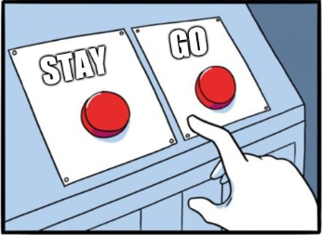
Should They Stay or Should They Go: Best Practices for Remediation of Struggling Medical Learners

Slide 2
Janelle Von Bargen, PhD
Behavioral Health Faculty
Associate Program Director
St. Francis FMRP – Wilmington, DE
6-6-6; 5 faculty
Terri Wall, PhD
Director of Behavioral Health
Behavioral Health Faculty
Sonya Dominguez, MD
Associate Program Director
Family Medicine Faculty
St. Vincent’s FMRP – Jacksonville, FL
10-10-10; 15 faculty
Molly S. Clark, Ph.D., ABPP Associate Professor UMMC Department of Family Medicine
10-10-10; 19 faculty
Melissa Arthur, Ph.D, LMFT Director Behavioral Science St. Joseph’s Hospital FMRP Associate Professor
SUNY Upstate Medical University Departments of Family Medicine and Psychiatry Syracuse, NY
14-15-13- FM, 6- TR- 19- faculty

Slide 3
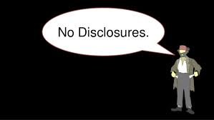

Slide 4
Goals and Objectives
Provide best practice guidelines to improve remediation strategies for the struggling medical learner.
Demonstrate the significance of the Behaviorist as part of the remediation team in FMRPs.
Provide a space to brainstorm ideas around remediation practices and ways to provide a formative learning environment for medical learners.

Slide 5
ACGME and Remediation
Milestones were developed to standardize the competencies for all Medical Learners.
Milestones should be used to categorize/define the deficit in order to support the significance and mandate for improvement.
Each residency program decides their own policies, but you may have Institution specific requirements. Decisions regarding remediation, probation, and dismissal are program dependent (not ACGME regulated).
Each state Licensing Board varies in requirements regarding reporting of remediation and probation status.

Slide 6
Remediation, Probation, and Termination in Residency Training
Remediation- Formal and Informal
Probation- Academic or Professional
Formal and Informal
Termination- Termination or Resigning
Smith, J et.al. Defining Uniform Processes for Remediation, Probation, and Termination in Residency Training. West Journal of Emergency Medicine (2017) Jan; 18(1): 110-113.

Slide 7
Documentation of Plan
Watch for warning signs and start the process early
Detailed documentation:
Deficiencies- specific examples
Expectations- specific and measurable (milestones)
Resources
Timeframe - how long, how often
Monitoring
Completion- Finalized? Documentation trail?

Slide 8
The Remediation Team
Program Specific Considerations
Recommended
PD or APD
GME Director
Behaviorist
CCC Member
Who needs to know?
Advisor (support and advocacy)
Other Faculty/External Preceptors
Chief Resident or Chief of Service

Slide 9
Case Based Activity -
Break into 4 groups - Discuss Case and answer questions – 10 min
Case #1 – 10 min
Case #2 – 10 min
Case # 3 – 10 min
Case #4 – 10 min
(5 min report from group/ 5 minute report what occurred with the real case)

Slide 10
Framework for the Case Discussion
What deficit(s) are you targeting?
What are the specific Milestones?
Specific goals/objectives for the learner?
Who should be included in the remediation process?
What will be the sources of feedback?
How will feedback be structured?
Specific reflection question for the learner.

Slide 11
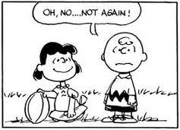
Lessons Learned
Training vs Employment
Human Resources Involvement (roles, expectations)
Logistics – scheduling concerns for time away, repeat rotations, residency extensions,
Privacy vs Transparency- responsibility to warn others?
Evaluations –
internal/external
Negativity vs Positivity Bias
Terminology
Coaching-corrective action-remediation probation-termination- resignation
Academic vs Professional Probation
Residency Fallout

Slide 12
Resources
Peers
HR
Uploads
Remediation form examples
Detailed outline of info

