Slide 1
One Physician’s Story: The Patient’s Voice
Macaran A. Baird, MD, MS
Professor and Head,
Department of Family Medicine & Community Health
September 14, 2017

Slide 2
Learning Objectives
By the end of this session, participants will:
Reflect upon the personal theme of facing our own mortality and a physician’s role as a patient
Be able to notice variations in the “personal voice” of this physician/patient
Discuss how gratitude and social factors influence one’s experience when facing serious illness

Slide 3
Personal Story
Grew up in small MN town, supportive parents
Two older sisters developed serious health problems as young adults
Positive experiences in school, college, sports, life
Married at 21 years, just celebrated 48th anniversary
Optimistic outlook, sometimes overly so

Slide 4
Why Family Medicine?
Wanted a rural life, full spectrum of care options
Couldn’t understand individuals without context
First context is family, then community, work, environment
Wanted to humanize medical care, education

Slide 5
This Physician’s Story
Rural family physician/therapist in MN – Five years
Residency Director, Oklahoma – Three years
Department Chair - SUNY, Syracuse – Eight years
Director of Primary Care - HealthPartners, MN – Four years
Professor & Med Director of health plan for Mayo Clinic – Three years
Professor and Chair - U of Minnesota DFMCH – Fifteen years
Chairman of Board, UCARE

Slide 6
2012-2013: My Illness & Recovery
MI in July 2012 while cycling north of Duluth, MN
Sept. 22-23, 2014 – sailing on Lake Pepin, MN
Then things really changed!

Slide 7
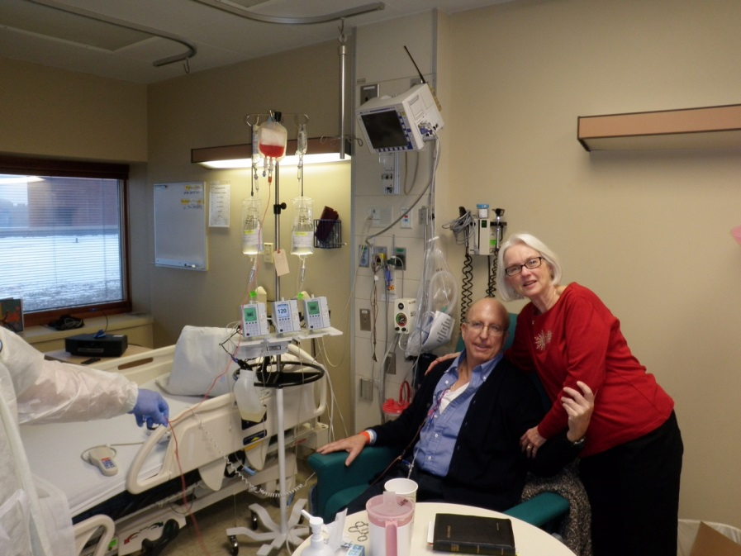
“This is like we landed on a new planet!”
(spousal voice – Kris Baird)

Slide 8
Dx: Acute Lymphocytic Leukemia, Philadelphia Chromosome +
Sudden need to adapt as physician, husband, father, academic leader, family
Immediate positive response to chemo: WBC decreasing, much nausea, immediate vomiting and rigors-treated with Demerol, fatigue, weight loss
Phase B treatment, more toxic to heart and lungs-anemic, accelerated angina, urinary retention, bleeding

Slide 9
Patient, Family Voice
Intensely connected to my hematologist & team
Still connected to my family physician, FM faculty
Acceptance & grateful even for a chance to say good-bye to everyone: spouse, children, friends
Grateful to physicians, staff & those who “went before me”
Assertive voice occasionally
Curious, engaged, sometimes playful

Slide 10
2012-2013: My Illness & Recovery
With transfusion Hgb 8-9 gms, platelets 10,000- 20,000: intermittent bleeding
October 19, 2012 – urgent angiogram: resignation since it could show non-treatable lesions, but all stints were open
Demand side MI – 15 hours of chest pain: OK to let go but could not tolerate continued pain. Then the pain improved, active voice & teamwork with ICU nurses and physicians helped
Decrease in kidney function: multiple angiograms & my second MI within four months, then decreased in cardiac output – pleural effusion, increased pulmonary artery pressure---Difficult time
Submitted paper to Family Medicine – “No Time for Complacency” – published in 2014 (Baird MA. Primary Care in the Age of Reform-Not a Time for Complacency. Fam Med 2013;46(1):7-10.)

Slide 11
Discharged to Home with Family
January- March 2013 – isolation status at home
April 2013, still having angina, resolved slowly each time, improved with large doses of long-acting nitrates and blood, platelet transfusions
Edema and nausea, night sweats, wild dreams
Family worries: impaired immune status, managing central venous line, daily heparin, will transplant work?
Tolerance for ongoing chemotherapy for 12 months, many side effects

Slide 12
Recovery at Home
“Tigger Symptoms” from low platelets
Remained in relative isolation at home for a total of 100 days from transplant
Daily visits to Bone Marrow Clinic at U of MN
Returned to Part Time Work U of MN – May 1, 2013
Shingles, then post-herpetic neuralgia x 7 months

Slide 13
Three Symptoms of a New “Syndrome”
First symptom - First five nights at home
Second symptom - Irregular respirations, plus tearful speech when talking
Third symptom - Heart sound changes
~~~
4. Now Named: The Overwhelmingly Grateful Syndrome – O.G.S.

Slide 14
Variations in my “Voice”
Optimistic
Pragmatic
Assertive
Playful
Receptive
Grateful

Slide 15
Career & Life Risks / Struggles
Decide when do we need our voice to be:
Optimistic, pragmatic, assertive, playful, receptive, grateful
Can this type of voice modulation be transmitted to others via example or genetically?

Slide 16
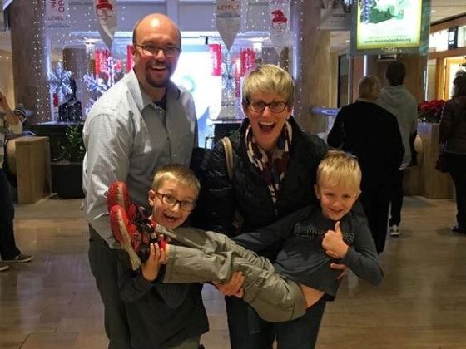

Slide 17
