Slide 1
Curriculum Design and Development: A Behavioral Science and Family Systems Focus
Julie M. Schirmer, LCSW
Matt Martin, PhD
Theodore Siedlecki, Jr., PhD

Slide 2
Disclosures
We have nothing to disclose.

Slide 3
Objectives
1) Apply the Core Principles of Behavioral Science, Family Medicine residency requirements, and stage theory to guide curriculum design.
2) Understand the multiple factors and use available resources that contribute to effective curriculum design.
3) Develop a beginning action plan, with multiple stages, that will guide curriculum efforts immediately and in the years to come.

Slide 4
When you have seen one FM residency…
Notes:
Every Family Medicine residency has to impart a core set of knowledge, skills, and attitudes to help their residents achieve competency. But the distinctive nature of each residency’s setting demands a unique curriculum design. On this worksheet we have identified some of the program characteristics relevant to curriculum design. Take 3 minutes to complete this worksheet to describe your residency. For today’s purposes, it is fine to estimate or guess.

Slide 5
Who is in the audience?
Stage of career development
New: 1-3 years
Mid: 4-10 years
Seasoned: 11+ years
University versus community based?

Slide 6
Who is in the audience?
Developing curriculum from scratch
Making a well-developed curriculum your own
Fulcrum* in the middle
* Fulcrum: the point on which a structure rests or is supported and on which it pivots.
Notes:
Audience scan:
1) career development: new: 1-3 years; middle: 4-10 years or later stage of faculty career in family medicine: 11+ years
2) setting: university, community, hybrid
3) Present curriculum stage: developing curriculum from scratch to well-developed curriculum, where you are making the curriculum your own

Slide 7
Stage Theory

Slide 8
The importance of
proper scaffolding

Slide 9
Elegant structures that last

Slide 10
Standards, Guidelines, and Milestones
Notes:
So we mentioned that every Family Medicine residency has to impart a core set of knowledge, skills, and attitudes to their residents. So where do we find what that core set is?

Slide 11
Are we covering the basics?
Notes:
When designing, reviewing, and evaluating our curriculum, we ought to consult three important resources:
-First are the ACGME Requirements for Family Medicine residencies. The ACGME is the Accreditation Council for Graduate Medical Education. It is the accrediting body for all medical residencies in all specialties. So this is the foundation.
-Second is the Recommended Curriculum Guidelines for Family Medicine Residents on Human Behavior and Mental Health developed by the AAFP (American Academy of Family Physicians). This document fleshes out ways to meet the ACGME requirements.
-And third are the Family Medicine Milestones which were developed jointly by the ACGME and the American Board of Family Medicine. The Milestones are how residents are evaluated, and so you might think of them as the goals and objectives of your curriculum.
optional notes:
[Guidelines also endorsed by the American Psychiatric Association (APA), the American Psychological Association (APA), the Association of Departments of Family Medicine (ADFM), the Association of Family Medicine Residency Directors (AFMRD), and the Society of Teachers of Family Medicine (STFM)}

Slide 12
ACGME Requirements for Family Medicine
IV.A.5.d) | Interpersonal and Communication Skills Residents must demonstrate interpersonal and communication skills that result in the effective exchange of information and collaboration with patients, their families, and health professionals. Residents are expected to:
IV.A.5.d).(1) | communicate effectively with patients, families, and the public, as appropriate, across a broad range of socioeconomic and cultural backgrounds;
IV.A.5.d).(2) | communicate effectively with physicians, other health professionals, and health related agencies;
IV.A.5.d).(3) | work effectively as a member or leader of a health care team or other professional group;
IV.A.5.d).(4) | act in a consultative role to other physicians and health professionals; and,
Notes:
The ACGME accreditation requirements are comprehensive. They cover every aspect of a residency, and they are written in broad strokes. This is an example from the section on the competencies residents are expected to achieve. It is good to be familiar with this document, but I find it hard to work from directly.

Slide 13
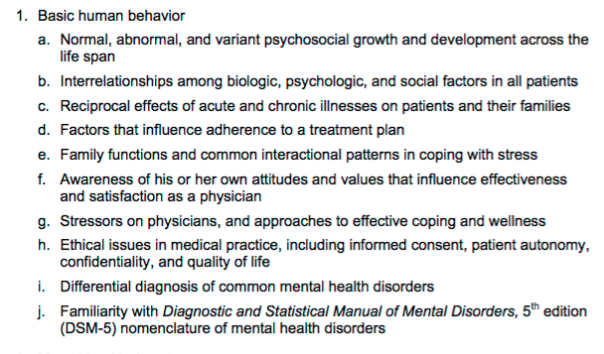
Curriculum Guidelines: Human Behavior and Mental Health
Notes:
The second resource, the Curriculum Guidelines, are more specific about the areas to be covered in our curriculum. This is an example of one section.

Slide 14
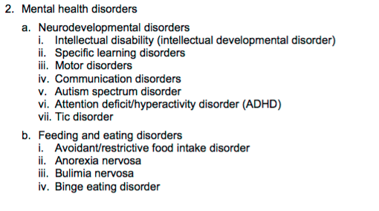
Curriculum Guidelines: Human Behavior and Mental Health
Notes:
And then the Guidelines drill down to even more specifics of topics to be covered. I found this helpful when looking for gaps in what we have covered in our didactics.

Slide 15
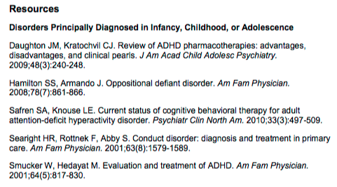
Curriculum Guidelines: Human Behavior and Mental Health
Notes:
The Guidelines also provide very useful resources for each of the areas to be covered. Here is one example.

Slide 16
Family Medicine Milestones
ACGME Competency | Family Medicine Sub-competencies
PATIENT CARE | 5
MEDICAL KNOWLEDGE | 2
SYSTEMS-BASED PRACTICE | 4
PRACTICE-BASED LEARNING AND IMPROVEMENT | 3
PROFESSIONALISM | 4
COMMUNICATION | 4
Notes:
The third resource, the Milestones, are competency-based developmental outcomes. They are important because resident progress is assessed using these milestones.
The Milestones, are organized around the 6 core ACGME competencies (Patient Care, Medical Knowledge, etc).
And Family Medicine has identified sub-competencies within each of these areas, resulting in 22 sub-competencies.
--Note if someone asks: EPAs (Entrustable Professional Activity) may incorporate multiple competencies.

Slide 17
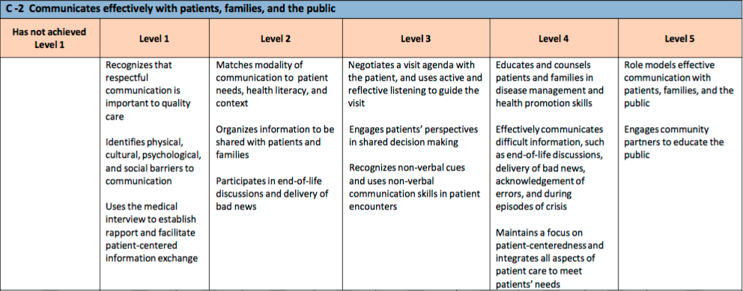
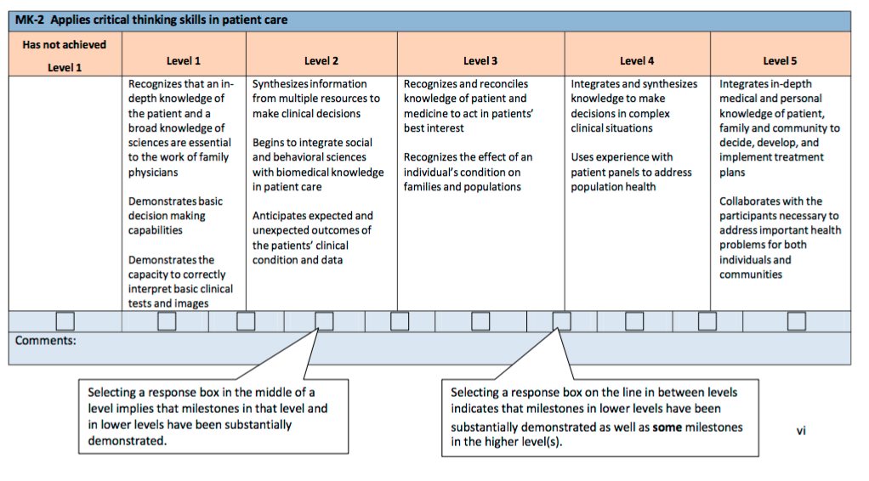
Family Medicine Milestones
Notes:
Here is an example of one Communication sub-competency: C-2 Communicates effectively with patients, families, and the public.
Each sub-competency has specific behavioral milestones, such as this one in Level 2: Matches modality of communication to patient needs, health literacy, and context.
There are 5 levels of competency, and Level 4 is designed to be the graduation target. Level 5 is aspirational.

Slide 18
Covering the Basics
ACGME Requirements for Family Medicine
Curriculum Guidelines: Human Behavior and Mental Health (AAFP)
Family Medicine Milestones (ACGME & ABFM)
Notes:
So, in summary, these 3 resources are useful to review as you plan your curriculum. We gave you the references on our Resource List. Now Matt will review some principles to keep in mind as you design your learning activities.

Slide 19
Curriculum Development

Slide 20
Learning Theory
Goal: make it easy for the learner
Three levels
Cognitive: what should I study?
Affective: why should I study?
Metacognitive: How do I study?

Slide 21
Learning Theory: Application
Create clear objectives, methods, and outcomes
Example: alcohol screening
Objective: to understand and demonstrate evidence-based alcohol screening protocol
Method: lecture, video, role play
Outcome: you observe resident skillfully using AUDIT

Slide 22
Learning Theory: Application
Allow learners to periodically choose topics that interest them
Example: resident teaching
Require residents to present or lead a discussion on a topic of their choosing

Slide 23
Learning Theory: Application
Evaluate the quality of the learning experience and make adjustments
Collect data
OSCE: beginning and end of year
Satisfaction surveys
Make adjustments based on feedback and performance

Slide 24
Learning Science
Take advantage of brain research by reading “Brain Rules” (John Medina)
Read it with entire faculty

Slide 25
My Favorite Rules
Rule #3: People don’t pay attention to boring things
Make transitions every 10 minutes using engaging, emotion-laden events
Rule #7: Stressed brains do not learn the same ways as non-stressed brains
Lead mindfulness exercise before your presentation
Rule#10: We are powerful and natural explorers
Give learners cases to diagnose using the DSM-5

Slide 26
Core Principles

Slide 27
Maine Medical Center FMRP
What we do well:
Interprofessional student teams
Integrated behavioral health
5th Stage: all faculty “own” behavioral health
Curriculum Development Goals:
Behavioral Health rotation
Spread of SBIRT throughout the teams
Enhanced integration of behavioral health issues into monthly SIM cases
Notes:
Brief description: 7-7-7 resident/year; community based with a relatively new med school affiliated with Tufts; IM, Sports Med and Preventive Med fellowships
Review and link what we do well and curriculum goals

Slide 28
University of Virginia FMRP
What we do well:
Interprofessional training with Clinical Psychology
Brief counseling; BATHE; M.I.
Emotional intelligence and awareness.
Self-care.
Curriculum Development Goals:
Enhance video observations
Non-pharmacological pain interventions
SBIRT training and incorporation into clinic routine

Slide 29
Duke/SR-AHEC FMRP
What we do well:
Substance use prevention
Health literacy
Integrated behavioral health
Community medicine
Quality Improvement
Curriculum Development Goals:
Inpatient observation and teaching
Outcome-based learning

Slide 30
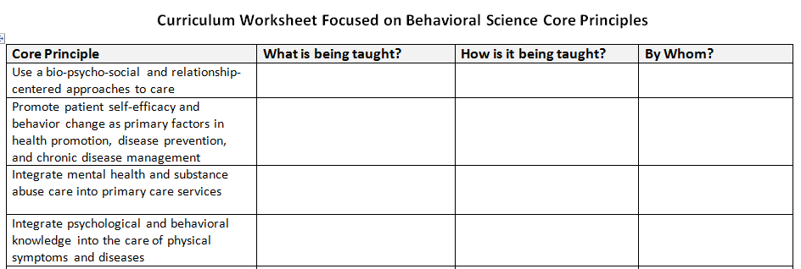
Individual Curriculum Worksheet

Slide 31
Individual Curriculum Plans

Slide 32
Triads

Slide 33
Take Home Points
Curriculum building is an ongoing developmental process
Standards guide what you do and how you build
Resources ground your curriculum
Department resources enhance or limit what you can do
Next steps: evaluate and measure

Slide 34
Please evaluate this presentation using the conference mobile app! Simply click on the "clipboard" icon on the presentation page.

