Slide 1
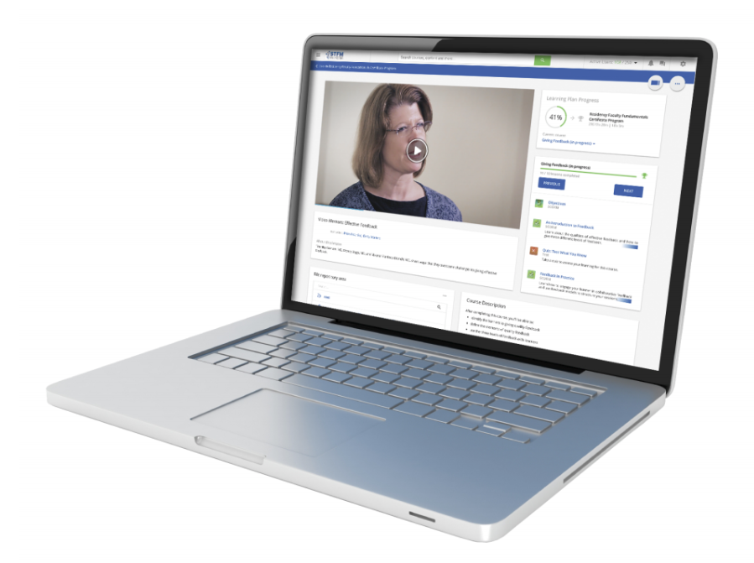
Training Our Educators:
Using the STFM Residency Faculty Fundamentals Certificate Program

Slide 2
Presenters
Paul Afek, MD
Jennie Jarrett, PharmD, MMedEd
Anjani Kolahi, MD
David Lick, MD, MPH, MBA;
Kate McCalmont, MD
Minerva Medrano de Ramirez, MD
Daniel Stulberg, MD
Emily Walters
Christine Young, MD

Slide 3
Objectives
Affirm the importance of timely faculty development for new faculty that provides the proper tools to ensure success as an educator.
Use a faculty development framework that addresses common gaps in the fundamental skills and knowledge of residency faculty educators.
Describe specific ways that graduates of the certificate program have gained institutional support and made time in their busy schedules for this model of faculty development

Slide 4
The Problem
There is a national shortage of Family Medicine faculty that is expected to worsen with increased demand for family medicine physicians
STFM Residency Accreditation Toolkit, STFM Launches Initiative in Response to Faculty Shortage. Ann Fam Med. 2015 May; 13(3): 290–291

Slide 5
The Need for Intervention
Residency programs need to:
Prepare faculty for success
Provide them with the necessary tools to perform the roles that are being requested of them
Provide role-modeling, mentoring, and support to new faculty

Slide 6
Effective Faculty Development
Is related to the context of practice
Gives participants opportunities to apply learning in the workplace
Sets goals and provides feedback
Makes needed change clear and feasible
Ensures transfer of learning
Cilliers FJ, Tekian A. Effective Faculty Development in an Institutional Context: Designing for Transfer.
Journal of Graduate Medical Education. 2016;8(2):145-149.

Slide 7
Potential Strategies & Their Limitations
Attending CME or national meetings
Lacks follow up and accountability
Institution-based faculty development
Tends to be sporadic and generalized
Often very basic
Individual mentoring
Time
Inconsistent, unstructured
Bad mentors yield bad outcomes
Good mentors get overwhelmed
Faculty development fellowships and advanced degrees (MMed, MPH, etc.)
Expense
Time
Faculty interest?

Slide 8
The Advantages of Online / Asynchronous Learning
Allows for on-demand learning
Self-paced
Can fit into a variety of busy schedules
Allows opportunities for reviewing/revisiting material
Does not require time away from the program
Typically less expensive

Slide 9
What is available to address these needs?

Slide 10
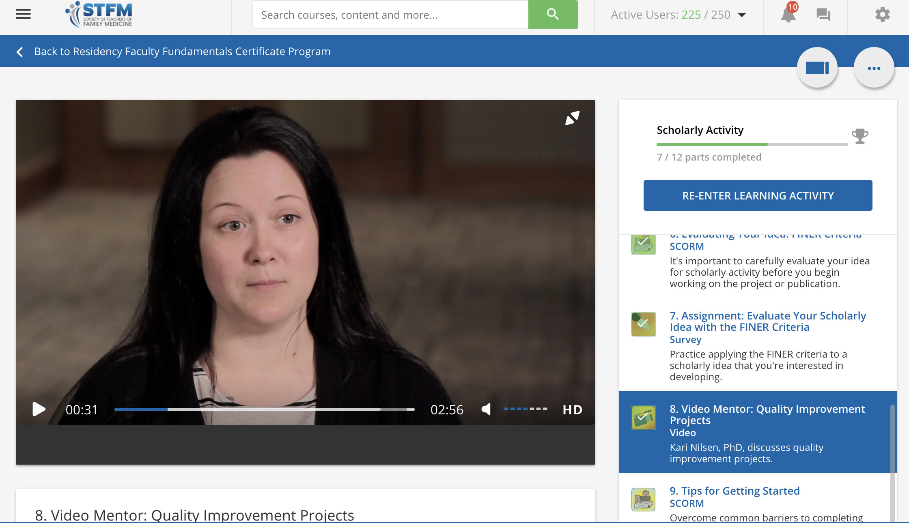
Residency Faculty Fundamentals Certificate Program
Developed by STFM under the guidance of the GME Committee
Launched June 2017
30 CME credits available
Online training in fundamental topics pertinent to ALL faculty
$995 for STFM members $1,495 for non-members

Slide 11
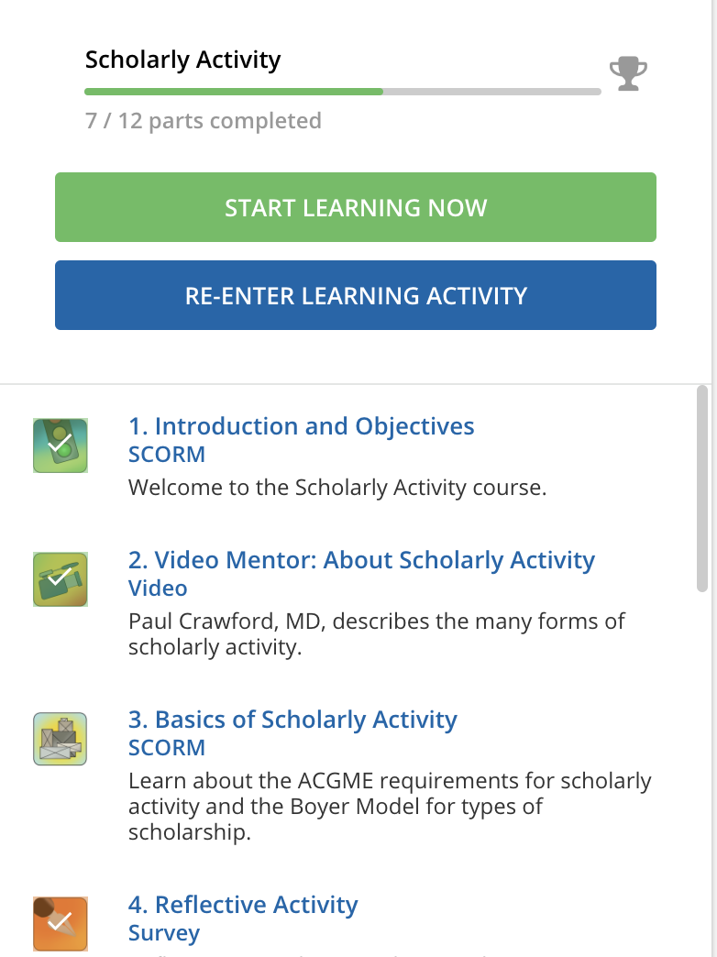
Certificate Program Content
14 courses on key topics
Individual courses include:
Interactive learning modules
Readings
Videos
Assignments
Reflective activities
Quizzes

Slide 12
Course List
ACGME Program Requirements
Competencies, Milestones, and EPAs
Structure and Funding of Residency Programs
Billing and Documentation Requirements
Recruiting and Interviewing Residents
ABFM Rules and Requirements
Scholarly Activity
Writing for Academic Publication
Curriculum Development
Didactic Teaching Skills
Clinical Teaching Skills
Assessment and Evaluation
Giving Feedback
Residents in Difficulty: Academic and Behavioral Problems

Slide 13
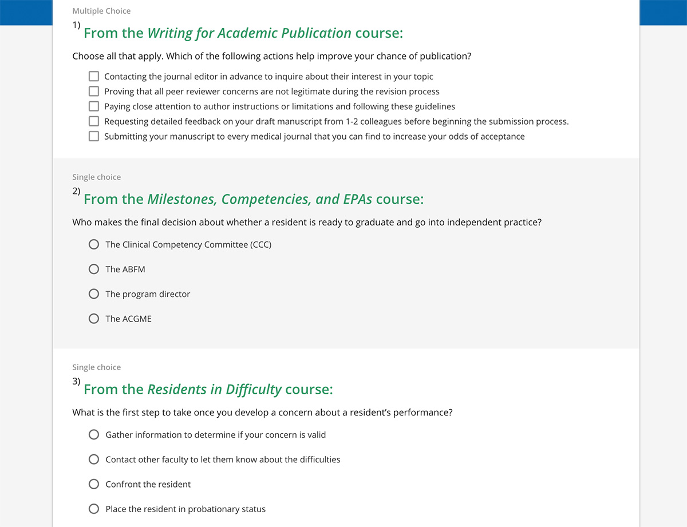
Certificate Program Content
Subject matter experts created the content of each course
Developed & reviewed by the GME Committee
Pre-test and post-test to evaluate improvement
Faculty Instructors provide feedback on select assignments

Slide 14
Self-Directed Learning
Clear, concise content in multiple modalities
Frequent quizzing and learning checks
Video mentors: stories & advice from experienced faculty
Assignments that require interactions with senior faculty and others at the program

Slide 15
Demonstration

Slide 16
Data from 22 months since the launch of the Certificate Program
Over 296 learners enrolled since launch in June 2017
Over 111 institutions have had faculty in the program
Includes learners from 40 states
41% of graduates have less than 1 year experience as faculty
47% of graduates have 2-5 years experience as faculty

Slide 17
Learner Professional Roles

Slide 18
Outcomes
Average pre-test score: 55.49%
Average post-test score: 93.68%
Many learners pick a timely topic or two to start with, then proceed in order from the beginning
Self-reported hours to complete the course averaged 40-50 hours.
The top 3 most effective courses
Structure and Funding of Residency Programs
Curriculum Development
Giving Feedback
93% of graduates said the information in the program was at the right level for them
Notes:
Most learners start at the beginning and then proceed in order…
…but many pick a timely topic or two to start with, then proceed in order from the beginning
93% said the material was at the right level for them
95% said the feedback from the faculty was helpful

Slide 19
Feedback from Learners
“Forced the learner to dig deeper than I would have as a normal core faculty. I also thought the research module was very helpful as doctors including myself get scared of the word ‘research’.”
“I liked that it was an internet based program that allowed me to do it at my own pace based on my clinical schedule.”
“It felt comprehensive, for a new faculty member. It allowed me the time and space to develop a research project, multiple curricular endeavors, and gave me a bunch of new approaches to clinical precepting. Well written! Loved the video interviews! Appreciated the mini quizzes and all of the written assignments!”
Several learners were surprised at how often they needed to “bother” their program directors.

Slide 20
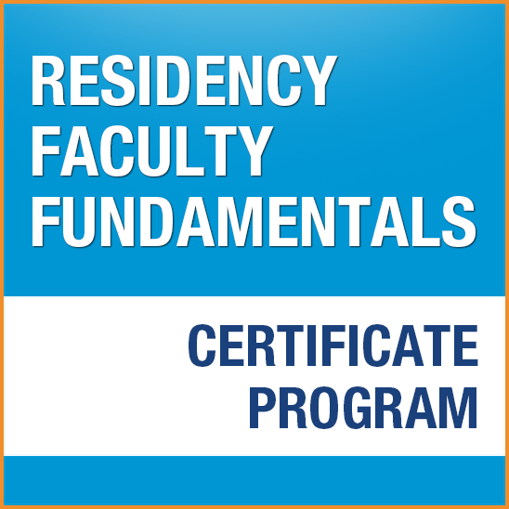
A Graduate’s Experience
Christine Young, MD
Assistant Program Director Mount Carmel Family Medicine Residency Westerville, OH

Slide 21
Residency Faculty Fundamentals in New Mexico: Integrating E-Learning Modules with Interactive Multi-Residency Collaboration
Kate McCalmont, MD
Dan Stulberg, MD
Paul Afek, MD
Minerva Ramirez, MD
Anjani Kolahi, MD

Slide 22
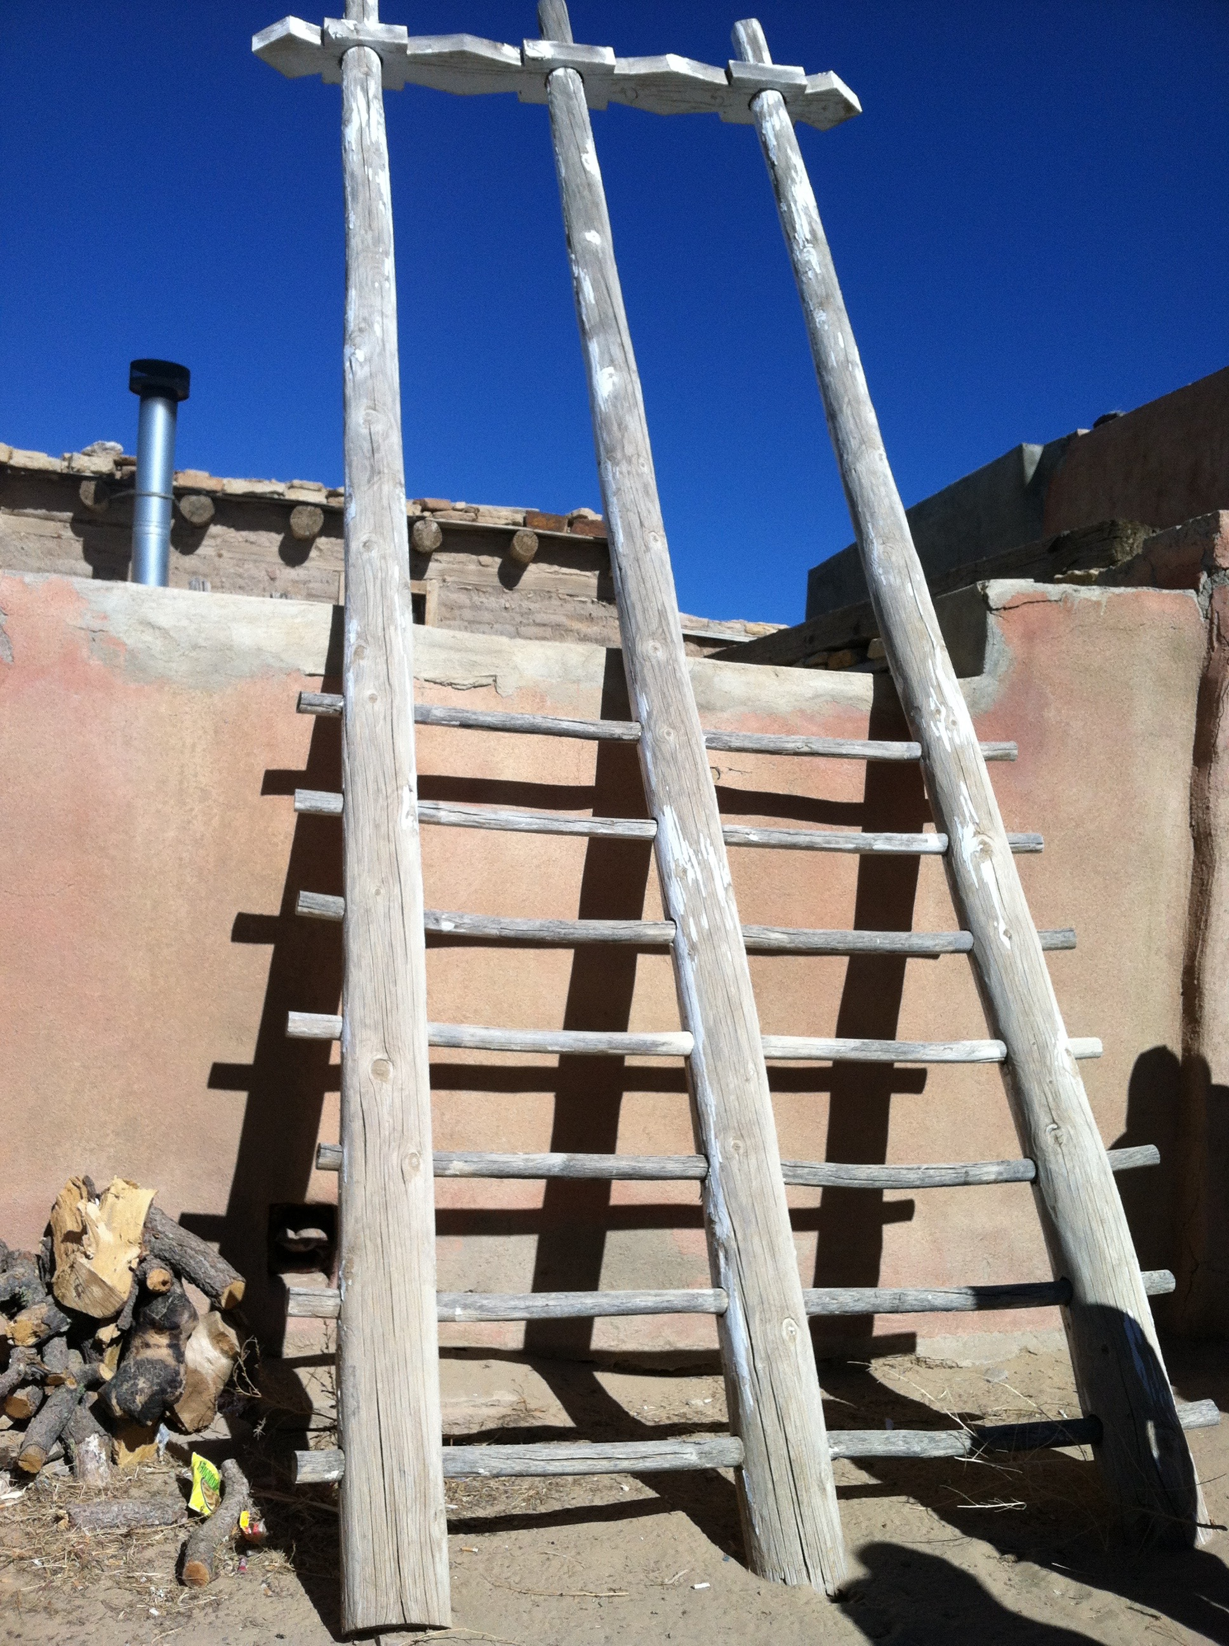
Development
Addressed need for formal faculty development
Collaborative approach with New Mexico Primary Care Training Consortium
Mission of NMPCTC to promote education, faculty development
Three programs across the state were engaged
Payment for course by respective programs for faculty to participate

Slide 23
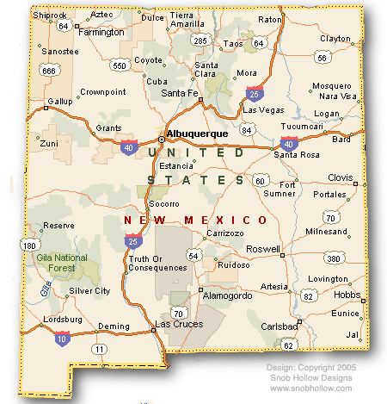
4 Residency Programs in New Mexico Two 3 year programs and one 1+2 program participated

Slide 24
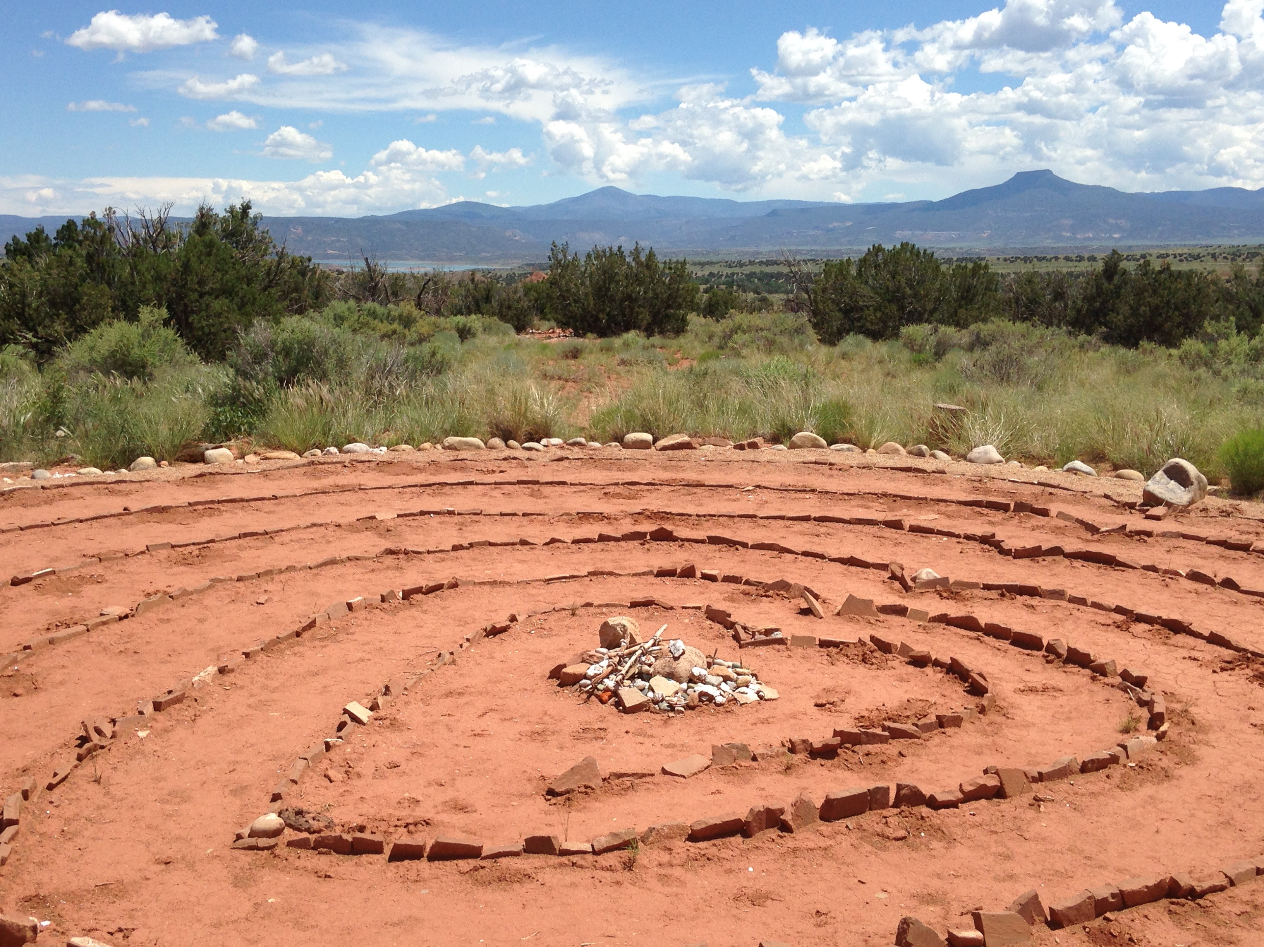
Time Commitment
Meetings:
Every other month for 2 hours (after hours or on weekend)
Met 7 times over the course of 1 year
Difficult for all faculty participating in the course to attend every meeting, but dates and times were adjusted to accommodate schedules as much as possible

Slide 25
Format of Meetings
Moved locations throughout the state
Albuquerque, Socorro, Santa Fe
Used Zoom to allow participants to call in/attend by video
Reviewed content and assignments from RFF modules
Group discussion, small group or partner activities
Role playing

Slide 26
Content
Covered 2 modules from the RFF course each time
Group selected modules that were pertinent to activities at that time of year
Reviewed resident evaluation module before CCC meetings
Scholarly activities before STFM abstract submission deadline
Shared experiences and responses to activities
Contacted residency director and DIO as a group for responses to certain assignments

Slide 27
Outcomes
Number of total participants
8 UNM, 2 Las Cruces, 2 Santa Fe
Guest participants (new faculty)
Participants at meetings
6 average (range 3-9)
Number who completed the course
5 completed
3 extended

Slide 28
Integration into Existing Promotion Requirements
UNM requires completion of courses through the Office of Medical Education
Large group teaching, small group teaching, feedback, mentorship, developing curriculum
The RFF course was accepted as an equivalent pathway for promotion to Assoc. Prof.

Slide 29
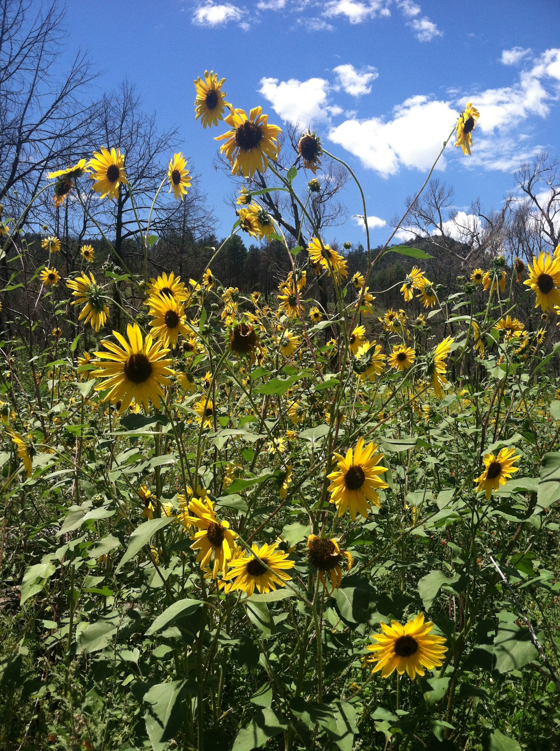
Reflections from Participants
Teaching theory, strategies for precepting were helpful
Contributed to sense of camaraderie and wellness among faculty
Working together was less isolating
Some aspects very specific to residency administration
Useful to share ideas across residency programs (from long-established programs to newly developing residencies)
Large and small programs

Slide 30
Other Models for Professional Development at UNM
Medical Education Scholars Program
Stanford Course: Excellence in Clinical Teaching Program
Achievement in Medical Education Program (prescribe courses through Office of Medical Education required for promotion)

Slide 31
Questions?

Slide 32
Audience Activity
Discuss with the person next to you:
1.) What are the topics for faculty development that are most needed at your site? (strategies for teaching in clinic, best practices for precepting, resident evaluation, supporting a struggling learner, presentation of didactics)

Slide 33
Audience Activity
Discuss with the person next to you:
2.) What format for faculty development do you see being the most useful and practical at your site (online, small group, presentation in large faculty meeting)?

Slide 34
Audience Activity
Discuss these questions with the person next to you:
3.) What are the next steps for implementing a program for faculty development at your site?

Slide 35
Take-Home Points
Programs need to equip faculty with the necessary tools to succeed as educators
Online education such as the STFM Residency Faculty Fundamentals Certificate Program can prepare new faculty members or provide additional training to established ones
The program can be used both individually or as part of a structured collaborative program for faculty development.

Slide 36
Thank you!

Slide 37
Disclosures

Slide 38
Please evaluate this presentation using the conference mobile app! Simply click on the "clipboard" icon on the presentation page.

