Slide 1
Diversity, Equity, and Inclusion in Academic Medicine: Moving from Awareness to Action
Tessa Rohrberg, MD | Kari Nilsen, PhD
Lynn Fisher, MD | Colleen Loo-Gross, MD MPH
Samuel Ofei-Dodoo, PhD | Morgan Weiler, MS4
Julie Galliart, EdD
University of Kansas School of Medicine- Wichita
Departments of Family & Community Medicine, Pediatrics, and Faculty Affairs
Notes:
Tessa: Good morning! Thank you for joining our group from the University of Kansas School of Medicine in Wichita. We get to share with you today some of the exciting progress our institution is making in DEI efforts.

Slide 2
Disclosures
None.

Slide 3
Objectives
Describe different ways of promoting diversity and inclusion at one’s own institution.
Identify themes from one university’s diversity and inclusion survey.
Identify how to implement similar surveys in their own institution.
Discuss successful and unsuccessful methods of increasing involvement in diversity and inclusion activities.

Slide 4
University of Kansas Medical Center (KUMC)
Background
KU School of Medicine (Kansas City, Wichita, Salina)
KU School of Health Professions (Kansas City)
KU School of Nursing (Kansas City, Salina)
KU School of Pharmacy (Lawrence, Wichita)
Mission
To improve lives and communities in Kansas and beyond through innovation in education, research, and health care.
Notes:
Tessa: The University of Kansas Medical Center has many components, with our main medical campus located in Kansas City, KS and regional campuses in Wichita and Salina, KS. Our group speaking today is located on the Wichita campus. We will touch on efforts from KUMC as a whole and on our regional campus.

Slide 5
Purpose
A strong commitment to DEI efforts helps attract and retain skilled and talented persons dedicated to excellence in education, research, patient care, and community and global initiatives.
Those attending more diverse institutions self-rate as better prepared to care for patients.
Family medicine residency applicants rated the cultural/racial/ethnic diversity of both the community and the program/institution a 4.3 out of 5 in importance in 2021.
Notes:
Tessa: Diversifying the healthcare workforce is essential for high-quality, high-value, culturally effective care.[1,2] Beyond educating more physicians from groups that are under-represented in medicine, students attending more diverse institutions self-rate as better prepared to care for patients.[3-5] Today, we will describe a campus-wide plan to address issues related to DEI through a continuous quality improvement model. Our current efforts, as well as projects in development, will be shared, and we will finish with time for audience discussion.
Now, Dr. Fisher will get us started.

Slide 6
KUMC Current Efforts
DEI Cabinet
Student admissions and selection
Rural Scholars
MEDPATH
Medical student curriculum initiatives
Student organizations
Student-led free health clinics
Students under-represented in medicine
Scholarships
Urban Scholars program
Affinity groups
Trainings
Safe Zone
Unconscious Bias
Notes:
Lynn – DEI Cabinet, Admissions
Kari – Rural Scholars, MEDPATH
Tessa – Student curriculum
Morgan – Student organizations, JayDoc
Samuel – Scholarships
Colleen – Affinity Groups
Julie – Trainings
Lynn: The KUMC DEI Cabinet is made up of representatives of all 3 campuses and from all the schools. A recent effort by the cabinet includes required campus wide training modules on various DEI topics. The committee also puts together various programming throughout the year and hosts an annual DEI Symposium. Last year’s theme focused on Care for Transgender Patients and this year’s theme will focus of care of Veterans.
Our student admissions and selections committee has been more purposeful in training interviewers about DEI in the past year. We also had an admission’s task force specifically evaluate how well our admission and selection committee forms consider a medical school applicant’s understanding of inclusion, diversity, equity, anti-racism, and social justice. Consequently, we have seen an increase in the number of underrepresented in medicine admitted to KU.
Kari: The Scholars in Rural Health program identifies undergrads from rural Kansas who are interested in building successful future careers as primary care physicians serving underserved rural areas. Sophomores in college apply for the program and undergo an interview process. If accepted to the program, once a student complete its requirements, successfully graduates from their undergraduate institution, and passes the MCAT with a score of 500 or above, they are assured admission to KU School of Medicine.
The MEDPATH Post-Baccalaureate Program is a twelve-month program designed to strengthen the biological and social sciences foundation of students preparing for careers in medicine. MEDPATH exists to create an institutional environment of appreciation of diversity and is a part of an educational pipeline for underrepresented students. The program aims to recruit and retain diverse students, and ultimately develops culturally and linguistically competent physicians who will work to eliminate health disparities and promote health disparity research.
Tessa: KUMC offers a variety of non-clinical and clinical DEI electives, including some that are in development. Additionally, the School of Medicine is conducting a systematic review of its curriculum for instances of bias and ensuring our DHEI learning objectives are purposefully addressed.
Morgan: The following are efforts led by students in hopes to create a more diverse medical student population and also engage local community in both Wichita and Kansas City.
Jaydoc clinic is a free student led clinic has been serving uninsured and underinsured populations in the greater Kansas City area since 2003. The vision came from a third year medical student who saw the need for equitable care for a large portion of the community. This cooncept later came to the Wichita campus and a second Jaydoc clinic was established in the heart of downtown Wichita. Today there are two Jaydoc clinics serving local community members. To date there are hundreds of patients who have had access to healthcare thanks to these clinics. Along with Jaydoc include a variety of student led organizations that continue the campus goal to create a welcoming inclusive environment.
Samuel: Urban Scholar Program and Sheffield Scholar Program
Colleen: One of the efforts our institution has made to create a more inclusive environment has been the creation of affinity groups. These include:
a group for faculty of color (FOCUS – Faculty of Color United in Support), providing a safe space to engage in meaningful dialogue and advance the understanding of both opportunities and challenges within our institution;
a group for faculty, staff, and students interested in advocating for LGBTQIA+ individuals, (PRISM) with overarching goals of enhancing visibility, fostering allyship, and empowering conversations that inspire systemic change;
as well as a group for individuals who are visiting or have immigrated to the US (INSPIRE – INternational Students and Professionals Interconnected in Research and Education), providing a space to share their academic and lived experiences as members of our community.
Julie: Trainings – Two trainings have become routine offerings across KUMC. A lot of medical schools and other organizations offer Unconscious Bias training, so I won’t say much about that. Safe Zone, though, is an LGBTQ + ally development program. Both trainings have trained facilitators to facilitate routine delivery of the trainings, both of which are open to any interested members of the campus community.

Slide 7
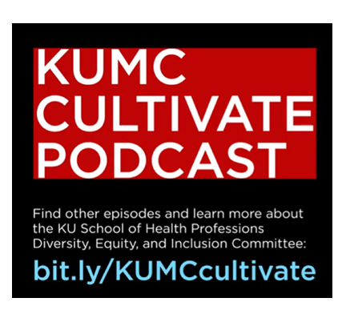
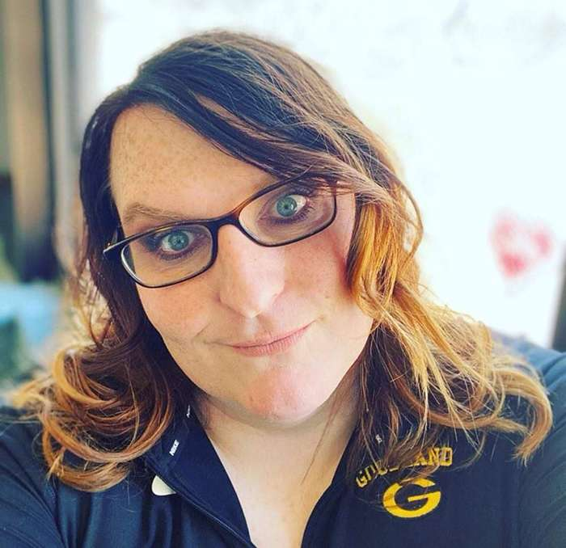
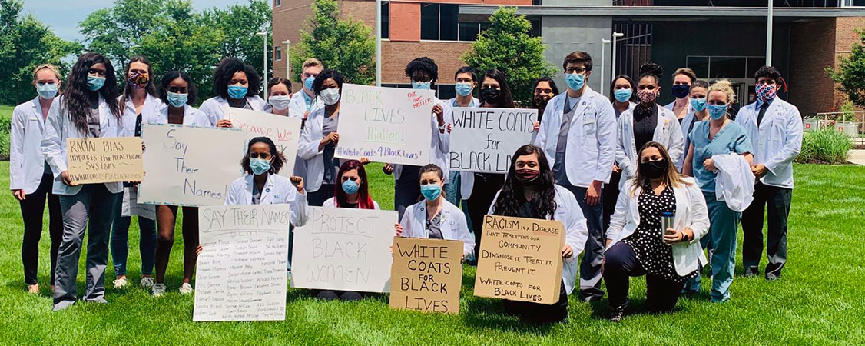
Notes:
Tessa: Here are some other examples of activities on our campus – the School of Health Professions has a DEI-based podcast available on many platforms. We have hosted screenings and discussions on the documentary Black Men in White Coats, along with a six-part educational series on structural racism. And Tori Gleason is a Master of Public Health student through our online Wichita campus who is working on projects to achieve health equity in the LGBTQ+ community in western rural Kansas.

Slide 8
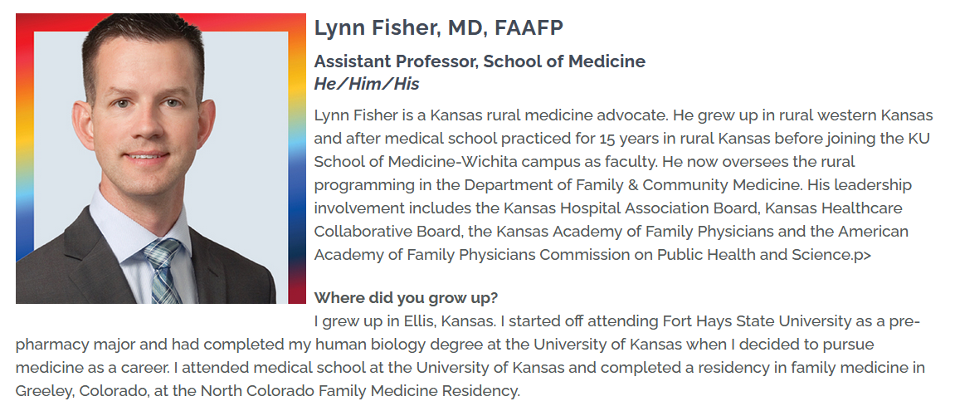
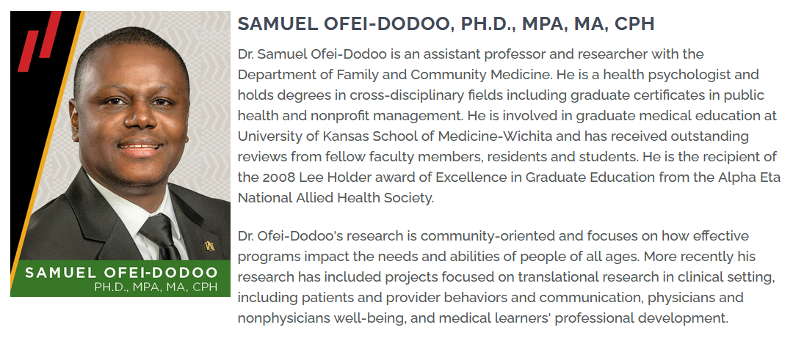
Notes:
Tessa: KUMC also coordinates events and programs to celebrate the heritage and diversity of our community members. Here are a couple examples of KUMC community member spotlights featuring members of our group today.

Slide 9
KUMC-Wichita History of DEI
2017
Lack of campus-specific efforts
Rejuvenated in 2020
DEI Committees
Diversity & Inclusion
Community Partnerships
Notes:
Samuel: The DEI program on our campus started in late 2016 as a steering group that comprised of faculty, staff, and students who looked for ways to advance DEI initiatives on our campus.

Slide 10
KUMC-Wichita DEI Survey (2021)
Mixture of students, faculty, and staff (N = 130)
Majority had not attended DEI events on any campus or virtually
Notes:
Kari: In order to kick start the work on our campus, the DEI committee decided to send a survey to faculty, staff, residents, and student learners. We received 130 responses across all categories. The most important finding from the survey was that many of the respondents had not attended a DEI activity on any of our campuses or a virtual activity.

Slide 11
KUMC-Wichita Survey Themes
Keep building awareness, but add action-oriented programming
Increase exposure to experts and those with lived experiences
Model inclusion and support departmental DEI efforts
Notes:
Julie: The survey asked six open-ended questions to collect responses about how people perceive campus DEI events, to gather ideas for new events or programs, and to generate general suggestions to improve diversity and inclusion on campus or through the work of campus DEI committees.
Three suggestions that were evident across the dataset are, first, it is important to:
Keep building awareness, but add action-oriented programming
While we heard things like, “press on with events and activities increasing awareness of our implicit biases,”
We also heard, “I do not feel enough events have been held re taking action”
So basically, there was a recognition of the importance of baseline awareness building, but a desire to find ways to help people take the next step once they have crossed that initial learning threshold.
Another suggestion was to Increase exposure to experts and those with lived experience
Several responses indicated that people are attending DEI events offered outside of the KUMC system in order to hear more from recognized experts in the field. Beyond that, though, it was clear that an expert can also be a person who has lived experience or personal testimony to share. For example, one suggestion was that we, “invite speakers about diversity in medicine from diverse backgrounds.”
There was also a lot of interest in connecting more with the community, and promoting “events involving marginalized communities outside of medicine”
One final suggestion was for us to Model inclusion and support departmental DEI efforts
Some respondents pointed out that our efforts so far have targeted improving the inclusive environment for LGBTQ + individuals or individuals of certain racial or ethnic backgrounds, and these folks encouraged us to broaden the scope to include folks like military veterans or to highlight certain subcultures of the cities our campuses reside within.
There were also a few comments suggesting that we need to be more intentional about reaching out to all departments and all stakeholders. One comment, for example, indicated that there are seminars for faculty and staff but not enough for students.
Sort of along a similar line, there were several suggestions for the committee itself to integrate into departments both to share brief DEI topics at departmental meetings and to help the departments develop their own programming.
So knowing this, we’d like to talk next about how our current efforts respond to some of these suggestions.

Slide 12
KUMC-Wichita Current Efforts
‘Advancing DEI’ noon meetings
Community projects
Community of Practice
Additional training
Addressing Microaggressions
Mentorship
FMIG Social Justice
Research and outreach
Notes:
Julie – ‘Advancing DEI’ noon meetings, Community Projects, Community of Practice
Colleen – Addressing Microaggressions, Mentorship
Morgan – FMIG Social Justice
Kari – research efforts
Julie: When our community partnerships committee first formed, the goal was to promote relationships with both internal and external stakeholders committed to health equity. One of the pieces of feedback we received was that people didn’t have any idea what was already happening on our campus among internal stakeholders to promote health equity. The Advancing DEI noon meeting series provided an opportunity for folks to share that information. We’ve heard from nine people or groups so far, representing both faculty research projects and student led initiatives.
The same committee has actively started reaching out to the community surrounding the medical school campus in Wichita, engaging in neighborhood association meetings and volunteer activities in the area. (Dr. Rohrberg, if you’ll go to the next slide for just a second), these are photos from our committee participating in a neighborhood cleanup project, which provides an opportunity for residents with less mobility or less access to resources to create healthier living environments in their homes. (Ok, go back to the previous slide. )
The next item on our list is a community of practice experience we’ve been piloting around the idea of what it means to be antiracist in academic medicine. This gets at that request for more action oriented programming and challenges participants to learn to identify and consider systemic issues that impact DEI.
Colleen: Late last year, our campus began offering a two-part training series on Addressing Microaggressions in Academic Medicine. At this time, the trainings have been provided as a faculty development opportunity across the campus, as well as to interested departments and residency programs, including a recent Grand Rounds presentation. The sessions have been well-received, with several more upcoming sessions planned.
As for mentorship, we know this is an important aspect in addressing in diversity, equity, and inclusion. This is true not only within our institution, but also when considering the pipeline to careers in medicine and healthcare. At the larger scale, there is a KUMC DEI Mentorship Workgroup with representation from the School of Medicine, School of Health Professions, School of Nursing, and each of our 3 campuses.
On our campus specifically, we have two medical student mentor groups – the first is a local chapter of the Health Career Collaborative, which is a national initiative to connect medical student mentors with students from underrepresented backgrounds at local high schools, in an effort to increase and support interest in pursuing future health careers. Another medical student organization has partnered with two local undergraduate universities to partner mentors with pre-med students – this year 85% of those mentees identify as being from a traditionally underrepresented background, and we are incorporating DEI trainings for medical student mentors, such as for unconscious bias.
Morgan: Last year, the Wichita family medicine interest group recognized the need to create a subcommittee focused on social justice issues and bringing opportunities for students to learn and engage. The subcommittees first large agenda item was bringing past American Academy of Family Physicians president Gary LeRoy to join in a town hall style session exploring ways in which we as students and faculty can bridge the gap of health inequalities in our community and beyond. Our goal for 2022 is to create a number of health equity posters which highlight a disease or health issue and also bring attention to health inequities experienced by different communities of color. The subcommittee is also connected with a myriad of other organizations on campus in order to promote DEI related programming around campus to students.
Kari: In terms of specific research and outreach, beyond what has been mentioned before, those of us in Family Medicine and Faculty Affairs have been endeavoring to increase inclusion of DEI into our research. Some examples include involvement in CERA by creating diversity-focused surveys for both medical students and residents, consistent presentations at primary care conferences, we currently have a cohort in the STFM anti-racism collaborative, and have started targeted scholarly activity with organizations such as Equality Kansas and local FQHCs.

Slide 13
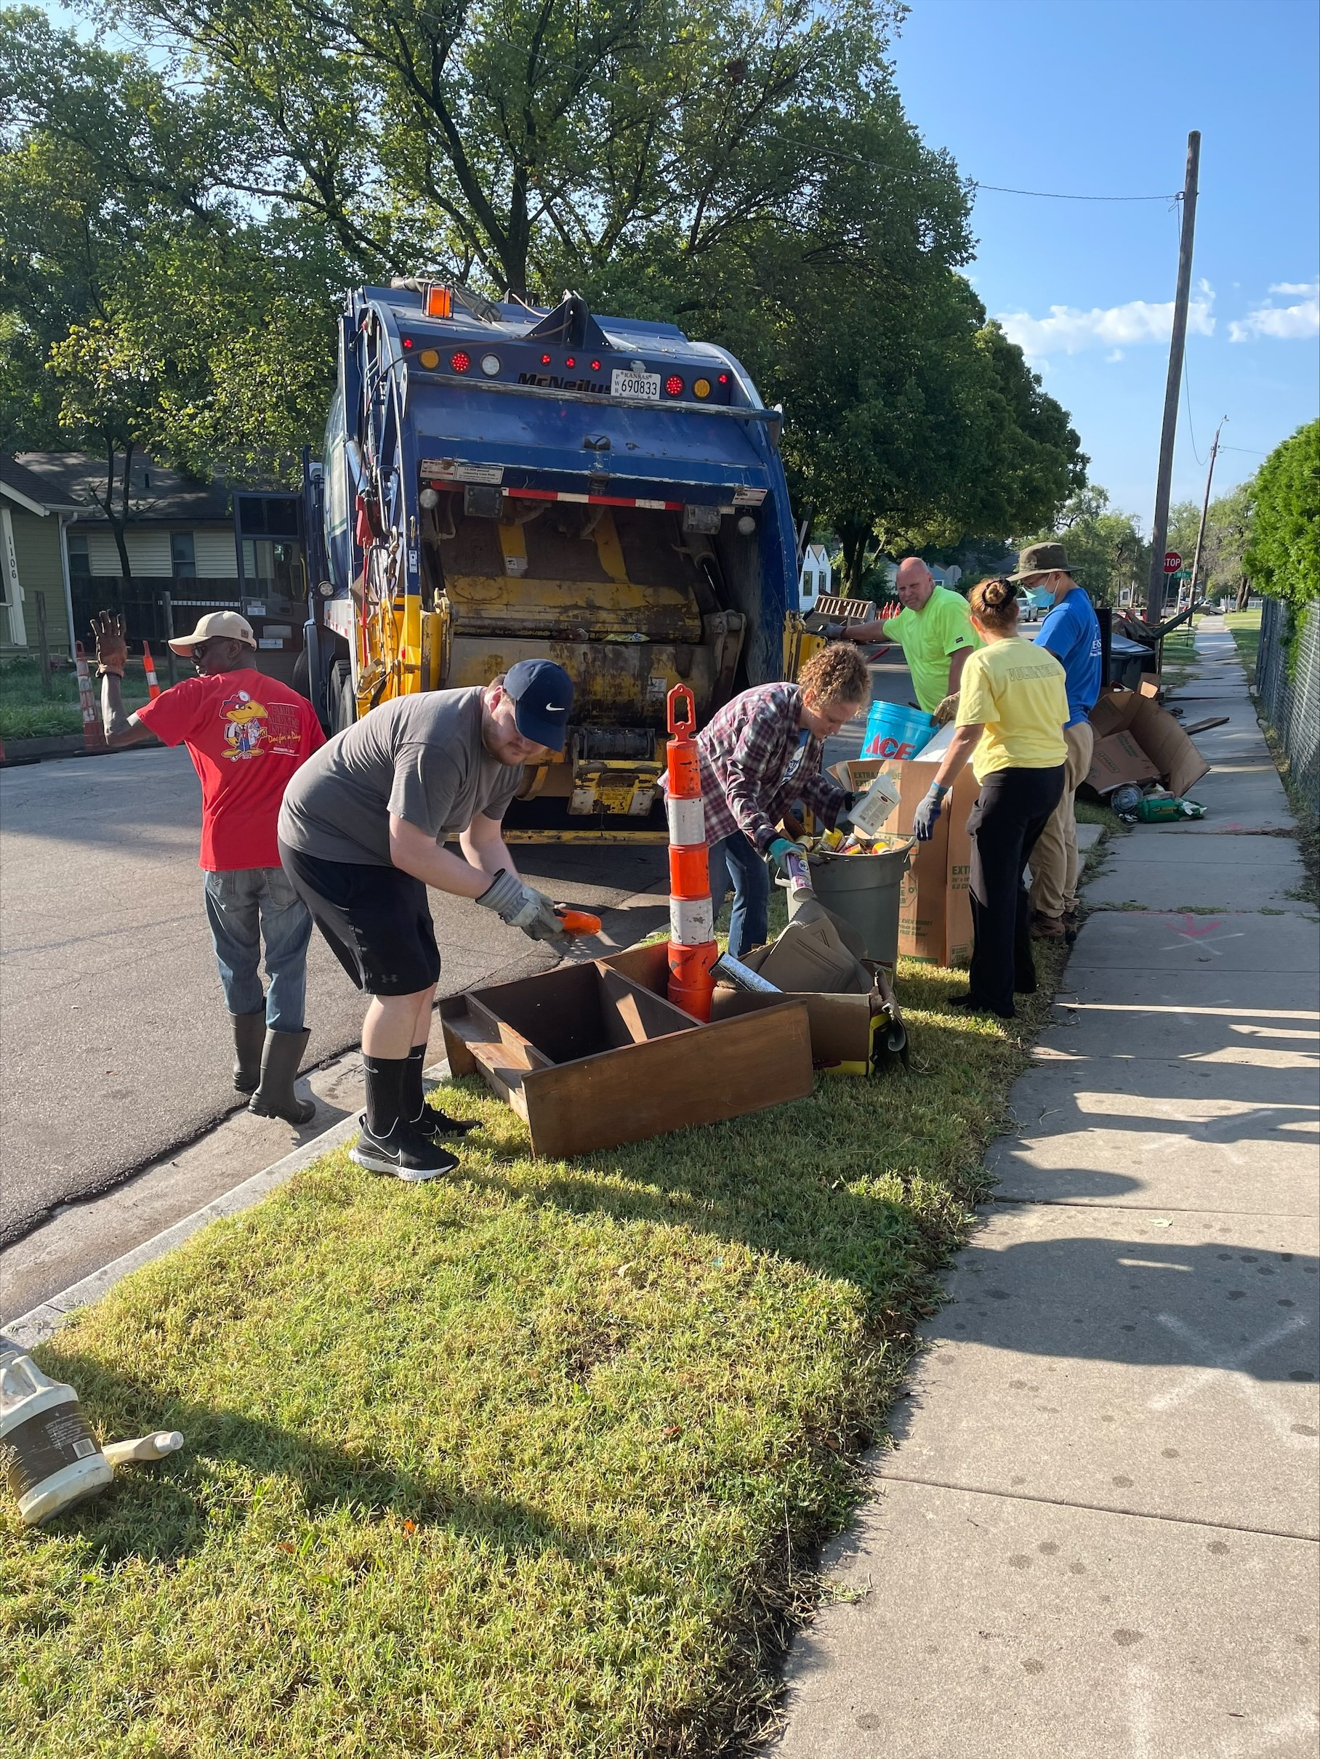
Notes:
Julie

Slide 14
KUMC-Wichita Current Efforts
‘Advancing DEI’ noon meetings
Community projects
Community of Practice
Additional training
Addressing Microaggressions
Mentorship
FMIG Social Justice
Research and outreach
Notes:
Julie – ‘Advancing DEI’ noon meetings, Community Projects, Community of Practice
Colleen – Addressing Microaggressions, Mentorship
Morgan – FMIG Social Justice
Kari – research efforts
Julie: When our community partnerships committee first formed, the goal was to promote relationships with both internal and external stakeholders committed to health equity. One of the pieces of feedback we received was that people didn’t have any idea what was already happening on our campus among internal stakeholders to promote health equity. The Advancing DEI noon meeting series provided an opportunity for folks to share that information. We’ve heard from nine people or groups so far, representing both faculty research projects and student led initiatives.
The same committee has actively started reaching out to the community surrounding the medical school campus in Wichita, engaging in neighborhood association meetings and volunteer activities in the area. (Dr. Rohrberg, if you’ll go to the next slide for just a second), these are photos from our committee participating in a neighborhood cleanup project, which provides an opportunity for residents with less mobility or less access to resources to create healthier living environments in their homes. (Ok, go back to the previous slide. )
The next item on our list is a community of practice experience we’ve been piloting around the idea of what it means to be antiracist in academic medicine. This gets at that request for more action oriented programming and challenges participants to learn to identify and consider systemic issues that impact DEI.
Colleen: Late last year, our campus began offering a two-part training series on Addressing Microaggressions in Academic Medicine. At this time, the trainings have been provided as a faculty development opportunity across the campus, as well as to interested departments and residency programs, including a recent Grand Rounds presentation. The sessions have been well-received, with several more upcoming sessions planned.
As for mentorship, we know this is an important aspect in addressing in diversity, equity, and inclusion. This is true not only within our institution, but also when considering the pipeline to careers in medicine and healthcare. At the larger scale, there is a KUMC DEI Mentorship Workgroup with representation from the School of Medicine, School of Health Professions, School of Nursing, and each of our 3 campuses.
On our campus specifically, we have two medical student mentor groups – the first is a local chapter of the Health Career Collaborative, which is a national initiative to connect medical student mentors with students from underrepresented backgrounds at local high schools, in an effort to increase and support interest in pursuing future health careers. Another medical student organization has partnered with two local undergraduate universities to partner mentors with pre-med students – this year 85% of those mentees identify as being from a traditionally underrepresented background, and we are incorporating DEI trainings for medical student mentors, such as for unconscious bias.
Morgan: Last year, the Wichita family medicine interest group recognized the need to create a subcommittee focused on social justice issues and bringing opportunities for students to learn and engage. The subcommittees first large agenda item was bringing past American Academy of Family Physicians president Gary LeRoy to join in a town hall style session exploring ways in which we as students and faculty can bridge the gap of health inequalities in our community and beyond. Our goal for 2022 is to create a number of health equity posters which highlight a disease or health issue and also bring attention to health inequities experienced by different communities of color. The subcommittee is also connected with a myriad of other organizations on campus in order to promote DEI related programming around campus to students.
Kari: In terms of specific research and outreach, beyond what has been mentioned before, those of us in Family Medicine and Faculty Affairs have been endeavoring to increase inclusion of DEI into our research. Some examples include involvement in CERA by creating diversity-focused surveys for both medical students and residents, consistent presentations at primary care conferences, we currently have a cohort in the STFM anti-racism collaborative, and have started targeted scholarly activity with organizations such as Equality Kansas and local FQHCs.

Slide 15
KUMC Projects in Development
Social Justice Toolkit
REPAIR project
Center for African American/Black Health
Center for Rural Health
Notes:
Tessa - Social Justice toolkit
Colleen – REPAIR project
Samuel – Center for African American/Black Health
Lynn – Center for Rural Health-
Tessa: There is a KUMC campus wide initiative to create a social justice toolkit, similar to our DEI toolkit, with a purpose to provide a depth of resources for all KUMC campuses which demonstrate the reality that power, privilege & oppression continue to support systemic injustice, AND how we as a healthcare community can respond while staying focused on transparency, empathy & compassion.
Colleen: The REPAIR, or REPAiring Institutional Racism, project is an ongoing initiative in partnership with our colleagues at the University of California San Francisco. It addresses racism in medicine by providing a theoretical framework for coordination of institutional trainings, community collaboration, and social justice and anti-racism curricula throughout the university. This project serves as an umbrella to encompass all of the various anti-racism initiatives that are ongoing at our institution.
Samuel: Another project at KUMC is the creation of a Center for Black and African American Health.
Lynn: Our current medical school executive Dean, Dean Ojo, issued a call in early 2020 for a renewed focus on rural health disparities in KS. Most of our state is rural in geography and about 25% of the population resides in rural & frontier counties. The CRH will be a hub on our Salina campus that focuses on rural research, education of medical students/residents, and service to our rural work force.

Slide 16
Questions for Thought
What has your institution successfully done to increase awareness of DEI?
What are some of the most well received events or programming?
What has not worked or been well received?
What has been successful at increasing the number of URM students, residents, faculty, or staff at your institution?
What role are FMIGs in advancing DEI?
What are best practices to increase involvement when trying to manage competing schedules of faculty, students, residents, and staff?
How do you find advocates or allies for DEI committees?
Notes:
Tessa: Thank you!
We would love to take questions now.
We also have the following questions to guide discussion on best practices, successes, and those activities that have been well received at your institutions.
If there are any projects we mentioned above that you have specific questions on, please feel free to reach out to us by our included emails.

Slide 17
References
Lett L, et al. Trends in Racial/Ethnic Representation Among US Medical Students. JAMA Netw Open. 2019;2(9):e1910490
Cohen J, et al. The case for diversity in the health care workforce. Heal Aff. 2002;21(5):90-102
Saha S, et al. Student body racial/ethnic composition and diversity-related outcomes in US medical schools. JAMA. 2008;300(10):1135-1145
Morrison E, Grbic D. Relationship between racial/ethnic diversity in a class and students’ perceptions of having learned from others. AAMC Anal Brief 2013;13:6
Hung R, et al. Student perspectives on diversity and the cultural climate at a US medical school. Acad Med 2007;82(2):184-192
Reede J. D&I in academic medicine. Acad Med 2012;87(11)1486-7
Orom H, et al. The social and learning environments experienced URiM students. Acad Med 2013;88(11):1765-1777
Smith D. Building institutional capacity for D&I in academic medicine. Acad Med 2012;87(11):1511-1515
Rodriguez J, et al. Where are the rest of us? South Med J. 2014;107(12):739-44
Adanga E, et al. An environmental scan of faculty diversity programs at US medical schools. Acad Med 2012;87(11):1540-1647
Youmans Q, et al. The STRIVE initiative. J Grad Med Educ 2020;12(1):74-79
Haggins A. To Be Seen, Heard, and Valued. Acad Med. epub 2020 Jun 23
Poma P. Race/Ethnicity Concordance Between Patients and Physicians. J Natl Med Assoc. 2017;109(1):6-8
KUMC DEI Toolkit https://www.kumc.edu/diversity/resources/diversity-equity-and-inclusion-toolkit.html

Slide 18
Thank You
Please contact Tessa Rohrberg (trohrberg@kumc.edu) or Kari Nilsen (knilsen@kumc.edu) with any questions!
Please be sure to complete an evaluation for this presentation.

