Slide 1
L34A: Community Preceptor Competencies
Darin Brink, MD
University of Minnesota
Jeffrey Morzinski, PhD, MSW
Medical College of Wisconsin
Notes:
As part of intro… we should plan to 1) say why we believe this is an important topic, and 2) find out the makeup of the attendees – learn something of their experience & concerns regarding community preceptors

Slide 2
Disclosures
No disclosures

Slide 3
Objectives
Identify the main competencies of effective community preceptors
Develop strategies and tools for assessing community preceptors using defined core competencies.
Propose methods for implementing faculty development content for busy community clinical preceptors
Notes:
Darin

Slide 4
Background
Scholarship on Preceptor Competencies
PEP (Preceptor Education Project)
FFI (Faculty Futures Initiative)
Sought to categorize and track FM faculty in order to strengthen their influence
Cluster faculty competencies according to their place on a continuum
Full-time research faculty → Volunteer clinical faculty
Notes:
Jeff: Both FFI and PEP were STFM – sponsored initiatives aimed at supporting excellent preceptor development. This slide shows something of the foundation they established.

Slide 5
Background (cont.)
All faculty demonstrate competence in 6 categories
Administration, Research, Teaching, Informatics, Care Management, Multiculturalism
Preceptor scholarship – Mainly “recruit and retain”
Some suggest competence for specific roles / goals:
Rural preceptors
Procedures
Urban pathways / community medicine / disparities
Behavioral science / Integrated care
Notes:
Jeff: This idea of focused competencies is of considerable value – in order to guide teachers and learners. However, there remains value in foundational competencies!

Slide 6
What are Global, Agreed-up Preceptor Competencies
Building on other contributions – two-state, (MINN / WIS) 4-institution collaborative took steps to focus on a global list – to train, develop and sustain
Notes:
Jeff -- … next, Darin will briefly review our methods to arrnve at our working set of competencies.

Slide 7
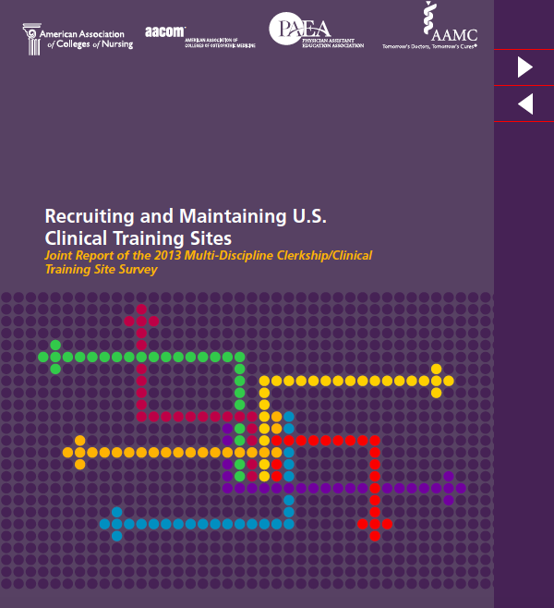
Notes:
Darin – this slide and the next few…up until Jeff sets up the case example/s

Slide 8
Notes:
Much work has already been done to identify the needs of community preceptors,^{4,12,13} to provide formal training for preceptors, ^{6,9,14} to help integrate students into busy clinical practices¹⁵ and to assess the instructional quality of a clinical site,^{16,17} but as yet there is no consensus on the key criteria for identifying, training or evaluating community preceptors. While there are established skills and behaviors (i.e. “milestones”, “competencies”, “observable behaviors”, “entrustable professional activities”, etc.) for medical students^{18,19}, residents²⁰ and for academic faculty^{21,22} there are currently no agreed upon skills, attitudes and behaviors for the diverse cadre of physician preceptors who teach students and residents.

Slide 9
Notes:
Darin

Slide 10
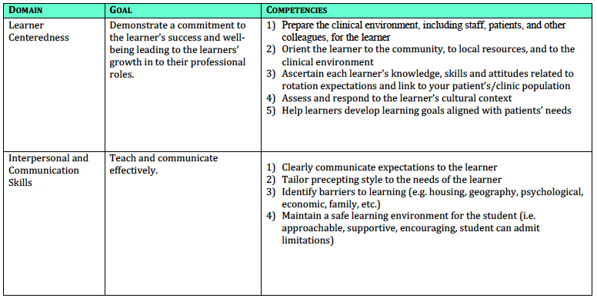
Notes:
Darin

Slide 11
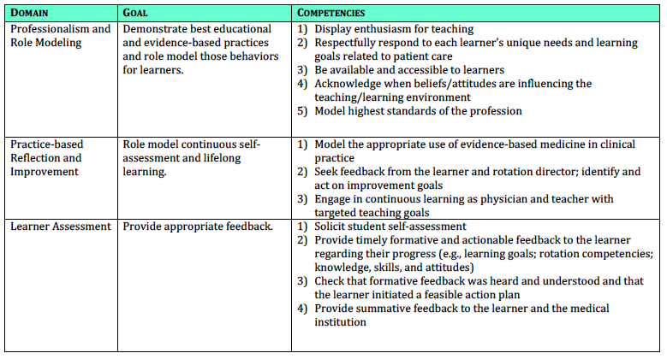
Notes:
Darin – as you wrap up this slide… would be a good time to ask for questions or comments on process & results.

Slide 12
From Competencies →Tools
Foundational Preceptor Competencies Lead to…
Assess
Develop
Sustain
Notes:
Jeff: Need continued work on tools and capacity in all three areas shown. … explain Sustain … to include the site and admin structures, to support and nurture capacity.
With you here today – we felt it beneficial to begin to work on the area of assessment.

Slide 13
Preceptor Assessment Rubric
Notes:
Jeff: Explain handout… includes competencies in Learner Centeredness / our domain #1. Move to next slide with instructions!

Slide 14
Your Input on “Assessment”
In domain of “Learner Centeredness” help create a rubric to assess preceptor competence.
Instructions
In groups, use worksheet to fill in details on one of five competencies associated with “Learner Centeredness”.
Refine categories if desired
Reach consensus on descriptive words - across the competence range
Be prepared to discuss your categories / descriptions
We will collect / collate / return to those who wish to contribute to next draft of foundational preceptor competencies & tools.
Notes:
Groups can be from 2-8 in size.
Refine categories if want to. (careful of “incompetent… poor” and the like)
Rough – in” the cells for their competency (6-10 minutes),
THEN we collect, draft a complete rubric and send around to anyone who signs up / wants to continue to refine and finalize.

Slide 15
Worksheet Discussion: “Learner Centeredness”
.
.
.
.
.
Notes:
Discuss (12 minutes) divided between:
-- Discussion of specific behaviors in each of the cells (go thru competencies one-by-one), and
-- How to complete FD with each competency.

Slide 16
Questions / Comments

Slide 17
References
Drowos J, Baker S, Harrison SL, Minor S, Chessman AW, Baker D. Faculty Development for Medical School Community-Based Faculty. Acad Med. 2017;92(8):1175-1180.
Erikson C, Hamann R, Levitan T, Stanley J, Whatley M. Recruiting and maintaining US clinical training sites: joint report of the 2013 multi-discipline clerkship/clinical training site survey. 2014. https://members.aamc.org/eweb/upload/13-225 wc report 2 update.pdf. Accessed July 26, 2017.
Srinivasan M, Li S-TT, Meyers FJ, et al. “Teaching as a Competency”: competencies for medical educators. Acad Med. 2011;86(10):1211-1220.
Rubrics for Assessment. See http://niu.edu/facdev/_pdf/guide/assessment/rubrics_for_assessment.pdf
Preceptor Competencies. Registered Nurse Professional Development Center (accessed Dec 2017). http://www.rnpdc.nshealth.ca/images/files/competencies.pdf
Steiner BD, Pathman DE, Jones B, Williams ES, Riggins. Primary care physicians’ training and heir community involvement. Family Medicine, Apr 1999, 257-262.
SAMHSA Core Competencies for integrated care (accessed Jan 2018). https://www.integration.samhsa.gov/workforce/core-competencies-for-integrated-care

Slide 18
Please evaluate this presentation using the conference mobile app! Simply click on the "clipboard" icon on the presentation page.

