Slide 1
FMIG – Structure Equals Success
Shannon Samuelson BA; Jennifer Raley, MD; Edward Strecker, MS4; Logan Yang, MS4, Allison Popovich, MS3, Bistees George, MS2

Slide 2
Objectives
Discuss our best practices for setting up and structuring an FMIG.
Identify key features for successful student officer engagement.
Explain how to grow and evaluate your FMIG.

Slide 3
Meet our FMIG
President - Edward Strecker MS4
Vice President - Logan Yang MS4
Recruitment Coord. - Suzy Warden MS4
AAFP Coord. - Allison Smith MS4
PCP @ PCP Coord. - Bistees George MS2
PCP Lite at the PCP Coord. - Jose Alex Reyes MS2
Community Service Coord. - Lisa Yi Liang MS4
MS2 Representative - Alexander Cantu MS2
MS2 Representative - Jake Brozek MS2
MS3 Representative - Haris Vakil MS3
MS3 Representative - Allison Popovich MS3
MS4 Representative - Mauli Dalal MS4
MS4 Representative -Sarah Ali MS4

Slide 4
Doing something right…
Best FMIG in Texas – 1st place – 2017 – Texas Academy of Family Physicians
Best FMIG in Texas – 2nd place – 2018 – Texas Academy of Family Physicians
Well attended procedure workshops and events
Averaging 15-20 students per year matching in Family Medicine

Slide 5
Procedures workshop

Slide 6
Setting up Your Family Medicine interest group
REINVISIONING or REENGAGING….

Slide 7
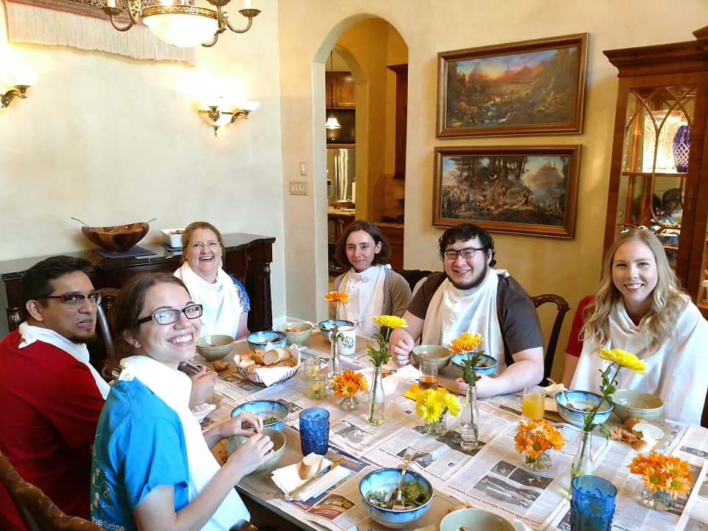
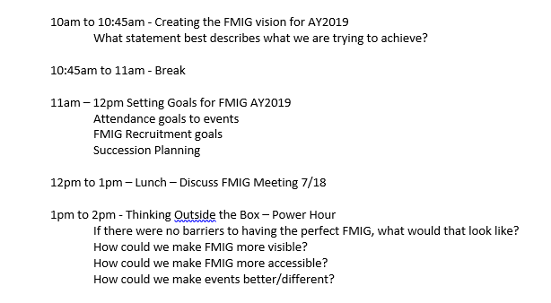
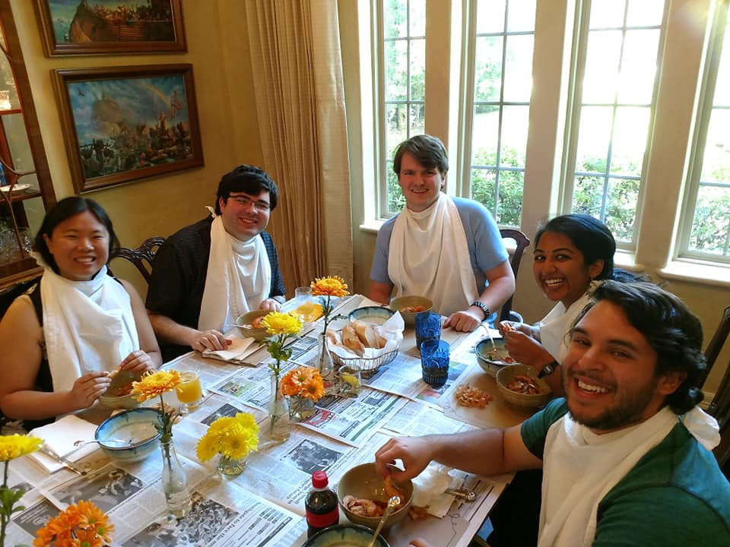
FMIG OFFICER Retreat!

Slide 8
Step One: Create a vision
“Family Medicine Interest Group (FMIG) is an active and engaged student group that shares the passion and fulfillment of FM, provides resources for students, professional skill development, and opportunities for service.”

Slide 9
Step 2: Strategic Planning
What are the specific needs for your institution?
What are your resources?
How do you measure your progress or success?

Slide 10
TIPS ON Assisting with Logistics
Advance booking on the calendar
Students compile test and rotation schedules for each year
Plan a year in advance
Book rooms
Monthly officer meetings

Slide 11
TIPS ON Assisting with Logistics
Peer to peer recruiting for events
Faculty to teach are sought by the faculty advisor
Students recruit and advertise to other students
Resident to resident recruiting
Incentivize teaching effort

Slide 12
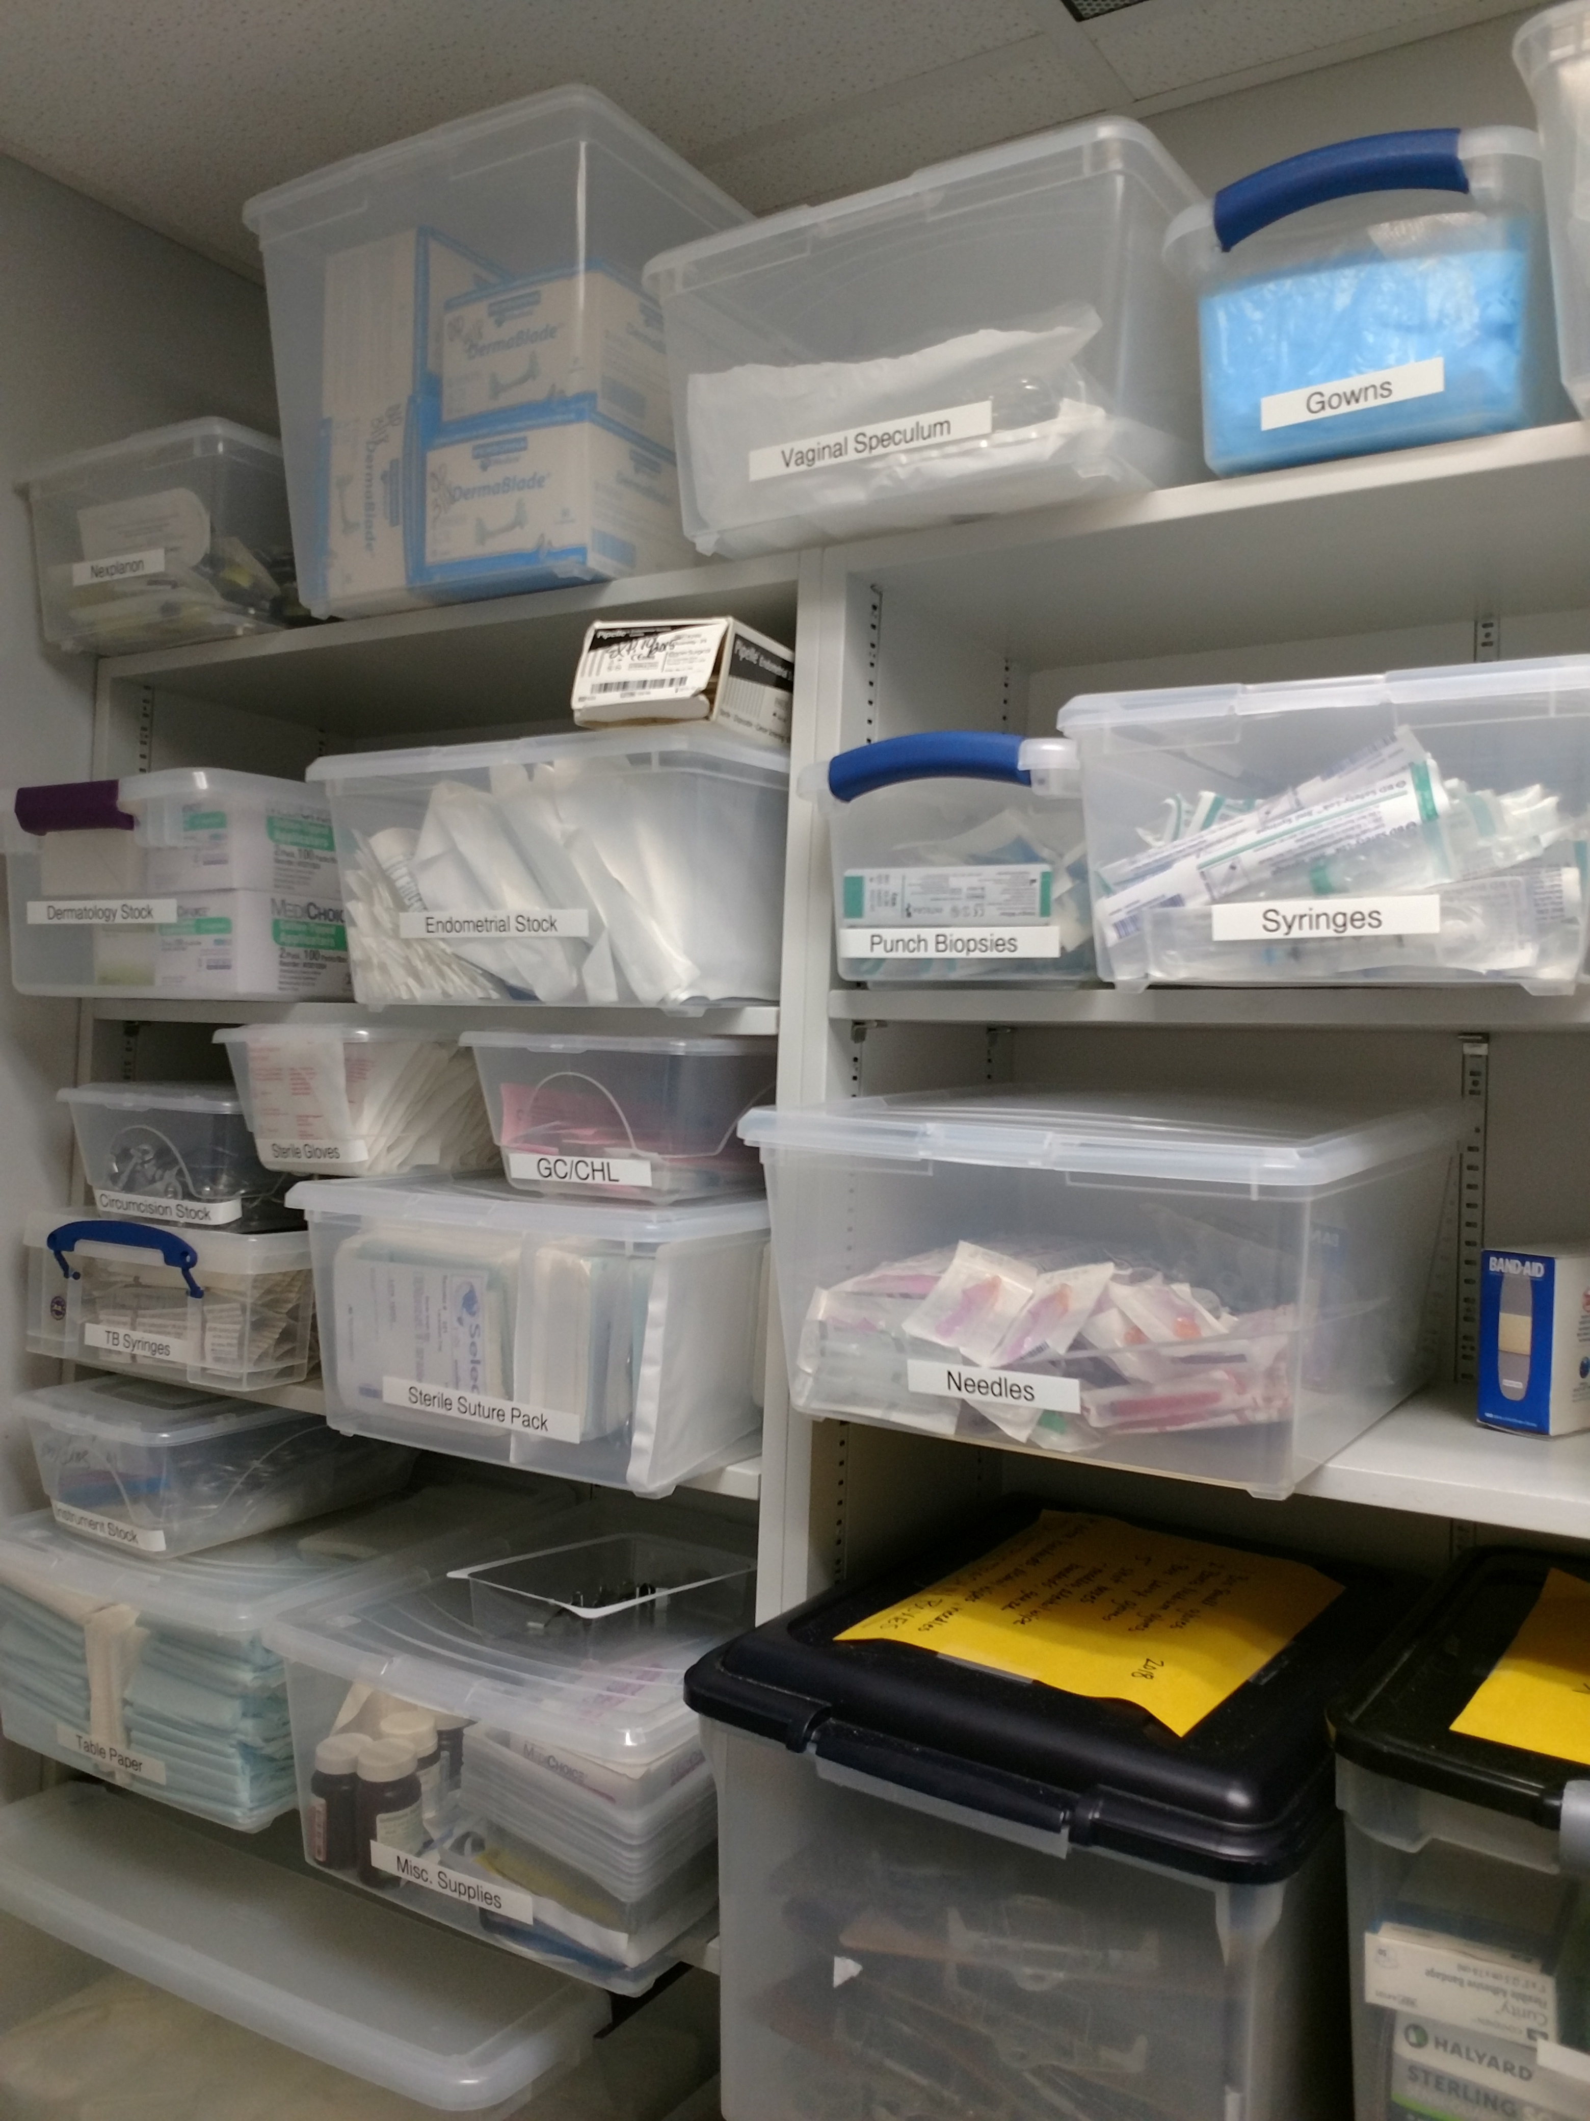
TIPS ON Assisting with Logistics
Organization of resources
Labeling Storage
Inventory of supplies/instruments
Online Sign Up Sheets
Survey Monkey
Keep lists of procedure needs

Slide 13
Cutting cost $
Put bins in the clinic for expired supplies
Use veterinary suture or similar for supply
Crockpot/super easy meals for officer meetings
Borrow instruments (label them)
Look at institutional auctions – Free equipment

Slide 14
Student/OFFICER Engagement
Start recruiting EARLY - MARCH
Keep the application process simple
Hold an interest meeting
Have detailed responsibilities
Let the current leadership choose who they want to work with but run it past the faculty advisor for confirmation
Hand offs, training, and officer experience matter

Slide 15
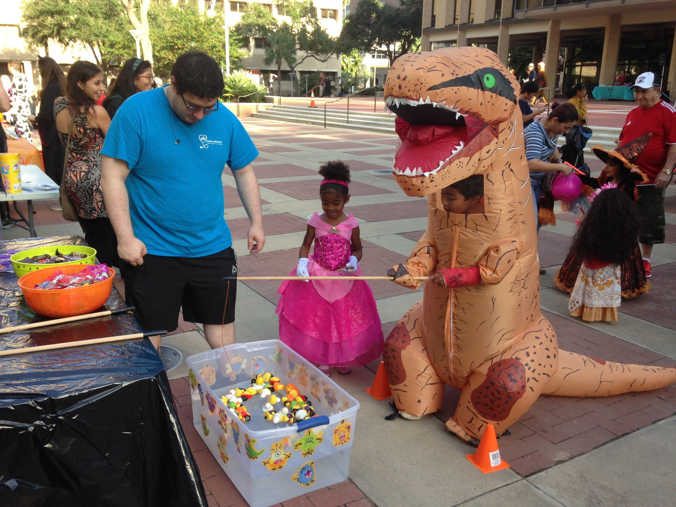
Division of responsibility
Assigning tasks/events to specific officers to manage
Job Decriptions are handy
President-Edward Strecker MS4
Vice President - Logan Yang MS4
Recruitment Coord. - Suzy Warden MS4
AAFP Coord. - Allison Smith MS4
PCP @ PCP Coord. - Bistees Abdelmalak MS2
PCP Lite at the PCP Coord. - Jose Alex Reyes MS2
Community Service Coord. - Lisa Yi Liang MS4
MS2 Representative - Alexander Cantu MS2
MS2 Representative -Jake Brozek MS2
MS3 Representative - Haris Vakil MS3
MS3 Representative - Allison Popovich MS3
MS4 Representative - MS4 Representative-Mauli Dalal MS4
MS4 Representative - Sarah Ali MS4
Logan Yang, MS4, Leading the Halloween Carnival

Slide 16
Creative problem solving
Use a TEAM APPROACH to
problem solving
Constantly look for:
Areas for improvements
Opportunities to streamline
Feedback
New ideas

Slide 17
Expanding your reach
Survey students to find out how they prefer to receive information about upcoming events or opportunities.
Email
Facebook
Other?
Word of mouth and student excitement are your BEST resources for advertising!
Limited seating, exclusivity, and FOOD are the participation trifecta!

Slide 18
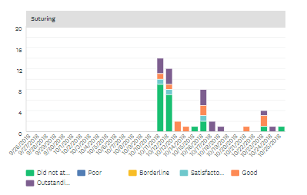
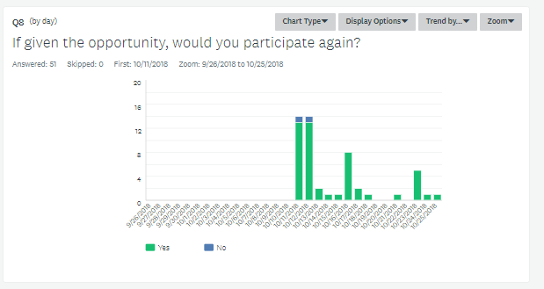
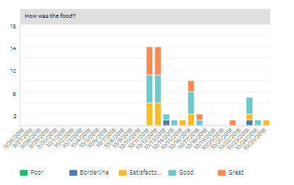
Gathering Feedback
We use survey monkey to collect information about events.

Slide 19
CHANGE IS NECESSARY
Embrace the chaos
Be succession focused
Your officers can’t stay forever
Stay up on technology
Students need to be determining areas for change or modification
Stay open to possibilities

Slide 20
For more information or tips, feel free to reach out to Shannon Samuelson - sosamuel@utmb.edu.

