Slide 1
A Method to Bridge the Gap between “Learning” and “Using” Motivational Interviewing
Claudia Allen, PhD, JD and Theodore Siedlecki, PhD
University of Virginia
Department of Family Medicine
October 12, 2018
Notes:
C and T

Slide 2
Disclosures
Nothing to disclose.
Notes:
c

Slide 3
Goals and Objectives
Participants will be able to:
Stimulate learners’ awareness of the emotional effects of person-centered vs authoritarian styles of influencing, and thus motivate learners to use Motivational Interviewing;
Increase the value of their own teaching time by raising the likelihood of medical learners and professionals actually implementing MI with the support of a flexible script; and
Describe and locate a compact (2.5 hr.) module that activates learners' motivation to master MI, delivers basic MI skills, provides a flexible script to scaffold learners, and includes a brief tool to assess the impact of the module.
Notes:
C

Slide 4
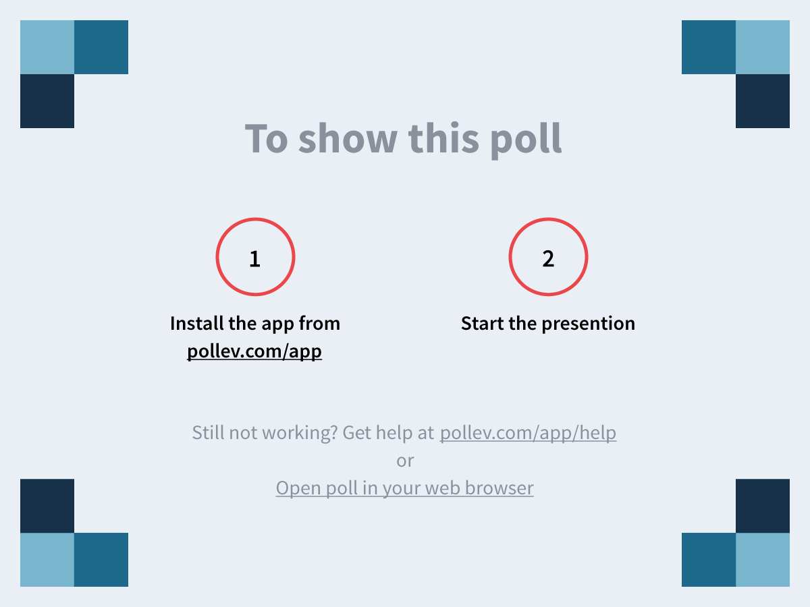
Notes:
How confident are you? https://www.polleverywhere.com/multiple_choice_polls/LFlQ8BK66P8BWbE

Slide 5
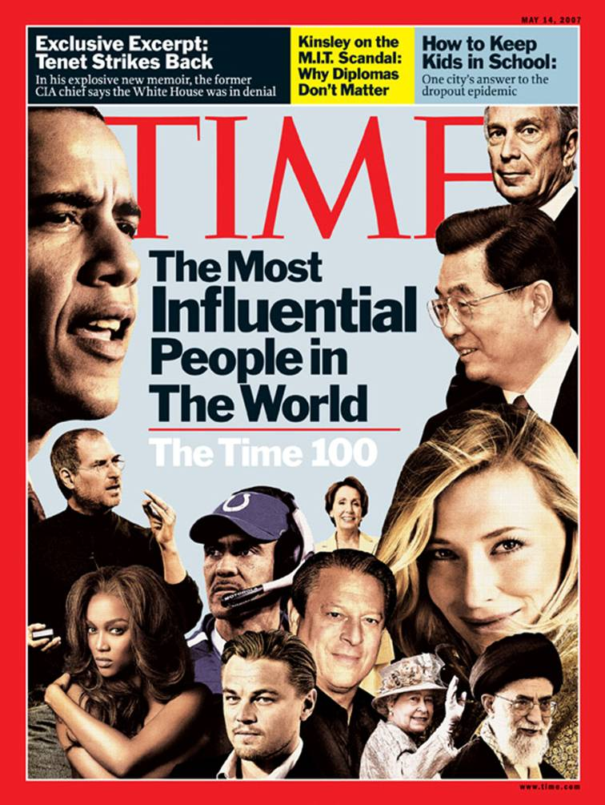
Most Influential Person Exercise
Break into groups of 4-6
Pick a scribe
Question 1
Question 2
Discuss in small group
Large group discussion of Question 3
Notes:
C

Slide 6
Question 1
List three behaviors of the helper that contributed to your REJECTING their influence.
Notes:
C

Slide 7
Question 2
List three behaviors of the helper that contributed to your ACCEPTING their influence.
Notes:
C

Slide 8
Question 3
Which of these lists is more similar to the change methods most commonly used in our medical culture?

Slide 9
Our MI Curriculum PGY 2
Pre-Measures of Importance and Confidence
Most Influential Person Exercise: 15 mins.
Didactics: 45-60 mins.
Post-Measures of Importance and Confidence
Pairs practice using flexible script & worksheet: 60-75 mins.
Second post-measure of Importance and Confidence
Videotape review of patient encounter: 15 mins.
Notes:
Ted
We have them use something real for the practicing in pairs, because it engages them in the reality of how it feels, and it doubles as a wellness activity.
Results of the video review inform the next year’s teaching.

Slide 10
Increase in Importance from Pre- to Post-Didactic was significant at the p < .05 level.
Increase in Confidence from Pre- to Post-Didactic was significant at the p < .01 level.
Increase in Confidence from Pre- to Post-Practice was significant at the p < .001 level.

Slide 11
Many aspects of M.I.
We focus on:
The Spirit of MI rather than the tools
“Every problem was once a solution”
Attempts to persuade create resistance
Different strategies for each stage of change
Notes:
Ted
They get the spirit of it when we ask them what it feels like when their preceptor tells them they just need to get faster doing notes.
They have the hardest time understanding that intervention is useful at the Precontemplative stage.

Slide 12
The “Spirit” of Motivational Interviewing
Collaboration vs. Confrontation
Evocation vs. Imposition
Autonomy vs. Authority
Notes:
Ted
Motivational interviewing is an approach for times when the barrier is not a knowledge gap.

Slide 13
Why do people develop negative habits?
External factors: life stresses
Internal factors: depression, boredom
So what do they do to feel better?
Coping strategies: adaptive and maladaptive
Notes:
Ted
Our mentor, Dr. Dave Waters, always reminded us of Jay Haley’s maxim: Every problem was once a solution.

Slide 14
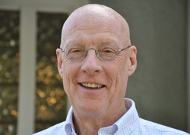
Our mentor: Dr. David Waters
When you meet resistance, think deficit.
(Ted: When you see won’t, think can’t.)
Notes:
Ted’s version: When you find yourself thinking won’t, instead think can’t.
Contrary to our instincts….
Information alone often doesn’t work! Why is that?
and
Attempts to persuade usually don’t help, instead we just create more resistance and increase stress.
Why is that? Think about when an attending tells you something like this:
“You really need to get more efficient at competing your clinic notes.”

Slide 15
Different goals and strategies at different stages
Example: Pre-Contemplation (resisting change) Stage: This is either a denial of the problem, or an awareness of the problem with an unwillingness to change.
Strategies for this stage:
Seek permission just to talk about it for a minute.
Open ended questions; thoughts and feelings.
Empathetically reflect the ambivalence.
Resist the righting reflex.
Reinforce the willingness to even talk about it.
Rate importance. Understand patient priorities.
Elicit patient goals. Link behavior to goals.
Roll with resistance.
Seek permission to offer information.
Notes:
Ted
what a realistic goal or intervention at each stage?
Residents often believe that there is nothing they can do if a person has no interest in changing a behavior. This is the stage I spend a few extra minutes on. I ask what can they do, I often have to say “too early for that one”.

Slide 16
Why a Flexible Script?
Scripted intervention as scaffolding for a new skill.
Learners worry “How do I say it?” and then avoid.
Sets them up for success, which reinforces use of skill.
Ensures they don’t forget the non-intuitive parts.
Fast way to jumpstart experiential learning.
Includes some fundamental elements.
Flow gives them a sense of the trajectory.
Flexibility allows adjustments for patients at different stages of change.
The script content is adapted from Miller and Rollnick.
Notes:
C
You could choose other fundamental elements for your version.
Largely drives itself.

Slide 17
1. Find the target behavior and defuse defensiveness
Clarify the agenda around a target behavior about which there is ambivalence:
So I understand that you are considering (quitting smoking, changing your diet, making different relationship choices). Is that right?
Defuse defensiveness: HDYFAB: Great, so how do you feel about talking with me about it today?
Notes:
***
C

Slide 18
2. Respectfully explore both sides of the ambivalence First, ask about the positive aspects of the behavior.
So I’m going to start with what might seem like a funny question. What are some of the good things about ____ (the negative behavior or not doing the positive behavior)?
People usually _______ because it has benefited them in some way. How has _____________ benefited you?
What do you like about the effects of ______________________?
Summarize the positives: So it sounds like…
Notes:
***
C
Giving examples is important.
Tricky language if someone is starting something rather than stopping.
If you don’t know what’s driving it, you can’t make a plan for changing.
It’s important that patients understand this.
Also reduces shame.

Slide 19
4. Explore Life Values and Goals to develop discrepancy
It helps if I get to know a little more about you in general. What aspect of your life is most important to you?
What sort of person do you strive to be?
If things worked out in the best possible way, what would you be doing a year from now?
Affirm “positive” goals and values. OK, so if I were to sum up your values, you really care about…and want to be the kind of person who….and if things went really well this next year, you’d be…
Notes:
***
C
This is the turning point of the interview. This is where my motivation stems from (trying to evoke motivation).
Residents felt this helped them know the patients better.

Slide 20
5. Ask for a decision
Restate the ambivalence; then ask for a decision.
So you’ve been trying to decide whether to check your blood sugar regularly. Part of you feels it’s important for your health, but another part of you likes it better when you just don’t worry about your health. After talking here today, do you feel clearer about what you’d like to do? What have you decided?
If decision is not to change, or no decision yet, skip ahead to Q 7
Notes:
***
C
Note the flexibility of the script.

Slide 21
6. Set SMART Goals
Goal setting – Use SMART goals (Specific, Meaningful, Assessable, Results-focused, Time-bound)
What will you do to prepare/get started in the next one or two days?
Who will be helping and supporting you?
What might get in your way?
Notes:
***
C
This is one of the places we teach smart goals.

Slide 22
7. If no decision, or decision is to continue the behavior, empathize with ambivalence
No decision: This is really a tough one because ….. (Explore to extent that patient allows.) Is there something that would help you make a decision/want to make a change?
Decision not to change at present: Are there mini or temporary steps you want to take while you are thinking more about this?
Would you be open to considering this question again the next time you come in?
Notes:
***
C
This is really important.

Slide 23
8. Successful wrap-up
Follow-up HYDYFAB: So, how has it been talking with me about this today?
I’m so glad you were willing to talk with me today about this. This is a tough issue...
Notes:
***
C
Regardless of the patient’s readiness to change right now, we want him or her to leave the encounter feeling respected and like it was a valuable step just to think aloud and talk about the issue. We don’t want them to leave feeling guilty, foolish, or discouraged.

Slide 24
Your turn to practice (AND to attend to your wellness)
Think of a health behavior that you are considering changing.
Pair up and take turns practicing the flexible script.
Then we’ll switch roles.
Notes:
T

Slide 25
Discussion and Questions
How did it feel to be the patient?
Did it affect your level of motivation?
How did it feel to be the provider?
What was easy?
What was hard?
Notes:
Ted

Slide 26
Notes:
Poll 2
Now how confident are you? https://www.polleverywhere.com/multiple_choice_polls/VJNP7ROOhCjecX6

Slide 27
Notes:
Relook at Poll 1
How confident are you? https://www.polleverywhere.com/multiple_choice_polls/LFlQ8BK66P8BWbE

Slide 28
Access our materials from the STFM Resource Library. Search under: 1) Today’s presentation title; 2) Keyword: “motivational interviewing;” or 3) Presenters Allen or Siedlecki

Slide 29
Final Questions and Comments Please complete the session evaluation forms!
Our contact information:
claudiaallen@virginia.edu tedsiedlecki@virginia.edu

Slide 30
3. Ask about the negative aspects of the target behavior
Now can you tell me about the down side of _______ (the negative behavior or not doing the positive)?
What are some of the things you would not miss about X?
Summarize the negatives: So on the other hand….

Slide 31
Assess and Build Commitment
On a scale of 1-10, how strongly committed would you say you are to …..? (1 being not at all interested, 10 being totally committed)
(If less than 5, ask what would make that number higher. And if that is not possible, then you can affirm that the time is not right for the person to make that change, and then skip to Q7.)

Slide 32
Assess and Build Confidence
On a scale of 1 to 10, how confident are you that you can do your next step?
If less than 7, what could make that number higher?

Slide 33
Survey
How confident are you that your residents actually use MI subsequent to your MI teaching sessions?
Scale of 1 to 10,
1 = “they don’t get it and don’t care”;
5 = “they get the concepts but don’t use in clinic;”
10 = “they use it frequently and well.”
Notes:
C

Slide 34
Survey
How confident are you that you have learned new ways to teach MI that will increase your residents’ actual use of MI?
Scale of 1 to 10,
1 = not at all;
5 = somewhat;
10 = definitely.
Notes:
C

Slide 35
Please sign into Poll Everywhere
Go to webpage: pollev.com/teds802
Wait for the poll to appear.
Wait for Ted to cue you to take the poll.
OR
To respond by text message:
Start a new message to 22333.
In body of the message, type: teds802.
You will receive a message: “You’ve joined Ted Siedlecki’s session…”
Wait for Ted to cue you to take the poll.

